Slide 2
How AI can transform your eCommerce
Sudhanshu
Bjarni
Bajaj
Asmundsson

Slide 3
How to Implement AI in 4 simple steps
LS Central the core commerce backbone
AI Enhanced Storefront - Adobe Commerce/Shopify
Agenda
Demo
Stages for successful Commerce implementation
What might be on the horizon?
Q&A

Slide 4
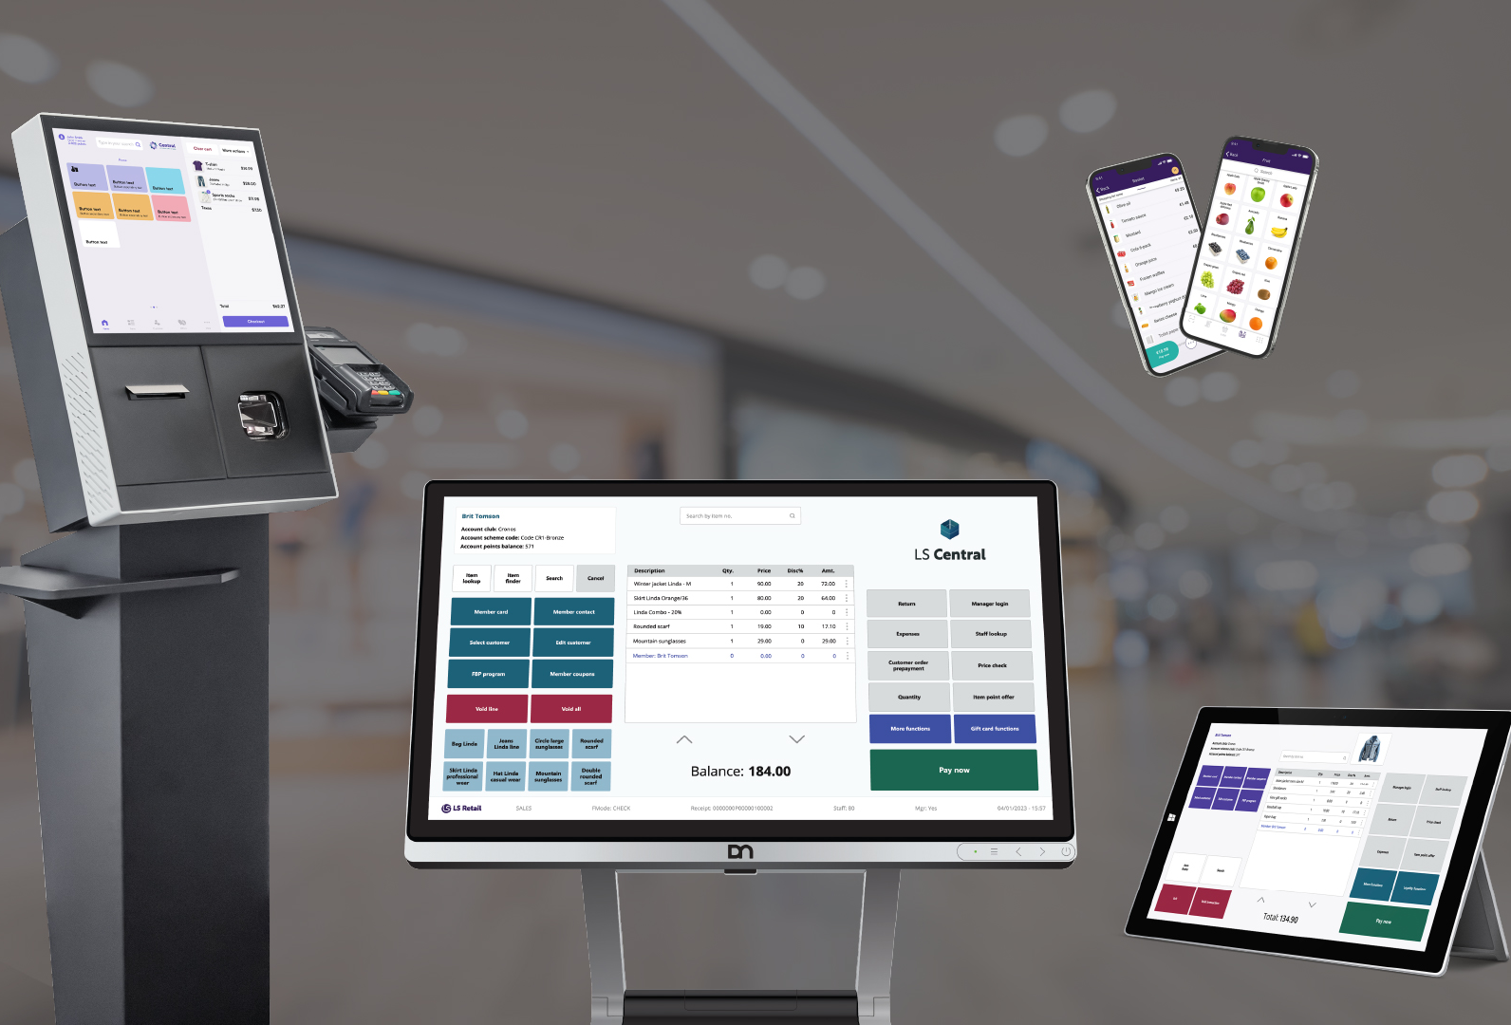
LS Central: A single retail operations platform
Unified platform for retail operations and online sales
Central source of truth for products, prices, and orders
Connects in‑store, back office, and eCommerce channels
Foundation that AI and storefront platforms build on

Slide 5

LS Central + eCommerce + AI
How It Fits Together
LS Central manages core retail data and business rules
eCommerce platform exposes products and experiences to customers
AI services enhance discovery, personalization, and automation
Data flows in both directions to keep channels in sync

Slide 6

How to Implement AI in
4 simple steps
Conduct an audit and identify your most significant pain point.
Begin with a small project and demonstrate the return on investment.
Integrate the tool into your existing system and analyze its impact.
Scale and expand your efforts to achieve greater results.

Slide 7


Slide 8

Adobe Commerce
What AI and machine learning features does Adobe Commerce offer to enhance personalization?
  Live Search
  Catalog Service
  Product Recommendations
AI to deliver fast and relevant search results tailored to customers’ on-site behavior and product popularity
Adobe Commerce includes 13 types of AI-powered product recommendations

Slide 9

Driving product discovery with Adobe Sensei AI
Adobe’s advanced AI capabilities are built into PAAS and enhanced through new Cloud and Optimizer solutions.
By leveraging native Catalog Services, businesses gain powerful tools for product discovery and merchandising.

Slide 10

What problems can Adobe Commerce Services solve?
Improve product discovery and conversion
Make data-driven merchandising decisions
Create omnichannel personalized experiences
Optimize payment processing
Manage data synchronization at scale
Win back lost customers and reduce returns

Slide 11
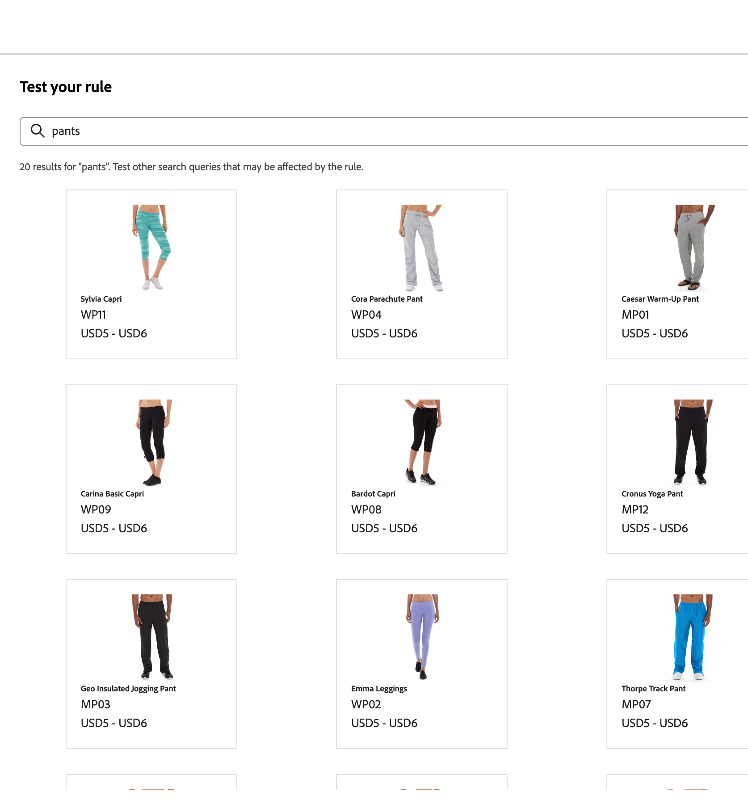
Live Search
  Create meaningful search experiences
  Take advantage of AI-powered dynamic faceting and re-ranking of search results
  Use a lightweight SaaS-based service
  Get technical by enabling GraphQL API, headless flexibility, API sandbox environments, and ultra-fast SaaS.

Slide 12
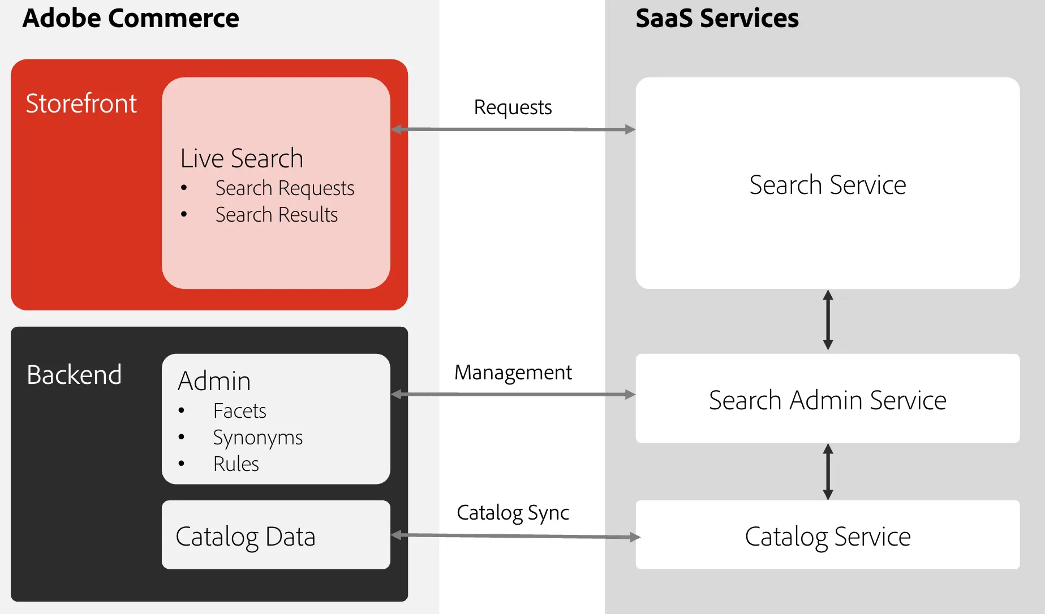

Slide 13
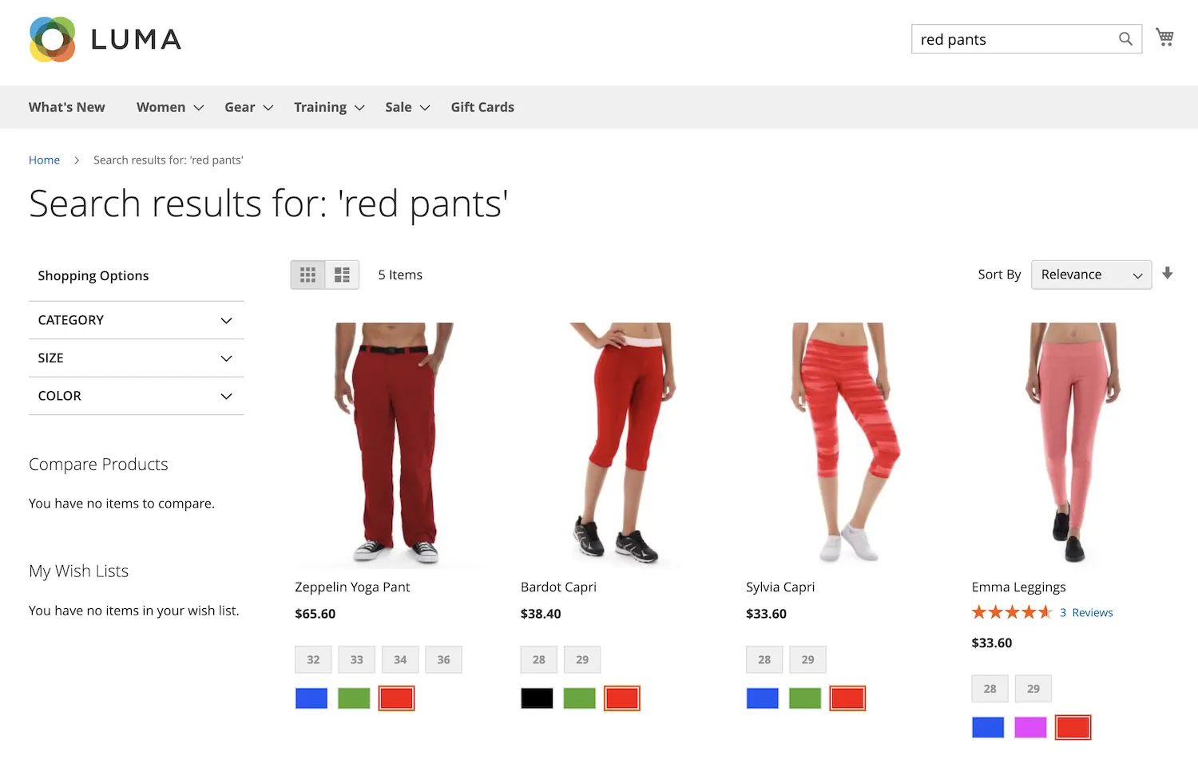
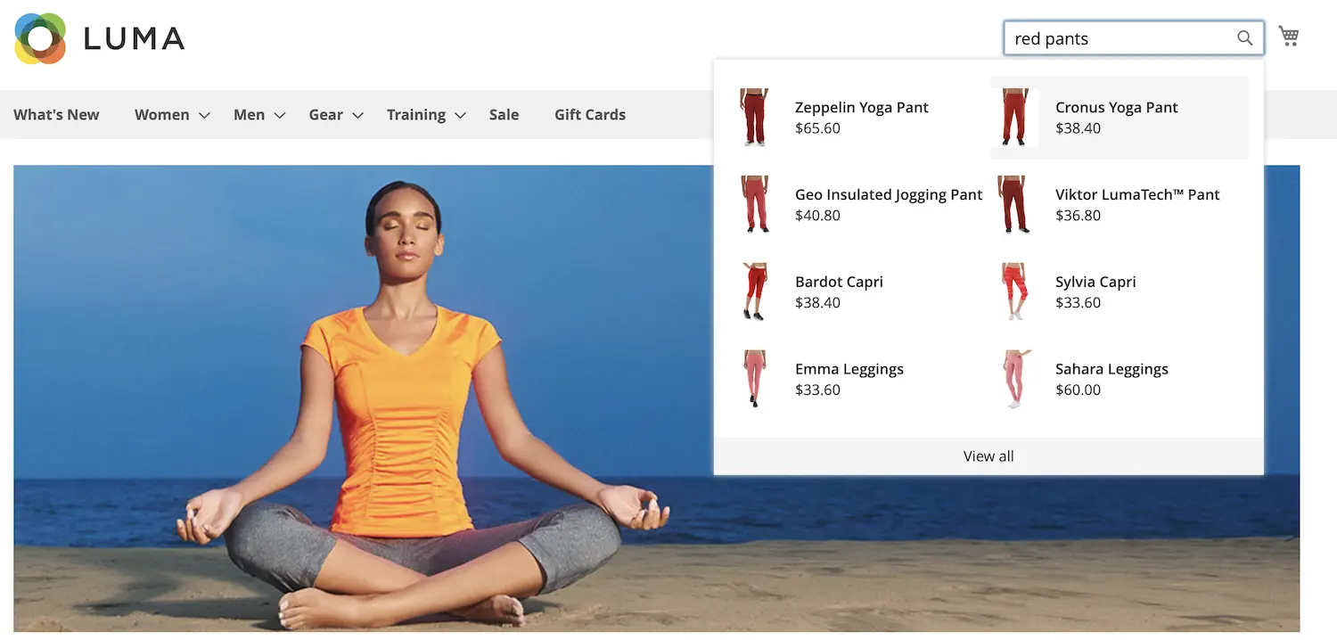

Slide 14
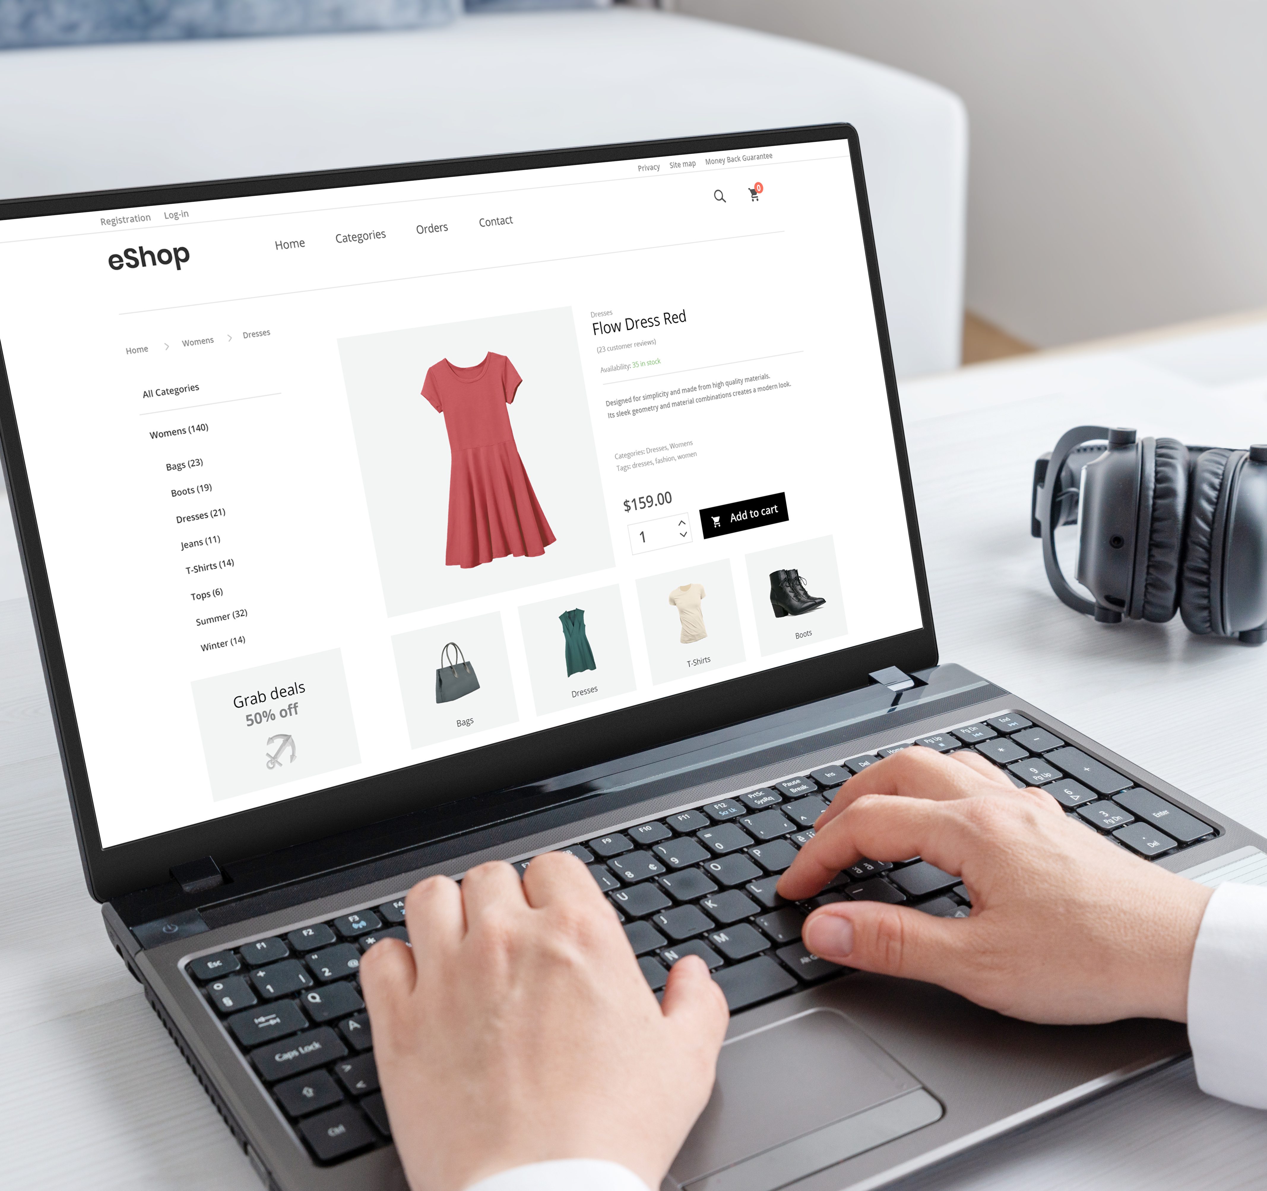
Product Recommendations
  Choose from nine distinct intelligent recommendation types
  Use behavioral data to personalize recommendations
  Measure key metrics relevant to each recommendation to help you understand the impact of your recommendations

Slide 15
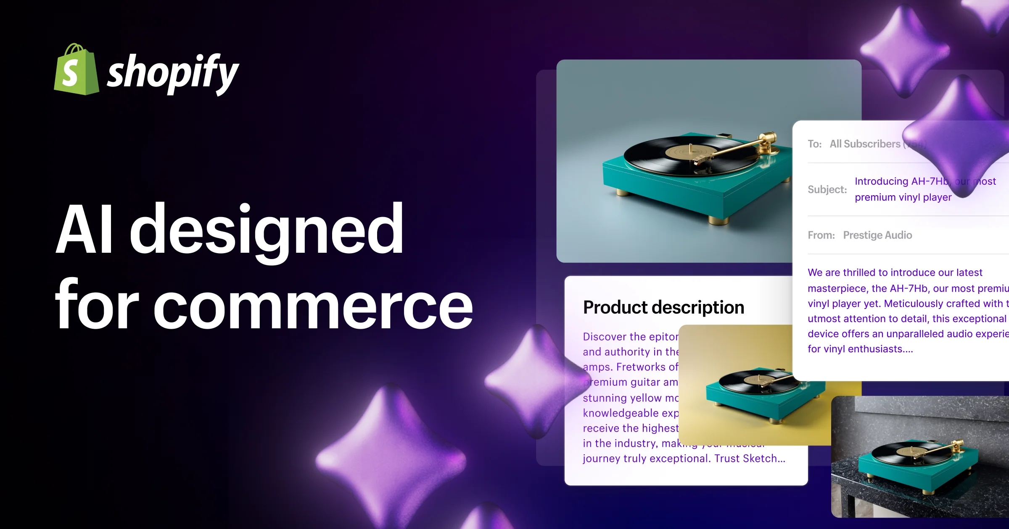

Slide 16
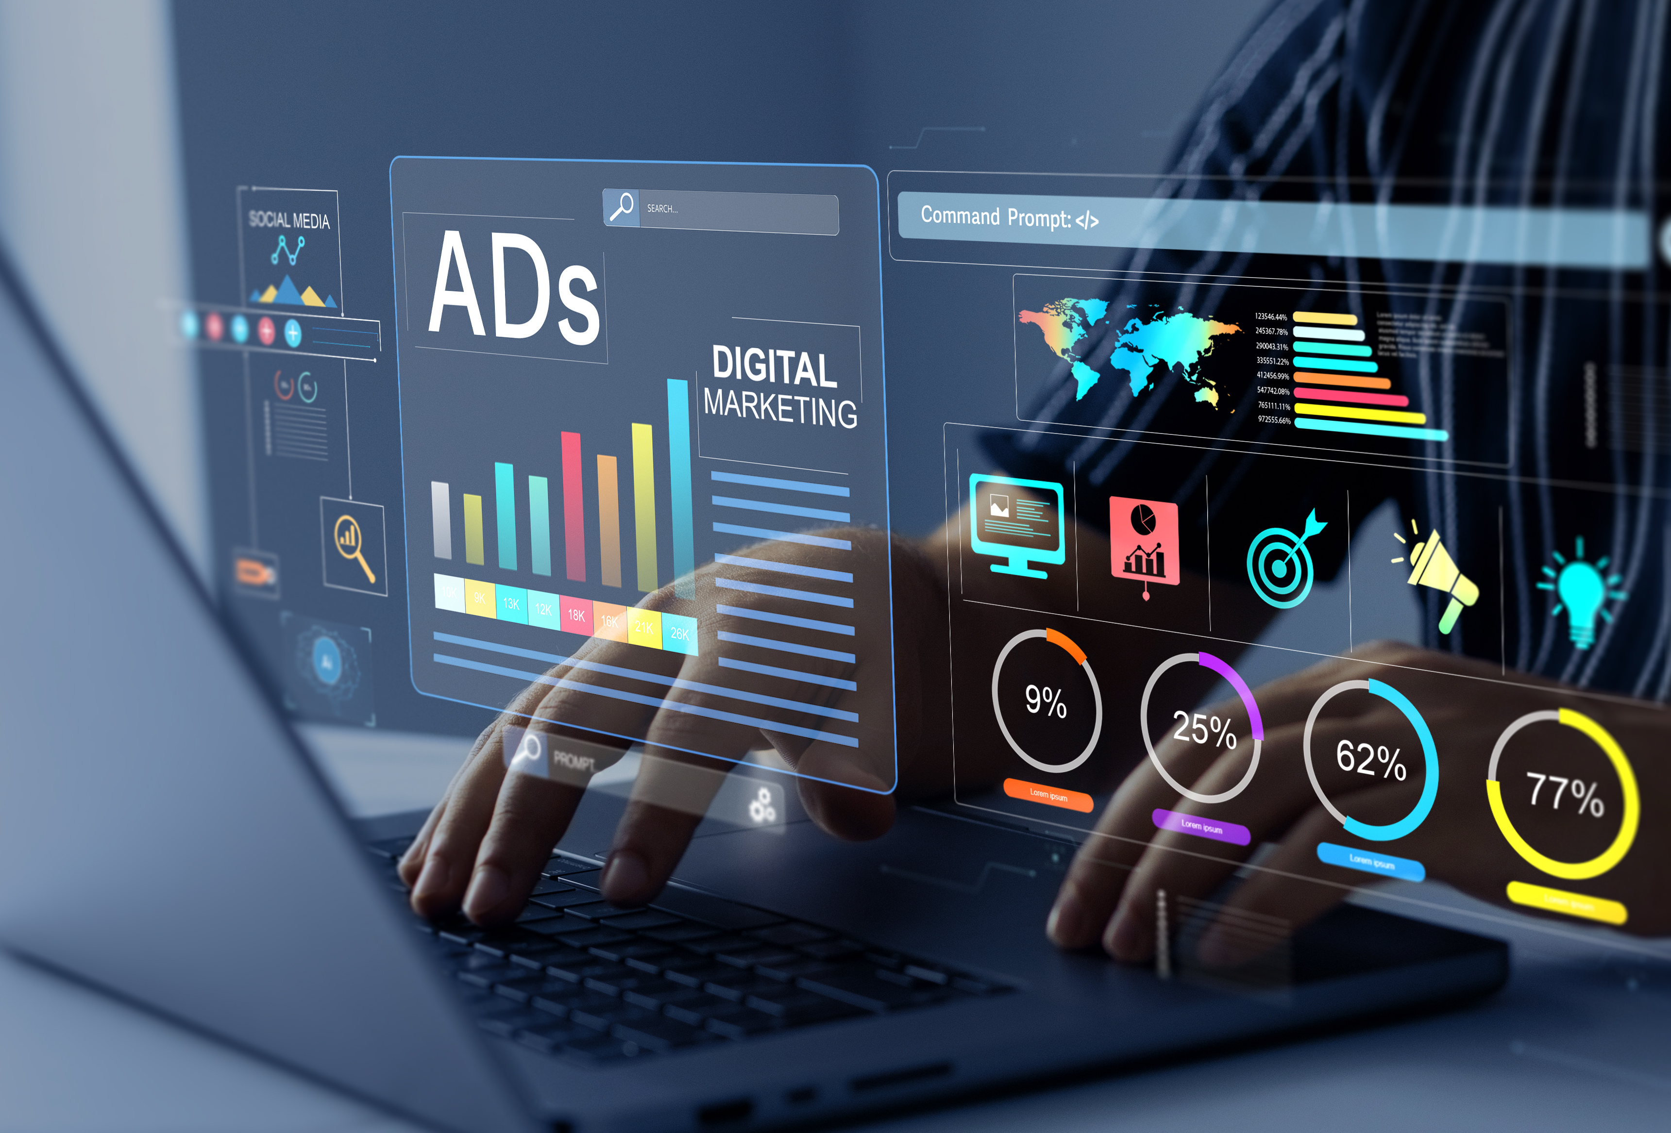
Shopify Magic
Shopify Magic tools and experiences are available
for free
Shopify Magic works on both desktop and mobile devices
All generally available features are available to all plans and in all languages.

Slide 17

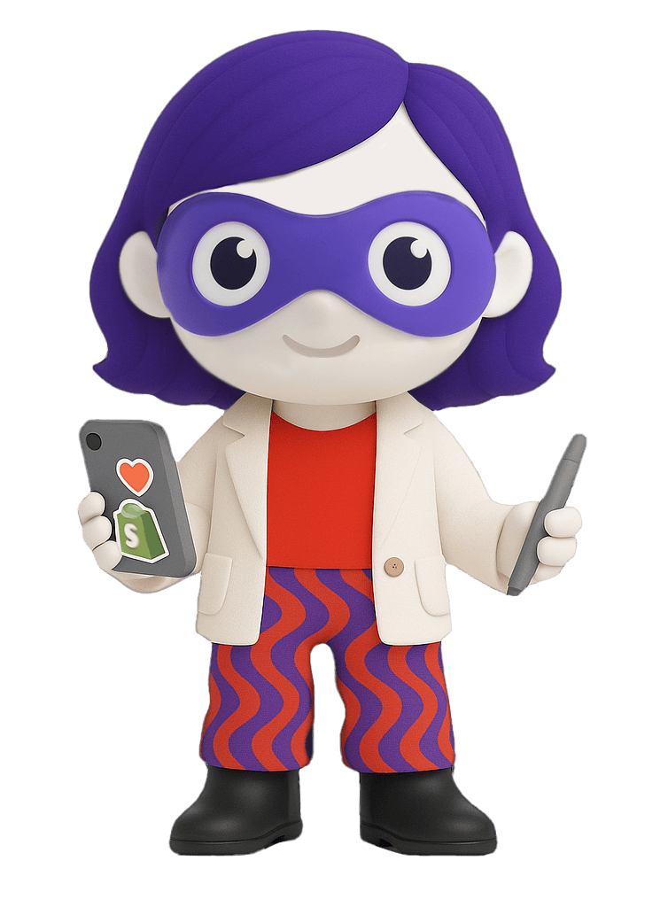
Sidekick
An AI-enabled commerce assistant for Shopify.
Designed to help you start, run, and grow your business.
Powered by Shopify Magic for personalized support.

Slide 18

Sidekick – Key Capabilities
Understands all of Shopify and your shop’s context.
Provides highly personalized and relevant assistance.
Handles a wide range of tasks using everyday language.

Slide 19
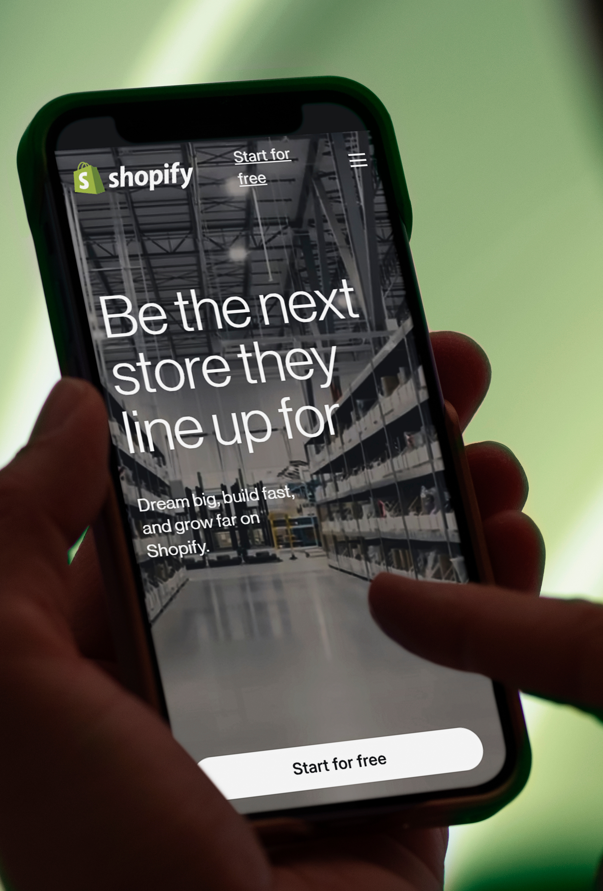
Benefits for Merchants
Jump-starts creative processes.
Improves store quality and performance.
Tackles time-consuming tasks efficiently.
Supports informed business decisions for all skill levels.

Slide 20

How Sidekick Works
Operates within the context of your shop.
Adapts as new content and actions are added.
Generates suggestions and completes tasks with your approval.
Never makes changes without your consent

Slide 21


Slide 22

Stages for a successful eCommerce implementation
Planning
Development
Launch
Maintenance

Slide 23

What might be on the horizon?
Predictive Testing/Targeting –
Adobe Commerce
Agentic AI for Operations –
Adobe Commerce
Shopify Pulse - Shopify
AI Store Builder - Shopify

Slide 24
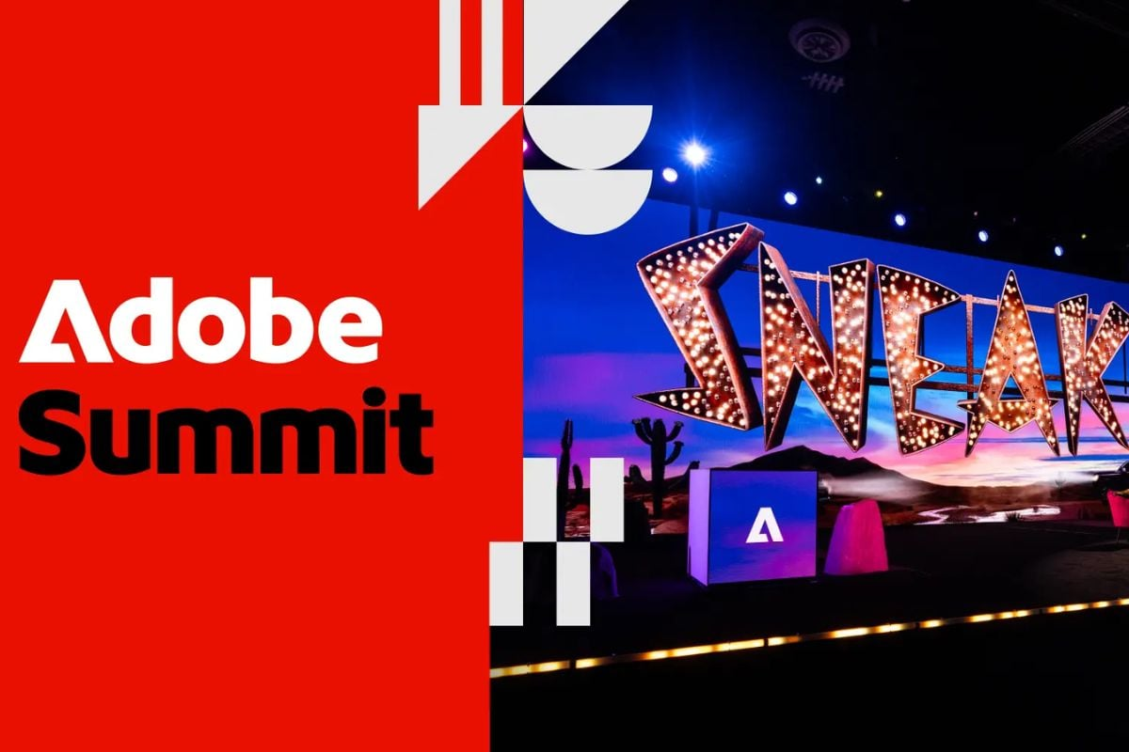
Adobe Commerce at Summit 2026
AI-Powered Discovery
Agentic Commerce Protocols
Brand Concierge
Commerce Developer Agent

Slide 25
THANK YOU

