Slide 1
QR ordering for restaurants
Sudhanshu
Alejandro
Bajaj
Vazquez

Slide 2
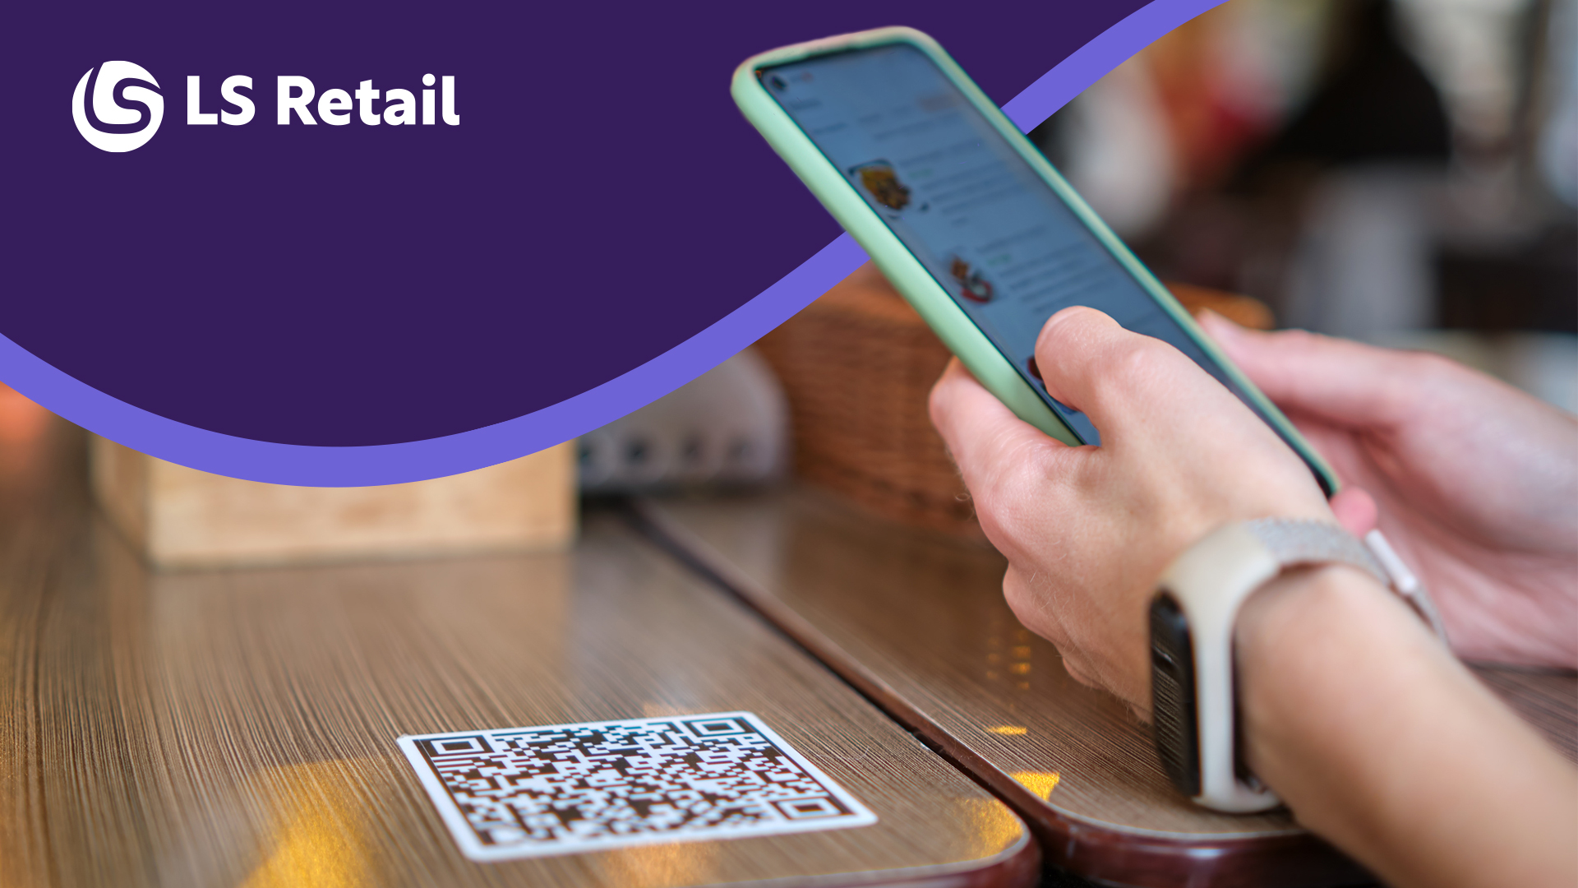

Slide 3
QR ORDERS: FROM SCAN TO SERVED
HOW IT WORKS: LS CENTRAL
HOW IT WORKS: ECOMMERCE PLATFORM
Agenda
LIVE DEMO
QR ordering for restaurants
CUSTOMER STORY
Q&A

Slide 4


Marketplace Theme
Progressive Web App (PWA)
Custom Theme
eCommerce API
Commerce Service for LS Central

Slide 5
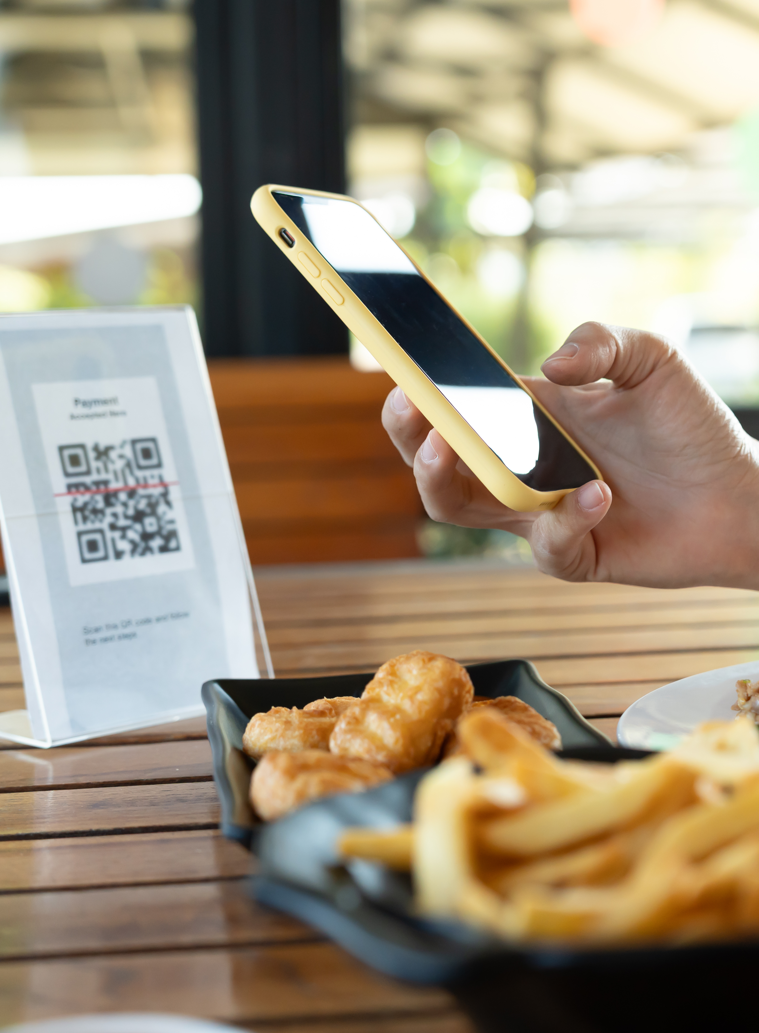
Introduction
The eCommerce for LS Central module acts as a software enhancement built on the LS Central system
This functionality is accessible via the eCommerce API​
The solution is delivered on top of Magento/Adobe Commerce platform.

Slide 6
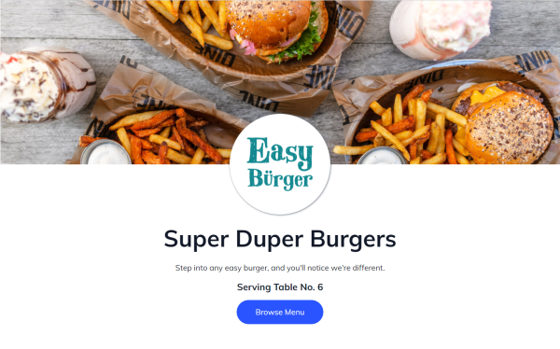
QR Ordering
Scan QR codes available on dining tables
Contactless payments without having to handle cash and engage in unnecessary contact.
Browse through menu items without waiting for the staff and request the menu.
Hospitality customers can also provide additional information in the form of order comments at checkout.

Slide 7
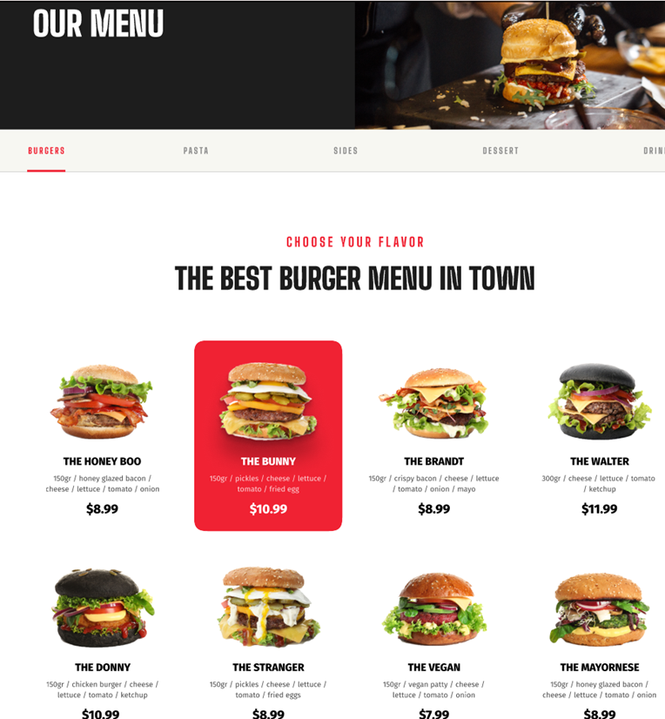
Ordering online
Configurable option to enable/disable Click & collect functionality from Magento admin panel.​
Accept Click & Collect as shipment method. ​
List of stores available for Click & Collect on checkout page. ​
Option to choose pickup store at the checkout page. ​
Select store either by map or through drop down list.​
Check availability of items within the store before placing order.​
Configurable options to select multiple payment methods for Click & Collect functionality.
(Pay at Store, Prepayment with Card, etc.)

Slide 8

Take away orders
Configurable option to enable/disable Click & Collect
Accept Click & Collect as shipment method. ​​
Configurable options to select multiple payment method for Click & Collect functionality.

Slide 9
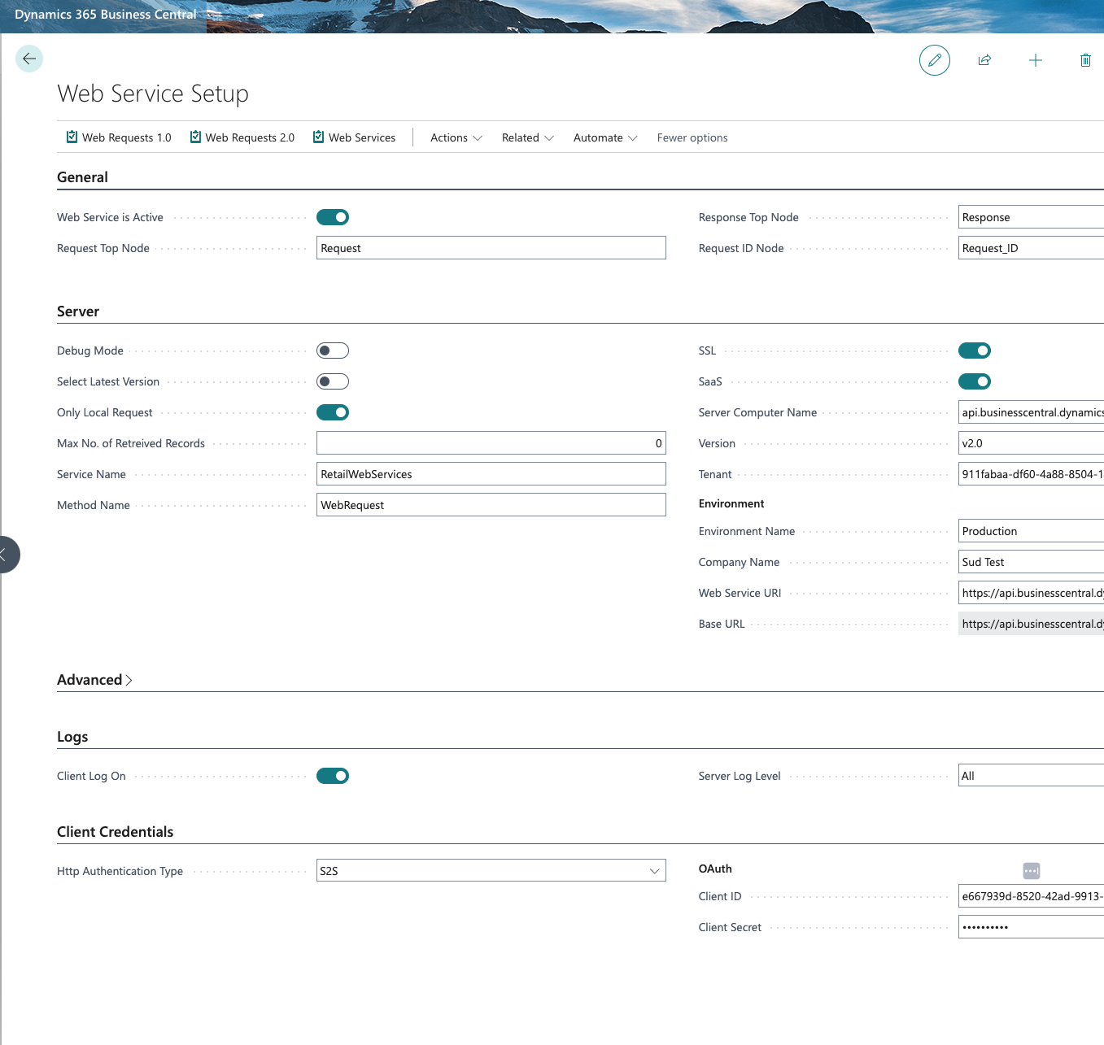
Set up eCommerce in LS Central
Web Service setup
  S2S Authentication
Web Requests 2.0 – Publish and subscribe
Setup web restaurant
Update the commerce tab on the Restaurant Card
Define menu hierarchy

Slide 10
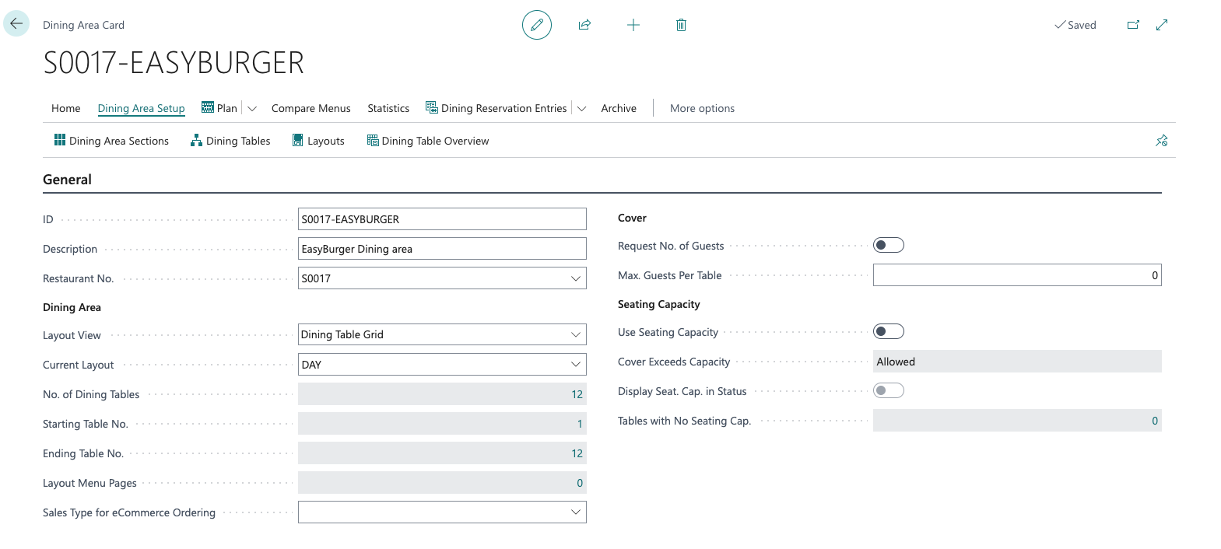
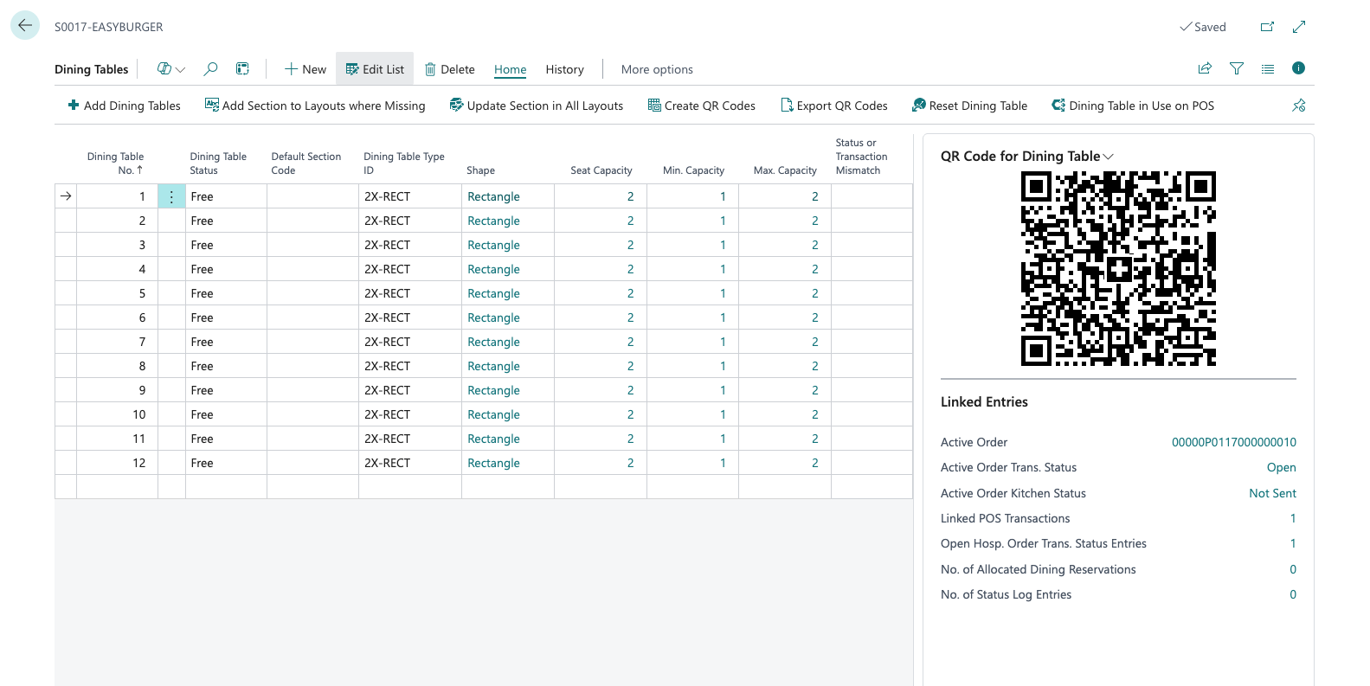

Slide 11
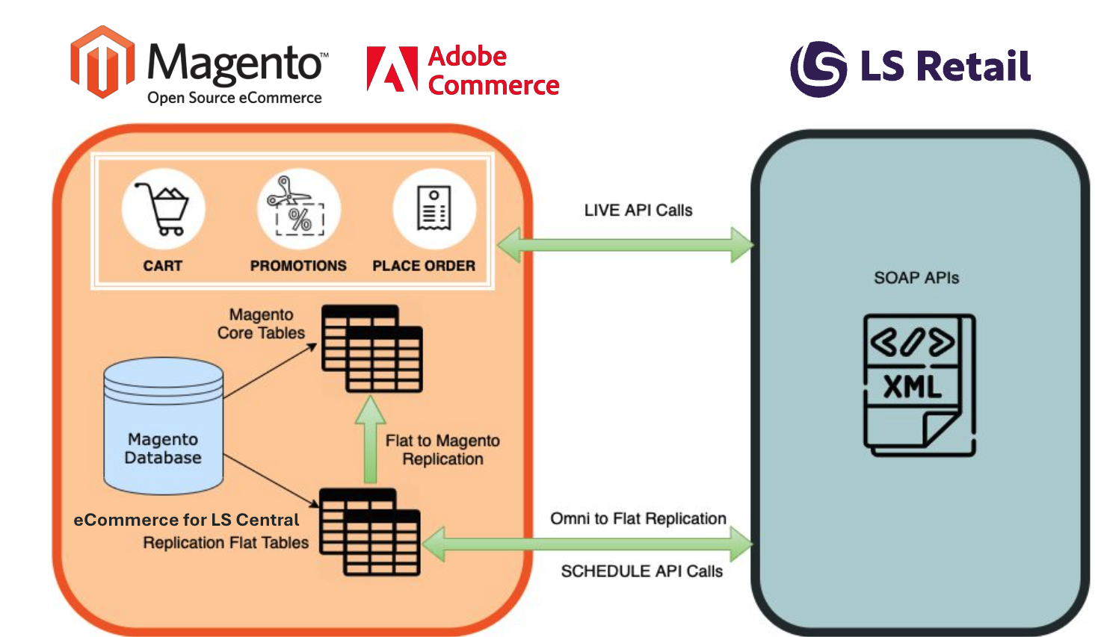

Slide 12
Mapping terminology
Magento | LS Central
Catalog → Products | Retail Item List
Catalog → Categories | Hierarchy Node
Catalog → Categories → Products in Category | Hierarchy Leaf
Product Attribute - Barcode | Item Barcode
Product Price | Item Unit Price including VAT
Product Attributes | Attributes
Catalog Rule | Periodic Discounts
Sales → Order | Customer Order
Customers → All Customers | Members Contact
Customers → Customer Groups | Member Club List → Member Schemes

Slide 13
eCommerce
POS
Point of Sale
Master Data
eCom Profile
Customer Loyalty
Takeaway
QR Code Ordering
Transaction Repository
KDS
Home Delivery
Activity
+
+

Slide 14
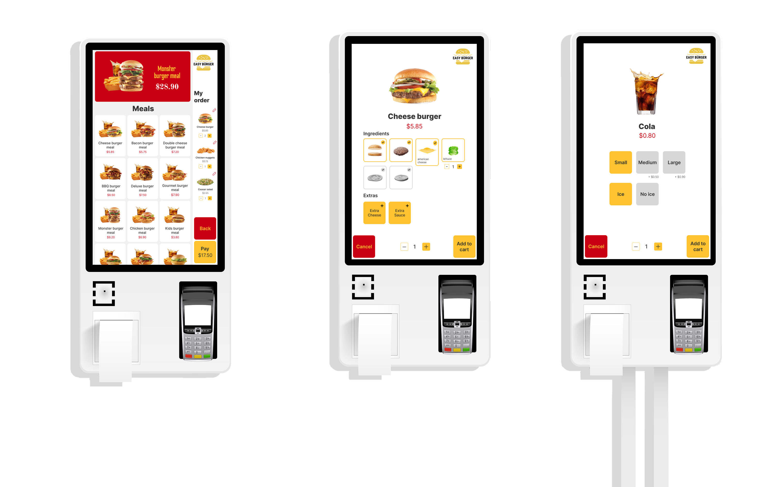

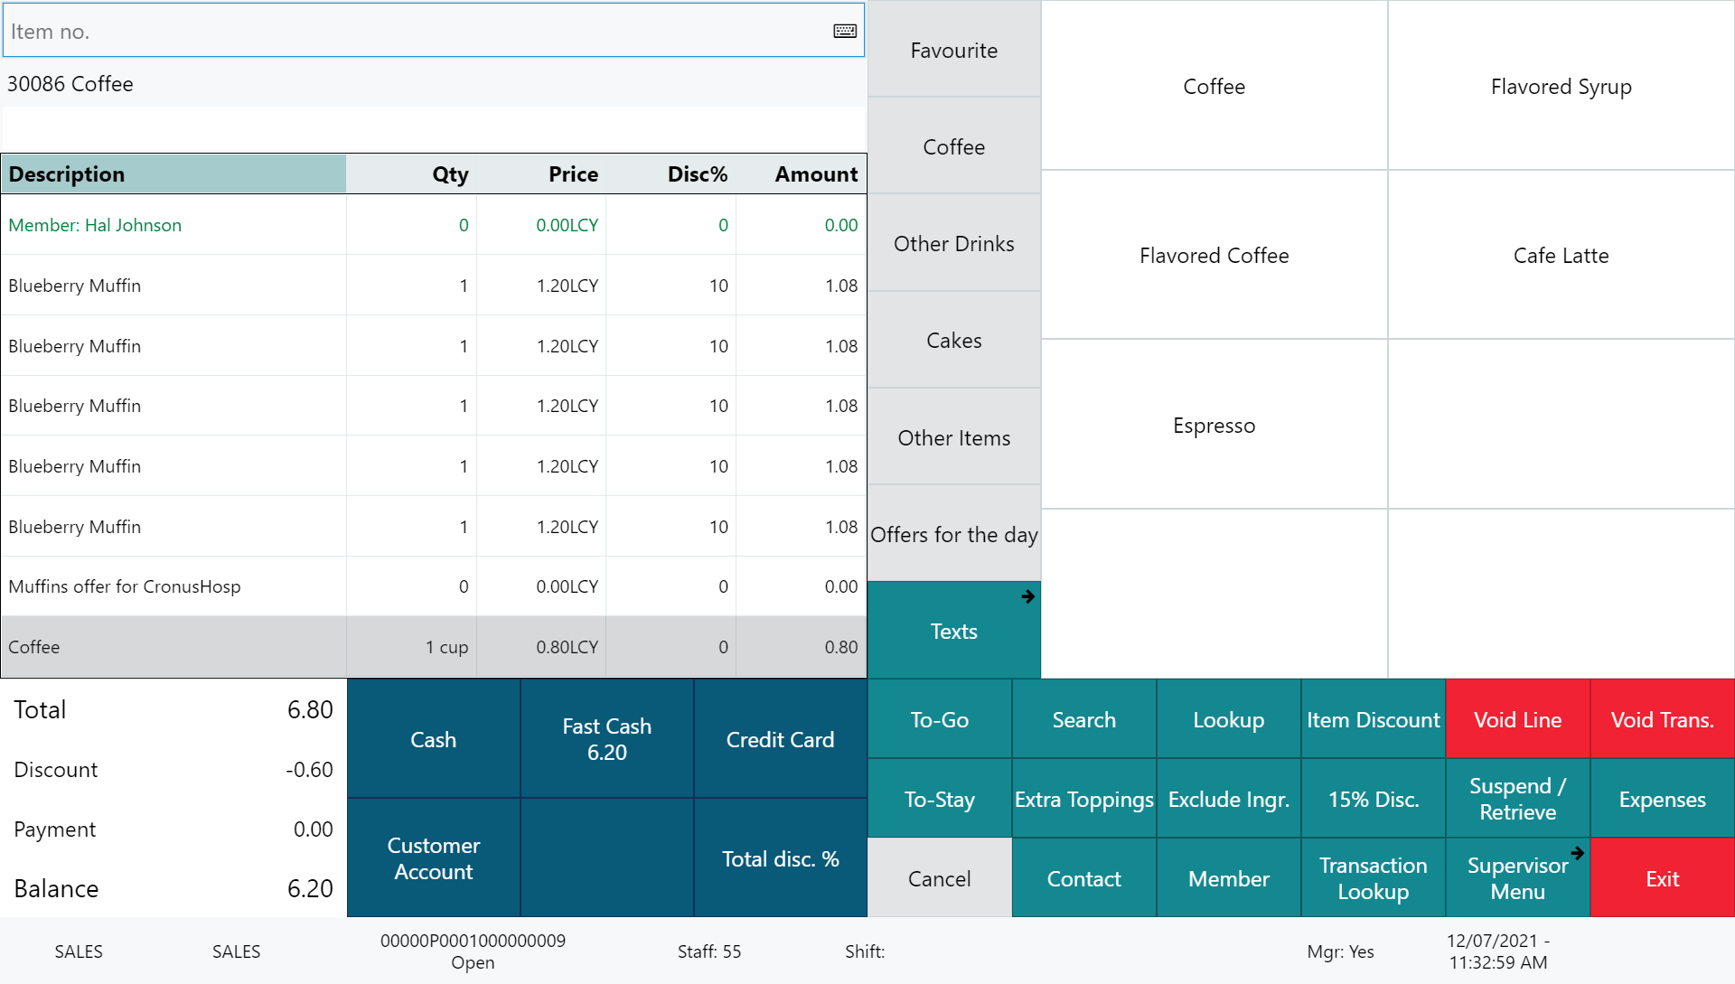





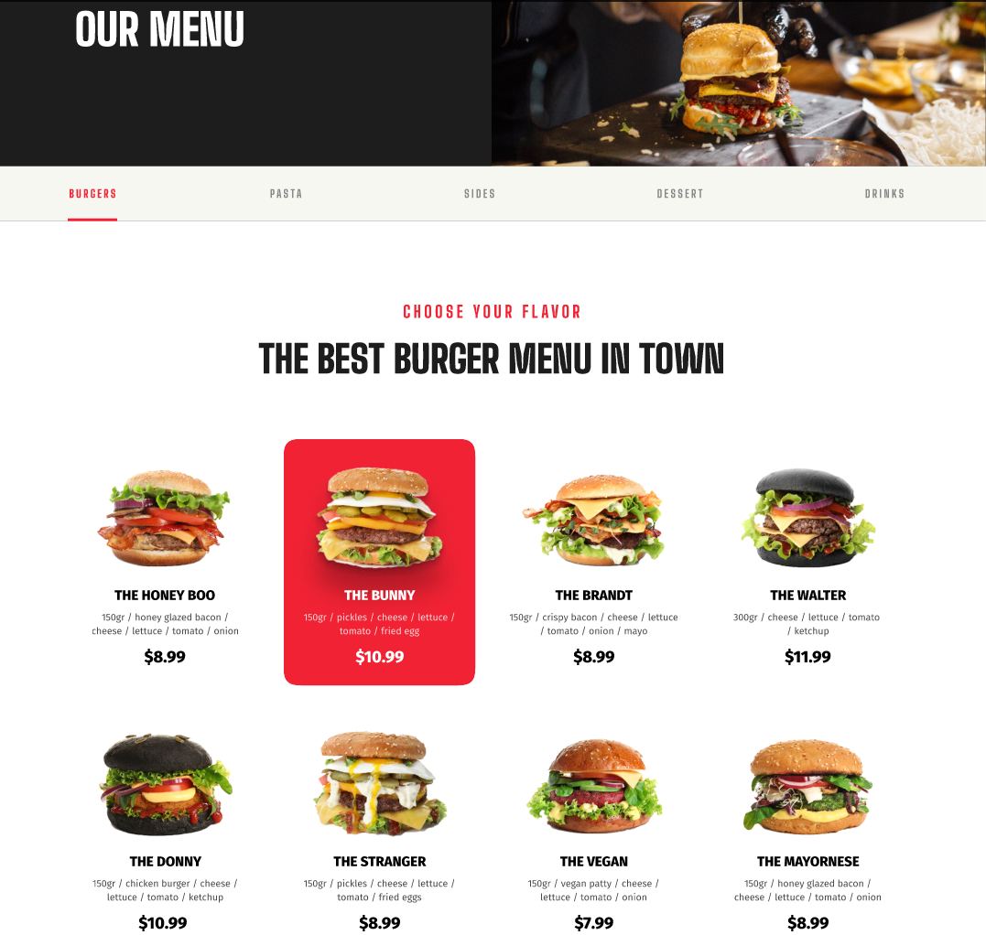

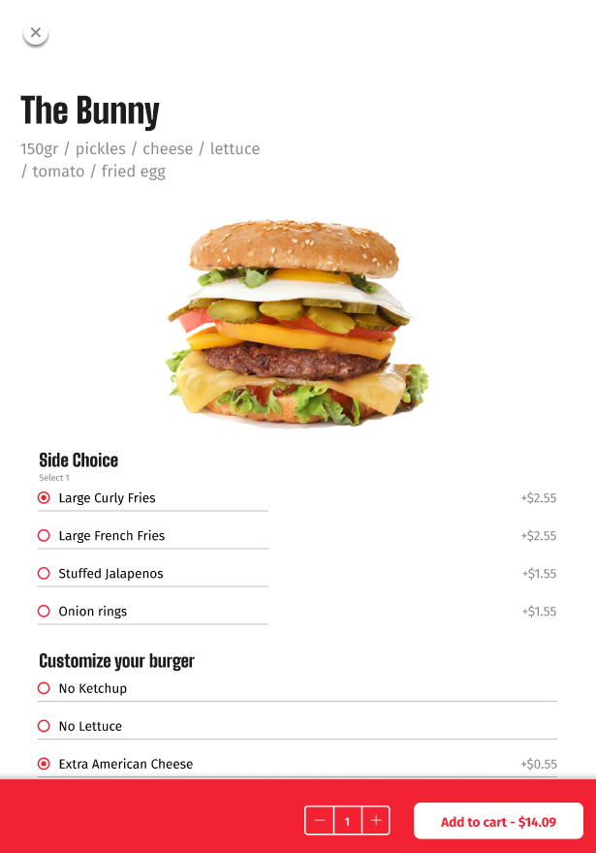
Restaurant
KDS preparation stations
Self Service Kiosks
POS 1
POS 2
LS KDS
Grill
KDS
Cold
Expeditor
station
Kitchen Service
Dessert
Bar
Online ordering

Slide 15
DEMO
QR ordering in action

Slide 16
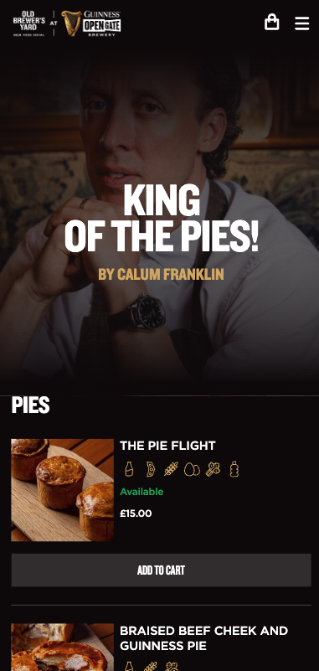
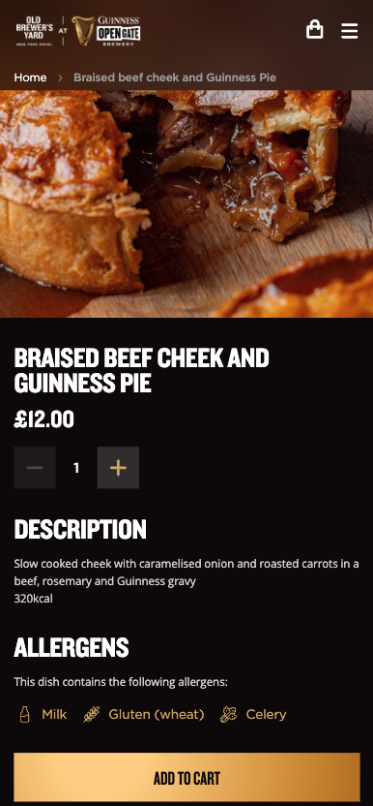
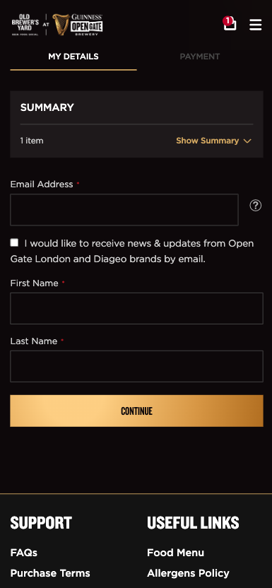
Customer Story
Custom Magento template with Adyen Payment Method
Apple Pay and Google Pay for faster checkout
Unified item management
Allergens information with icons
Simple checkout process
Checks kitchen status every 30 secs

Slide 17
