Slide 1
LS eCommerce
How to embark on an eCommerce project?
Zeeshan Khuwaja
Kristjan Asvaldsson
Product Owner
Solution Lead

Slide 2
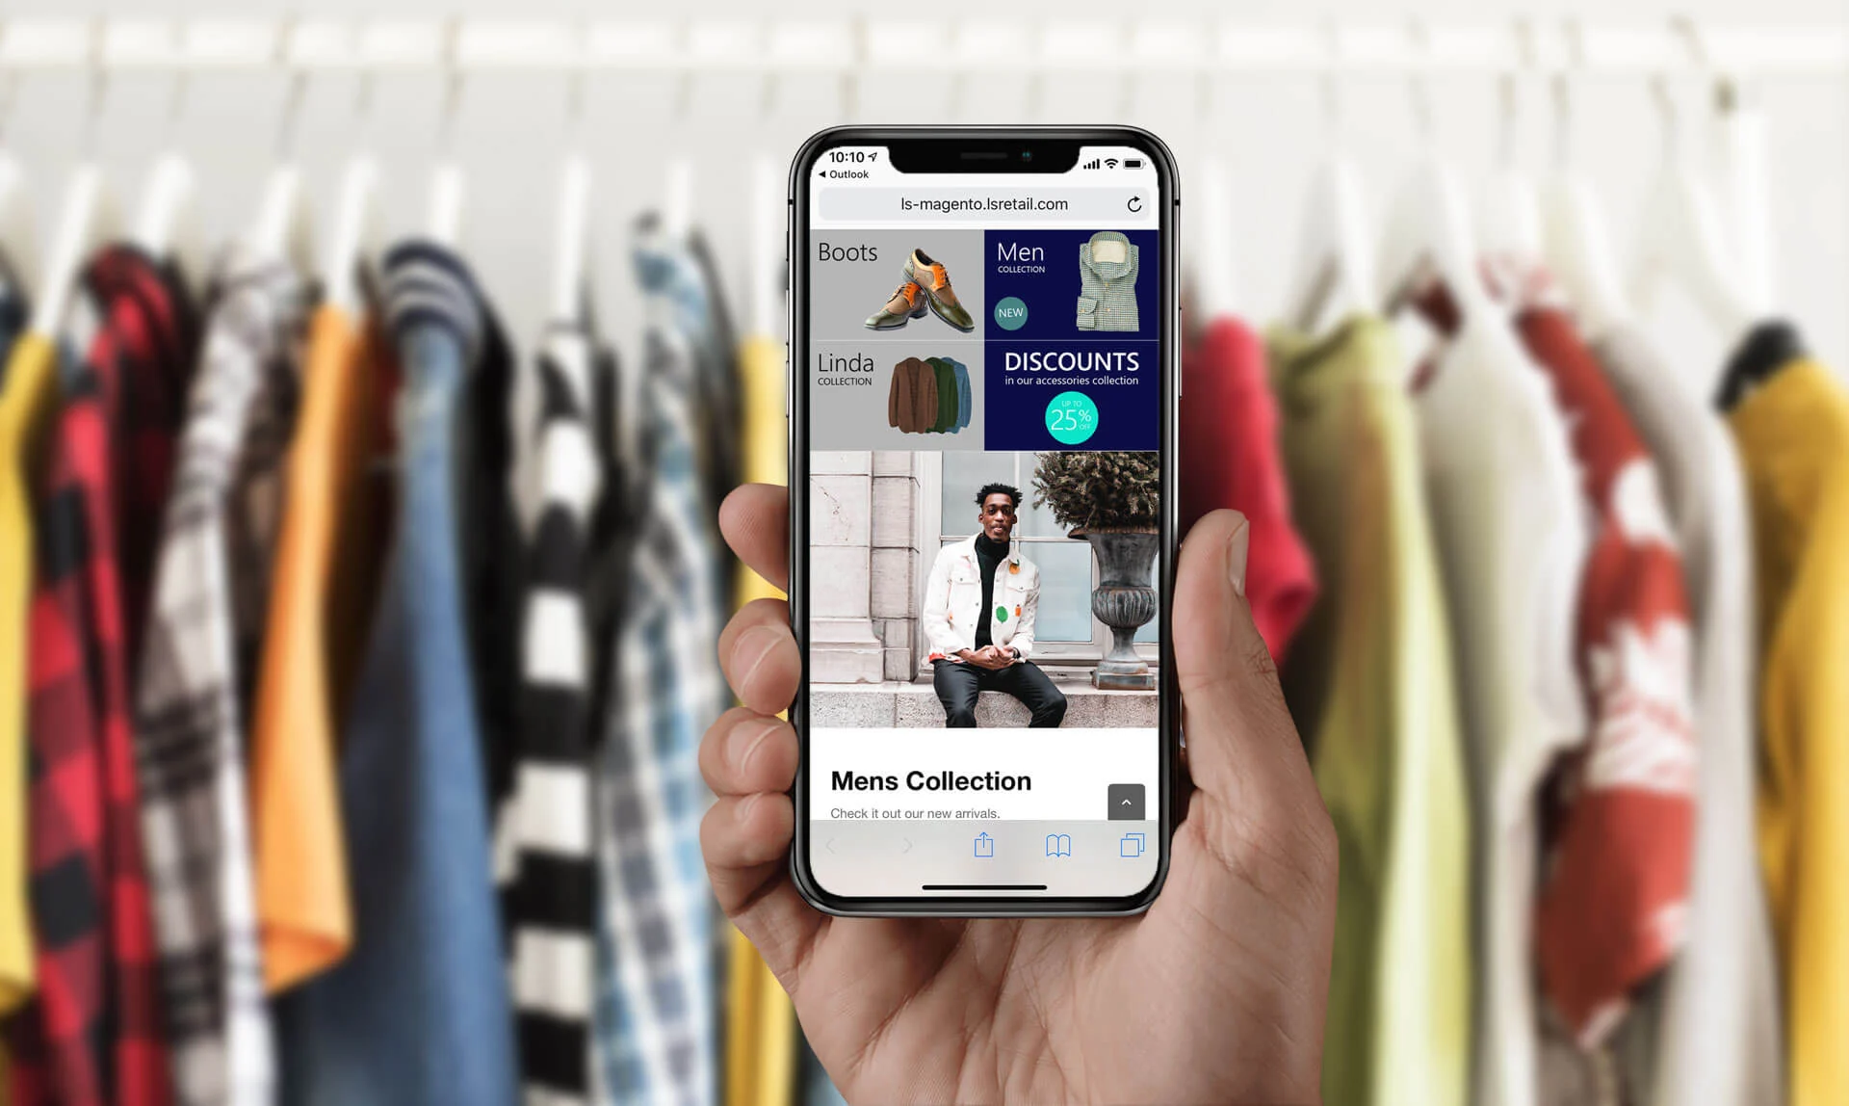

Slide 3
Introduction

Slide 4
Introduction
What is LS eCommerce ?
Eco System
Installation
Configuration

Slide 5
Introduction
What is LS eCommerce
Eco System
Installation
Configuration

Slide 6
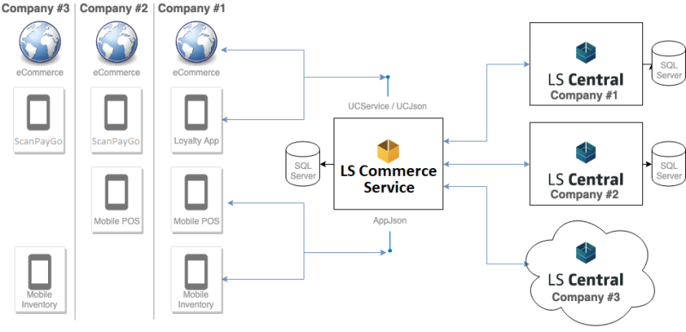

Slide 7
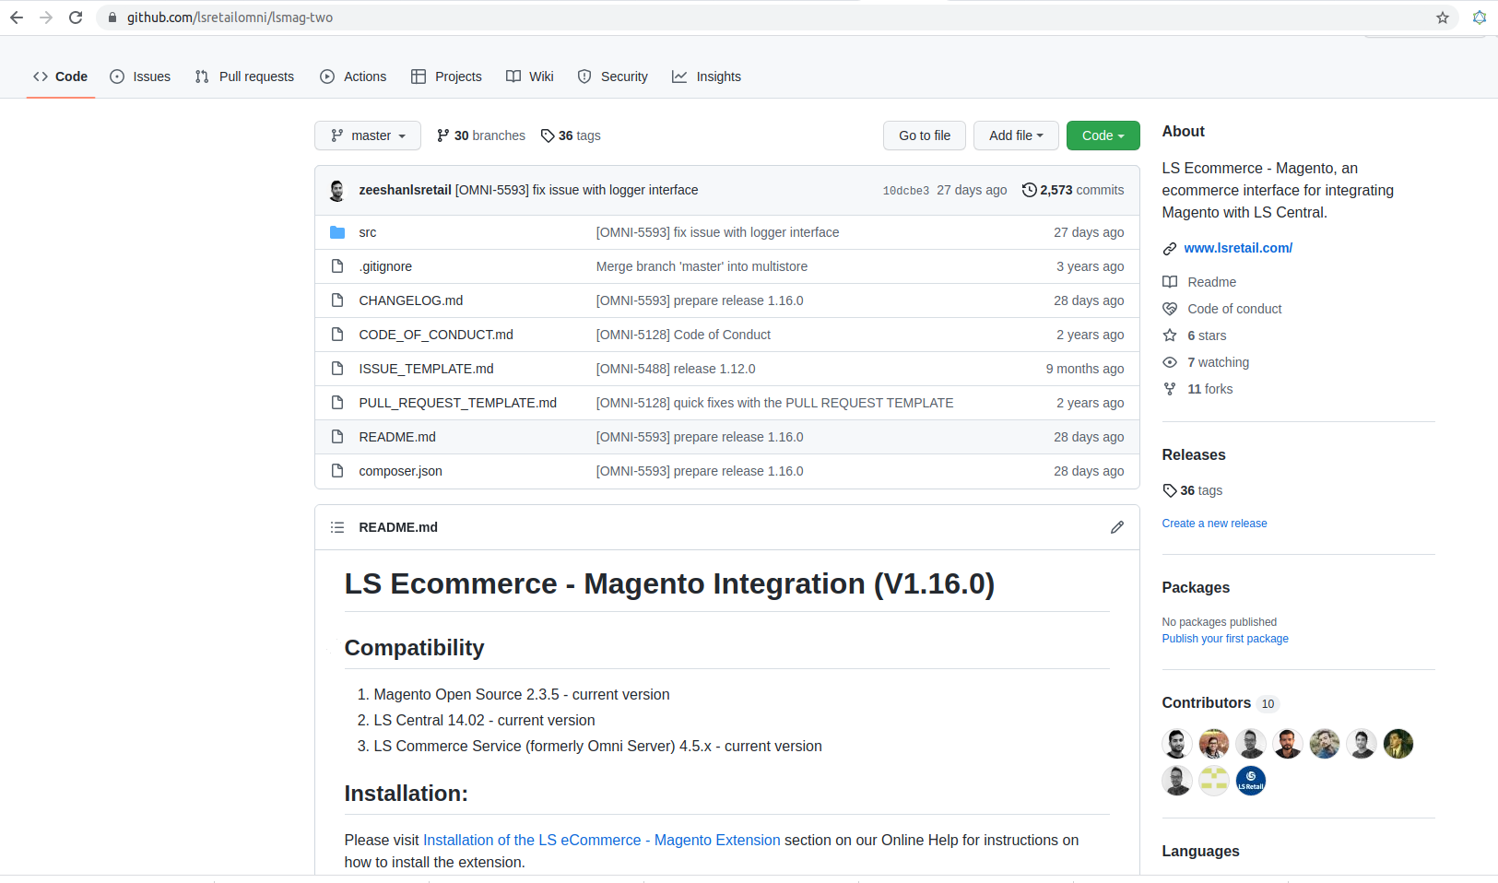

Slide 8
Introduction
What is LS eCommerce
Eco System
Installation
Standalone
Virtual Machine
Configuration

Slide 9
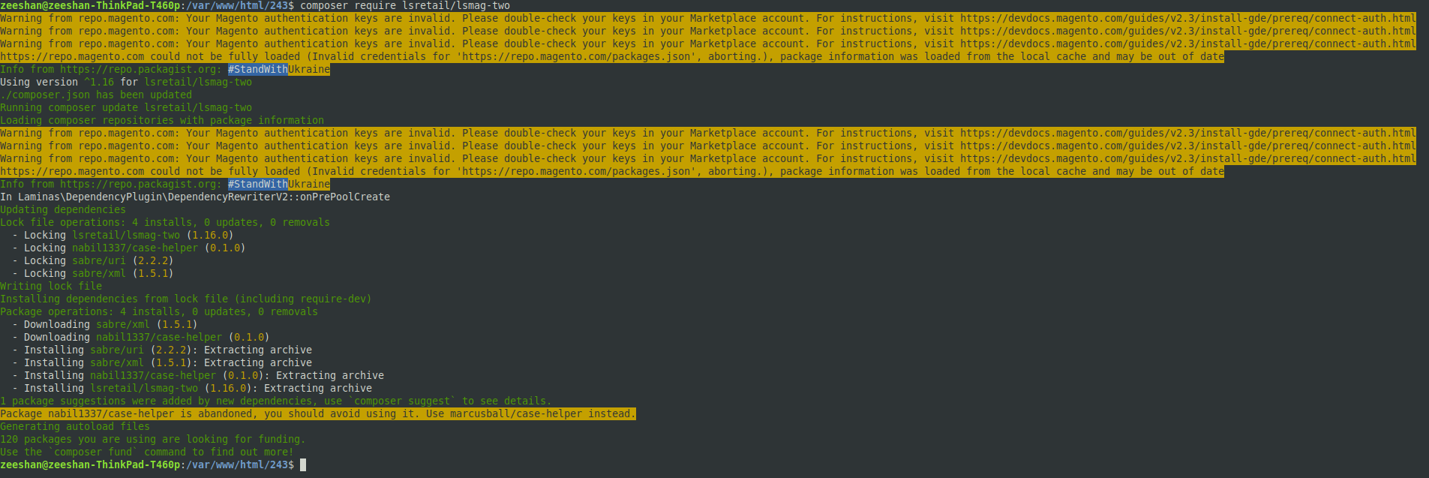

Slide 10
Introduction
What is LS eCommerce
Eco System
Installation
Standalone
Virtual Machine
Configuration

Slide 11
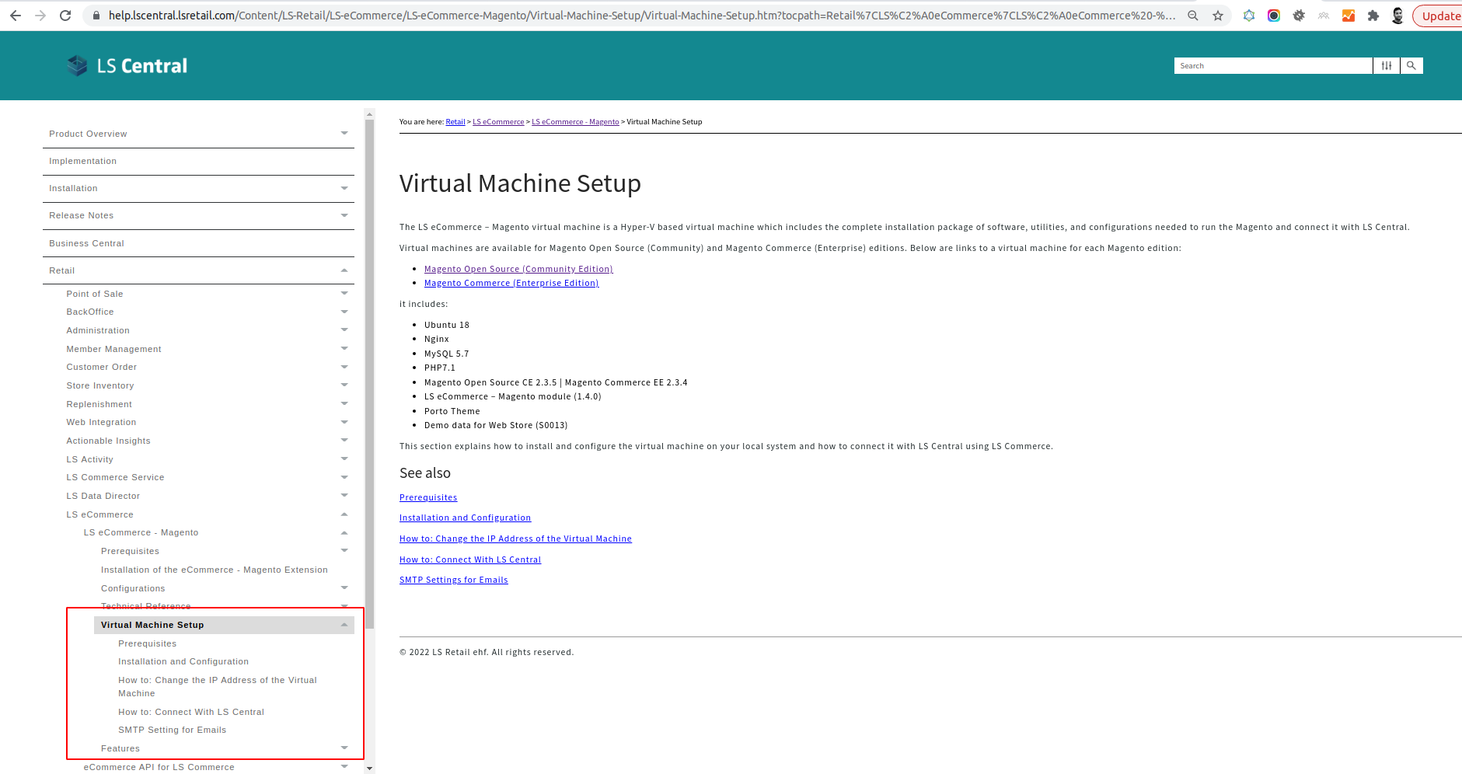

Slide 12
Introduction
What is LS eCommerce
Eco System
Installation
Configuration

Slide 13
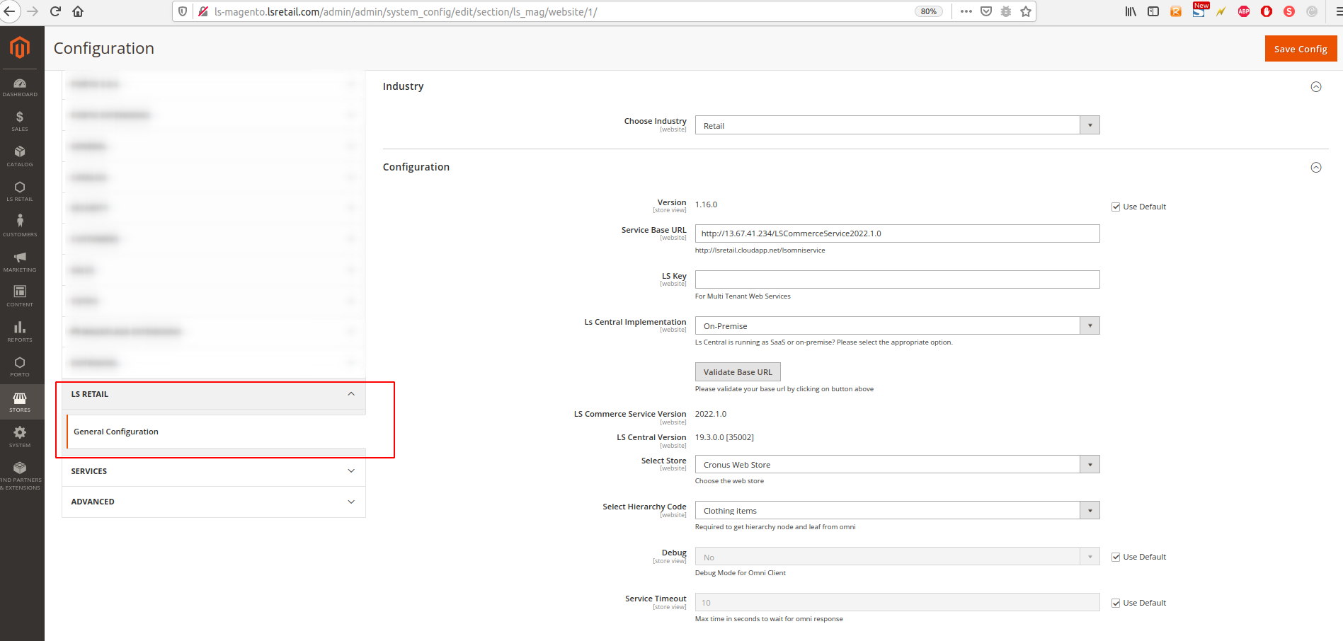

Slide 14
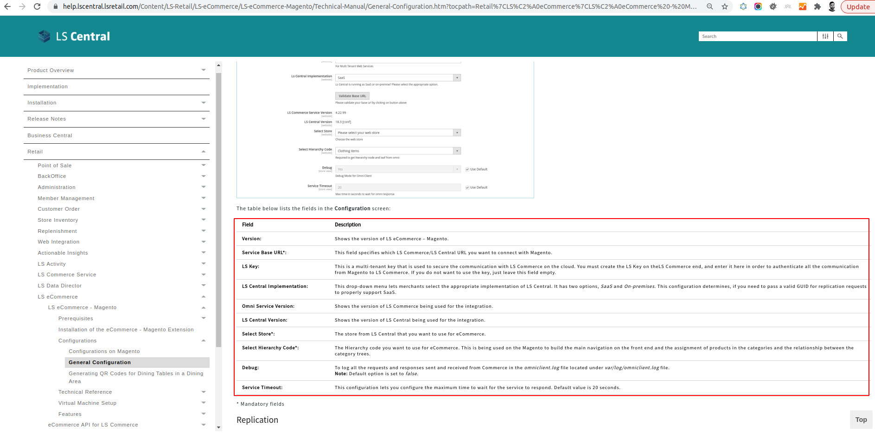

Slide 15
Run a Project?

Slide 16
Run a Project ?
Scoping
Selecting the Magento Platform
UI – Look and Feel
Hosting

Slide 17
Scoping
Client Requirements.
Supported Features.
Gaps ?

Slide 18
Run a Project ?
Scoping
Selecting the Magento Platform
UI – Look and Feel
Hosting

Slide 19
Adobe Commerce/Magento Platform
Costing.
Store Size.
Scalability.
Hosting.
Advance Features.
Support.

Slide 20
Run a Project ?
Scoping
Selecting the Magento Platform
UI – Look and Feel
Hosting

Slide 21
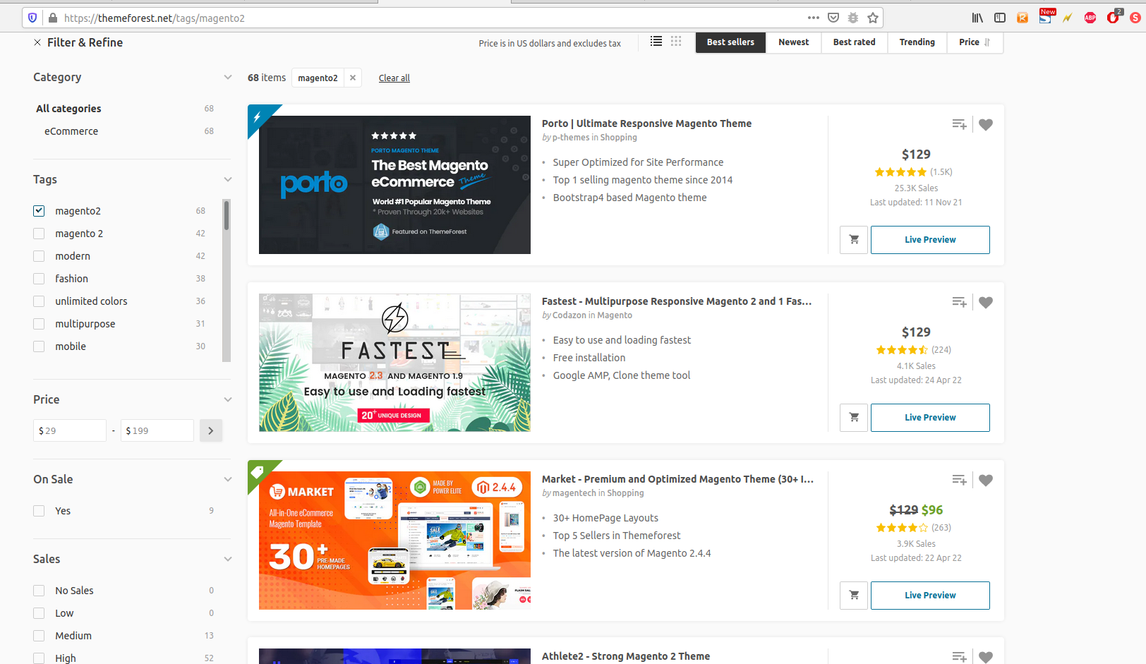

Slide 22
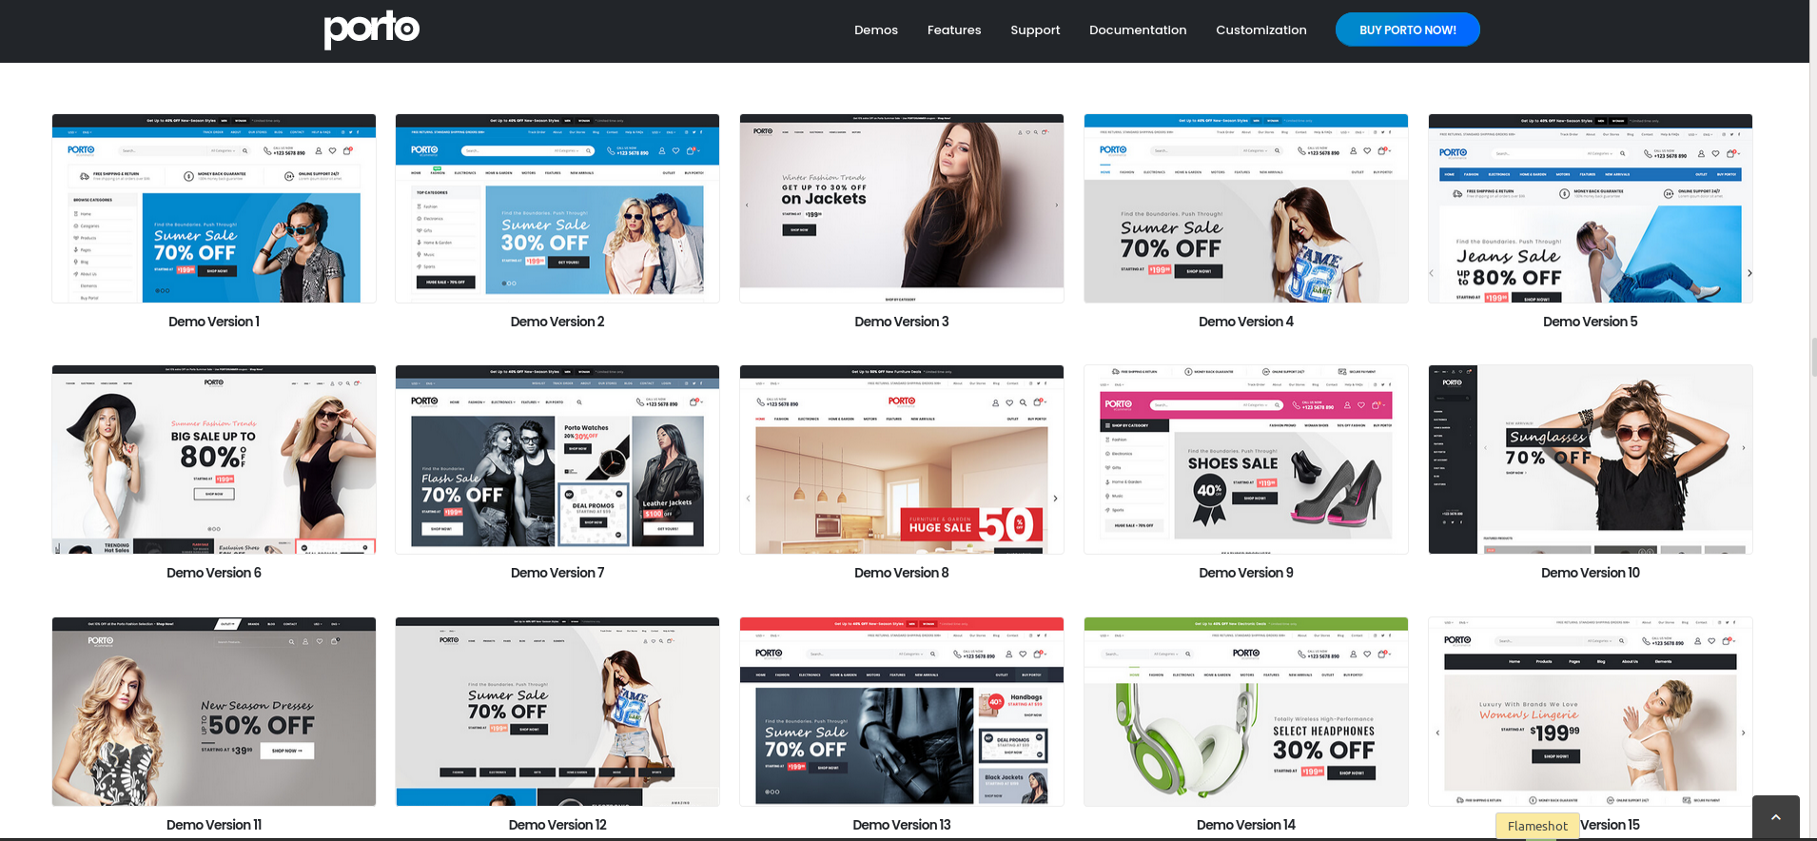

Slide 23
Run a Project ?
Scoping
Selecting the Magento Platform
UI – Look and Feel
Hosting

Slide 24
Hosting
Magento Commerce Cloud.
On Premise.
Third party.

Slide 25
Customization?

Slide 26
Customization
Frontend - UI
Magento
LS eCommerce – Magento module
LS Commerce Service
LS Central.

Slide 27
LS Retail Consultancy
Discovery Workshops.
Training.
Customization Requests.
Deployment.

Slide 28
Questions?

Slide 29
Thank you!

