Slide 2
eCommerce for
LS Central
What’s new?
Petur Thor
Bjarni
Sigurdsson
Asmundsson

Slide 3

Bjarni Asmundsson
New Product Director
eCommerce for LS Central

Slide 4



3rd party
eCommerce
providers

Slide 5

3rd party
eCommerce
providers
Local Inventory

Slide 6
3rd party
eCommerce
providers
Local Inventory
3rd party
marketplaces

Slide 7
3rd party
eCommerce
providers
Commerce Service
for LS Central
Local Inventory
Scan
Pay
Go
3rd
Party
Apps
3rd party
marketplaces

Slide 8

Adobe Commerce
Magento
LS Retail extension for Adobe Commerce and Magento

Slide 9
Adobe Commerce
Magento
LS Retail extension for Adobe Commerce and Magento
Unified solution approach

Slide 10
Adobe Commerce
Magento
LS Retail extension for Adobe Commerce and Magento
Unified solution approach
Can be deployed as “stand-alone”
Available for retail and F&B (restaurants)
Supporting headless commerce

Slide 11
What’s new?
Retail
Stand-alone
integration options
eCom API moved to
LS Central
Multi-location sourcing
Time based discounts
Data migration (eCom API)
Stock protection rules
Push notifications (PWA)
Online refunds phase I
Effective inventory
Multi-currency support for loyalty points
Wishlist synchronization

Slide 12
What’s new?
Restaurants
Improved QR code
group ordering
Multiple KOTs for online orders
Queue counter support
Unavailable items support
Data translations for hospitality elements
Past date basket calculation

Slide 13

Shopify
Easier
Simpler
Faster
Driven from
LS Central
Simplified integration with all the needed elements
Ideal for merchants that do not require unified commerce
Transitioning to Microsoft’s BC connector

Slide 14
What’s new in eCommerce for LS Central - Shopify?
Retail
Smart order routing
Multi store fulfillment
Market support
GraphQL Transition
Virtual items
Shortage support
Partial shipments
Store send
CnC orders fulfilled from Warehouse
Sales order posting
Order edits
Shopify gift card support

Slide 15

Shopify – BC Connector
LS Central extending the functionality of Microsoft’s Shopify Connector
Supported features from LS Central
  Customer order creation
  Member management
  Extended variant framework
  Retail images
  Click & Collect via POS
  Fulfillment, posting & webhooks
  Market support
  Metadata and many more
Migration support from existing LS Central Connector

Slide 16
How will this affect LS Central - Shopify?
Retail
Smart order routing
Multi store fulfillment
Market support
GraphQL Transition
Virtual items
Shortage support
Partial shipments
Store send
CnC orders fulfilled from Warehouse
Sales order posting
Order edits
Shopify gift card support

Slide 17
Shopify – BC Connector
All new feature development will be delivered through the BC Connector
We will continue to fully support the existing connector
  The existing connector is targeted for sunsetting in version 31 (Wave 2 2027)
These features are already available in the LS Retail extension
for Microsoft Shopify Connector
Smart Order Routing remains a work in progress
During this transition, we will focus on actively supporting
partners and clients migrating to the new solution
Retail
Smart order routing
Multi store fulfillment
Market support
GraphQL Transition
Virtual items
Shortage support
Partial shipments
Store send
CnC orders fulfilled from Warehouse
Sales order posting
Order edits
Shopify gift card support

Slide 18
Shopify
Demo

Slide 19
Google
Local
Inventory
Ads

Slide 20
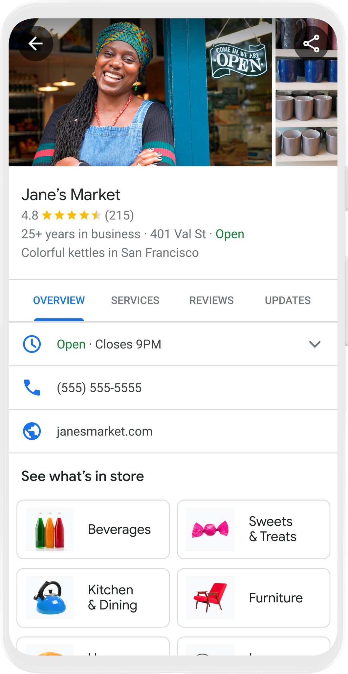
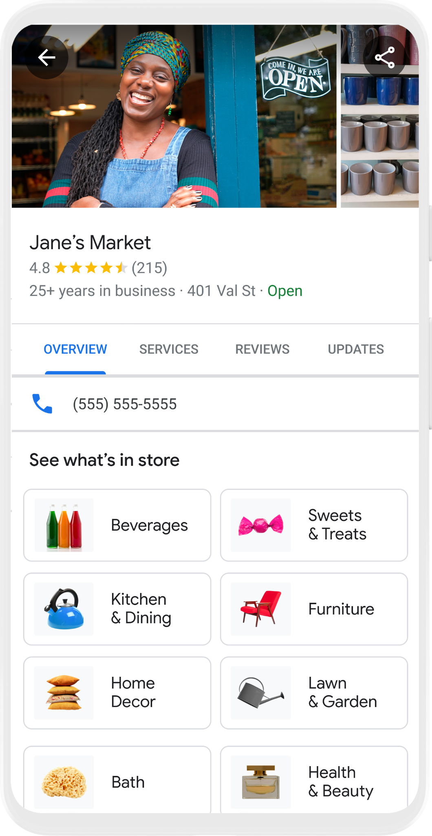

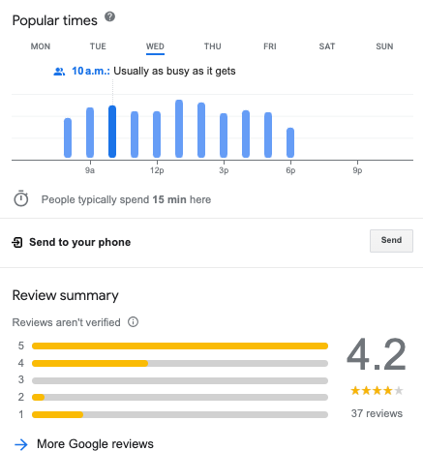
4.8
See What’s In Store

Slide 21
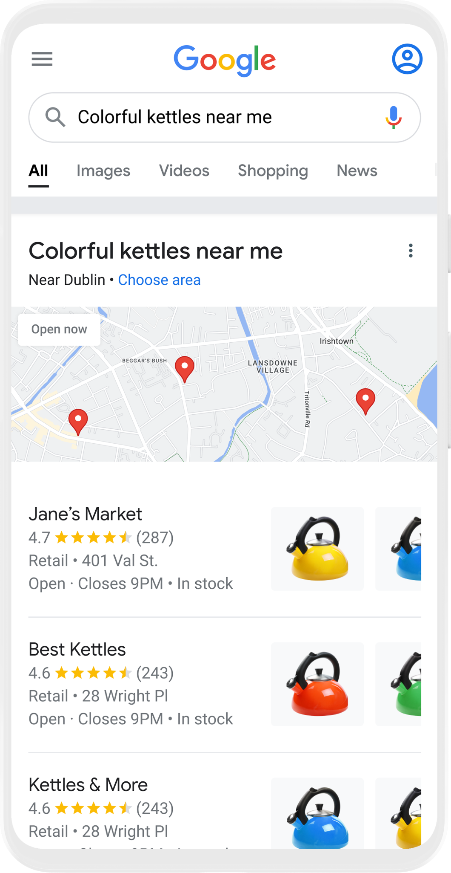
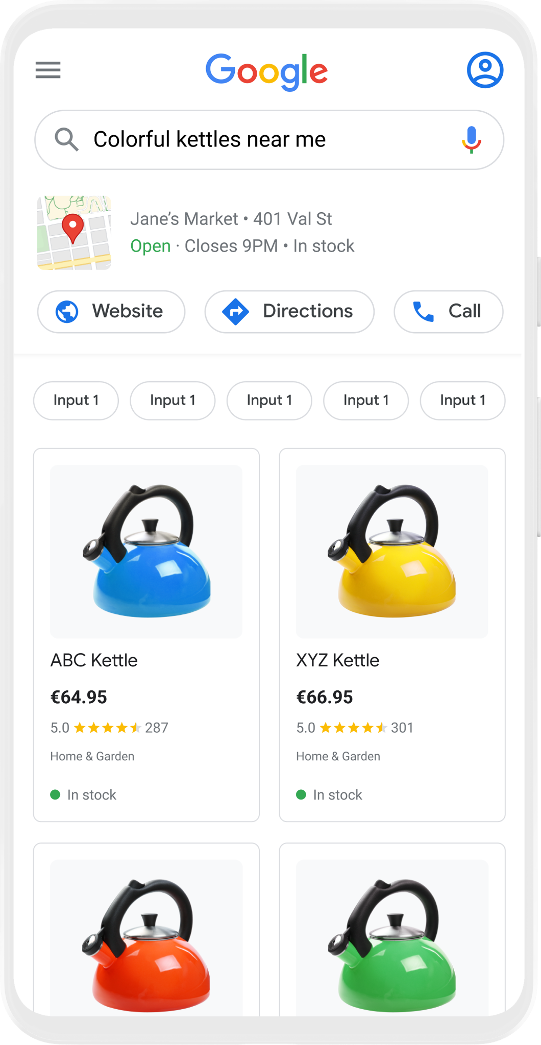

Free Local Product Listings
Showcase your store’s products for free on Google Search
Google Search
Shopping Tab
Google Business Profile
Red
Yellow
Large
Electric
Blue

Slide 22
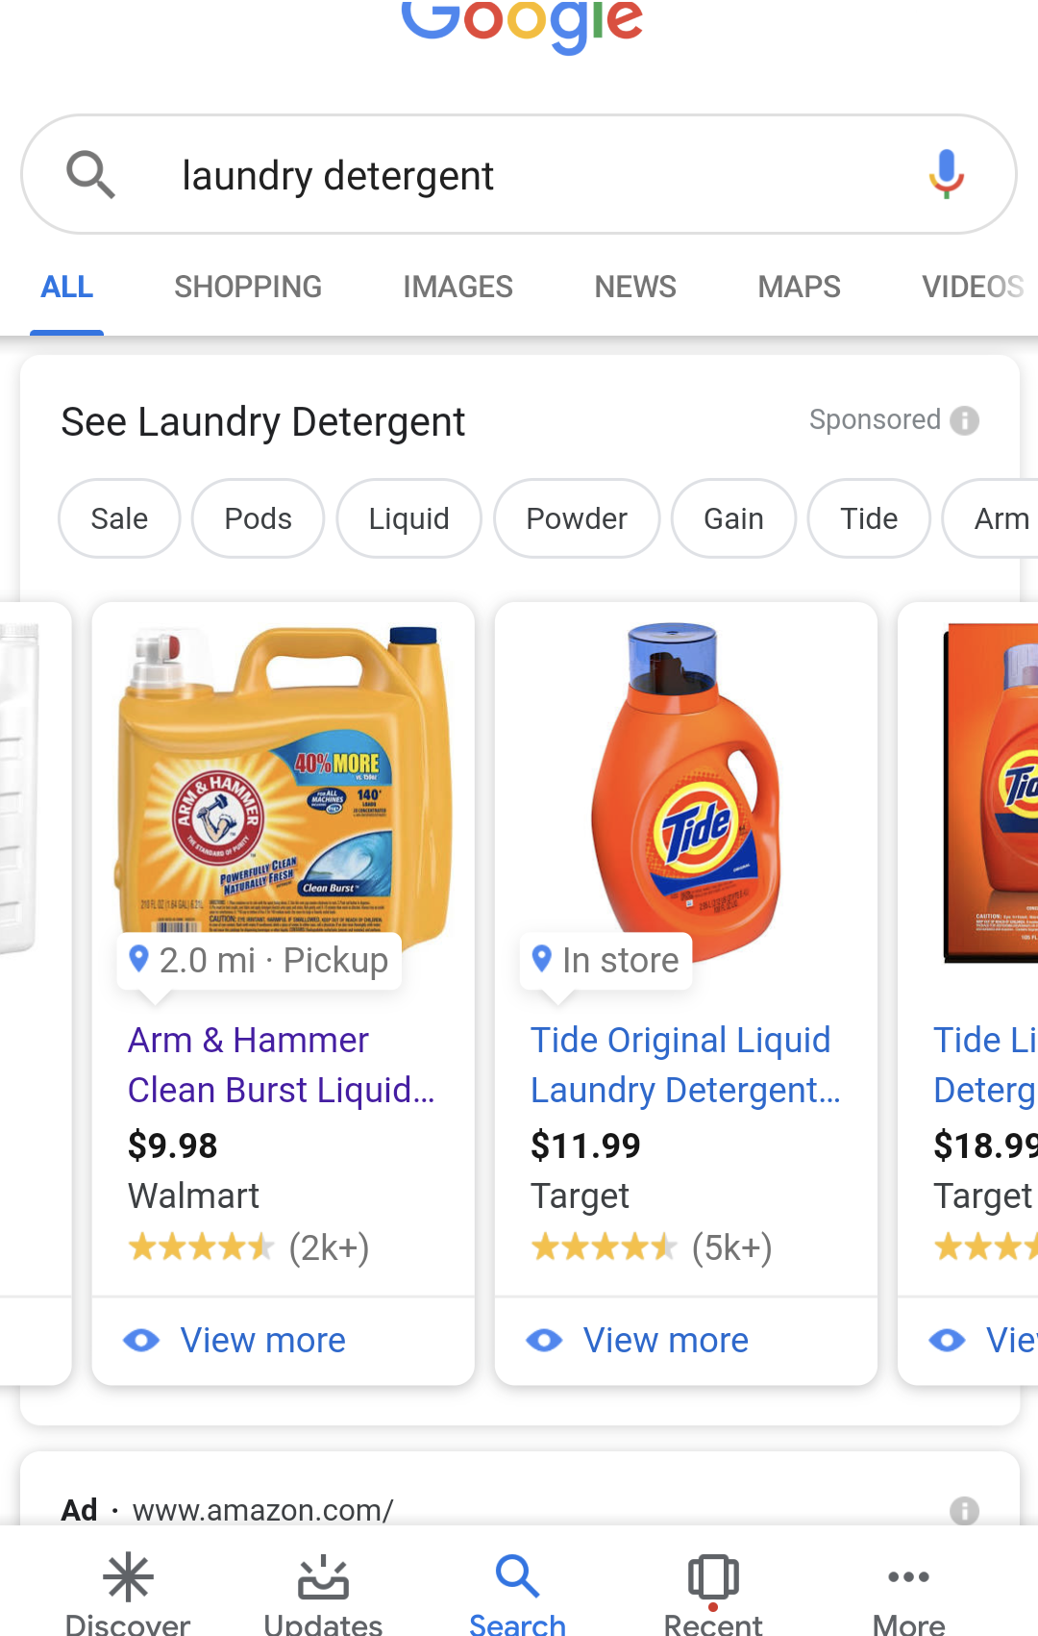
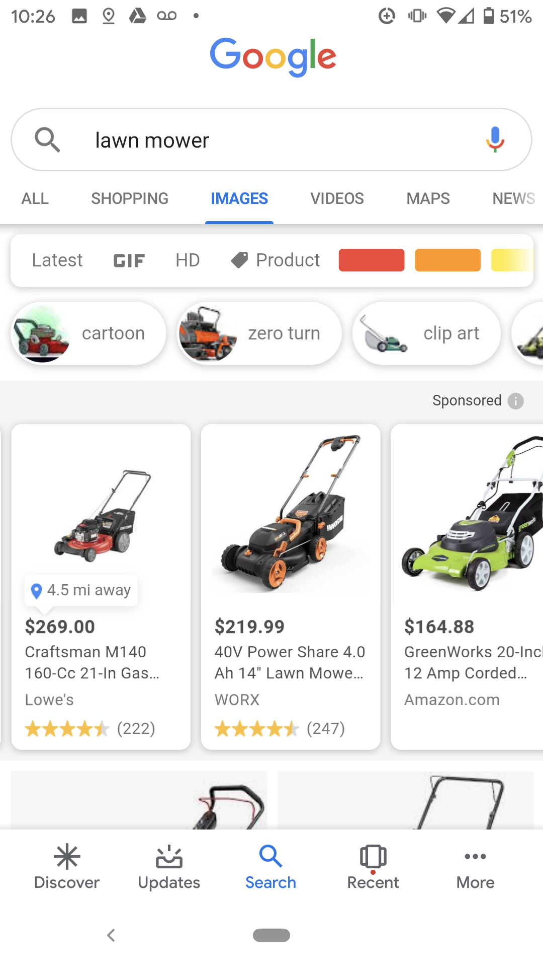
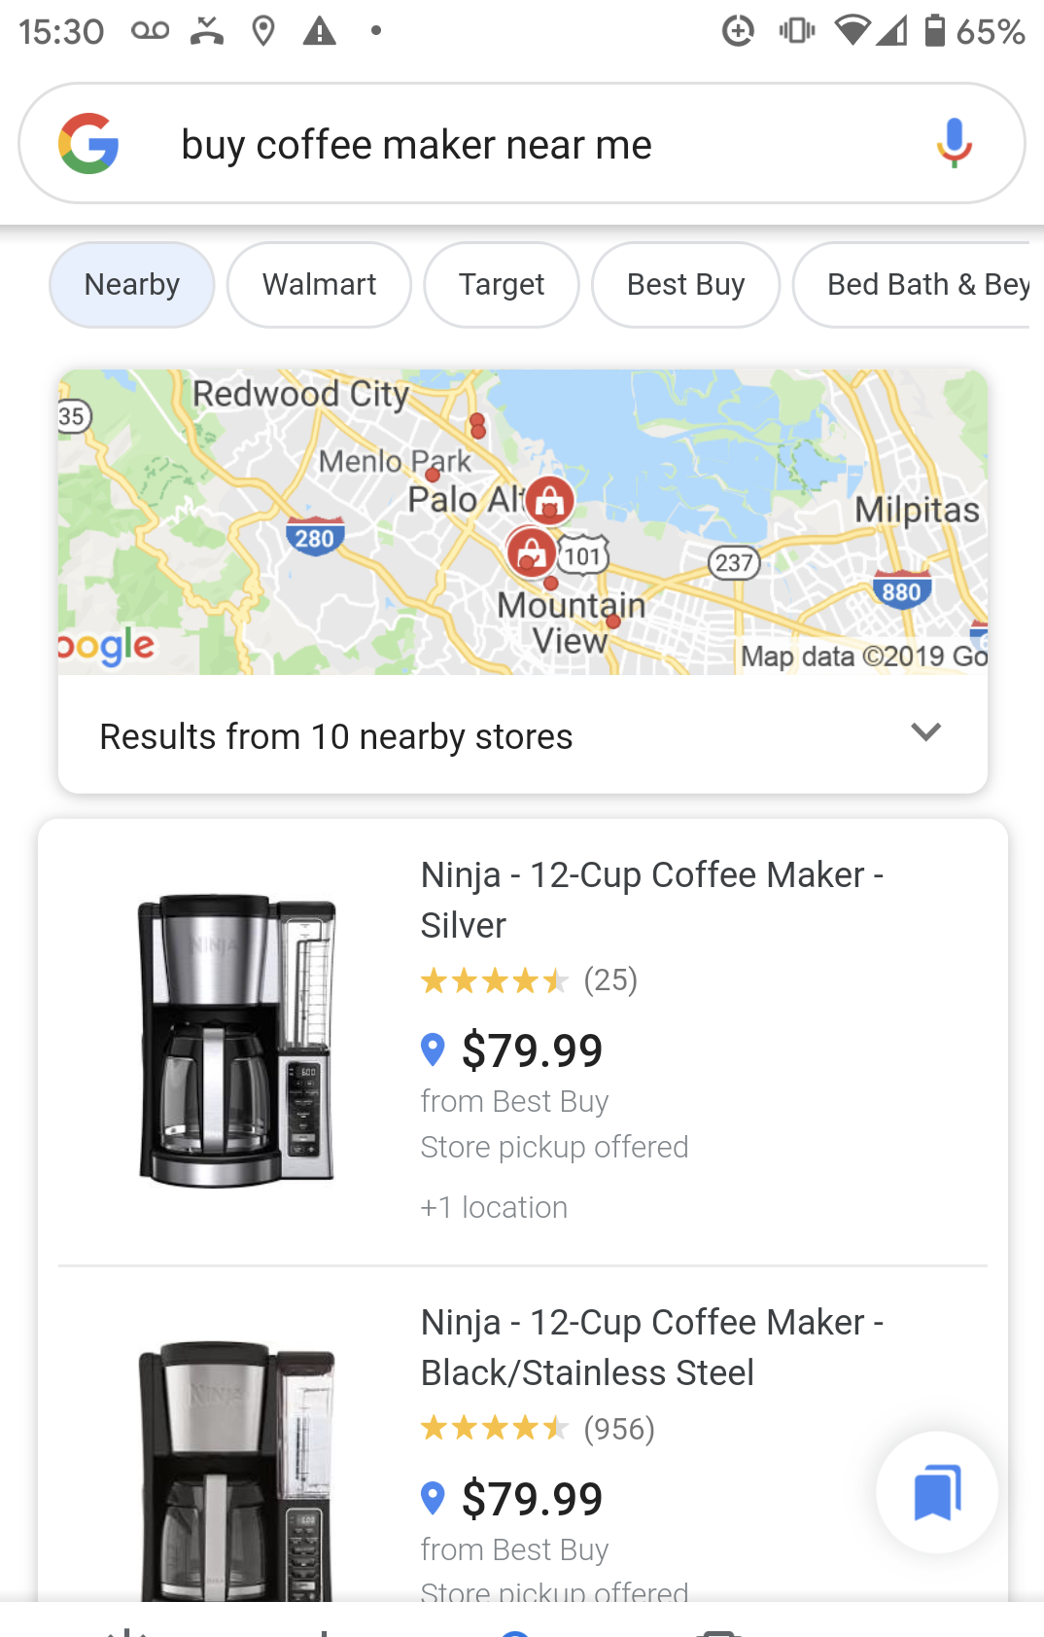
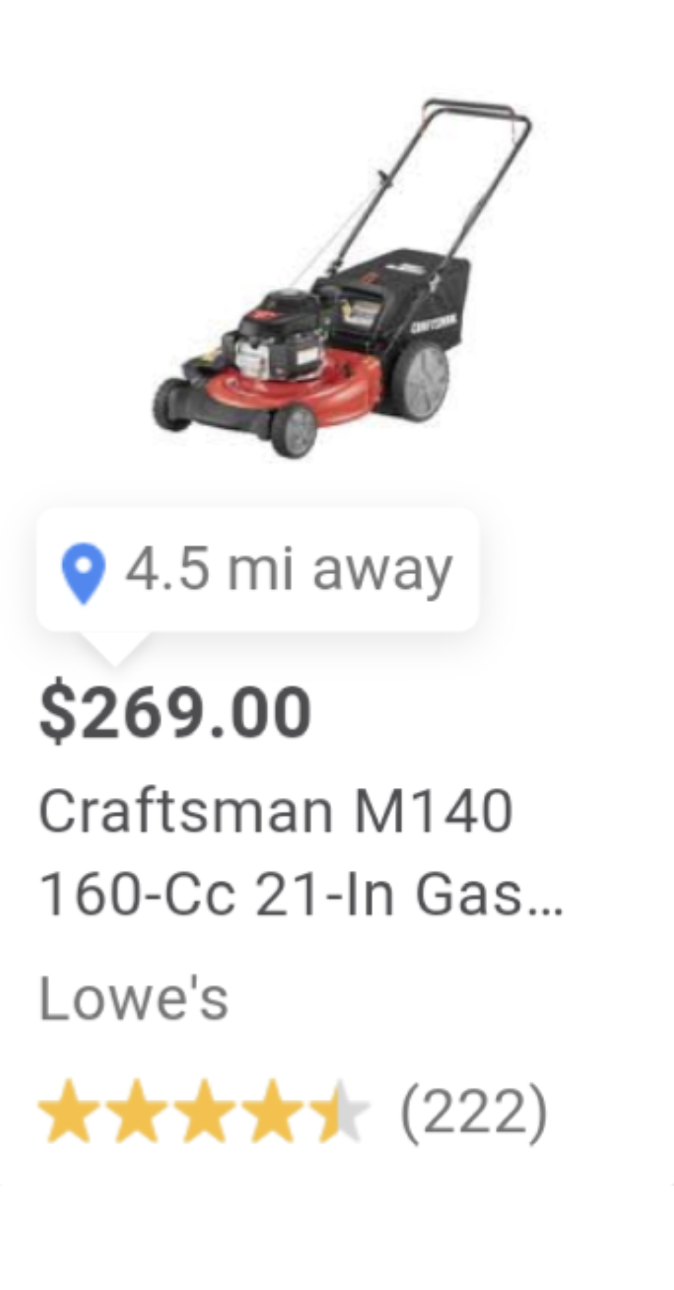
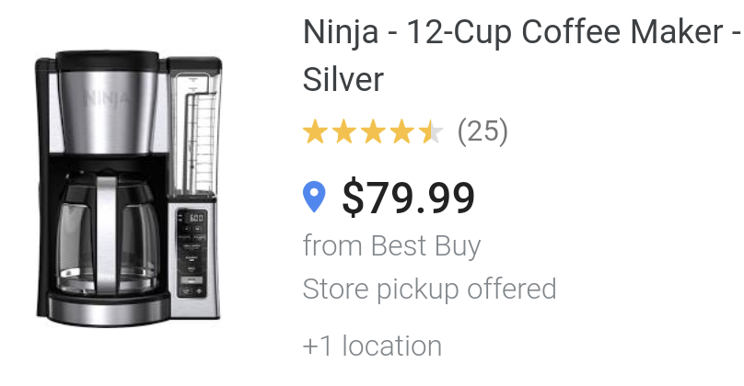
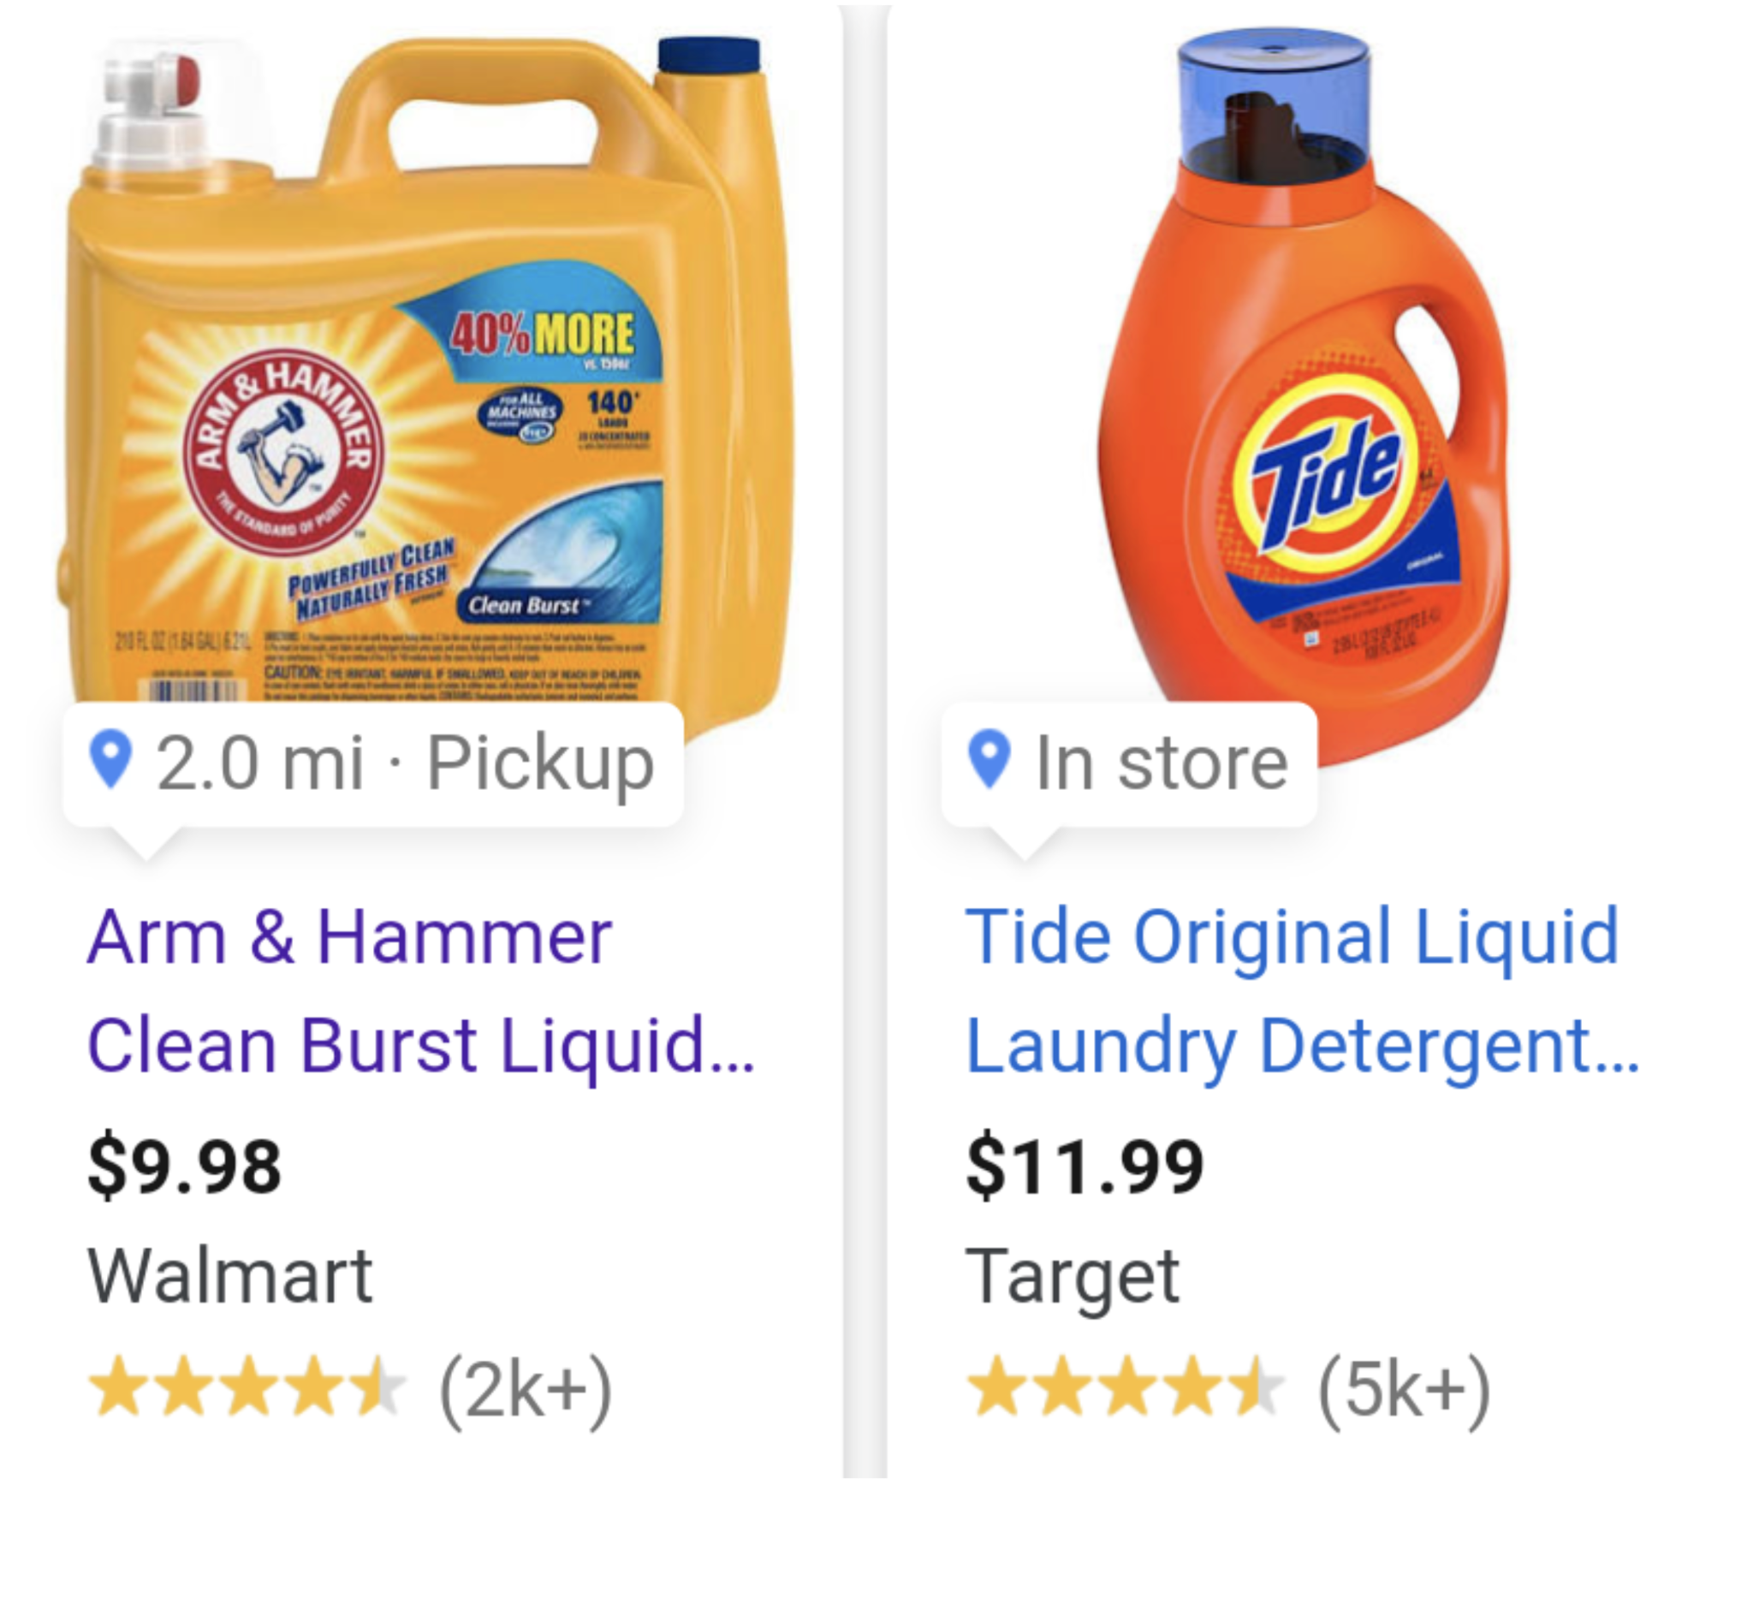

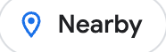

Local inventory Ads
Drive more in store sales with highly targeted Ads campaigns
Top of Page Results
Image Search
Shopping Tab
2.0 mi · Pickup
Nearby
4.5mi away

Slide 23
3rd party online market-places
An extendable framework for custom marketplace integrations
Following our Shopify architecture
Default integrations provided by LS Retail
Starting with Shopee

Slide 24
LS Retail Academy
CF-710 eCommerce for
LS Central
CF-720 eCommerce for
LS Central - Shopify
CF-730 eCommerce for LS Central - restaurants

Slide 25

Roadmap – LS Central v29
Magento - Retail
  Enhancing Online Refunds
  Migration support for eCom API transition to LS Central
  Click & Collect improvements (BO support)
Magento - Hospitality
  LS Retail Academy: CF-730 eCommerce for LS Central - restaurants
  Support for Tips
Magento – general
  Hyva – Theme & Checkout

Slide 26
Roadmap – LS Central v29
Shopify
  Migration support to LS Central Shopify BC connector
  Enhancing Online Refunds
  LS Retail Academy: LS Central Shopify BC connector
Online Marketplaces
  Partner / Project driven feature requests
Ad-hoc review on feature requests from Partners and Projects

