Slide 2
Does anyone recognize these challenges?
24 hours is not enough for operational processes
Replenishment processing time
Statement Posting time
Document Posting time
Cost Adjustments
Table locks
Deadlocks
POS or User facing challenges

Slide 3
Operational challenges
When the baby grows
Damir Babikov
Bjarni Asmundsson
Long term enthusiastic
Event longer term enthusiastic

Slide 4
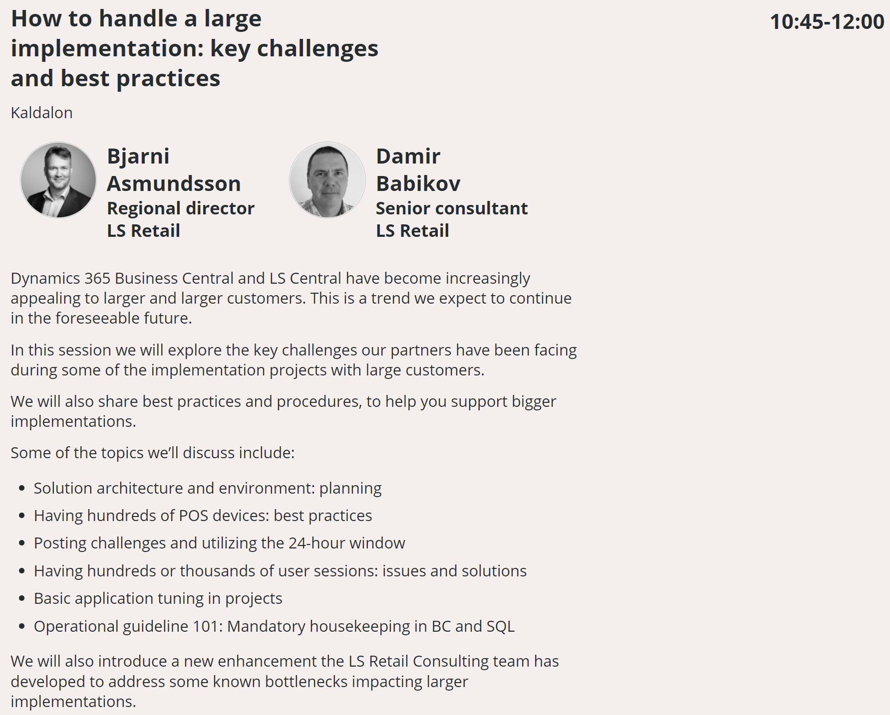
What should we be addressing
Agenda - conneXion (lsconnexion.com)

Slide 5
Architecture
SaaS
Hybrid SaaS
OnPrem
OnPrem - Online POS
OnPrem/Hybrid - Store Server and POS clients
OnPrem/Hybrid - Fully resilient POS

Slide 6
SaaS
Integrations
Cloud services
Continuous upgrades

Slide 7
Hybrid and OnPrem Architecture
For Hybrid SaaS
LS Hybrid Cloud Server
For Hybrid SaaS and OnPrem
LS Update Services
SQL Server / SQL Express
Microsoft Dynamics 365 Business Central service tier
LS Central AppShell
LS Hardware Station
LS Data Director
LS KDS

Slide 8
Server config - Get it right from the start
SQL Server – all about RAM and fast disks
DONTs
Mechanical drives
Standard SSDs
Shared resources
DOs
Enough RAM
Azure Premium SSDs
few of them (OS, Data, Log, Temp)
High IOPS
MaxDOP and CoThP
Maintain free space in database
Maintain indexes
OS
Data
Log
TempDB

Slide 9
Server config - Get it right from the start
Service Tier – all about CPU and RAM
DONTs
? Don’t skip the DOs
DOs
Good CPU and RAM
Adjust Data Cache parameter
More than one service tier on the same box
Distribute Services
Load Balancer

Slide 10
Normal Challenges
The 24 hours syndrome
The evilness of table extension

Slide 11
Large Scale Highlights
What Worked Well
Scaling and load balancing
Update Service
Deployment of releases
Surprises
180 w/s requests per second
1800 concurrent user connection
30000 batch requests per second
Do
Create custom telemetry
Use performance counters
Enable Query Store
Automate testing
Don't
Install components manually
Ignore guidelines
Forget to update documentation
Use same service account and machine for all services

Slide 12
Planning Large Scale
Q: will it work?
Challenges: many unknowns
Number of active users
Volumes of activity
System response time
Hardware requirements (POS, kiosks, kitchen, etc.)
Cost of solution

Slide 13
Deploying
Q: How do we roll out?
Challenges: execute planned deployment of hardware & software in predictable and repeatable fashion
Multiple environments – development, production and all in between
Initial build of all environments
Update of all environments – platform, application and data

Slide 14
Managing or Business as Usual
Q: Is it working?
Challenges: real time monitoring and alerts
How well is it working – what is considered normal
Custom telemetry – specific events emitted by solution, captured, stored and evaluated in near real time
Detect and resolve issues before users had a chance to report them
Business continuity and recovery plans – keep up to date and practice execution

Slide 15
Operation Guide 101
Make sure both hardware and software is configured best possible way to fit the client needs
Review solution performance metrics once a year at least
Monitor data growth
Log tables
Archive Data
Index Optimization
Action tables
Desktop Browser – avoid older browsers
SQL Compatibility Level

Slide 16
Performance audits or reviews
Structural approach
Review environment, hardware and software
Very often reasons for major bottlenecks are found in hardware or software configuration or solution architecture
Base SQL tuning
Identifying in fast and structured way where there are challenges
Senior resources from LS Retail, presence in all regions
Minor footprint on client environment
Following slides are showing combined data from few live client environment in multiple time-zones / regions.
Data is aligned to client time-zone

Slide 17
How do we do this?
This is low footprint on client’s environment, only thing needed is installing Microsoft Monitor Agents on the servers.
LS Retail provides Secret Key and Azure Log Workspace ID which are configured in the Agents.
Then data starts getting collected into private Workspace in LS Retail’s Azure environment.
As data is collected it is parsed / washed and then presented in PowerBI

Slide 18
Windows Performance Counters
CPU
Disk
Network
RAM
SQL server(s)
Service Tier Servers
Other servers
Basically, all Servers can me added to monitoring and the log files parsed for recognized events.

Slide 19
Deadlocks
Worst thing ever!
Processes being rolled back
Opening Hours

Slide 20
Deadlocks take #2

Slide 21
Table locks
These are so bad as well

Slide 22
Long running SQL Queries
Long running SQL Queries is normal, it is just identifying if there are abnormal processes in between and if it can be scheduled or planned better

Slide 23
Long running SQL Queries – take #2

Slide 24
What is the goal here?
Entry point
Audit/analyzes platform with PowerBI dashboards
Partners or clients can sign up and push data in
Standard view and analyzes
High level identifications on bottlenecks
Further analyzes or reviews
More detail review and analyzes
SQL auditing tools
Activate and use SQL Query Store
Extensions or Code review
Give partner/client direct access to the outcome report
LS Retail has already used this approach on multiple installations in different regions, with successful results on identifying bottlenecks and where to focus for enhancements

Slide 25
What is next?

Slide 26
Contact the PM closest to you!
PMEurope@lsretail.com PMMEA@lsretail.com PMAmericas@lsretail.com PMAPAC@lsretail.com

