Slide 1
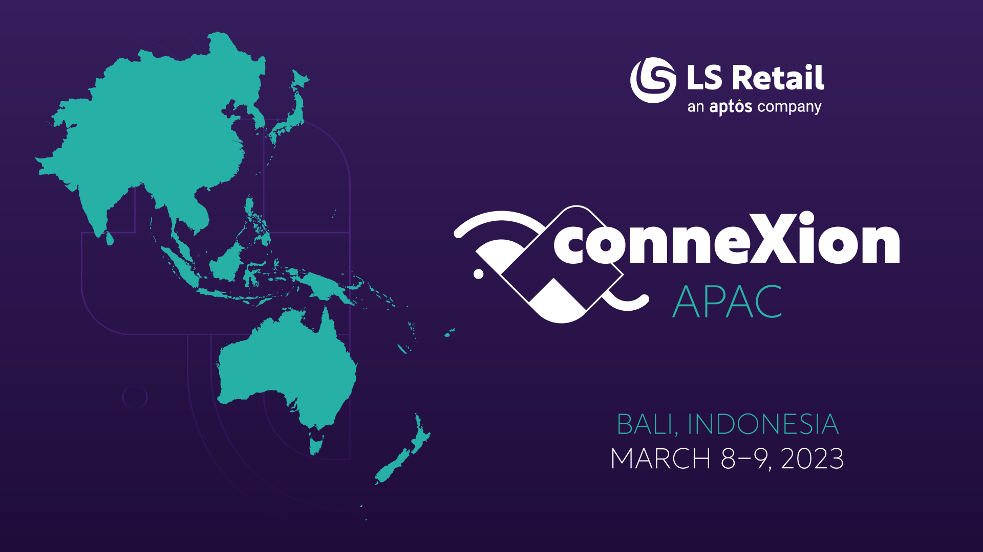
Notes:
1

Slide 2

SaaS Best Practice
Harry Yaw
Functional Consultant
Adalbjorg Karlsdottir
Onboarding Lead
Notes:
2

Slide 3

Best Practices
Notes:
3

Slide 4

Time for Bali Coffee
Notes:
4

Slide 5

SaaS Hot Cake
When you bring me in your
SaaS Journey …
Notes:
5

Slide 6
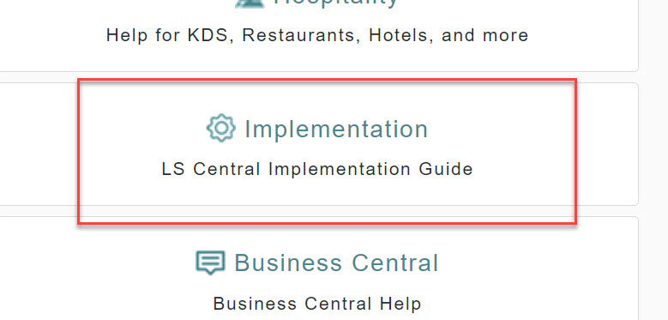
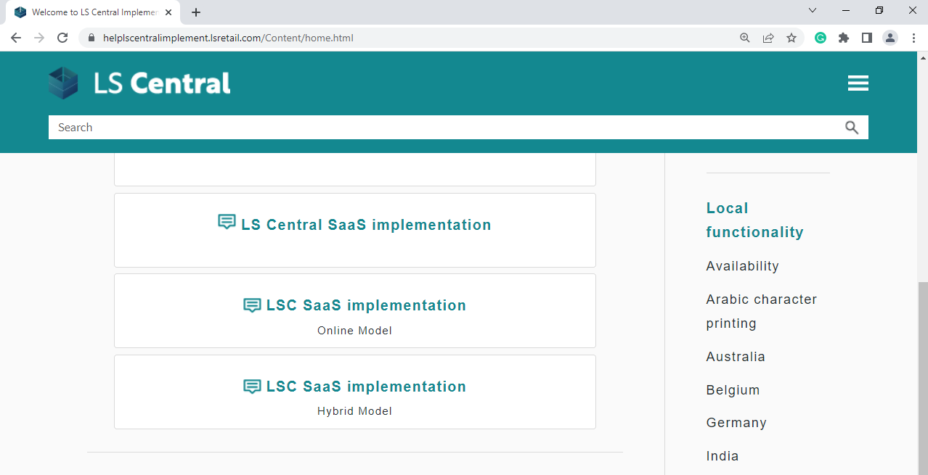
Implementation Guide
LS Retail Online help
Notes:
6

Slide 7
Objective
To understand Microsoft Partner Central and Admin Center
Hardware Station using Update Services
To know where to find Information, Guidance & Support related to SaaS
Data Migration
Onboarding and CAP
Notes:
7

Slide 8

Agenda
Manage your customer
Support method & Tools
Support channel
Notes:
8

Slide 9
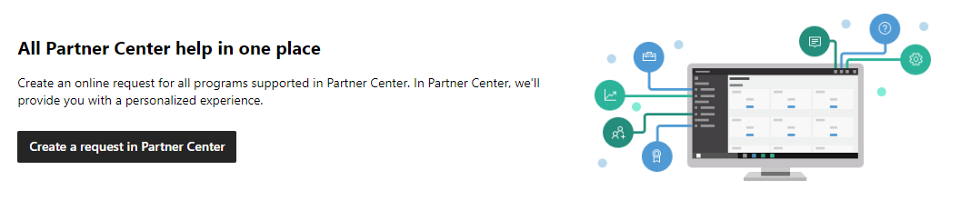
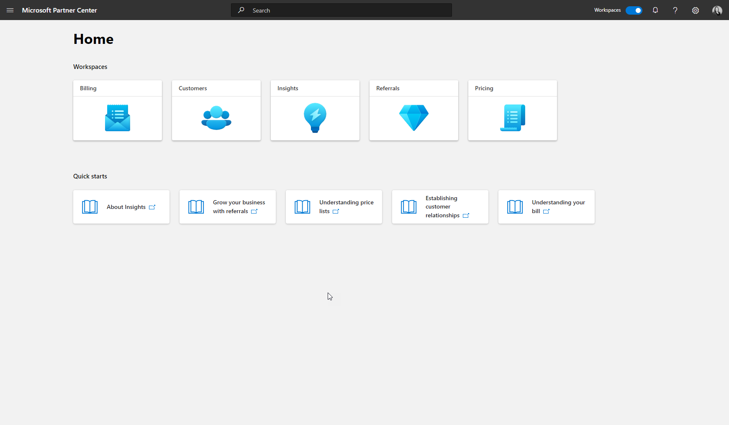
Partner Center
CSP and MPN Signed
Subscription
Billing
Create new Tenant
Notes:
9

Slide 10
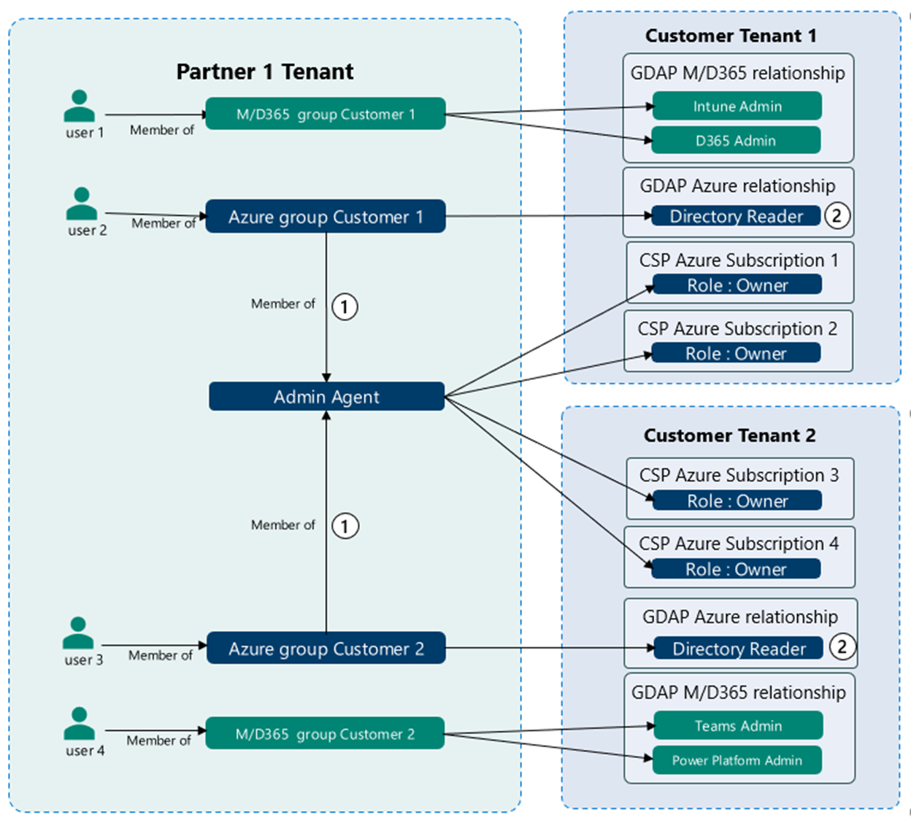

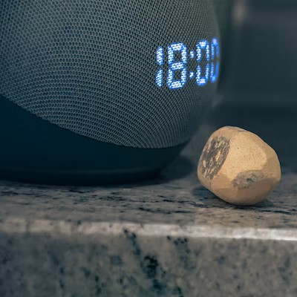
Partner Center – Delegate Admin Access
Delegate Admin access for support and development
Without Consuming License
New Granular Delegated Admin (GDAP)
Notes:
10

Slide 11
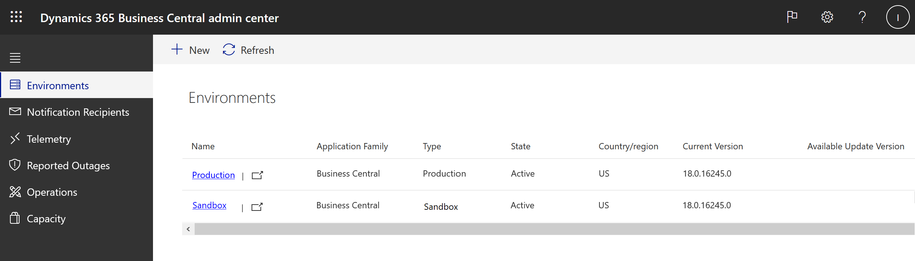
Admin Center
Managing
Customer Tenant
Notes:
11

Slide 12
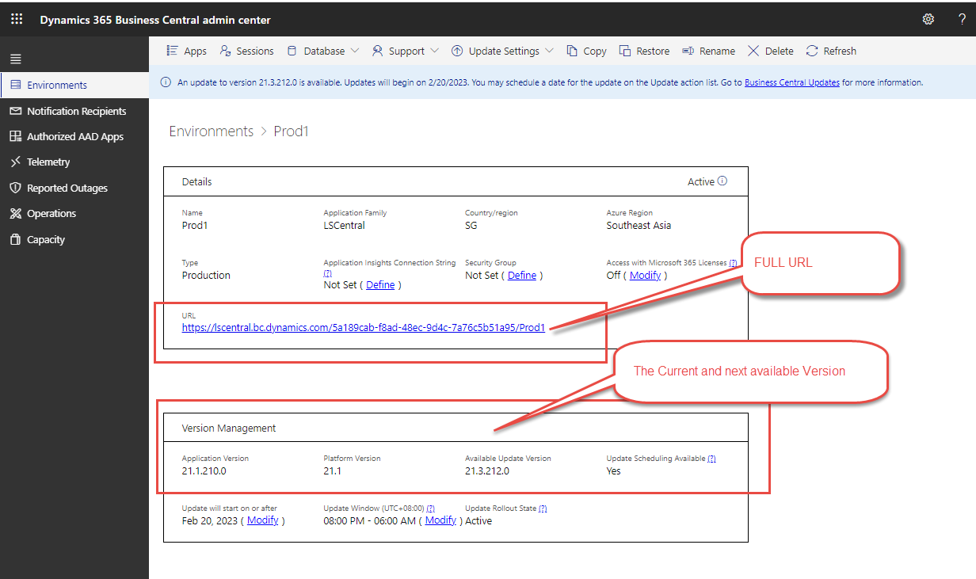
Admin Center – Tenant Environment Info
Notes:
12

Slide 13
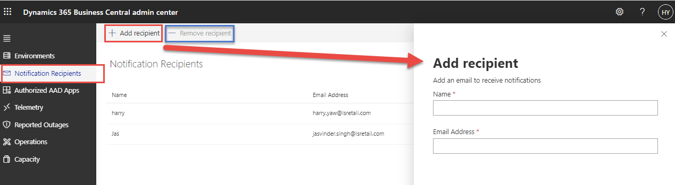
Admin Center – Notification
Notes:
13

Slide 14
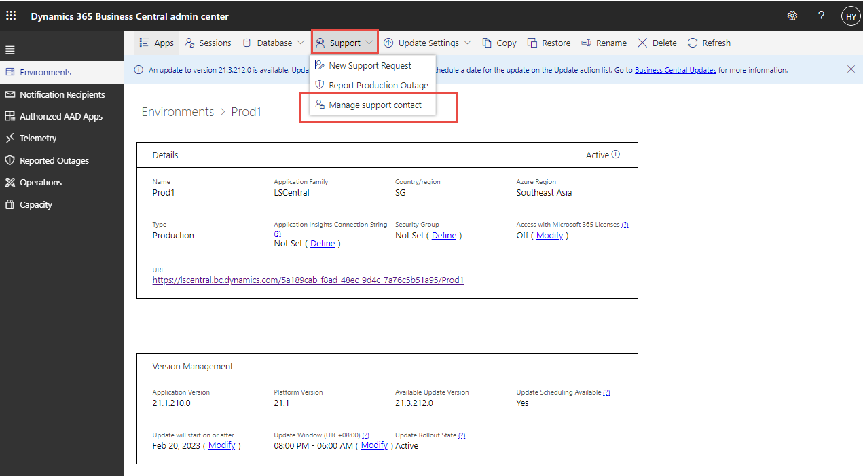
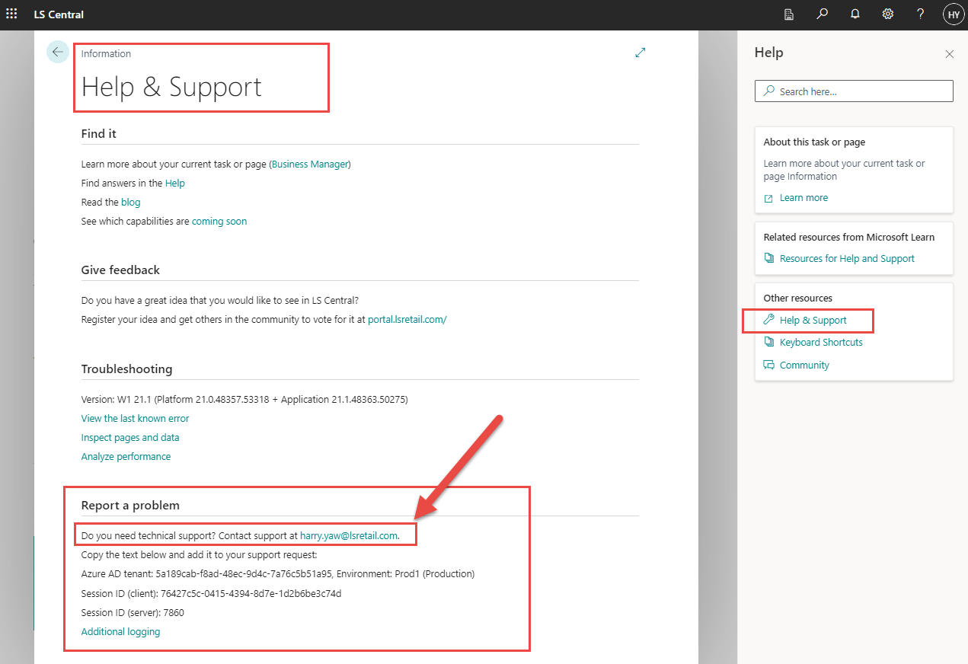
Admin Center – Your Help and Support info
Notes:
14

Slide 15
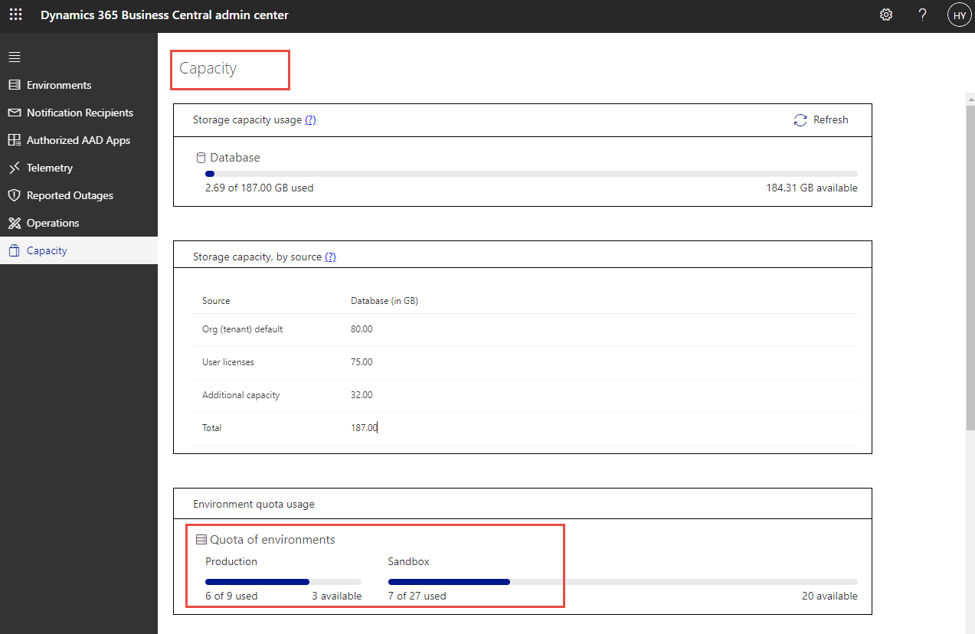
Admin Center- Capacity
Notes:
15

Slide 16
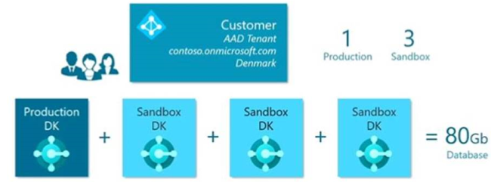
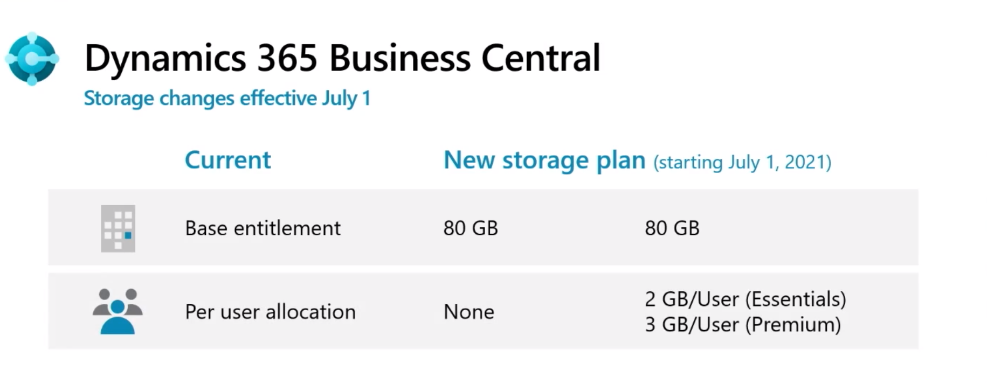
Admin Center - Managing Storage Capacity
80 GB of database storage capacity across all environments
The Premium and Essential subscription gives each LS Central SaaS customer 1 production & 3 sandbox environment free of extra charge.
Notes:
16

Slide 17

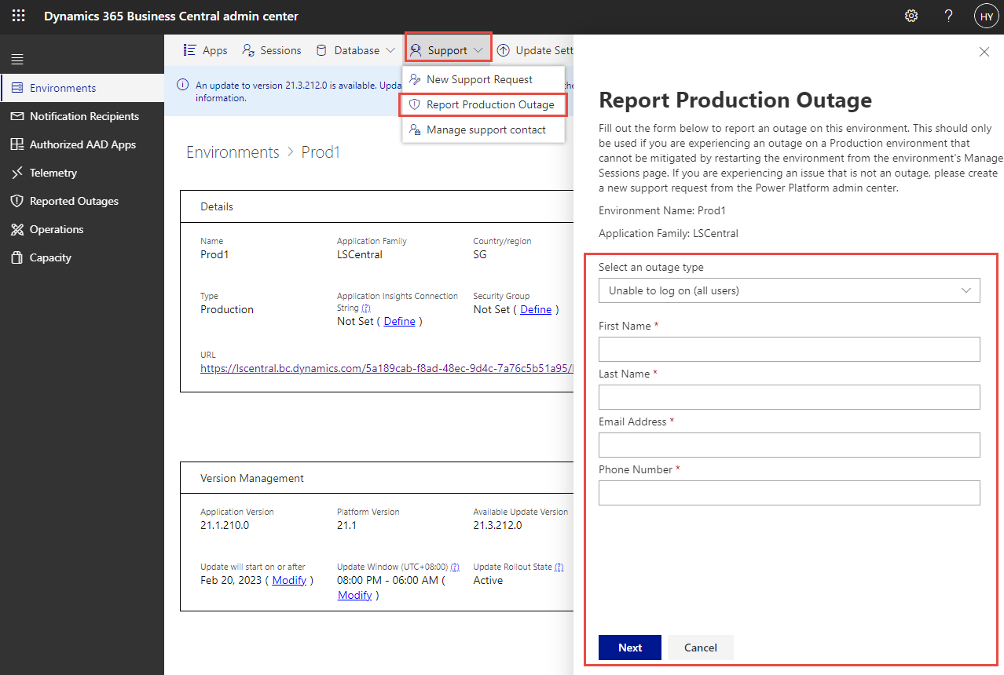
Admin Central – Report Outage
Outage Strategy
Customer / Partner Create support ticket
How to report outage
Notes:
17

Slide 18

Agenda
Manage your customer
Support method & Tools
Support channel
Notes:
18

Slide 19

Support Concept
Support concept with customer Who’s doing what
Hybrid environment
Version Update
Testing Extension Apps
Notes:
19

Slide 20
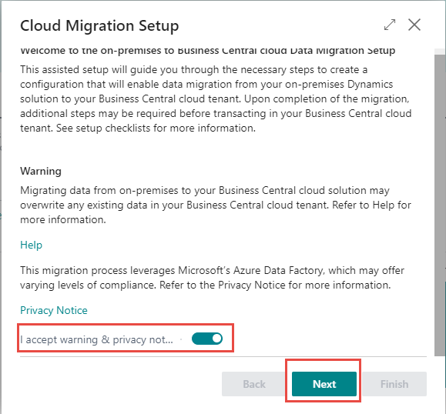

Migration Tools
Temp DB
VS
Notes:
20

Slide 21


Database size
30GB in each migration run
XXX GB
Data
30GB
Notes:
21

Slide 22

Deployment experiences
Notes:
22

Slide 23

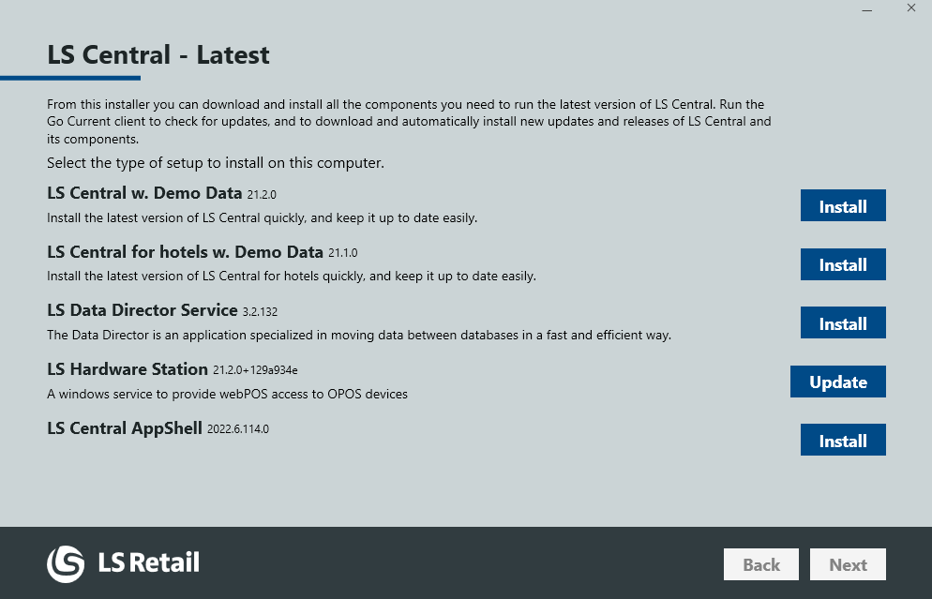
Update Service Deployment
Notes:
23

Slide 24

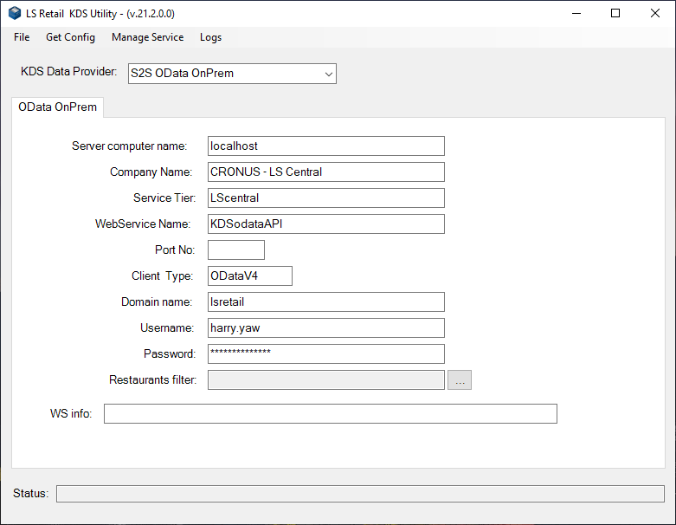
KDS Version
Notes:
24

Slide 25
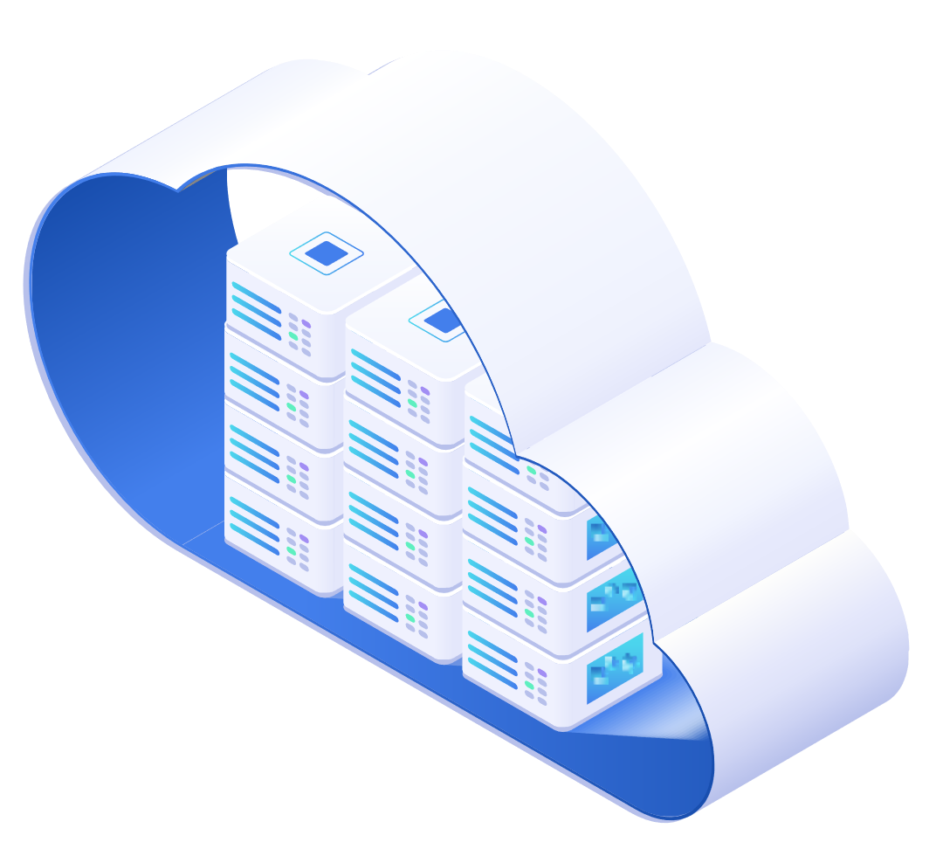

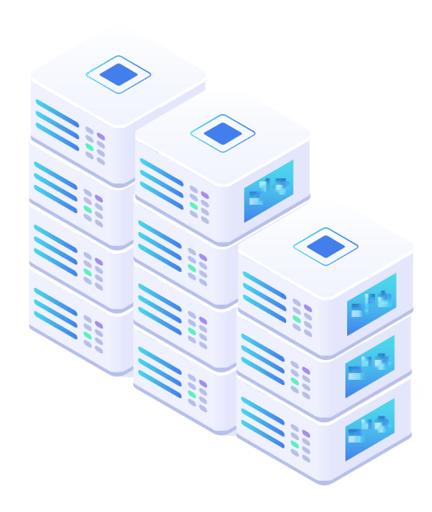
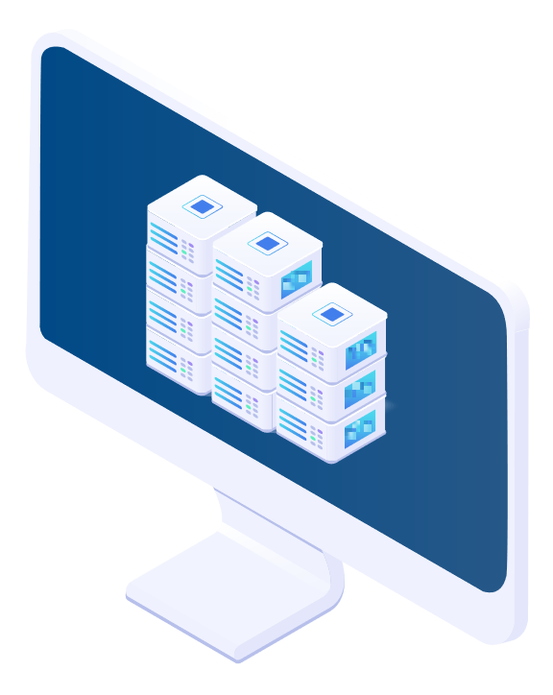

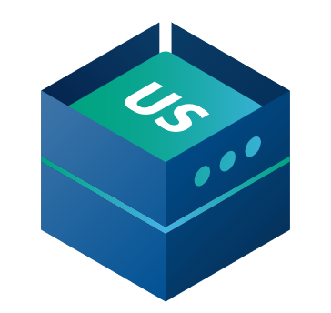
Update Service Online OR Offline
Online POS
Offline POS
HEAD OFFICE IN THE CLOUD
BACK OFFICE
Sales data pushed after each sale
(Webservice)
Sales data pushed after each sale
(Webservice)
Data Director
Master data pulled from HQ
(Scheduled Webservice job)
STORE 1
STORE 2
Hardware Station
Master data replicatied to POS
(Data Director)
HYBRID CLOUD
COMPONENT SERVER
Master data replicatied to POS
(Data Director)
Hardware Station
Service Tier
LS Appshell
POS Database
POS MASTER
Offline POS server
Offline POS server
DATA DIRECTOR
UPDATE SERVICE
Notes:
25

Slide 26
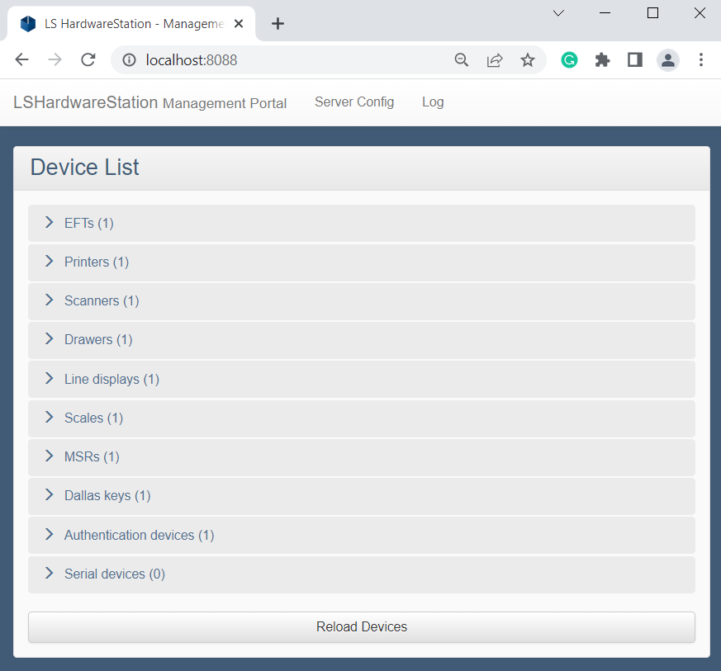

Hardware Station
HTTPS
Use authority signed certificates
For testing purpose
Self-Signed Certificate
Notes:
26

Slide 27

Sandbox
* Upgrade Test
** Debug
*** Development
****UAT Test
***** New Functions
Don’t create endless testing company
1 Production environment
Sandbox 1
Sandbox 2
Sandbox 3
80Gb
Notes:
27

Slide 28

Agenda
Manage your customer
Support method & Tools
Support channel
Notes:
28

Slide 29

Support - Invitation
Onboarding Team
CSP
LS Central on SaaS Overview Session
Notes:
29

Slide 30

Support – Book Session
A link where you can book session at the time that suits you.
Notes:
30

Slide 31
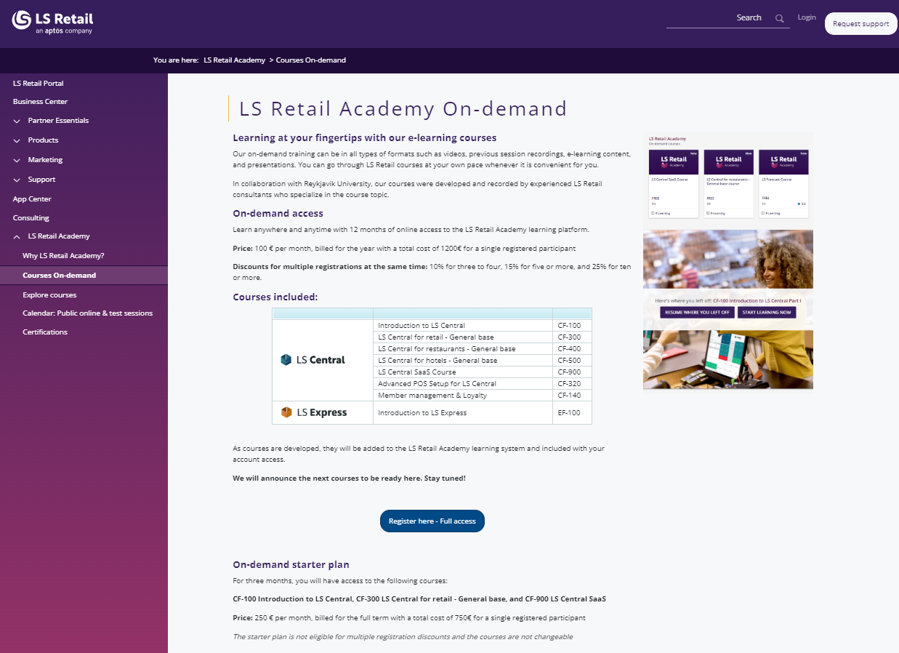
LS Academy – On demand
Notes:
31

Slide 32

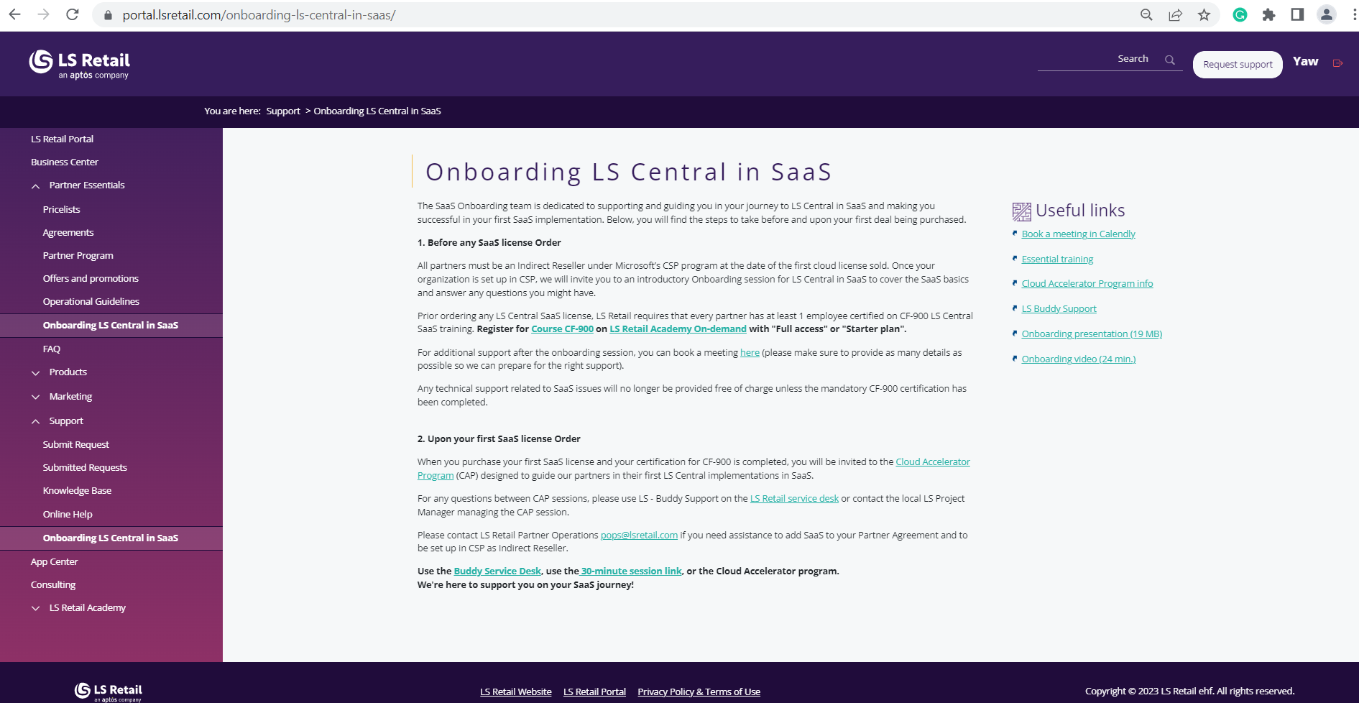

LS Support Channel
Notes:
32

Slide 33


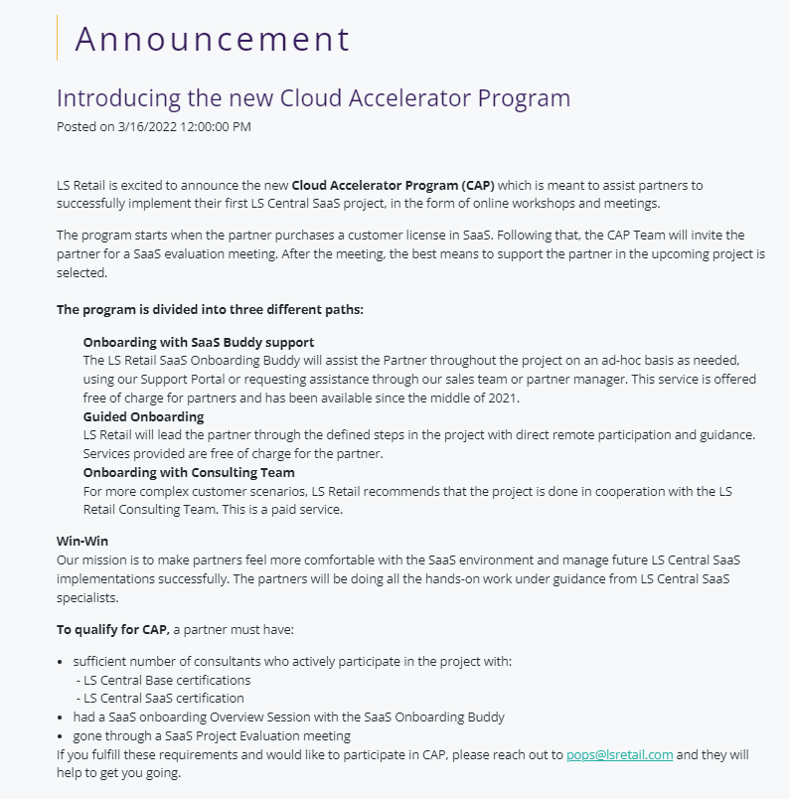

LS Support Channel
CAP
1st
Cloud Acceleration Program
Notes:
33

Slide 34



LS Support Channel - CAP
Guided Onboarding options
CAP Team
- Project Manager
Consultant
1 Hour time
Notes:
34

Slide 35
LS Support Channel – Phase 2 CAP Paths Options
Onboarding with Buddy Support
01
Guided Onboarding
02
Onboarding with Consulting Team
03
Notes:
35

Slide 36
Summary
Use Admin Center
Use Update Services
Use LS Support Channel
Best Practices
Notes:
36

Slide 37

Conclusion
Notes:
37

Slide 38
Questions?
Notes:
38

Slide 39

Notes:
39

