Slide 2
Replication
Best practices and
Data Director
Hasse Nielsen
Anil Momin
Technical Consultant
Technical Consultant
Kristjan Asvaldsson
Solution Lead

Slide 3
Menu for the day
Methods of Replication
Distribution Location card
Different Central versions
Security
Best practices

Slide 4
Methods of replication
Good old Data Director way (SQL -> SQL)
Web Service with Data Director (SaaS -> SQL)
Web Replication (SaaS -> SaaS)
Update Service (SaaS -> Azure -> SQL)
Check out: SaaS Architecture and Replication

Slide 5


Data Director - Distribution Location card
LS Central
Scheduler
Scheduler gets Actions & Replication counter with WS from source host
Scheduler sends job to DD Web Service
DD WS creates DD job and sends to Source DD
DD pulls/inserts data from/to database (On Prem) or SaaS
IIS
DD Web Service
(WS Distribution Server)
SaaS
LS Central WS
(Web Server)
DD Service
(Data Director)
Database
(Replication)

Slide 6
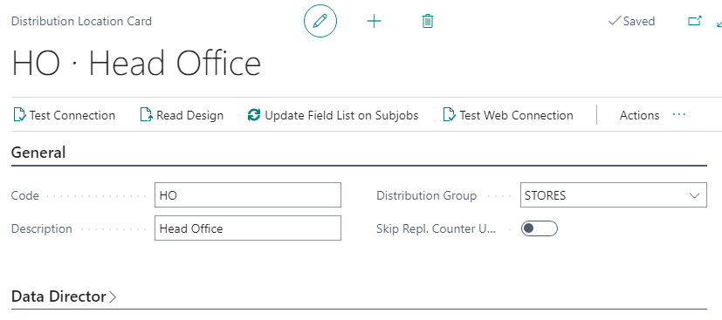
Data Director - Distribution Location card
General
Data Director
WS Distribution Server
Replication
Web Server
LS Central
Scheduler

Slide 7
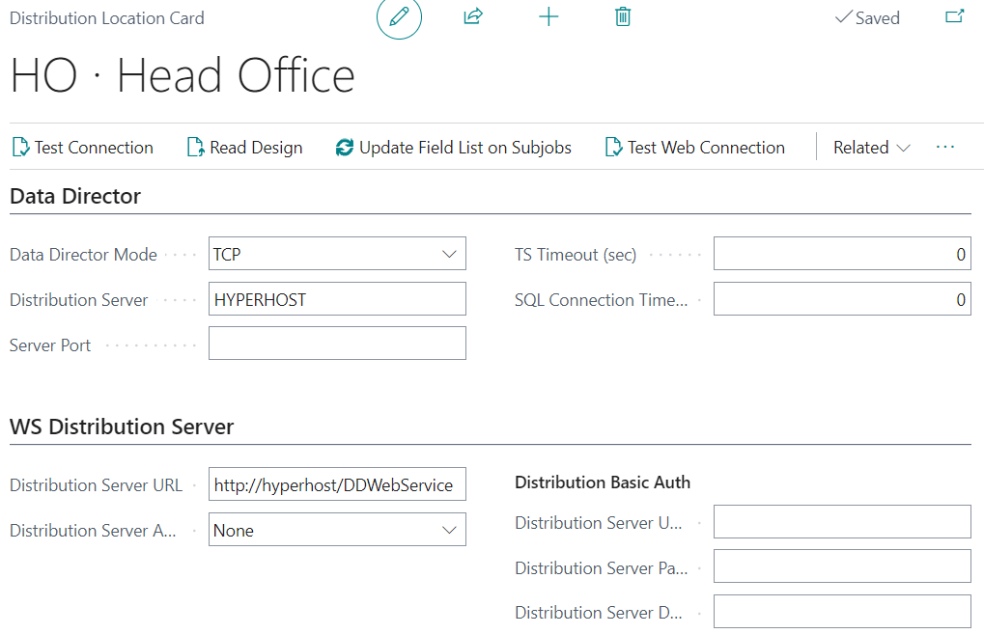
Data Director - Distribution Location card
Data Director
    DD Host
WS Distribution Server
    DD Web Service on IIS
LS Central
Scheduler
IIS
DD Web Service
(WS Distribution Server)
DD Service
(Data Director)

Slide 8
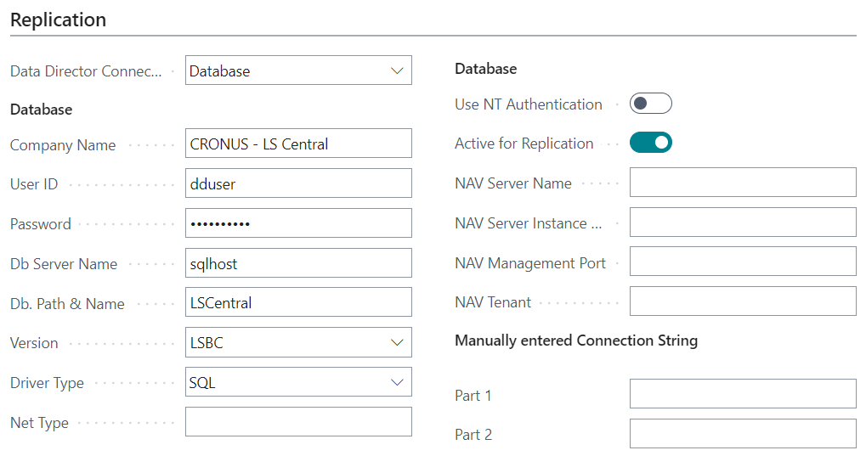
Data Director - Distribution Location card
Replication
    Database mode
    SQL Connection string
LS Central
Scheduler
IIS
DD Web Service
(WS Distribution Server)
DD Service
(Data Director)
Database
(Replication)

Slide 9
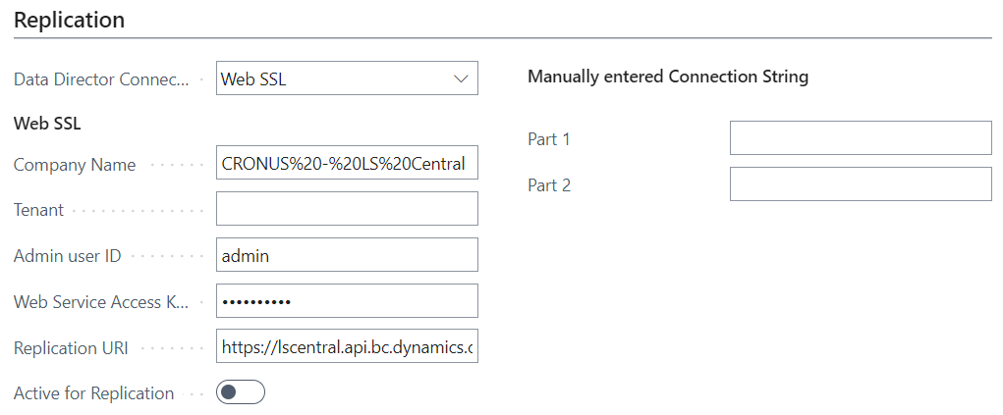
Data Director - Distribution Location card
Replication
    Web SSL mode
    RetailWebServices URL
    Username and Web Key
LS Central
Scheduler
IIS
DD Web Service
(WS Distribution Server)
SaaS
LS Central WS
(Web Server)
DD Service
(Data Director)

Slide 10
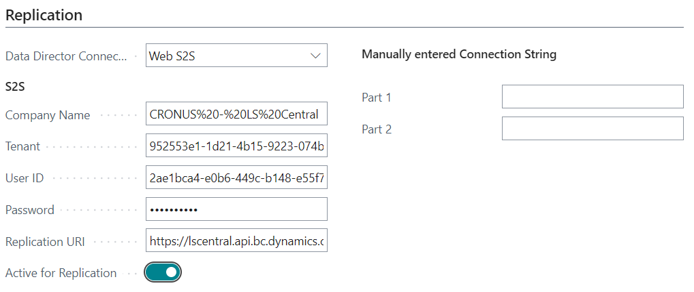
Data Director - Distribution Location card
Replication
    Web S2S mode
    RetailWebServices URL
    Client Id and Secret
    Tenant Id
LS Central
Scheduler
IIS
DD Web Service
(WS Distribution Server)
SaaS
LS Central WS
(Web Server)
DD Service
(Data Director)

Slide 11
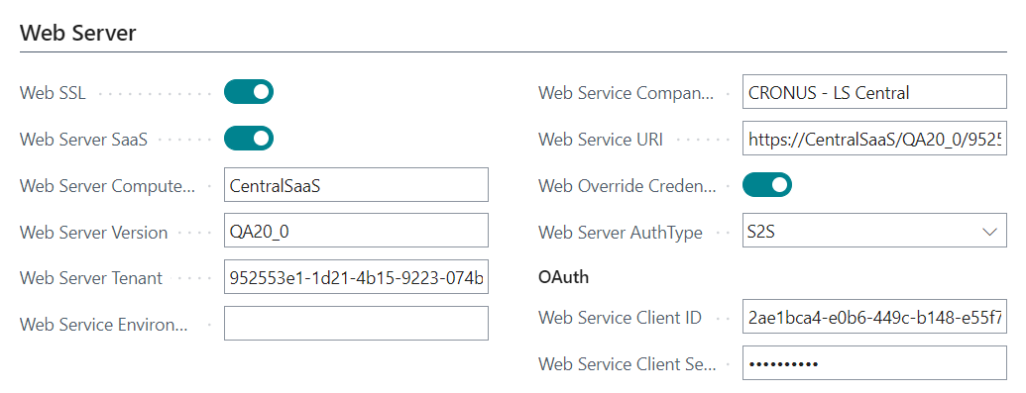
Data Director - Distribution Location card
Web Server
    LS Central Web Service to query for Pre-actions / Replication counter
LS Central
Scheduler
SaaS
LS Central WS
(Web Server)

Slide 12
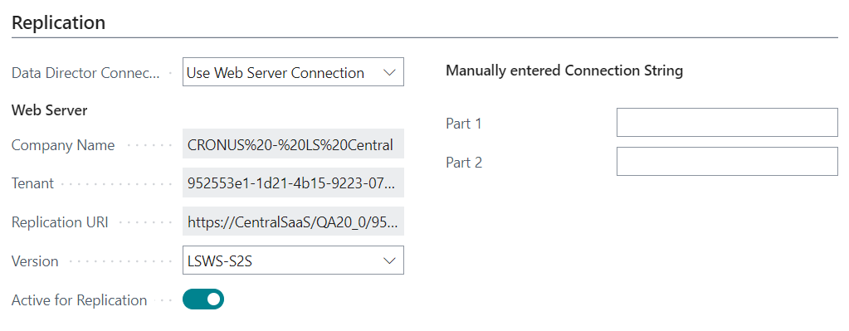
Data Director - Distribution Location card
Replication
    Use Web Service Connection mode
LS Central
Scheduler
IIS
DD Web Service
(WS Distribution Server)
SaaS
LS Central WS
(Web Server)
DD Service
(Data Director)

Slide 13
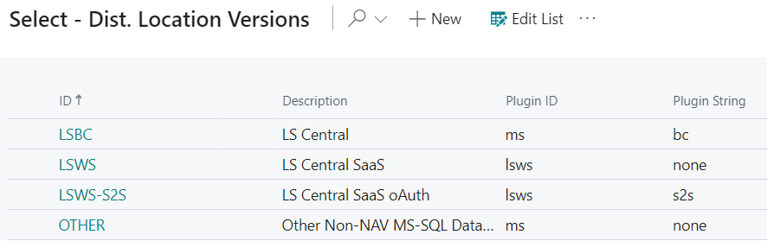
Data Director - Distribution Location card
Dist. Location Version
  LSBC
  LSWS
  LSWS-S2S

Slide 14
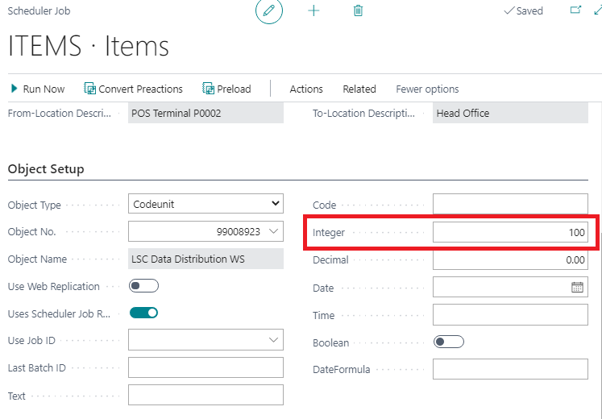
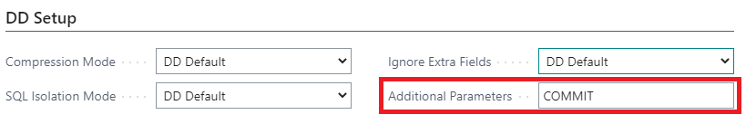
Data Director – Scheduler Job
Change default batch size by set value to Integer field
Option to Commit each batch, default Commit is done when whole job is done processing

Slide 15
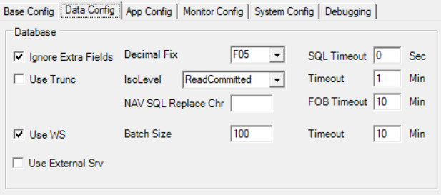
Data Director - WS Replication
DD Configuration
  Use WS

Slide 16
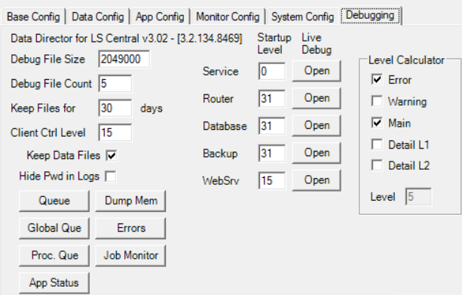
Data Director - WS Replication
DD Configuration
  Use WS
  Debugging

Slide 17
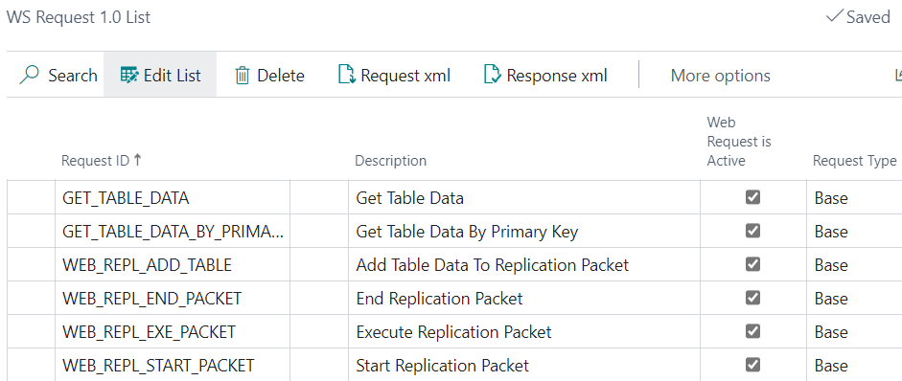
Data Director - WS Replication
LS Central Web Services v1
GET_TABLE_DATA
GET_TABLE_DATA_BY_PRIMARY_KEY
WEB_REPL_ADD_TABLE
WEB_REPL_END_PACKET
WEB_REPL_EXE_PACKET
WEB_REPL_START_PACKET

Slide 18
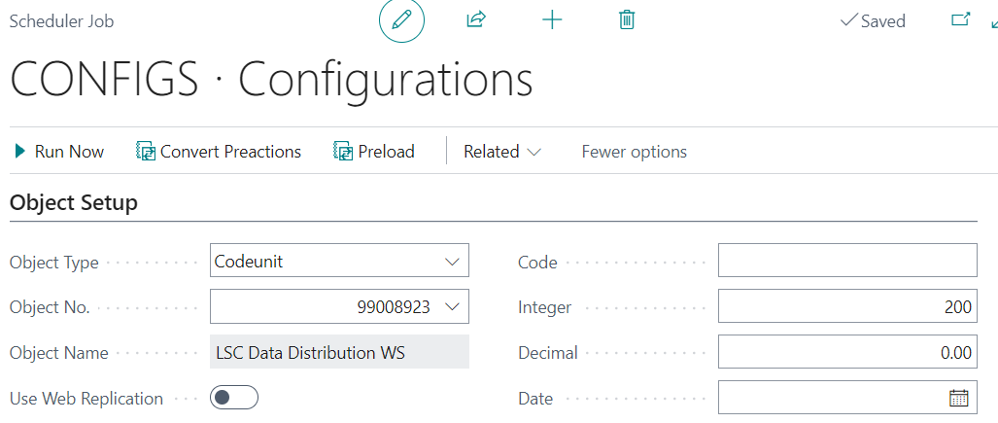
Data Director - WS Replication
Scheduler Job
  Object No. (codeunit)
  Job batch size (default 100)

Slide 19
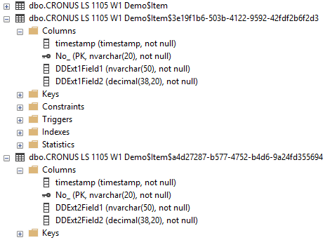
Data Director – Different LS Versions
LS Central v15
  Main table with Guid Ext.
  Primary key same
  Records in sync

Slide 20

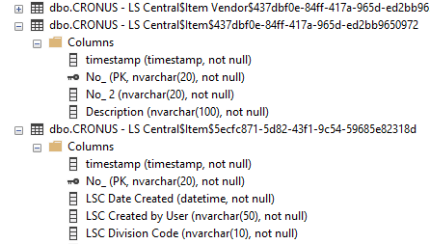
Data Director – Different LS Versions
LS Central v17.5
  Main table with Guid Ext.
  LSC Prefix
  Primary key same
  Records in sync
  Standard Tables without Prefix
  Additional fields with Prefix

Slide 21
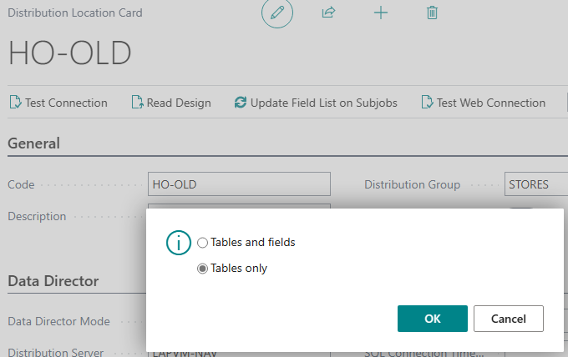
Data Director – Different LS Versions
Scheduler Job
  Read design for remote host (not the one where scheduler is running)
  Only read Table Design

Slide 22
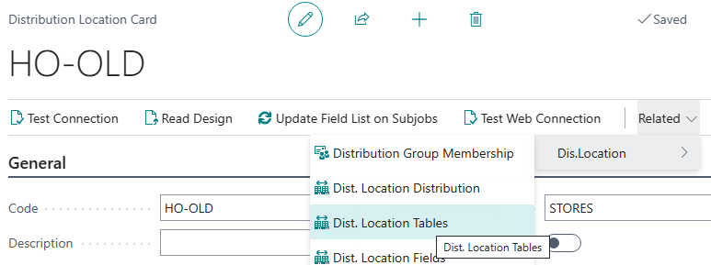
Data Director – Different LS Versions
Scheduler Job
  Read design for remote host (not the one where scheduler is running)
  Only read Table Design
  Open Dist. Location Tables

Slide 23
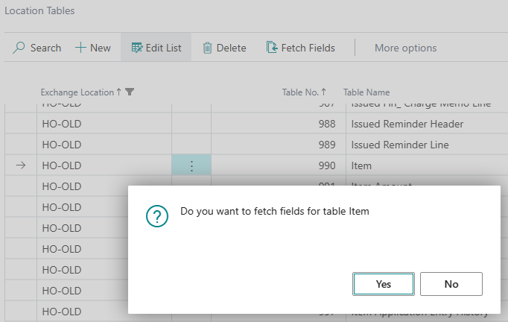
Data Director – Different LS Versions
Scheduler Job
  Read design for remote host (not the one where scheduler is running)
  Only read Table Design
  Open Dist. Location Tables
  Only get fields for Standard tables (if there are ext fields in them)

Slide 24
Data Director – Different LS Versions
Scheduler Job
  Read design for remote host (not the one where scheduler is running)
  Only read Table Design
  Open Dist. Location Tables
  Only get fields for Standard tables (if there are ext fields in them)
  Date / Time fields may need fixing from DateTime

Slide 25
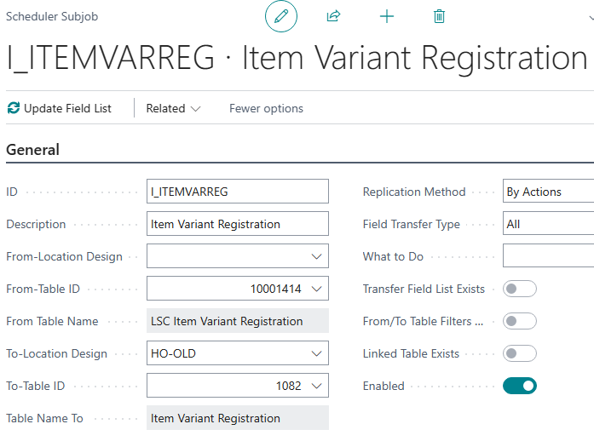
Data Director – Different LS Versions
Scheduler Job
  Table Mapping
  LSC Tables don’t need field mapping, select all Fields

Slide 26
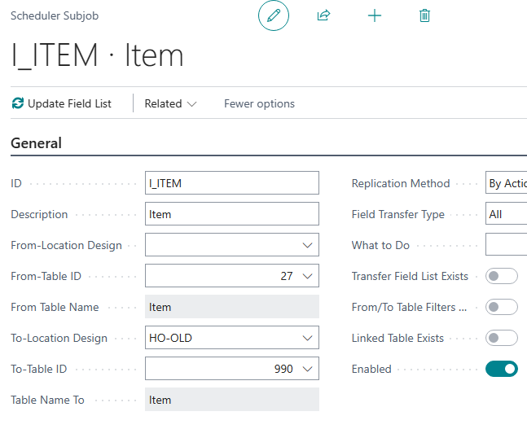
Data Director – Different LS Versions
Scheduler Job
  Table Mapping
  LSC Tables don’t need field mapping, select all Fields
  Standard Tables may need field mapping

Slide 27
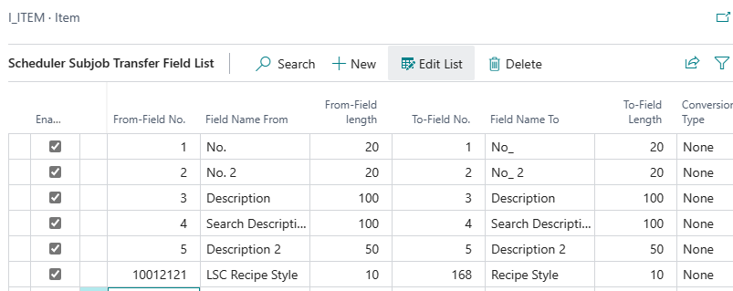
Data Director – Different LS Versions
Scheduler Job
  Table Mapping
  LSC Tables don’t need field mapping, select all Fields
  Standard Tables may need field mapping
  Map fields

Slide 28
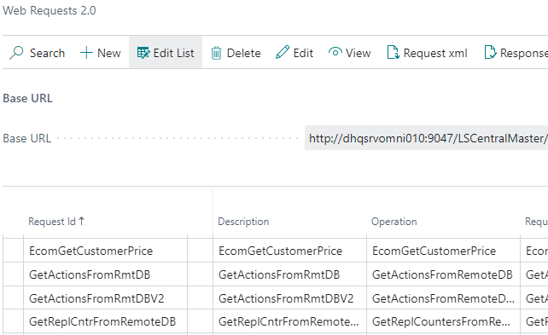
Data Director – Different LS Versions
Web Services
  Get Pre-Actions
  Get Replication counter

Slide 29
LS Central - Web Replication
Web Replication is an internal BC method to replicate data
Replication without the Data Director

Slide 30
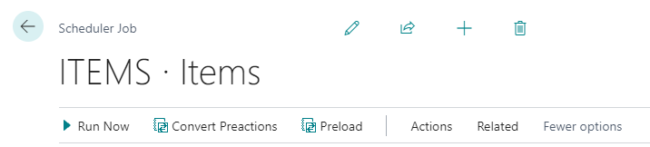
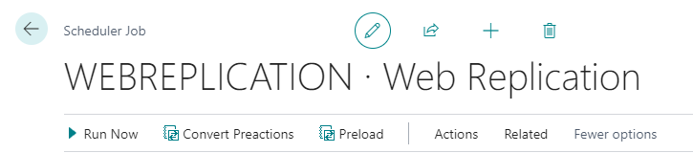
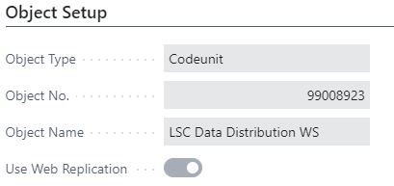
LS Central - Web Replication
Scheduler jobs (replication jobs) to create replication requests, passed to web replication module
Replication of the actual data handled by the web replication module
Activate Web Replication, Scheduler Job Card, flag “Use Web Replication”

Slide 31
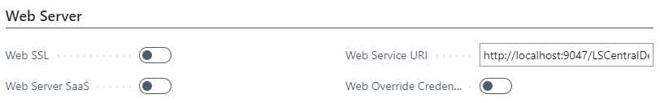
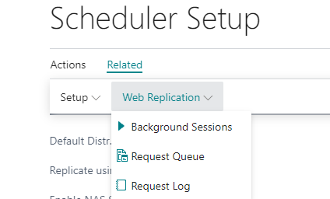
LS Central - Web Replication
All Destination Locations must have valid Web Server Connection.
All UI related to the web replication module can be found from the Schedular Setup card page

Slide 32
LS Central - Web Replication
Replication Limitations with this Method
  From distribution location can only be current location
  Only data push is valid
  Normal jobs it only supports Add-Update, not delete
  Only replication between identical tables, that is from table to the same table

Slide 33
Offline Replication
Pulling HO from Stores
Pulling Azure from Stores
Manual Replication

Slide 34
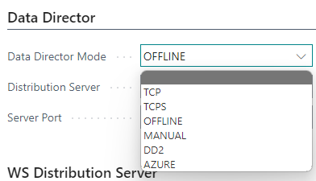
Offline Replication
OFFLINE
MANUAL
AZURE

Slide 35
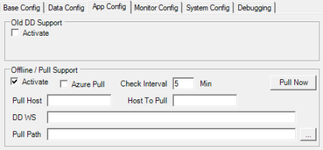
Offline Replication
OFFLINE
  Pull Host
  Host To Pull
MANUAL
  Pull Path

Slide 36
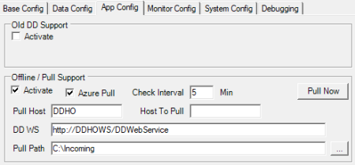
Offline Replication
AZURE
  Azure Pull
  Pull Host
  DD WS
  Pull Path

Slide 37
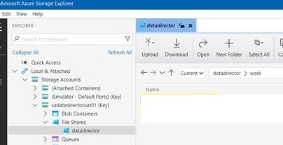
Offline Replication
AZURE

Slide 38
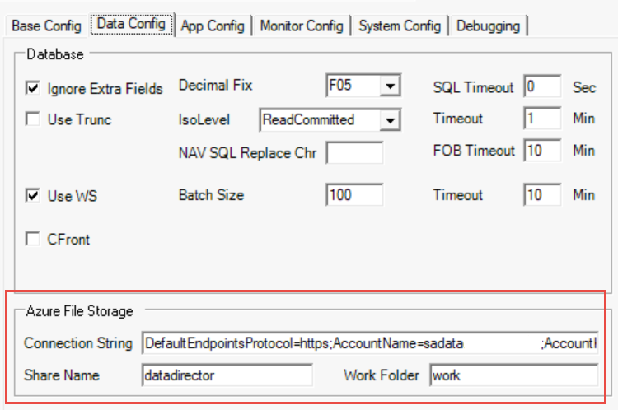
Offline Replication
AZURE
  Azure File Storage

Slide 39
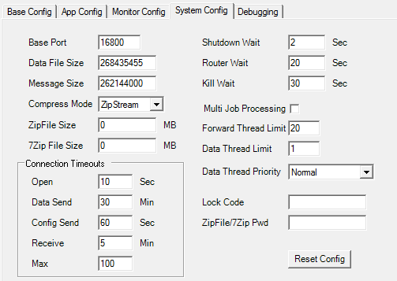
Security
MD5Hash
SHA-256
Zip Password
Lock Code
Can only be changed at local configuration, not remotely

Slide 40
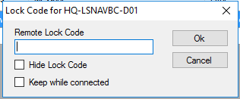
Security
Lock Code usage
When sending DD Configuration
When Cancel/Modify Job in Job Monitor

Slide 41
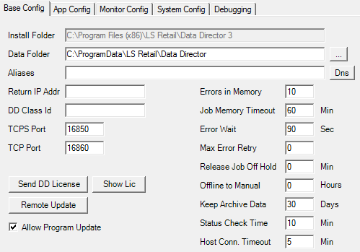
Security
TCPS

Slide 42
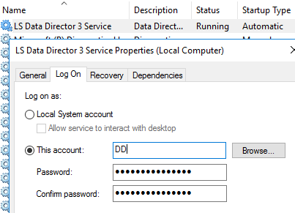
Security
TCPS
Service Log On
User Account same on both Source & Destination

Slide 43
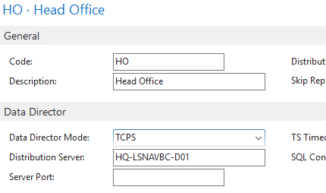
Security
TCPS
Service Log On
User Account same on both Source & Destination
DD Mode

Slide 44
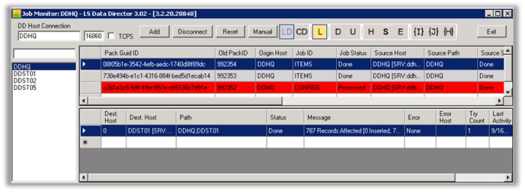
Monitoring
Local Monitor

Slide 45
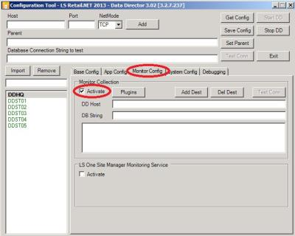
Monitoring
Local Monitor
Central Monitoring

Slide 46
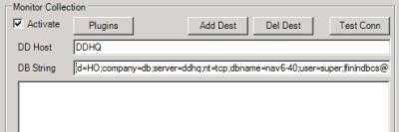
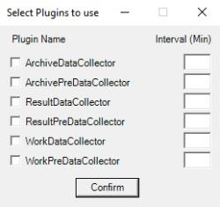
Monitoring
Local Monitor
Central Monitoring
  Central location

Slide 47
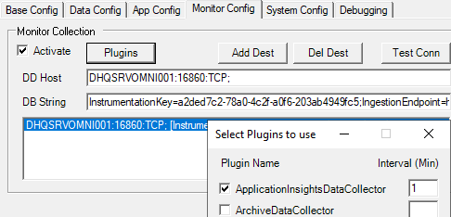
Monitoring
Local Monitor
Central Monitoring
  Central location
Application Insight

Slide 48
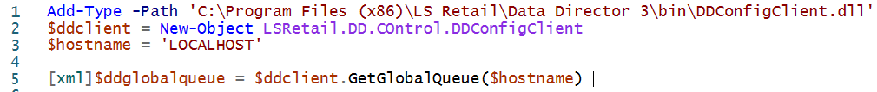
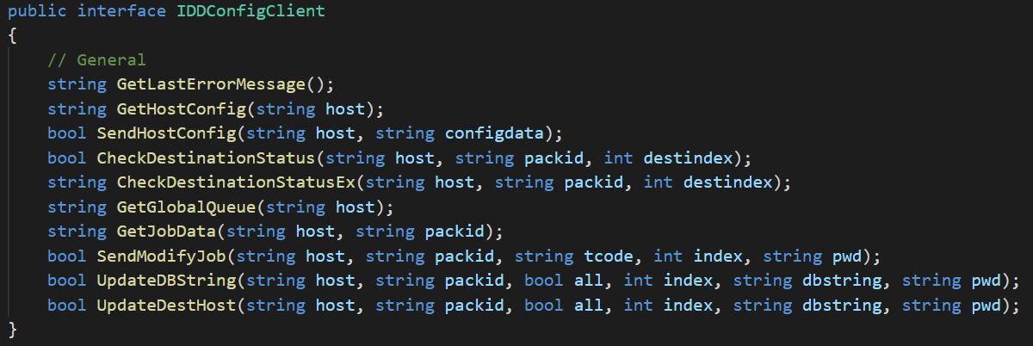
Monitoring Data Director with Powershell
Or use NAV - Microsoft.Dynamics.Nav.PowerShellRunner

Slide 49
Debugging
Debug to file
Live debugging
IIS WS Logs
Data Files
Log file size
Queue status

Slide 50
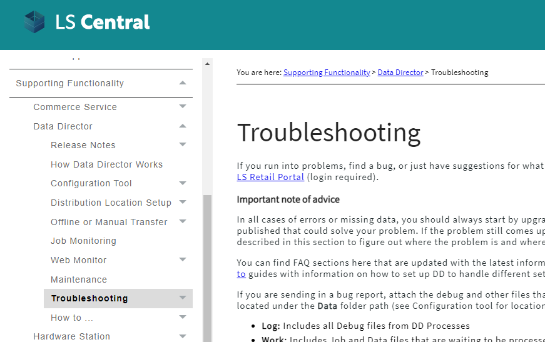
Data Director Help

Slide 51
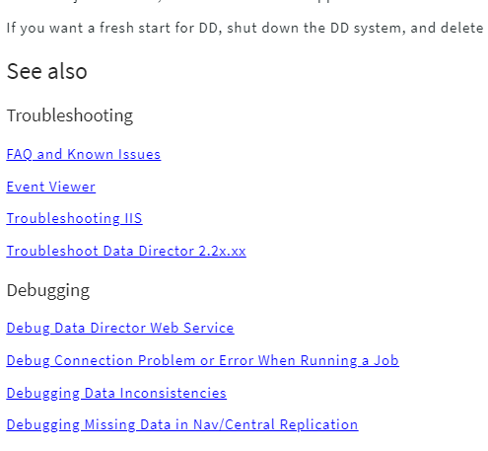
Data Director Help

Slide 52
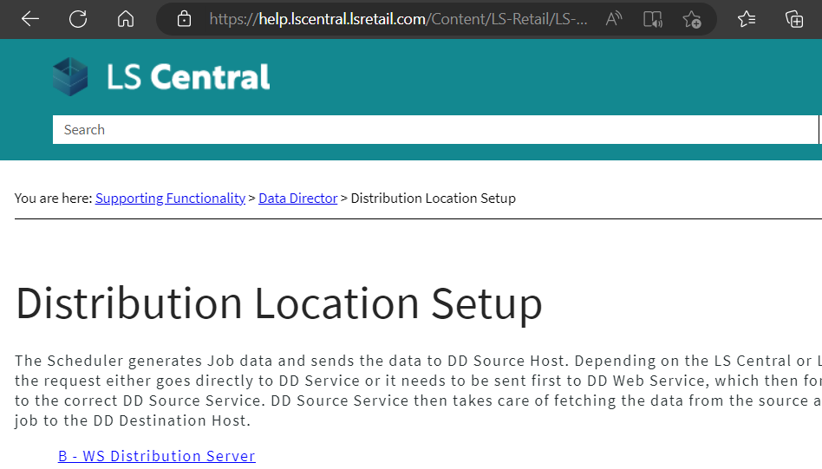
Data Director Help
Online help to refresh your memory on what is needed

Slide 53
Data Migration Strategies
Replication
  Web Replication using web services (SaaS)
  Data Director (On Prem and SaaS)
  Copy Data between companies
Configuration Packages
  Use Configure packages
  Flexible and easy to manage
  More control as you can select tables as well as fields to move
  Assisted Setup
Cloud Migration Tool

Slide 54
LS Central – Moving to the Cloud
Older than LS14.2
LS Central 14.2 and later
LS Central latest
LS Central SaaS
Using Upgrade Codeunits
Using Table Migration Extensions
Using Cloud Migration Tool
On-premises
SaaS

Slide 55
Hybrid Cloud Component from Microsoft
  A tool from Microsoft to move data from OnPrem Business Central Database on the SaaS environment.
  Supports BC ver14 through 20 but for LS you need to update to LS 17.5
  Support multiple companies using Cloud Migration Management page.
  Use Azure SQL Database for large data loads

Slide 56
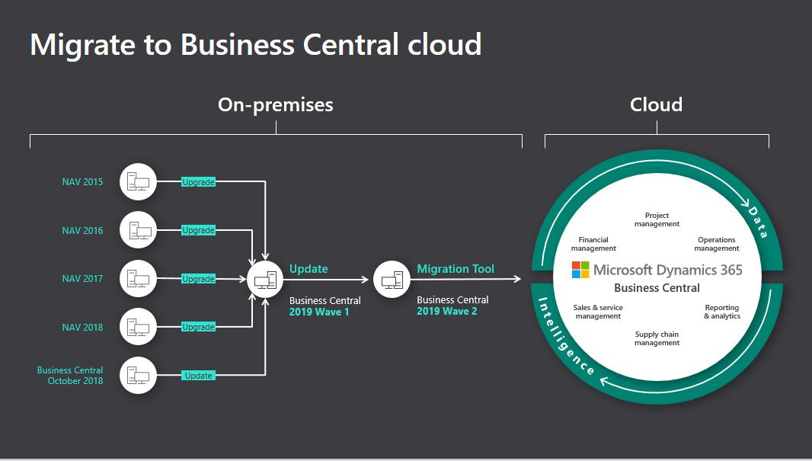
Hybrid Cloud Component from Microsoft

Slide 57
Run through the Basic Steps
Have a target environment with a paid subscription of BC
Determine which data to migrate
  For Business Central on-premises
  For Dynamics NAV, upgrade to Business Central on-premises
Migrate data, using the Cloud Migration Setup assisted setup guide in Business Central online
Test the result of the migration
Set up users, permissions, and other configurations in Business Central online
Stop using the on-premises solution, switch off the migration, and tell users to start using Business Central online for daily business

Slide 58
Key points to note for Data Migration
  Do not set up cloud migration for a production environment that is already in use for business.
  Manage Cloud Migration from the BC Online and your OnPrem solution still remains operative.
  Any existing data in Business Central online will be overwritten with data from your on-premises solution after the data migration process runs.
  The process doesn't look at any permissions within the applications you're transferring data between, only SQL permissions

Slide 59
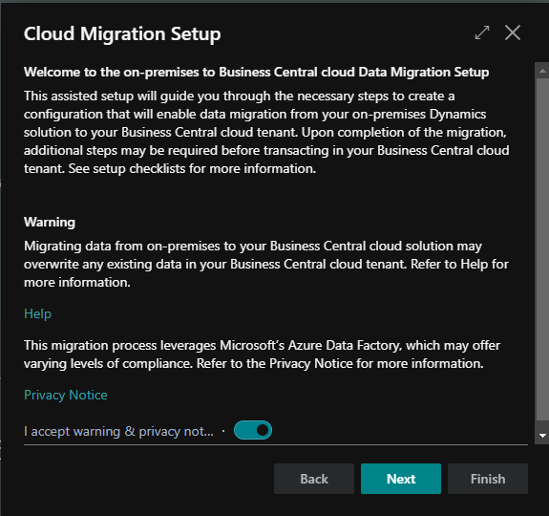

Hybrid Cloud Component from Microsoft

Slide 60


Hybrid Cloud Component from Microsoft

Slide 61


Resources
LS Central SaaS Implementation Guide
LS Retail Partner Portal

Slide 62
Thank you

