Slide 1
Customer Keynote
Kristjan Johannsson
Chief Commercial Officer

Slide 2
Nabila Rahim
Senior Product Owner for Digital Sales Solutions at adidas
Prashant Kumar Patel
Director of Operations & Development at University of Waterloo
Karim Sabri
Master Version Responsible at Inter IKEA Group
Sigurdur Long
Chief Information Officer at Blue Lagoon

Slide 3
Overview of LS Central at IKEA
Cooperation since 1986
26 IKEA markets operating with LS Central
Various number of different Customer Meeting Points per market

Slide 4
Karim Sabri
Master Version Responsible at Inter IKEA Group

Slide 5
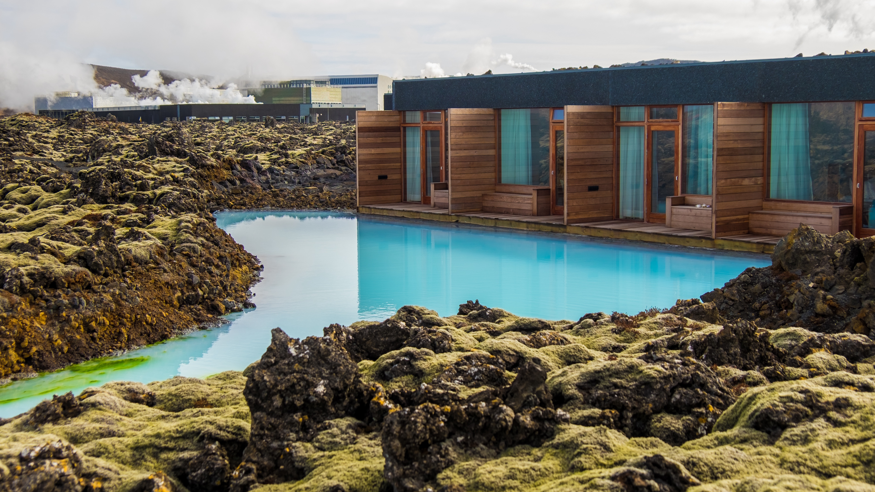
Overview of LS Central at Blue Lagoon
Cooperation since 2019
Using retail, hospitality, activities, hotels and ERP
Number of hotel rooms: 100 in two hotels
Number of POS: 55
Online with all operations (four restaurants, four retail shops, booking engine and two hotels

Slide 6
Sigurdur Long
Chief Information Officer

Slide 7
Overview of LS Central at adidas
Cooperation since 2000 with LS Retail
Number of stores approx. 1400
Number of POS approx. 4800
Next big milestone: Implementation of SAP S4 HANA with LS Central as POS

Slide 8
Nabila Rahim
Senior Product Owner for Digital Sales Solutions

Slide 9
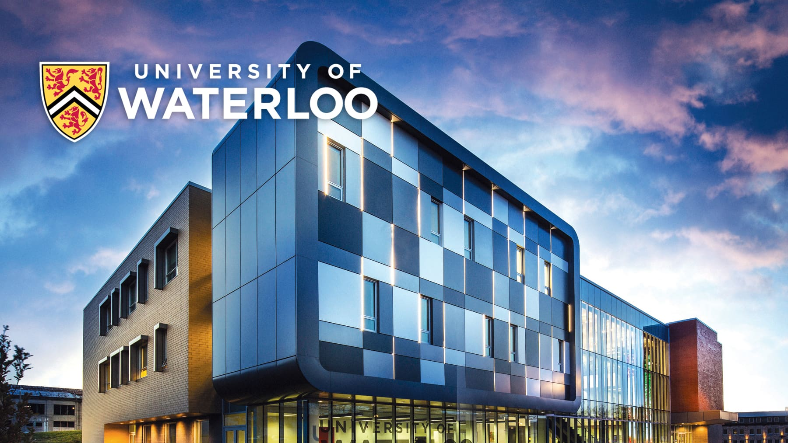
Overview of LS Central at University of Waterloo
Cooperation since 2016
Convenience stores, F&B operations / restaurants / hospitality
Planning Activities & Member Management
10 stores

Slide 10
Prashant Kumar Patel
Director of Operations & Development

