Slide 2
BC telemetry & AI: Environmental monitoring and performance intelligence for large-scale LSC deployments
Bjarni Asmundsson
Damir Babikov

Slide 3
What is observability?
BC telemetry Basics
LS Central: Why observability matters
From simple logs to AI insights
Tooling today: BC Telemetry Buddy & friends
Agenda
Why AI-enabled observability is the next step
Azure architecture overview
Demo: AI in action
Q&A (Ask me anything as long as it is simple)

Slide 4
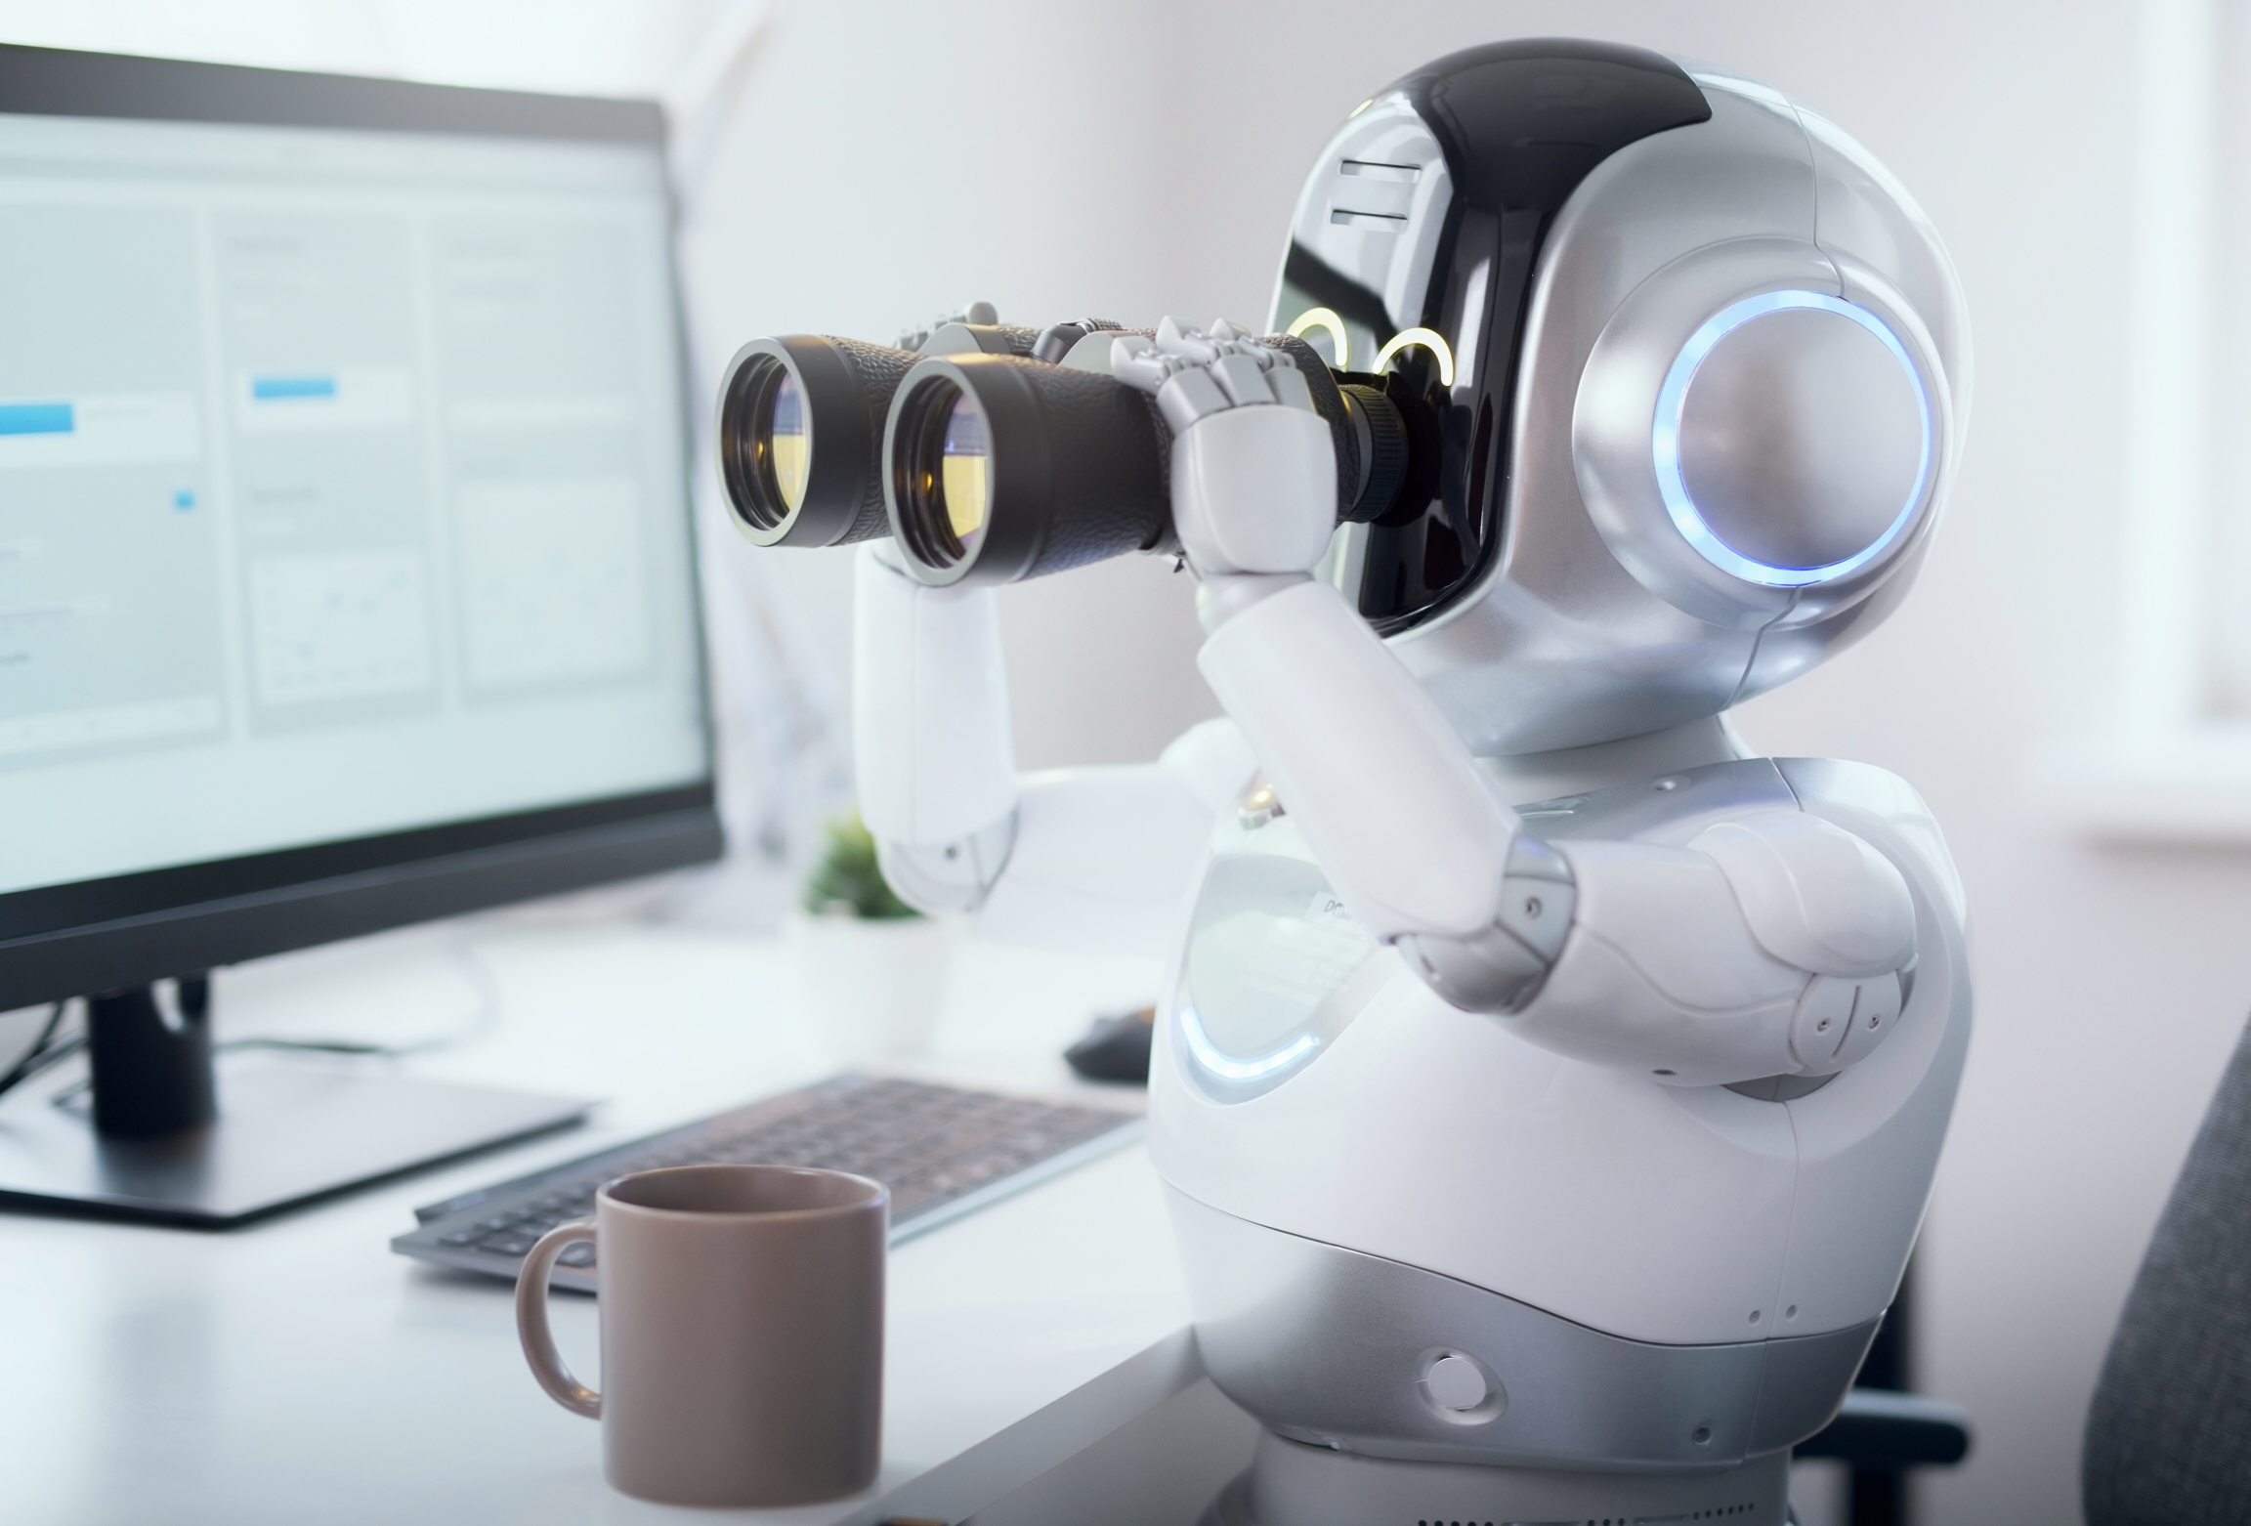
What is observability?
Observability: The art of knowing what’s happening inside your systems—without psychic powers!
Why it matters: Proactive issue detection, performance tuning, and happy customers.
Key ingredients: Telemetry, monitoring, and a dash of AI.

Slide 5
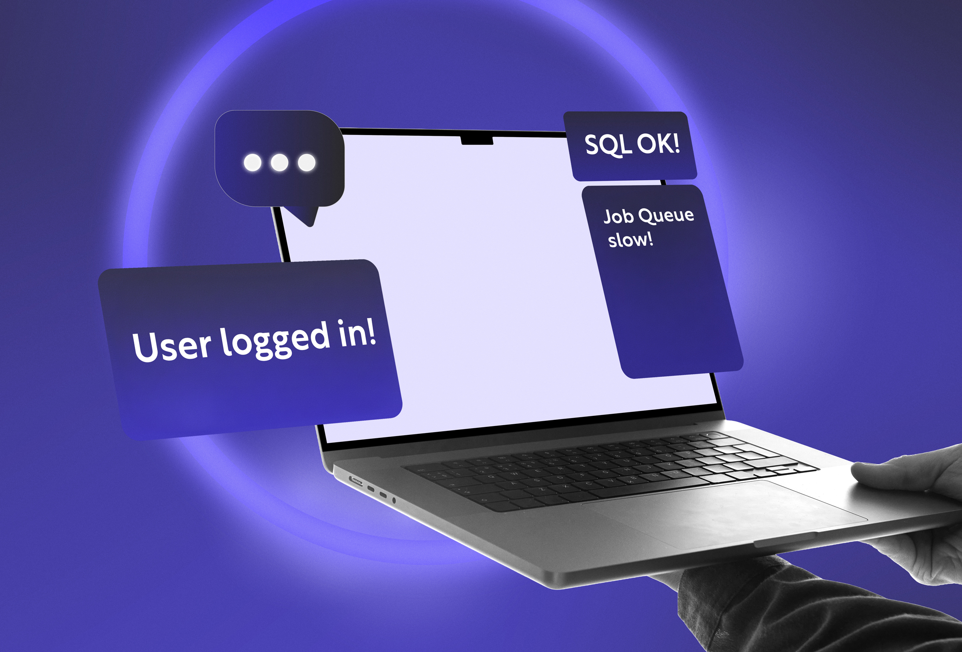
BC telemetry basics
Telemetry = Data about what’s happening in Business Central.
Types:
  Event logs (Who did what, when?)
  Performance counters (How fast? How furious?)
  Custom traces (KPI for LS Central and your extensions)
“If BC could talk, telemetry is what it would say!”

Slide 6

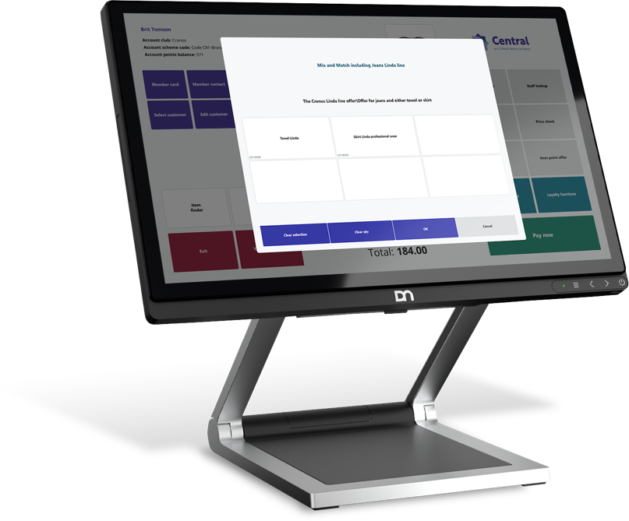
LS Central & telemetry
New extension by LS Retail
LS Central builds on BC telemetry for retail-specific insights.
Examples:
  POS transaction posting
  Statement calculation
  Replication health
  Customer journey tracking
“It’s like CCTV for your retail operations - minus the grainy footage.”

Slide 7
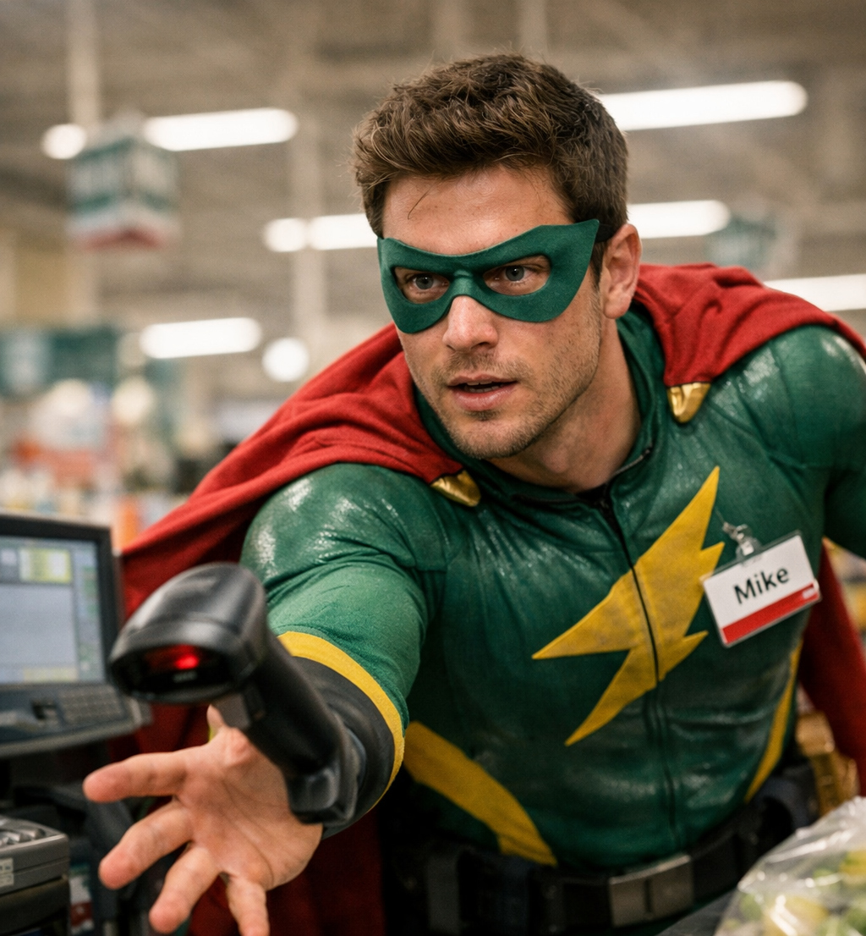
Why observability matters
Spot issues before customers do
(be the hero, not the villain).
Optimize performance and reduce downtime.
Enable data-driven decisions for retail success.
“Because guessing is for game shows, not business!”

Slide 8
Simple to complex – The journey
Start: Basic log collection (“Did it break?”)
Next: Correlate events (“Why did it break?”)
Advanced: AI-driven anomaly detection (“Will it break?”)
“It’s like evolving from a magnifying glass to a crystal ball.”

Slide 9
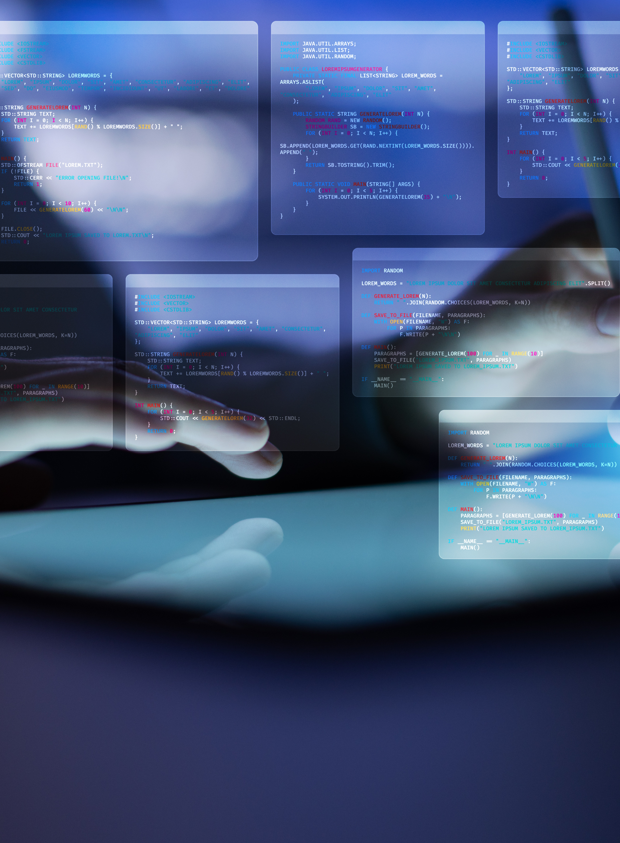
Tooling today
BC Telemetry Buddy (VS Code Extension by Waldo):
  Powerful, free tool for developers and consultants.
  Query and analyse Business Central telemetry data on demand from within VS Code.
  Features: guided setup, flexible authentication, event catalogue, schema discovery, VSC context aware,
  New: file-based knowledge
  Great for troubleshooting and learning telemetry, not for live/real-time dashboards and SRE support

Slide 10

Tooling today, part 2
Other tools in the wild:
  Azure Monitor Workbooks
  Power BI reports and dashboards
  Azure Data Explorer (Kusto): Advanced querying and visualization for large telemetry datasets.
  Custom scripts and log viewers
  New: Observability Agent directly in LAW and APPI

Slide 11

“
“In short: BC Telemetry Buddy is your trusty Swiss Army knife, but AI-Driven Observability is like having a whole toolbox…with a robot assistant who never sleeps!”

Slide 12

Why AI-enabled observability is the next step
Limitations of current tools:
  Manual analysis required – can be time-consuming and error-prone.
  Hard to correlate events across tenants, environments, or BC versions.
  Reactive: You find problems after they happen.
AI-enabled observability advantages:
  Proactive anomaly detection – AI spots issues before users do.
  Version-agnostic: Universal schema means no more tool rewrites for every BC update.
  Automated root cause analysis and recommendations.
  Scalable for multi-tenant, high-volume LSC environments.
  Integrates with Azure security and compliance features.

Slide 13

Azure cloud architecture for observability
Key components:
  BC Telemetry
  Log Analytics Workspace
  Azure OpenAI and ML
  Azure Storage
Data flows securely from BC/LS Central to Azure for analysis.
“All the magic happens in the cloud - no rabbits required.”

Slide 14

AI-driven observability
How it works
AI models analyse telemetry for patterns and anomalies.
Universal schema: Decouples BC version from analysis.
Cognitive broker: Orchestrates queries and responses.
“Think of it as Sherlock Holmes with a GPU.”

Slide 15
DEMO
AI in action

Slide 16
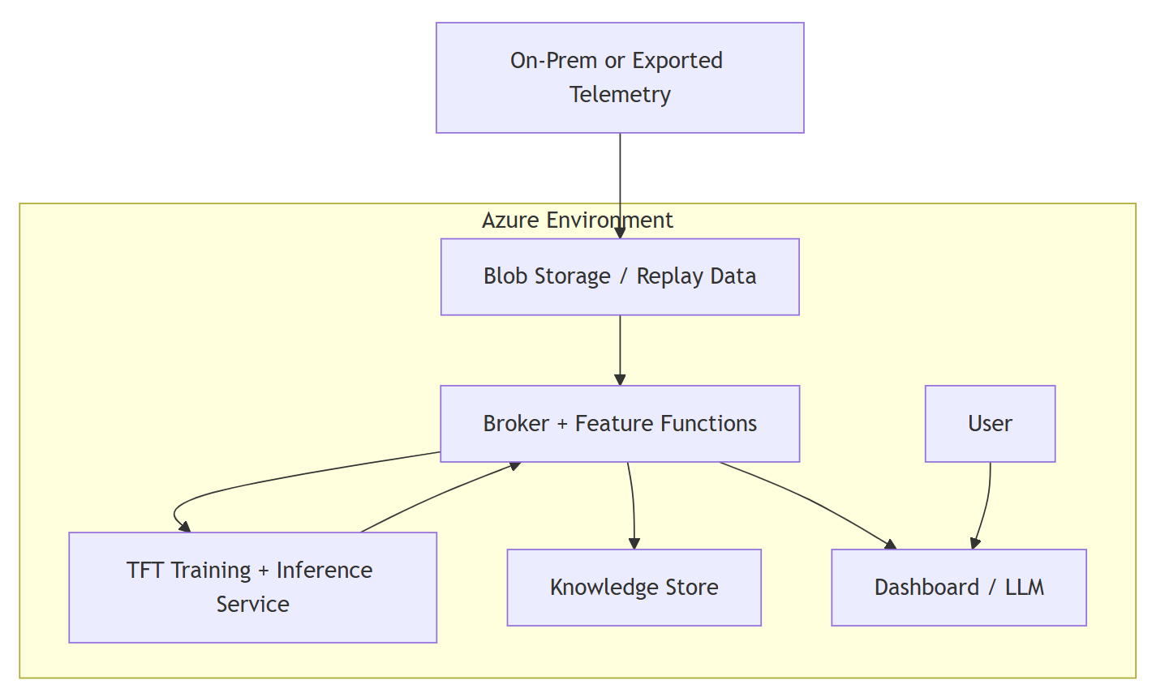
What was that in plain English
LLM
ML / DL
TFT
SRE
DAG

Slide 17

Data privacy & security
GDPR-compliant data handling.
PII redaction before AI analysis.
Tenant isolation: Your data stays yours.
“Because nobody wants their secrets shared… except on social media.”

Slide 18

Operational governance
Managed identities for secure access.
Optional resets for new software versions.
Cost-effective scaling using Azure resources.
“Observability that won’t break the bank - or your nerves.”

Slide 19
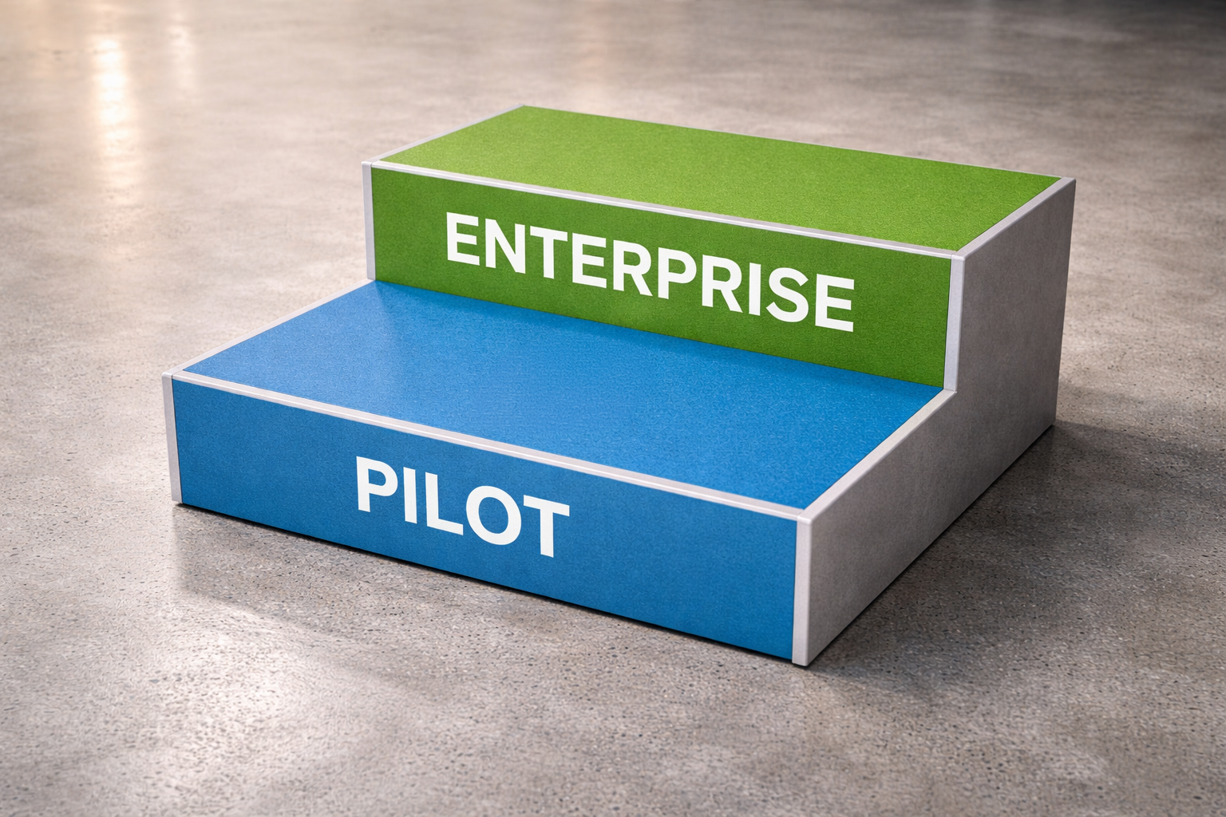
Implementation path
Enable BC Telemetry + DCR
Decide on KPI
Document architecture
Evaluate data and AI models
POC in Copilot Studio
Enterprise scale using Azure resources including Bot Service for full control
“Start small, scale smart, and keep your IT team smiling.”

Slide 20

Key takeaways
Observability is essential for LS Central success.
AI transforms raw data into actionable insights.
Azure architecture ensures security and scalability.
“With great observability comes great responsibility - and fewer headaches!”

