Slide 1
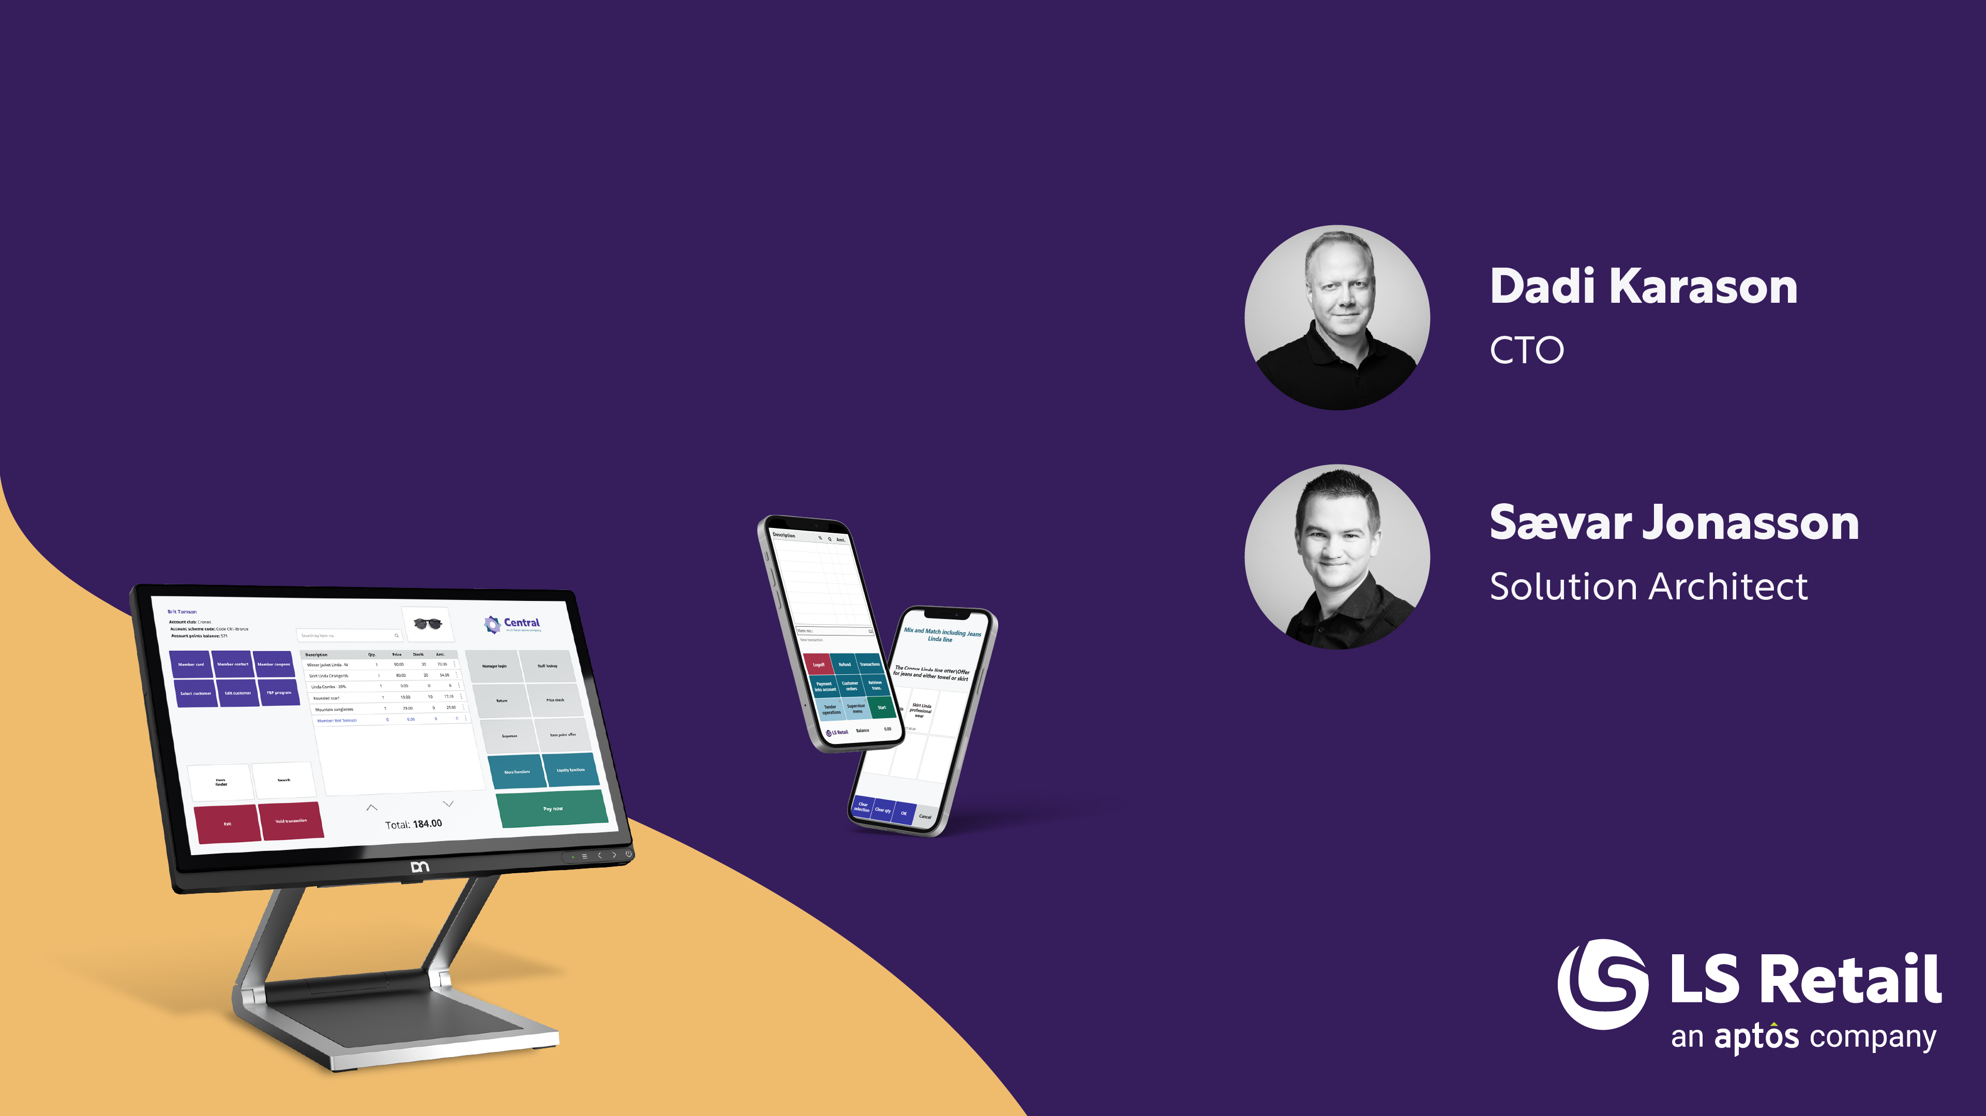

CentralConnect
LS Central integration to SAP Webinar

Slide 2




About
LS Central Built on a solid base
LS Central extends head-office platforms
Leveraging the Microsoft Dynamics 365 investment and ecosystem
More than 40,000 businesses use Business Central as their ERP
LS Central is recognized by Gartner® as a representative vendor in the Digital-Business-Ready POS applications

Slide 3

A global POS solution
The LS Central Point of Sale solution has a unique market advantage
We have a global presence that is unmatched by competitors
This global footprint makes LS Retail the ideal provider for retailers who want to work with the same solution in all the regions and countries where they operate
  Some competitors have good coverage in multiple regions with 1-3 verticals
  Some competitors have good coverage in multiple verticals with 1-3 regions
  But LS Retail is unique with coverage in multiple verticals in multiple countries

Slide 4
What is Central Connect
Middleware build by LS Retail in the Microsoft environment
Standardized integration framework using the Microsoft Azure environment
Master data synchronization
Sales export
Transaction export
Configurable mappings, without custom coding

Slide 5

Benefits
Reduced custom development
Flexibility for hybrid scenarios
  E-Commerce
  POS click and collect
  Drop shipment
Scalability
  Acts as a hub, easy to plug in new systems
  Easier to adapt to SAP 4/Hana (public/private cloud)
Cost of Ownership
  Less custom SAP development
  Faster integration projects
  Lower long-term support costs

Slide 6
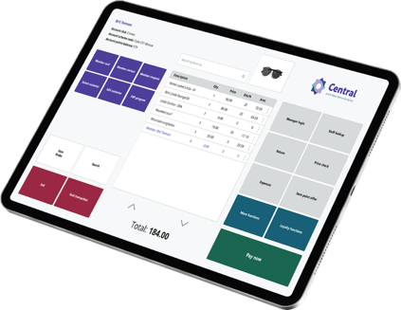
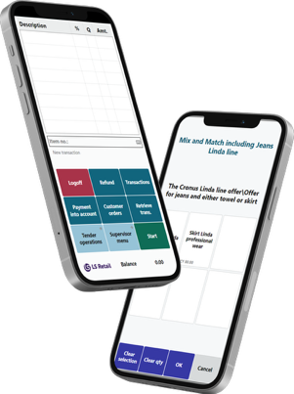
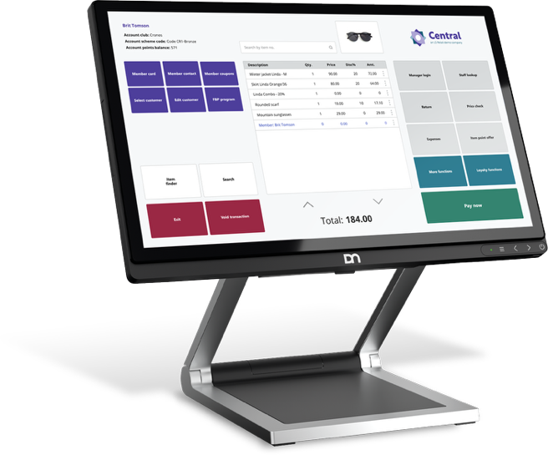
Supported versions
SAP S/4HANA
  Public Cloud (via Odata API / API Business hub)
  Private Cloud / On-Prem (via Odata, BAPIs)
Business Central (LS Central)
  Business Central SaaS (cloud, API v2.0)
  Business Central On-Prem (via API v2.0 / Odata)
Decoupled via Central connect
  Uses Xml + mappings avoids version lock-in
  Upgrades on SAP or BC side only require manual changes to data mapping

Slide 7

Central Connect License
LS Central required
Fixed monthly subscription
Customer to maintain Azure
environment and cost

Slide 8

CentralConnect ǀ New & Backlog
Streamlined the user interface in LS Central
Logging mechanism improved
Work in progress: Send transactions near real-time
Backlog: Send Inventory adjustments between systems near real-time
Backlog: Pick / Receive result sent between systems near real-time
Backlog: AI enable Central Connect

Slide 9


Data flow from head-office
Azure storage used for temporary data storage.
Azure function handles distribution and packaging
Data packages inserted into Azure storage
Message created in message queue
Data imported into LS Central
Data validated and inserted into LS Central tables
Data processed
Validation before insert
Insert
Storage
Master Data /
Retail documents
Azure function
Message queue
Message imported

Slide 10
Retail sales flow
Sales data flow from LS Central and into Azure storage
End of day in LS Central triggers an Azure function
  Creates data package with tender information
  Trigger import into data management via Rest API
SAP Retail
Azure Function
Transactions
End of day procedure
Daily retail operation
Storage
Retail documents
Retail documents

Slide 11
Transaction process
Transaction data flow from LS Central and into Azure storage
End of day in LS Central triggers an Azure function
  Creates data package
  Stored in Azure storage
  Azure function to trigger import and packaging
SAP Retail
Azure Function
End of day procedure
Daily retail operation
Storage
Transaction/
Retail documents

Slide 12
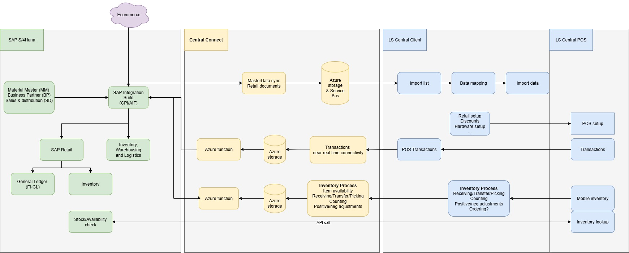
Architecture overview

Slide 13

Click and collect / BOPIS
  Ecommerce orders
    Work on SAP Backend
    Same for Click & Collect
  Member management, benefits (earn/use Points, Offers and special prices)
    Included in LS Central
    External options available, can use offer and special prices setup from LS Central.
    Different case by case, need further discussions

Slide 14

Requirements
Data needs to be written and read from Azure Storage
Current format is XML
  We may support other types such as Json and CSV as well
Customers maintains and creates Azure environment

Slide 15

Summary
SAP S/4HANA system of record
Inventory processes included
Azure environment
Items, Barcodes, Prices, Vendors, Inventory docs,etc.
Transactions
Stock movements
EOD statements

Slide 16
Q&A

