Slide 2


LS Central in SaaS - Onboarding
Adalbjorg Karlsdottir
Ricardo Moinhos
Onboarding Lead
Senior Onboarding Specialist
adalbjorg@lsretail.com
Ricardomo@lsretail.com

Slide 3







About the evergreen train
It’s Automatically renewed and repeatedly made valid.
It requires internal change to bee successful, not only within LS Retail but within our partners organizations too.
  Continuous improvements
  Continuous delivery
  Rapid implementation
  Automation

Slide 4

Go

Slide 5
But don‘t just jump on board!
Go

Slide 6


Educate yourself
Implementing LS Central SaaS is a process that should be approached with strategy
Educate yourself on the differences between LS Central SaaS and on-premise and determine the principal activities of your future LS Central SaaS operations
SaaS Resource page
LS Central Implementation Guide
Onboarding LS Central SaaS and CAP
Educate yourself
LS Academy
CF-900 is now available On-demand

Slide 7

Understand the support process
Understand the support process and your responsibility in supporting your customers.
Outage communication strategy
Partner Center
Delegated Administrator
Admin Center
Learn more about Support
Business Central reselling partner, means that you will get requests for support from your customers that you must triage, investigate, and either resolve or escalate to Microsoft or LS Retail, depending on the issue's nature.
As a Business Central reselling partner, you are an administrator of your customers' Business Central tenants, and you are the first line of support

Slide 8

Automation is your BEST friend
In a SaaS business, direct labor is your enemy. Automation is your friend.
When you neglect to automate core business processes and then cover it up with people, you ensure long-term unprofitability and engender a culture that undermines long term success.
Solve problems through automation, and then add people to push sales and service performance over the top, not to provide the basic function.
Make test environment as close to real environment as possible.
Don’t forget to test Hardware Station, printing, etc…

Slide 9


Cherry pick your first customers
Cherry pick your customers, focusing only on those that have the highest need and are the easiest to reach.
Don’t chase the big, bad elephants that need special features, requires a long sales cycle and has restrictive legal requirements.

Slide 10
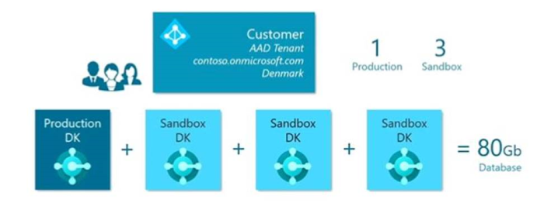
Production Environment
Every Production Environment comes with 3 sandboxes which all add up to the 80 GB of free space.
Approx 50% compression
Learn more
+ 3/2/1 GB per user

Slide 11
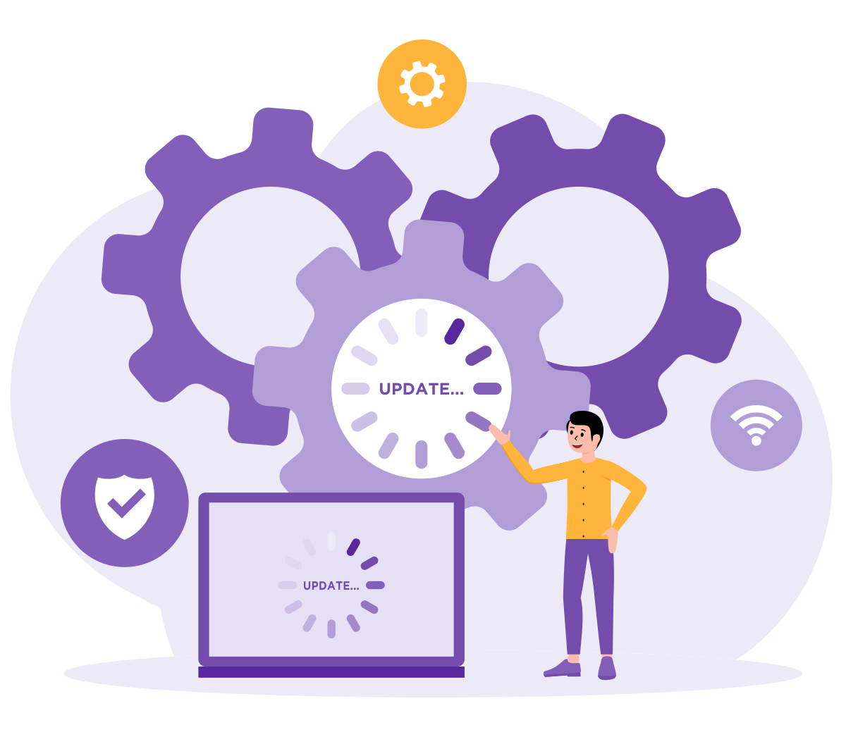
What is your support concept?
What is the customer ready to pay for?
  Per hour
  Monthly service fee
Offline POS - you need more time for support etc.
Online – Hardware Station updates

Slide 12


Template database
Template database contains standard components
Creating a customer database from a template:
Reduces the time for data setup
Ensures that databases are created consistently
Start with on-premise database and create a new company
Basic Setup needed for running HO, Store and POS
  Run Retail Setup -> Insert default data
  Use Import/Export Worksheet to get POS setup data
GL/Account
Posting Groups
General Ledger Setup
Unit of Measure
Source Code
Reason Code
Payment Method
No Series
Retail Setup
Store
POS
Tender Type
Staff Permission
POS Setup
Keep the template database up to date on the newest LS Central SaaS version
Keep it clean!

Slide 13

Get ready

Slide 14

A stress-free go-live
Do a test implementation before starting the customer implementation
Develop a plan for onboarding

Slide 15


Onboarding with a new Customer
On-Premise
Copy of Template Database
- Master data
- Opening balance
- Quantities
Customer
Tenant
LS Central SaaS
Customer
Database
Migrate
How to Migrate
Adjust setup
Adjust setup
Customer test
Database/company
Test
Test

Slide 16

Onboarding with On-Premise Customer
When it is time to decide whether to undertake upgrade or re-implementation, our advice is to re-implement if LS Central's version is older than v15 and has extensive customizations.
In the case of upgrades and migration, we strongly advise you to review the data before migration.
  Which elements might be left behind?
  The value of old data?
Learn more
We advice you to:
Upgrade to latest version before you migrate to LS Central SaaS

Slide 17
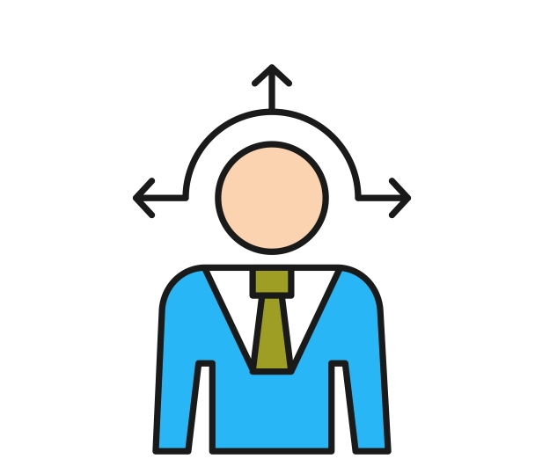
Online or offline POS?
In LS Central SaaS, you can choose between two deployment options:
  Online POS
  Offline POS.
You can also combine the two.
To select the right deployment option for each customer, consider:
  The pros and cons of each option alongside specific customer factors (volume of transactions, stability and quality of internet connection, etc.)

Slide 18
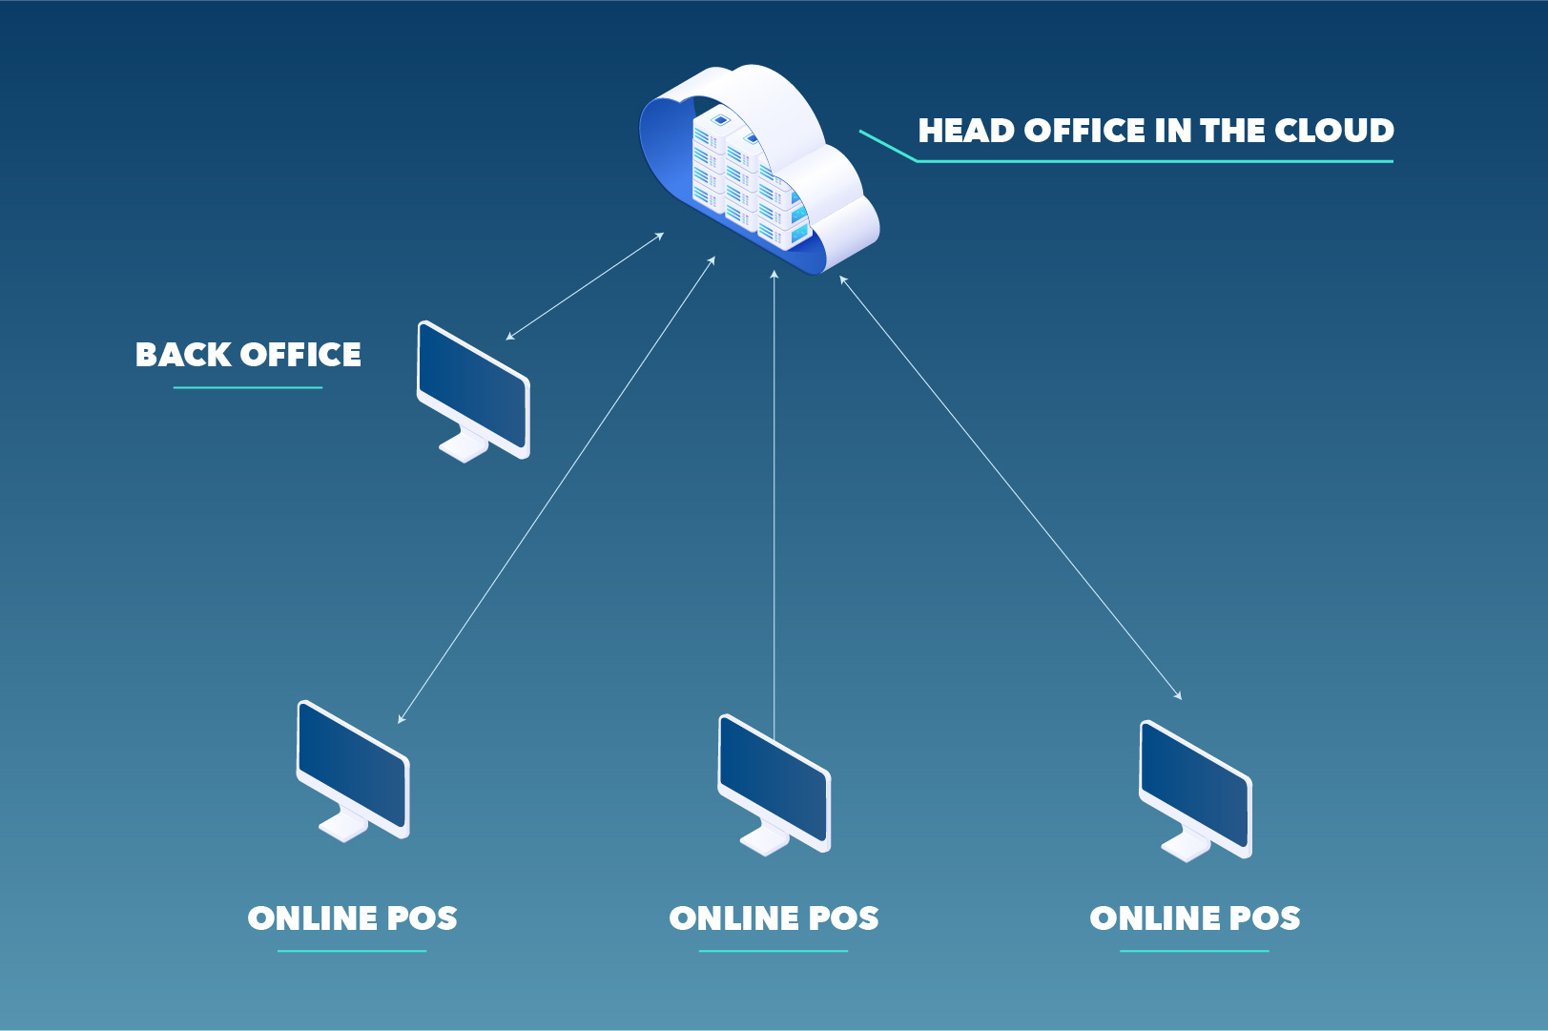
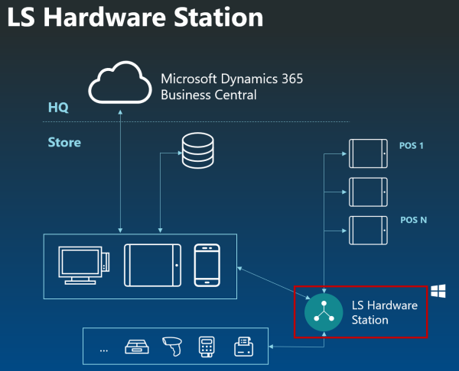
Online POS
POSs and back-office users run a modern web client and connect to the LS Central SaaS and are reliant on the internet works and they have access to the LS Central SaaS always
Software installation:
Hardware station
Install Hardware Station using Update Service
Web Replication

Slide 19
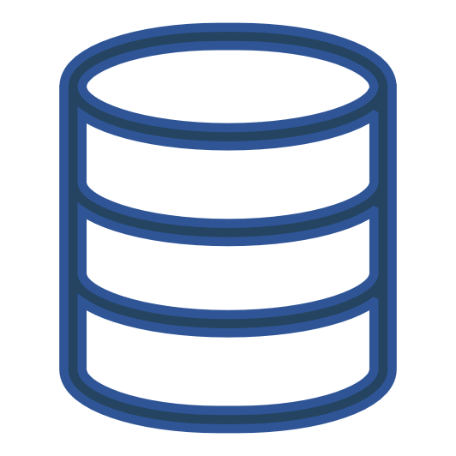
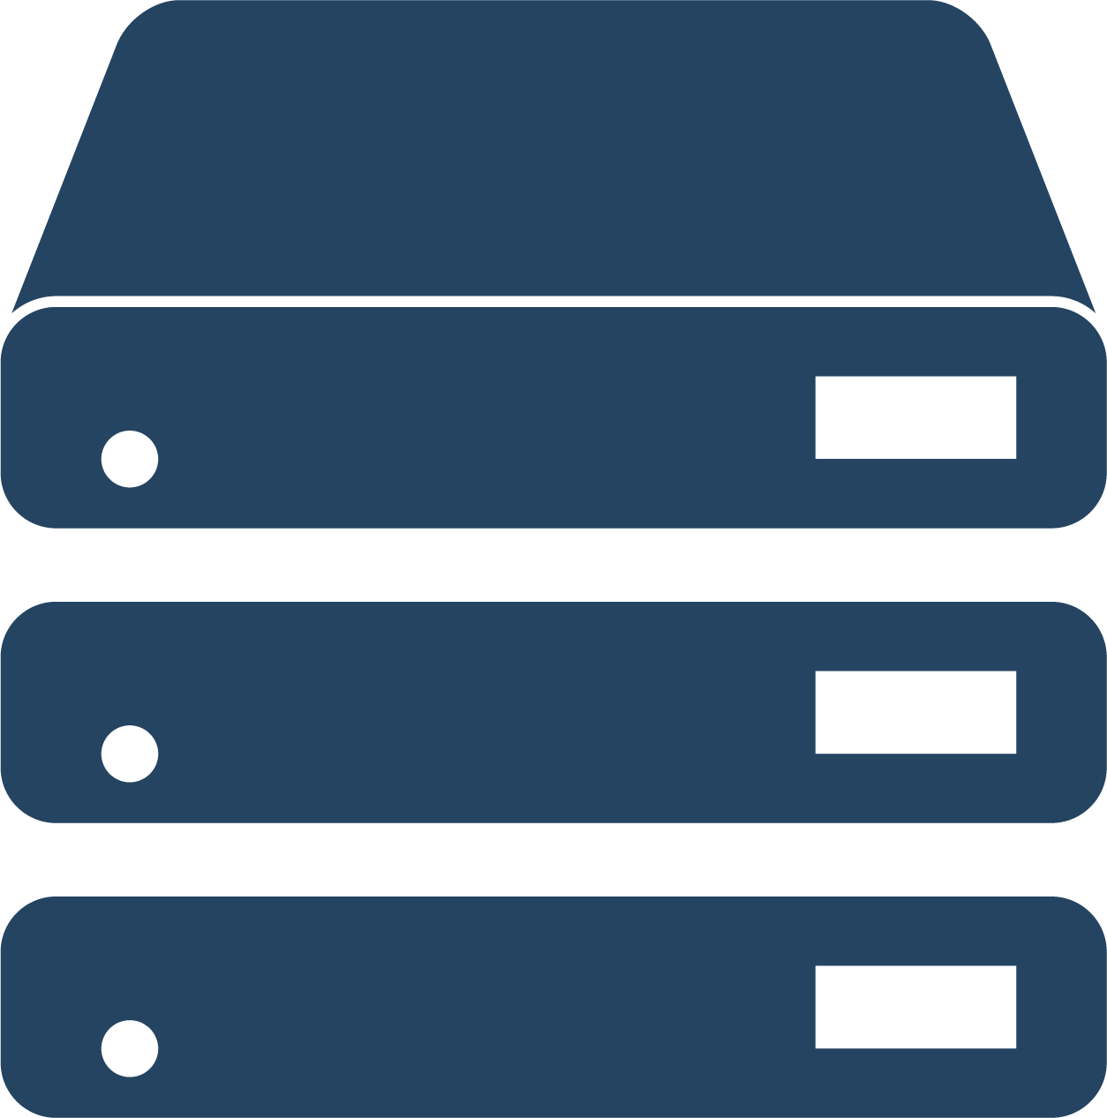
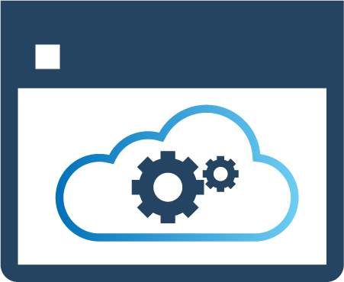
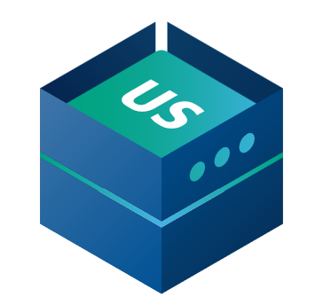


Offline POS overview
SaaS
  Hybrid Component Server
HEAD OFFICE IN
BC SaaS
DD Webservice mode​
HYBRID
COMPONENT SERVER
POS MASTER
DATA DIRECTOR
UPDATE SERVICE
DD
DD
STORE 1
STORE 2
Offline POS
Offline POS
Offline POS
Offline POS

Slide 20

Offline POS overview
The NEW replication
  Azure Storage Replication
  LS24.0
  No more Hybrid Component Server
HEAD OFFICE IN
BC SaaS
STORE 1
STORE 2
Offline POS
Offline POS
Offline POS
Offline POS

Slide 21

Offline POS - Web Repl. Using Azure Storage
Azure Storage Account
  Owned by customer
HEAD OFFICE IN
BC SaaS
STORE 1
STORE 2
Offline POS
Offline POS
Offline POS
Offline POS

Slide 22

Offline POS history
Offline POS - Web Repl. Using Azure Storage
Azure Storage Account
  Owned by customer
Scheduler Replication Job
  Creates a package
  Registers destinations
HEAD OFFICE IN
BC SaaS
POS | Created | Inform. | Import.
10 | X
15 | X
STORE 1
STORE 2
10
15
Offline POS
Offline POS
Offline POS
Offline POS

Slide 23
Offline POS history
Offline POS - Web Repl. Using Azure Storage
Azure Storage Account
  Owned by customer
Scheduler Replication Job
  Creates a package
  Registers destinations
POS inquires about data for that POS
  POS fetches package information from HO
HEAD OFFICE IN
BC SaaS
POS | Created | Inform. | Import.
10 | X
15 | X | X
STORE 1
STORE 2
10
15
Offline POS
Offline POS
Offline POS
Offline POS

Slide 24
Offline POS history
Offline POS - Web Repl. Using Azure Storage
Azure Storage Account
  Owned by customer
Scheduler Replication Job
  Creates a package
  Registers destinations
POS inquires about data for that POS
  POS fetches package information from HO
POS fetches the package from Azure Storage Account
HEAD OFFICE IN
BC SaaS
POS | Created | Inform. | Import.
10 | X
15 | X | X
STORE 1
STORE 2
10
15
Offline POS
Offline POS
Offline POS
Offline POS

Slide 25

Offline POS history
Offline POS - Web Repl. Using Azure Storage
Azure Storage Account
  Owned by customer
Scheduler Replication Job
  Creates a package
  Registers destinations
POS inquires about data for that POS
  POS fetches package information from HO
POS fetches the package from Azure Storage Account
Package imported to POS and marked as completed at HO
HEAD OFFICE IN
BC SaaS
POS | Created | Inform. | Import.
10 | X
15 | X | X | X
STORE 1
STORE 2
10
15
Offline POS
Offline POS
Offline POS
Offline POS

Slide 26

Before you start
It is important that you:
Have finished the LS Central General Base Course training
Know how Data Distribution and Replication is set up and works in LS Central
Basic PowerShell knowledge (Learn more)
Are familiar with Update Service (Learn more)

Slide 27
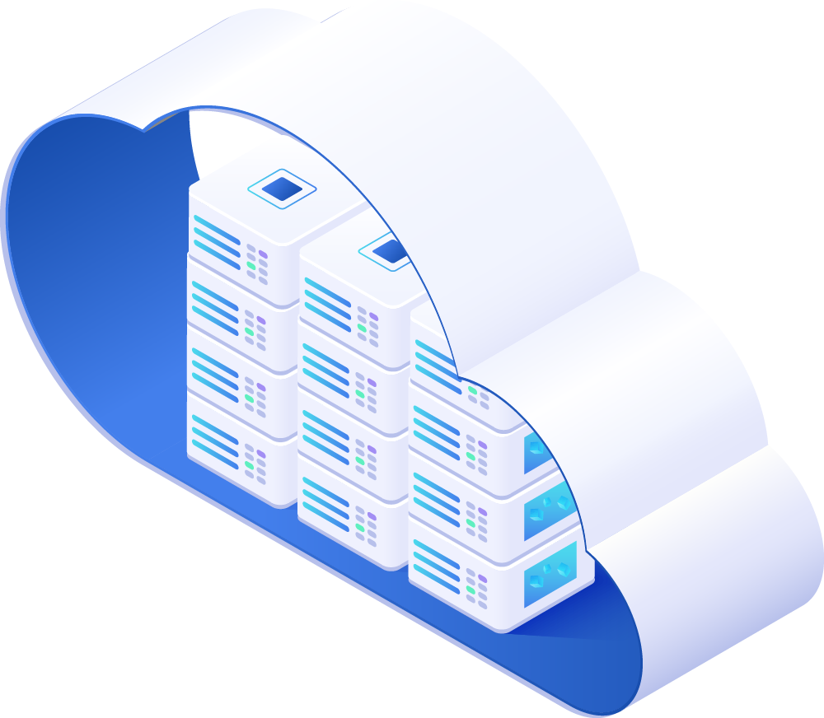
Head Office in LS Central SaaS
GL/Account
It’s important to finish all setup in the Head Office Tenant before you start implementing.
Posting Groups
General Ledger Setup
Unit of Measure
Source Code
Reason Code
Payment Method
No Series
Retail Setup
Store
POS
Tender Type
Staff Permission
POS Setup

Slide 28
Offline POS – how to set up?
Steps to setup the Hybrid server
Steps to setup the Offline POS using Azure Storage replication

Slide 29
Offline POS using Azure Storage replication
Benefits:
Less expensive to run
Simpler to set up than the HCS.
Simpler to upgrade and stay current
New features

Slide 30
What do I need to do when a new update is released?​
Update is available
Last date to schedule update
Outside upgrade window
LS Central release candidate
Upgrade window
To be extended to 5 months
Please refer to Flexible Update Management
Day 1
Day 60
Get familiar with the new release
Test your addons on the new release
Set Scheduled Update date and define update time window in the Business Central Admin Center
Notify customers

Slide 31
Maintenance and upgrades
LS Central maintenance and upgrade overview
Managing customer tenant updates
Managing POS updates Online Model
Managing POS updates Hybrid Model
LS Central Release Candidate page

Slide 32
Important!
Update Window
Schedule an update date
If you don't set a date in the Scheduled Update Date field, Microsoft will update the environment automatically on any day between the default date and the date that is shown as the last possible update date in your notification email. If you don't want your environment to be updated automatically, change the update date to one that fits you better.
Schedule an update date

Slide 33
Hardware Station online in SaaS - Https
Can use http if localhost
Https recommended for increased security
SSL certificate
Self-signed for testing only
One certificate per customer setup using DNS management see link:
How to use Https in LS Hardware Station

Slide 34

Application insight for telemetry
It is important to connect the tenant to Application Insights
You can monitor health, updates and also monitor if extensions are affecting performance etc.
Learn more
These videos on GitHub are helpful to guide you to connect your tenant to Application insights
Here is the power BI performance report referred to in one of the videos.
How telemetry can help you solve problems in a live SaaS environment

Slide 35

Going to SaaS - how can we help you?
Pre-sales
Before go-live
After go-live

Slide 36

CAP
Cloud Acceleration Program

Slide 37
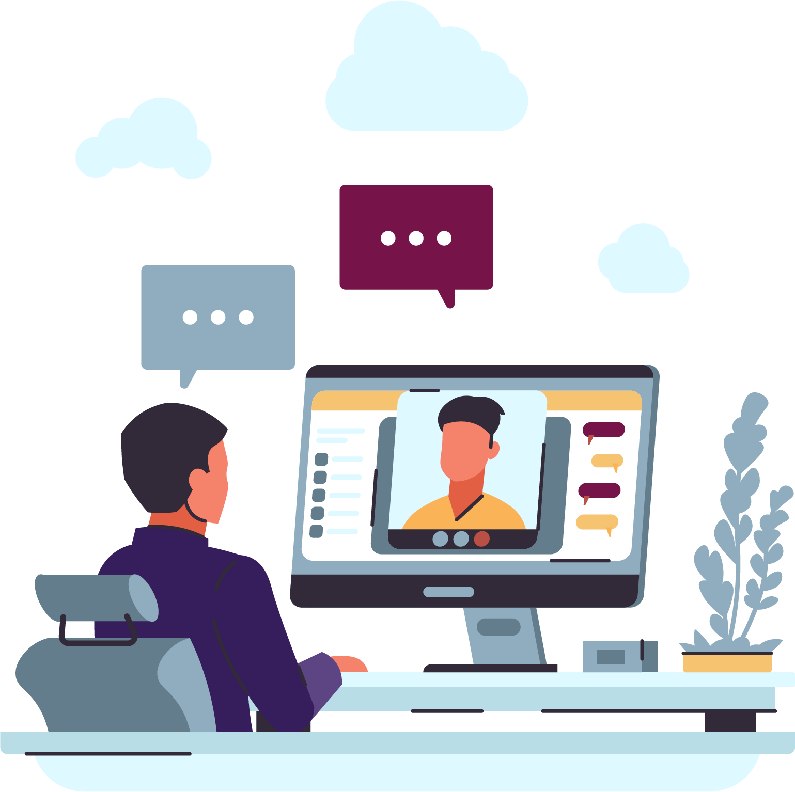
Book a session with the Onboarding and CAP Team
  The sessions with SaaS Onboarding and CAP are free of charge.
  Book your overview session when it fits you
  Use link
  Link to book an Onboarding session
  Do you need a 30-minute session to ask any SaaS-related questions
  Use link
  Link to book a session with the CAP team
  More information on Onboarding SaaS and CAP

Slide 38
Thank you

