Slide 1
LS Express
More than a POS
Gudrun Olafsdottir
S.Marta Sigmarsdottir
Product Director
Product Owner

Slide 2























Availability
Denmark
Finland
Germany
Australia
France
Spain
New Zealand
Great Britain
Iceland
The Netherlands
UAE
Mexico*
Austria*
United States
South Africa
Sweden*
Switzerland
Singapore
Belgium
Canada
Hong Kong
Luxemburg
The goal is to make LS Express available where Business Central is available
Philippines

Slide 3


Slide 4

It’s so simple!

Slide 5

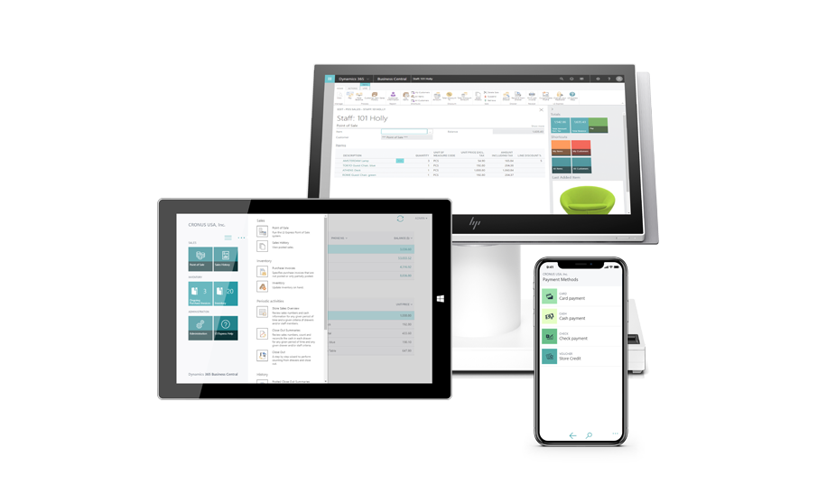
It’s so simple!

Slide 6

It’s so simple!
5 Locations
10 LS Express POS’s

Slide 7

It’s so simple!
12 Stores
18 LS Express POS’s

Slide 8
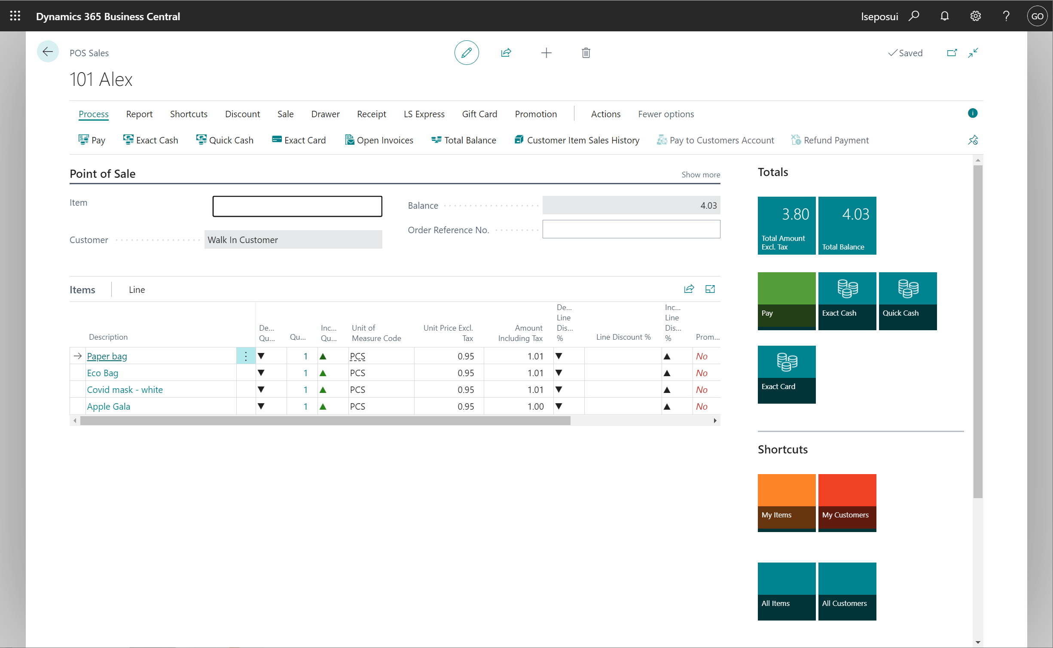
It doesn’t look like a POS!

Slide 9

We hear you!

Slide 10



Slide 11
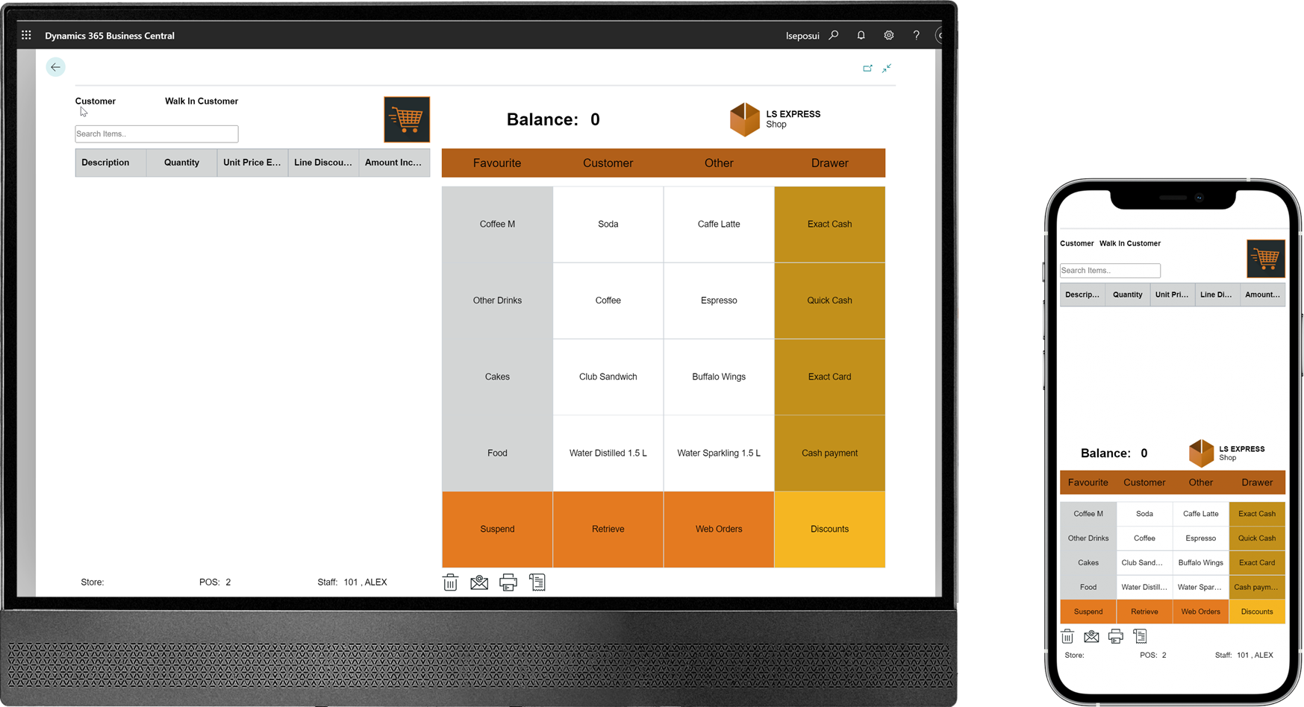
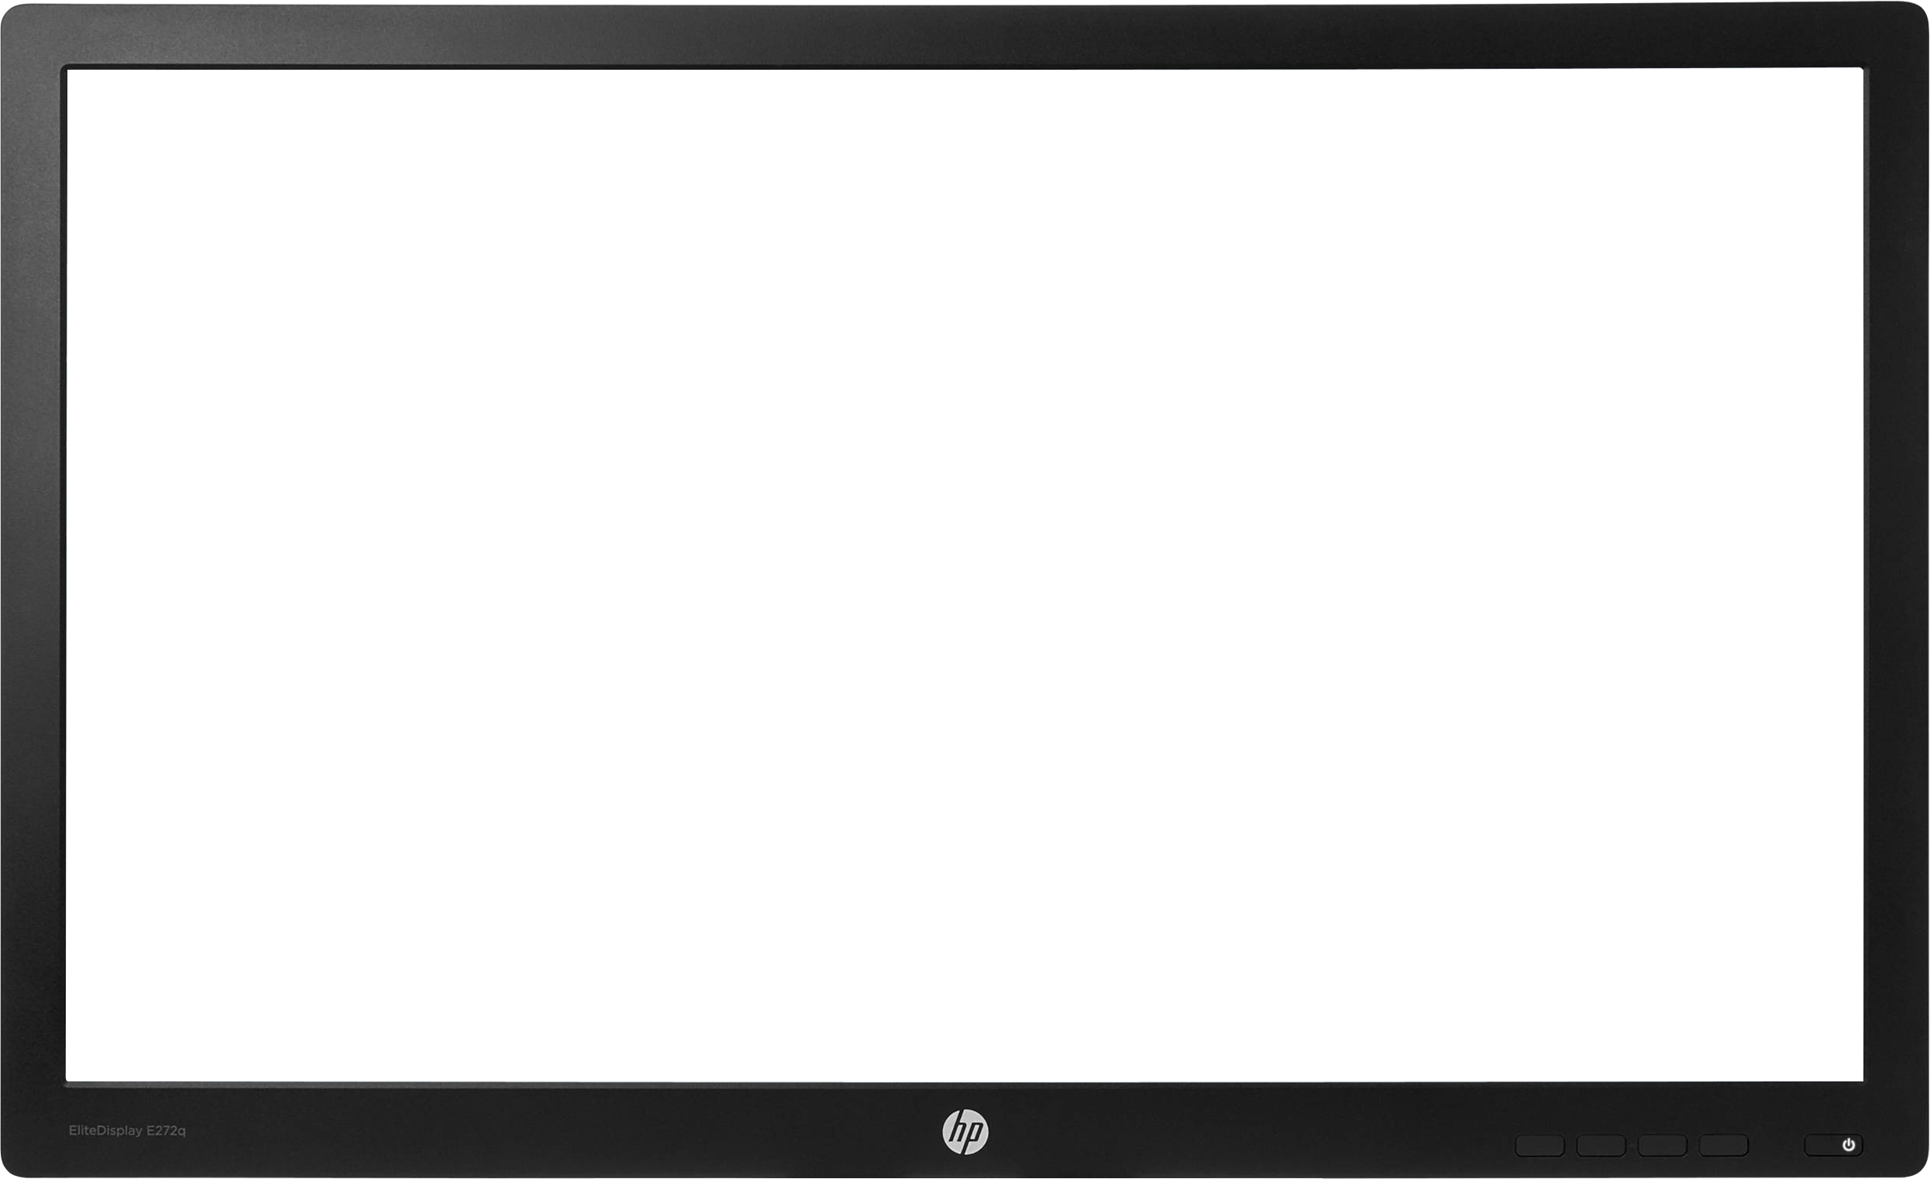
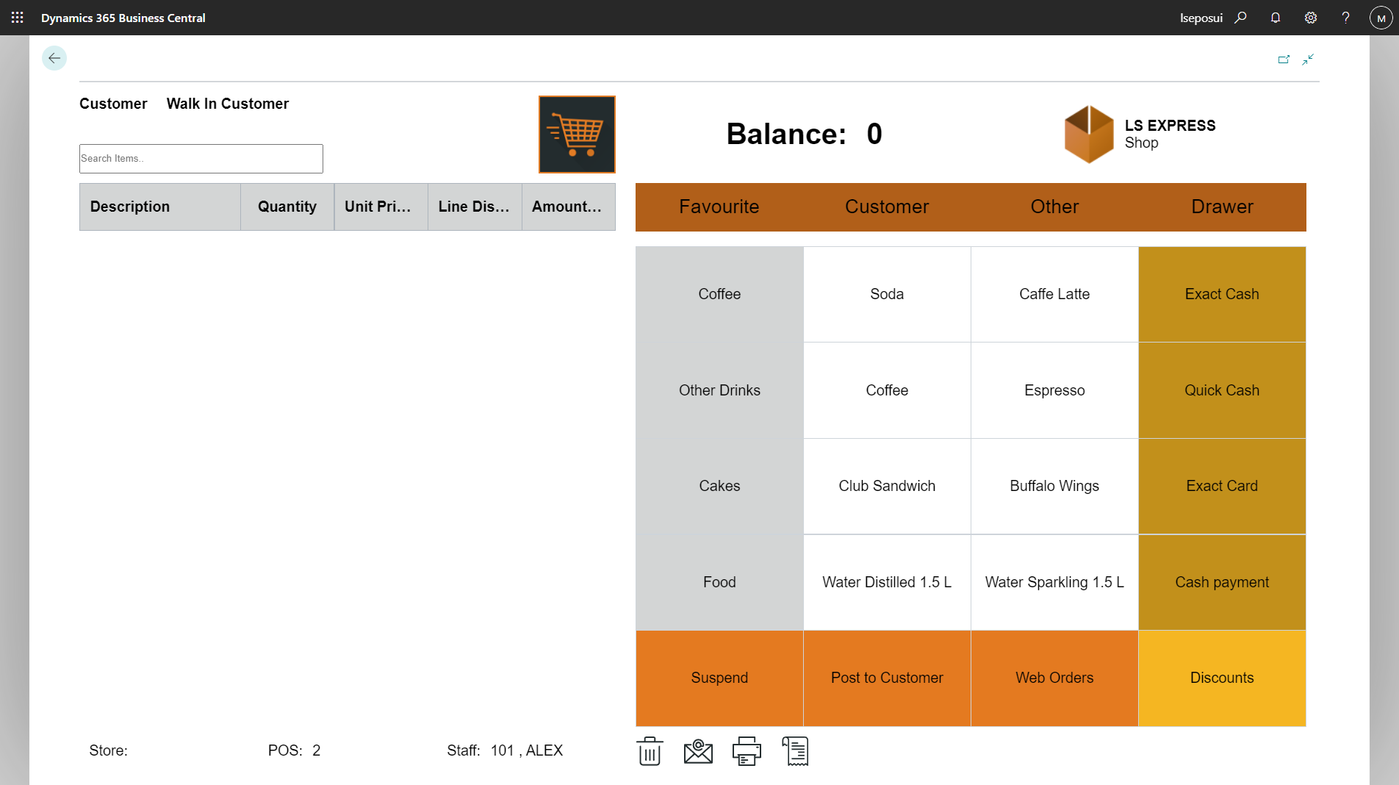

Slide 12
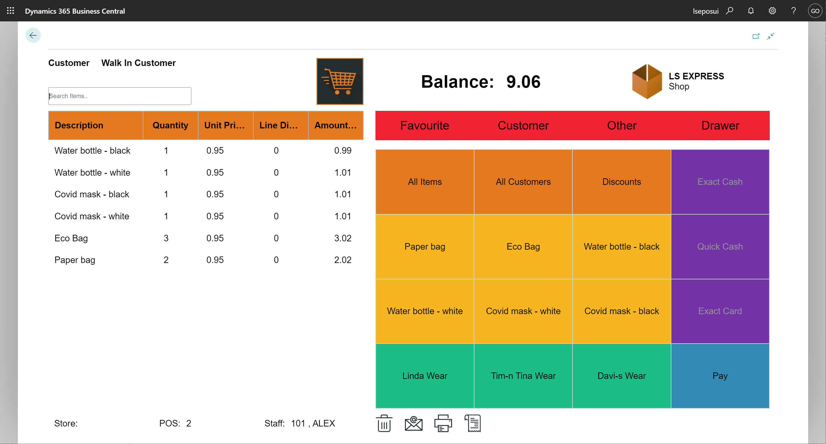

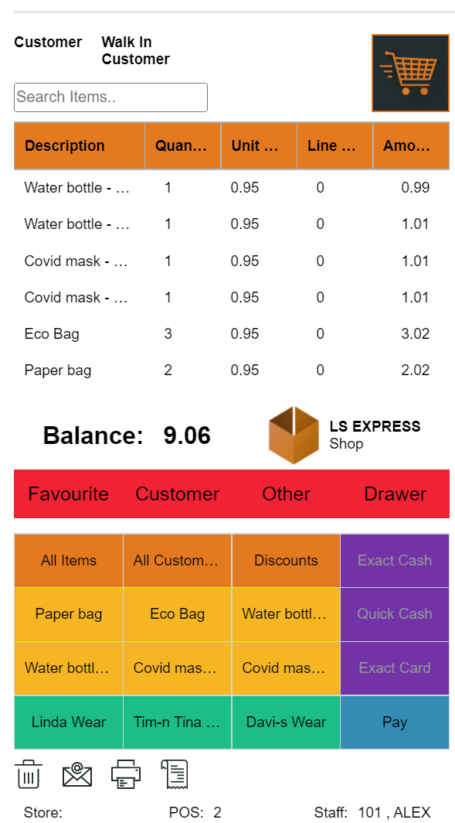

Slide 13
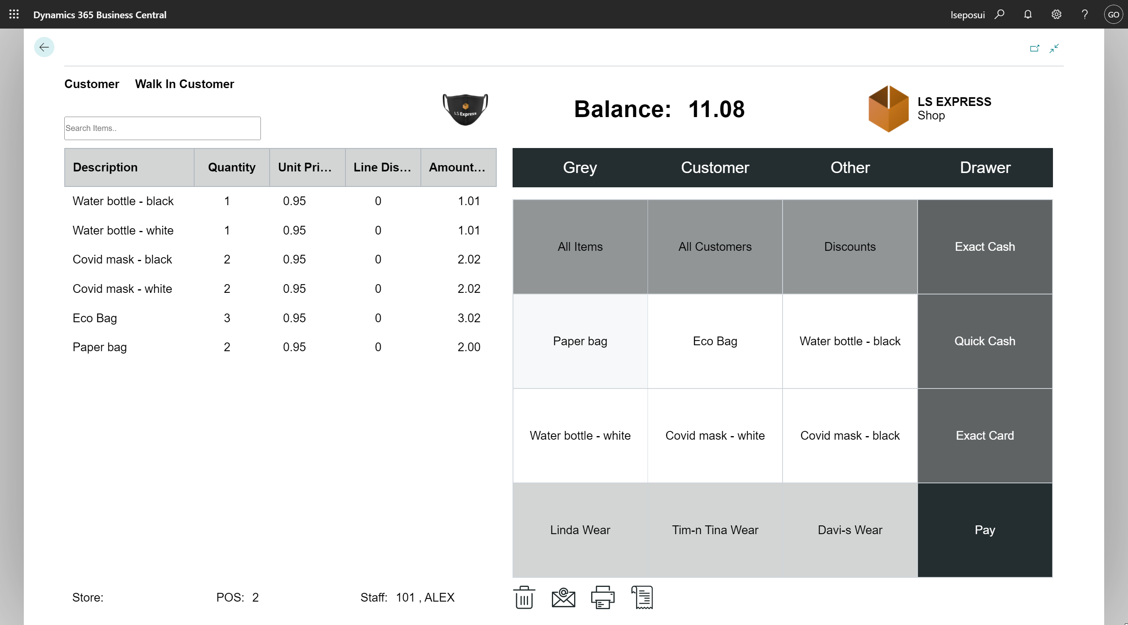
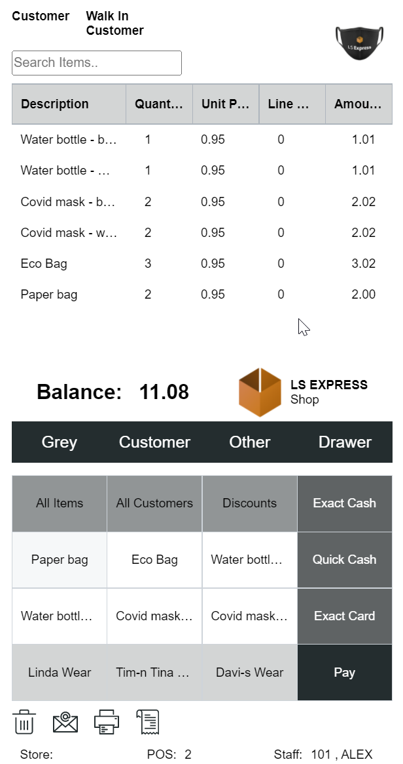

Slide 14
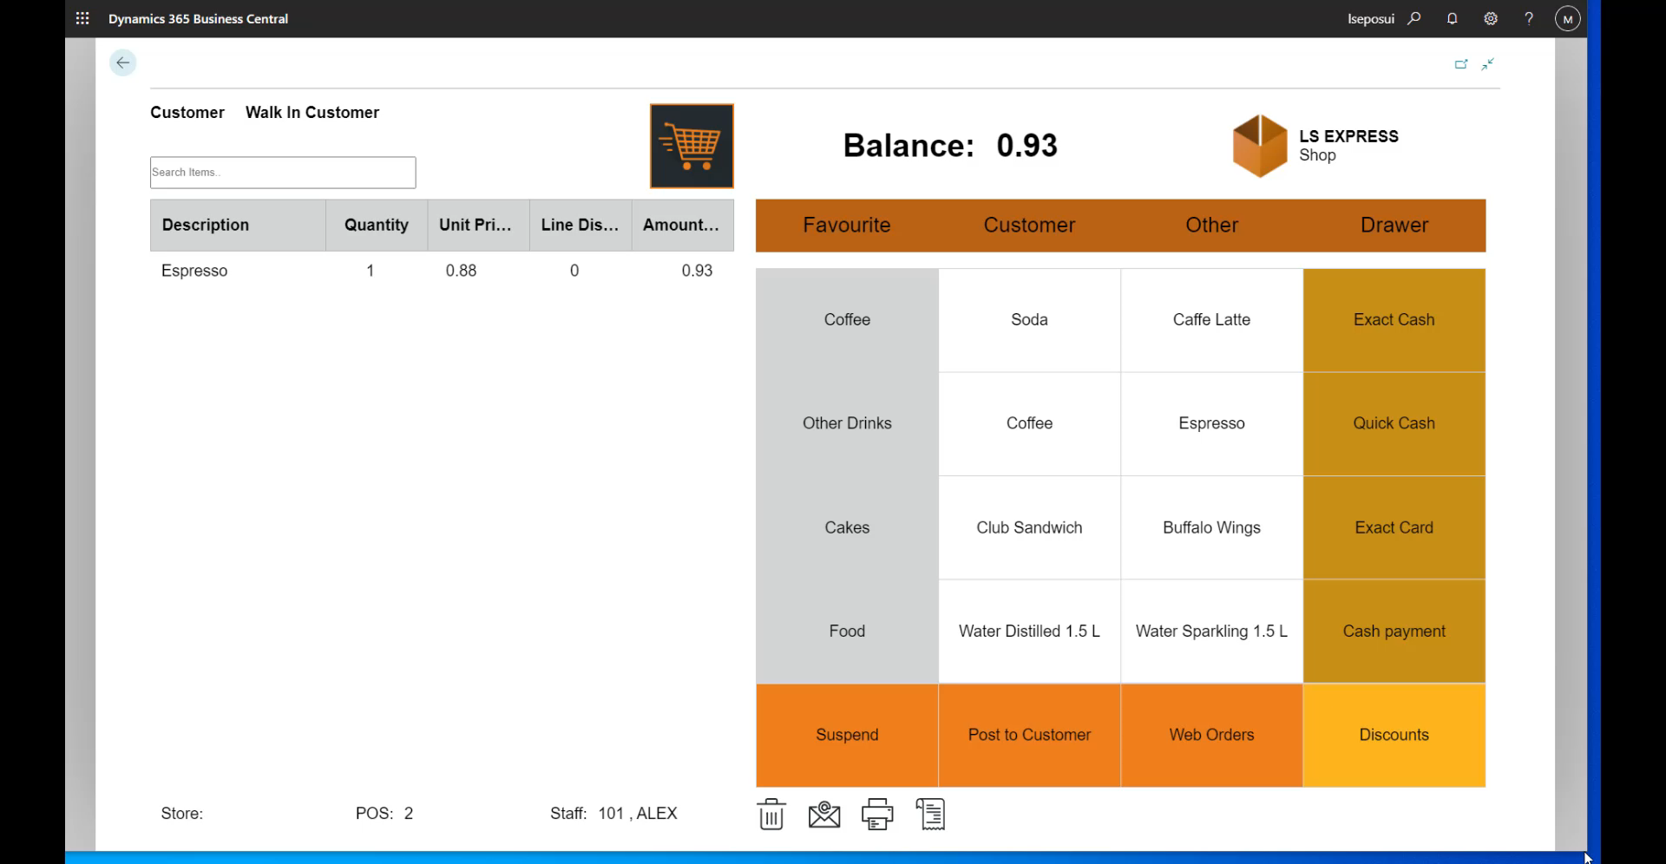

Slide 15


Slide 16
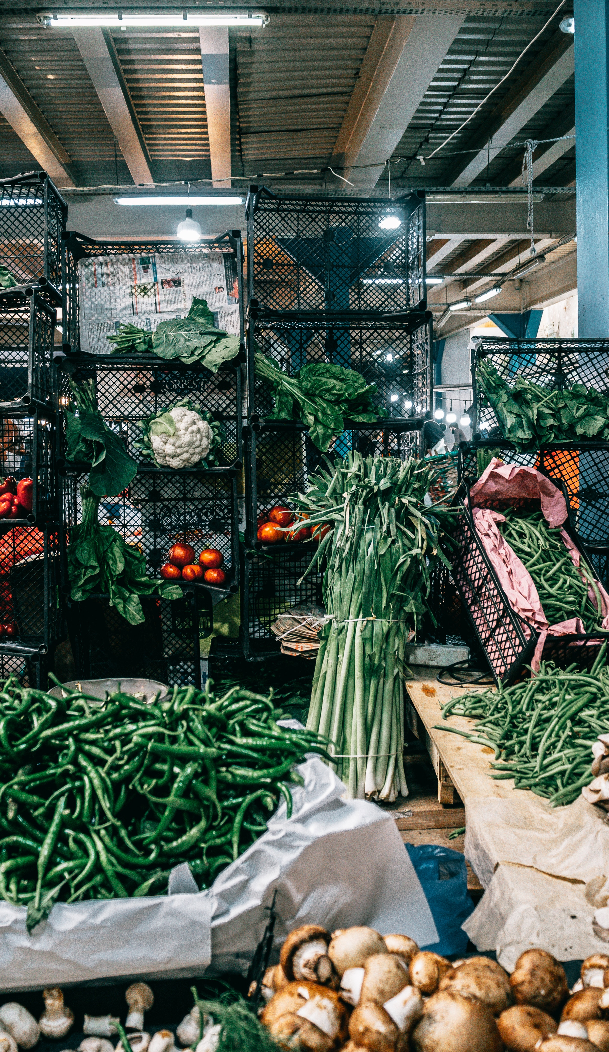
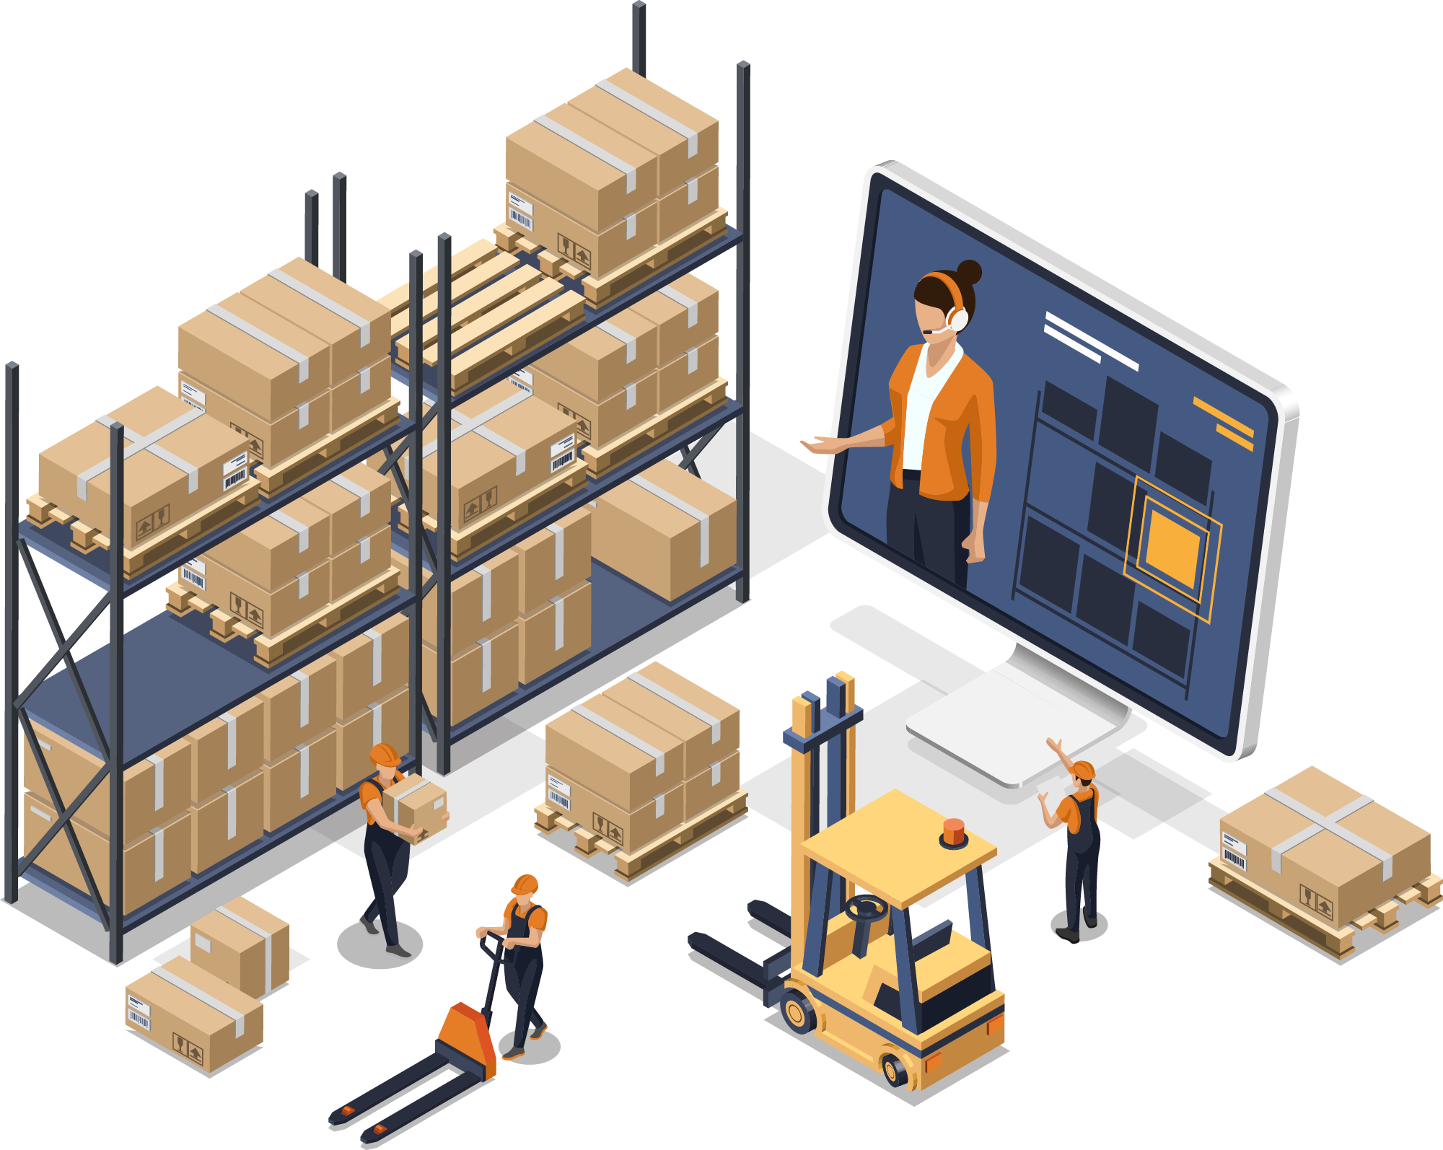
Wholesaler/warehouse/Cash & Carry
In the cloud with Business Central
Need a retail POS
  No store
  Occasional sales over the counter
  Credit cards

Slide 17
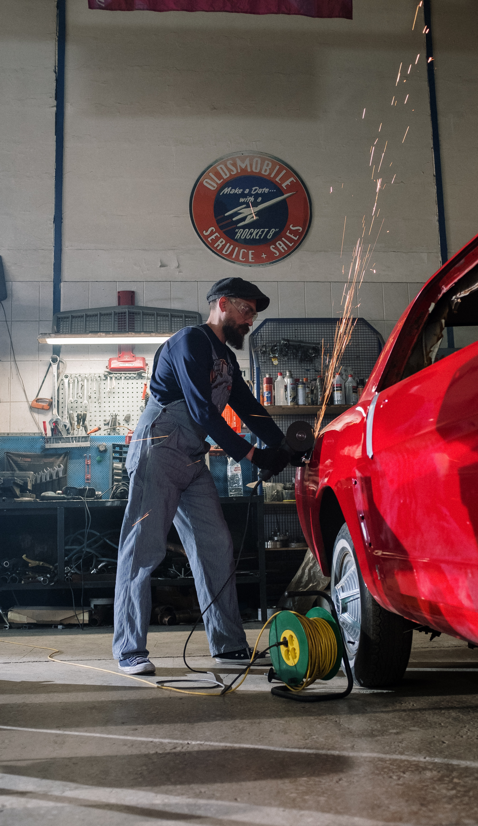
Car service
Selling:
  Services – online booking in Shopify
  Parts from stock
  Beverages, Air Fresheners etc.
Pay for Service Orders in POS
LS Pay for Credit Cards
Coming!

Slide 18

“This suite of software can satisfy an unlimited amount of business needs in the retail space with the powerful Business Central back-end and the personalization possible in LS Express”
*Dave Durrenberger, System Solutions LLC

Slide 19
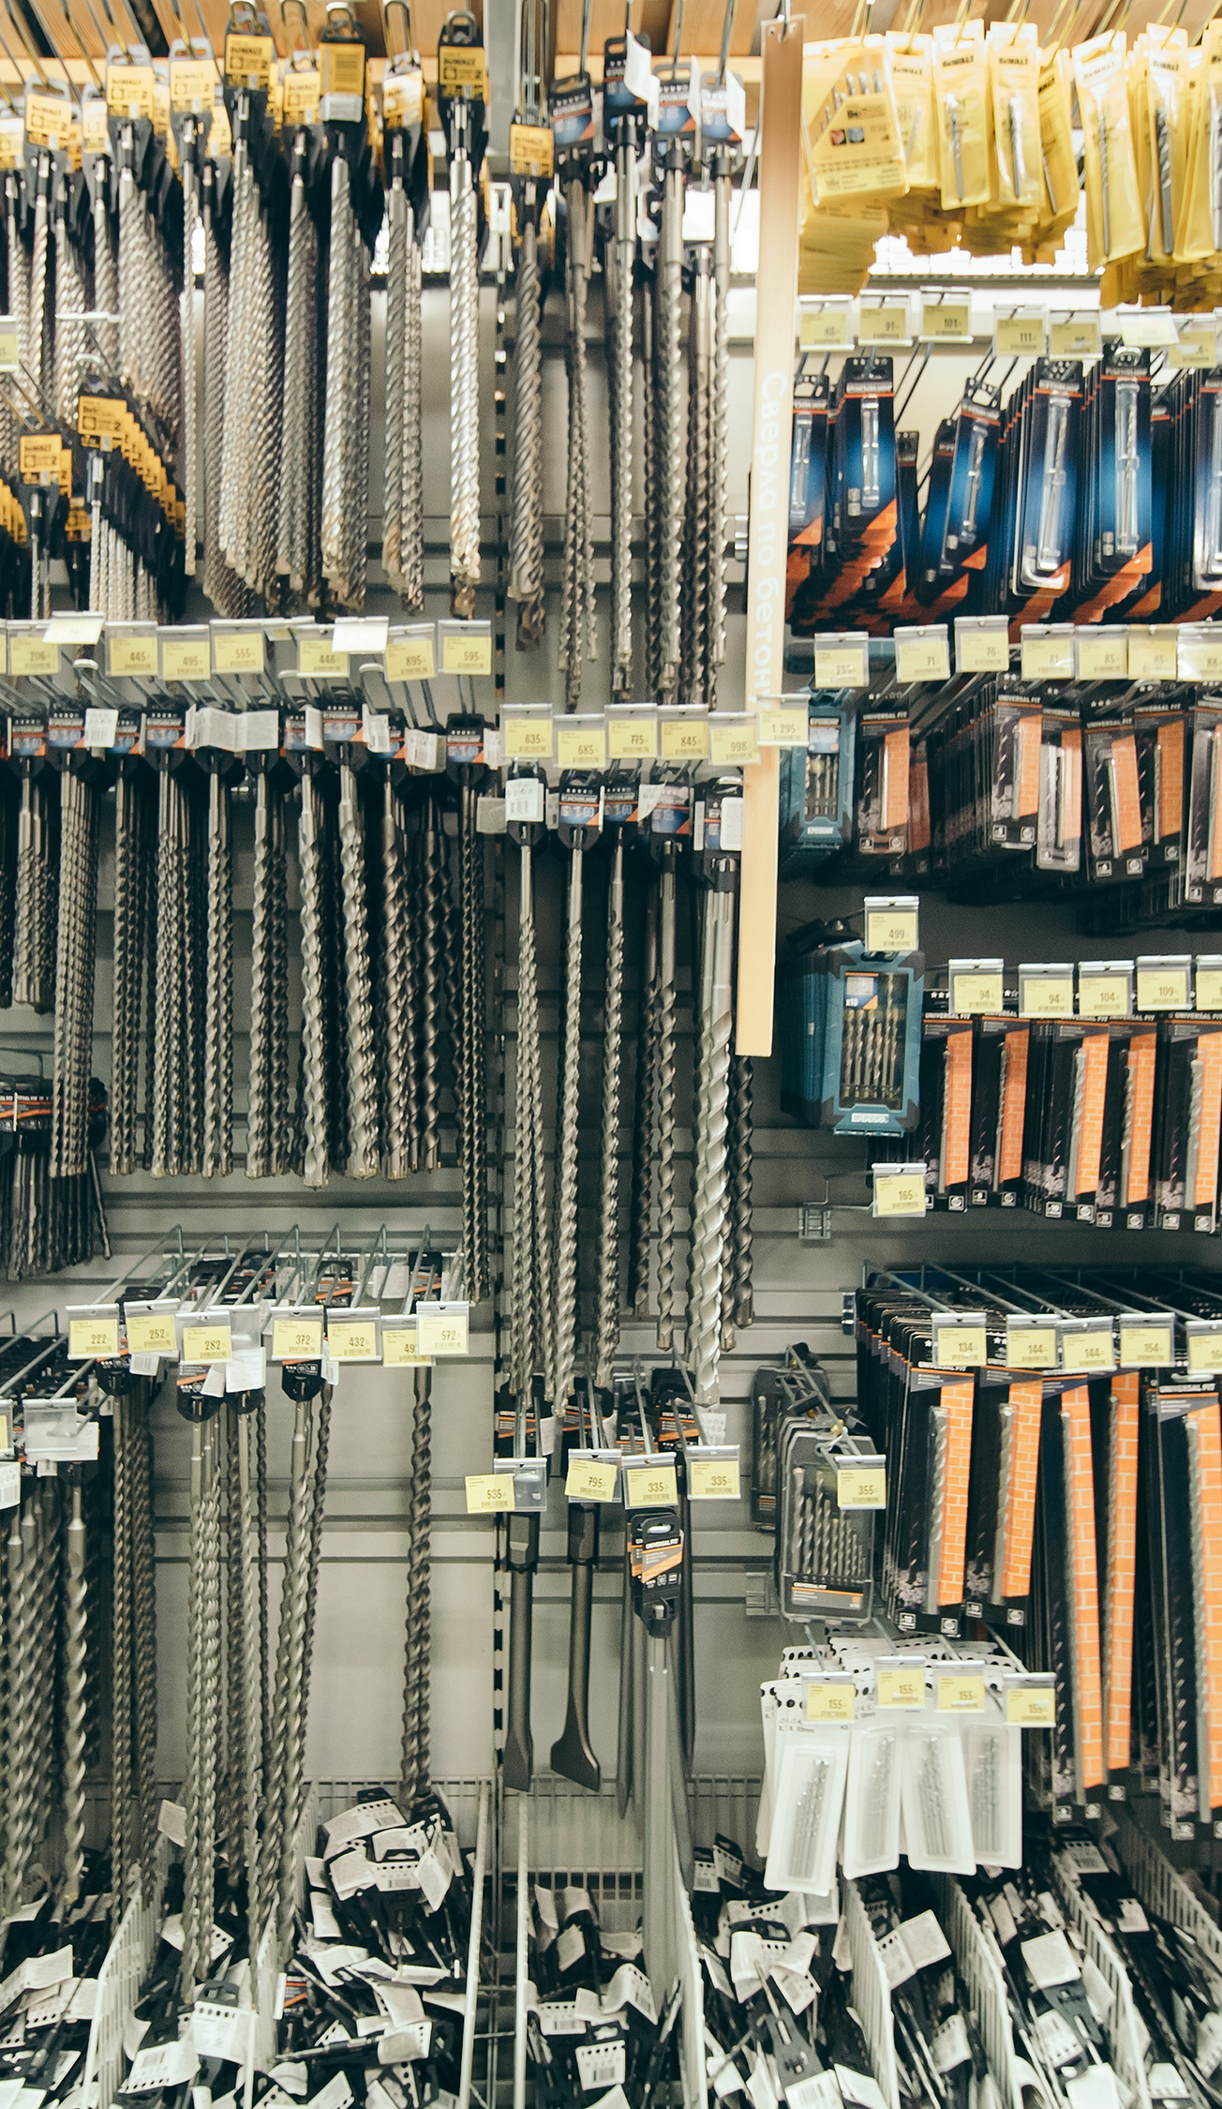
DIY and Hardware stores
Upgraded from Microsoft Dynamics RMS
to LS Express
Re-use existing hardware
B2B and B2C
Catalogue items, lot numbers etc.
E-commerce with built in Shopify connector

Slide 20

Coffee shop
Need a simple POS system
Kitchen printing functionality
Promotions
Takeaway orders online
Credit cards
  LS Pay Service
Coming!

Slide 21

Winery
Book tasting sessions online
Selling
  In-store
  Pop-up locations
  Fairs and Farmers Markets
LS Pay service on IOS / Android
Coming!

Slide 22
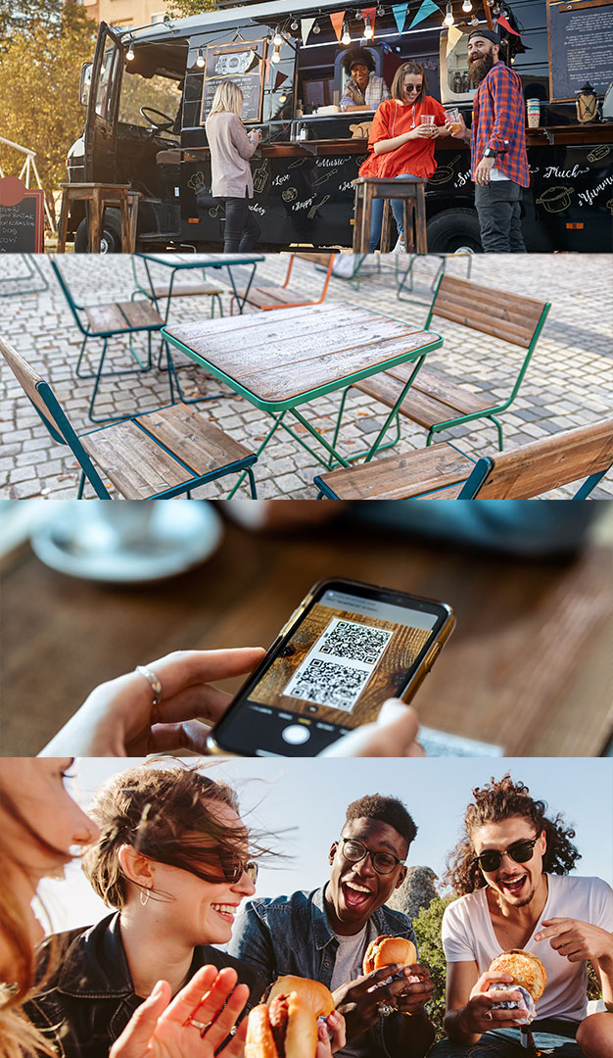
Contactless dining
No more standing in line
Customers scan QR Code:
  View the Menu
  Submit an order
  Pay online
  Get your food once it is ready

Slide 23


Slide 24
Questions?

Slide 25
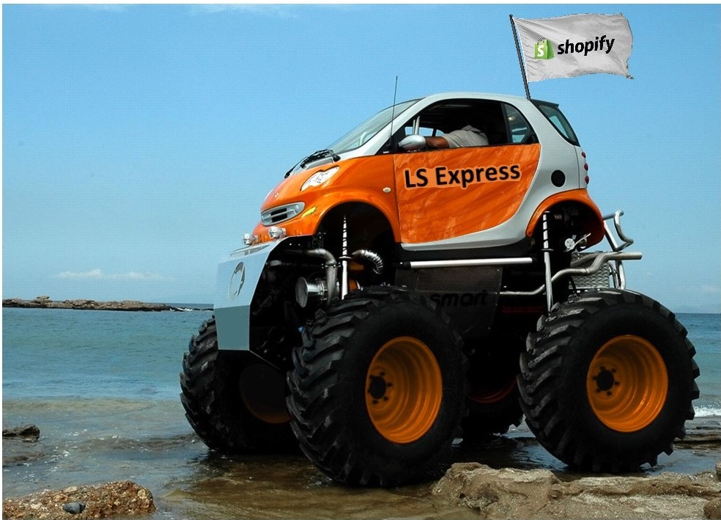
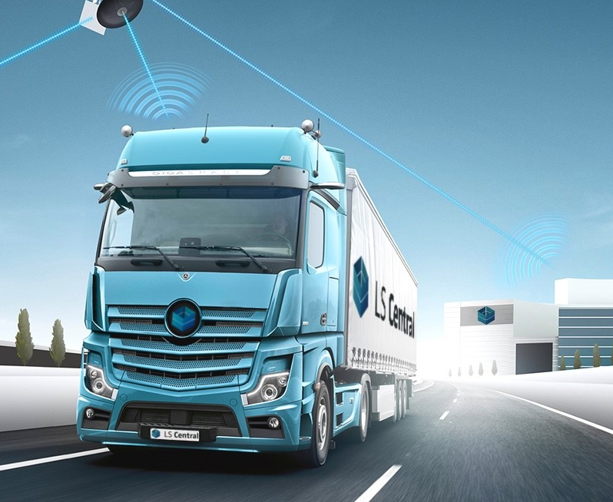
Simple but powerful

Slide 26
Thank you

