Slide 1
Getting savvy with LS Pay
Haukur Ingi Agustsson
Product owner

Slide 2
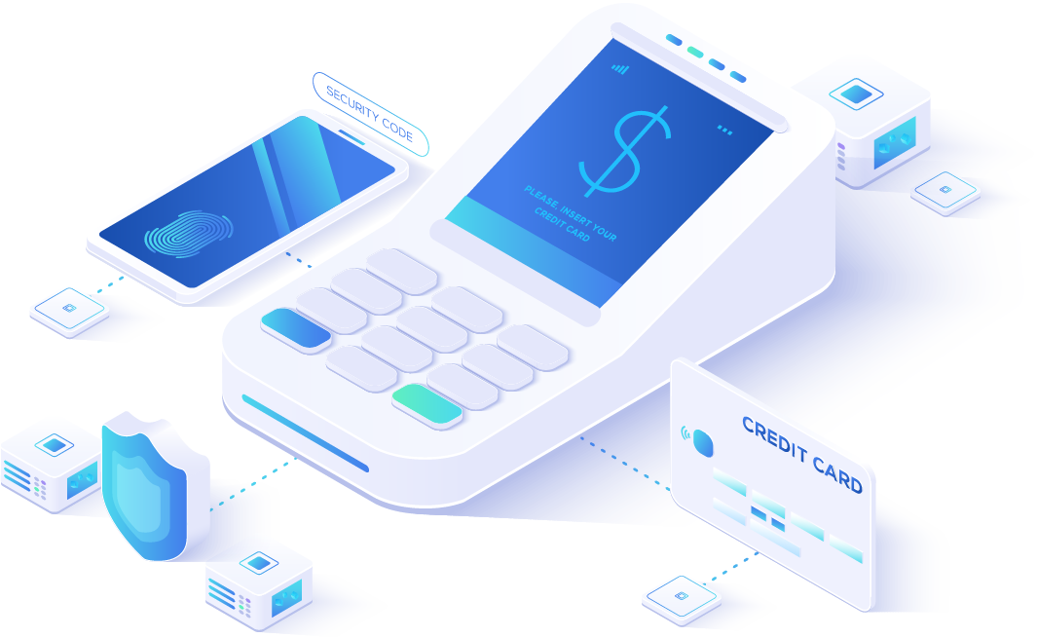
Agenda
LS Pay architecture
Install and configure LS Pay
Test LS Pay transactions
Troubleshooting
POS customizations for EFT functionality
LS Express
Q&A

Slide 3
LS Pay architecture

Slide 4
Architecture
HO/BO
Call center
Self check-out
Hardware
Station
LS Pay
Service
LS Pay
LS Pay

Slide 5
Functionality
35 plugins
Depends on Payment Service Provider
Standard POS functionality

Slide 6
Configure LS Pay

Slide 7
Configure LS Pay
Install LS Hardware Station
Start Virtual Station
Create and configure EFT
Configure settings
Load

Slide 8
Configure LS Central
Retail User
Store currency
Hardware profile
Try it out

Slide 9
Troubleshooting

Slide 10
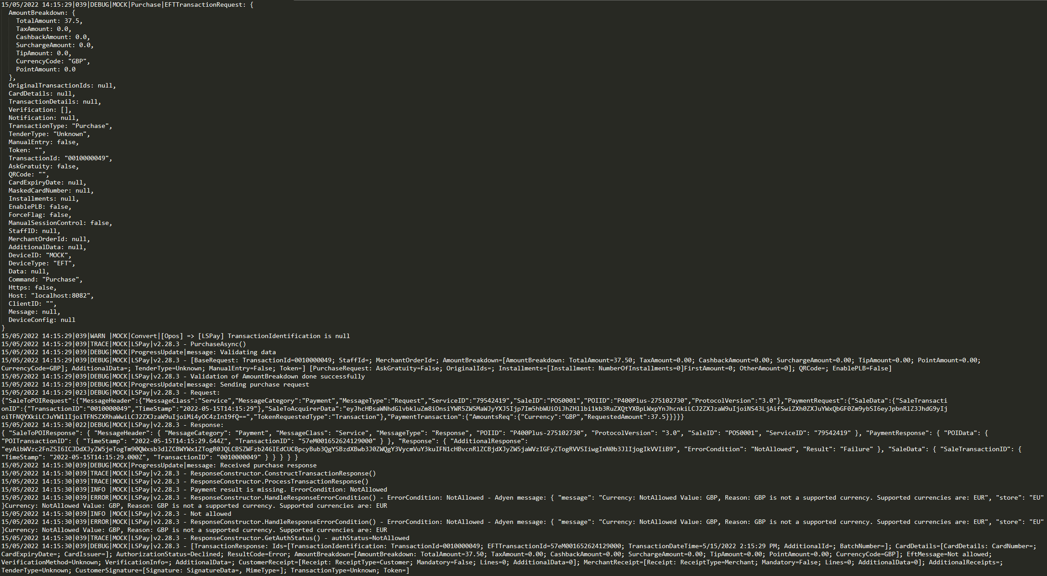

Slide 11
Customization

Slide 12
Customizations
Payment service provider specifics
Country regulations
Extensions

Slide 13
LS Express

Slide 14
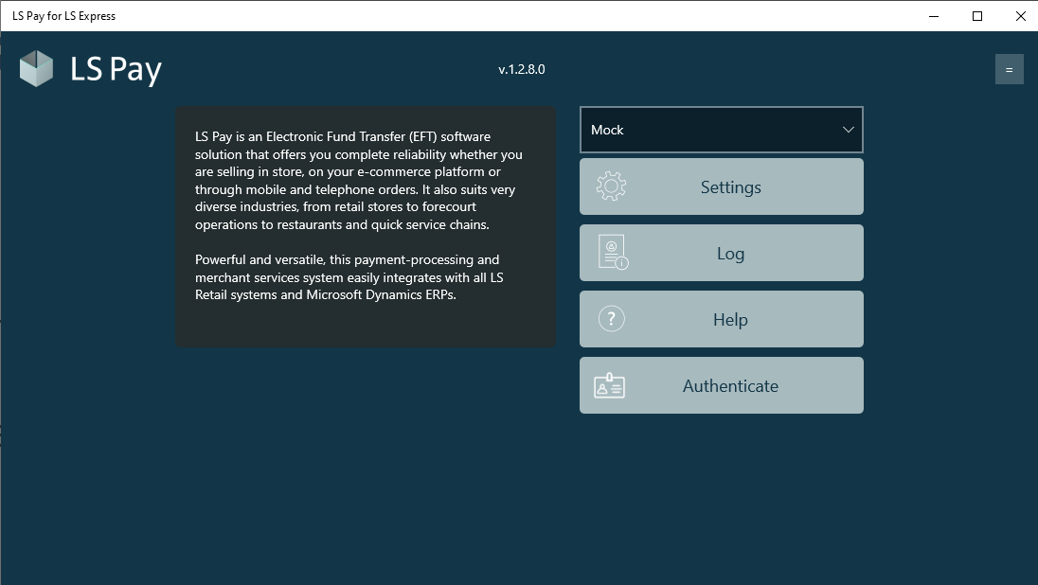
LS Express
App
Limitations
LS Pay Service

Slide 15
Q&A

