Slide 2

An autonomous store running only on ScanPayGo!
The Nær story
Sigurður Ari Sigurjónsson
Director of Business Development

Slide 3
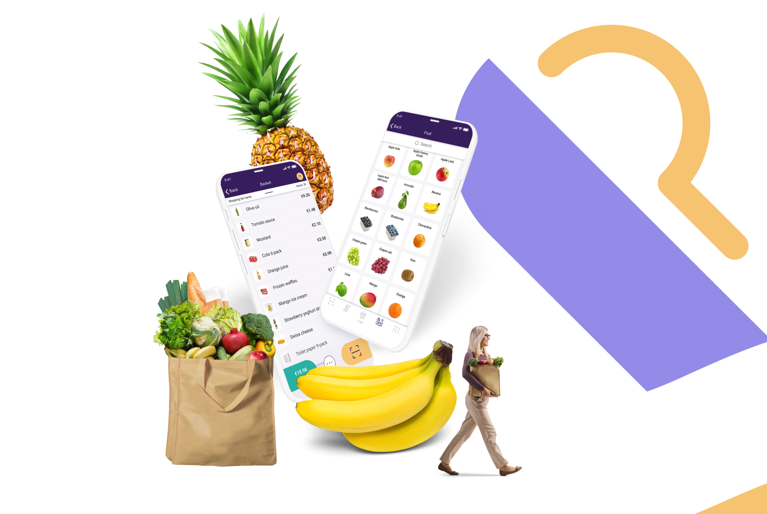
Where to start?

Slide 4
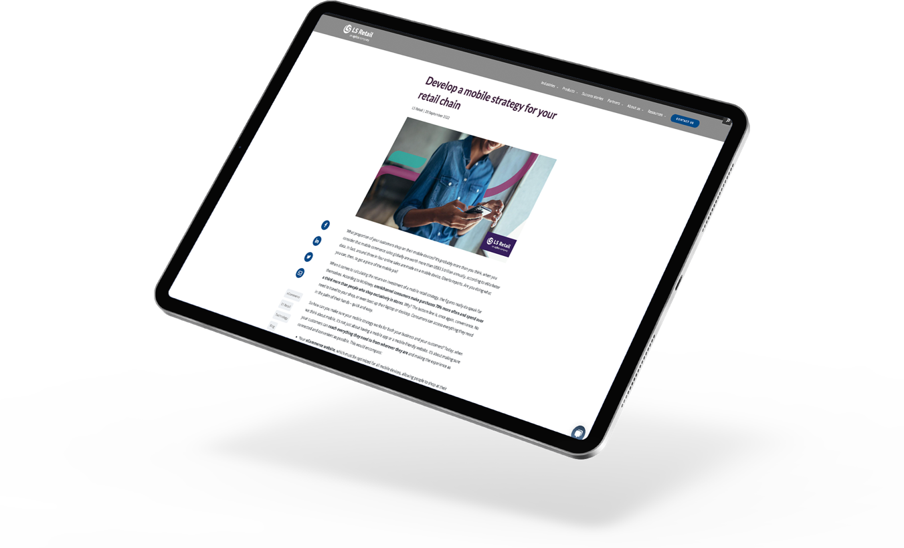
Develop a mobile strategy for your retail chain
Understand your customers
Focus on the customer experience
Carry out SWOT and competitor analysis
Look at the big picture
Get key stakeholders onboard
Read the blog!

Slide 5
The Nær concept – startup
Nær
a.
(í meiri nálægð) closer; nearer; closer in;

Slide 6
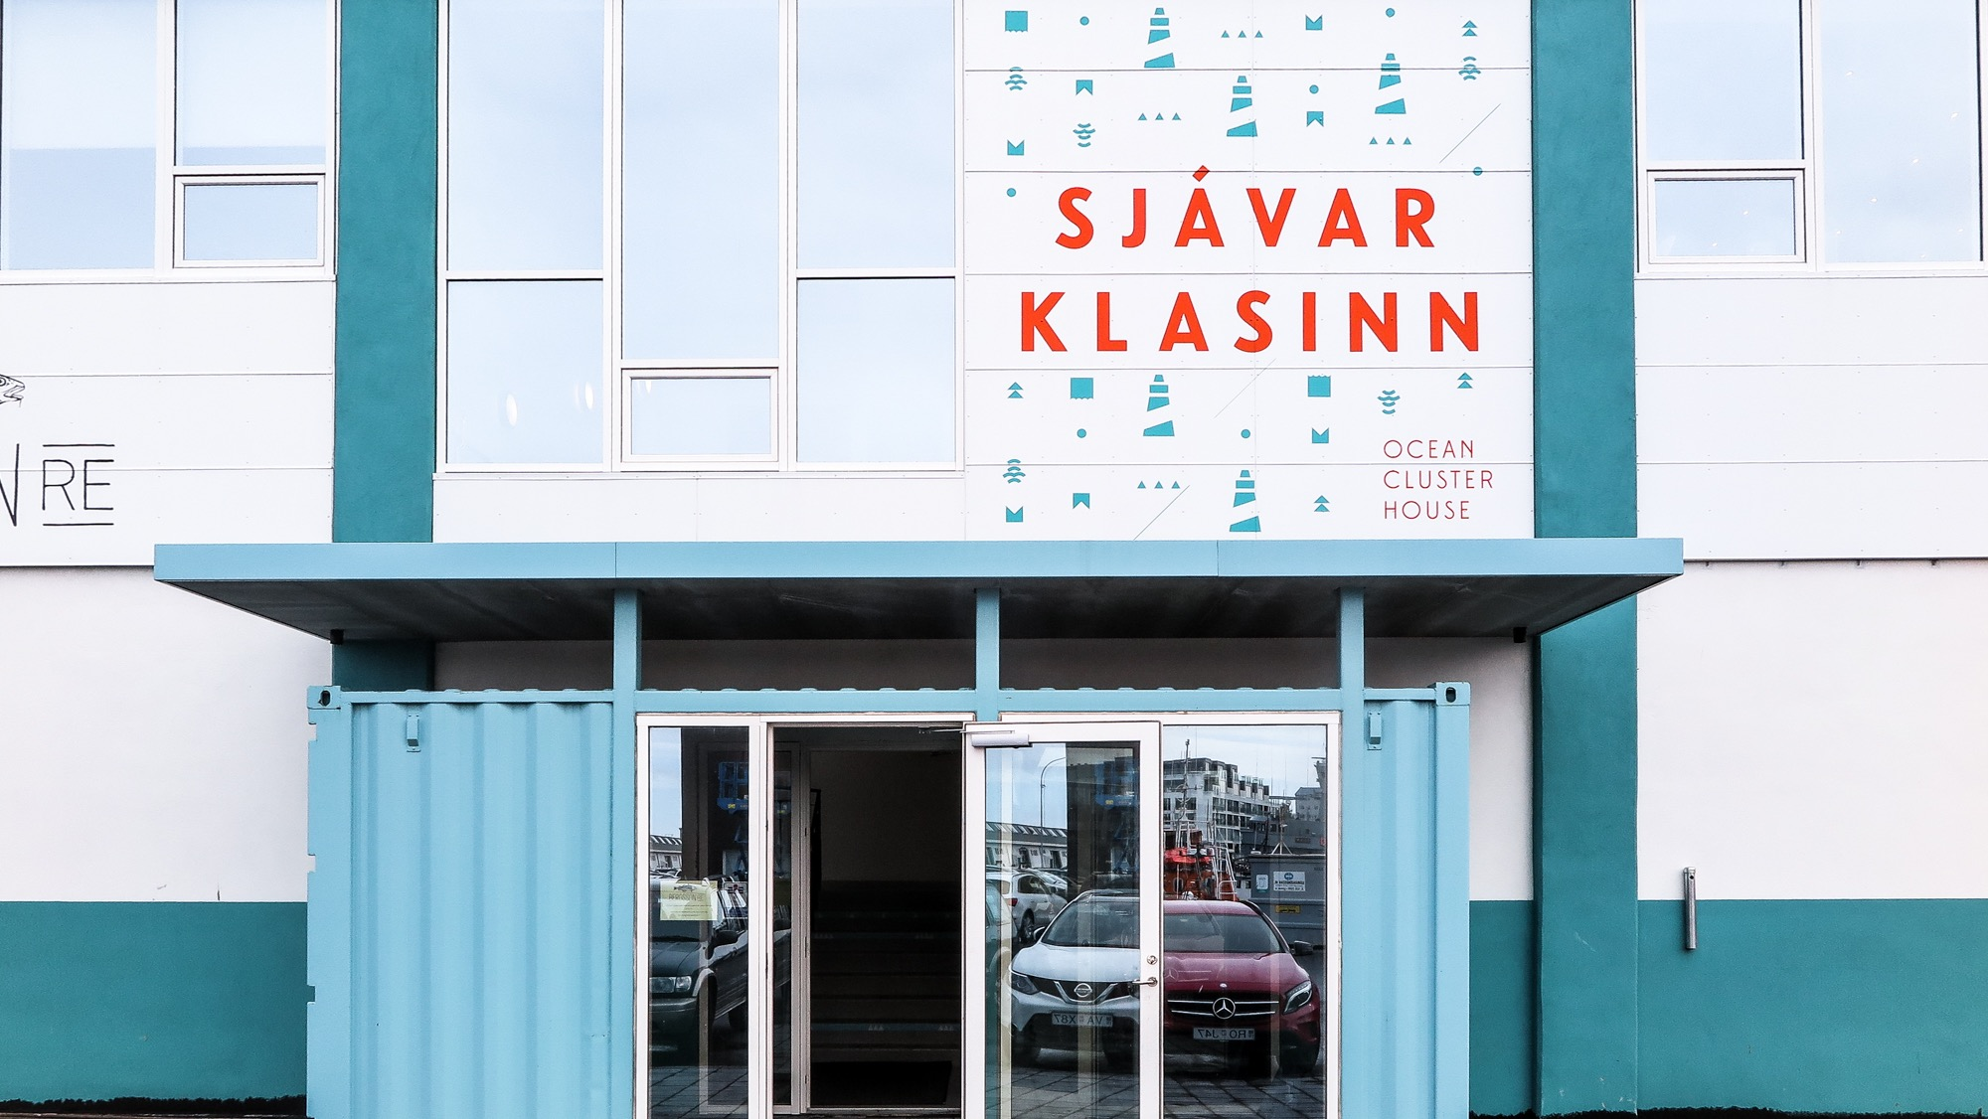


Slide 7
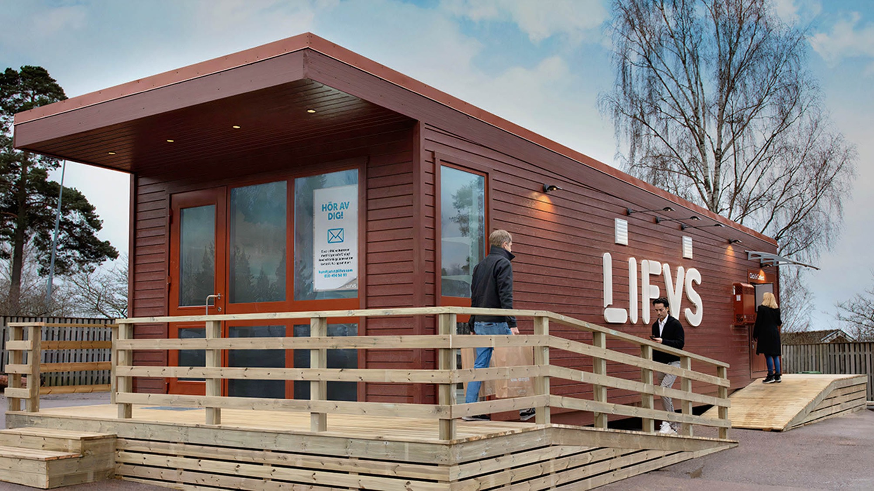


Slide 8


Slide 9
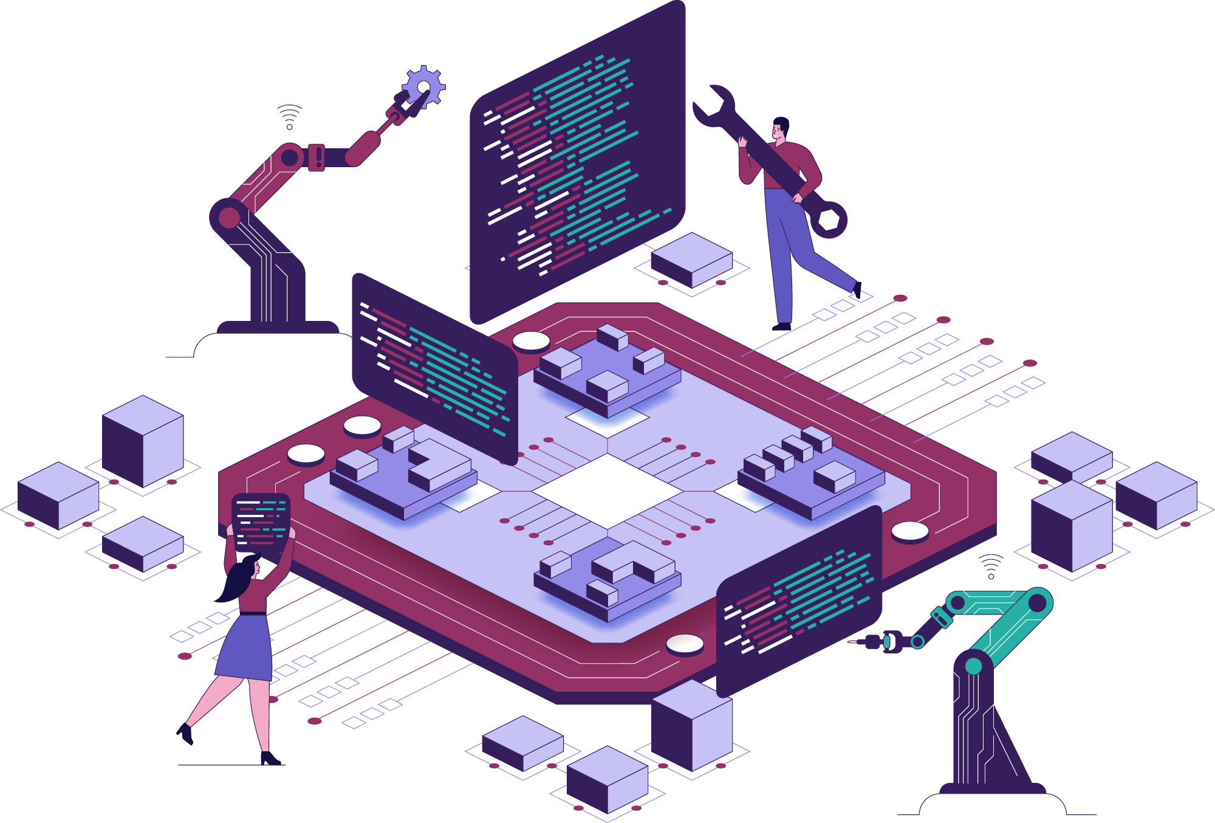
Next steps – would it work?
LS Retail would support their SPG app journey but…
…they needed an LS Retail partner to work with
NVL
recently became a partner, but with extensive experience. Especially in grocery

Slide 10


Slide 11
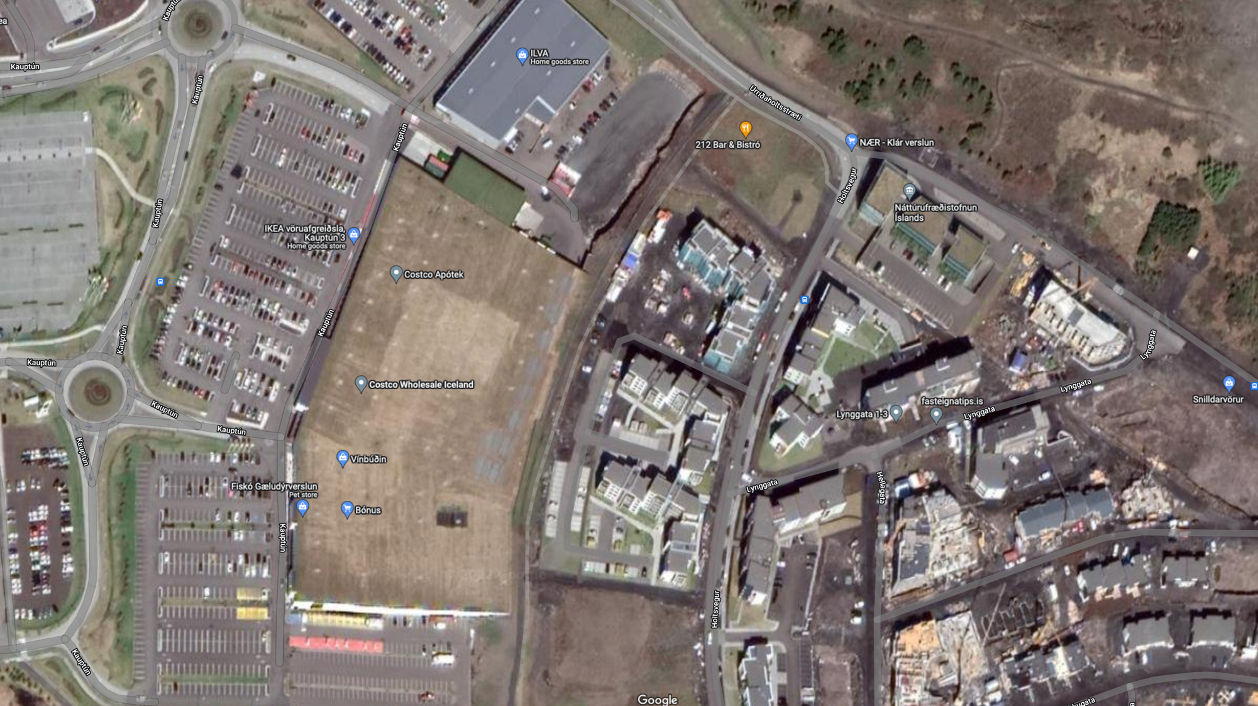




Slide 12


BC prod.
02.05
3rd Go live 19.06
3rd Go live 19.06
1st Go live Jan/Feb/Mar
1st Go live Jan/Feb/Mar
Finally!
Go live
20.07
2nd Go live 22.04
2nd Go live 22.04
1st UAT
30.05

Slide 13
Our Pilot process – weekly UAT
App had been released but…
…was not ready to go into production
The weekly UAT group
Payment integration
Numerous innocent/independent testers from within LS Retail + other
The first “in-production” version live
  You have only one opportunity to succeed with the customer
  if that fails you are less likely to get them back

Slide 14

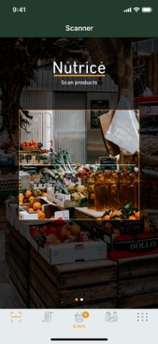
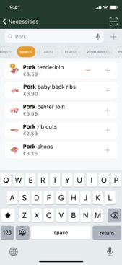
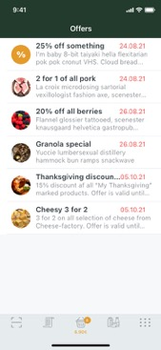
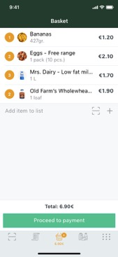
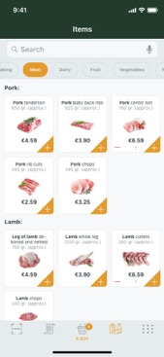
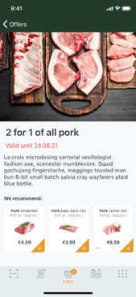
App was developed

Slide 15
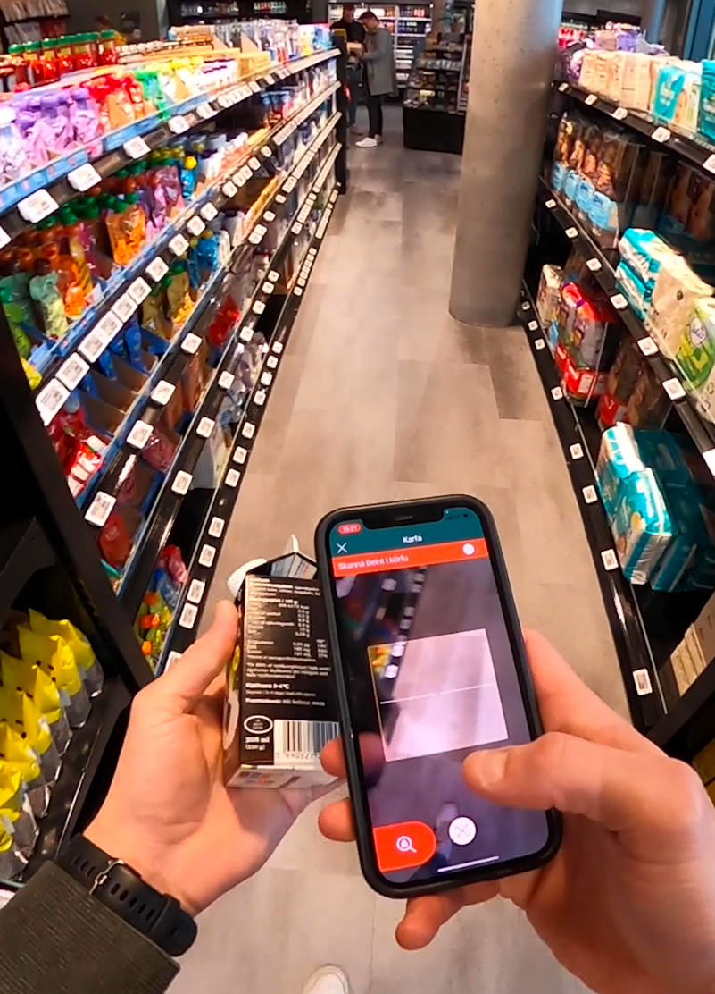


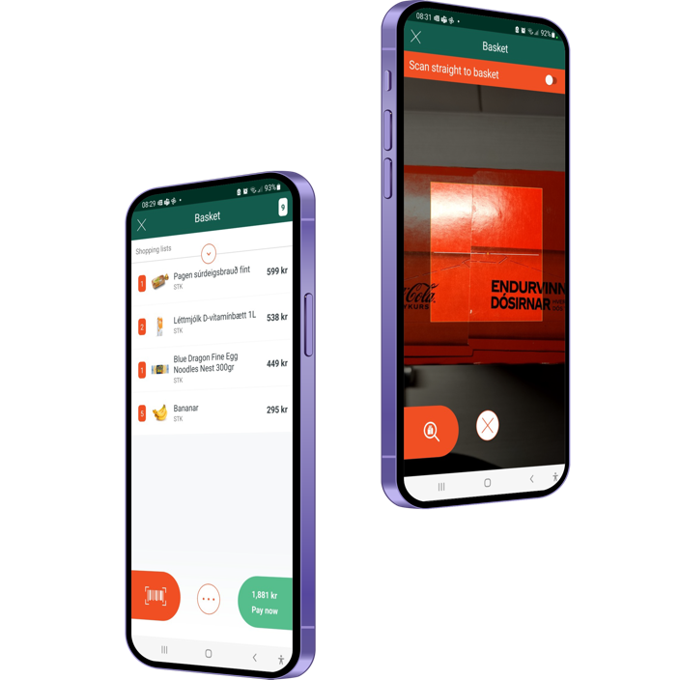



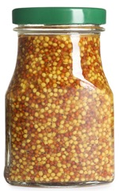
Into this live version

Slide 16
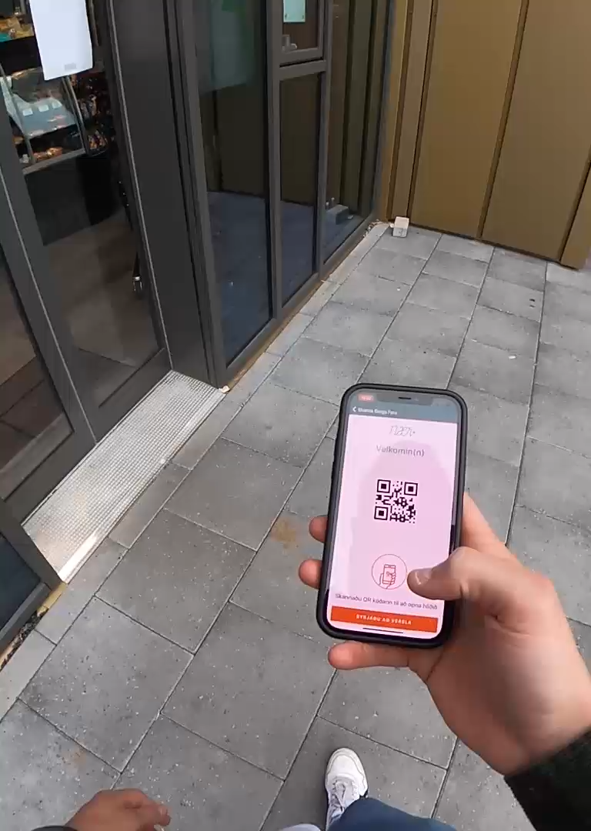
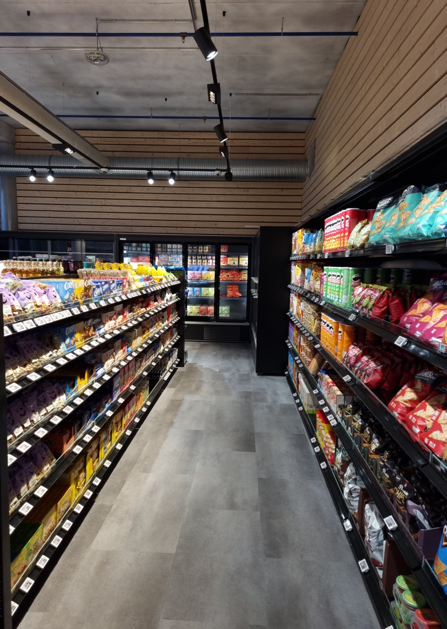
Technology used
You can only open the door with a timed QR code from the app
HD Security cameras with sensor technology
Connected to the Icelandic social security number registry – every individual with the app is recognized
No LS Central POS device in store
All scanning, opening, checkout and payment process in the SPG app
Further additions planned

Slide 17
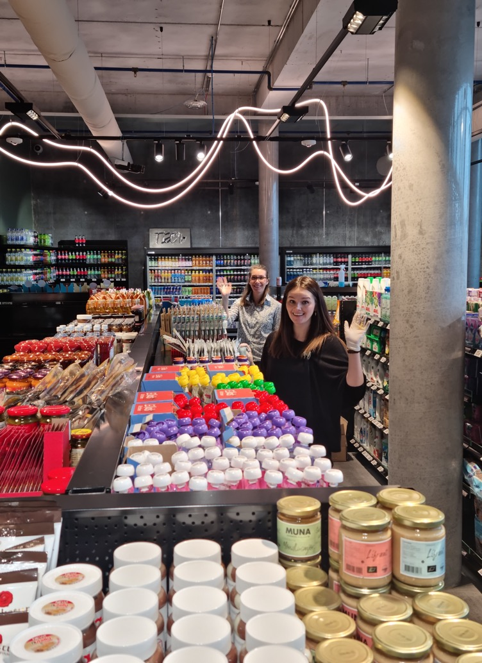
What are the daily operations?
A person present for at least 2-3 hours per day – their role is to:
  Receive goods
  Replenish stock
  Make sure that the store looks good
  Review the fresh goods
Vendors replenish stock themselves in some cases

Slide 18
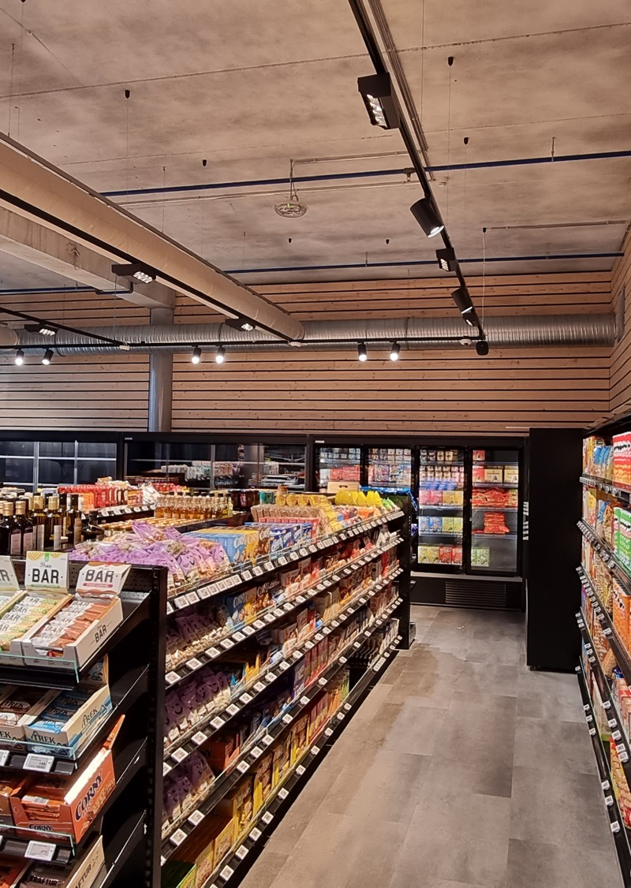
Learnings
What are the take aways for LS Retail
UAT is key
Close relationship with retailer
UI has been very well accepted

Slide 19

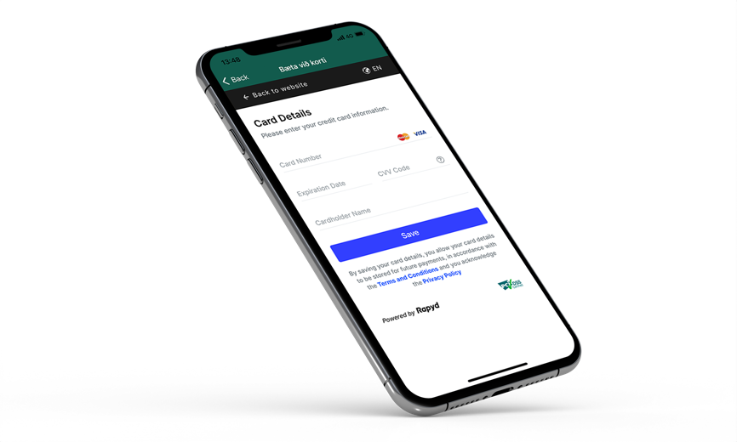
Payment process is pain

Slide 20

Young people really embrace the concept

Slide 21
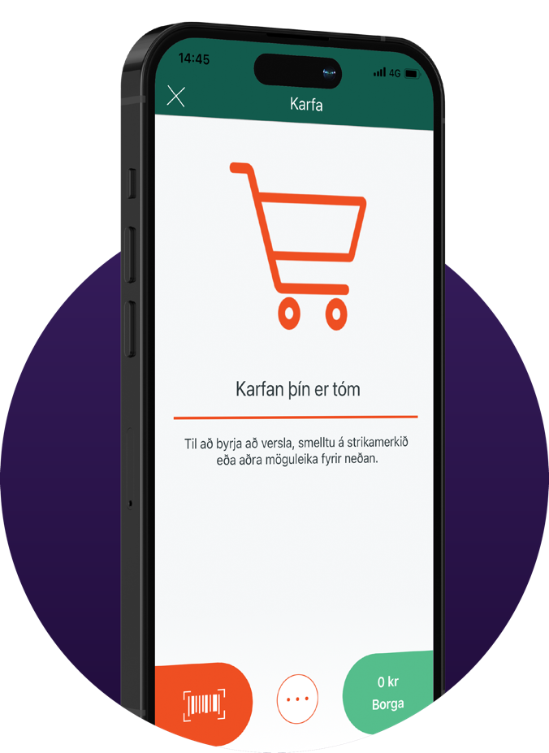

90% are iPhone users!

Slide 22

Shop at all hours
24/7 standby phone

Slide 23

Modern marketing approach low cost

Slide 24



No TV campaign
No printed ads
No radio ads

Slide 25

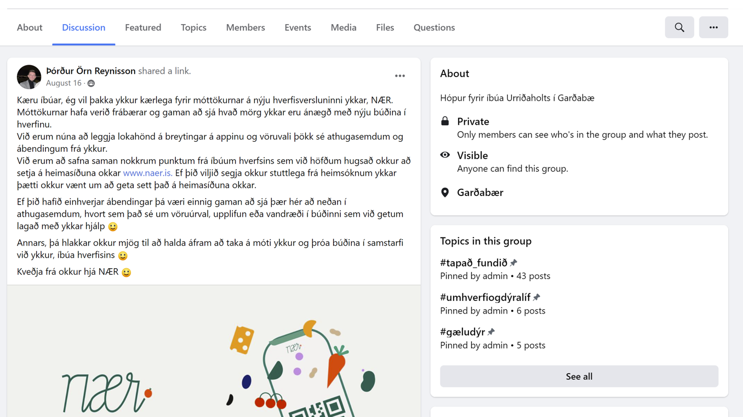

Slide 26
Interesting takeaways from their experience

Slide 27

90%
of sales
7:00-24:00
Most sales
16:00-18:00 and 21:00-23:00
Morning shopping
super fast and small
Mostly energy drinks

Slide 28


High
retention
rate
+70% of their shoppers have done more than 3 purchases

Slide 29
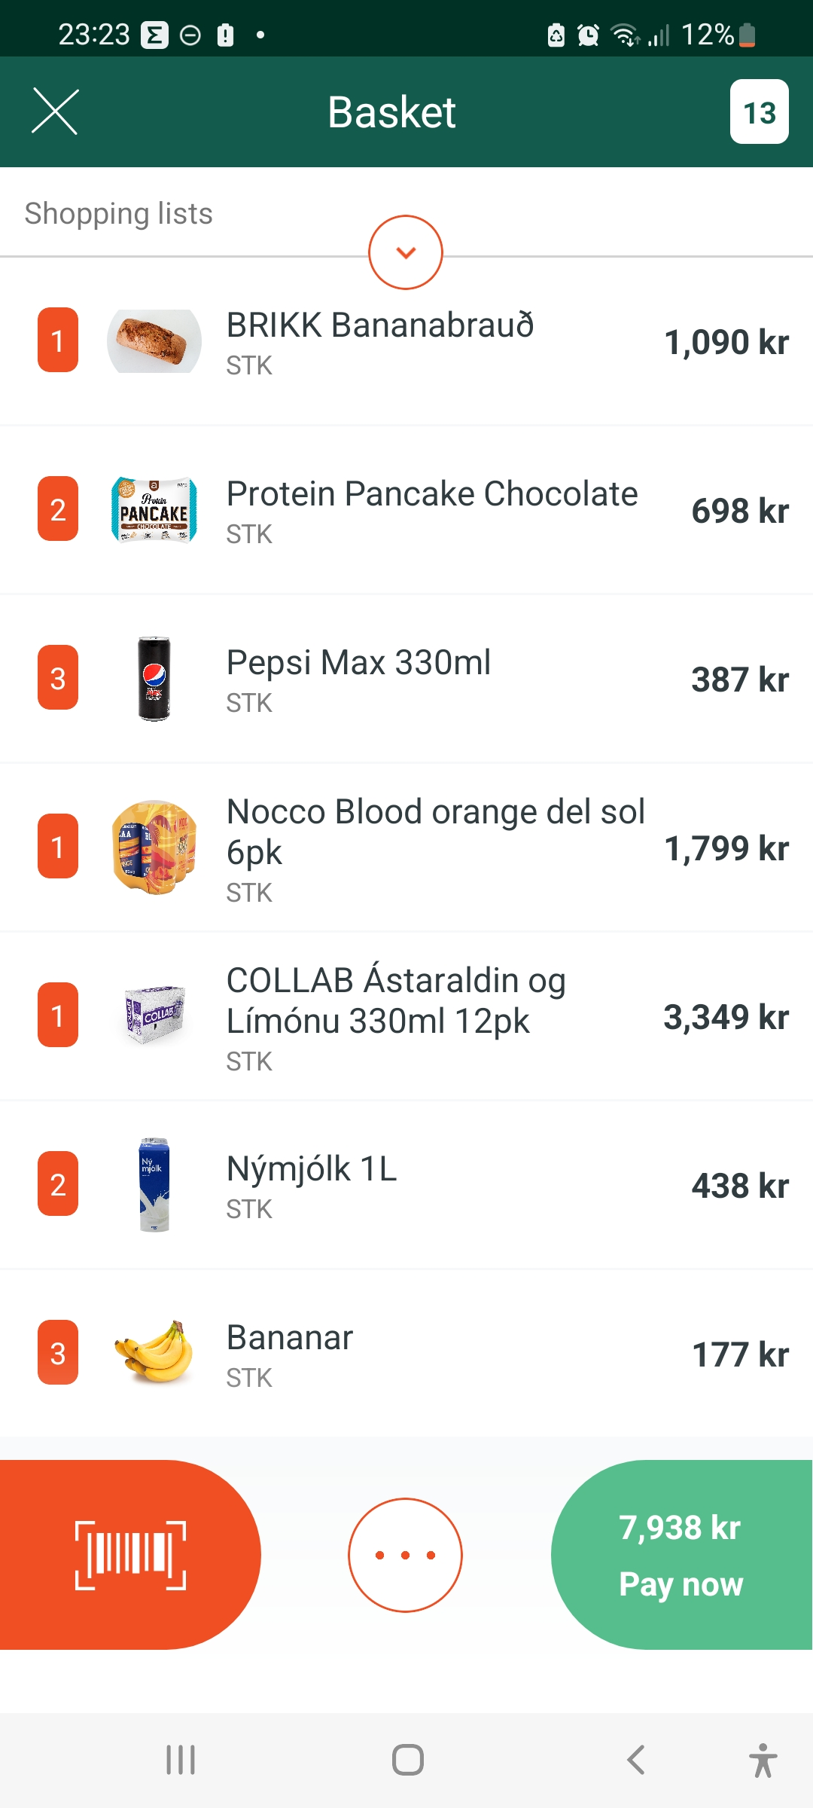

Slide 31

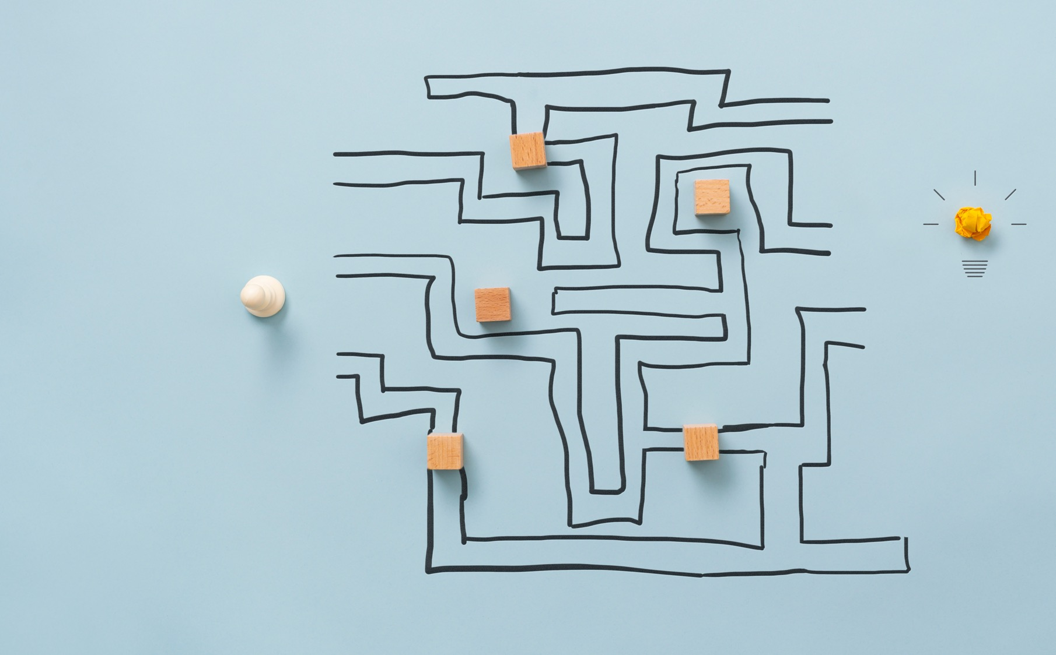
Current
obstacles
Logistics
Adaption of app
Survey feature not implemented

Slide 32
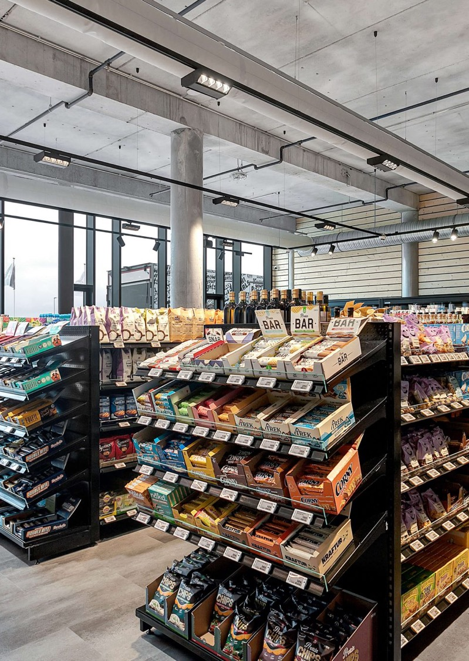

What is next
Where to open the next store?
Fully utilize Member management
Take in Mobile Inventory for counting
LS Insight for reporting
SaaS

Slide 33
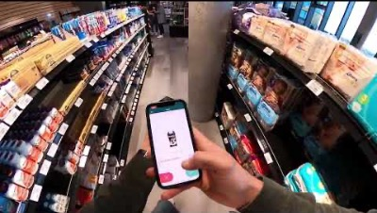

Slide 34
Thank you

