Slide 2


Go beyond your retail limits with LS Central Add Ons
Alejandro Vázquez
Principal Consultant
Urdur Anna Bjornsdottir
Consulting Director

Slide 3


Slide 4

Agenda
Why LS Central add-ons?
Beyond LS Central Verticals
Duty Free Add-On
Loyalty Integration Solution
Professional Services
Q&A

Slide 5
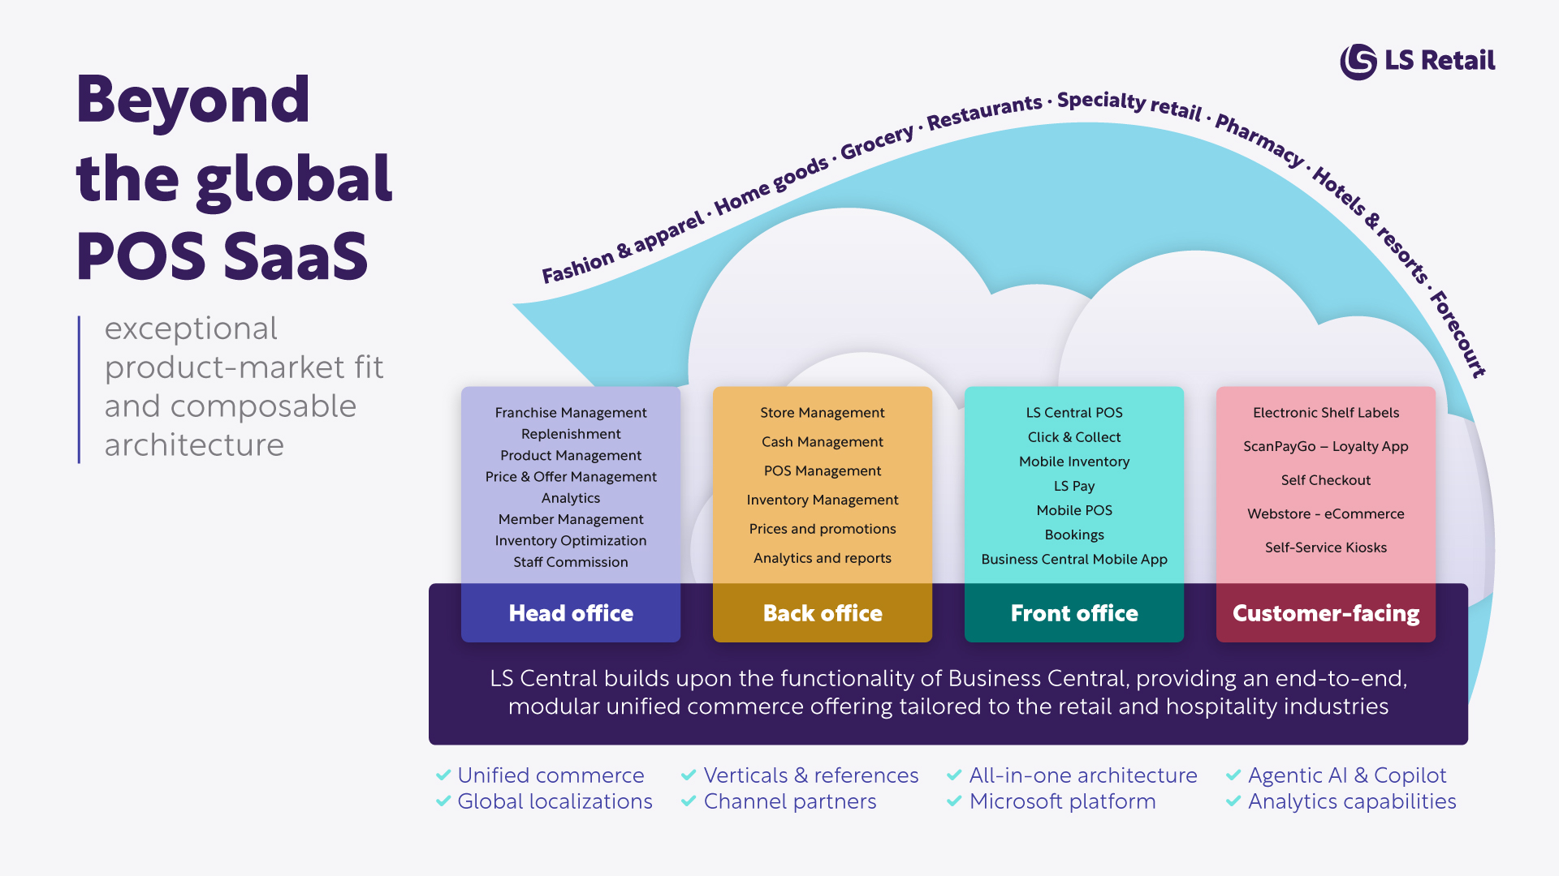

Slide 6
Extend LS Central with
LS Central add-ons

Slide 7


LS Central add-ons
Duty Free for LS Central
Flexible handling of tax, pricing, and custom rules based on the traveling route and/or nationality of the customer.
Tax free, tax refunds, final prices, and discounts
Product allowances and limitations, by quantity or amount
Security tamper-evident bag
Multi-leg boarding cards for in-transit passengers

Slide 8

LS Central add-ons
Ferry for LS Central
Features smooth and easy process to book and redeem reservations, with or without prepayments on the POS for the benefit of both customers and staff members.
Reservations linked to passenger identification/boarding cards
Table reservations with specific items reserved from an online platform
Table reservation seated and redeemed by passenger identification
Allowing payment for a reservation to be used for other services
Value coupons for specific items or item groups at specific outlets or outlet groups
Fast-Track POS for staffed or customer self-serviced reservation redemption

Slide 9

LS Central add-ons
RMS for LS Central
Helps companies, with the management of the routes and vessels, with gaining route-specific sales information and with automation of route-specific processes.
Support route specific sales information for data insights
Use entry or GPS location to identify revenues trends
Simple leg change – commonly to change VAT and dimensions
Full leg change – like simple leg change plus additional statement management

Slide 10

LS Central add-ons
Loyalty integration for LS Central
Integration to connect with your desire multichannel marketing and customer loyalty platform. Supporting retailers looking to unify their customer engagement and loyalty efforts across all channels.
Customer lookup at POS using email or phone number, retrieving real-time profile data from Loyalty
Instant display of loyalty points and applicable rewards.
Personalized promotions based on personalized campaigns
Rewards Vouchers based on monetary value
Real-time transaction updates send to Loyalty
Voyado/Diller support

Slide 11

LS Central add-ons
Central Connect
An LS Central integration to head-office platforms. Ideal for enterprises that need the powerful retail functionality that LS Central offers, but want to maintain their current ERP
Middleware build by LS Retail in the Microsoft environment
Standardized integration framework using the Microsoft Azure environment
Master data synchronization
Sales export
Transaction export
Configurable mappings, without custom coding

Slide 12

LS Central add-ons
ROWA
Automated Storage and Retrieval System for Medication. Robot integration that streamlines the service in pharmacies and offer pharmacists to be closer to the customers.
Build on the WWKS 2 standard
Works with ROWA and all major pharmacy robots
LS Central for pharmacies keeps track of what items are allowed in the robot.
Stock query, LS Central for pharmacies can request a stock update from the robot to update inventory

Slide 13

Extend LS Central with
Duty Free add-on

Slide 14




Unified customer experience
Hospitality
Restaurants – Bars - Lounges
Travel retail
Before security – Post security – Duty free/Duty paid
Services
Sleeping cabins – Wellness services – Travel information

Slide 15

Travel retail
Tax calculation based on the travelling route
Prices, discounts and posting based on the route
Tax refund / Reverse tax discount
Quantity or amount limitation
STEB handling
Currency utility
Capture of boarding card information
Capture of passport information
Flight information and timetables

Slide 16

Profiles and Posting
Posting setup based on route
From site to site
From site to country
From country to country
From country to country using Groups from duty
Groups from Duty Free posting setup for arrival and departure
Posting group
Limitation group
STEB group
Tax discount group

Slide 17

Country groups and flights
Country groups
Grouping countries together or excluding countries
This can be used under Duty Free posting setup Destination type
Flights
Set up timetable for each flight
Departure and arrival traveler
  Posting group
  Custom limit group
  Gate bag group
  Reverse tax discount group
  Can be setup for each flight

Slide 18
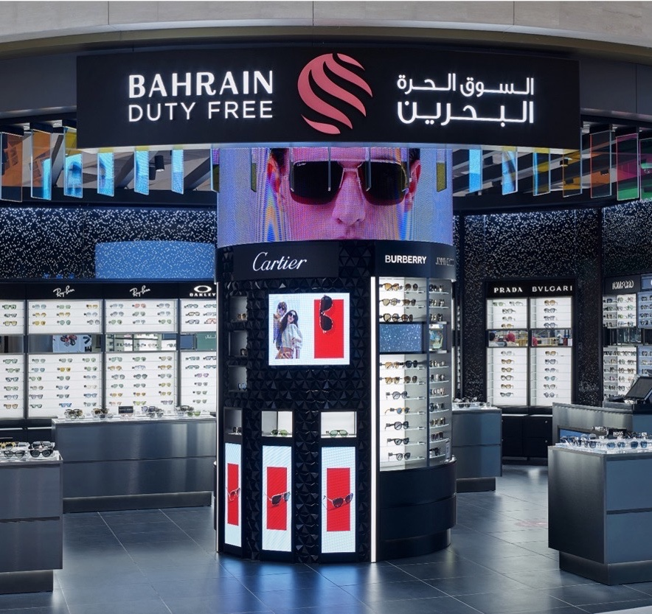

Bahrain Duty Free
Bahrain Duty Free was established in 1991. Today the company operates several duty free outlets within Bahrain International airport, including a Departures and Arrivals shop and a landside outlet called “A to Z” located in the arrivals hall. Bahrain Duty Free also operates the Khalifa Bin Salman Port Shop.
“With LS Retail software we can now track individual transactions from the POS to the General Ledger, which has maximized our control over our business.”
Shibu Abraham
Head of IT & Logistics
Read the full success story
https://www.lsretail.com/customers/bahrain-duty-free

Slide 19




Extend LS Central with
Loyalty integration add-on
%
%

Slide 20



Loyalty Integration System for LS Central
Voyado
Loyalty Integration
System
Diller
Your loyalty

Slide 21












Loyalty Integration: a single modular system
Run all your business with an end-to-end loyalty solution
Centralize management
& visibility
Get consistent and reliable member data from your Loyalty Provider
Add functionality as you need it
Decrease cost of ownership

Slide 22

Available as SaaS in the secure and scalable Microsoft cloud
Anywhere, anytime access to business data
Lower capital expenditure
Data security and compliancy
Automatic updates
Scale up and down as needed

Slide 23


Specialized functionality
for Loyalty
Standard Methods
Create members
Update members
Customer
Processes
Identify members
Send transactions
Customizations
Promotions & Rewards
CO Job Queue Tasks
and many more...

Slide 24

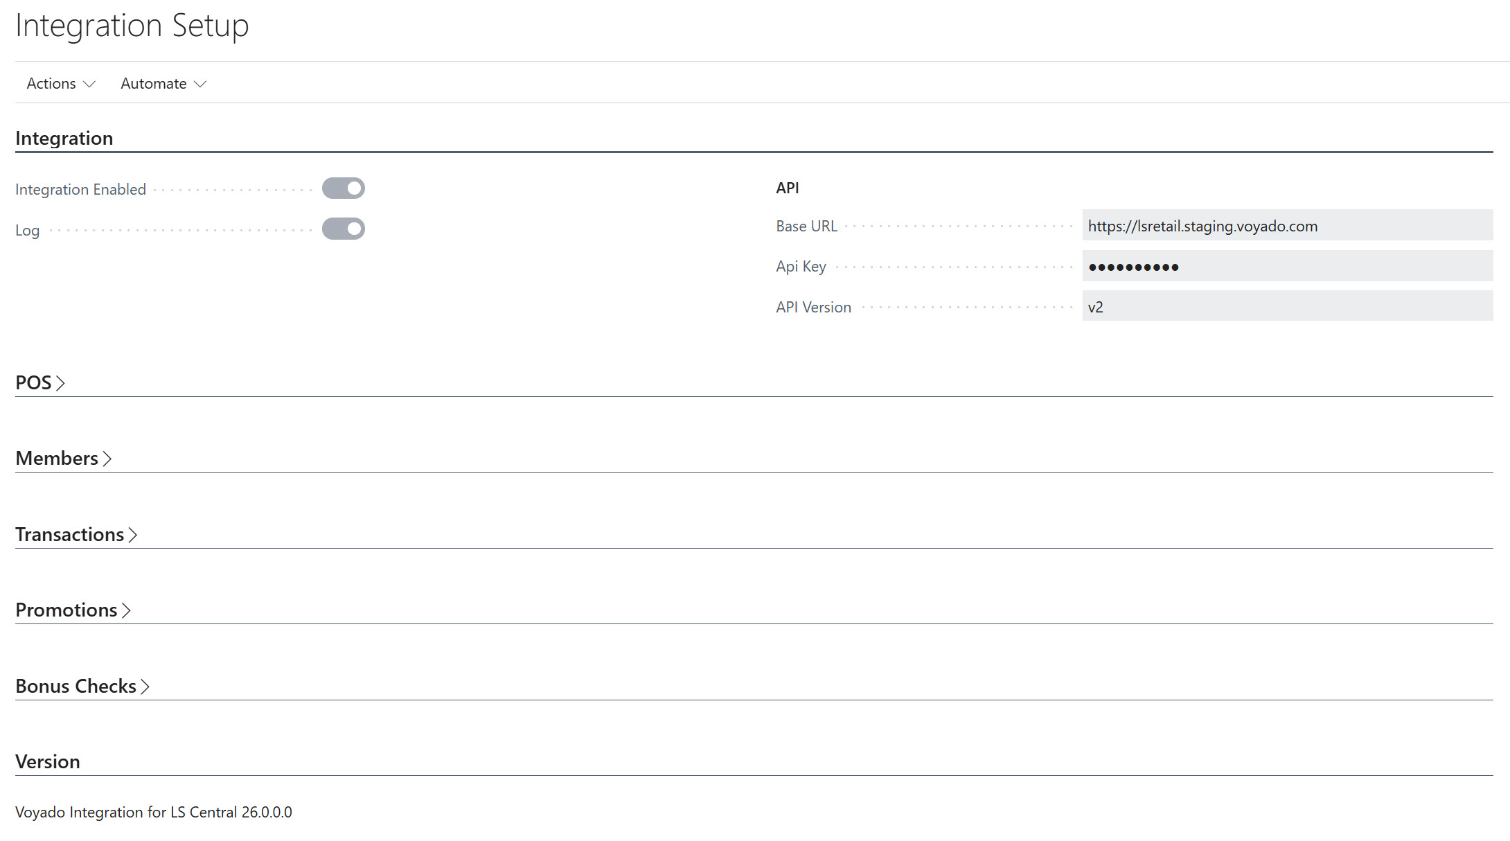
Easy Setup
Integration Setup:
  Page has been updated for readability
  Sections has been adjusted, and unnecessary options have been removed.
New interfaces:
Enums to support different interfaces i.e. API version
Enums to support multiple search methods i.e. Mobile phone no, Email, SSN.
Update Log:
Our new log permits to check every call to the API and check the Json payload for troubleshooting.

Slide 25
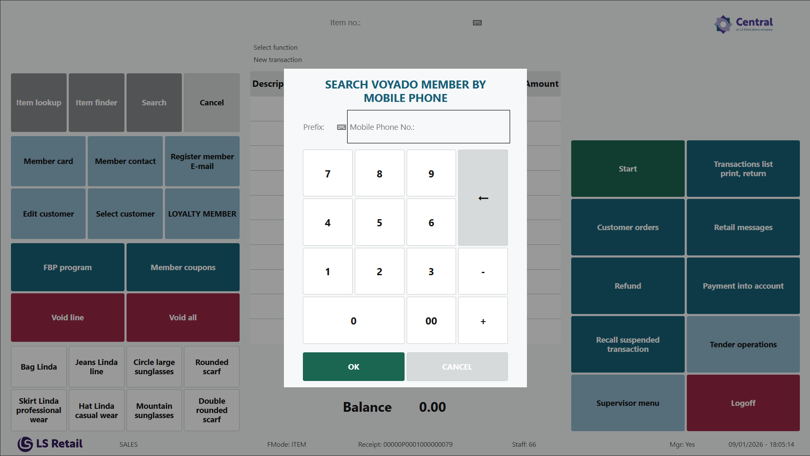
New POS Panels
Search:
Mobile Phone No. updated
Email updated
SSN added
Loyalty Member Info
Has been updated to support
LS Central standard logic

Slide 26
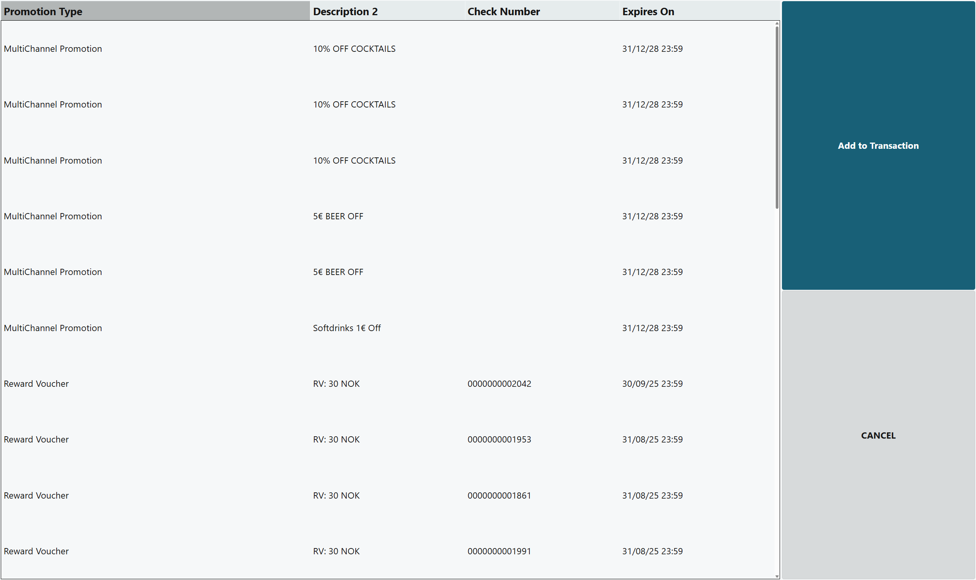
Promotions & Rewards Unified
New unified panel that shows up both promotions and rewards.
All benefits can be added to the journal at the same time.

Slide 27
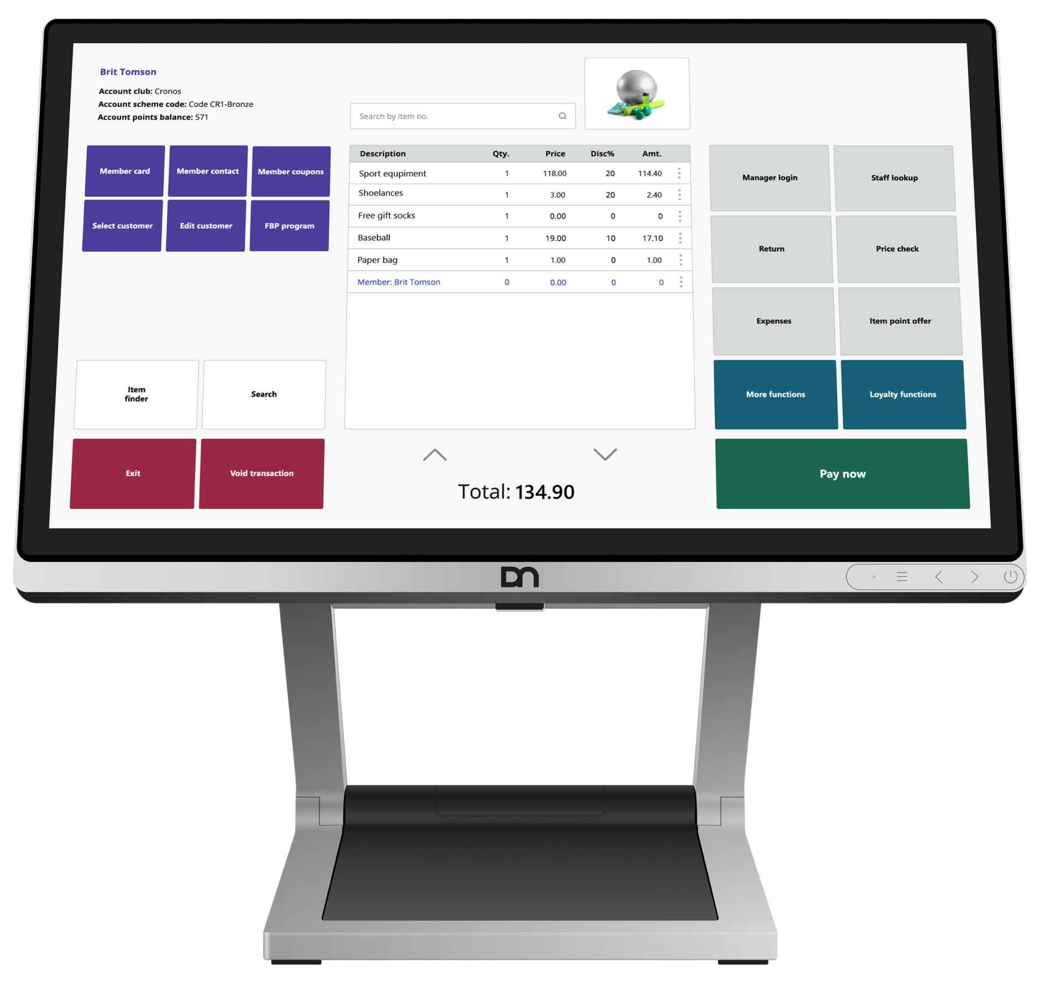
Demo

Slide 28

Other business needs?
LS Retail is offering partners and customers the possibility to request certain features or integrations as LS Central Add-Ons or into the standard product.
If approved the work required is a part of a SOW delivery.
The professional services team works in collaboration with the product team to develop needed functionality to the LS Central through a Co-Innovation process.
Quality controlled and released to next standard version available or to an add-on available on Microsoft Market Place.

Slide 29


A global professional services team
Johann Thorlaksson
CCO and PrimeAttention
Urdur Anna Bjornsdottir
Europe
Jennifer Oddo
Americas
Dipesh Karunakaran
MEA&I
Bjarni Asmundsson
APAC

Slide 30


We collaborate with partners to make them and their customers more successful.
Global team of 100 people
Diverse team
Extensive experience
Subject matter experts
Technical Consultants
Functional Consultants
Solution Architects
Project Managers
Support partners in sales and in the full project lifecycle
Increase the quality of the implementations
Bring extra capacity and specialized industry expertise
Reduce project risk and cut down implementation time
Bring customer insights into product development

Slide 31
Our consulting services
Architecture
Environments and Multi Company support
Localizations / Fiscal Requirements
Replication Service support offline capabilities
Upgrade Path & Migration
Seamless upgrade planning
Data and Code migration
Implementations
System setup and app deployments
Configuration of system features adjusted to the customer needs
POS
POS (Online & Offline)
Update Services
LS Pay, Hardware Station, KDS
Customizations
Requirement analysis and technical design
Custom development, testing and deployments
Integrations
Offers web services & APIs for ERP, CRM, payments
Add-Ons and Co-Innovation
Create Add Ons for customer requirements
Develop new features into the standard product

Slide 32






LS Retail PrimeAttention
a dedicated customer service desk offering:
Ad-hoc to advanced 24/7 support
2nd and 3rd level support with SLAs
Additional services to strategic and selected customers
Dedicated support manager and skilled regional professionals

Slide 33

GET AHEAD OF COMPETITION WITH
LS CENTRAL ADD-ONS

Slide 34
Q&A
Time for questions

Slide 35
Q&A
Q: Can Duty Free Retail be implemented by the Partner?
A: Yes, it can. In the past, before we standardized this delivery, our consulting team was usually involved in every implementation of Duty Free. The partners will of course learn how to do the implementation after they've done it with us. So maybe first and second time they do it with us. But then when they got a hang of the set up, such as with the LS Central main app, they should be able to implement by themselves. For us, it is an advantage that more customers are using the product. So we are able to maintain and deliver a qualified product for the future.
Q: Is there an hourly rate for consulting services?
A: If you need an hourly rate for consulting services, that will depend on the engagement and other factors - how long it is, in which region you are located etc. Please reach out to us to ask for an offer to to get consulting services in your region and on your project.
Q: Where can I find out about the price of add-ons?
A: LS Retail partners can log on the LS Retail Portal and navigate to the Pricelists section. We have a section there Consulting Add-ons pricelists where you can download the SaaS and On prem perpetual pricelists.
Non-partners can send an inquiry about prices to PMEurope@lsretail.com to get information.

Slide 36
Thank you

