Slide 1
Simplifying payments with LS Pay
Petur Thor Sigurdsson
Product Director

Slide 2

LS Pay
Offering EFT integrations to the leading PSPs, in each of our main market regions – allowing our customers to have a choice

Slide 3





LS Pay – High level architecture
Adyen
Adyen
LSPay API
LS Pay
Engine
Verifone
Verifone
Nets
Nets

Slide 4
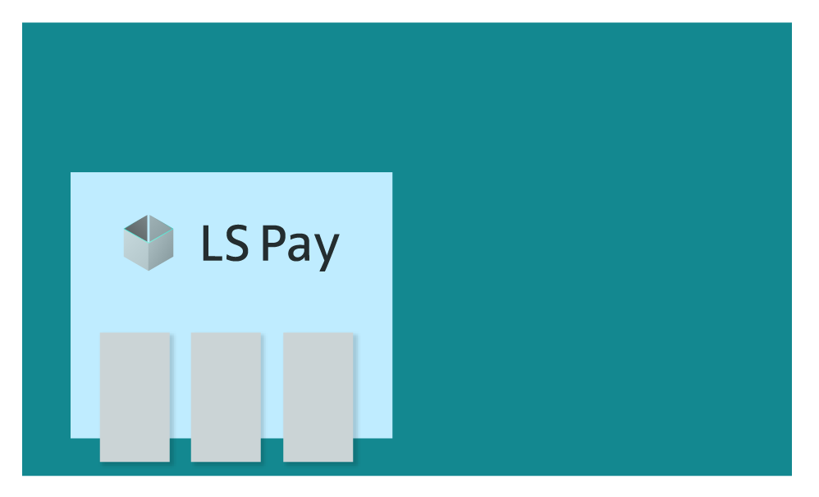
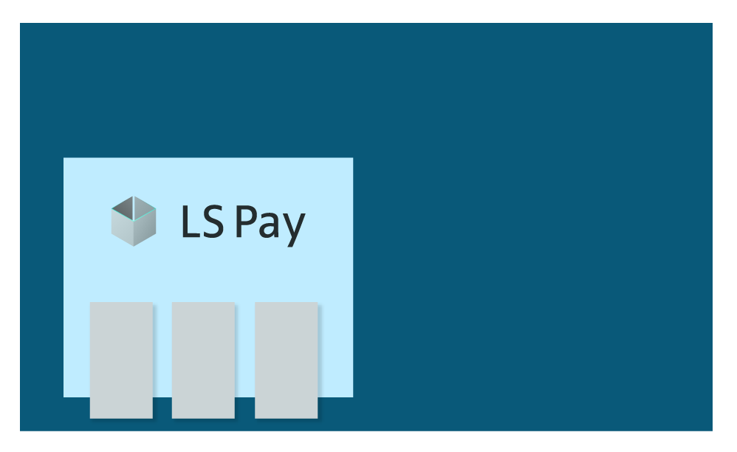

LS Pay – Deployment
HO/BO
Call center
Self check-out Kiosks
Scan Pay Go
Hardware
Station
LS Pay
Service
3rd party
POS provider

Slide 5
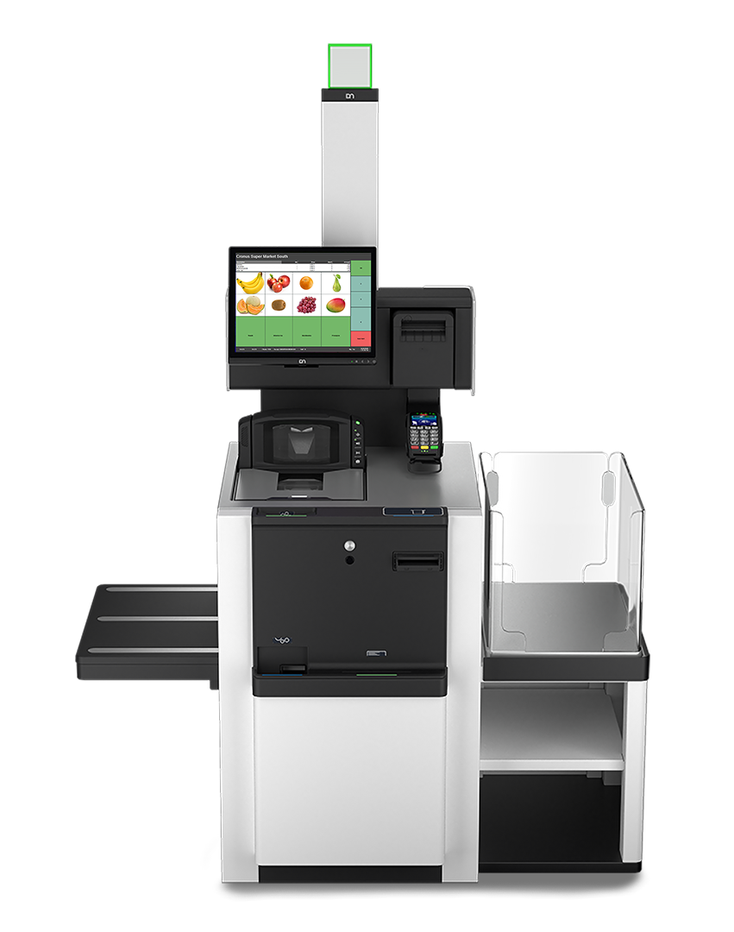
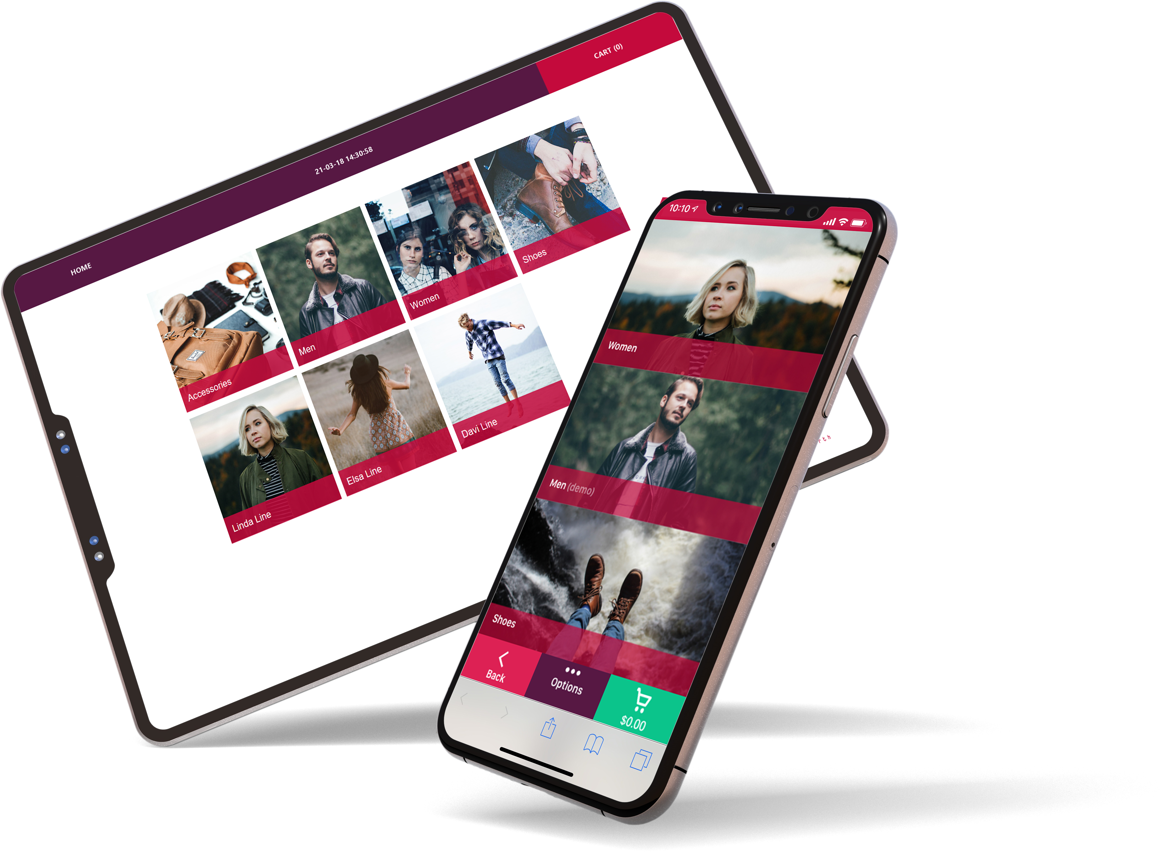
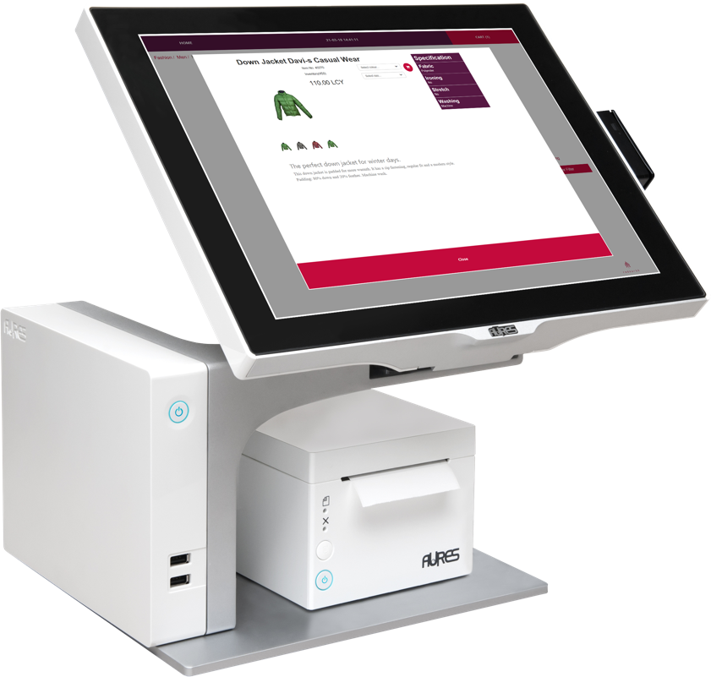
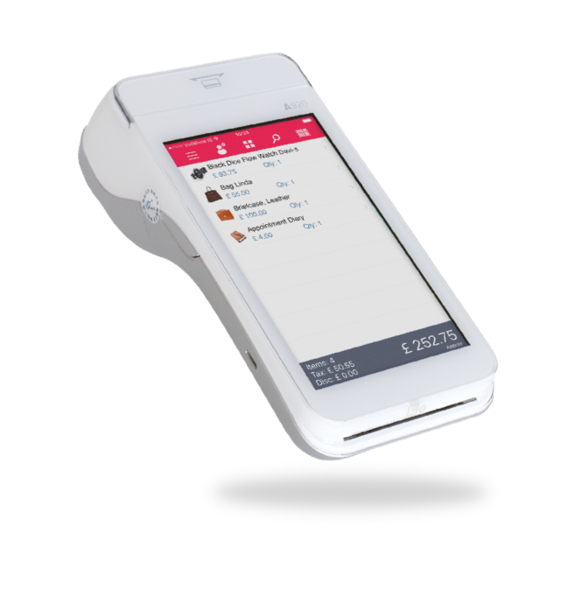
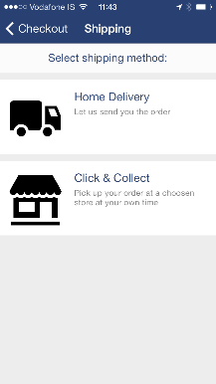
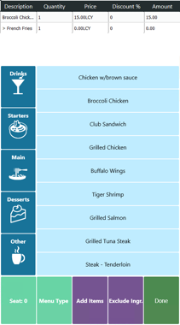
Supporting all platforms & form factors

Slide 6
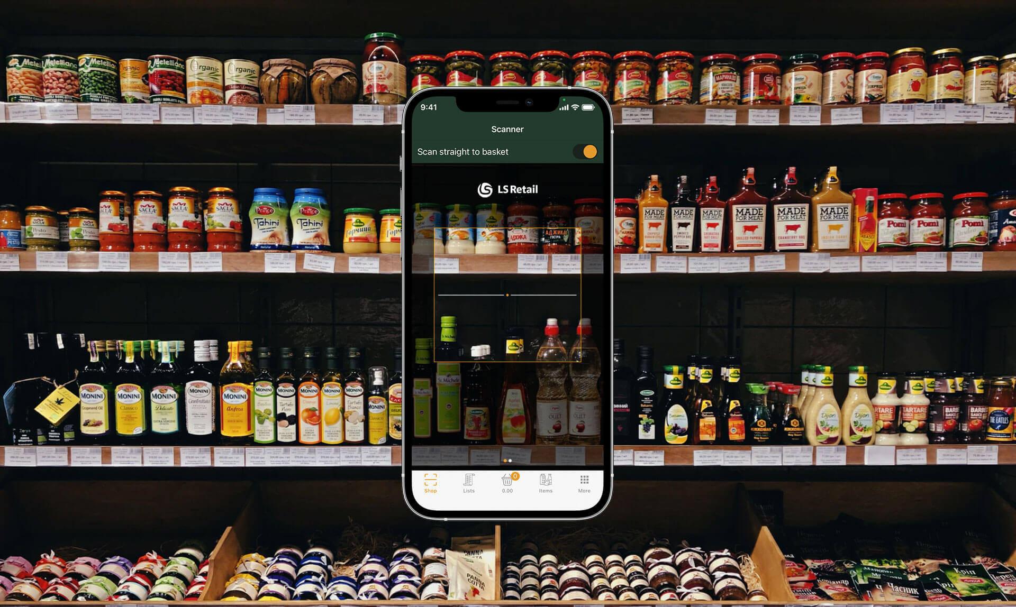

Slide 7
Supported functions
Purchase
Refund
Void
Get transaction
Get last transaction
Get last raw transaction
Cancel
X and Z reports
Start Session
End session
EBT
Pre-auth tokenization
Full capture tokenization
Purchase tokenization
Return tokenization
Signature verification
Voice authentication
Reprint receipt
Reprint card receipt
Display QR code on PED
Subscription tokenization
FSA Debit Card

Slide 8


Security
LS Pay is out of scope for PCI DSS related vulnerabilities
LS Pay is out of scope for PCI DSS certification

Slide 9
LS Pay
Footprint

Slide 10
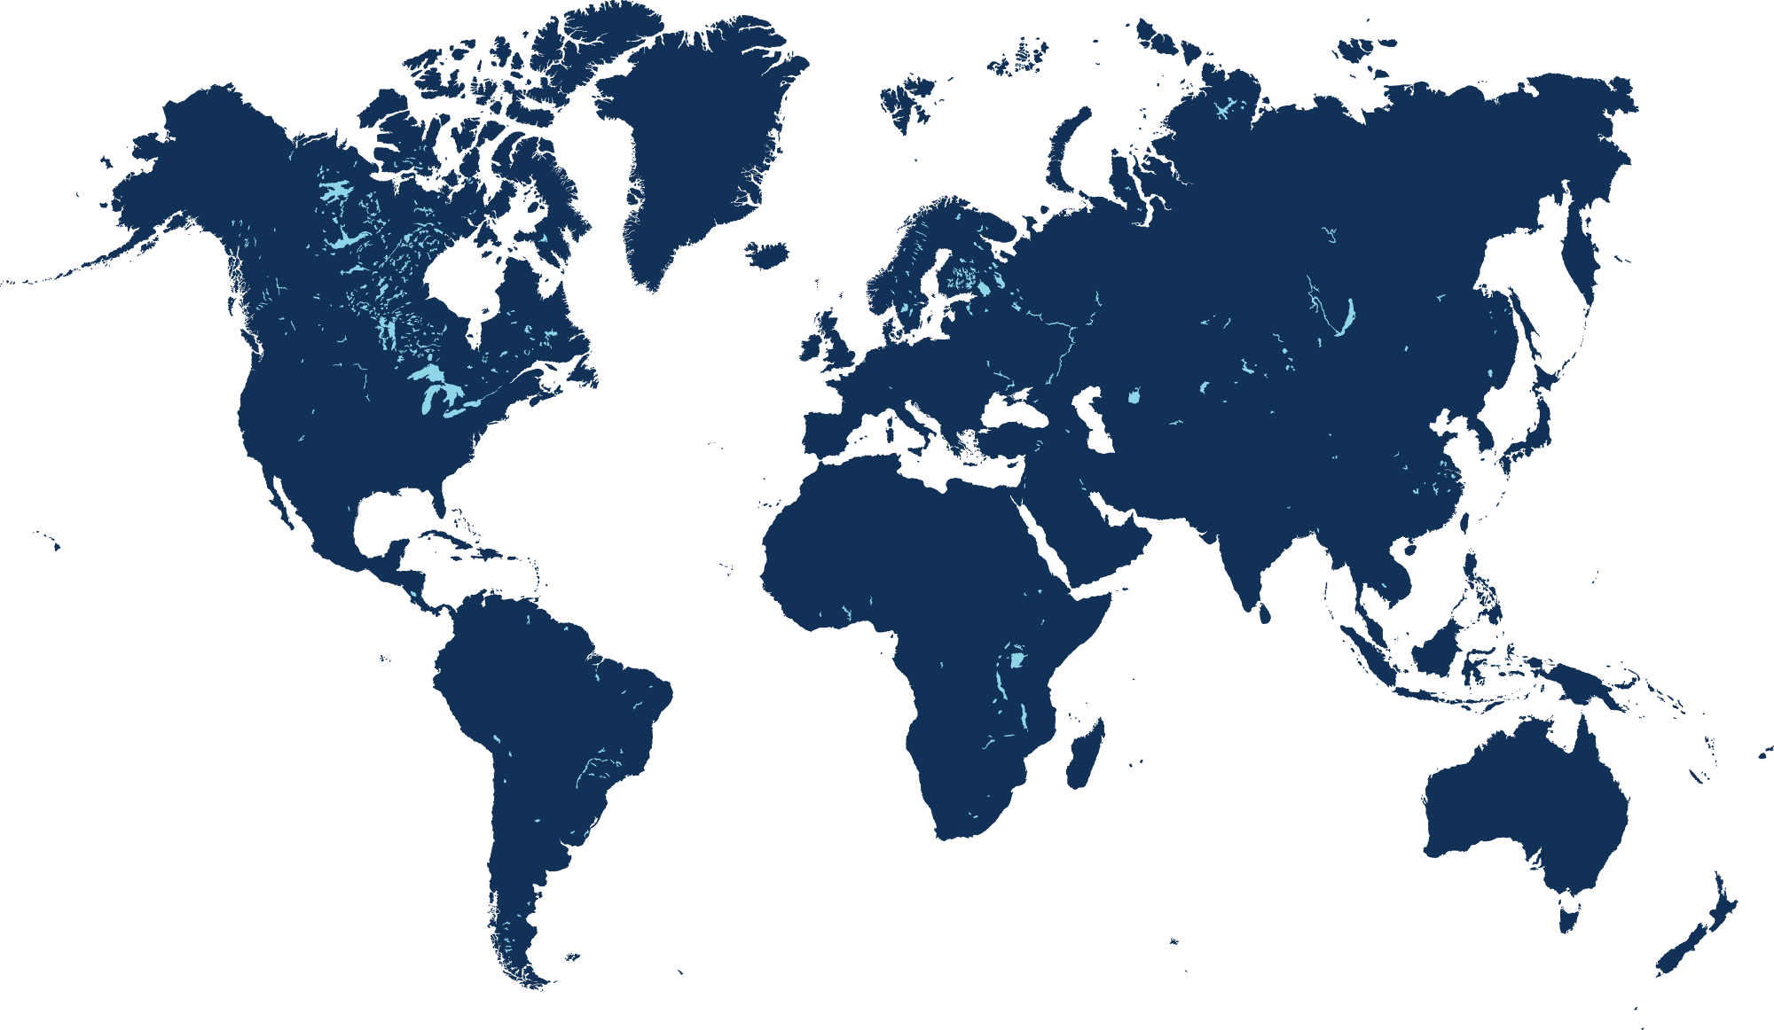
35+
Payment integrations
worldwide

Slide 11
























Slide 12
50+ supported countries

Slide 13

Supported PSPs - Europe

Slide 14












Vision - Europe

Slide 15
Supported PSPs - Americas

Slide 16



Vision - Americas

Slide 17
Supported PSPs – MEA & India

Slide 18





TBD
Vision – MEA & India

Slide 19
Supported PSPs - APAC

Slide 20



Vision - APAC

Slide 21
Alternative payments

Slide 22


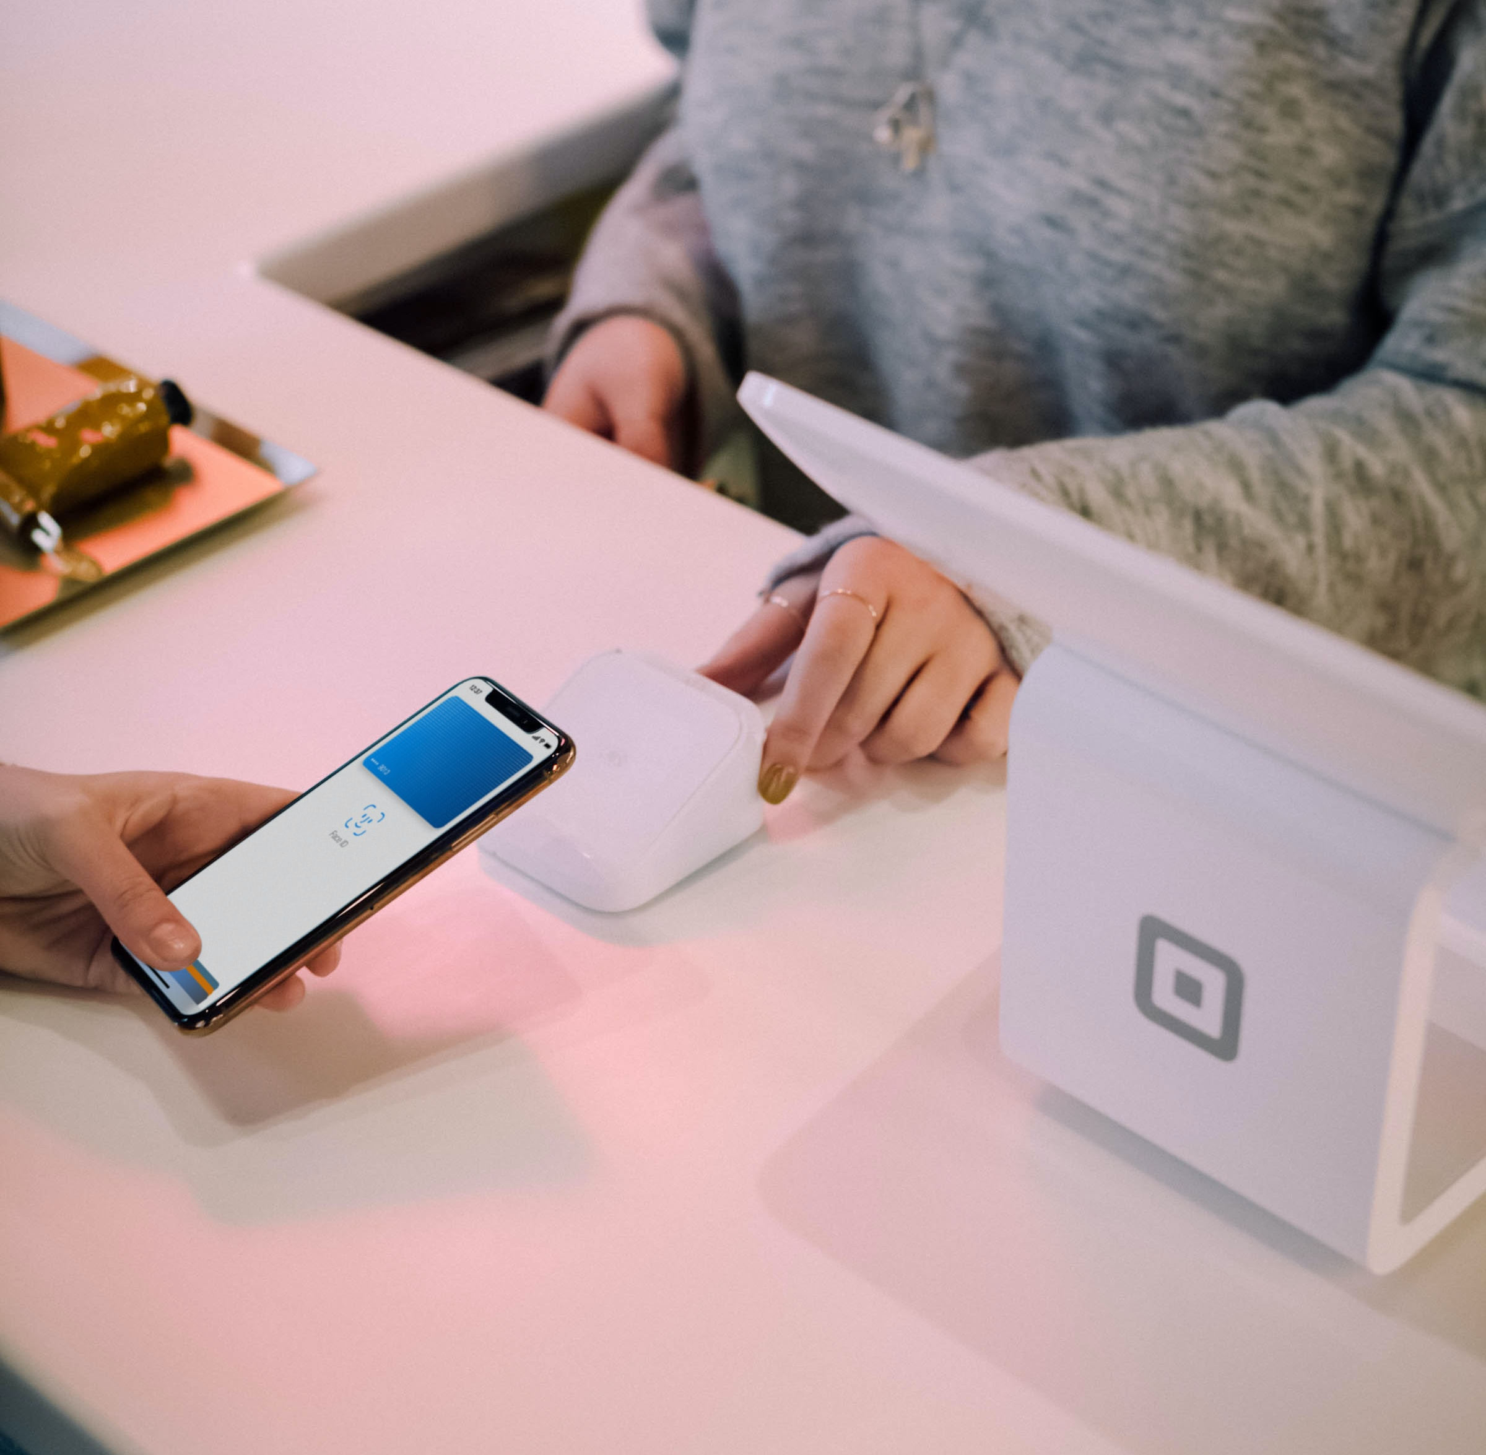







Slide 23
How to get started?

Slide 24
Getting saavy with LS Pay
Today 16:45 – Rima A
Haukur Ingi Agustsson
Product Owner

Slide 25
What’s next?

Slide 26




Our roadmap
QR code payments on the POS
Customer engagement via the PED
Online payments (QR code) on the kiosk
Wearable payments (wristband tokens)
“PIN on glass”

Slide 27
Q&A

