Slide 1
LS Central
All the Latest
Matthías Matthíasson
Product Director LS Central

Slide 2
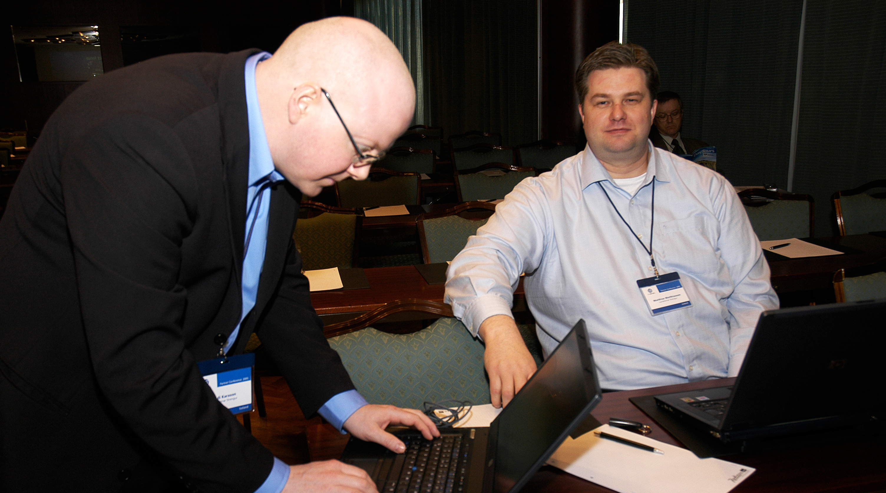
Our origin??

Slide 3
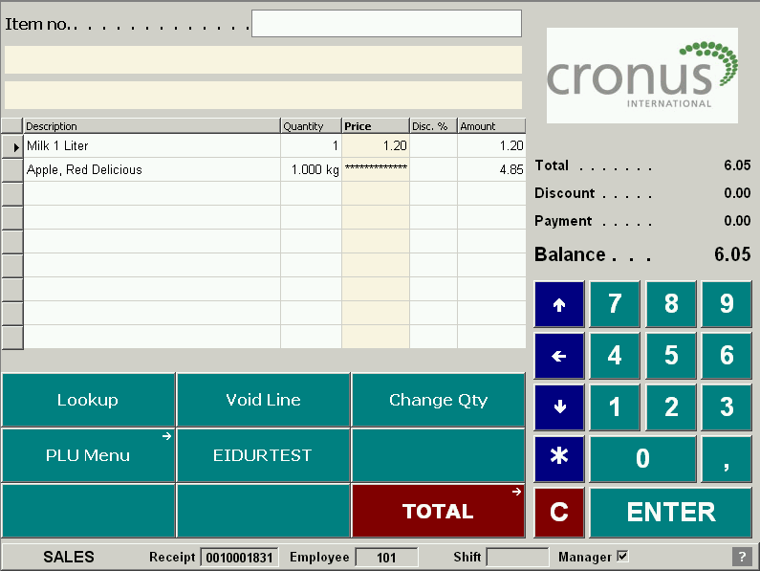
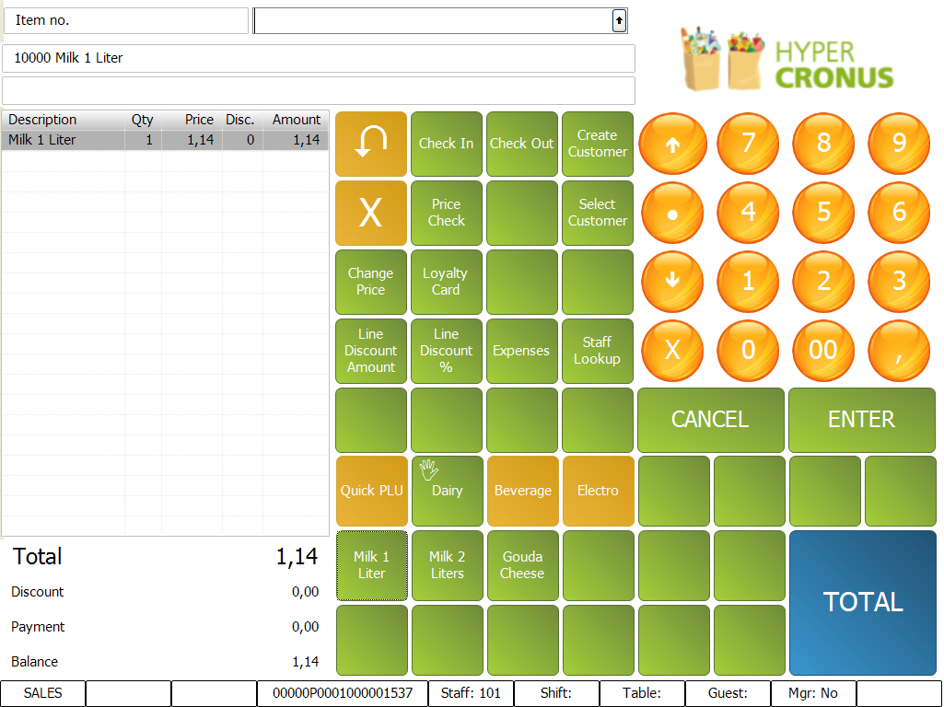
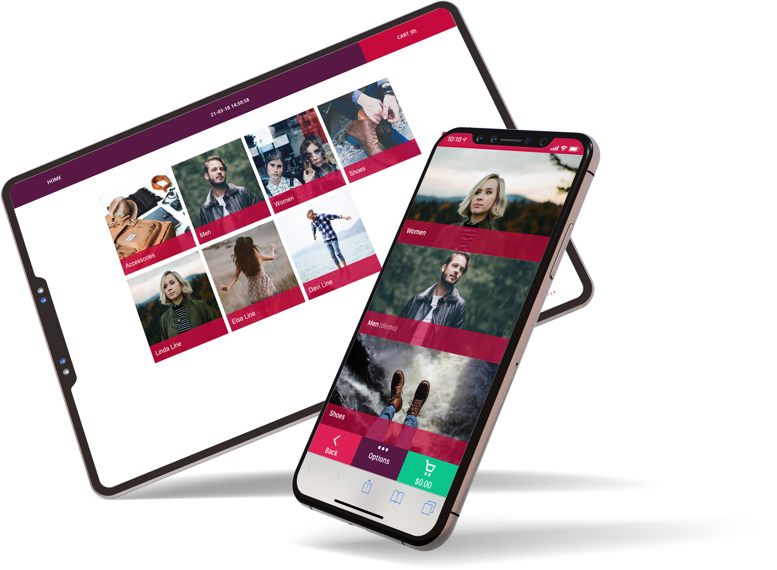
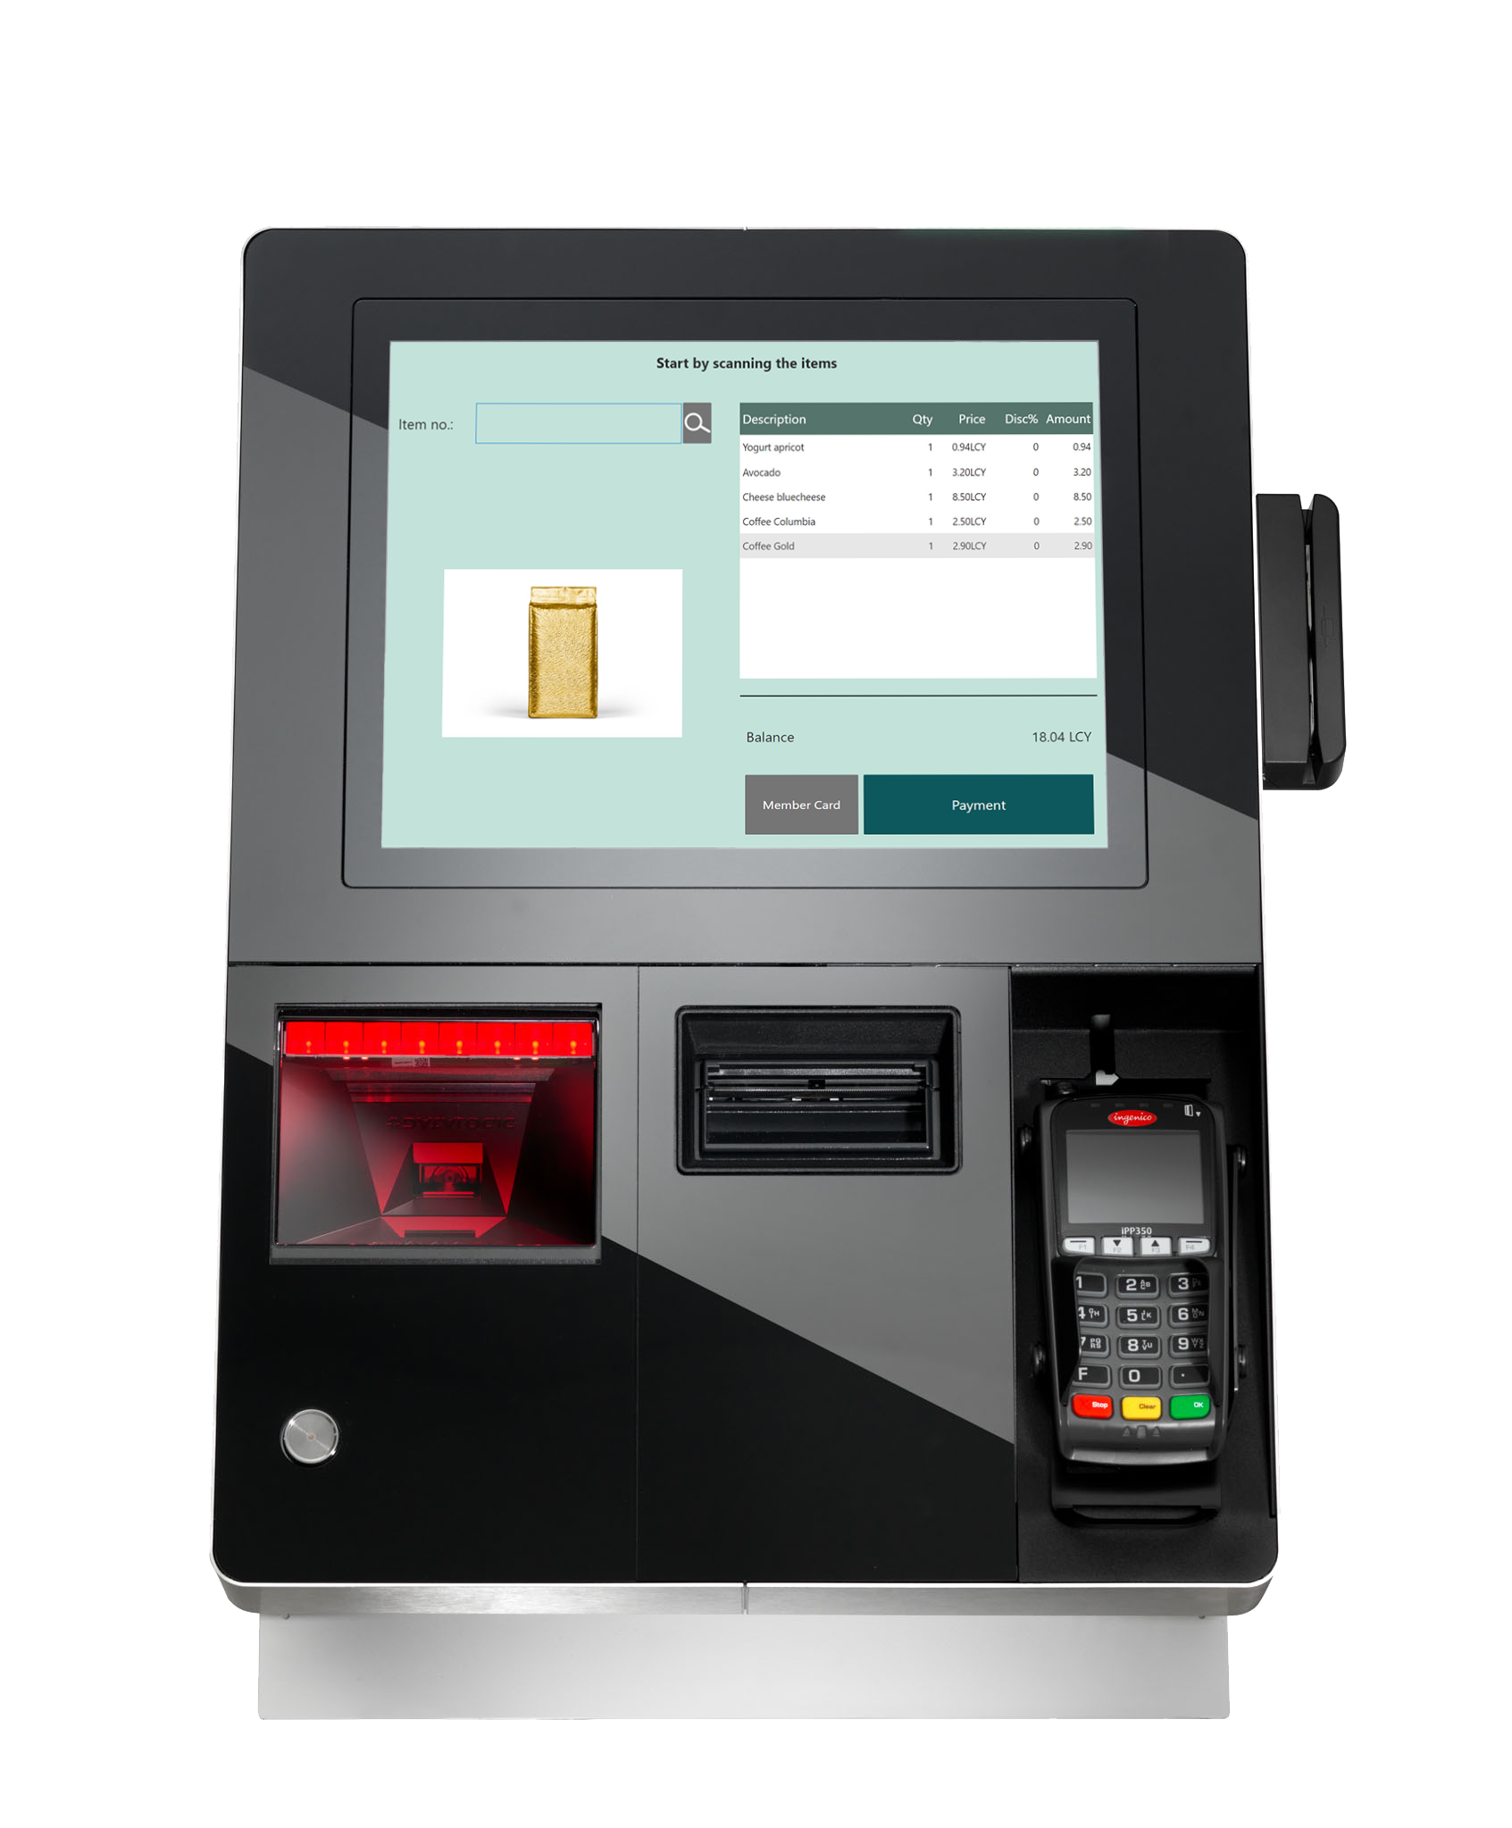
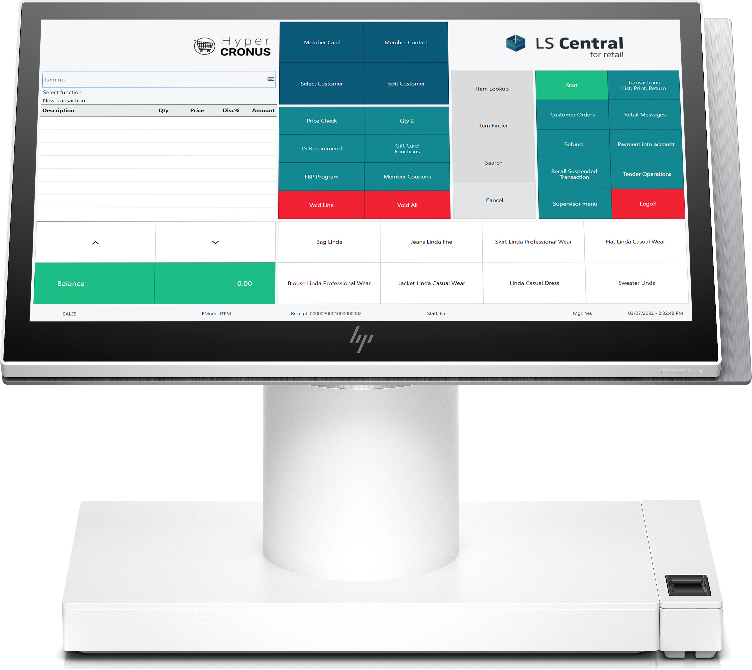
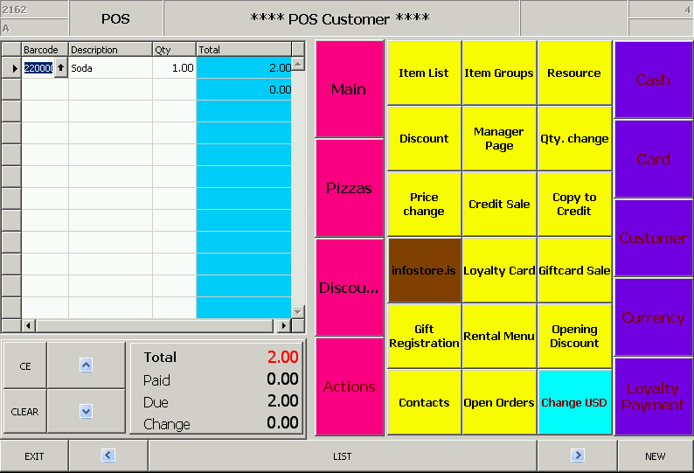
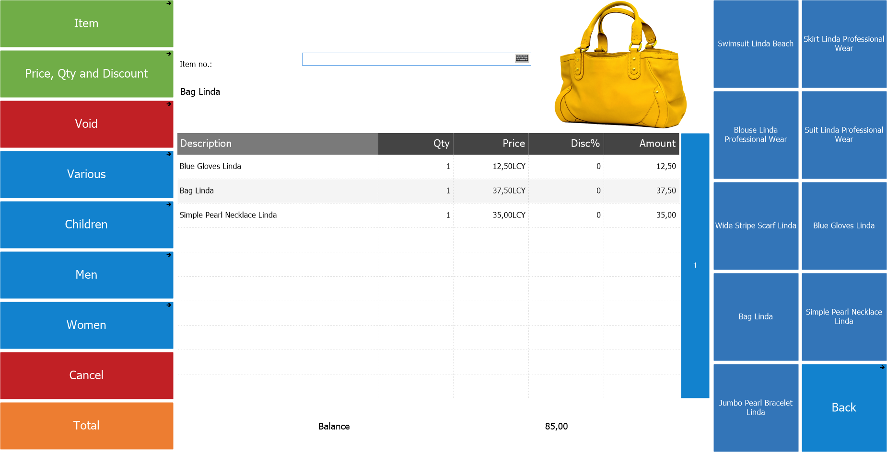
Landsteinar Retail - PlusPOS
LS Nav
LS Central
We have come a long way
This is where we are now
InfoStore

Slide 4
We have come a long way!!

Slide 5
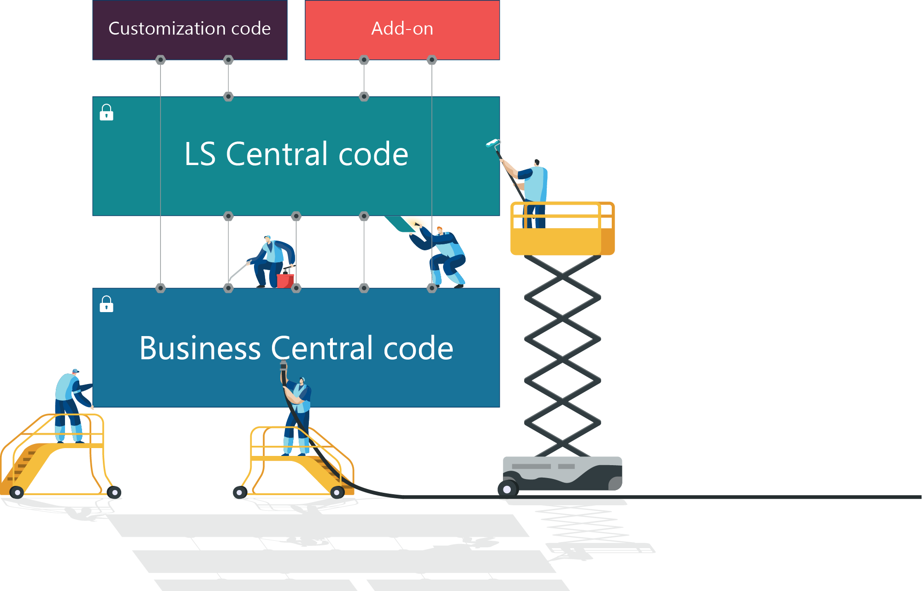
Extensibility framework
Coding with events & extensions
Built for upgradability
Makes migration easier, simpler and faster
Still keeping the ability to extend the functionality
This technology has ability to stay current without projects

Slide 6
Universal code compliant
LS Central will be compliant by
1st of October 2022 (21)

Slide 7
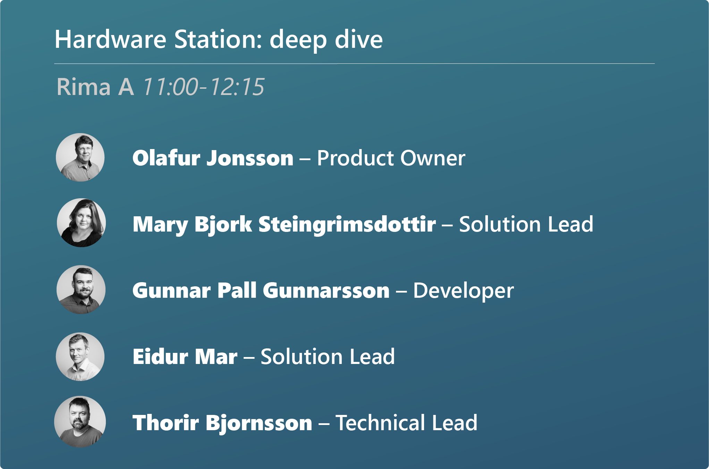
Universal code compliant
LS Central will be compliant by
1st of October 2022 (21)
Taking out all DLLs
Hardware station
EFT
Fiscalization
Other integration @POS

Slide 8
Releases / Requests
Highest priority by development teams
Event request
Internal/Global scope
SaaS critical bugs
HotFixed to SaaS
Release every two weeks
Major/Minor releases (BC updates)
Hotfix with events + internal/global

Slide 9
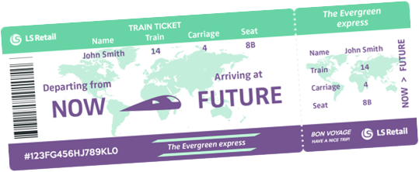
The evergreen train

Slide 10
Localization

Slide 11
Localization

Slide 12
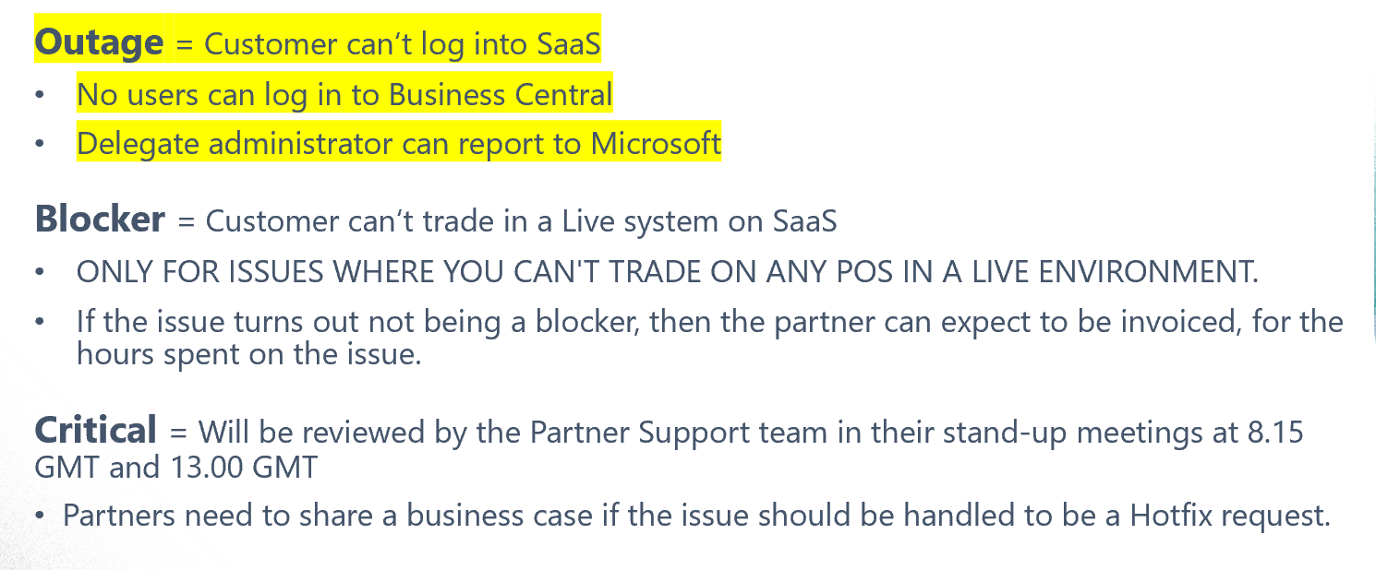
Partners SaaS
24/7 support for production environments

Slide 13
Partners’ journey to SaaS
Cloud
Acceleration
Program
Phase 1
CSP (Cloud solution provider)
Onboarding overview meeting
Training
Phase 2 – CAP
Sell license
Evaluation meeting - With buddy support - Guide onboarding - With consulting

Slide 14
SaaS Replication
Dynamics 365 cloud
Web replication
Architecture
Data Director
SaaS?
Web Replication
What is it?
HQ
Hybrid component server
Store
Online POS
Offline POS
Offline POS Service

Slide 15
SaaS replication
Dynamics 365 cloud
Web replication
Architecture
Data Director
SaaS?
Web Replication
What is it?
Hybrid Component Server
Offline POS and SaaS
Hybrid component server
HQ
Hybrid component server
Store
Online POS
Offline POS
Offline POS Service

Slide 16
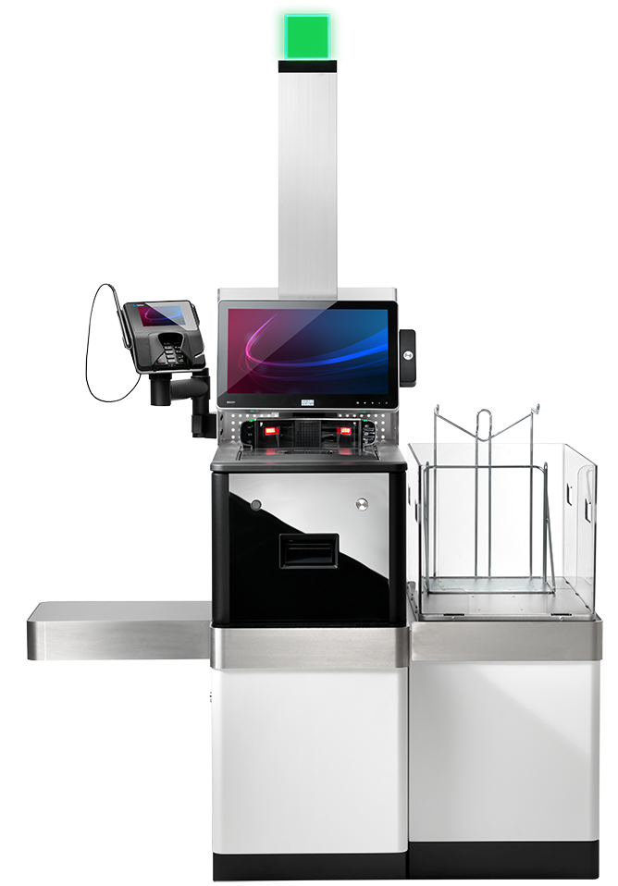
POS in SaaS
LS Central POS
WebPOS
No DLL
Online vs. offline
Mobile vs. stationary
SaaS vs. on premise
AppShell vs. web browser
Hardware Station
SaaS vs. on premise
SaaS considerations
Devices supported
Customization
Fiscalization
Serial connection
LS Pay / EFT

Slide 17
LS Pay
Support for LS Central – Card not present transactions
36 Payment integrations completed by end of Q2 2022
Now supporting In-app payments in our ScanPayGo application
Interesting roadmap elements

Slide 18
The world is changing
New trends
This Photo by Unknown Author is licensed under CC BY

Slide 19
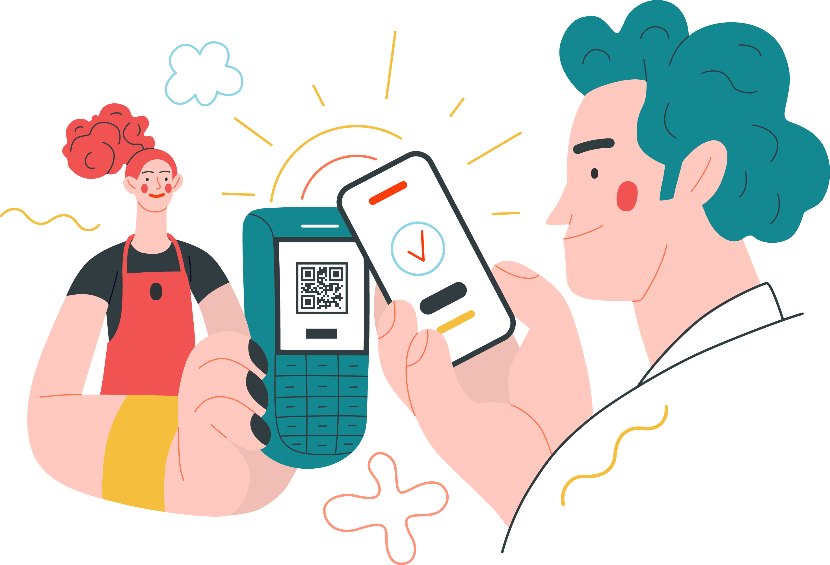
Contactless shopping
Self Ordering in hospitality
Self Checkouts
3rd party self-checkouts
LS Central POS
Scan Pay Go (SPG)
Customer app
Self-scanning
Pay on phone

Slide 20
eCommerce
Shopify launch at conneXion
Non-unified commerce
SaaS support underway
Hospitality
Take away and QR code ordering
"Headless commerce" with
PWA front ends
Traditional web front ends

Slide 21
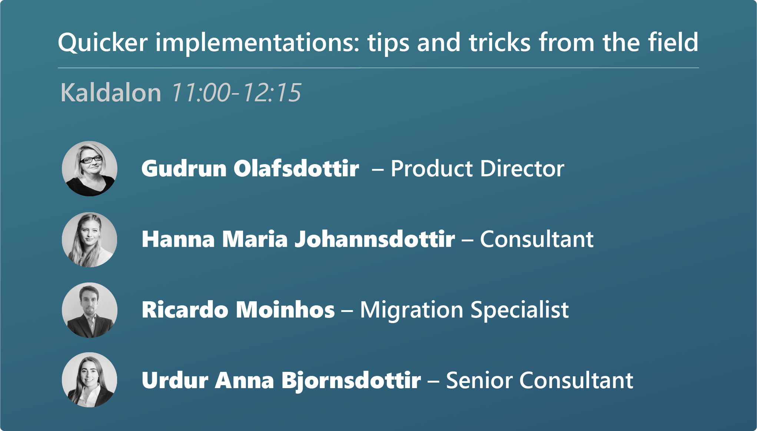
Implementation Experience
SaaS
Large Customers
Templated

Slide 22
Hospitality
Unified Experience
Self-ordering stations
Phone-ordering
At the table – QR code (PWA)
eCommerce

Slide 23
Hotel
Unified Experience
PMS (hotel)
Activity
Staff Management

Slide 24
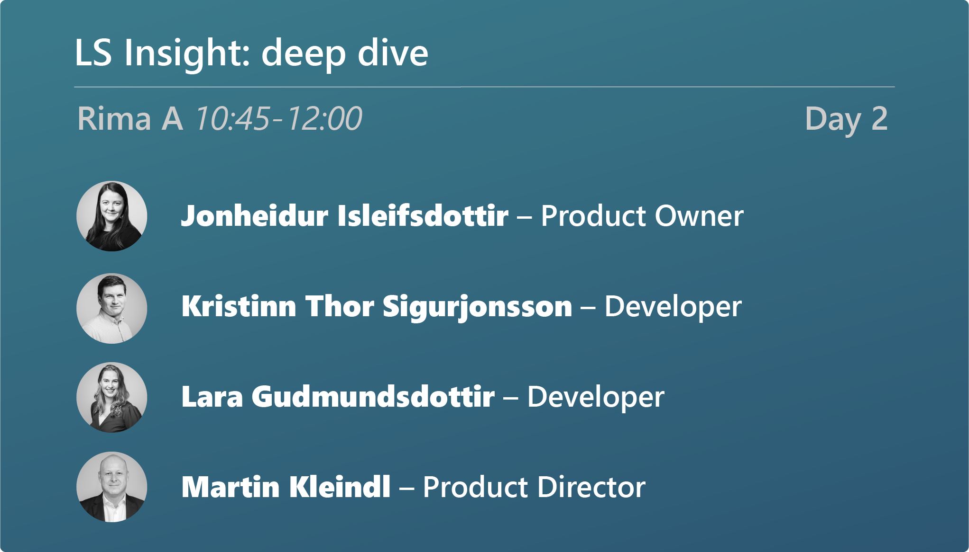
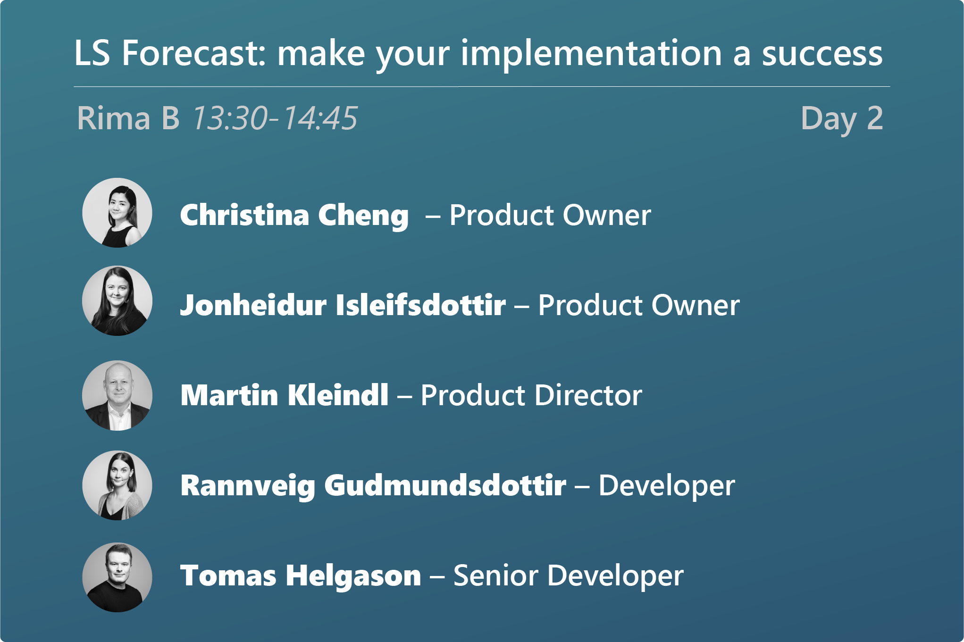
Intelligent cloud suite
LS Insight
Massive report rework
New reports
Improved onboarding journey
LS Recommend
Release of V2, which supports LS Central SaaS
Simplified setup, improved scalability
LS Forecast
Various improvements

Slide 25
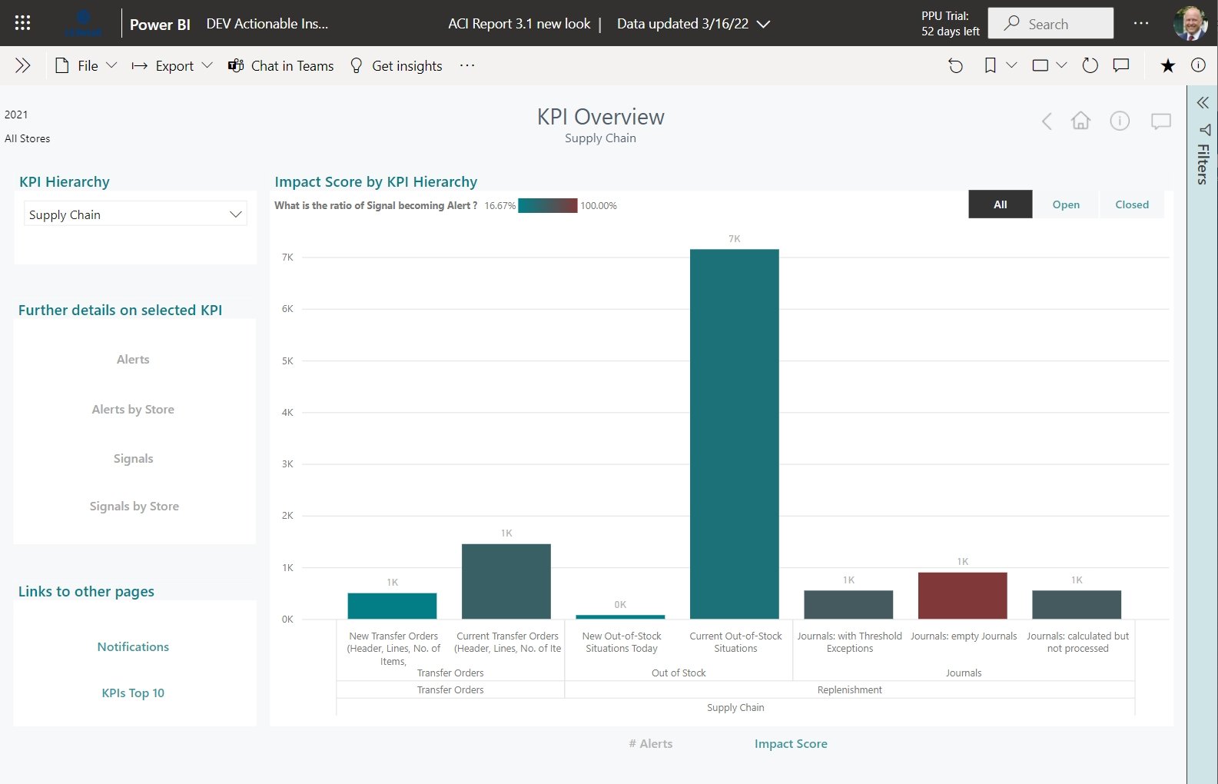
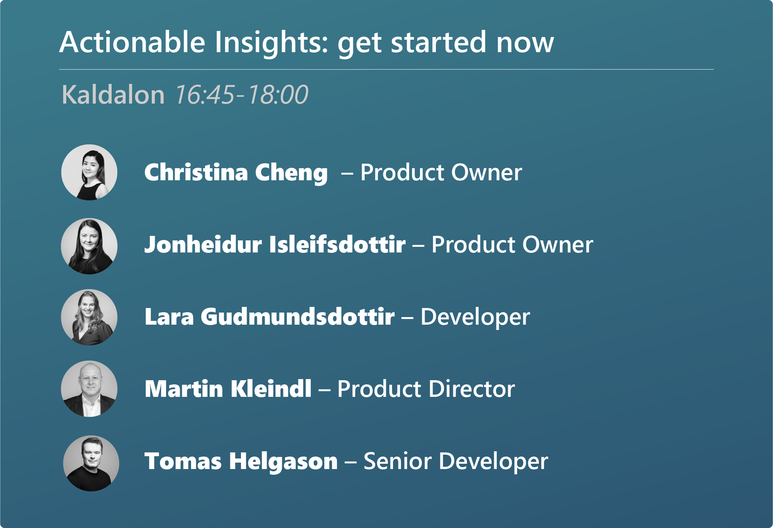
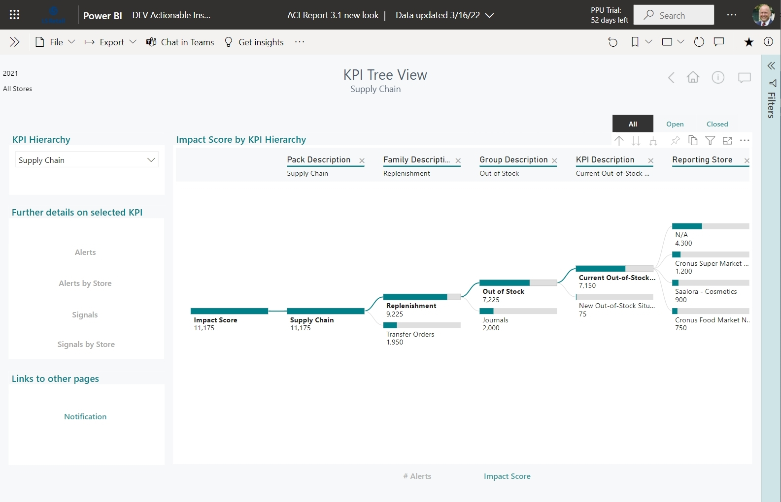
Actionable Insight
New functionality in LS Central
Collects data from various areas in LS Central and calculates snapshots for selected KPIs
48 KPIs supported
A rule and notification engine informs the users proactively in exceptions
Dashboards in LS Central and LS Insight
Released with 19.5

Slide 26
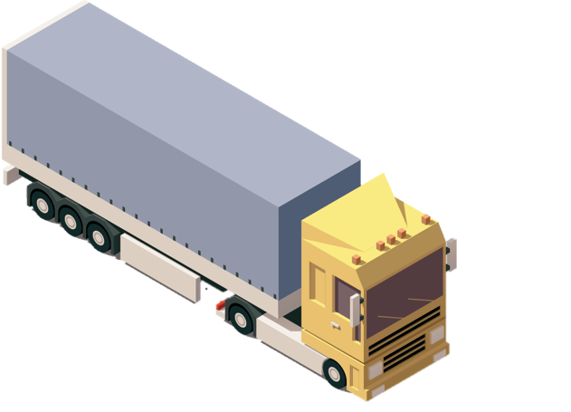
Replenishment
Improvements and new features
such us:
Parallel calculation in BC SaaS
Massive Manual Replenishment improvements
Store Stock Redistribution improvements
Roadmap for Replenishment and LS Fashion

Slide 27
Pharmacy
Big customer implementations
Local requirements
Certification
Going to AL (19)
Fully browser-based
Extendibility

Slide 28
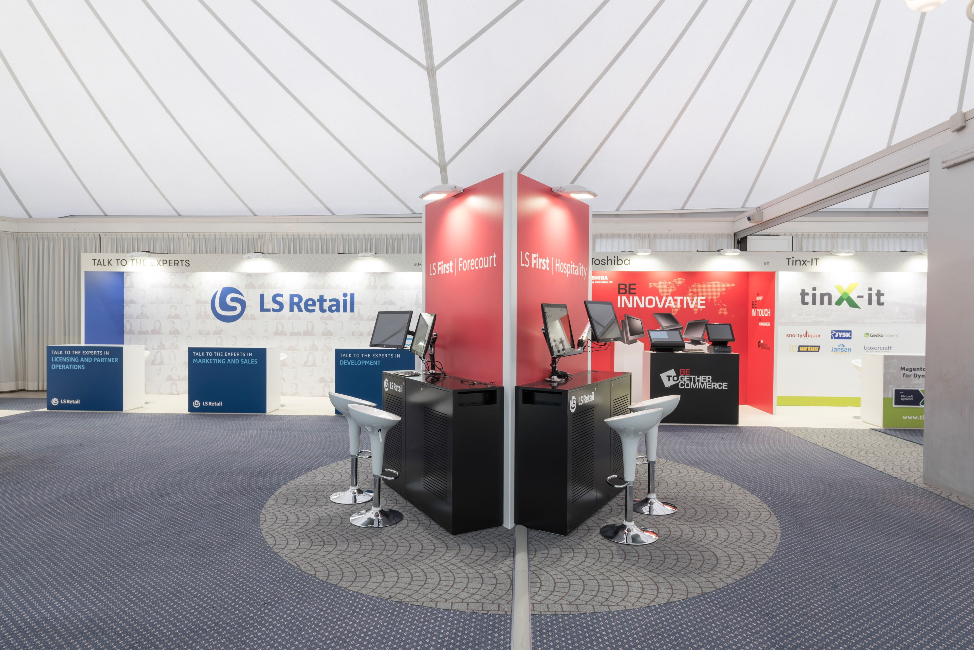
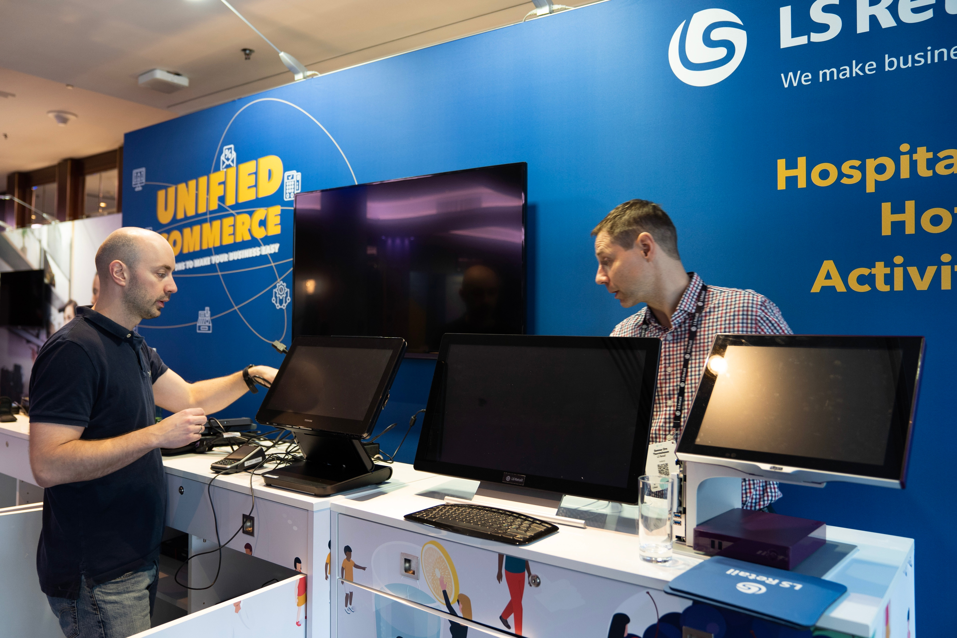
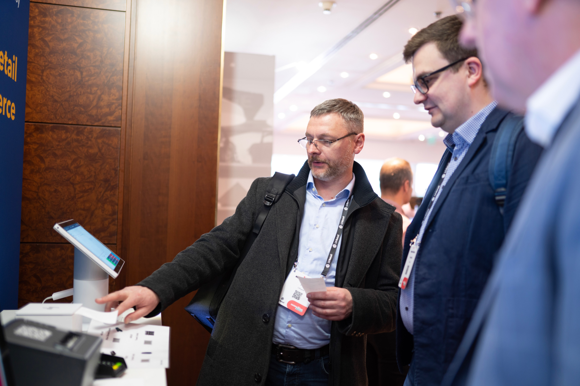
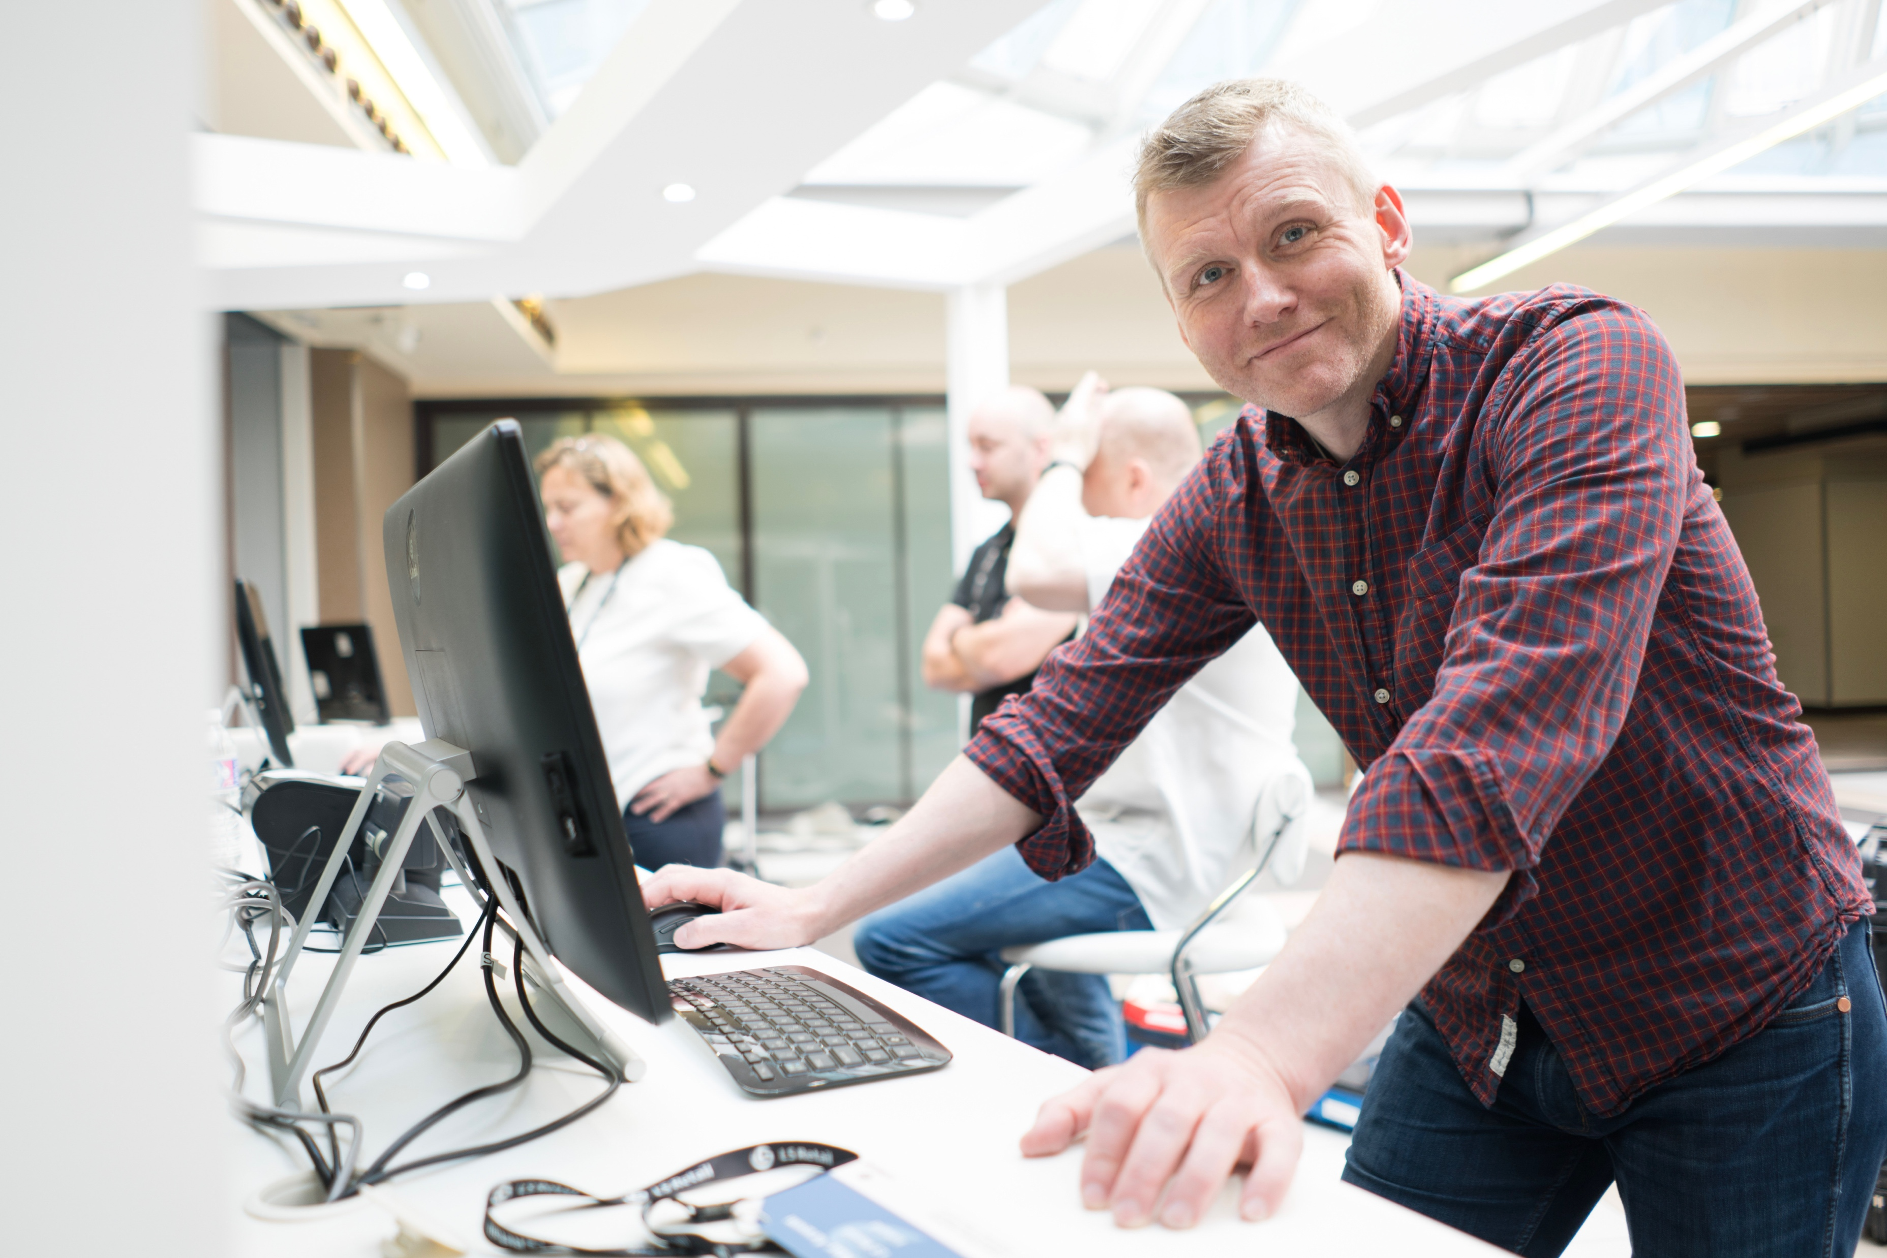
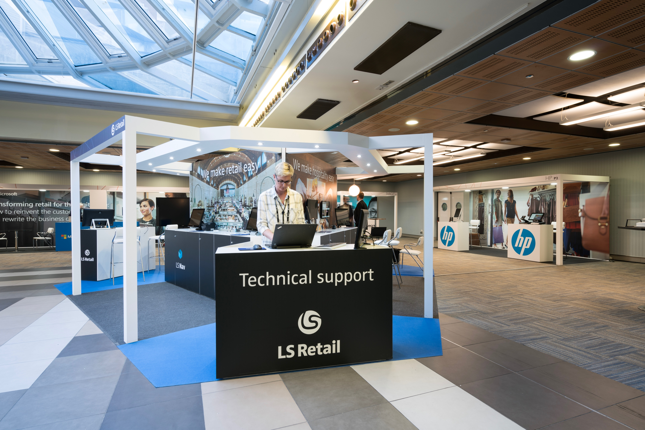
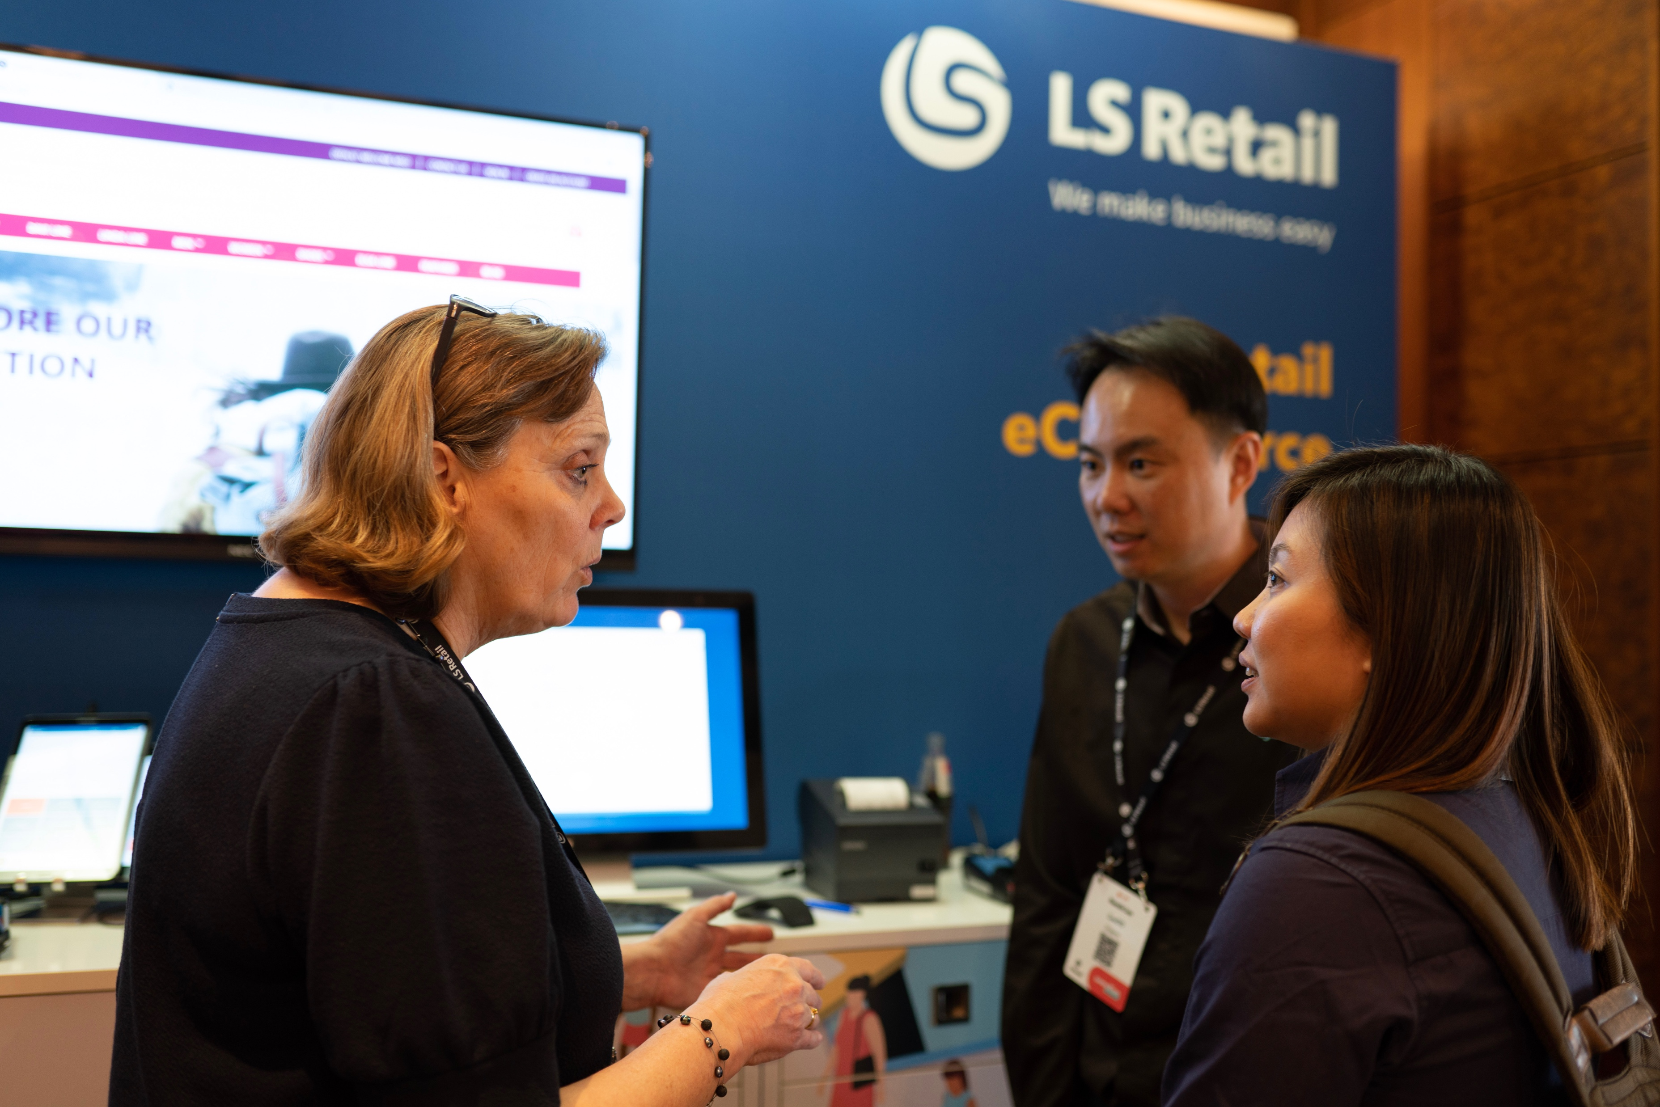
LS Retail
Experience center

Slide 29
Meet LS Central leadership team
Meet the team
Ask questions
Opportunity to influence the future of LS Central

Slide 30
Create the future
with us

Slide 31
Create the future
with us

Slide 32
We are just getting started

Slide 33
Questions?

