Slide 1
LS Central for pharmacy
Modern dispensing
Henrik Thordarson
Stefán Georgsson
Pharmacist
Product Director

Slide 2
Pharmacy software for pharmacies of all sizes
It covers the daily routines in a pharmacy, from back office to POS
It manages various types of prescriptions, handles drugs effectively and keeps track of the pharmaceutical stock across all stores
It supports effective data structure for medications and efficient handling of pharmaceuticals
Unified commerce, including efficient handling of online orders
LS Central for pharmacy

Slide 3
Modular design of LS Central for pharmacy
Country
Integration
Each component in the system is like a Lego brick with seamless data integration
For customers, this means that it is now possible to update the system without a major upgrade project
Can function as a standalone pharmacy solution or a complete ERP, retail and pharmacy solution
Supports Unified Commerce unifying all channels & running them from the same back-end solution
Member management or loyalty program is integrated part of the solution
LS Pharmacy
LS Central
MS Dynamics 365 Business Central
Part of the LS Central family

Slide 4
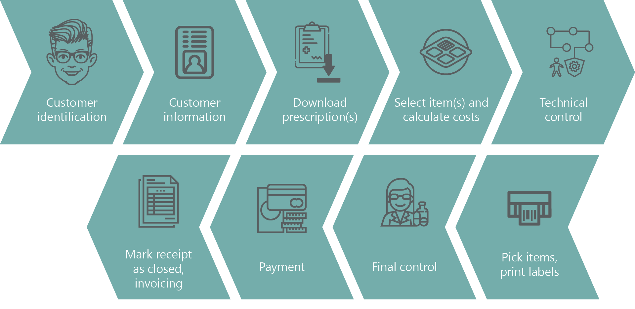
e-Prescription flow in LS Central for pharmacy

Slide 5
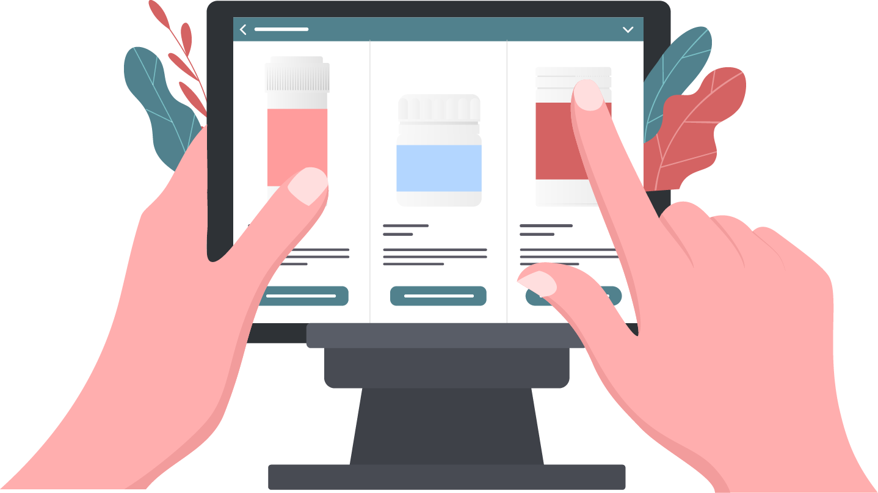
Demo

Slide 6
Why LS Central for pharmacies?
Have a fully integrated dispensing, Retail and ERP solution in ONE software suite
Manage various types of prescriptions and handle drugs effectively
Keep track of your stock across all stores and do replenishment
Manage user-access and permissions
Rely on a standard Microsoft & LS Retail Platform securing a modern and future proof solution
Summary

Slide 7
Closed focus group meeting
During Connexion 2022 in Iceland there is a closed focus group meeting.
If you are interested, contact us at the booth and we will check availability.

Slide 8
QA

