Slide 1
Hybrid Component Server
Setup, Configuration & Maintenance
Adalbjorg Karlsdottir
Thorir Bjornsson
Onboarding Lead
Technical Lead
Ricardo Moinhos
Dipesh Karunakaran
Migration Specialist
Senior Consultant

Slide 2

Hybrid

Slide 3







Get familiar with:-
  Concept of Hybrid
  Hybrid Component Server (HCS)
  HCS Setup
  POS Setup
  Recommendations
  Q&A

Slide 4



On Premise or Online (SaaS)?
Point of Sales (POS) Deployment options:
On Premise
Online (SaaS)

Slide 5


On Premise or Online (SaaS)?
Point of Sales (POS) Deployment options:
On Premise
Online (SaaS)
Hybrid

Slide 6
On Premise or Online (SaaS)?
Point of Sales (POS) Deployment options:
On Premise
Hybrid
Online (SaaS)
Selecting the Right Deployment depends on:-
Volume of Transactions
Stability & Quality of Internet
Additional Hardware Cost
Availability of IT Team, etc.

Slide 7

Hybrid POS
Benefits of Hybrid POS
Gives ability of cloud hosting & the resilience of an offline POS.
Includes POS master database for new roll outs.
Includes tools and methods to install and manage components.

Slide 8
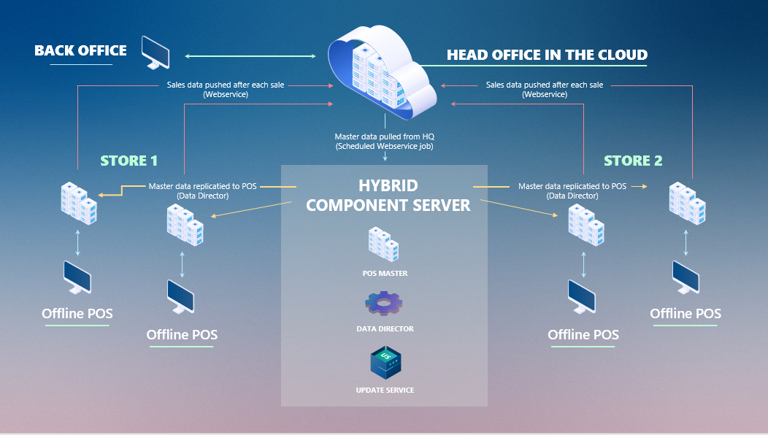
Hybrid POS Deployment
Option 1 : - Offline POS database

Slide 9
Complex and the heaviest in terms of maintenance
Multiple databases needs to be kept up-to-date on the newest version
Guarantees Optimal POS Uptime

Slide 10
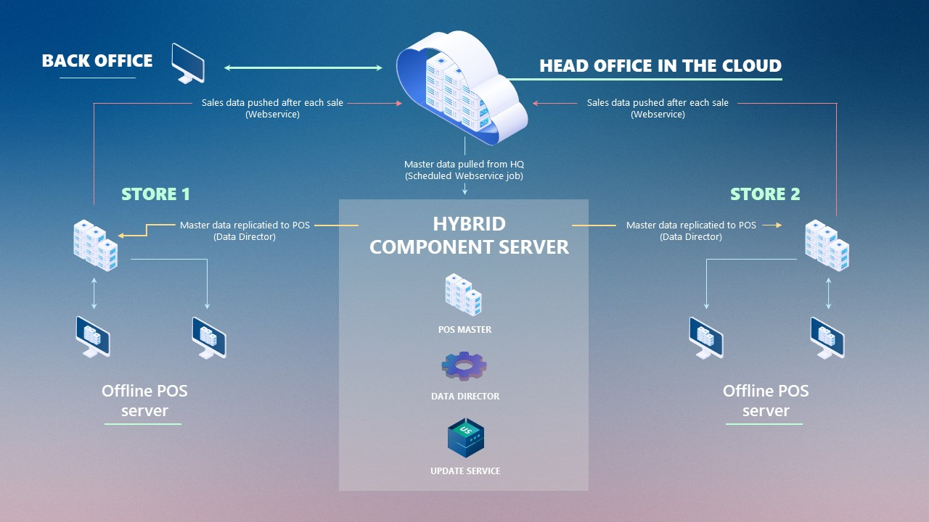
Hybrid POS Deployment
Option 2 : - Offline POS Server database

Slide 11
POSs are connected to the Offline POS Server database using the web client.
Only 1 database per store needs to be kept up-to-date on the newest version
POSs require minimum component installation

Slide 12
POS master database is a template database used for rolling out new stores and POS
DD is used to update the offline POS with master data like items, prices, offers, customers, and so on from LS Central SaaS/Head Office
Update Service is a tool that helps you manage offline environment and keep it up to date with the newest releases and related components.
Note:-
Hybrid Component Server is not a part of the SaaS service.
Customer or partner needs to host it and manage it.
The server can be in Azure or on an in-house server.

Slide 13


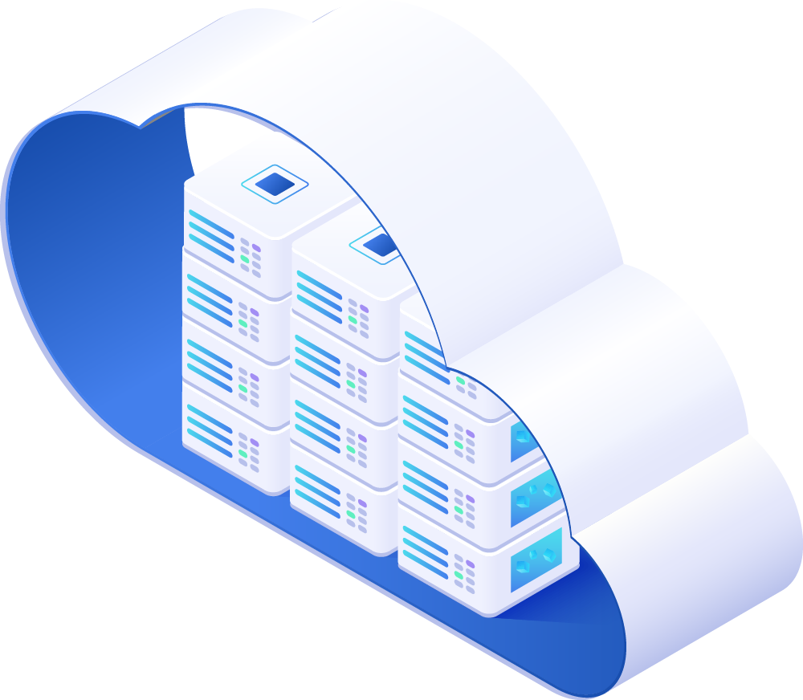
Head Office Setup for Hybrid
It is recommended to finish all setup in the Head Office Cloud Tenant before you start implementing the Hybrid Component Server.
GL/Account
Posting Groups
General Ledger Setup
Unit of Measure
Source Code
Reason Code
Payment Method
No Series
Retail Setup
Store & Related Setups
POS Terminals
Tender Type
Staff Permission
Note:-
HCS Configuration files are imported in Head Office Database
Web service setup is completed
POS Setup

Slide 14

Pre-requisite for HCS Setup in Azure
Azure Account
(Customer Owned or Service from Partner)
Create the following in Azure:-
  Resource Group
  Network Interface
  Storage Account
  Container
  Virtual Network
Customer LS Central license file & DD License File
Download the Script & .JSON files from LS Retail Portal

Slide 15
Hybrid Component Server Setup

Slide 16


Setup Methods
  Easier to make changes in the variable parameter
  Has a User-friendly interface

Slide 17
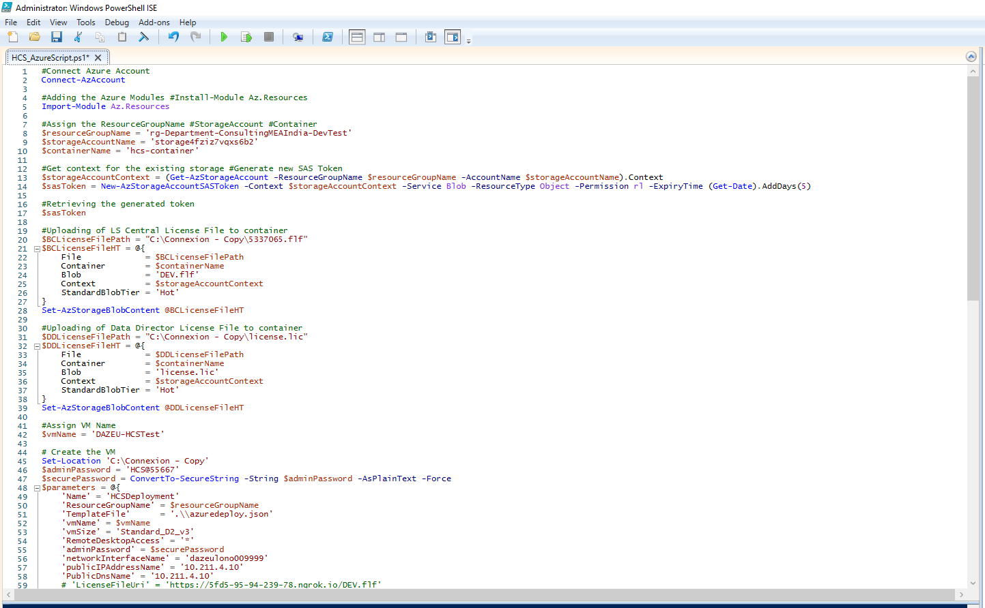

Slide 18
Step 1 - Create the SaaS Token
Section | Details | Script
1.A | First assign the following using the script:- Resource Group Storage Account Container | $resourceGroupName = ‘XXXXXXX' $storageAccountName = ‘XXXXXXX' $containerName = ‘XXXXXXX'
1.B | Run the script Get context for the existing storage | $storageAccountContext = (Get-AzStorageAccount –ResourceGroupName $resourceGroupName -AccountName $storageAccountName).Context
1.C | Run the Script Generate new SAS Token | $sasToken = New-AzStorageAccountSASToken -Context $storageAccountContext - Service Blob -ResourceType Object -Permission rl -ExpiryTime (Get-Date).AddDays(5)
1.D | Run the Script to retrieve the generated token | $sasToken

Slide 19
Step 2 – Upload LS Central & DD License
Section | Details | Script
2.A | Mention the path were the LS Central license file is stored in the script | $BCLicenseFilePath = “C:\lsretail\DEV.flf" $BCLicenseFileHT = @{ File = $BCLicenseFilePath Container = $containerName Blob = 'DEV.flf' Context = $storageAccountContext StandardBlobTier = 'Hot' } Set-AzStorageBlobContent @BCLicenseFileHT
2.B | Mention the path were the DD license file is stored in the script | $DDLicenseFilePath = "C:\Connexion - Copy\license.lic" $DDLicenseFileHT = @{ File = $DDLicenseFilePath Container = $containerName Blob = 'license.lic' Context = $storageAccountContext StandardBlobTier = 'Hot' } Set-AzStorageBlobContent @DDLicenseFileHT

Slide 20
Step 3 –Virtual Machine on Azure
Section | Details | Script
3.A | Assign Virtual Machine using the script | $vmName = ‘LS Central'
3.B | Script for creating the VM | Set-Location 'C:\Connexion - Copy' $adminPassword = 'HCS@55667' $securePassword = ConvertTo-SecureString -String $adminPassword -AsPlainText -Force $parameters = @{ 'Name' = 'HCSDeployment' 'ResourceGroupName' = $resourceGroupName 'TemplateFile' = '.\\azuredeploy.json' 'vmName' = $vmName 'vmSize' = 'Standard_D2_v3' 'RemoteDesktopAccess' = '*' 'adminPassword' = $securePassword 'networkInterfaceName' = 'dazeulono009999' 'publicIPAddressName' = '10.211.4.10' 'PublicDnsName' = '10.211.4.10' 'HCSWebServicesURL' = 'https://lscentral.api.bc.dynamics.com/v2.0/1c7cbf82-aa4a-49a5-97cf-6103dc32716f/Production/WS/Die%20Bude/Codeunit/RetailWebServices' 'HCSWebServicesUsername' = 'cloudmaster' 'HCSWebServicesPassword' = 'V3jdRGx60YgI04eKbBZxPu+FmLb0dYmG+KquTqIlOY8=' 'StorageContainerName' = 'hcs-container' 'StorageSasToken' = '?sv=2020-08-04&ss=b&srt=o&se=2022-05-13T16%3A53%3A45Z&sp=rl&sig=H0niScHKw2cbxddqjcu%2BilmH8DRvNI%2FbLcr4vlWoQLE%3D' 'Verbose' = $true 'enableBootDiagnostics' = $false # 'DeploymentDebugLogLevel' = 'All' } New-AzResourceGroupDeployment @parameters

Slide 21
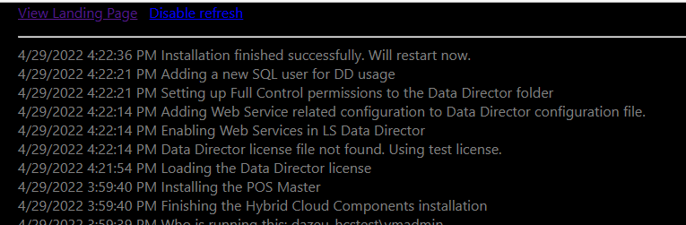
Step 4 – Tracking of VM Creation
To check the status of VM creation and installation of software’s, enter the below URL in browser:-
Http://Public IP Address Name of Azure Network

Slide 22


DEMO

Slide 23
Method 2

Slide 24
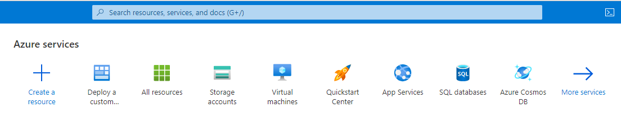
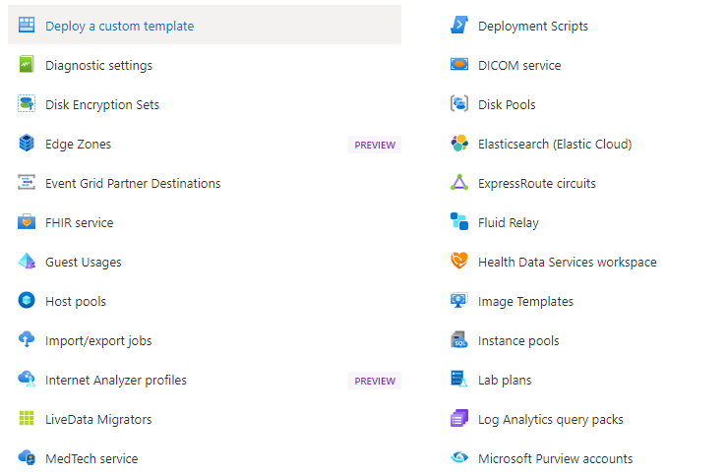
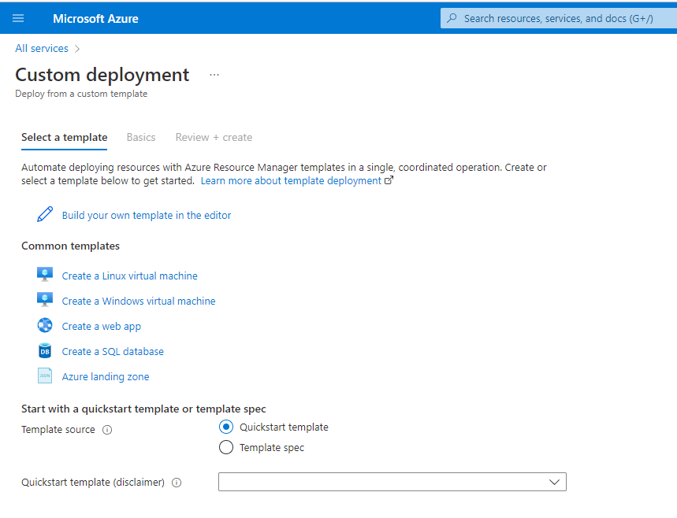
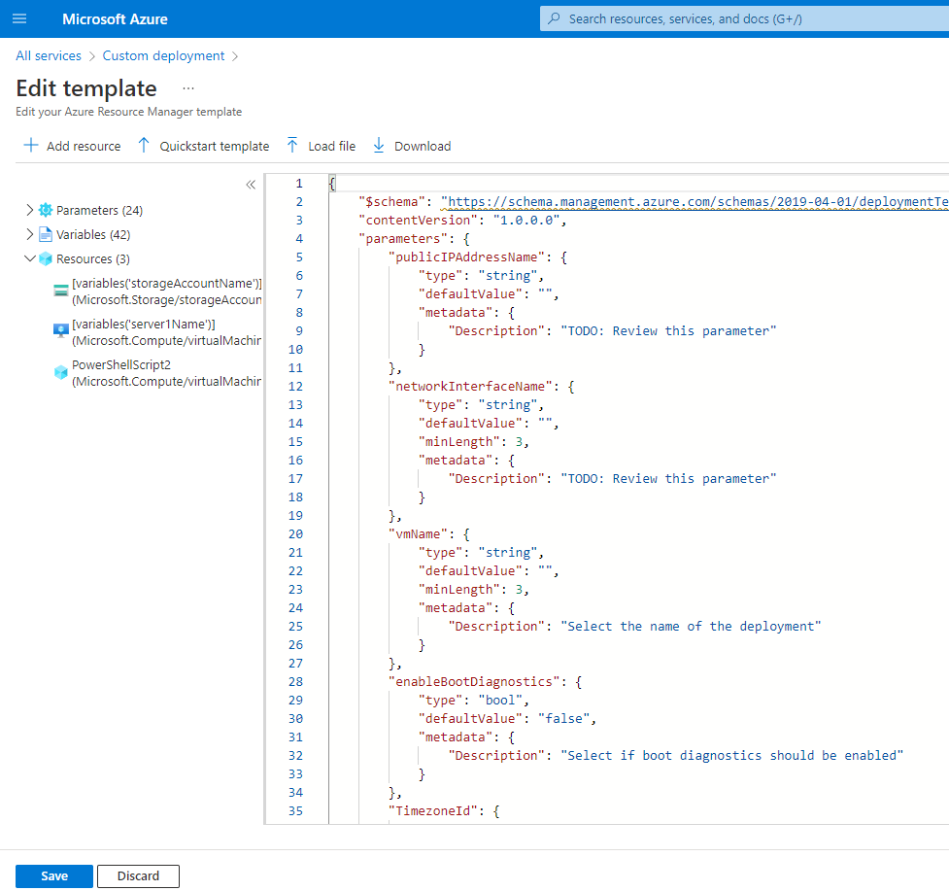
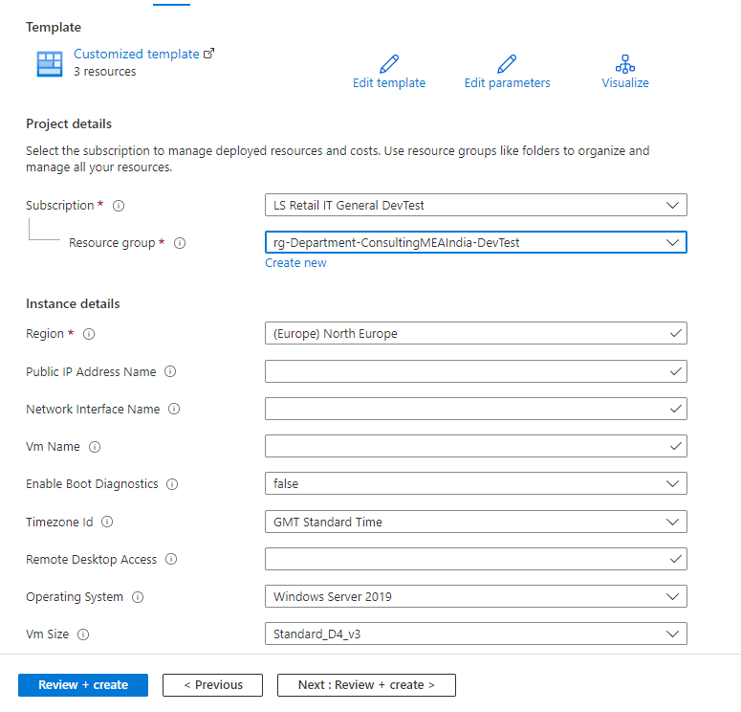
Step 1 :- Open Azure and Click on More Services
Step 2 :- Look for Deploy a Custom Template
Step 3 :- Click on Build your own template in editor
Step 4 :- Upload the JSON File
Step 5 :- Mention the Variables & click on Review + Create

Slide 25
DEMO

Slide 26
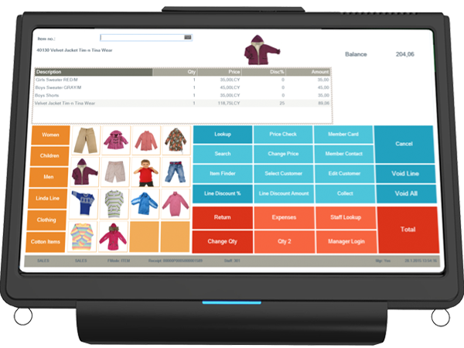
Preparing First POS

Slide 27
Preparation and installation of first POS device
Preparation:-
Distribution Location for each offline POS in POS Master
Replication of POSs data to POS Mater
Installation:-
Run command. C:\LS Retail\Hybrid Cloud Components> & .\NewDatabasePackage.ps1 -Import
Create an installer from Update Service Server Management
Run the installer in POS.

Slide 28
DEMO

Slide 29

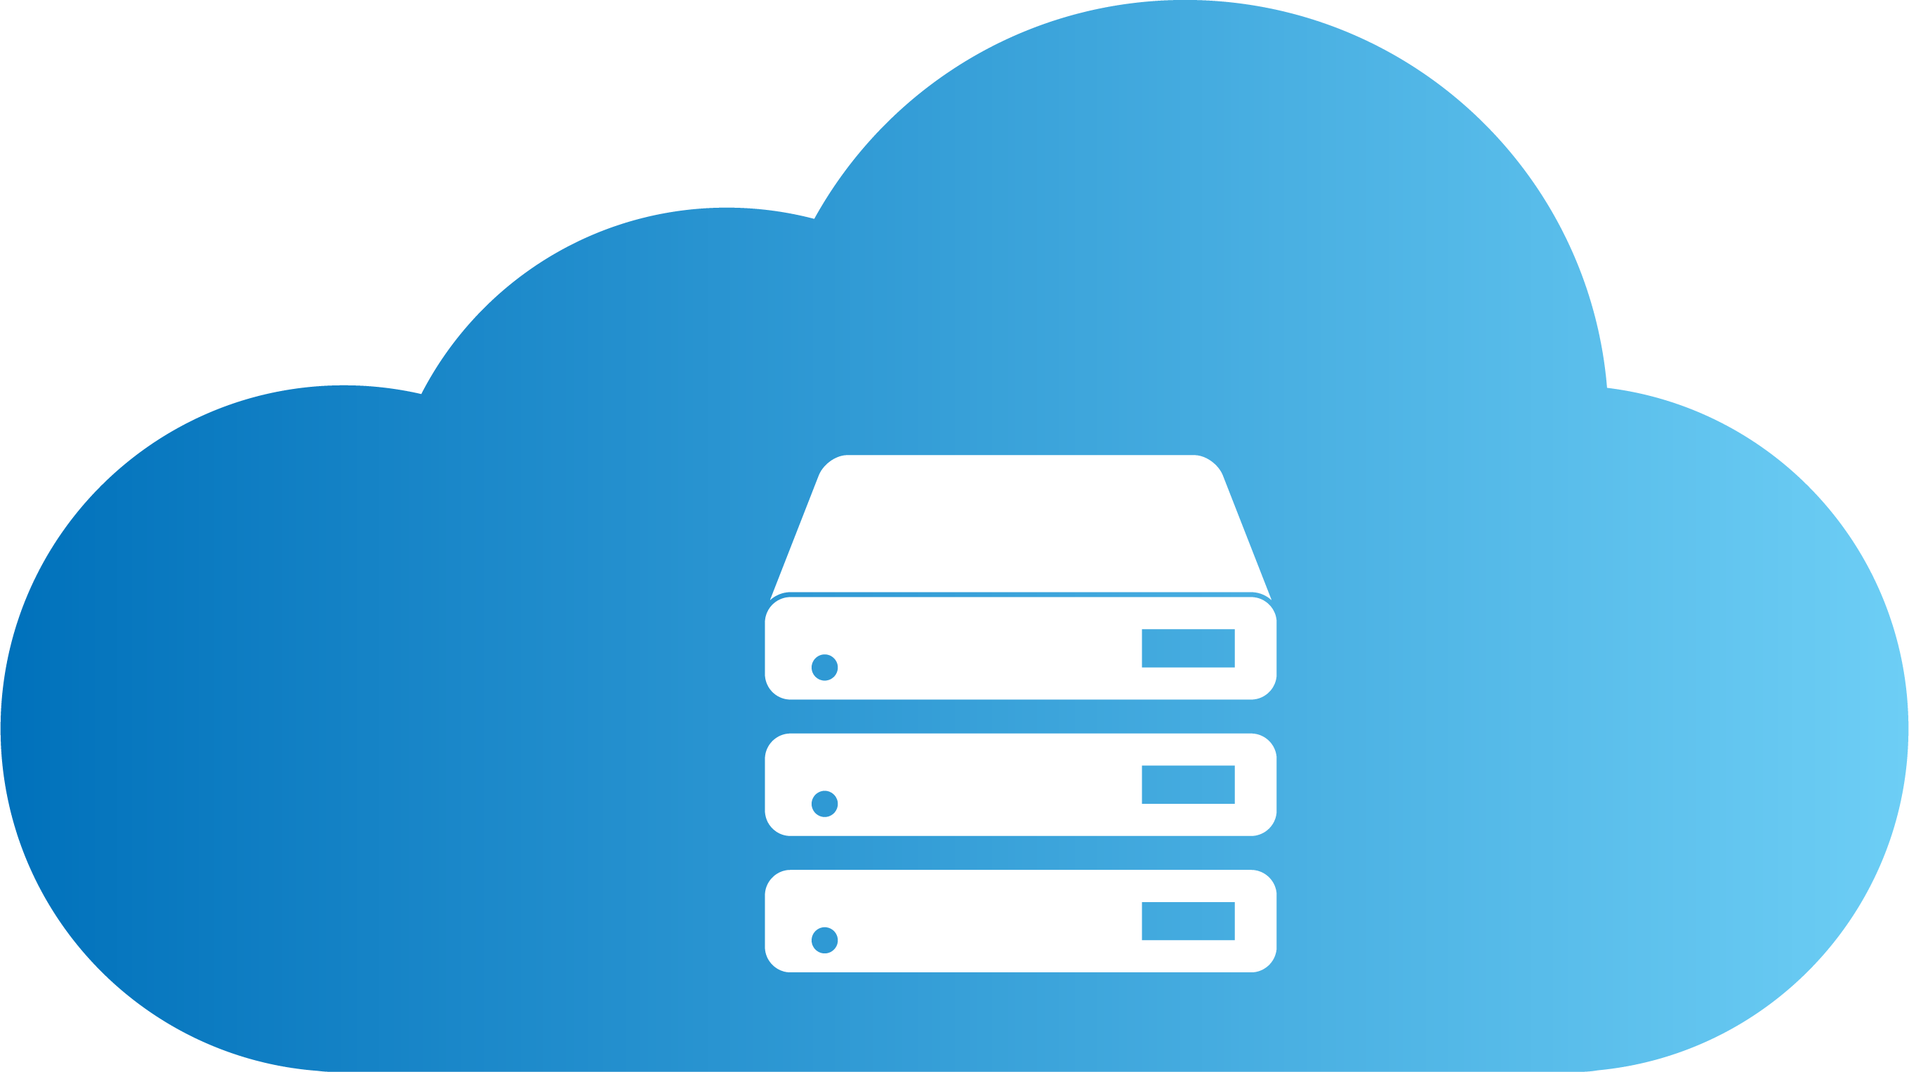

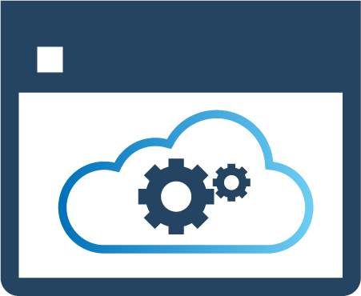
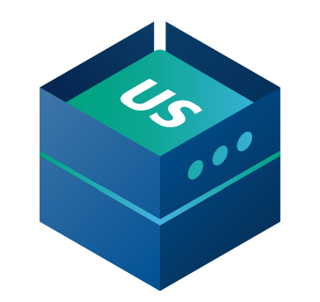
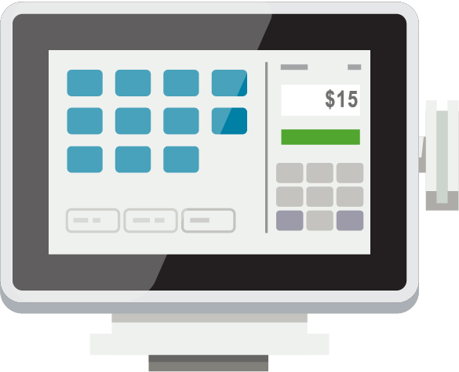
Head office user
HEAD OFFICE IN THE CLOUD
Send transaction Webservice
DD Webservice mode​
Send transactions using Web Replication​
HYBRID
COMPONENT SERVER
POS MASTER
DATA DIRECTOR
UPDATE SERVICE
DD
DD
STORE 1
STORE 2
Back office
Offline POS
Offline POS
Offline POS
Offline POS

Slide 30
Recommendations – HCS
Update the HCS and HO in SaaS simultaneously, so HO and offline POS is always using the same version of LS Central.
Version for HCS
Version for POS
Test Environment | Production Environment
A-Series with 2 - 4 vCPU’s | D-Series with 4 vCPU’s
RAM 8Gb | RAM 8-16Gb
Resilient POS | High volume POS
CPU i5 | CPU i7
RAM 4-8GB | RAM 8GB
Preferably SSD hard drive or fast spindle HDD or HHD (recommended for Windows 10) | SSD Drive

Slide 31
Questions?

