Slide 1
Replenishment
what’s new?
Martin Kleindl | Christina Cheng
Product Director | Product Owner

Slide 2
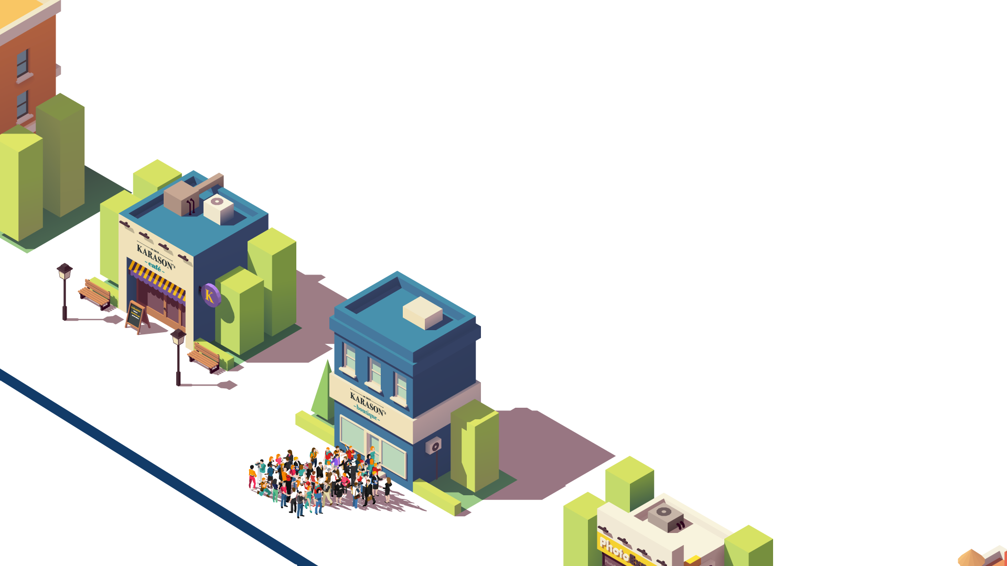
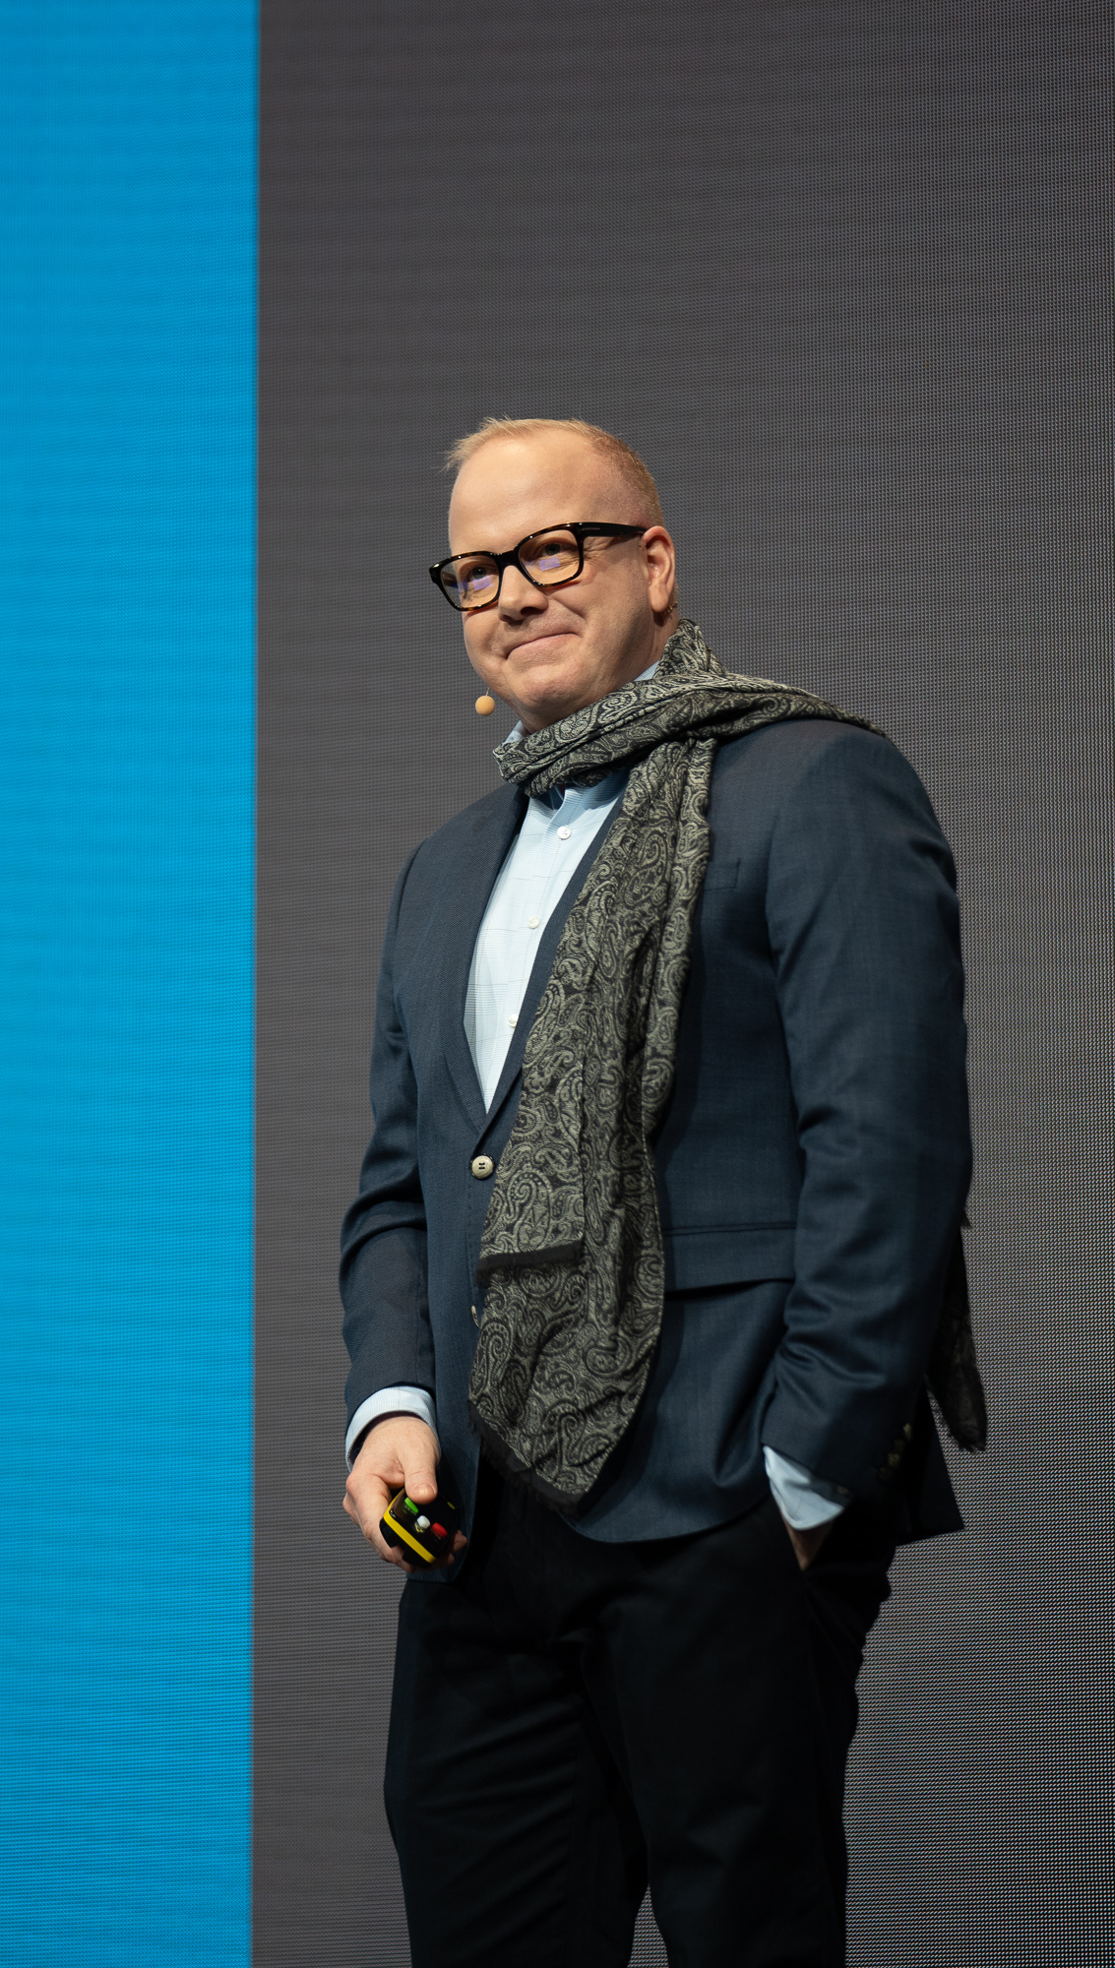

Slide 3
Small startup
Multiple stores
Mobile solutions
Multiple industries in one solution
Multiple countries
eCommerce

Slide 5
The REAL story behind!

Slide 6
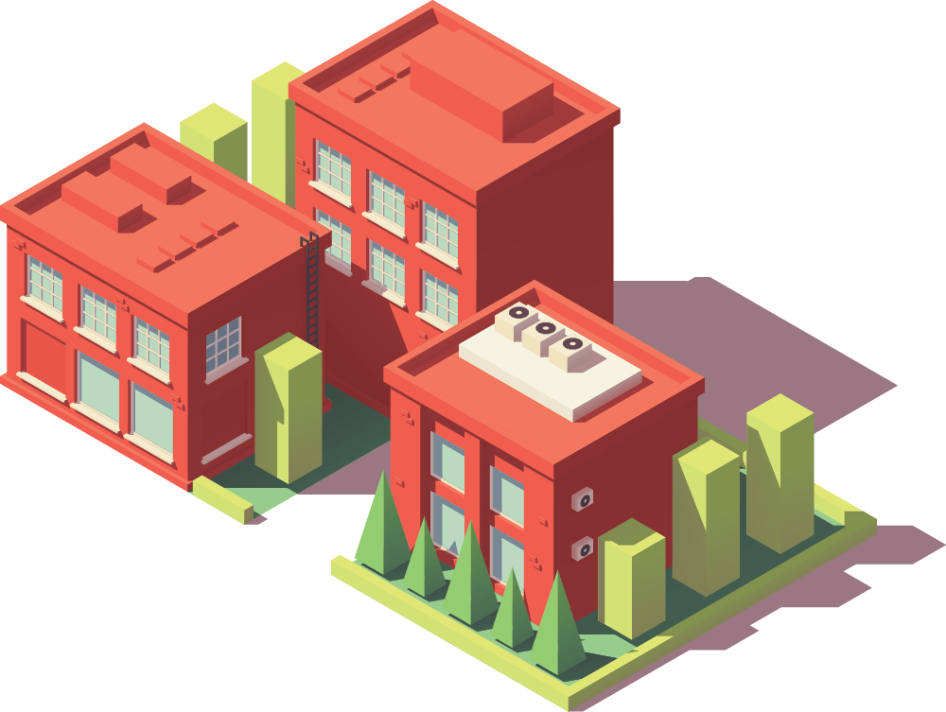
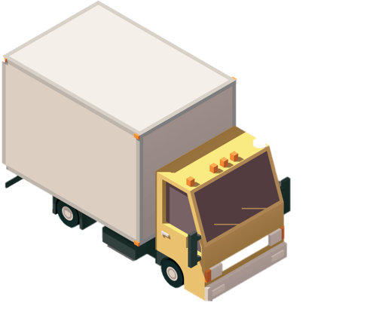
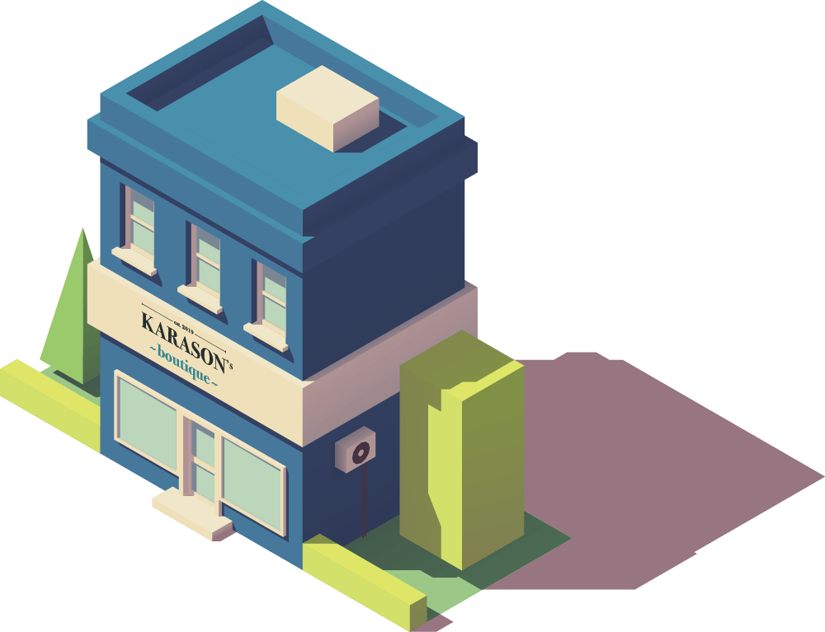
Company milestones
First store opened
Vendors
Manual Purchase Orders

Slide 7
Company milestones
First store opened
Vendors

Slide 8
Company milestones
First store opened
Vendors

Slide 9
Company milestones
First store opened
Replenishment
Vendors
Automatic Replenishment to calculate Purchase Order Proposals

Slide 10
Company milestones
First store opened
Replenishment
Vendors
Stock
Demand
Proposal

Slide 11
Company milestones
First store opened
Replenishment
Vendors
Sales History Adjustment to capture sales history from existing store for NEW store (with factors)
NEW STORE opening

Slide 12
Company milestones
First store opened
Replenishment
Vendors
FESTIVAL in the city !!
Stock
Demand
Proposal

Slide 13
Company milestones
First store opened
Replenishment
Vendors
Planned Demand Events shape future demand for events, discounts and promotions
FESTIVAL in the city !!
+25%
Stock
Demand + 25%
Proposal

Slide 14
Company milestones
First store opened
Replenishment
Vendors
Sales History Adjustment to correct the unusual sales history due to the event

Slide 15
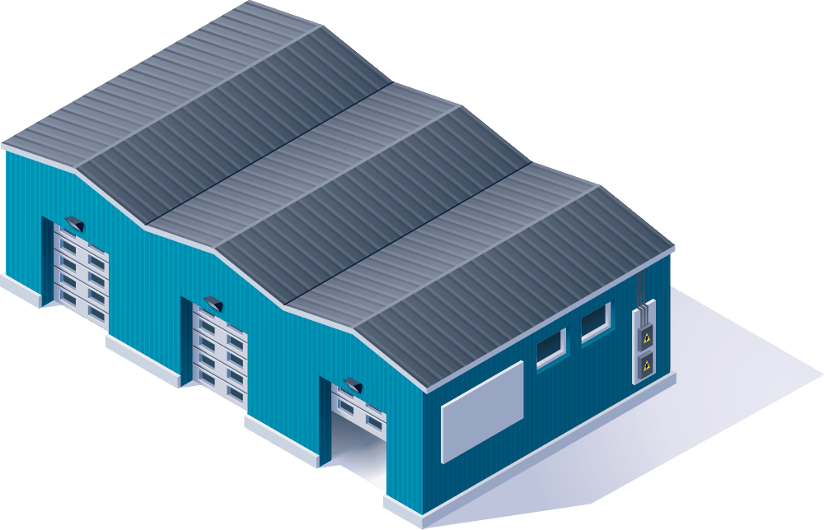
Company milestones
First store opened
Replenishment
Warehouse opened
Vendors
FURTHER GROWTH !!! Warehouse needed

Slide 16
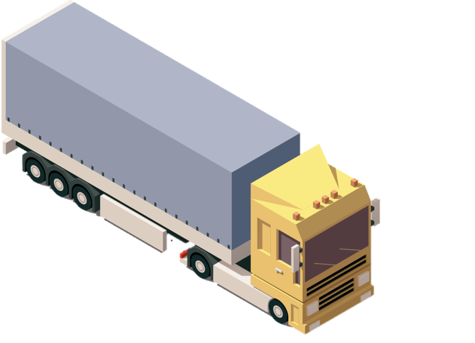
Company milestones
First store opened
Replenishment
Warehouse opened
Vendors
Purchase
Proposals
Transfer
Proposals

Slide 17
Company milestones
First store opened
Replenishment
Warehouse opened
Vendors
Purchase
Proposals
Out of Stock situations detection and consideration in forecast calculation
Transfer
Proposals

Slide 18
Company milestones
First store opened
Replenishment
Warehouse opened
Vendors
Warehouse shortage Transfer Rules to calculate how to distribute existing stock to stores with demand
Purchase
Proposals
Transfer
Proposals

Slide 19
Company milestones
First store opened
Replenishment
Warehouse opened
New countries
Vendors
Multi-Company Replenishment Central Purchase and cross-border distribution to Sales Companies
FURTHER GROWTH !!! Expansion to new countries
Own Replenishment calculation
Country A
Country C
Country B

Slide 20
Company milestones
First store opened
Replenishment
Warehouse opened
New countries
eCommerce
Vendors
eCommerce Specific demand calculation for eCom, B2B and Franchise
Country A

Slide 21
Replenishment benefits:
Reduced operational cost
Increased availability
Less Out-of-Stock
Improved working capital
for seasonal and non-seasonal items

Slide 22
Feature Improvements (1/2)
Retail Sales budget improvements* Workflow and User-rights Top-down and Middle-Out planning with Distribution Curves
Lifecycle Planning Worksheet improvements Improved usability with Tree-view Top-down data maintenance
Store Capacity Integration (SSR) New concept to replenish items, based on Store Capacity Replenish from group of similar items For retailer with opportunity-buy model

Slide 23
Live Demo

Slide 24
Feature Improvements (1/2)
Retail Sales budget improvements Workflow and User-rights Top-down and Middle-Out planning with Distribution Curves
Lifecycle Planning Worksheet improvements Improved usability with Tree-view Top-down data maintenance
Store Capacity Integration (SSR) New concept to replenish items, based on Store Capacity Replenish from group of similar items For retailer with opportunity-buy model

Slide 25
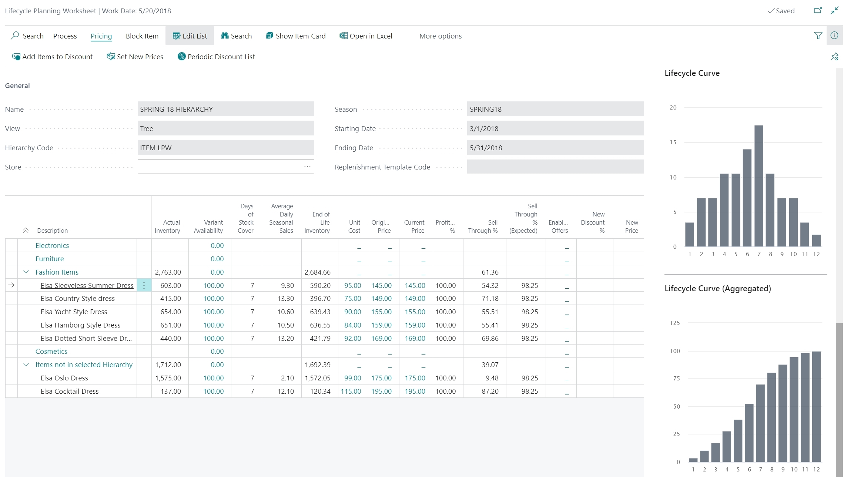
Lifecycle Planning Worksheet
Inventory Status
Cost Price, Sales Price
Sell Through %

Slide 26
Lifecycle Planning Worksheet
New Price or Discount %
New Price or Discount %

Slide 27
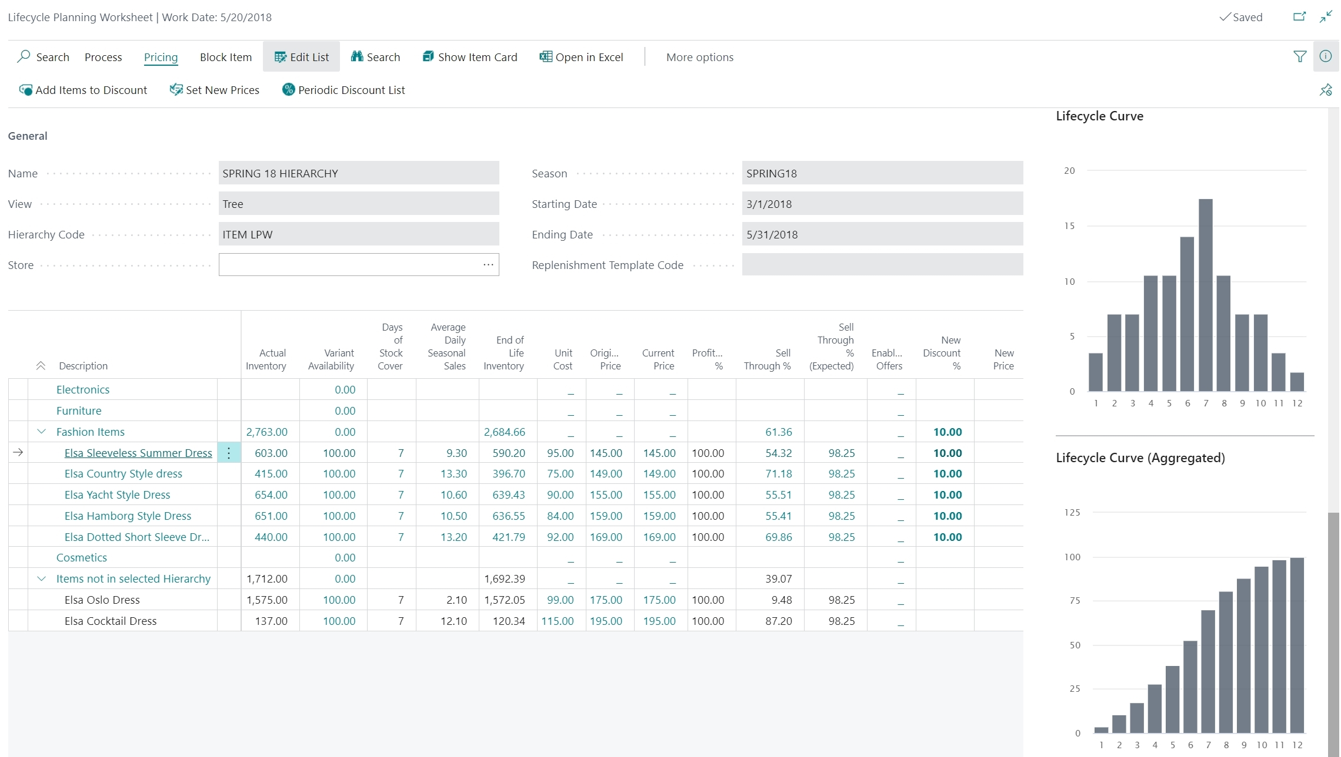
Lifecycle Planning Worksheet
New Price or Discount %
New Price or Discount %
Top-Down maintenance

Slide 28
Feature Improvements (1/2)
Retail Sales budget improvements Workflow and User-rights Top-down and Middle-Out planning with Distribution Curves
Lifecycle Planning Worksheet improvements Improved usability with Tree-view Top-down data maintenance
Store Capacity Integration (SSR) New concept to replenish items, based on Store Capacity Replenish from group of similar items For retailer with opportunity-buy model

Slide 29
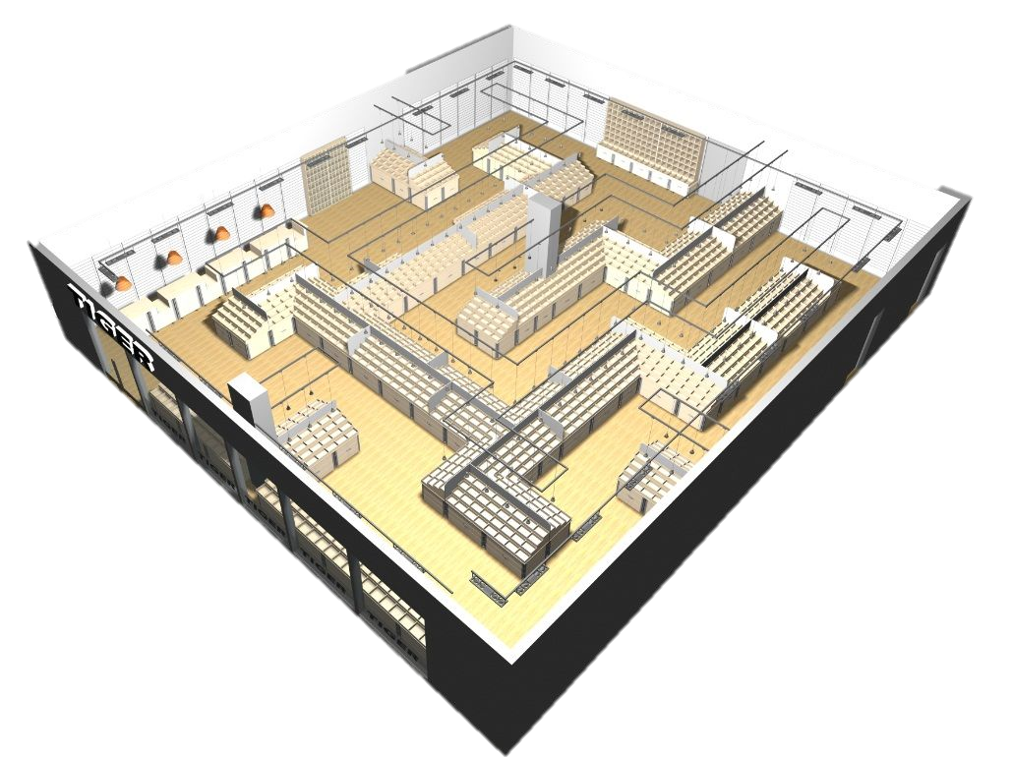
Store Capacity Integration to
Store Stock Redistribution
Men’s (30%)
Process
Set Capacity Goals
Measure Capacity Usage
If understocked,
Propose items from Warehouse - of same group - with available stock
Select items
Create Transfer Orders
Shoes (35%) - Men (15%) - Women (20%)
Kids (10%)
Women’s (25%)

Slide 30
Feature Improvements (2/2)
Manual Redistribution handling (Variants)* Easier, simpler, faster! New approach to manually replenish full Dimension Patterns
Parallel Replenishment calculation (SaaS) Usage of parallel Background sessions (instead of NAS)
Manual Replenishment overhaul Various improvements and performance tuning

Slide 31
Live Demo

Slide 32
Feature Improvements (2/2)
Manual Redistribution handling (Variants) Easier, simpler, faster! New approach to manually replenish full Dimension Patterns
Parallel Replenishment calculation (SaaS) Usage of parallel Background sessions (instead of NAS)
Manual Replenishment overhaul Various improvements and performance tuning
Test Results: Replen. Item Quantity Calculation (10.000 items, 50 stores, 36 Mio. Item Ledger entries)
Without parallel processing: ~66 minutes
With 10 parallel threads: ~7 minutes
-89%

Slide 33
Feature Improvements (2/2)
Manual Redistribution handling (Variants) Easier, simpler, faster! New approach to manually replenish full Dimension Patterns
Parallel Replenishment calculation (SaaS) Usage of parallel Background sessions (instead of NAS)
Manual Replenishment overhaul Various improvements and performance tuning

Slide 34
The future
Replen. Journal calculation - Performance Code tuning Introduce parallel processing Multi-warehouse Replenishment Warehouse to Warehouse transfers
Multi-company Replenishment (for SaaS) Multiple database support with webservices

Slide 35
Questions

Slide 36
New Headquarter
opened !

Slide 37
~hotels~
to be continued ….

