Slide 1
LS Central
SaaS Architecture and Replication
Aðalbjörg Karlsdóttir – Onboarding Lead Kristján Ásvaldsson – Solution Lead Stefán Konráðsson – Solution Architect Matthías Matthíasson – Product Director

Slide 2
Architecture

Slide 3
Architecture
Retailer Hosted or
Outsourcing Hosted
HQ
Data Director
Store
Offline POS
Offline POS Service

Slide 4
Architecture
Retailer Hosted or
Outsourcing Hosted
HQ
Data Director
Store
Online POS
Offline POS
Offline POS Service

Slide 5
Architecture
Dynamics 365 cloud
HQ
Store
Online POS

Slide 6
Architecture
Dynamics 365 cloud
HQ
Hybrid component server
Store
Online POS
Offline POS
Offline POS Service

Slide 7
Architecture
Web Replication
Dynamics 365 cloud
HQ
Hybrid component server
Store
Online POS
Offline POS
Offline POS Service

Slide 8
Scheduler

Slide 9
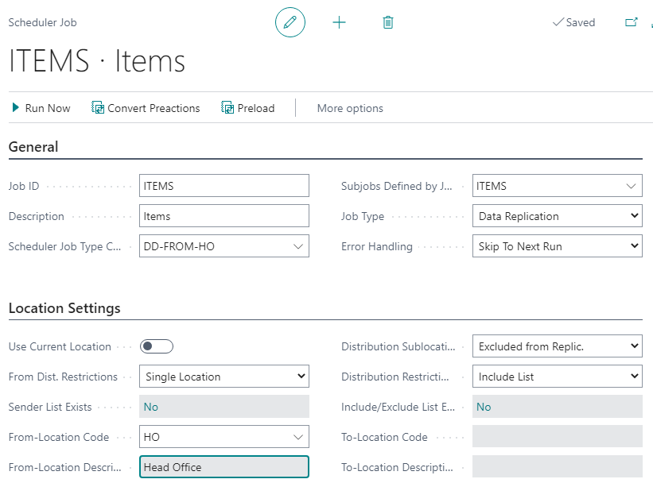
How does Scheduler create requests
Scheduler runs Scheduler Job
Scheduler Job has list of tables that should be replicated which are defined as Sub Jobs
Source where to get data from
Destinations where data should be updated

Slide 10
How does Scheduler create requests
Three types of replication:
Normal Job
Normal Job By Replication Counter
Action Job By Pre-actions/Actions

Slide 11
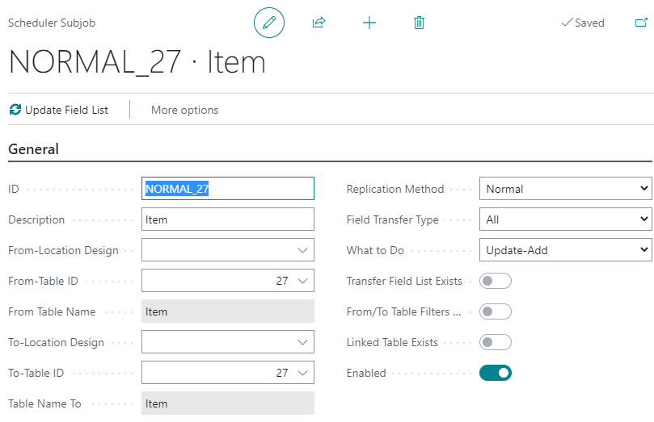
How does Scheduler create requests
Normal Job
Data is synchronized to match the source.
Full sync, Update-Add-Delete
Partly sync, Update-Add

Slide 12
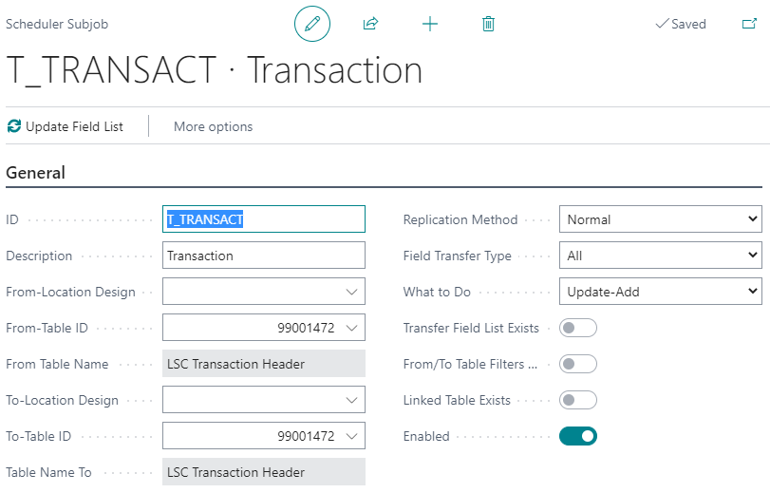
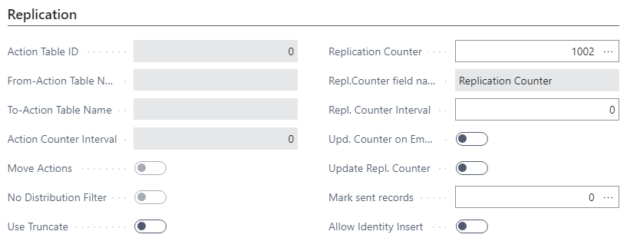
How does Scheduler create requests
Normal Job By Replication Counter
Specified counter field implemented in the table
Counter is updated when record is inserted or updated

Slide 13
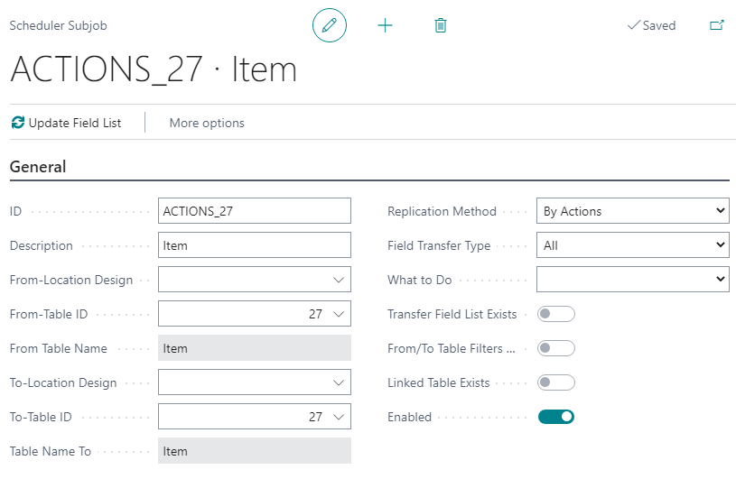
How does Scheduler create requests
Action Job By Pre-actions/Actions
Change logging is needed
Keeping track of changes, Pre-Actions
Convert Pre-Actions into Actions according to Table Distribution Setup

Slide 14
Data Director

Slide 15
Data Director
DD gets the data
Generates data files and compresses the data
Sends it over to destination Host
Destination host unpacks the data and inserts the data
DD Service
Destination Host
DD Service
Hybrid Server

Slide 16
Data Director
LS Central
Scheduler
Scheduler gets Actions & Replication counter with WS from source host
Scheduler sends job to DD WS
DD WS creates DD job and sends to Source DD
DD pulls/inserts data from/to database (On Prem) or SaaS
IIS
DD Web Service
(WS Distribution Server)
SaaS
LS Central WS
(Web Server)
DD Service
(Data Director)
Database
(Replication)

Slide 17
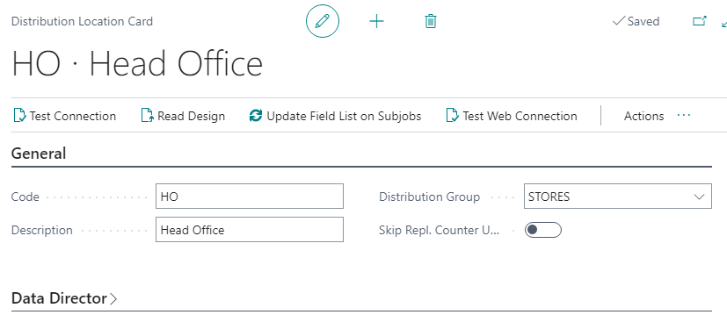
Data Director
Distribution Location card
Data Director
WS Distribution Server
Replication
Web Server
LS Central
Scheduler

Slide 18
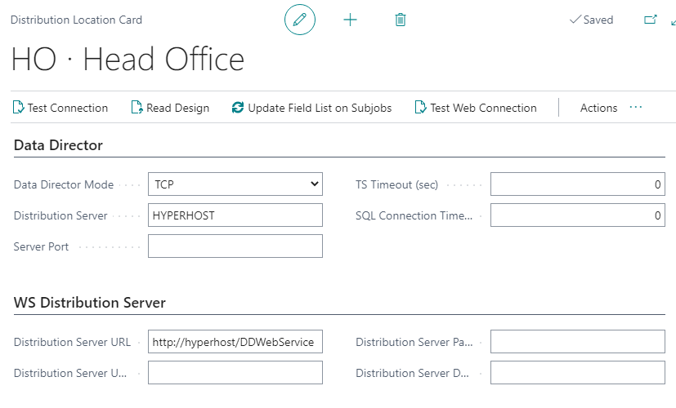
Data Director
Distribution Location card
Data Director
DD Host
WS Distribution Server
DD Web Service on IIS
LS Central
Scheduler
IIS
DD Web Service
(WS Distribution Server)
DD Service
(Data Director)

Slide 19
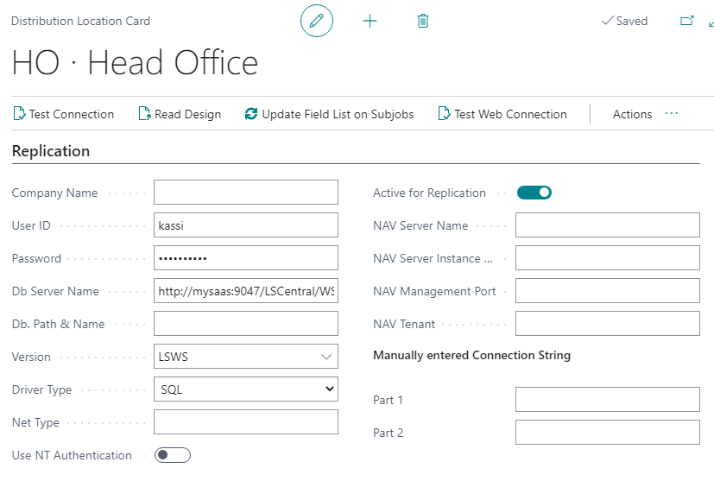
Data Director
Distribution Location card
Replication
Database / SaaS Connection
LS Central
Scheduler
IIS
DD Web Service
(WS Distribution Server)
DD Service
(Data Director)

Slide 20
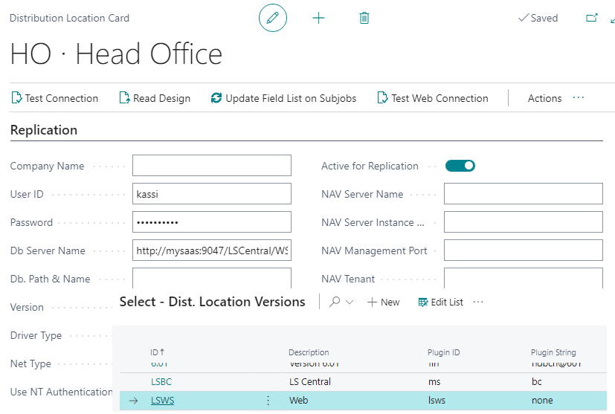
Data Director
Distribution Location card
Replication
Database / SaaS Connection
LS Central
Scheduler
IIS
DD Web Service
(WS Distribution Server)
SaaS
LS Central WS
(Web Server)
DD Service
(Data Director)
Database
(Replication)

Slide 21
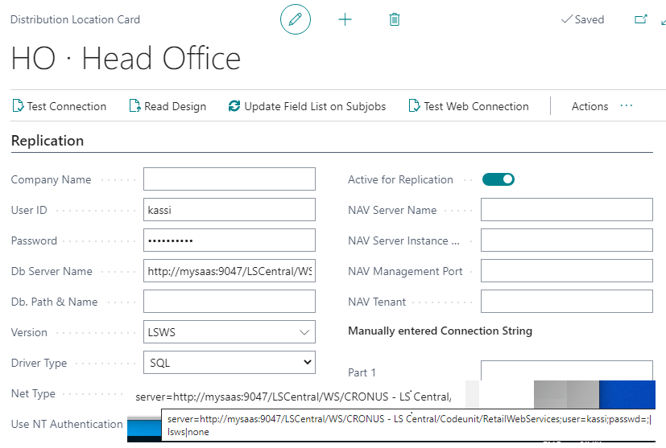
Data Director
Distribution Location card
Replication
Database / SaaS Connection
LS Central
Scheduler
IIS
DD Web Service
(WS Distribution Server)
SaaS
LS Central WS
(Web Server)
DD Service
(Data Director)
Database
(Replication)

Slide 22
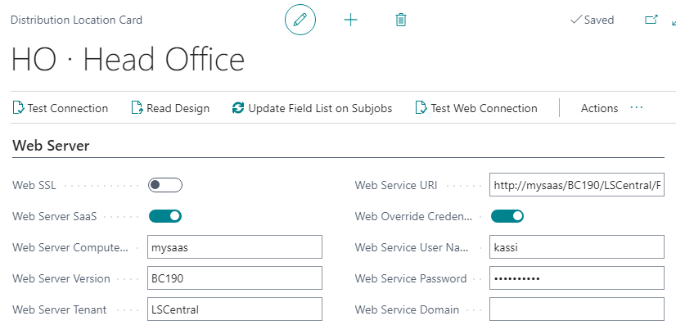
Data Director
Distribution Location card
Web Server
LS Central Web Service to query for Pre-actions / Replication counter
LS Central
Scheduler
SaaS
LS Central WS
(Web Server)

Slide 23
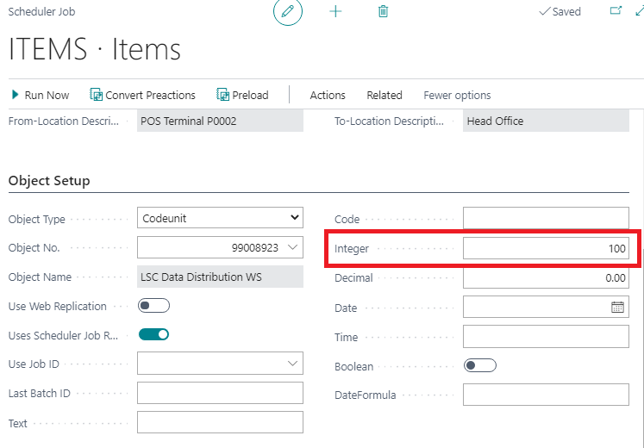
Data Director
Scheduler Job
Change default batch size by set value to Integer field
Option to Commit each batch, default Commit is done when whole job is done processing

Slide 24
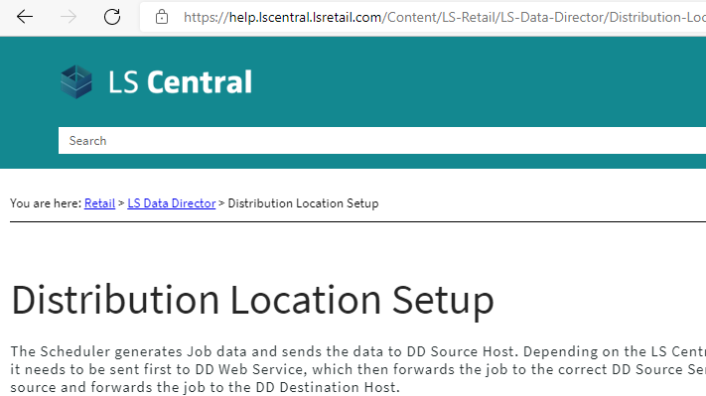
Data Director
Online help to refresh your memory on what is needed

Slide 25
Send Transaction

Slide 26
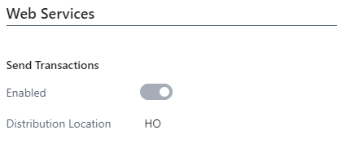
Send Transaction
How to Send Transactions
Several way to Send Transactional Data
Replicate by Scheduler Jobs, indirect
Replicate using Data Director, direct / indirect
Controlled by POS Functional Profile (Data Director)
Replicate using web requests, direct
Controlled by POS Functional Profile (Web Services)

Slide 27
Send Transaction
Replicate using web requests (SendTransaction)
Two Methods
By dedicated web request SendTransaction Can be run directly or in background Session xmlport defines tables and fields.
By using Web Replication in Background Session No xmlport Includes all fields for selected tables.

Slide 28
Send Transaction
How to Extend
Web Request SendTransaction
New xmlport, implementing all fields and table (SendTransactionXML). New codeunit to publish the new xmlport (SendTransaction). New codeunit to extend the standard SendTransactionUtils Use events to implement changes (SendTransactionUtils).
Web Replication in Background Session
New codeunit to extend (add) tables to send local procedure OnAfterLoadTransactionTables(var TransactionHeaderTemp: Record "LSC Transaction Header" temporary; var BufferUtility: Codeunit "LSC Buffer Utility")

Slide 29
Web Replication

Slide 30
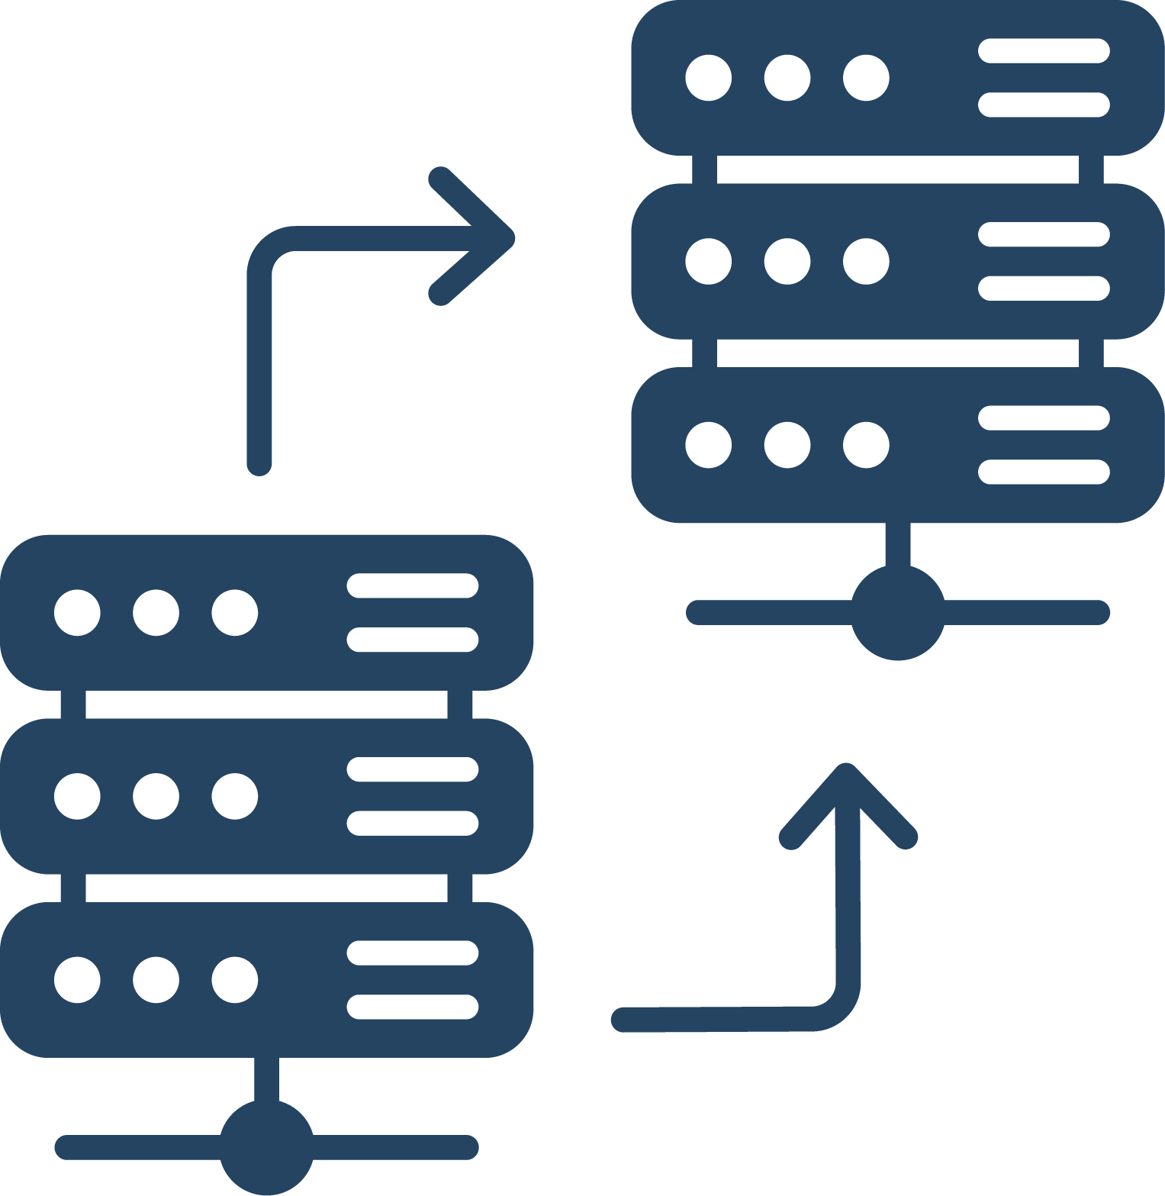
Web Replication
Web Replication is an internal BC method to replicate data
Replication without the Data Director
The process is divided in to two separate steps
Scheduler jobs (replication jobs) to create replication requests, passed to web replication module
Replication of the actual data handled by the web replication module

Slide 31
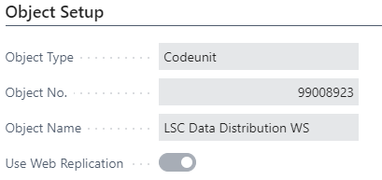
Web Replication
Activate Web Replication, Scheduler Job Card, flag “Use Web Replication”
Replication Limitations with this Method
1. From distribution location can only be current location. The user must define the “Use current Location”. This means that the source and process location must be the same location or in other words, only data push is valid.
2. This process only supports
a. For by Actions jobs it only supports Add-Update and Delete
b. For Normal jobs it only supports Add-Update, that is not “delete” and therefore not what could be subscribed as “data sync”. Normal job without replication counters (small tables) would only be able not add or update existing records from the source to the destination, leaving any extra existing records at the destination.
Only replication between identical tables, that is from table to the same table.
Some other filtering limitations, constants on linked table.

Slide 32
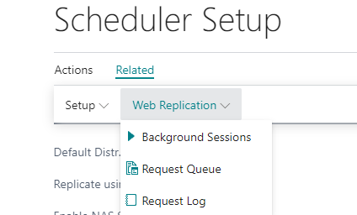
Web Replication
All Destination Locations must have valid Web Server Connection.
All UI related to the web replication module can be found from the Schedular Setup card page

Slide 33
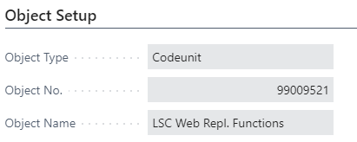
Web Replication
The web replication module that processes the replication requests is run by schedular job
Schedular job to run codeunit 99009521
To process incoming request at each Destination Locations
Publish codeunit 99009520 with the service name “WebReplicationODataMgt”

Slide 34
Company Replication

Slide 35
Company Replication
Web Replication
Web Replication
Dynamics 365 cloud
Environment

Slide 36
Company Replication
Web Replication
What is Company Replication?
What challenge does Company Replication Solve?
Company Replication
Dynamics 365 cloud
Environment

Slide 37
Company Replication
Web Replication
What is Company Replication?
What challenge does Company Replication Solve?
What do you think? – DISCUSSION PLEASE
Company Replication
Dynamics 365 cloud
Environment

Slide 38
Hybrid

Slide 39
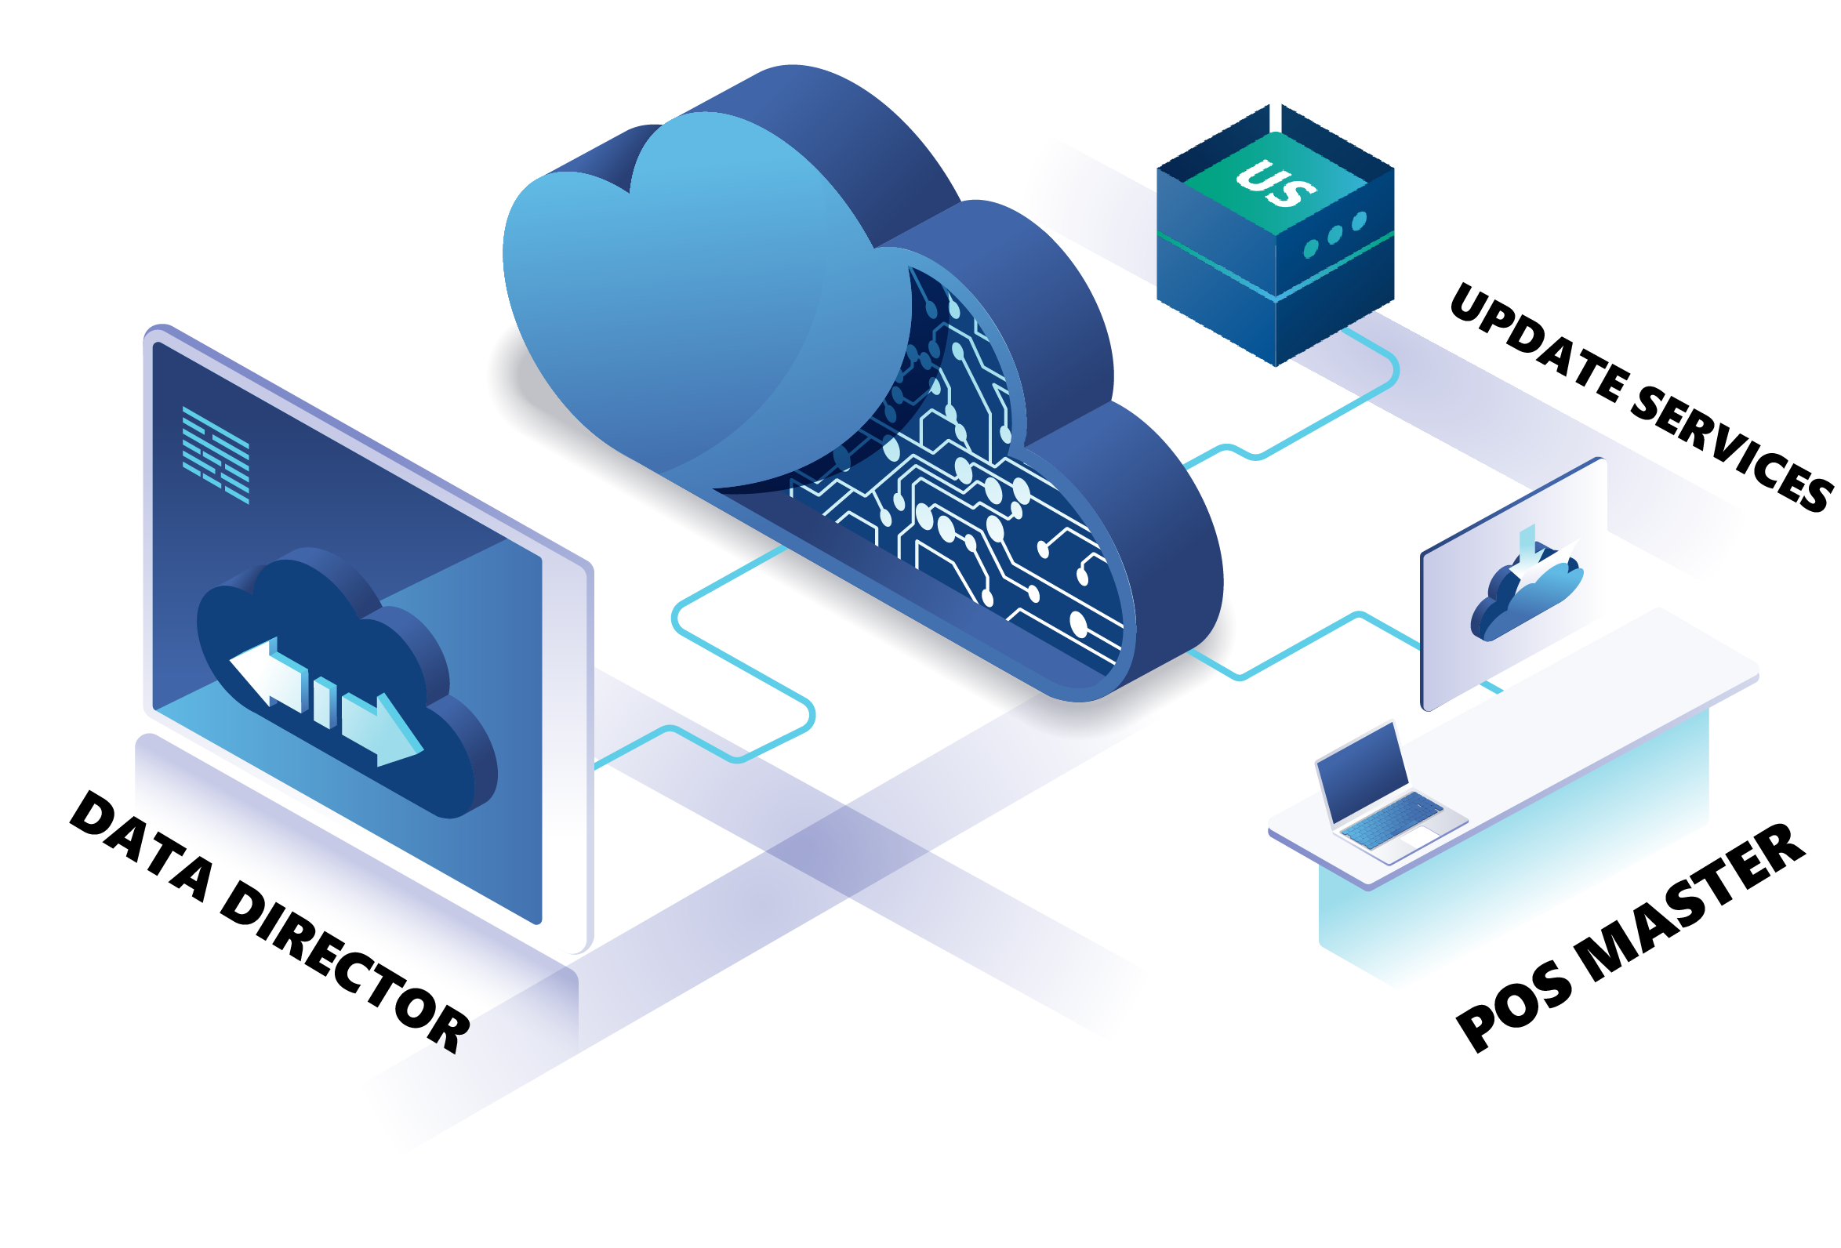
HYBRID COMPONENT SERVER
Hybrid Component Server

Slide 40
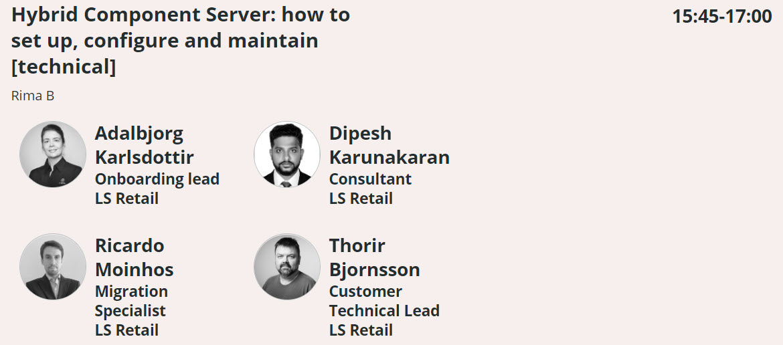
HCS in more detail

Slide 41
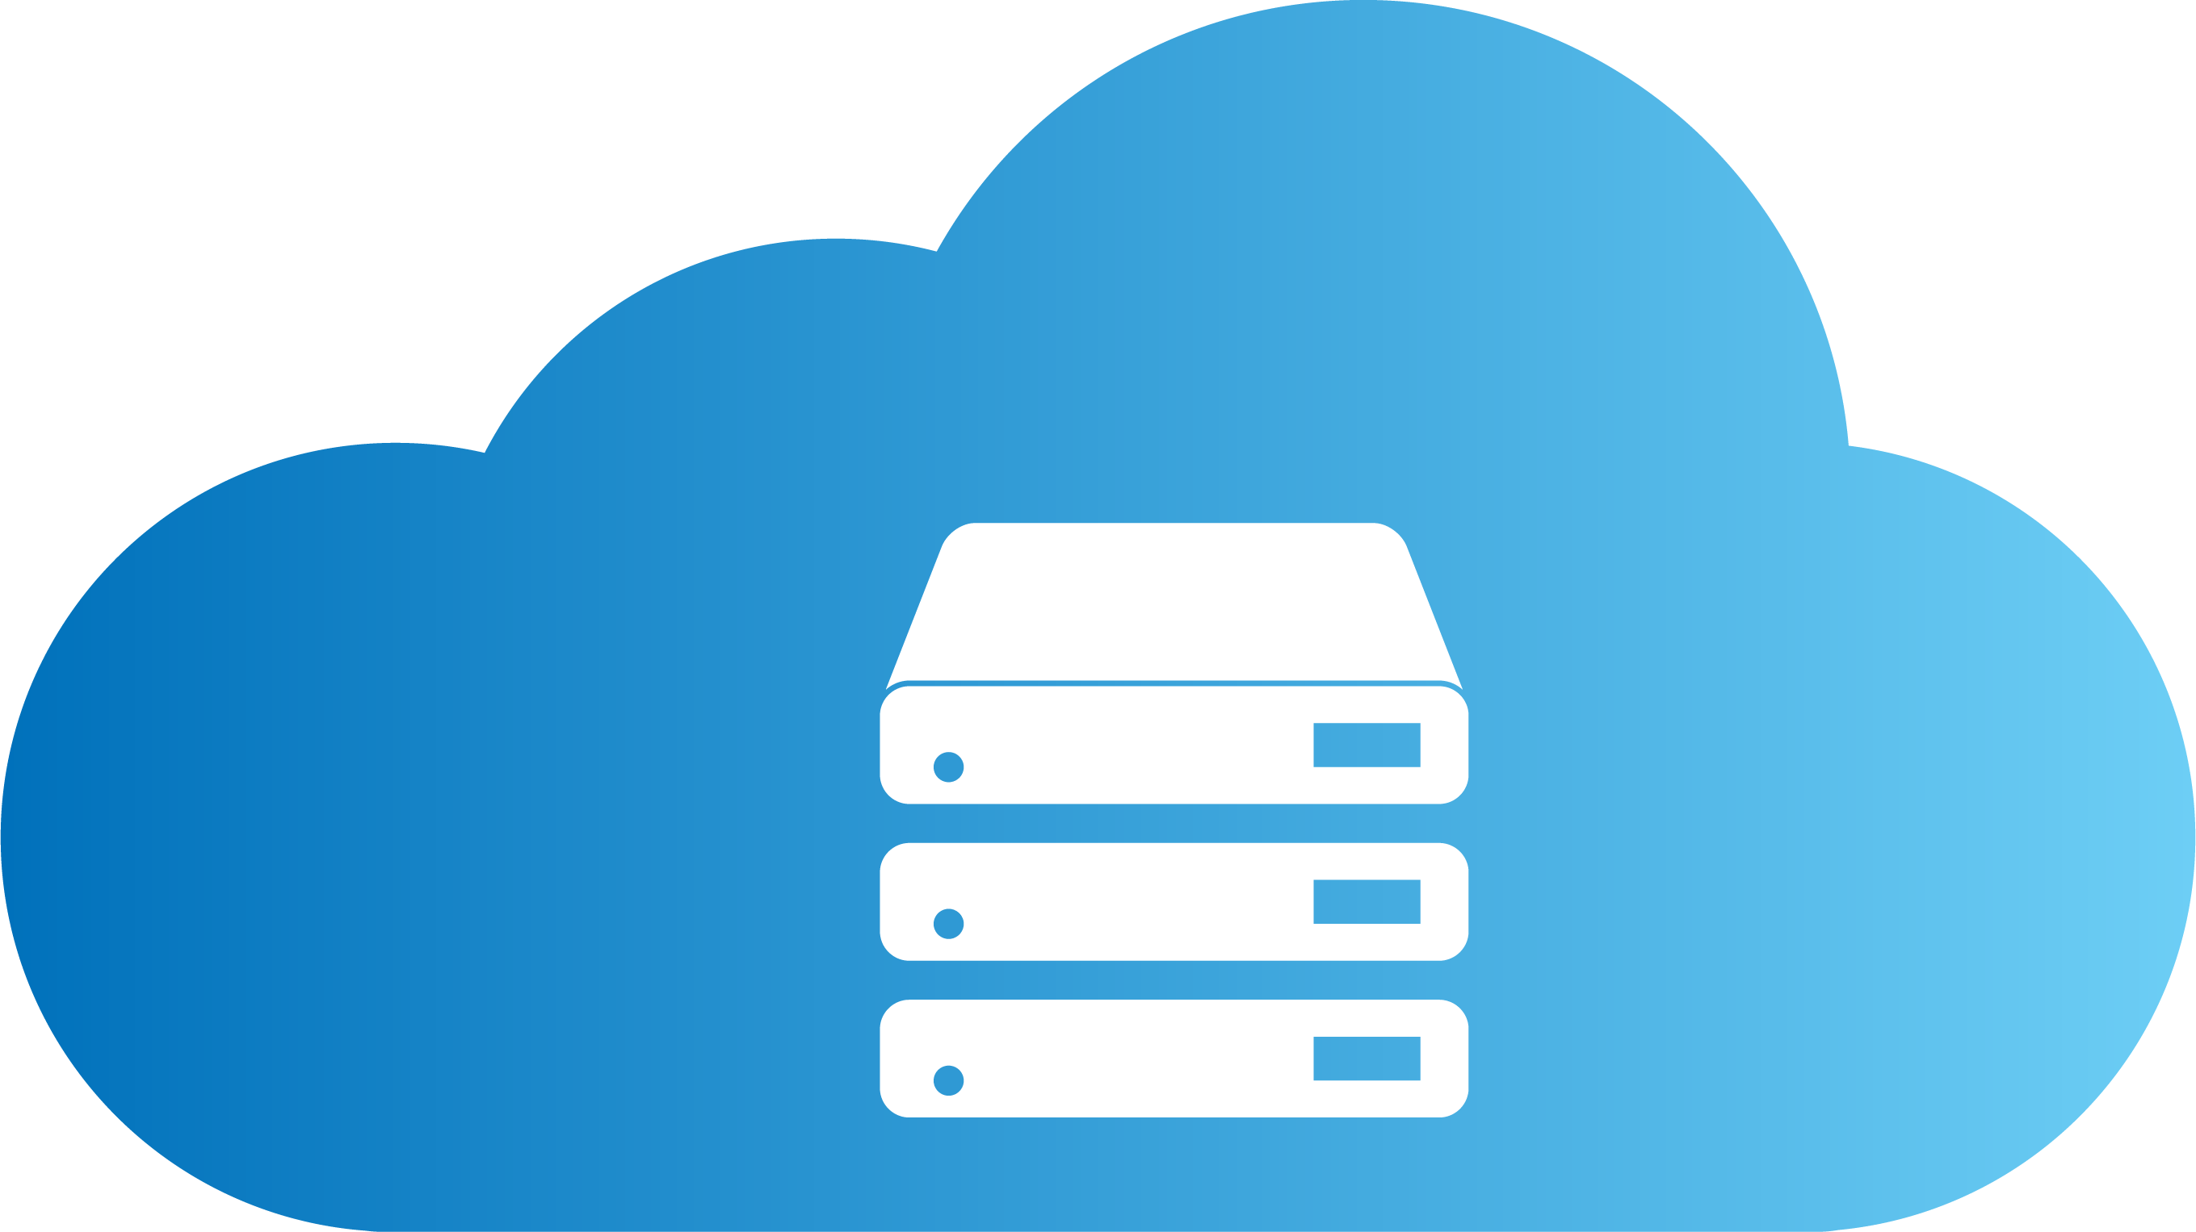
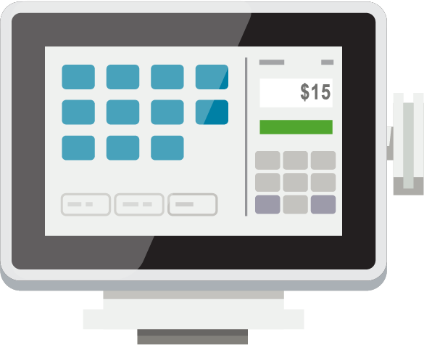
Head office user
HEAD OFFICE IN THE CLOUD
SendTransaction WS
DD Webservice mode​
SendTransaction using Web Replication​
HYBRID
COMPONENT SERVER
POS MASTER
DATA DIRECTOR
UPDATE SERVICE
DD
DD
STORE 1
STORE 2
Back office
Offline POS
Offline POS
Offline POS
Offline POS

Slide 42
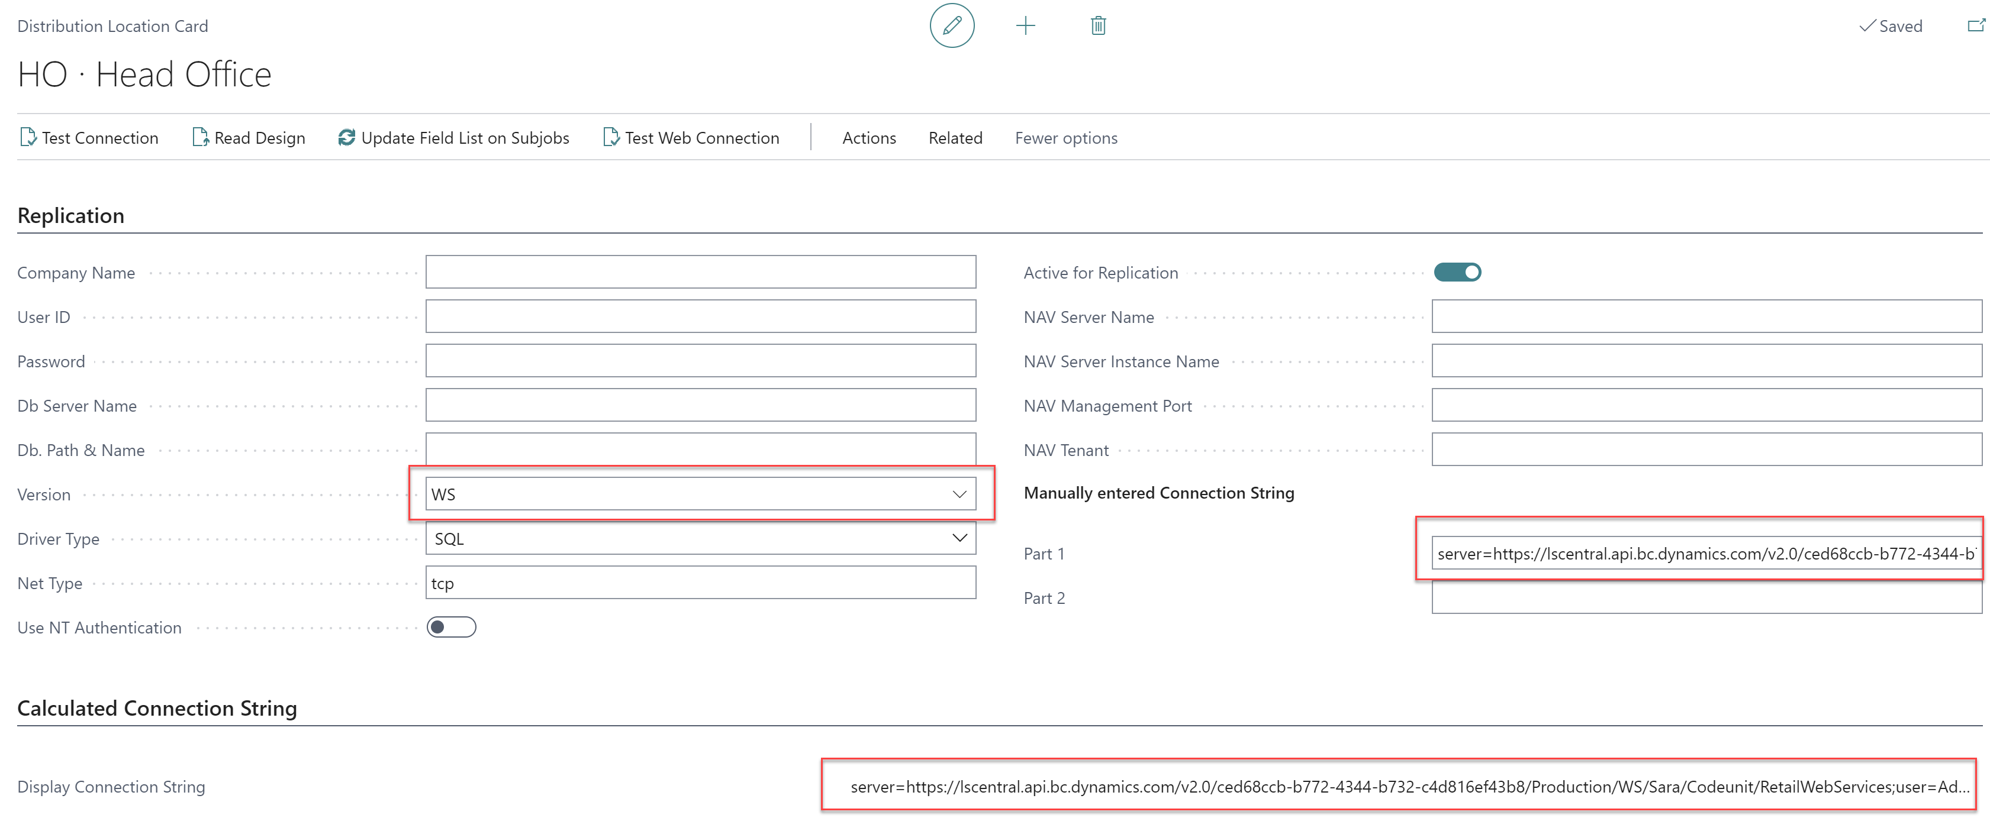
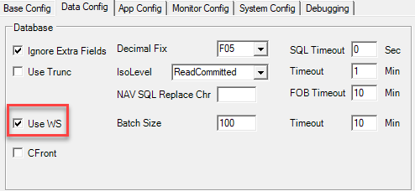
HO to HCS
HCS
POS MASTER
DATA DIRECTOR
UPDATE SERVICE

Slide 43
HO to HCS - performance
Leaner Preaction logs
Split jobs
Smaller batches
Initial job as a normal job
HCS
POS MASTER
DATA DIRECTOR
UPDATE SERVICE

Slide 44
HO to HCS - performance
Leaner Preaction logs
Split jobs
Smaller batches
Initial job as a normal job
HCS
POS MASTER
DATA DIRECTOR
UPDATE SERVICE

Slide 45
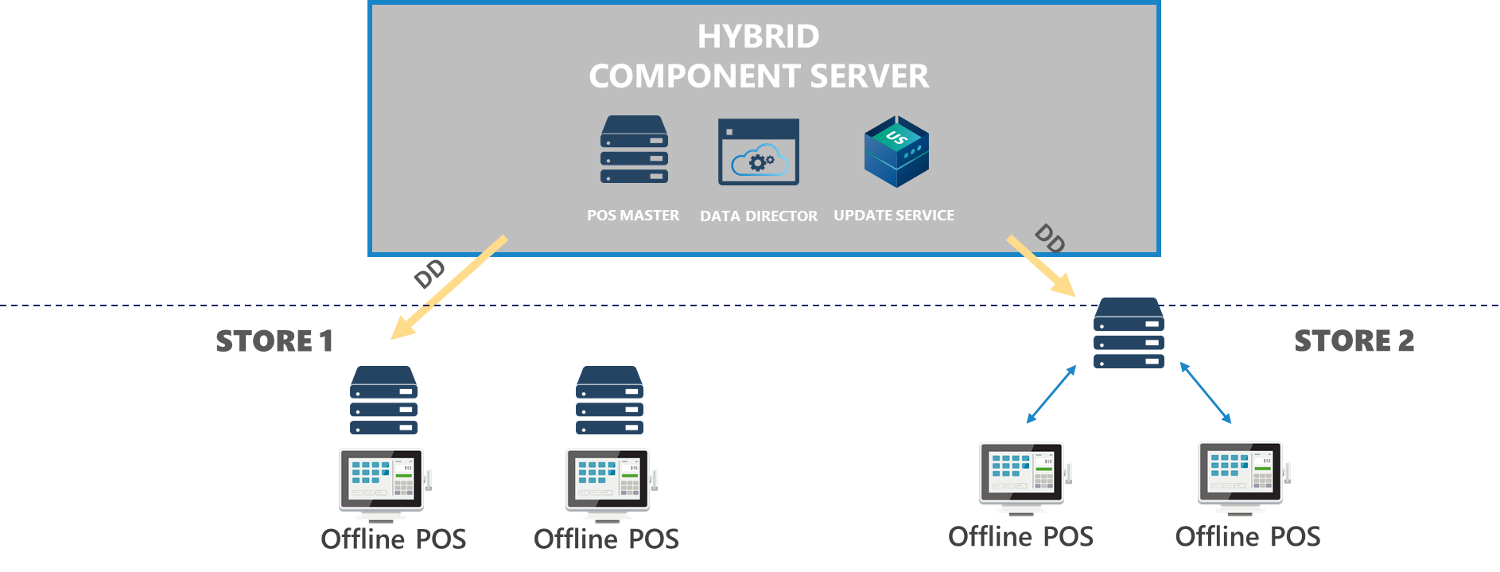
HCS to offline POS
AZURE
v
Hybrid Component Server
Firewall
Firewall
POS

Slide 46
HCS to offline POS
AZURE
Hybrid Component Server
v
Firewall
Firewall
POS
VPN Tunnel

Slide 47
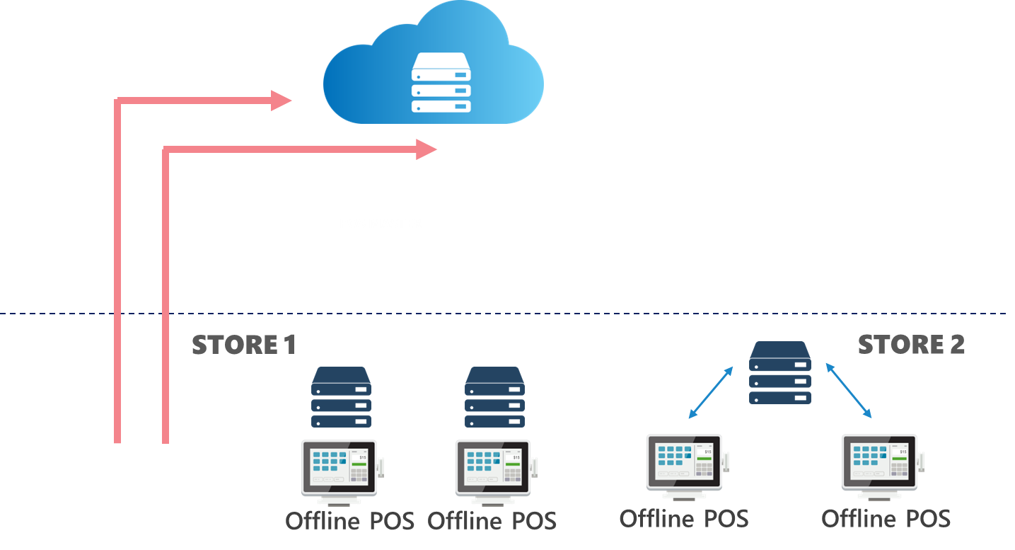
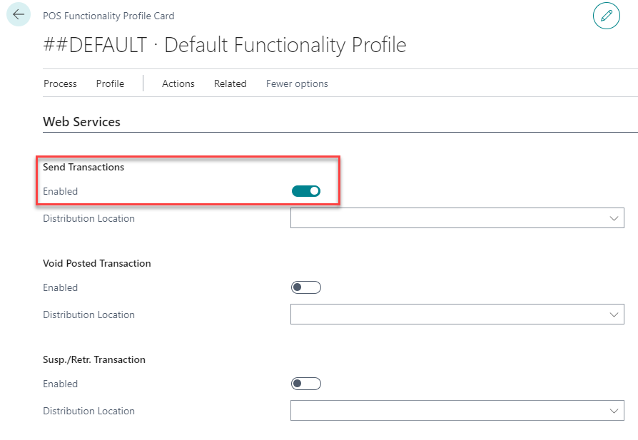
Send transaction

Slide 48
Send transaction

Slide 49
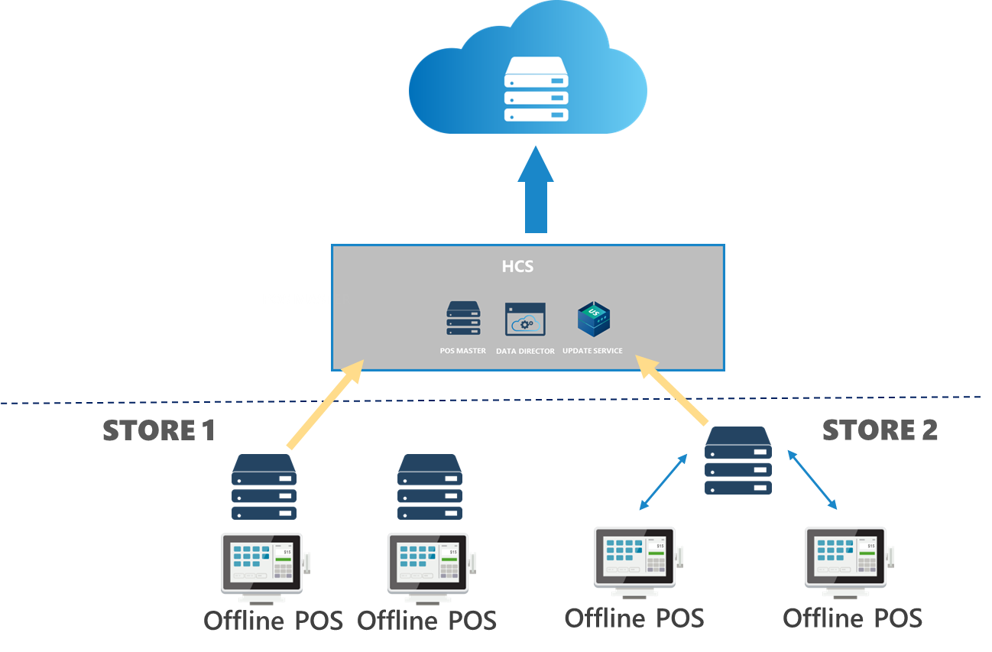
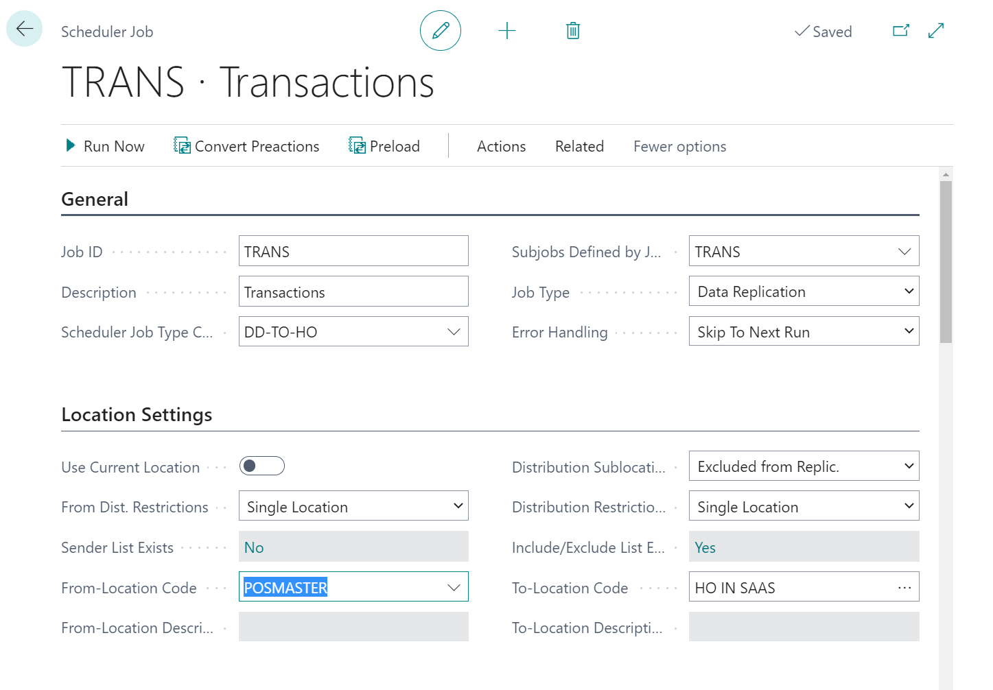
Send transaction

Slide 50
Send transaction

Slide 51
Head office user
HEAD OFFICE IN THE CLOUD
SendTransaction Web service
DD Webservice mode​
SendTransactions using Web Replication​
HYBRID
COMPONENT SERVER
POS MASTER
DATA DIRECTOR
UPDATE SERVICE
DD
DD
STORE 1
STORE 2
Back office
Offline POS
Offline POS
Offline POS
Offline POS

Slide 52
Q&A time

