Slide 1
LS Central POS: implementing the DLL free webPOS
Ólafur Jónsson
Eiður Már Arason
Product owner
Solution lead
Bjarki Hall
Senior Developer

Slide 2
Session format
Deep Dive is a process for delivering hands-on information on a system in a detailed way
Deep Dive provides a background information and Live demonstration of a product
The task of the workshop participants is to be active and ask questions in the end.

Slide 3
2017
Feb
2016
webPOS start design and coding
webPOS pre-release
2018
Apr
2019
Oct
2022
webPOS Full release
DLL free POS
winPOS (14.24) last release POS = webPOS
DLL removal starts
webPOS timeline

Slide 4
NoDLL POS - when will we get there?
June : NoDLL POS pre-release candidate
Sept : LS Central 20.4 with NoDLL. Selected installations.
Sept+ : Distribution to all clusters
LS Central AppSource compliant first quarter of 2023

Slide 5
DLL’s
Toolbox
-- In Loving Memory --

Slide 6
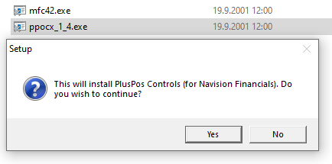
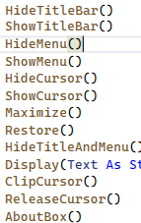
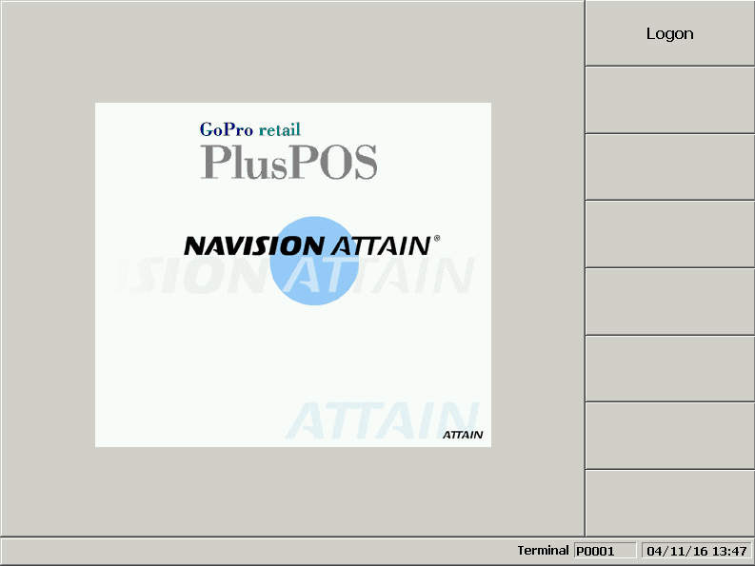
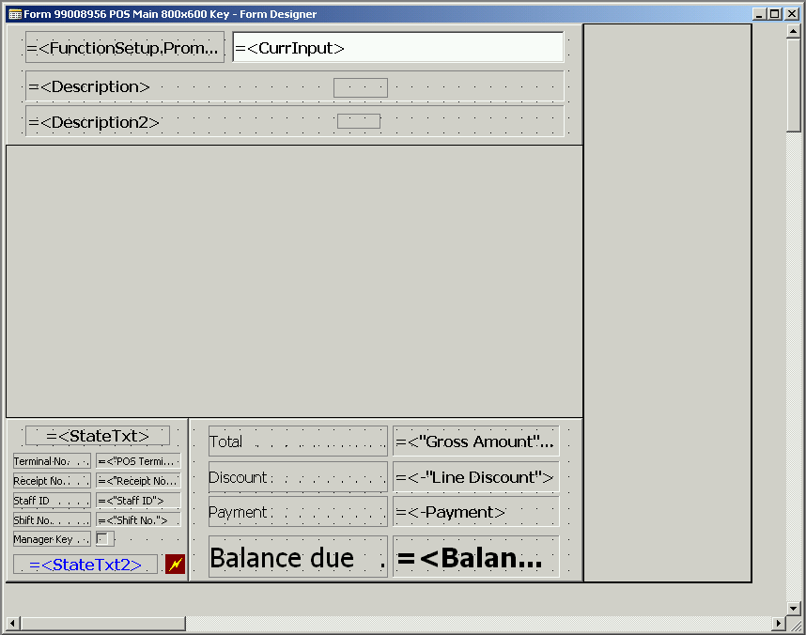
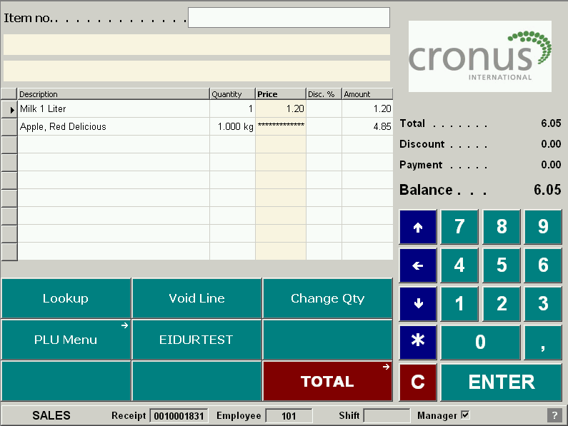
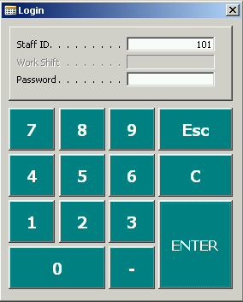
~Year 2000 (OCX’s)
Landsteinar (GoPro) Retail PlusPOS

Slide 7
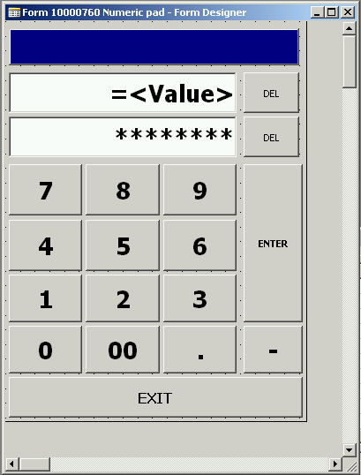
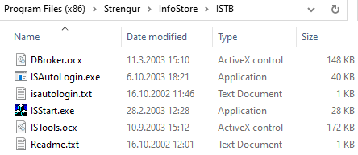
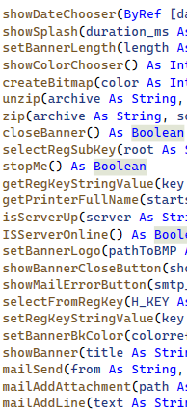
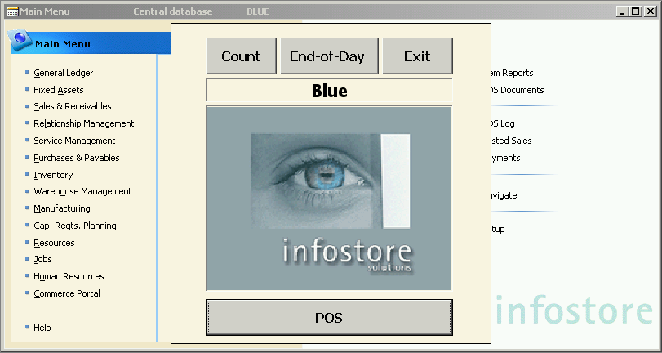
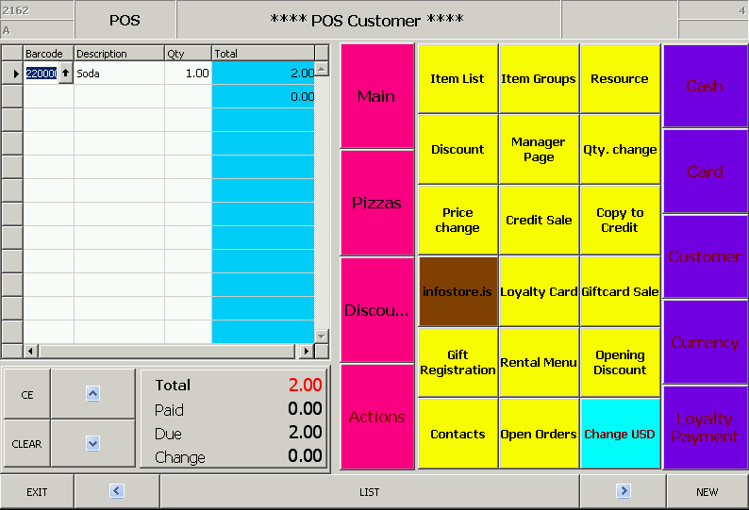
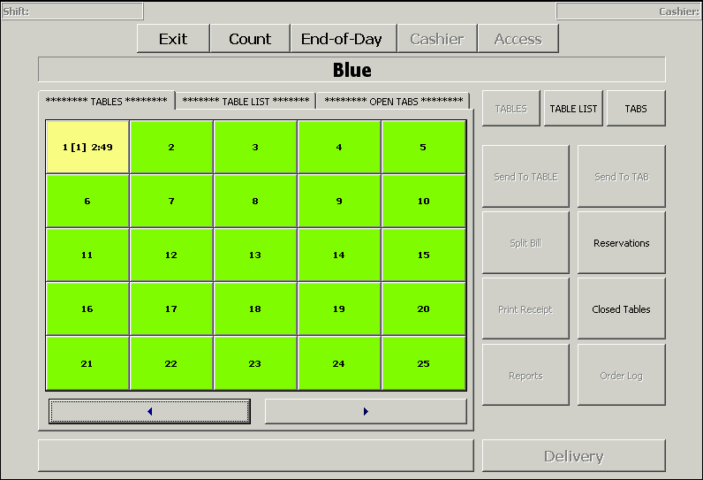
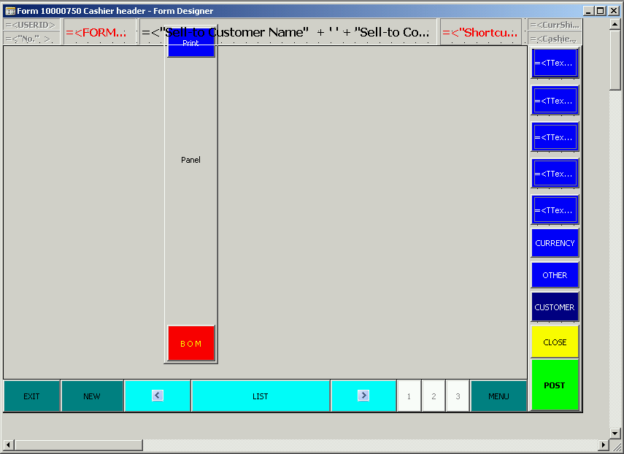
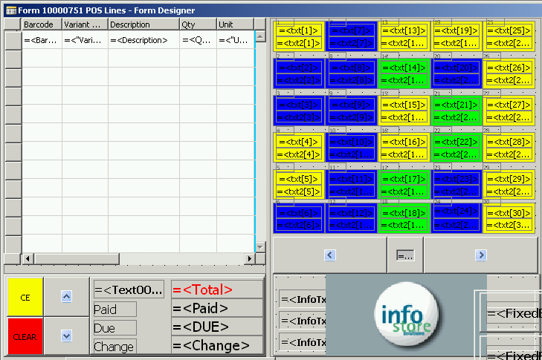
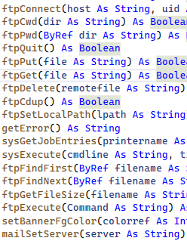
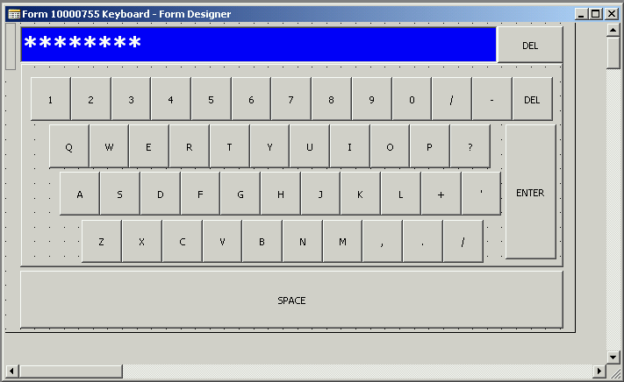
~Year 2003 (OCX’s)
Strengur’s Infostore POS

Slide 8
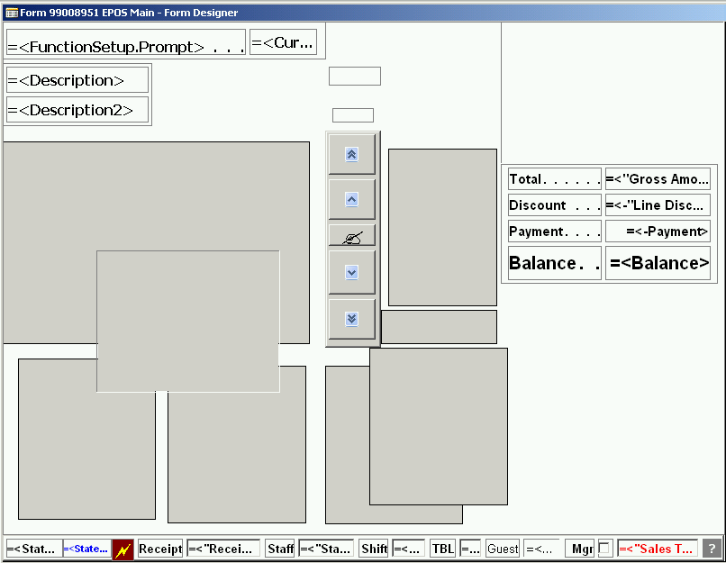
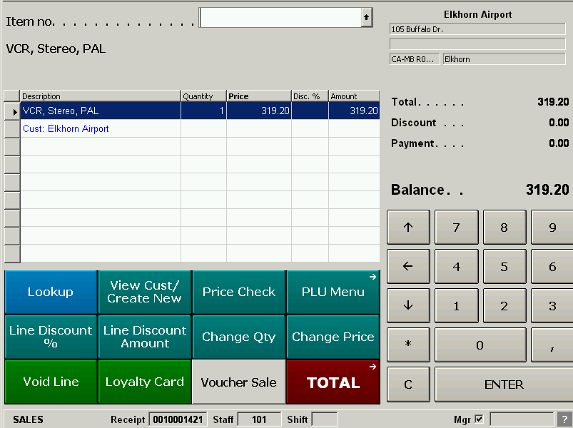
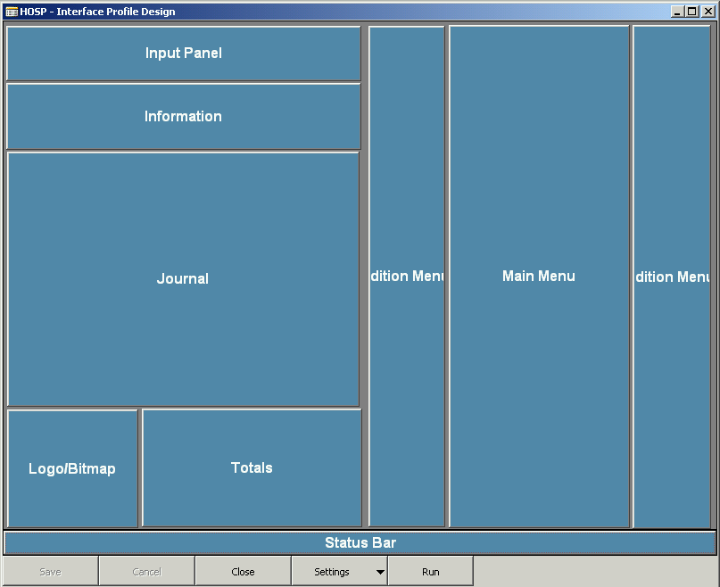
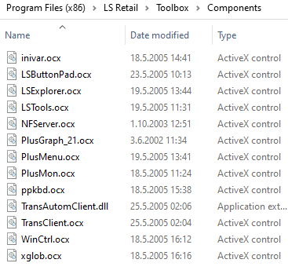
~Year 2005 (The first DLL?)
Landsteinar Strengur’s LS Retail POS

Slide 9
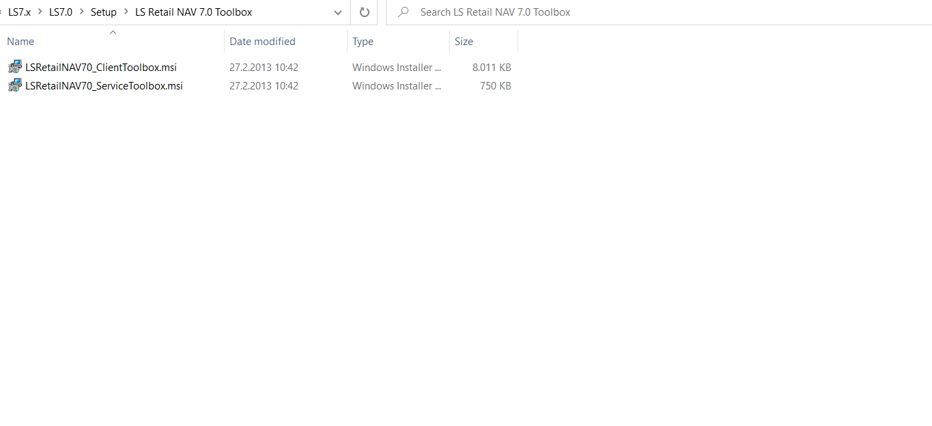
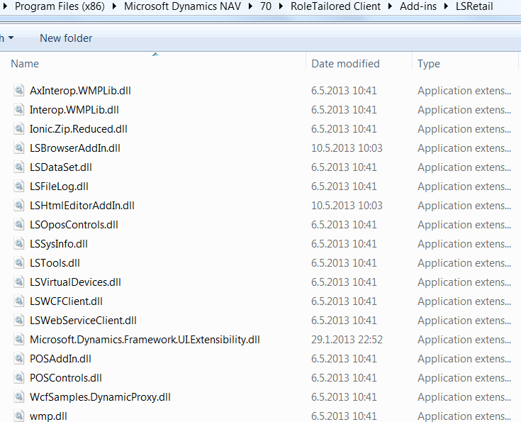
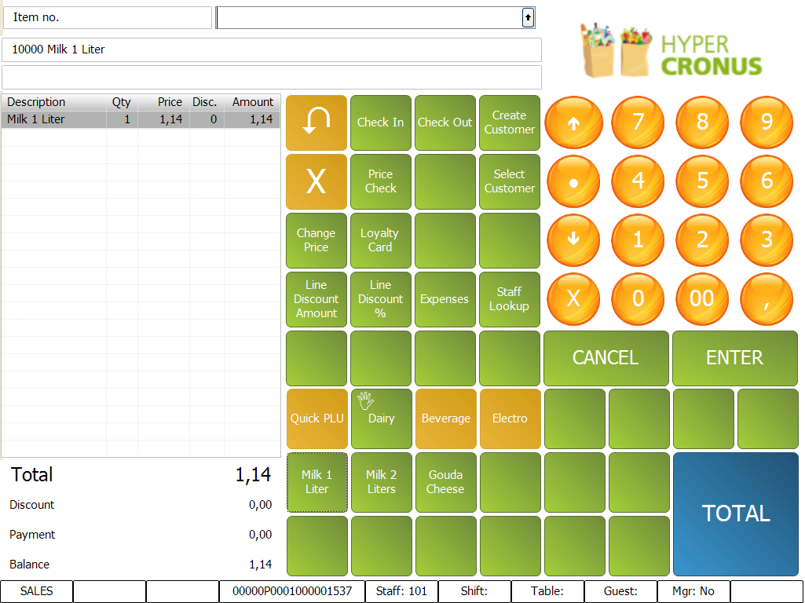
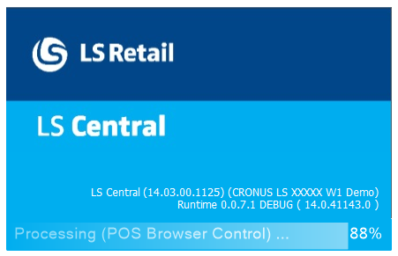
Year 2013 (.NET Add-Ins)
LS Retail NAV 2013

Slide 10
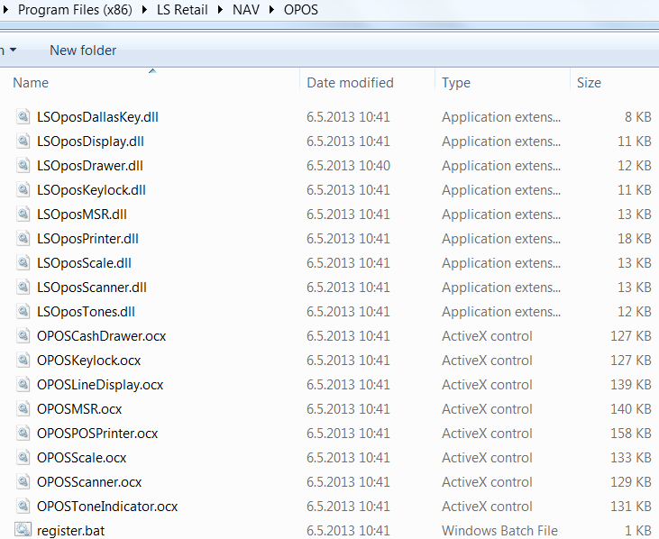
LS Retail 2013 OPOS

Slide 11
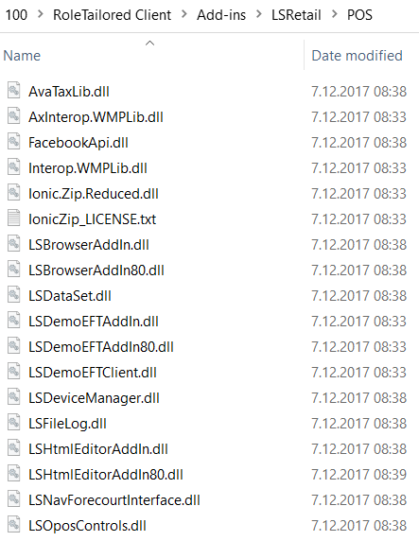
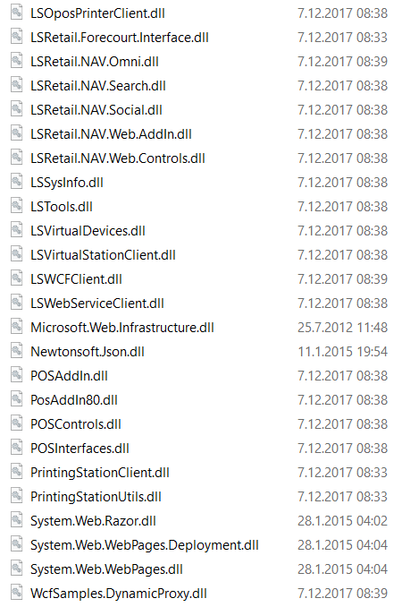
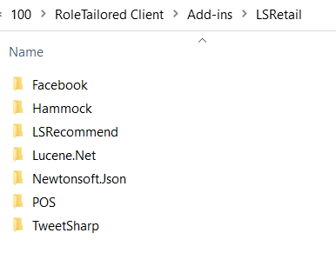
Year 2017 LS Nav 10.10

Slide 12
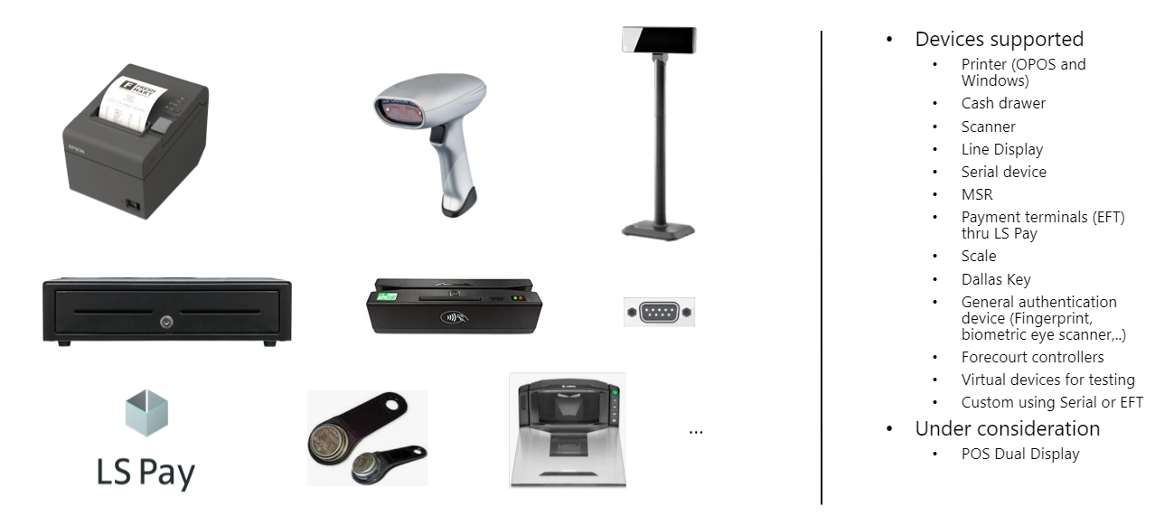
2017 Madrid
Station
OPOS Solved

Slide 13
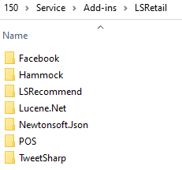
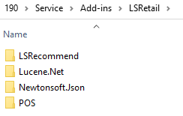
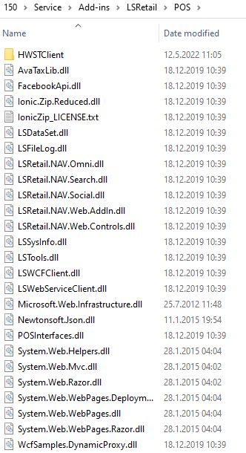
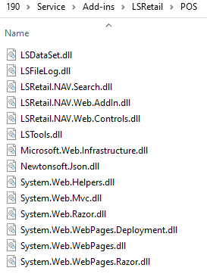
Dec 2019 Windows Client Discontinued ☺☹
LS Central 15.0
LS Central 19.5

Slide 14
~2020 – 2022 dotnet.al
LS Central 15.0
LS Central 19.5
dotnet
{
assembly("LSFileLog")
assembly("LSDataSet")
assembly("LSHardwareStationClient")
assembly("System.Xml")
assembly("LSRetail.NAV.Omni")
assembly("LSTools")
assembly("LSRetail.NAV.Search")
assembly("System.Net.Http")
assembly("LSRetail.NAV.Web.AddIn")
assembly("LSRecommend")
assembly("TransAutomClient")
assembly("LSWebServiceClient")
assembly("LSWCFClient")
assembly("LSRetail.NAV.Web.Controls")
assembly("DDConfigClient")
assembly("mscorlib")
{
type("System.Text.UTF8Encoding"; "UTF8Encoding")
type("System.Convert"; "Convert")
type("System.Security.Cryptography.SHA1CryptoServiceProvider";
}
assembly("System")
{
type("System.Security.Cryptography.X509Certificates.X509Certificate2"; "X509Certificate2")
….
}
}
dotnet
{
assembly("LSFileLog")
assembly("LSRetail.NAV.Search")
assembly("LSRetail.NAV.Web.AddIn")
}
DotNet Wrappers
JSON
HTTPClient
Etc..

Slide 15
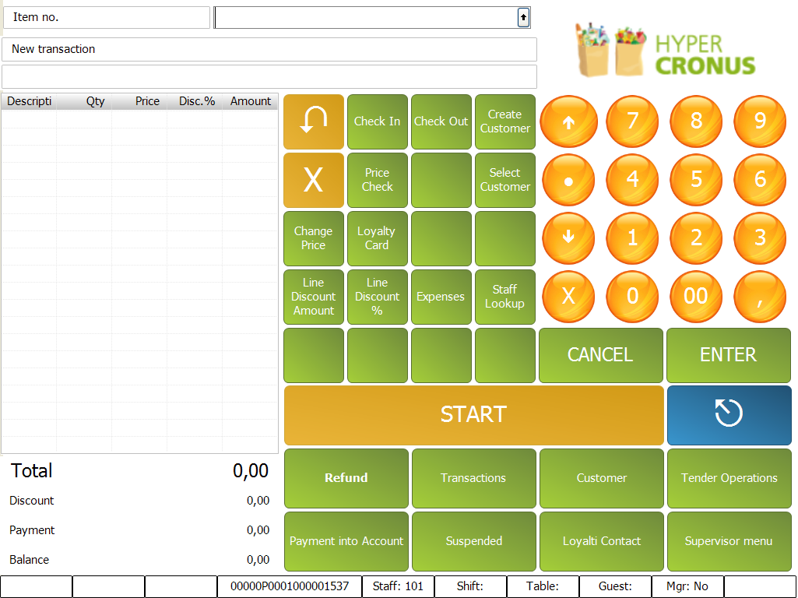
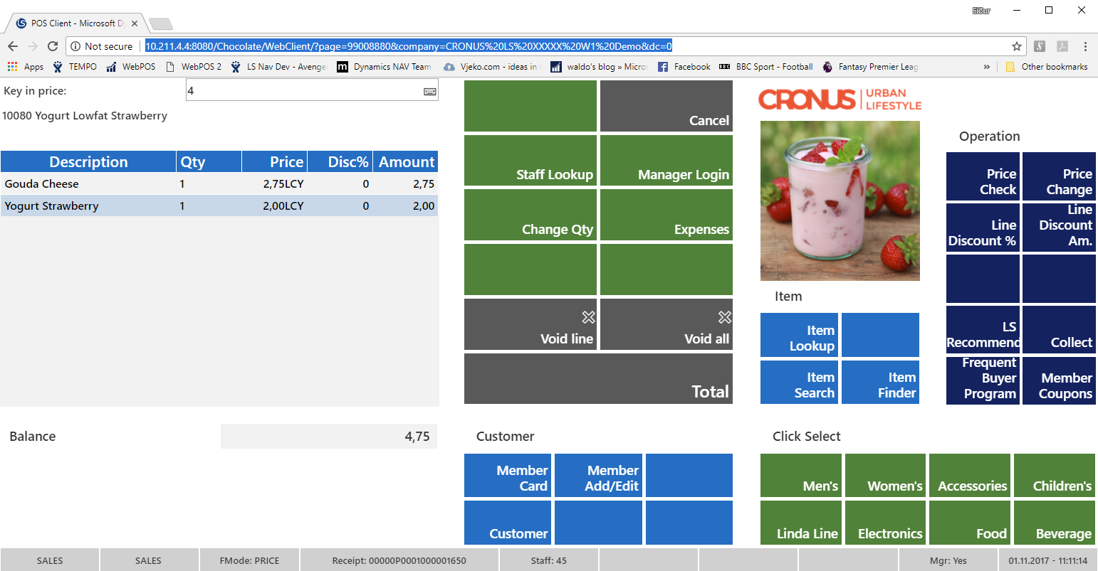
Removing the WebPOS DLL
Windows Client
Web Client
Saas Client
Client
POS Functions (DLL)
HTML
CSS/JS
JSON
JSON
Run On Client
POS Functions (DLL)
LS Central System APP
Server
EPOS Control DOTNET
EPOS Control HTML
EPOS Control NoDLL
EPOS Control Interface Codeunit (The POS API)
LS Central/Hosp/Hotels/Pharmacy/…
3rd Party Extensions

Slide 16
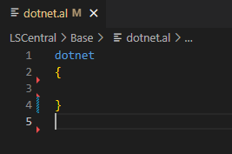
Short DEMO ☺

Slide 17
Removing the Web Service Client
codeunit 99009542 "LSC Http Wrapper"
{
// A wrapper around the Http variable types in AL:
// The Codeunit is split into the following regions:
// 0. Global Variables (prefixed with m_ to prevent collisions with other variable/procedure names)
// 1. METHOD (GET|POST|...) + URL (base + parts + queryParams) + Timeout
// 2. AUTH Type (None,Basic,Windows(NTLM),Digest,BearerToken,APIKey) + Cert + Credentials (Username,Pwd,Domain)
// 3. HEADERS (Default vs. Request vs. Content) + Cookies (not-supported in AL) + Http-type utils
// 4. BODY (req/res content) + Type (None, Form-Data, X-WWW-Form-URLEncoded, RAW, BINARY, GRAPHQL) + Encoding
// 5. RESPONSE (Body, Cookies (not supported yet in AL), Headers, StatusCode, Error, Time, Size) + Diagnostics
// 6. Feature-Flags (turn features on/off)
// 7. Http-type ref Getters
// 8. Init + Send
// 9. Integration Events
#region 0. Global Variables
// Member properties
var
// Client itself + res/req messages
m_HttpClient: HttpClient;
m_RequestMessage: HttpRequestMessage;
m_ResponseMessage: HttpResponseMessage;

Slide 18
Web Templates

Slide 19
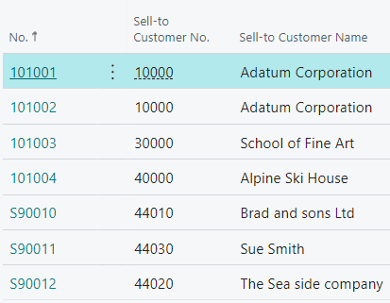
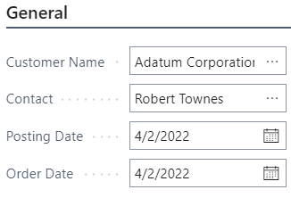
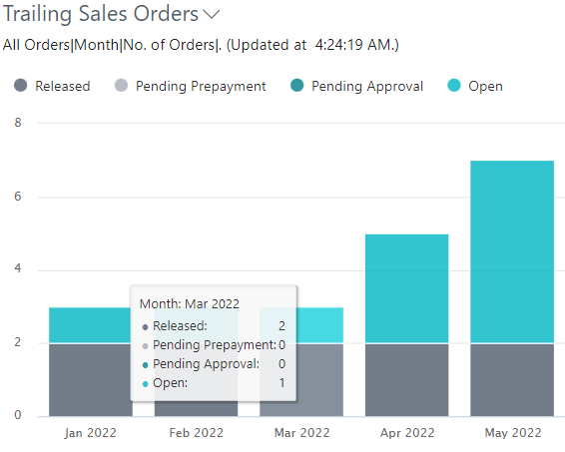
Web Templates – Introduction
Business Central User Interface
consists mostly of Pages (Lists, Cards, Dialogs, …)
Control Add-ins
enable custom web content (HTML, CSS, JS, …) in the UI
like “embedded” views
can communicate between JS and AL
the POS is a Control-Addin
POS User Interface
consists mostly of POS Controls (buttons, input, grid, …)
POS Web Templates
like Control Add-ins - for the POS!

Slide 20
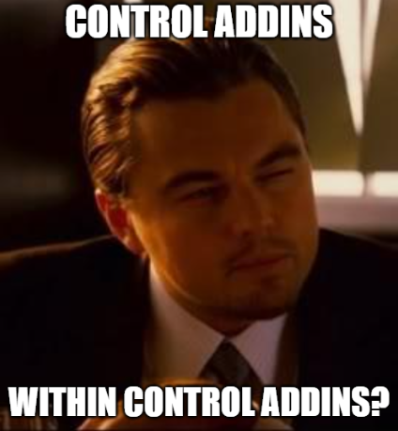
So…

Slide 21
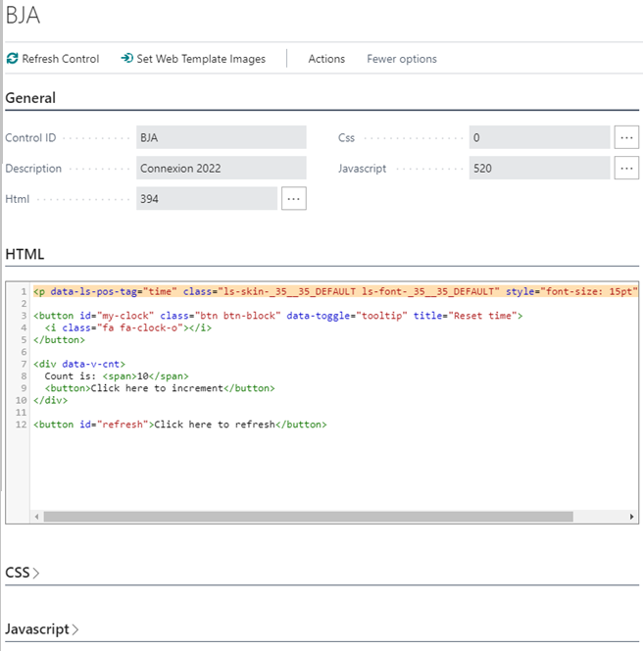
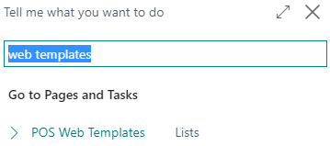
How to make one?
“It’s just data”
Open the “POS Web Templates” page:
Create New entry (or open from list)
Add your code (HTML, CSS and/or JS)

Slide 22
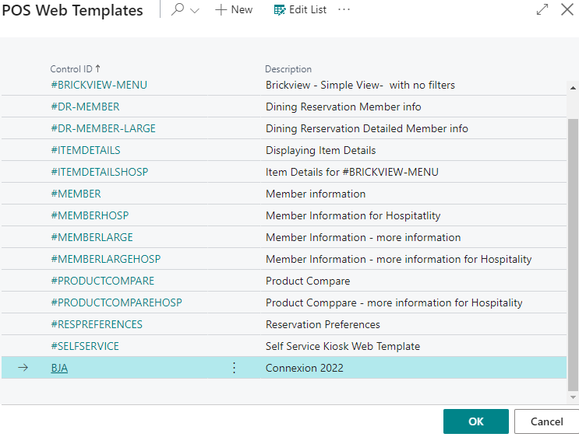
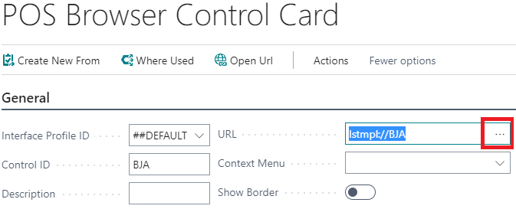
How to show one?
Open the POS Browser Control list
Create New entry (or open from list)
Add a URL:
lstmpl://[tmplID]
lstmpl://BJA
URL field’s assist lets you:
Pick from a list
Create new templates
Edit templates
Open Url action:
Opens template page
Opens external urls
Controls can be added to POS Panels

Slide 23
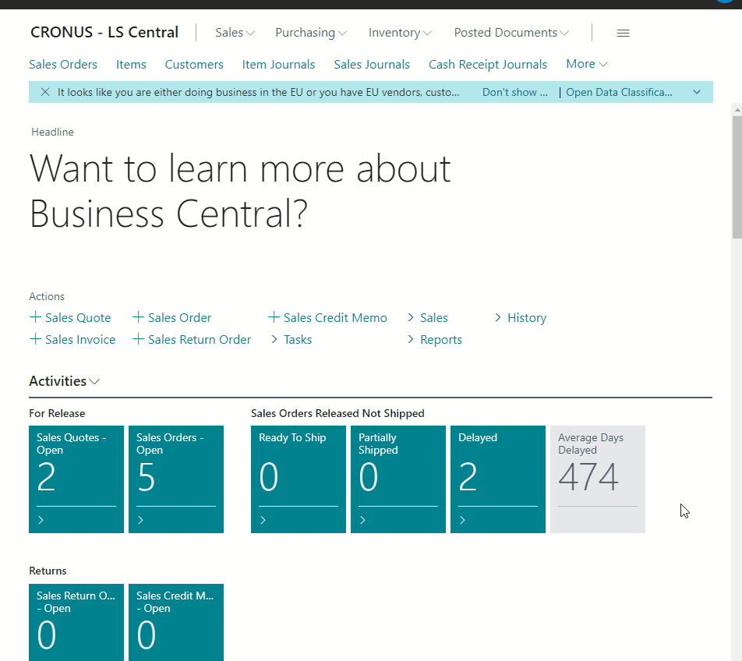
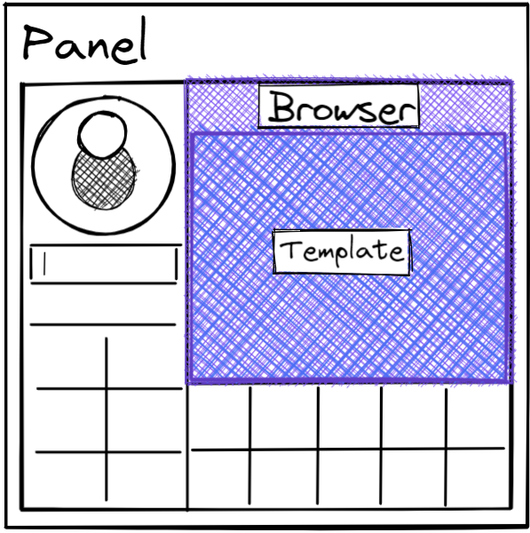
Setup Recap
Panels
Browser Controls
Web Templates
Tip: Design Mode
(Retail user - POS Super User)

Slide 24
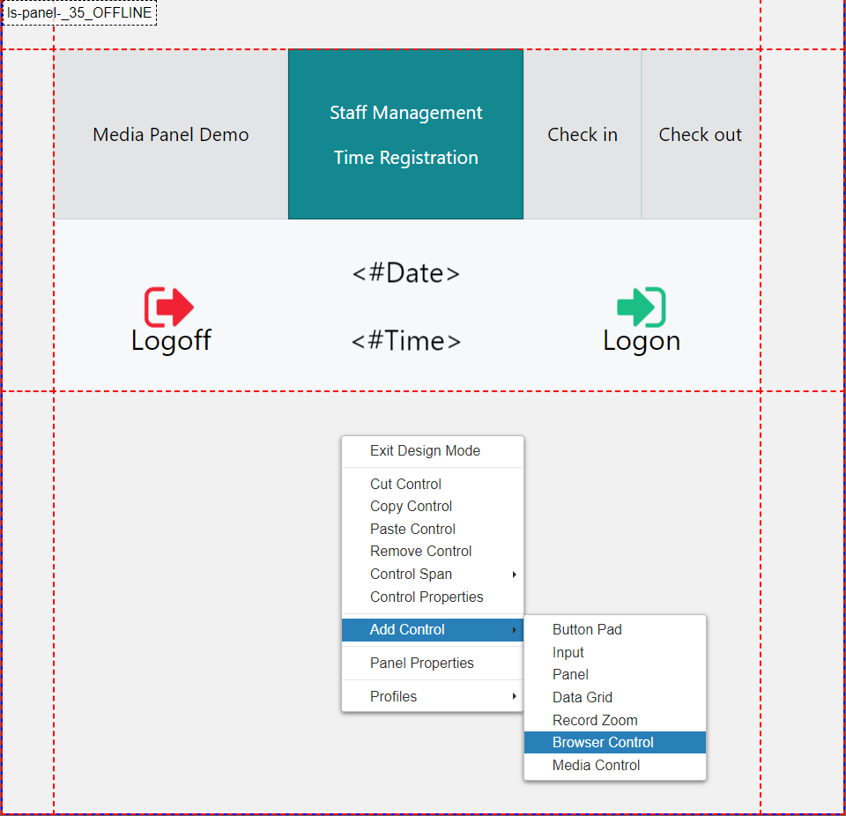

Slide 25
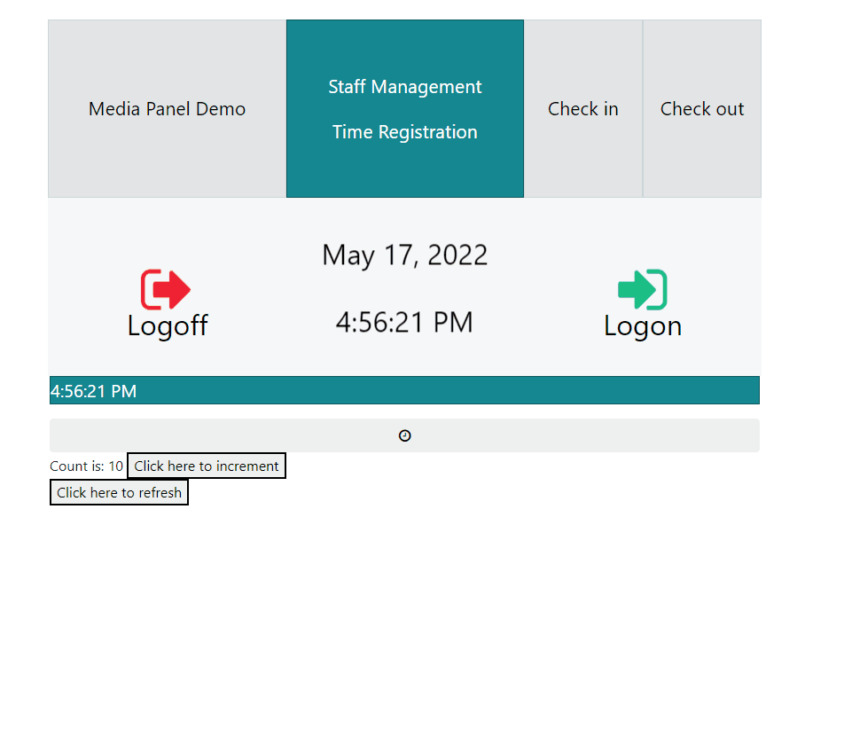
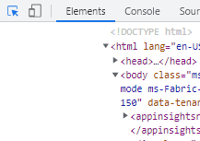

Slide 26
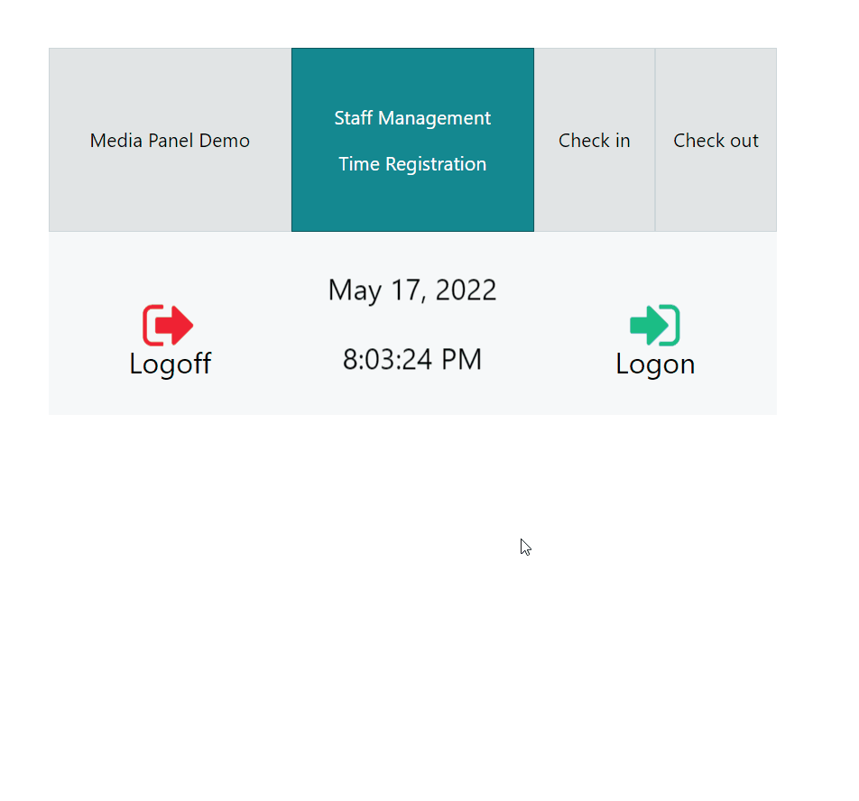
Experimental_

Slide 27
What can Web Templates do?
Components: Use them to extend parts of the POS UI
Member-view shows currently selected member
Clicking the member can open a modal with more info
App: Use a Web Template as the main control of the POS
Maybe you already have a web app and want to extend it?
Self-Service kiosk handles everything in JS<->AL until payment
New/Custom Features - Use the power of the web browser
Some things can’t be done in AL
You can send a WebService to Azure Functions or local server
Or you can do it in the browser!
PDF viewer, QR code generator, Maps, AI,
AL Developers are hard to find, Web Developers are not

Slide 29
Examples
Raw Html:
<button>Click me!</button>
JS in HTML + HTML in JS:
<script>console.log(1);</script>
document.body.innerHTML += “<button>Click me!</button>”
Bootstrap class (Font-Awesome icons):
<button class="btn">Click me!</button> & <i class=“fa fa-home”>
Opt-out of libraries if only html and starts with <!doctype html>:
<!doctype html><button>Click me!</button>
POS HTML-Binding
<p data-ls-pos-tag="time“ class=“ls-skin-_35__35_DEFAULT“></p>
Base64 URLs:

Slide 30
Examples

Slide 33
Examples

Slide 35
Examples

Slide 36
External Templates

Slide 37
External Templates – Stackblitz

Slide 38
Web Templates v1.0
Started in 2017 – initially known as “Clienteling”
Demand for “customer-facing” content in POS & “web-designs” in winPOS
We were working on the webPOS (knew the power/flexibility)
We already had the “Browser Control”:
UI as a standalone/isolated web page
Windows client used WebBrowser control in Window Forms (uses Internet Explorer)
Web Client used an “iframe” in current browser
Neither one accidentally affects its container
They worked on both types of POS-es (shared server code)
Both clients used DLLs to make web requests to SOAP codeunits
Already had the code in DotNet, C/AL didn’t have Json/HttpClient types (like in AL)
Works offline (libraries are included)
KnockoutJS (HTML data-bind), Bootstrap v.4.1.2 (CSS styles) & JQuery (JS helpers)
Also came with a small “POS Library”/API called LSWebTemplatesMainScript/LSClientelingMainScript

Slide 39
Web Templates API v1.0 – C/AL (later AL)
PosCtrl.Navigate(ControlID: Text; Url: Text)
Browser Control ID and the URL pointing to its next content:
http://localhost/BC/GetData/?table=27
lstmpl://[tmplID]/[serviceName]/[methodName]/[?arg1=val1&arg2=val2…]
tmplID: ID of the Template that the browser control should be showing
serviceName: Name of the Web Service that the Web Template should be calling
defaults to ‘RetailWebAPI’, which exposed all procedures in POS Web API (CU 10012735)
methodName: Name of the procedure/endpoint of the codeunit/web service
arguments: key-value pairs as URL query parameters
Web based approach (REST, JSON, Stateless) – each call is a new session
Can send “raw” data to browser controls / templates by using:
methodName = ‘###URLDATA’ or include skipWebCall in args
doesn’t trigger web request from client, good for AL->JS messages

Slide 40
Web Templates API v1.0 – JS API
LS.CallWebAPI(serviceName: Text; methodName: Text; parametersJson: JsonObject);
sends Web Service call to BC from the current template (shorthand for Navigate)
LS.SendPosCommand(control: null; command: Text; parameter: Text);
sends POS Command to AL (PLU_K, VOID_TR, NAVIGATE, …) with a parameter (“control” is ignored)
LS.Navigate(url: Text);
just like AL, parses url, then triggers onTemplateNavigation + CallWebAPI
target other browser controls by doing ‘[ctrlID]lstmpl://…’, like ‘[MY_BROWSER]lstmpl://…’
if Template ID changes in the URL, the browser control switches to that template
LS.ShowAlert(msgText: Text; msgType: Text; timeoutMs: Integer)
shows alert banner/drawer on top of screen with a message, color depends on type, closes after timeout
LS.Context: JsonObject with POS Tags key-values, so <#Time> = LS.Context.time = ‘13:30’

Slide 41
Web Templates API v1.0 – JS Events
We look for globally defined functions (on the window object) as event subscribers:
onTemplateReady = () => { … }
guaranteed to run when libraries have finished loading
onTemplateNavigation = (url: string, requestParams: JsonObject) => { … }
invoked when template invokes LS.Navigate or receives Navigate from the outside
onTemplateData = (data: JsonObject) => { … }
data: { methodName: Text, parameters: JsonObject, result: JsonValue, serviceName: Text }
callback for successful CallWebAPI with the response
onTemplateError = (msg: Text) => { … }
callback for failed CallWebAPI with error message
onTemplateUpdatePOSTags(tags: JsonObject)
invoked when POS Tags change, all Tags are sent on startup
onPOSTransactionFinished = () => { … }
invoked on POS Tag change (has been removed, is implemented in #BRICKVIEW template)
NOTE: make sure you don’t overwrite LS.onTemplateReady, etc., use LS_OVERLOADS.onTemplateReady instead

Slide 42
Web Templates API v2.0 (18.4)
API still works from v1.0 - didn’t want breaking changes
Instead of global callbacks, we use async-await
Invocation + Result are in the same place:
LS.InvokeAL(methodName: Text; args: JsonObject): JsonValue
const data = await LS.InvokeAL(‘GetData’, { tableNo: 27 });
better than LS.CallWebAPI/LS.Navigate + onTemplateData
LS.InvokePosCommand(command: Text; parameter: Text)
LS.Navigate always gets handled by the POS and queued if browser control hasn’t loaded
previously, navigating a browser control would force it to load in the background
LS.ShowAlert returns ID which can be used with LS.HideAlert
LS.Context now has LS.GetValue / LS.SetValue / LS.ExtractKey (<#Time> -> time conversion)
can update POS Tags in all Templates, like a “broadcast”
Fully customizable functionality with asynchronous/modern code in mind

Slide 43
Web Templates v2.0 – Local Requests
We have never got this from MS:
result := Codeunit.Invoke(codeunitID: Integer, methodName: Text, args: List of [Variant])
Reason for SOAP + Web Services
url + username + password
but it complicated setup
it had performance overhead – even though it was just calling itself
new WS session - different state (Terminal ID, Staff ID, POS Transaction, POS Session, …)
Local Requests
we migrated all DLL web-service logic into AL (Http Wrapper + Utils + Tester)
but to solve setup + performance issue, we decided to make Local requests the default
they signal the OnLocalRequest Event from POS Control Interface
if a request is unhandled by the event, it will fallback to a web request (prevents breaking change)
web requests can still be made, but you have even finer control in AL itself
this change also means the call has access to the GUI session’s state

Slide 46
Performance

Slide 47
“Why is my POS slow?”
Usually, bad performance is due to a software doing too much of something
If we want to increase the performance, we must remove or change these parts
Which increases the risk of breaking something that relied on it happening
Often, it’s the platform we’re using, but:
Browsers keep optimizing (IE is gone)
Windows apps can finally upgrade Edge Legacy to Webview 2 (Chromium)
Microsoft keeps optimizing Business Central
We also keep optimizing our platform
Shouldn’t everything be getting faster?

Slide 48
POS Architecture

Slide 49
Considerations
Logging in could take under 1s and other times it could take up to 5s
Some of the overhead experienced is out of our control and fluctuates:
DLLs
Need to be started and loaded into memory by BC first time a user signs in after restart
This makes 1st load of DLL execution paths slower
Cold starts
BC optimizes things behind the scenes after a restart and for each session
This makes 1st load of Data slower, but can also happen when Azure is saving resources
Database roundtrips
POS uses GUI session in BC, which can use temporary records and cache data between calls
BC tries to minimize how often the server needs to fetch from SQL in these cases
Network latency
How much distance is between client and server affects the time it takes to send data
Hardware, etc.
Measurements are always affected by computer speed (both server and client)

Slide 50
How to measure?
Server:
We now have POS Debug Log which can measure:
Duration, how long it took an event to be processed in AL
DataSize, how much data is being sent to the client
The data needs to be packaged, sent over network and parsed by the client
So, the less we need to send, the less we need to process
Note: Logging can impact performance and so can the cache (warm vs. cold)
Client:
Chrome Developer Tools allow us to record all interactions with the POS
“Idle time” is where the client isn’t doing anything (e.g., waiting for AL)
“Scripting” is where the client is doing some work
We started by only testing local OnPrem environment
Simpler, it ignores network overhead, the fastest use-case
We’ll be able to compare SaaS results by running the same tests there and spot differences/regressions

Slide 51
POS Startup + First render
We’ve been minimizing the startup impact of the POS
We removed libraries and compressed everything we could
POS style went from: 121 KB to 91 KB
POS script went from: 1.369 KB to 886 KB
POS bundle went from: 4.75 MB to 2.01 MB (more files, though)
We’ll continue estimating which parts we can dynamically load later in the POS
NoDLL POS also sends less data when starting
The POS script number above includes a blueprint of all the controls’ default values
We use the blueprints to only send the modified values from server
More computation + Bigger startup file -> Less bandwidth

Slide 52
First render of controls
Network speed is affected by distance and the amount of data sent
We’ve made sure the client has all the default values of POS Control fields
This enables us to only send the “diff” when a control is sent to the client for the first time
A typical button had 2165 letters before, if it’s empty it’s now 68 - 97% less
This greatly reduces the number of bytes sent, which increases network performance

Slide 53
POS Startup Flamechart

Slide 54
Client Profiler - Chrome Browser
Is the client/browser slow?
Client=77ms
Server=161ms
From where I’m testing,
it doesn’t look like it…
but there can always be spikes

Slide 55
Client communication
BC 2022 w1 (April) release introduced a new throttling feature
How many requests can be sent to the server
We couldn’t do that, since we already queue our requests and send one-by-one
This is non-blocking, so user can keep scanning/clicking
We are investigating ways of making this more “opt-out”-able for slower environments
We render a “loading indicator” when we consider a task being slow
Configurable in the POS Interface Profile
Default value is chosen with 0 – currently 3000 ms, turn it off by choosing -1
Next, we’ll focus on click-prevention/blocking for specific buttons/commands
Asynchronous => Race conditions
“Layout shift”

Slide 56
Hidden Controls
POS Design mode can reveal blank controls:
e.g., Buttons, POS Tags, etc. that aren’t and won’t be in use
If you have demo data or old setup, you might see if some of the tables can be cleaned up
Too much data in a table can affect the time it takes to interact with that table
We will also try to find opportunities to optimize these kind of scenarios
Compressing data, like Retail Images, might also be an option to make the DB “lighter”
we do use the same image server as Microsoft for automatic scaling (just in case)

Slide 57
Browser tools

Slide 58
Other tools - Chrome Browser
We use the standard dev tools
Recently, we got access to more
We’re writing more focused tests
covering wider area
JS, AL, real vs. emulated,
Unit/Integration/E2E
We want to write more tests
while they should be faster
so, it’s a good motivation!
Did a session on Monday
Slides will be available

Slide 59
Performance Profiler Page
Available in BC 2022 w1 (20.0)
Which extension is causing slowness in AL?
Just hit Start and Stop, no vscode needed! Can download and send us the data

Slide 60
AL In-Client Profiler

Slide 61
BC Snapshot Debugging

Slide 62
Additional Pages/Info
When reporting error or slowness, the key might be in:
The new POS Debug Log
AL Telemetry/SQL Monitoring
New standard pages for DB
View the last known error
Too much event traffic?

Slide 63
BC Error Dialog & Event Recorder

Slide 64
Microsoft Documentation
Microsoft has a lot of information in their documentation about performance:
https://docs.microsoft.com/en-us/dynamics365/business-central/dev-itpro/performance/performance-developer#al-performance-patterns
They also hold Launch Event twice a year with performance-focused updates
LS developers get training sessions with MS MVPs – always something new to learn!
If you spot something we’re missing then we either have a valid reason or we just haven’t had the time to change it, due to it being old code?
We do have a large codebase (~5800 objects)

Slide 65
Dos and Don’ts
Dos:
Try to find the root of the problem
The more info the more helpful
Try cleaning up old data
Keep the software up to date
Don’ts
Uploading too much data to the client
Refresh everything for the sake of refreshing

Slide 67
Thank you

