Slide 4


Thorir Bjornsson
Customer Technical Lead
Thorir@lsretail.com
Setting up LS Central in SaaS
Johann Sveinsson
Senior Developer
johann@lsretail.com

Slide 5
Agenda
Getting Started
  Partner Center
  Global Administrator
  Delegated Administrator
Admin
  Administrator Center
  Managing Environments
  Capacity Quota
Extension Management
Replication and Architecture
App Shell and Hardware-Station
Lessons Learned

Slide 6
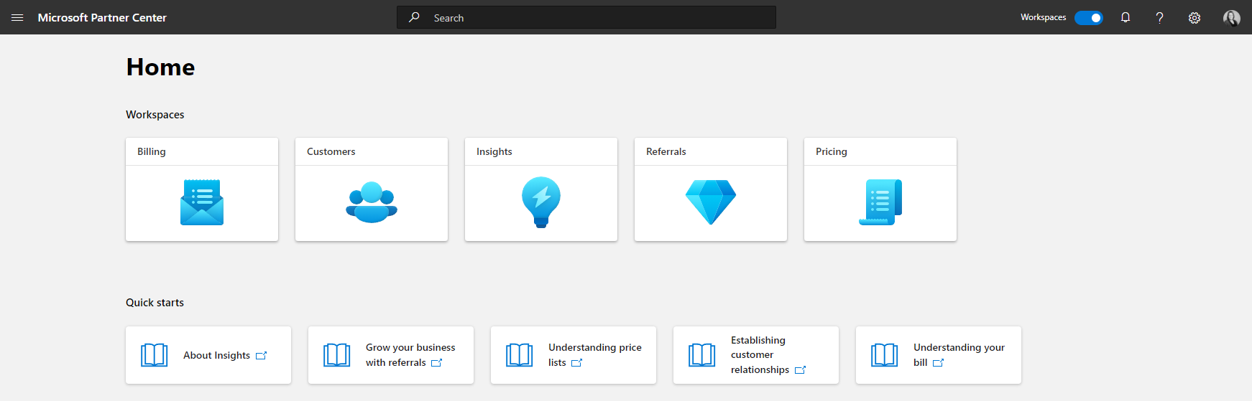
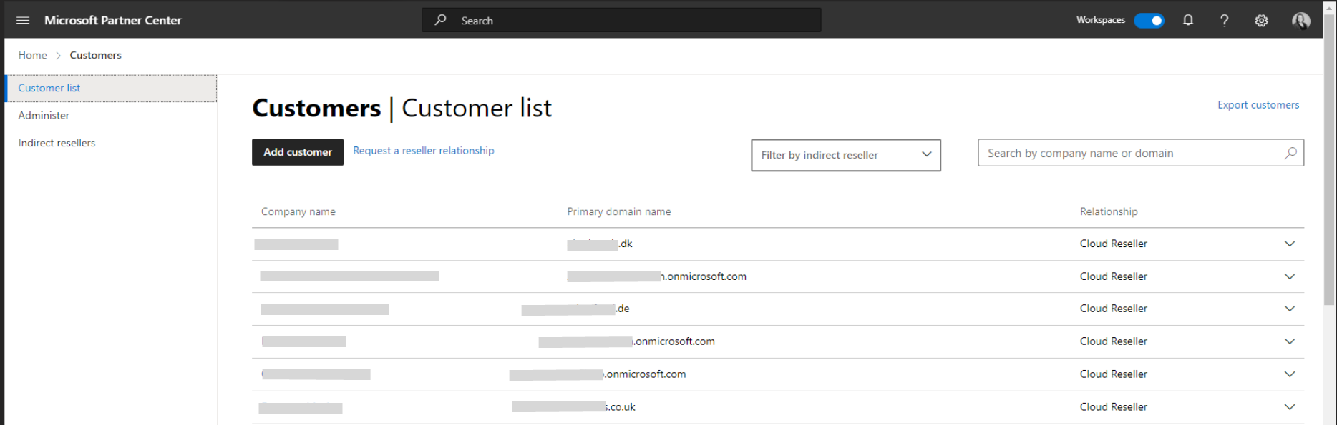
Partner Center
In Partner Center, you can:
  Manage your Microsoft account and users
  Access your customer's tenant
  Manage Customer Subscriptions

Slide 7

Global/Internal Administrators Role
Unlimited Control Over the products in your subscriptions
Can Access most of the data in LS Central
Can add multiple admins to redistribute task
Manage Upgrade Schedules
Create & Monitor Environments (Production & Sandbox)
Manage access of Delegated Administrator (partner access)

Slide 8
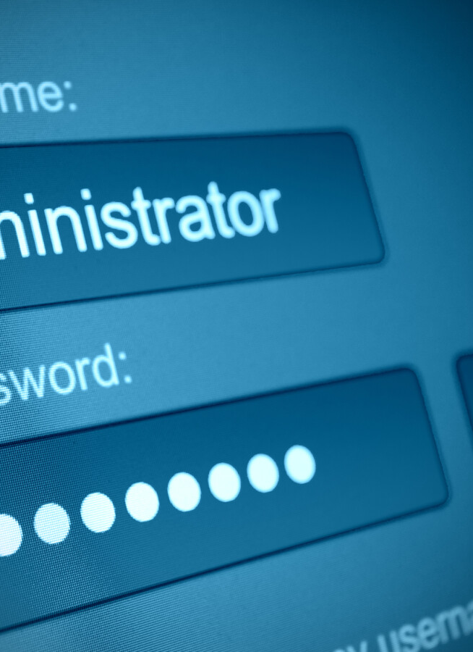
Delegated Administrators Role
Admin and development access to Customer LS Central SaaS tenants
LS Central SaaS access without consuming license of Customer
First line of support for your LS Central SaaS customers

Slide 9
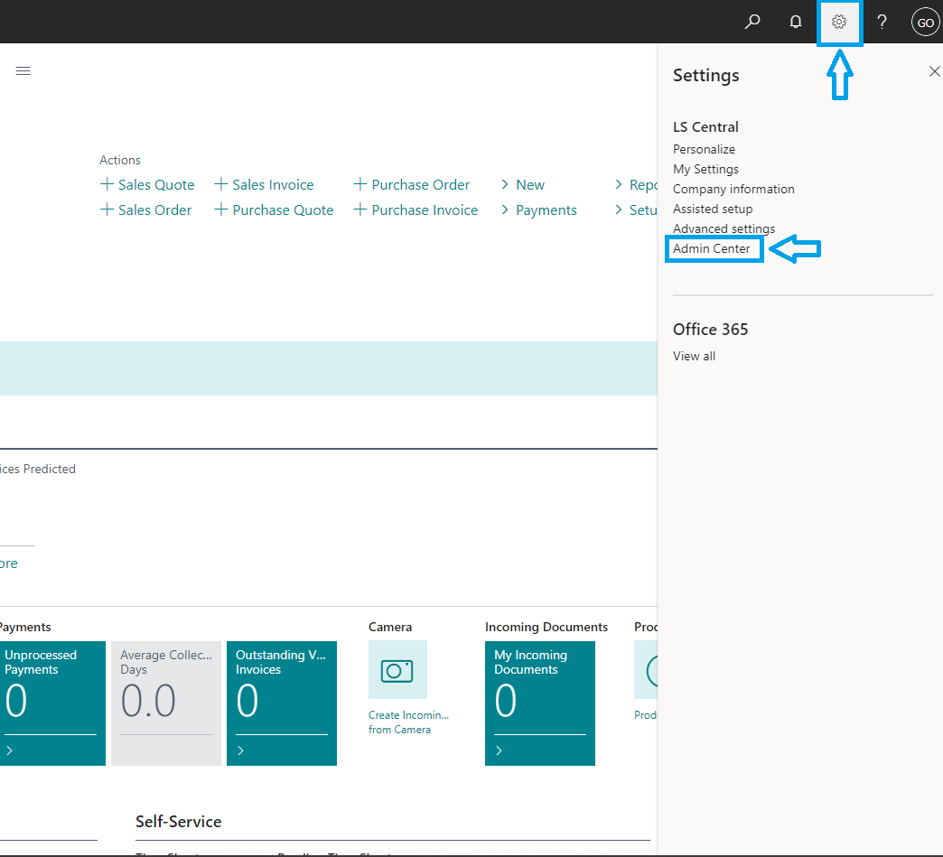
Ways to Access Administration Center
Internal Administrators and Delegated Administrators can access the administration center
It can be accessed after signing into business central -> Settings -> Admin Center.
Alternatively, it can be accessed by using the below URL. Replace the [Tenant_ID] with tenant ID of your LS Central. https://lscentral.bc.dynamics.com/[TENANT_ID]/admin

Slide 10
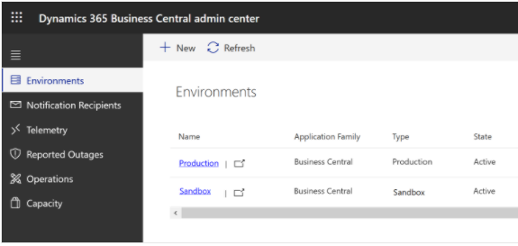
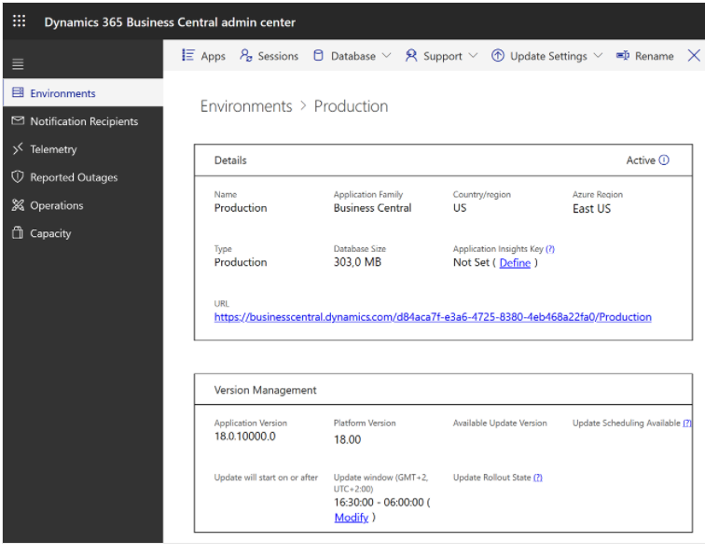
Managing Environments
Environments Tab has the Production & Sandbox Environment in admin center
Click Name column to view further details.
You can do the following here:
  View and work with production and sandbox environments for the tenant
  Manage Sessions
  Manage Update Schedules
  Rename an environment
  Restore an environment
  Raise Support Request

Slide 11
Types of Environments
Production Environment
Sandbox Environment
Live LS Central SaaS Environment
High Performance Tiers in Azure
Automatic Backups to protect business data
Test or Development LS Central SaaS Environment
Comparatively lower Performance Tiers in Azure
No Backups but data export option is available
Other Notes:
Sandbox environment that includes data from production environment can be created for debugging purposes.
Apps can be deployed from Visual Studio Code to Sandbox environment directly.
Environments can be deleted in admin center. But please note that the action is irreversible

Slide 12

Exceeding capacity quota
Exceeding Storage limit won't interrupt transaction
No automatic charges for the extra storage occupied by these environments.
Restriction will be placed on creating or copying environments
These operations will also be blocked for the customers who have more environments than they're entitled to, according to their subscription and purchased environment add-ons.

Slide 13
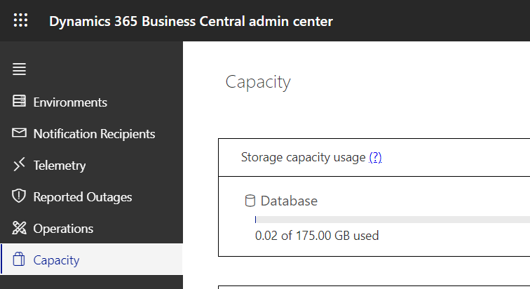
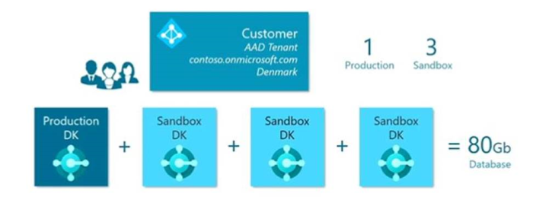
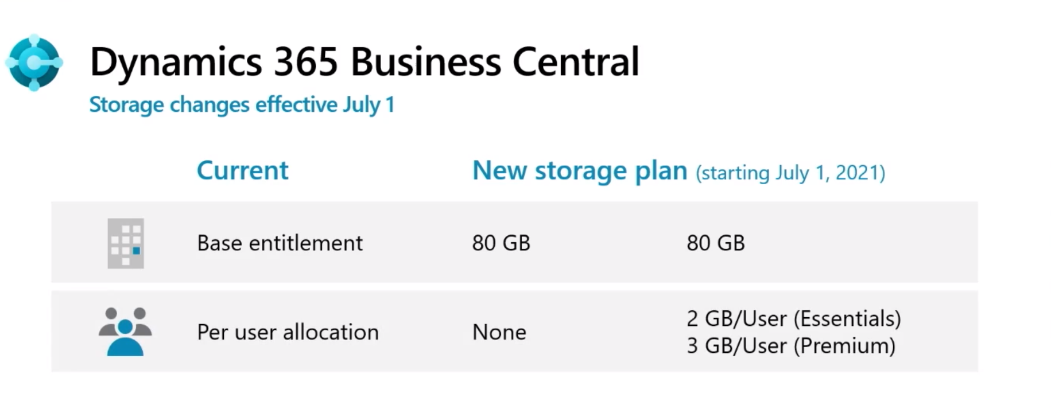
Managing Storage Capacity
Capacity tab shows information on available space
The Premium and Essential subscription gives each LS Central SaaS customer 1 production & 3 sandbox environment free of extra charge.
80 GB of database storage capacity across all environments.
Additional Storage based on the number of licenses. Premium 3GB, Essential 2GB & Device 1GB. Learn more

Slide 15
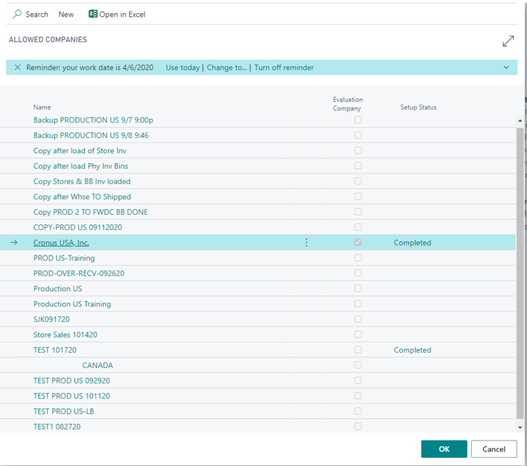
Don’t do this

Slide 16
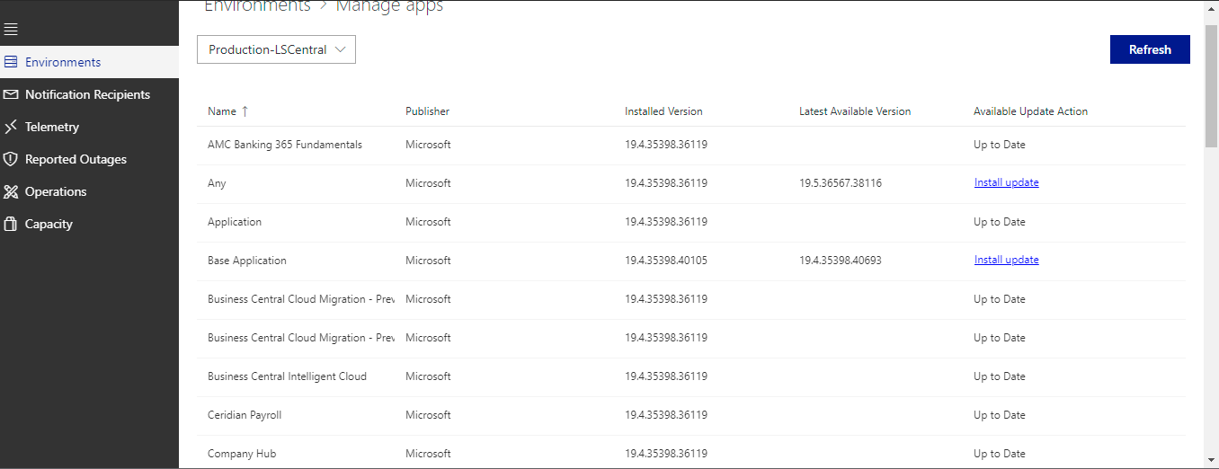
Extension Management
Multiple Verticals
Development / Deployment Strategy
Constant Monitoring
Upgrade!!!

Slide 17
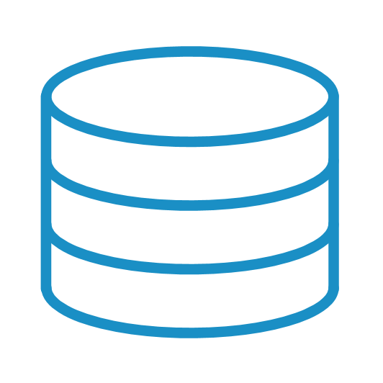


Online implementation
SaaS
POS and Client is a Web Client - only a browser is needed
LS recommend to use Chrome and for the POS “LS Central App Shell”
Import data with Configuration Packages
Replicate data between companies with Web Service Replication
Replication not as fast as before
Company 1
Master Date
Company 2
Company 3
Online
Client
Online
Client

Slide 18
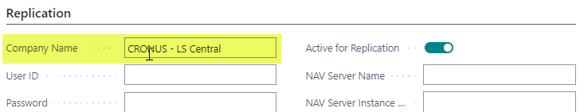
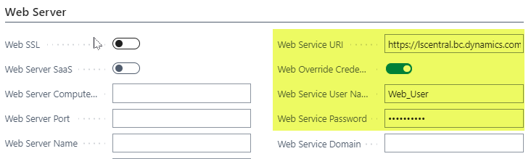
Web Replication in SaaS
Distribution Location
Web Service URI
Web Service User
Test Web Connection
Web Service URI:
http://<web server>/v2.0/<tenant>/Production/WS/CRONUS - LS Central/Codeunit/RetailWebServices
Web Services:
Web Service Setup:

Slide 19
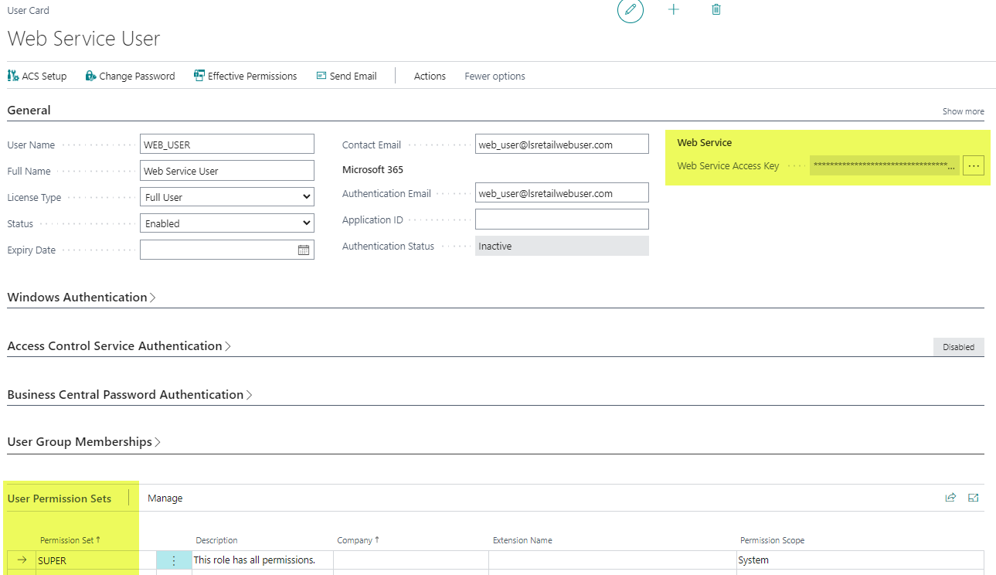
Web Replication in SaaS
Web Service User
Web Service Access Key
  The password on the Distribution Location Card
BC User

Slide 20
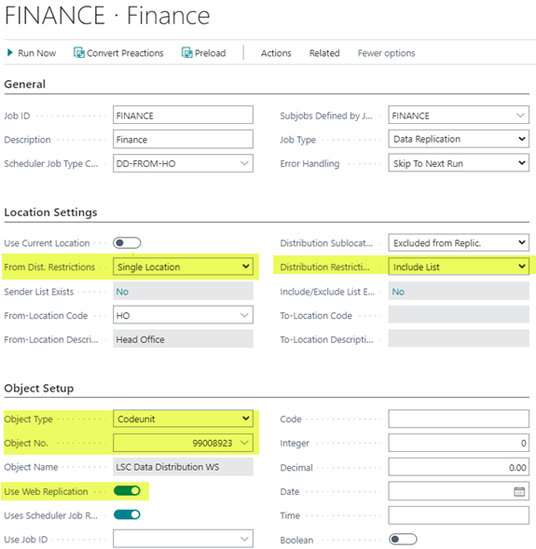
Web Replication in SaaS
Scheduler Job
Distribution Location
Scheduler Job
  Codeunit 99008923 “LSC Data Distribution WS” used for all replication
  “Use Web Replication”

Slide 21
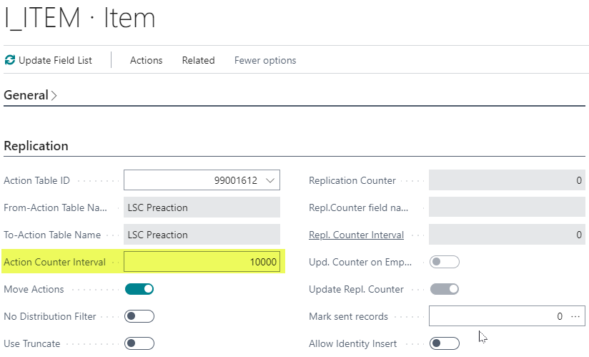
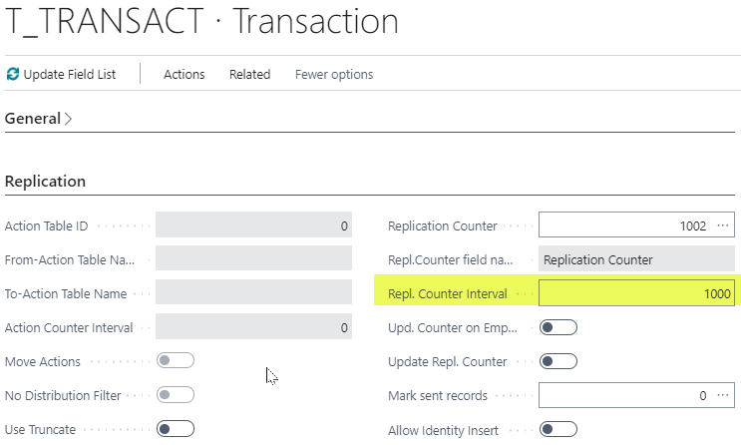
Web Replication in SaaS
Scheduler Sub Job
Configured as before
Action/Normal jobs
Not possible to replicate between different tables
Web Replication packages size have some limitations therefore it is good to use:
  Action Counter Interval
  Repl. Counter Interval

Slide 22
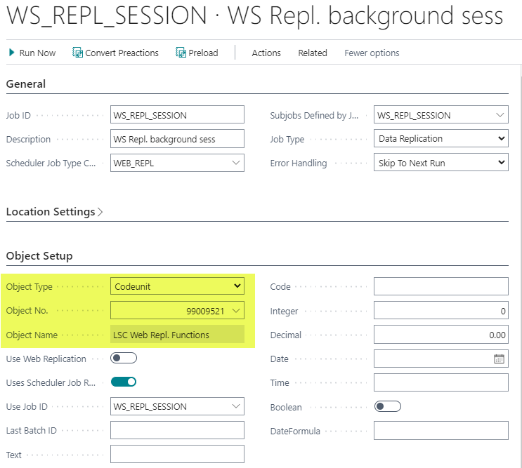
Web Replication in SaaS
Scheduler Job
Codeunit 99009521
“LSC Web Repl. Function”
Processing the Web Replication Request Queue

Slide 23
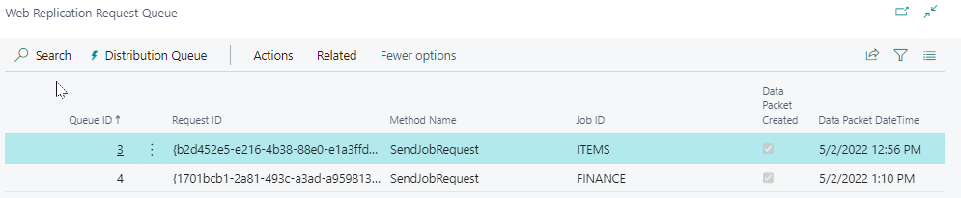
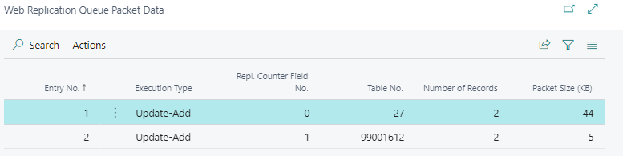
Web Replication in SaaS
Scheduler Setup
Monitor the Web Replication
Request Queue
Packet Date

Slide 24


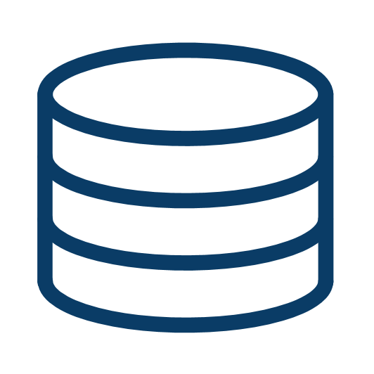




Online implementation
LS Retail Update Server
POS and Clients are web browsers, recommended to use LS Central App Shell
Hardware Station
Configured for https secure connection with SSL Certificate
LS Update Service
BC version
Hardware Station
LS Update Service Client
https
LS Update Service
Hardware Station
POS
POS
POS
Client
LS Update Service Client

Slide 25

Hybrid Implementation HCS
On-Prem Hybrid Cloud Component Server
Hosted in Azure or on own hardware
HCS is a communication layer between SaaS and Store/POS where the scheduler is running
POS or Store running fully offline
Online functionality with Web Service Requests
Send Transactions
Member Management
Customer Order
Customer validation …..
Client
Hybrid Component Server
Web Service
Offline
Store Server
POS
POS
POS
Offline POS
POS

Slide 26


Hybrid Implementation – Data Migration
Data Migration from On-Prem to SaaS
On-Prem HCS – Integration Runtime Service
SaaS – Setup and process for the integration
Azure Data Factory
Import Files
SQL access
Configuration Packages
Client
Data Migration
Hybrid Component Server
Import files
Client
Configuration Packages
Data
Integration runtime Service

Slide 27


Hybrid Implementation - Offline POS database
POS and Clients are web browsers using the LS App shell
POS is online to the Hybrid Server or Offline (stand alone)
Data replication with Data Director
Scheduler is running in the Hybrid Server
SaaS
Client
Offline POS
Data Director
Hybrid Component Server
Offline POS
Online POS

Slide 28

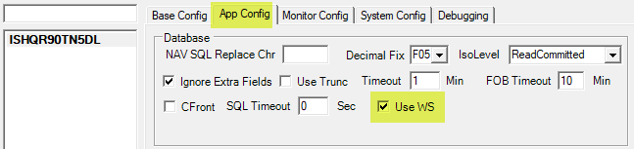

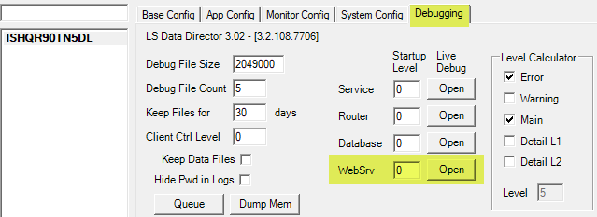
Hybrid Implementation – Replication
SaaS
Data Director Configuration
Data Director instance on-prem
Data Director plug-in to SaaS with Web Service
Job Monitor
Data Director
Hybrid Component Server

Slide 29
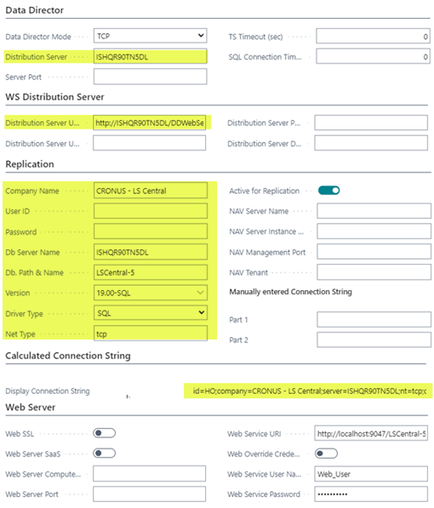
Hybrid Implementation - Replication
Distribution Location
On-Prem SQL server plug-in
Distribution Server URI
  http://ISHQR90TN5DL/DDWebService/
  Used for communication between Scheduler Job and Data Director

Slide 30
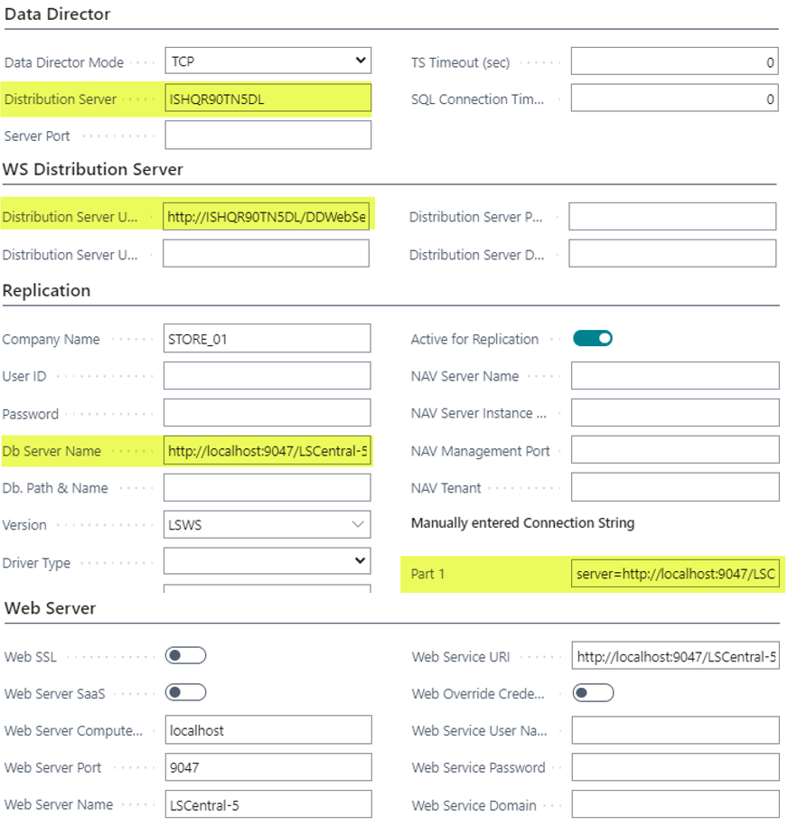
Hybrid Implementation - Replication
Distribution Location
BC in SaaS, web service plug-in
Distribution Server URI
Create connection String in field “Db Server Name” or in “Part 1”
http://localhost:9047/LSCentral-5/WS/STORE_01/Codeunit/RetailWebServices
server=http://localhost:9047/LSCentral-5/WS/STORE_01/Codeunit/RetailWebServices;nt=tcp;|lsws|none

Slide 31
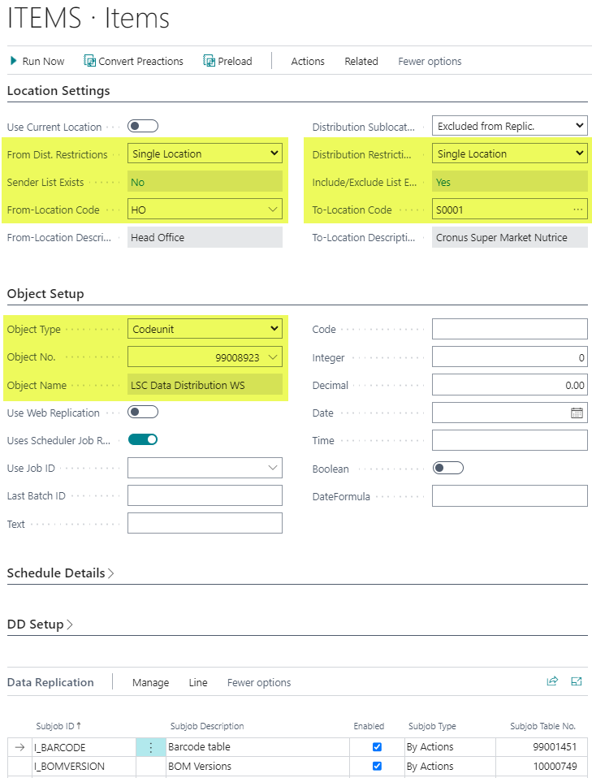
Hybrid Implementation - Replication
Scheduler Job
From-Location
  Single Location
  Include List
To-Location
  Single Location
  Include List
Object No.: 99008923 “LSC Data Distribution WS”
Sub jobs configured as before

Slide 32
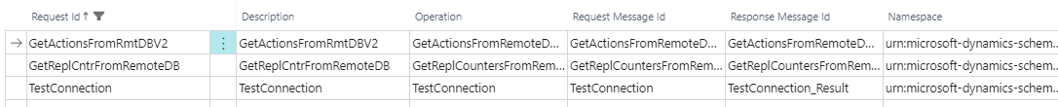
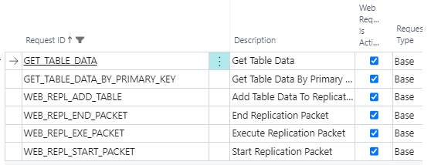
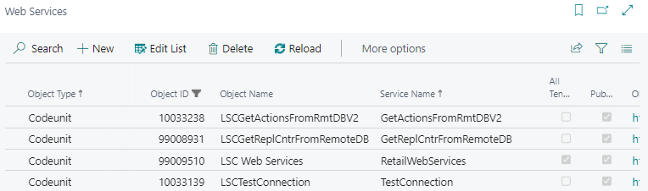
Hybrid Implementation - Replication
Web Services
TestConnection
GetActionsFromRmtDBV2
GetReplCntrFromRemoteDB
GET_TABLE_DATA
GET_TABLE_DATA_BY_PRIMARY_KEY
WEB_REPL_ADD_TABLE
WEB_REPL_END_PACKET
WEB_REPL_EXE_PACKET
WEB_REPL_START_PACKET
Web Request 2.0
Web Request 1.0
Web Services

Slide 33
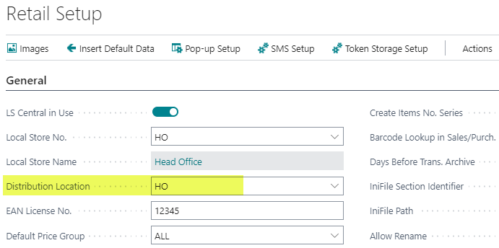
Hybrid Implementation - Replication
Retail Setup
“Distribution Location” defines if replication counters or actions are retrieved with web services

Slide 34
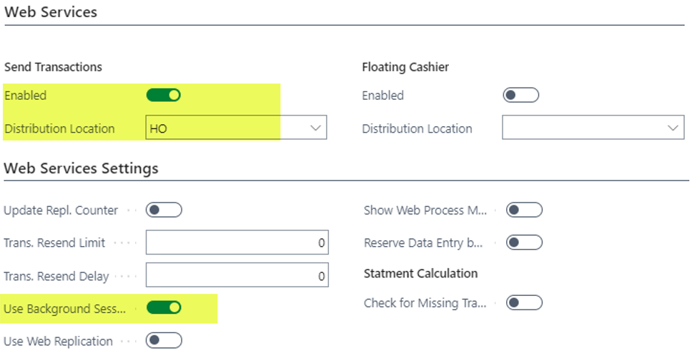
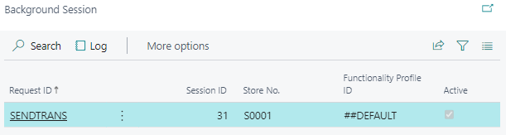
Hybrid Implementation – Web Service -Transactions
Replicate Transactions with Web Service from the POS’s
Distribution Location
  Web Service URI
Functionality Profile
  Send Transaction
  Use Background Session
  Use Web Replication same as Data Director Web Replication
    WEB_REPL_ADD_TABLE
    WEB_REPL_END_PACKET
    WEB_REPL_EXE_PACKET
    WEB_REPL_START_PACKET
  Easy to add new fields
POS Terminal
  Background Sessions
  Log
Functionality Profile:

Slide 35


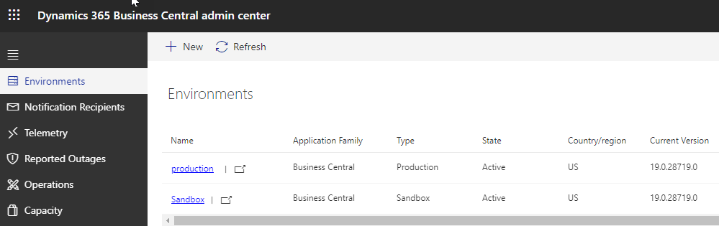
Hybrid Implementation – Test Environment
Create a Sandbox (test) environment
Update new app releases to the Sandbox for testing before updating Production with the Admin Center and use LS Update Service for on-prem sites
SaaS
Production
Sandbox
Client
Data
Director
Data
Director
Hybrid Component Server
Test environment
Hybrid Component Server
Offline Test POS
Offline POS

Slide 36
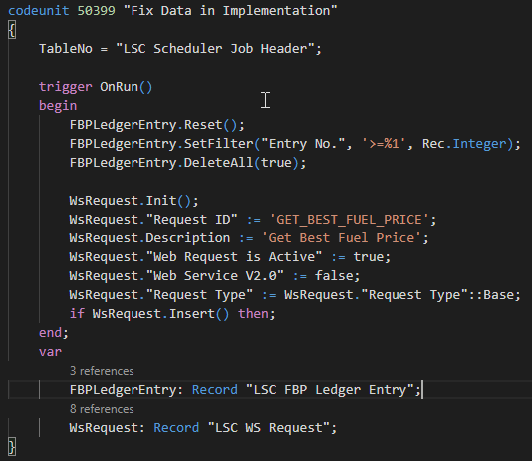
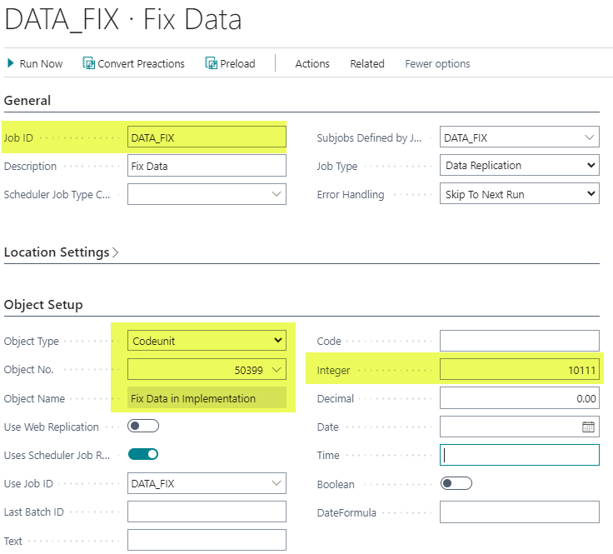
How to fix data in SaaS with codeunit
Create a codeunit in Visual Studio Code for code fixing
Install the code fixing app in the cloud instance
Create Scheduler Job to run the codeunit. Parameters from the Scheduler Job can be used for the functionality if the codeunit takes the table “LSC Scheduler Job Header” as a parameter

Slide 37
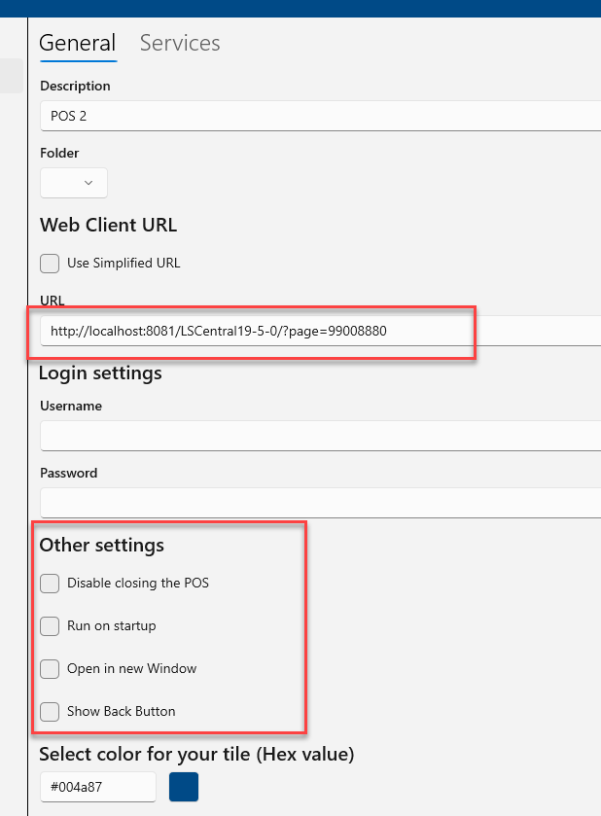
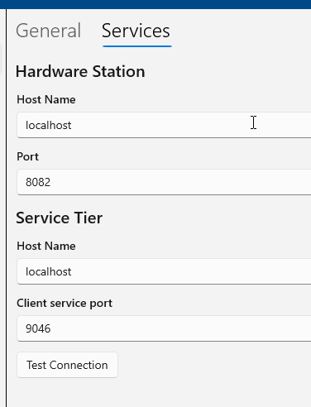
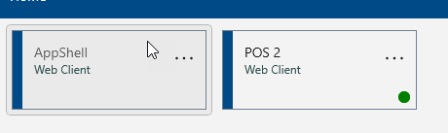
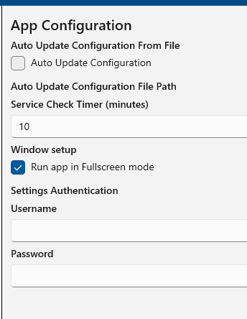
Windows App Shell settings
Build in app Services App config and services

Slide 38
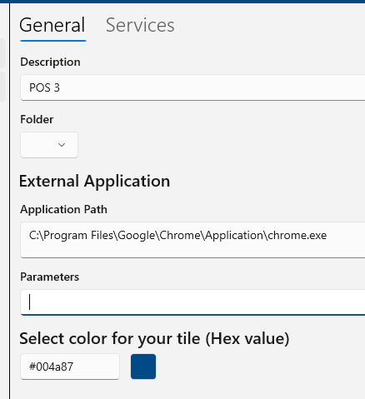
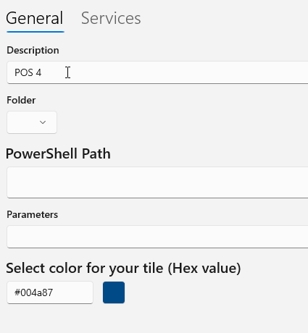
Windows App Shell
External app Powershell

Slide 39
Windows App Shell
Will automatically fire up second screen as dual display if configured.
Can run external apps
Can run Powershell commandlets

Slide 40
LS Update
Help
https://help.gocurrent.lsretail.com/docs/get-started.html
Yammer group
https://www.yammer.com/gocurrent/?show_login=true#/home
Hybrid model - Installation and configuration
https://helplscentralimplement.lsretail.com/Content/Hybrid-Model-Installation-
And-Configuration.htm?tocpath=LS%20Central%20SaaS%20Implementation%7CHybrid%20model%20-%20Installation%20and%20configuration%7C_____0

Slide 41
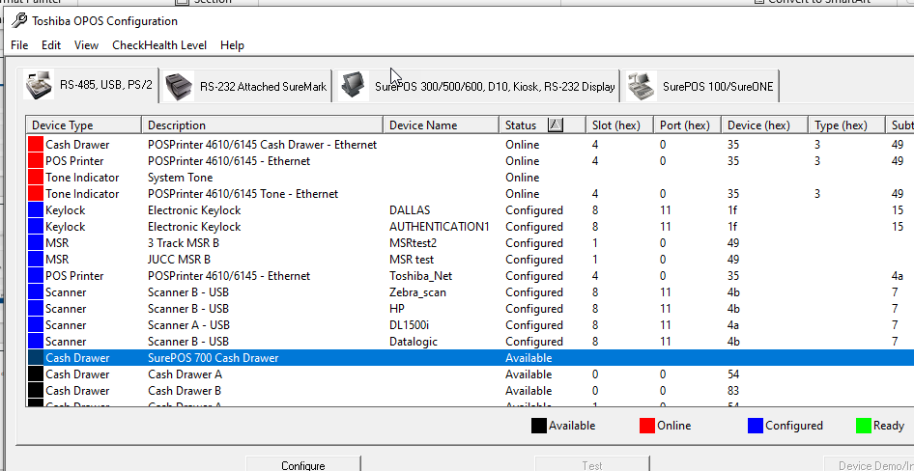
LS Hardware Station
Configure first with OPOS config tool
Config tool Toshiba

Slide 42
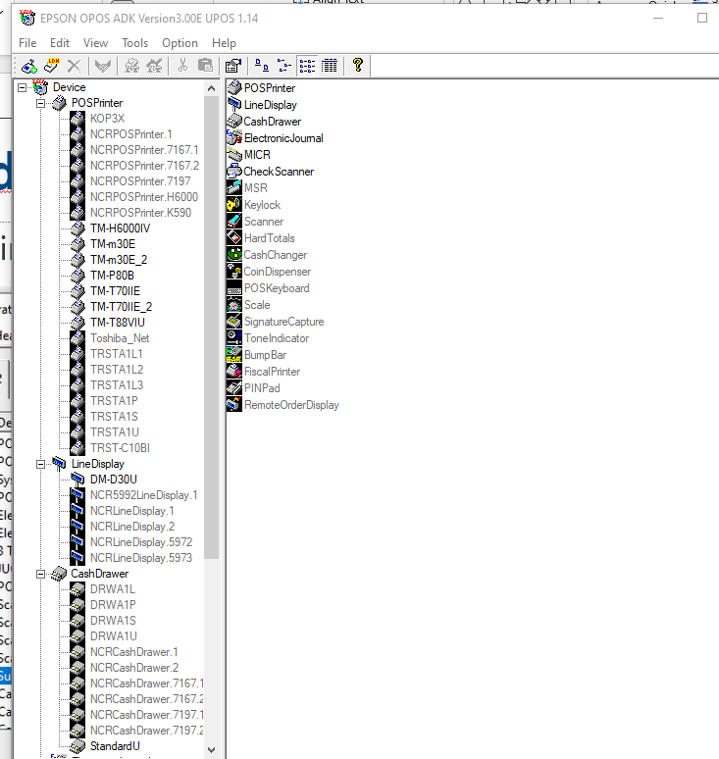
LS Hardware Station
Epson config tool

Slide 43
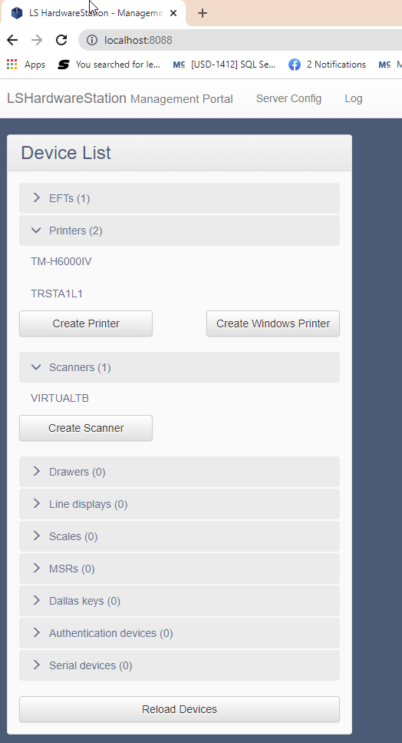
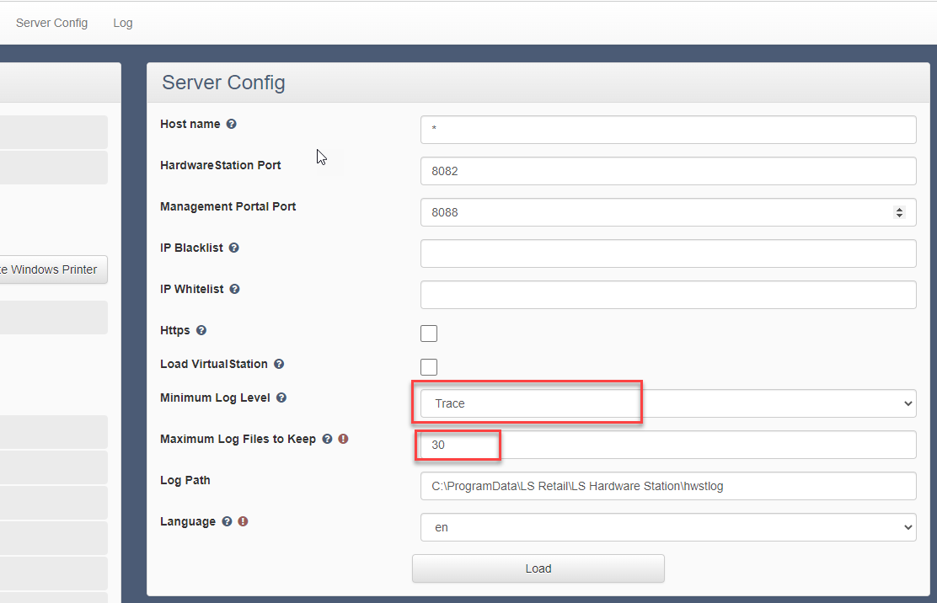
LS Hardware Station

Slide 44
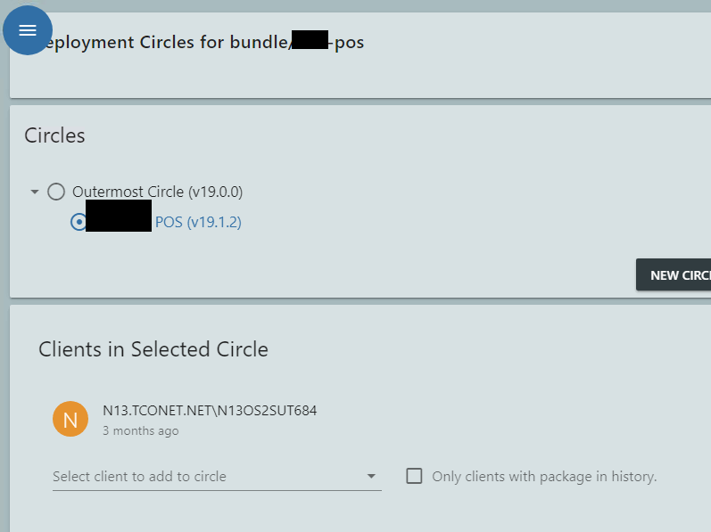
LS Update

Slide 45
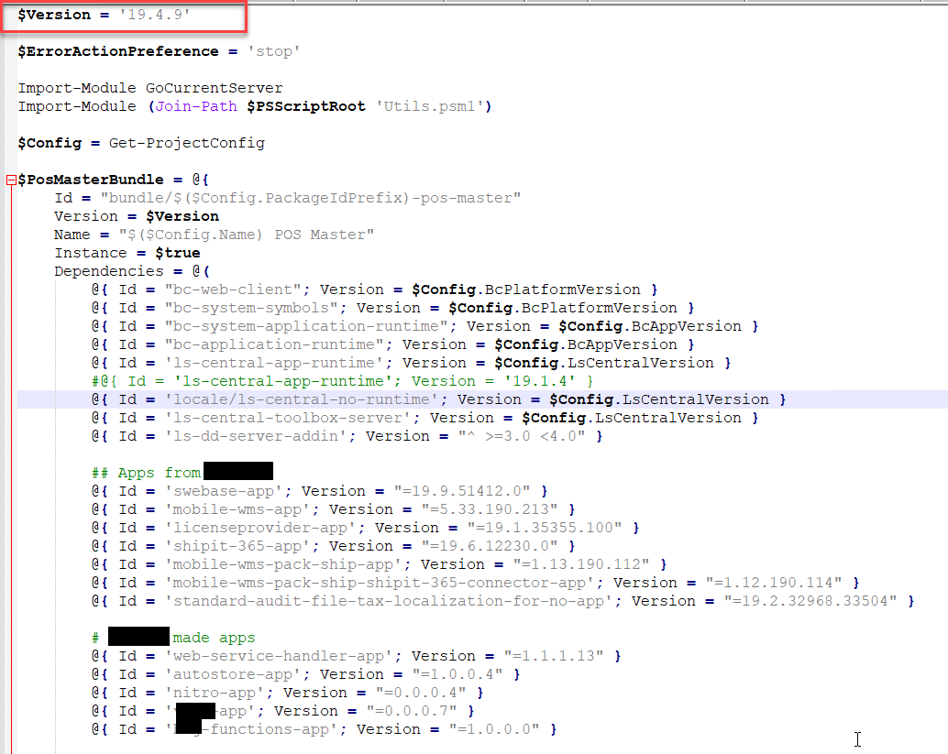
LS Update

Slide 46
Lesson learned
LS Update service
Versioning
Powershell
LS Hardware Station
XML files distribute
Do not configure more than using
Windows App Shell
Central config via XLM

Slide 48

Questions?

Slide 49
Thank you

