Slide 1
LS Central SaaS Experiences
(stories from the field)
Panel Discussion

Slide 2
Participating Partners
Dynavics UK
IT.Integro Poland
NAS Conception Germany
AdmiNetwork Hungary

Slide 3
Dynavics UK
Lluis Badenas
lluis.badenas@dynavics.co.uk

Slide 4
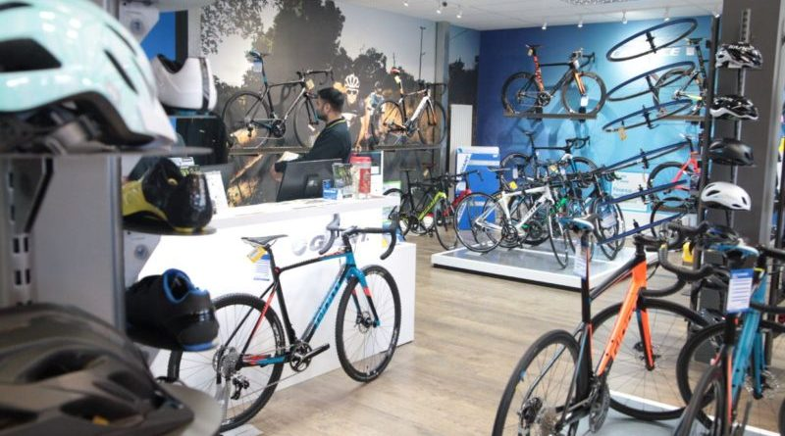
“Cycling stores”
Main metrics:
80 users, 44 POS,14 stores,
UK only
Timeline:
March – December 2021 full SaaS
BC reimplementation
LS Central + Salesforce eComm integration
BIG BANG Go Live

Slide 5
“Cycling stores”
Positive experience:
No replications of the Data Director removes a lot of friction points
LS Buddy helping us through the process
Excellent support and involvement from LS Retail Account Manager
Challenges:
Very early version of LS Central SaaS, “uncharted” territory
Customer Orders not completely there in the beginning
Adyen Refund Issue, LS Central vs LS Pay teams
What would you do differently?
Reinforce customer engagement in testing, and our standard functionality validation when it is a new solution
Treat LS Central SaaS as a product, not just a setup mode of LS

Slide 6
IT.Integro
Poland
Jakub Abram
jakub.abram@it.integro.pl

Slide 7
“Customer X” – Coffee chain
First BC + LS Central SaaS implementation in Poland
Scope:
Business Central + LS Central + PL Localization
POSes, Purchases, Inventory, Finance Banking
5 stores, 13 POS, 16 users
LS Pay / Adyen (1 day implementation)
Challenges:
Short implementation time – 2 months
LS Central cluster for Poland took longer than expected
Localization for Poland (fiscal printers integration to SaaS)
Getting test environment ready quickly (ex. POS setup, data migration)
24/7 operations vs SaaS upgrade

Slide 8
NAS Conception
Germany
Nico Straub
nico.straub@nasconception.com

Slide 9
Fast Food Restaurants in Saudi Arabia
23 users, 4 POS, 2 restaurants
Scope:
Integrate two fast food restaurants in the existing BC environment
with the existing 19 companies
Positive experience:
Migration from public to LS cluster within one week
Our predefined templates could quickly be rolled out
Challenges:
Implementation period 4 weeks to go live
Applying the seamless Arabic translations

Slide 10
AdmiNetwork
Hungary
Zsolt Takas
zsolt.takacs@adminetwork.hu

Slide 11
Sport Vision
BC + LS Central SaaS + HCS + HU localization
8 users, 1 store currently (5 stores until end of this year), 2 POS, 3 LS Inventory PDA
Timeline of project:
6th January – Contracted
28th February – Go Live
6th March – First store opened
Positive experience:
Easy to onboard to SaaS with OnBoard Buddy Support
When we had issues with the App Source validation, we received great support
Using the Update Service for POS installation is simple and quick

Slide 12
Challenges:
Short period of time to implement (8 weeks)
Microsoft was slow to open the HU cluster and AppSource registration was a little bit complex
System outage on the first live day caused by MS update
HCS Script had to be reviewed with MS Consultant to work fine
Complications with the DUR license
What would you do differently?
More time to do analysis for a better understanding
Higher focus for training the customer

Slide 13
Thank you

