Slide 1
LS Central
How telemetry can help you solve problems in a live SaaS environment
Ricardo Moinhos
Migration Buddy

Slide 3
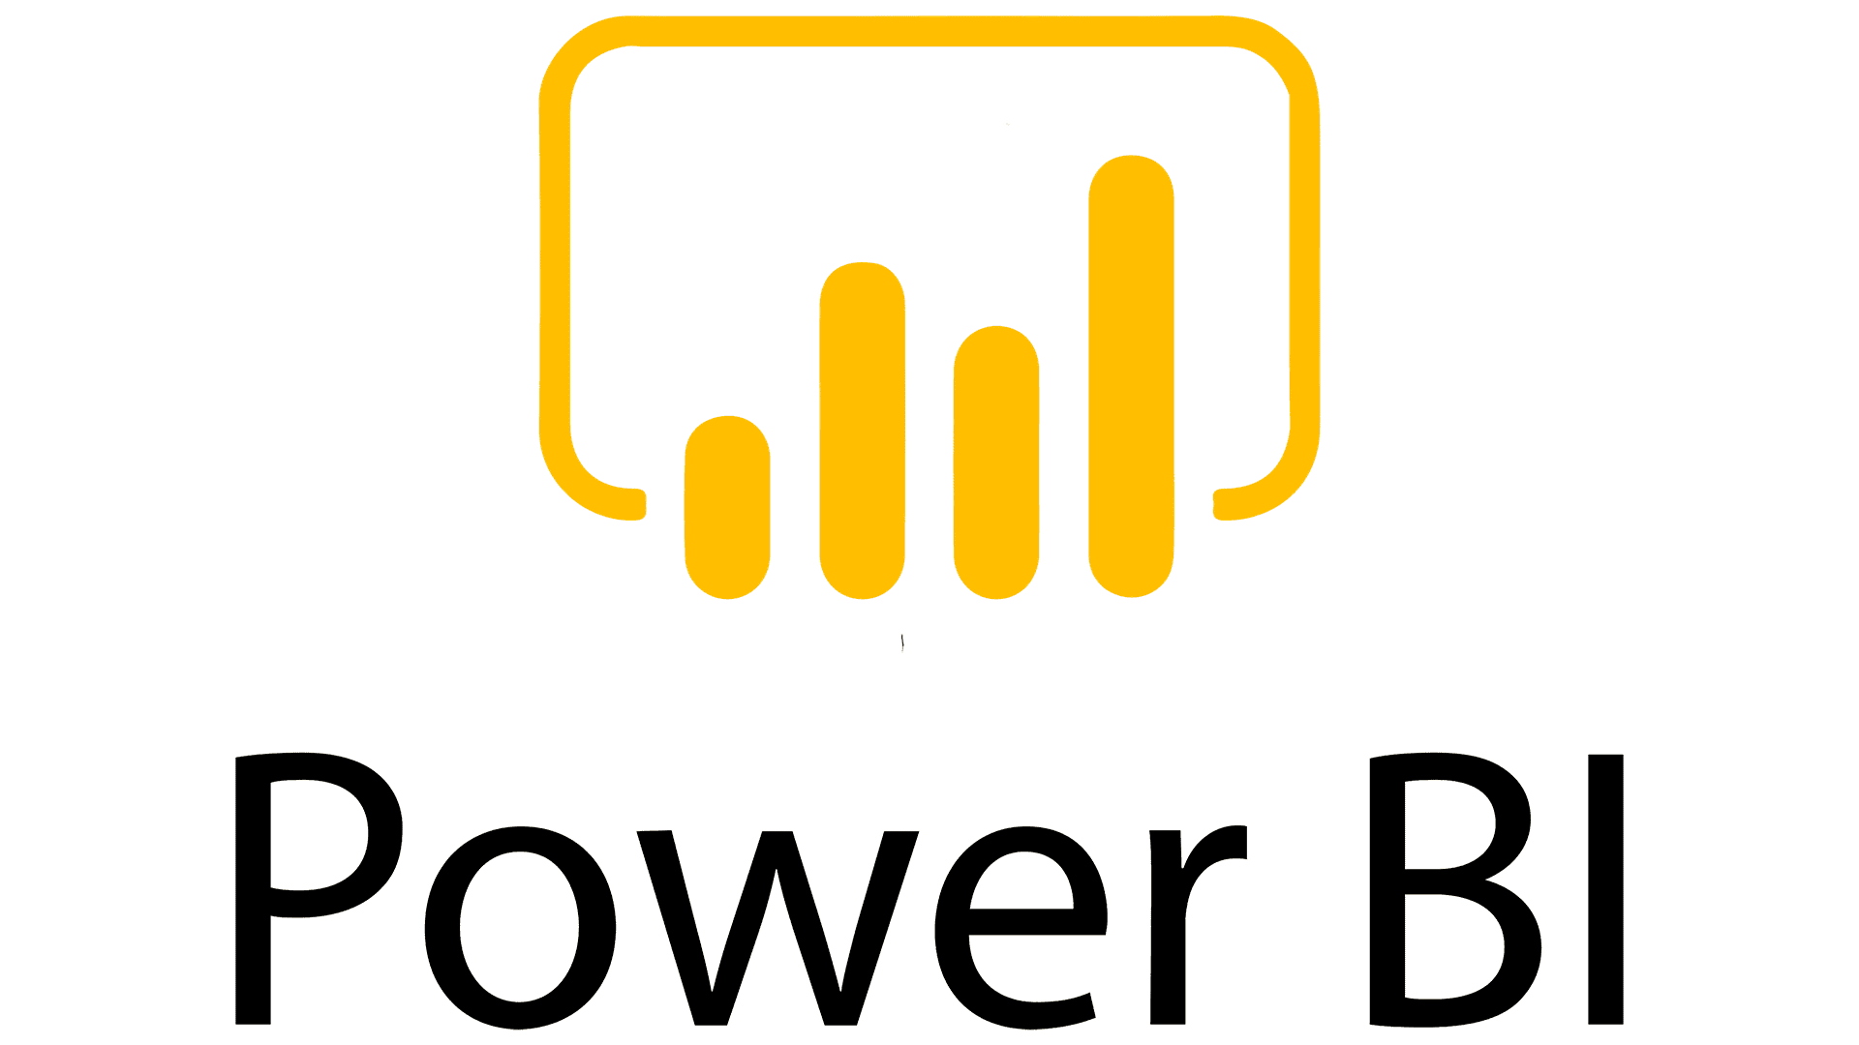
What is telemetry?
Telemetry is…
the science or process of collecting information about objects that are far away and sending the information somewhere electronically
Source: Cambridge Dictionary
Azure Monitor
Alerts
Power Platform
Data Lake

Slide 4
Why should you be using it?
Tool to troubleshoot Business Central
Events list will grow in the next few years
Allows you to analyse other kind of things

Slide 5
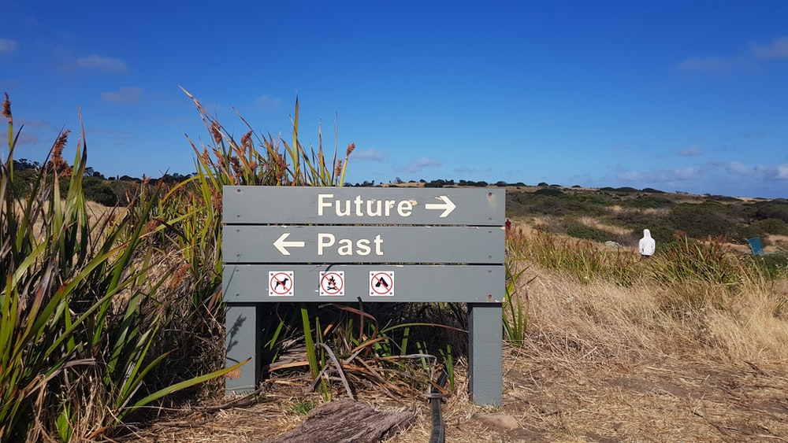
Why should you be using it?
Tool to troubleshoot Business Central
Events list will grow in the next few years
Allows you to analyse other kind of things
And, most of all, because you want to be part of the future!

Slide 6
What does it give you?
A lot of insights (Telemetry Event IDs)
Database Deadlock / Lock Timeout
Long Running AL methods/SQL Queries
Extension Lifecycle
Extension Update
Web Service Requests (Incoming / Outgoing)
Feature Telemetry
Page View
Task Scheduler
Job Queue
Authorization
Company Lifecycle
Email
And more…

Slide 7
What does it give you?
Works for Microsoft, LS Central, partner and customer extensions
Works on SaaS and on-premise environments
Custom events to log and solve specific issues
No performance impact expected

Slide 8
Why aren’t you using it yet?
Is it because you don’t know how to set it up?

Slide 9
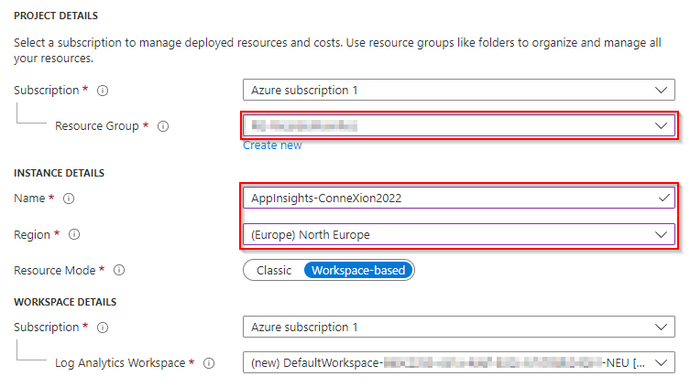
Why aren’t you using it yet?
Is it because you don’t know how to setup it up?
Azure Portal

Slide 10
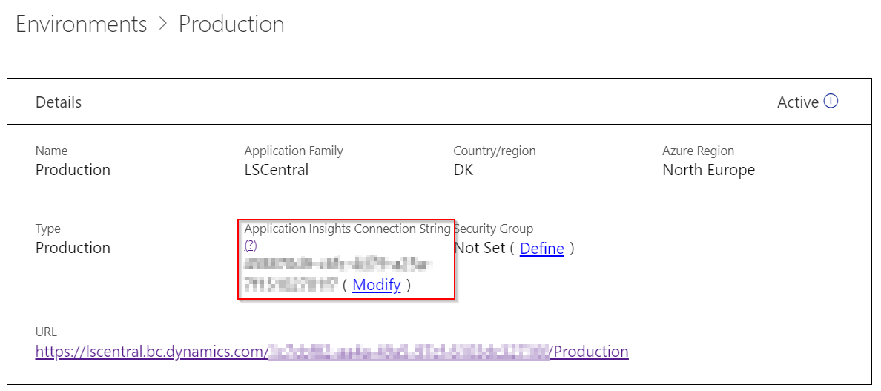
Why aren’t you using it yet?
Is it because you don’t know how to setup it up?
For SaaS environments
Dynamics 365 Business Central Admin Center

Slide 11
Why aren’t you using it yet?
Is it because you don’t know how to setup it up?
For on-prem environments
From the Business Central Server Administration
From the Powershell Console
Set-NAVServerConfiguration -ServerInstance BC200 -Keyname ApplicationInsightsConnectionString -Keyvalue 'InstrumentationKey=11111111-2222-3333-4444-555555555555;IngestionEndpoint=https://westeurope-1.in.applicationinsights.azure.com/'

Slide 12
Why aren’t you using it yet?
Is it because you don’t know how to setup it up?
At the extension level

Slide 13
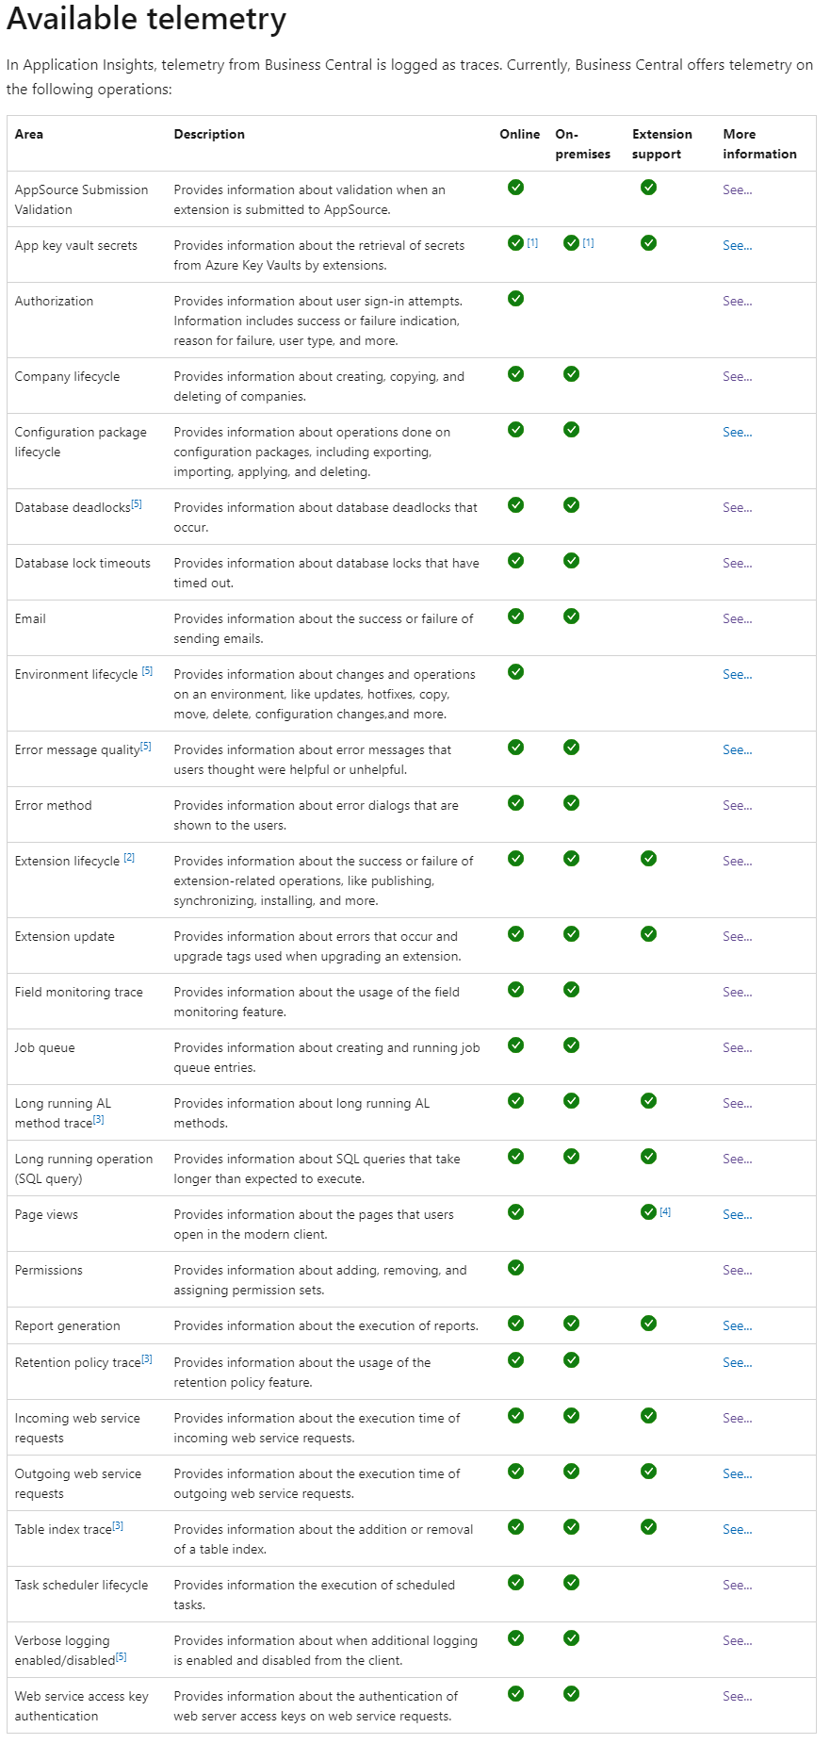
Why aren’t you using it yet?
Is it because you don’t know how to setup it up?

Slide 14
Why aren’t you using it yet?
Is it because you don’t know how to setup it up?

Slide 15
Why aren’t you using it yet?
Is it because you don’t know how to setup it up?

Slide 16
Why aren’t you using it yet?
Is it because you don’t know how to setup it up?

Slide 17
Why aren’t you using it yet?
Is it because you don’t know how to set it up?
Is it because it might cost you money?

Slide 18
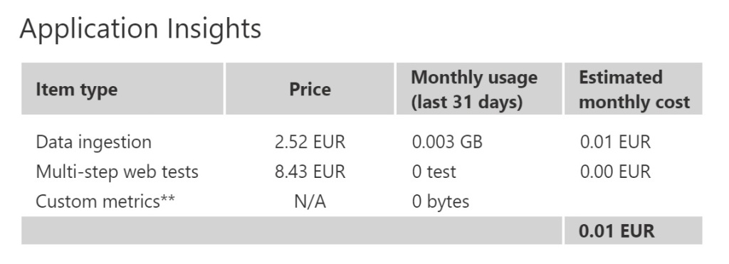
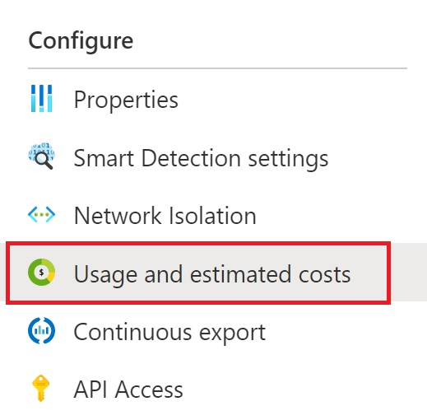
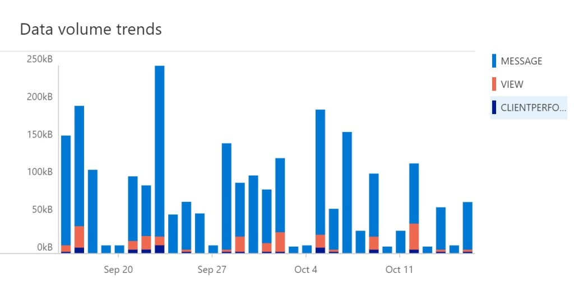
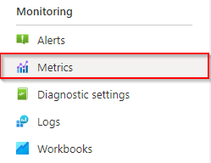
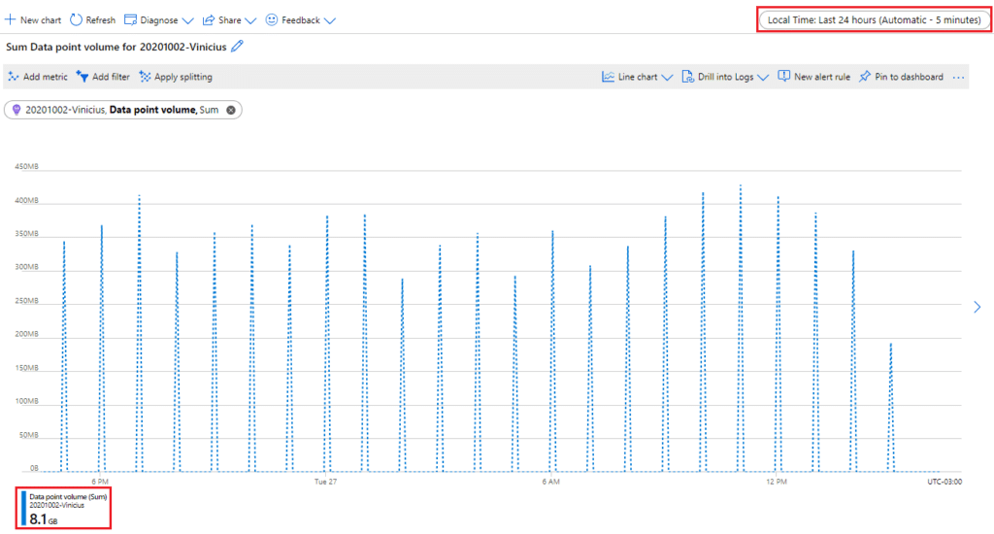
Why aren’t you using it yet?
Is it because it might cost you money?
Azure Portal
Data Ingestion
5 GB of data ingestion per billing account per month at no charge
Basically, it is the data sent by your application to Application Insights, and you have 5GB per billing account per month at no charge. Once you exceed the 5GB, you will be charged per GB.
Data Retention
30 days of data retention at no charge
It is the retention period you want to keep your data ingested available. Application Insights includes 30 days of data retention at no charge, for workspace-based resource mode.

Slide 19
Why aren’t you using it yet?
Is it because you don’t know how to set it up?
Is it because it might cost you money?
Is it because there’s a learning curve and you need to invest time in KQL and/or PowerBI?

Slide 20
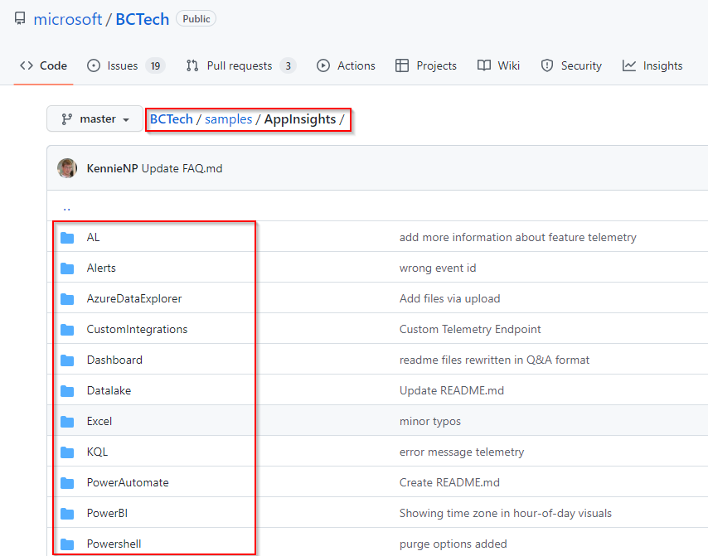
Why aren’t you using it yet?
Is it because you need to invest time in KQL and/or PowerBI?
Business Central Tech Samples
http://aka.ms/BCTech

Slide 21
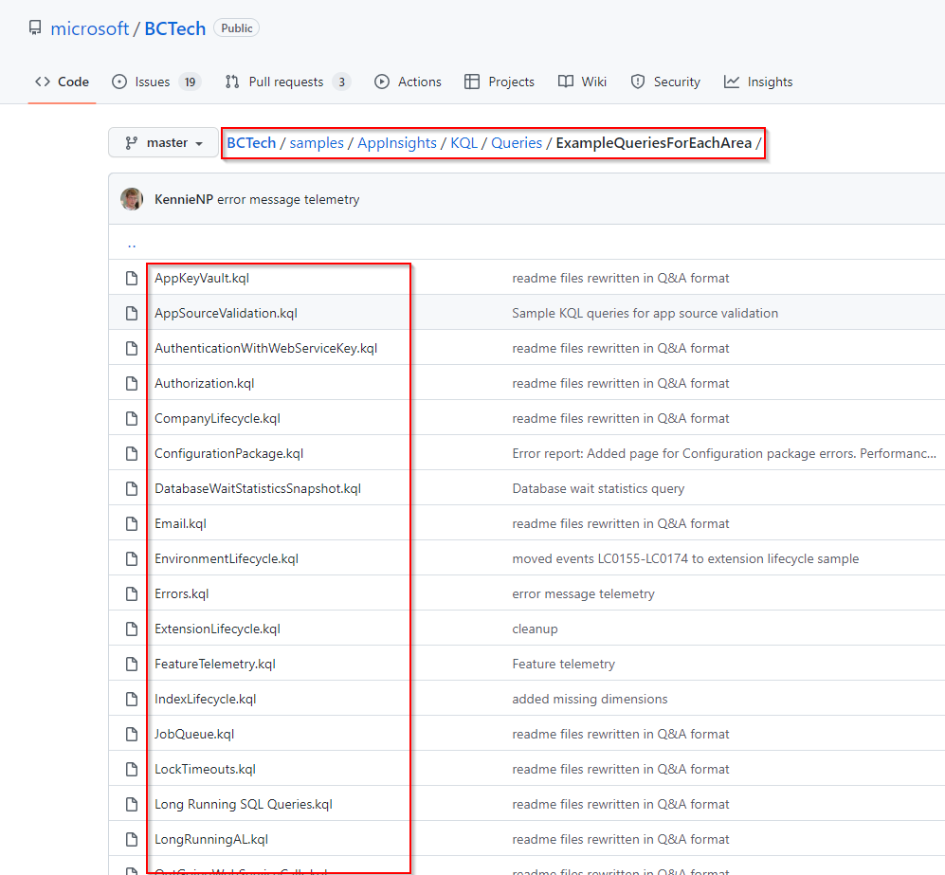
Why aren’t you using it yet?
Is it because you need to invest time in KQL and/or PowerBI?
Business Central Tech Samples
http://aka.ms/BCTech
KQL Queries Examples
Can be pasted directly in the Application Insights logs explorer

Slide 22
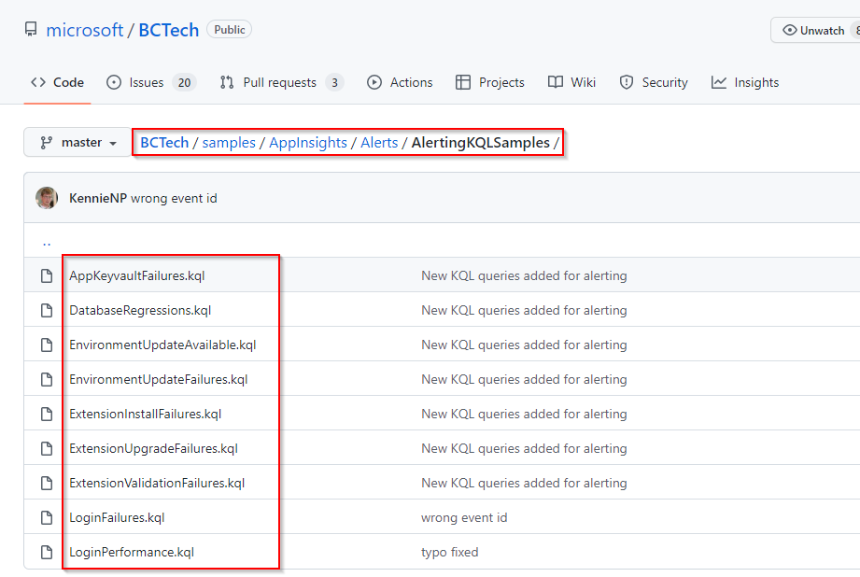
Why aren’t you using it yet?
Is it because you need to invest time in KQL and/or PowerBI?
Business Central Tech Samples
http://aka.ms/BCTech
KQL Queries Examples
Can be pasted directly in the Application Insights logs explorer
Alerting KQL Samples
Used to setup Alerts in Application Insights

Slide 23
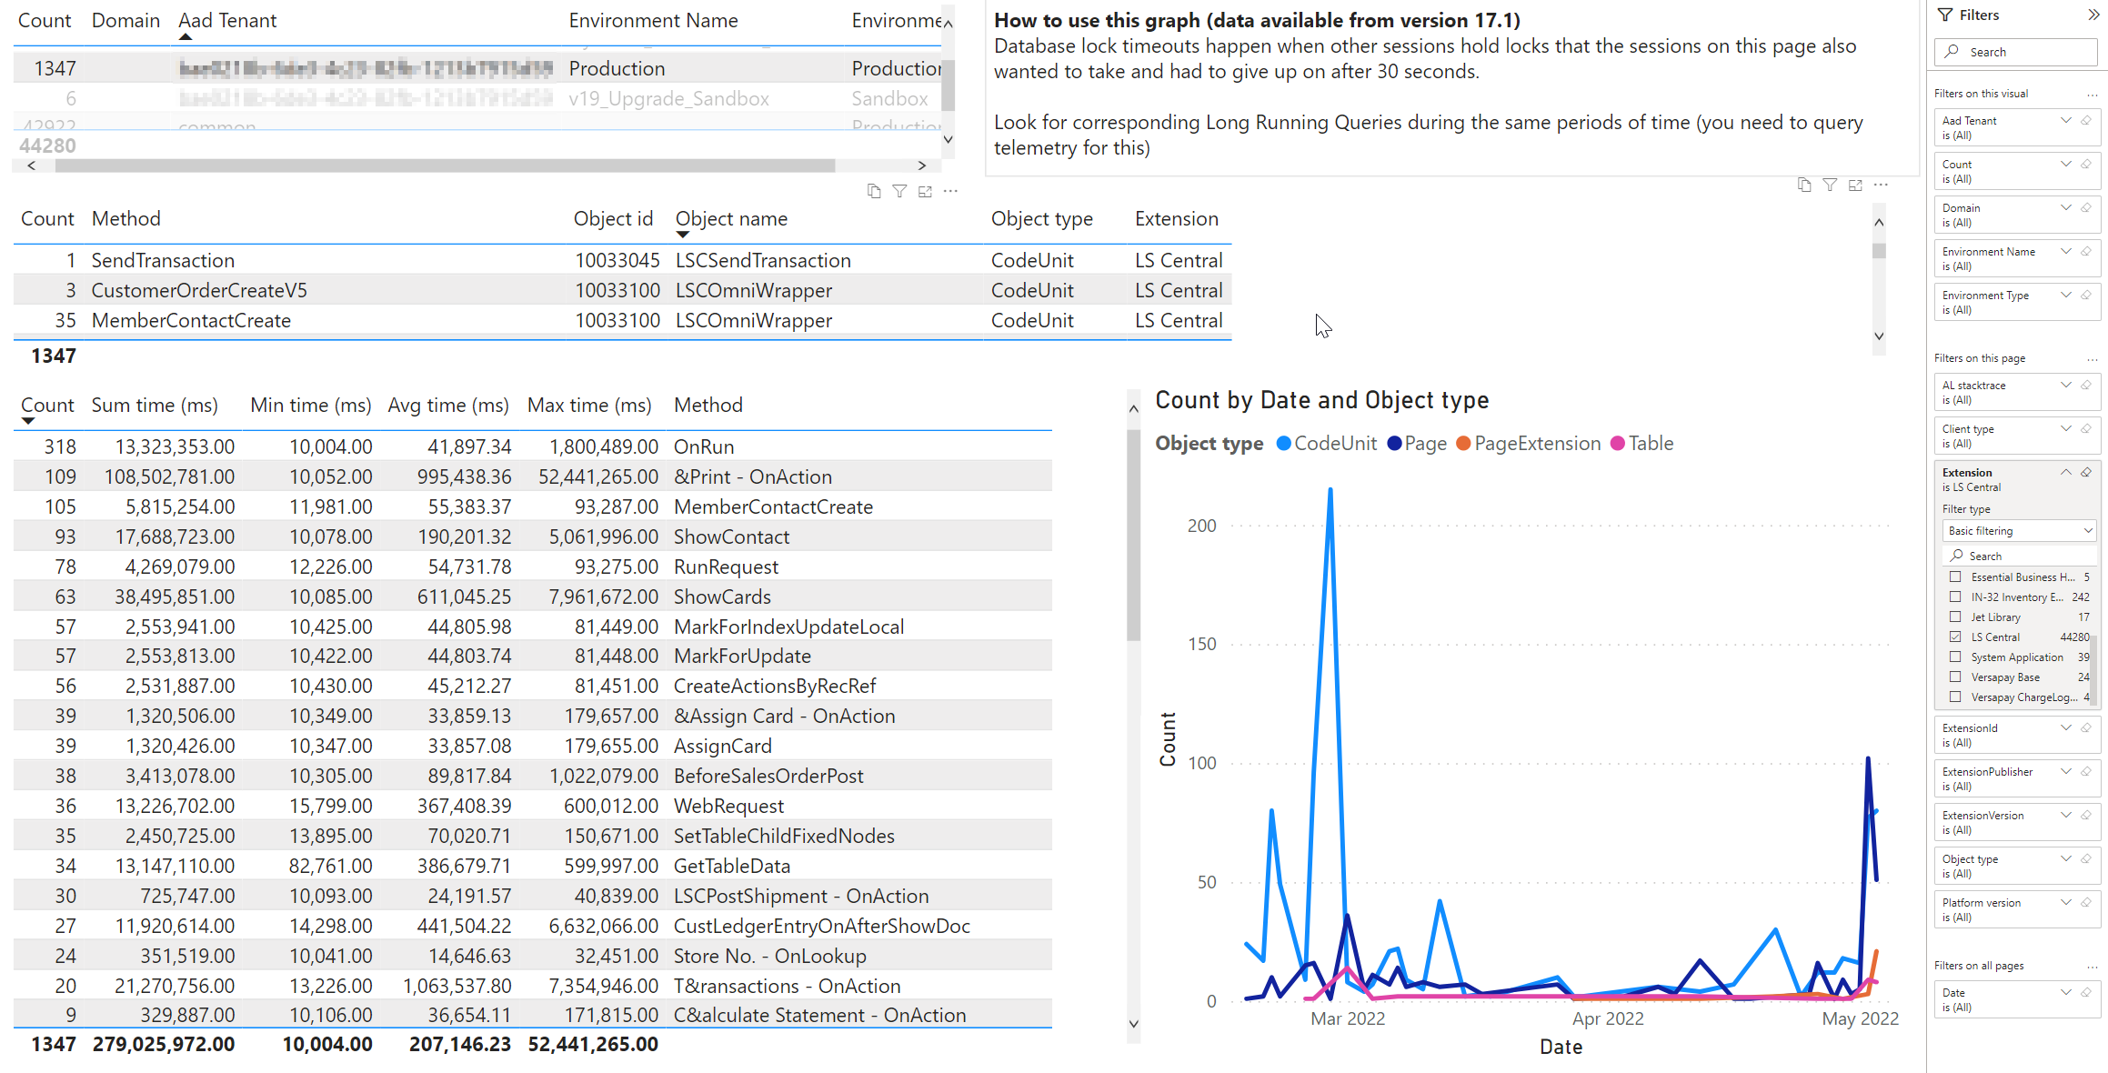
Why aren’t you using it yet?
Is it because you need to invest time in KQL and/or PowerBI?
Business Central Tech Samples
http://aka.ms/BCTech
KQL Queries Examples
Can be pasted directly in the Application Insights logs explorer
Alerting KQL Samples
Used to setup Alerts in Application Insights
Power BI app
https://aka.ms/bctelemetryreport

Slide 24
Where do you want to be?

Slide 25
Resources
Create a new Azure Application Insights resource - Azure Monitor | Microsoft Docs
Enable Sending Telemetry to Application Insights - Business Central | Microsoft Docs
Creating custom telemetry signals for Application Insights - Business Central | Microsoft Docs
Azure Monitor cost and usage - Azure Monitor | Microsoft Docs
Telemetry Event IDs in Application Insights - Business Central | Microsoft Docs

Slide 26
Now is time for questions

