Slide 1
Update Service
for LS Central
Thorir Bjornsson
Damir Babikov

Slide 2

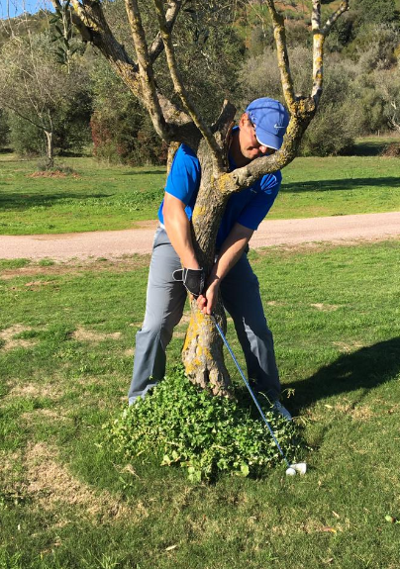
Speakers
Thorir Bjornsson
Damir Babikov

Slide 3
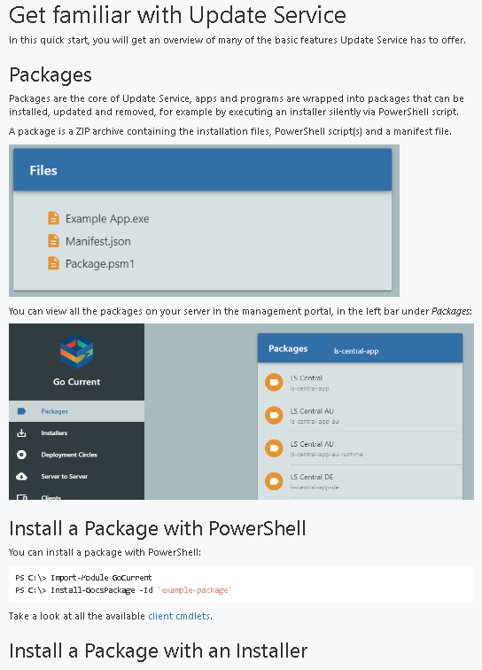
Overview of Update Service (LSUS)
Packages
Versions
Bundles
Monitoring
Deployment circles
Multiple environments
Client - Server
Database and files

Slide 4
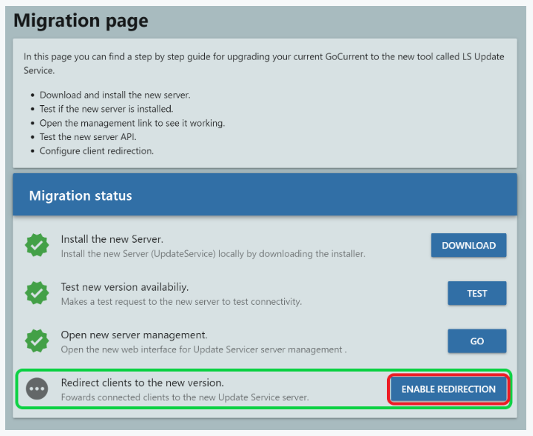
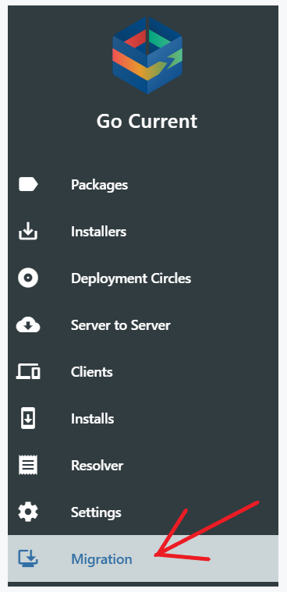
Migration from Go Current
If you are lucky enough to be using Go Current already – your life is about to change for better!
  .NET Core
  REST API
  Azure AD & Storage
  New interface
  GUI package import
  Ongoing install track
  Notifications
  And more...

Slide 5
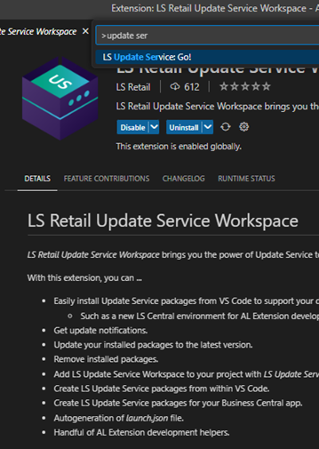
Case Study A
Architecture overview
  Latest LS Central version, updated every month
  Financials + Retail, offline POS
  On-premise, load balanced service tiers
  Single HO database
  SQL in HA mode, single cluster, 2 nodes, multiple environments (DEV, UAT, LIVE)
Why LSUS
  Update Service workspace (VS Code Extension)
  Distributed extension development support using DevOps + Update Service
  Dedicated LSUS for various environments

Slide 6

Case Study B
Architecture overview
  Ferry company
  Version - 20.3 just upgraded from 19.5
  Next upgrade planed this fall
  Configuration – Mixture of online, offline on Vessels and Head Office
  Service tiers – Vessel Main, Hospitality, NAS and Web services
  Databases – Ho and Vessels
  Retail POS online, Hospitality POS Offline
  Mobile POS
  Replicated environment
  LSUS distributed as well, HO and Vessel servers

Slide 7

Case Study B
Why LSUS
  Imaging of POS done via mix of SCCM and LS Update
  Upgrade of the newest version 20.3 all done through LS Update
  All updates done via Deployment circles
  Very limited update window
  Monitoring installs in LS Update
What if not LSUS
  Manual update of all POS and servers
  Scripting the update by some other means

Slide 8
Case Study B
Example of changes to push out License and new Hardware Station
  Edit the Bundle
  #POS license
  @{ Id = "$($Config.PackageIdPrefix)-pos-license"; 'Version' = ">=1.0.9"}
  # POS HW station
  { Id = 'ls-hardware-station'; 'Version' = ">=20.5.0" }
  Updated Bundle
    Id = "bundle/$($Config.PackageIdPrefix)-posrt-new"
    Version = '20.3.3'
  Pushed out via Deployment Circle

Slide 9
Case Study C
Architecture overview
  Older BC version
  On-premises, major public cloud hosted
  Regional load balanced service tiers
  Multiple databases, SQL HA, in several clusters, 3 nodes each
  Over 1000 locations, 3000 users, high transaction rate, many integrations
Why Update Service
  Ability to perform unattended installations
  Central update of thousands of existing installs
  Ability to extend the LSUS and create own packages (based on standard, as well as completely bespoke)

Slide 10

Future of Update Service
Development team and LS Retail commitment
  Team of three, led by father of Go Current Arnthor Magnusson
Roadmap & New Features
  Simplified project management and package creation
  Deploy new installation remotely
  Scheduling
  Improved deployments & monitoring
New Platforms

Slide 11
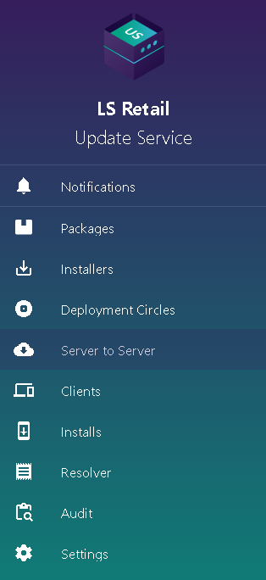
Want to Know More?
Finding help online
  https://help.gocurrent.lsretail.com/docs/get-started.html
Yammer
  https://www.yammer.com/gocurrent/
Contacting LS Retail support via Partner Portal
  https://portal.lsretail.com
Git repo of examples
  https://github.com/lsretail/go-current-examples
Use all of above to suggest new features
and contribute to development of Update Service

Slide 12
Thank you

