Slide 1
Enable your customers with LS eCommerce
Petur Thor Sigurdsson
Product Director

Slide 2






eCommerce
POS
Master Data
Store Inventory
Point of Sale
Basket Calculation
Hospitality
Customer Loyalty
Click & Collect
Customer Orders
Transaction Repository
Token Vault
Gift Cards
Activity
KDS
Pharmacy
+
+

Slide 3

eCommerce API
LS Commerce Services

Slide 4
eCommerce API
LS Commerce Services

Slide 5
Traditional UI
Progressive Web App (PWA)
eCommerce API
LS Commerce Services

Slide 6
Magento
Demo

Slide 7
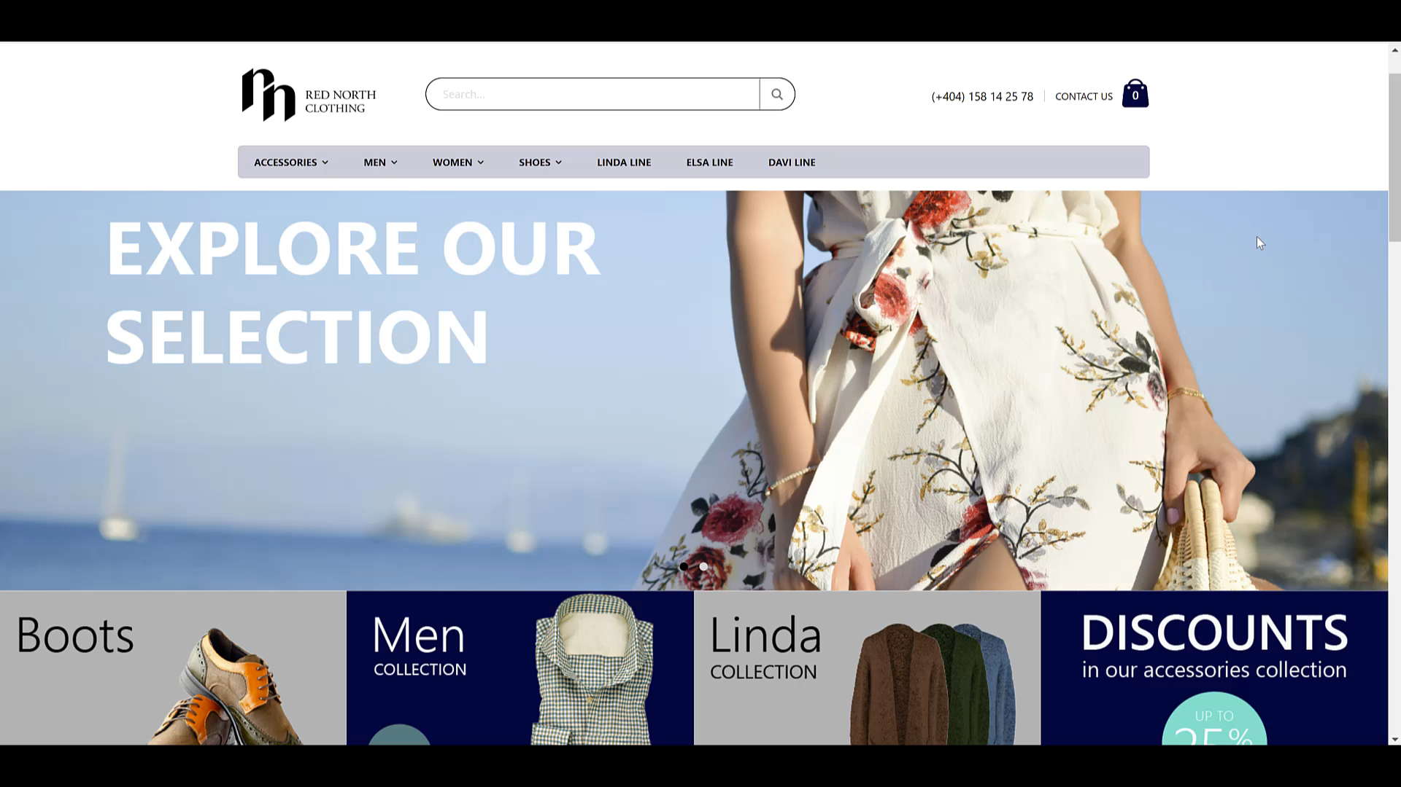

Slide 8


Slide 9
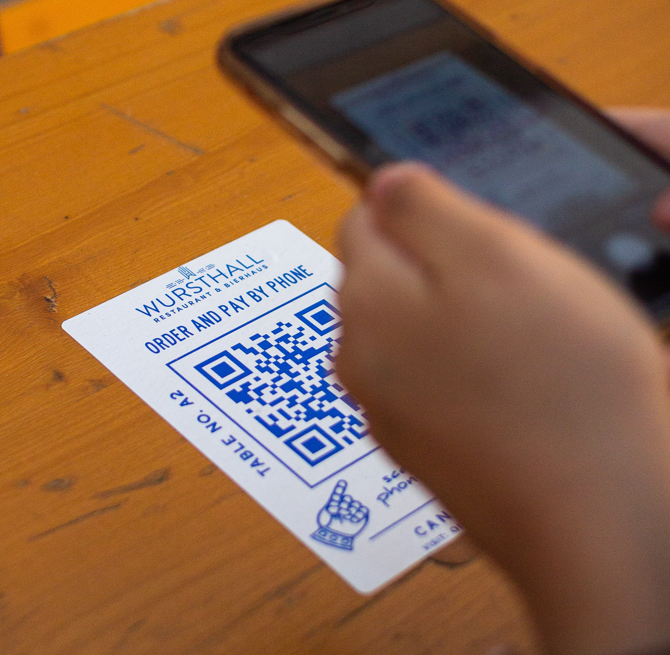
Online food ordering
Online food ordering
Take away
Dine in
Contactless QR code ordering
The order is instantly posted to LS Central and routed to the KDS system for preparation

Slide 10
Contactless food ordering
Tomorrow at 10:45
Gunnar Orn Thorsteinsson
Petur Thor Sigurdsson
Product Director
Product Director

Slide 11
What's next ?

Slide 12

LS Activity
Web presence for LS Activity
Online resource booking
Spas, beauty treatments, massages, golf tee times, cooking classes, etc.
Front end available on Magento
API access for 3rd party web platforms

Slide 13
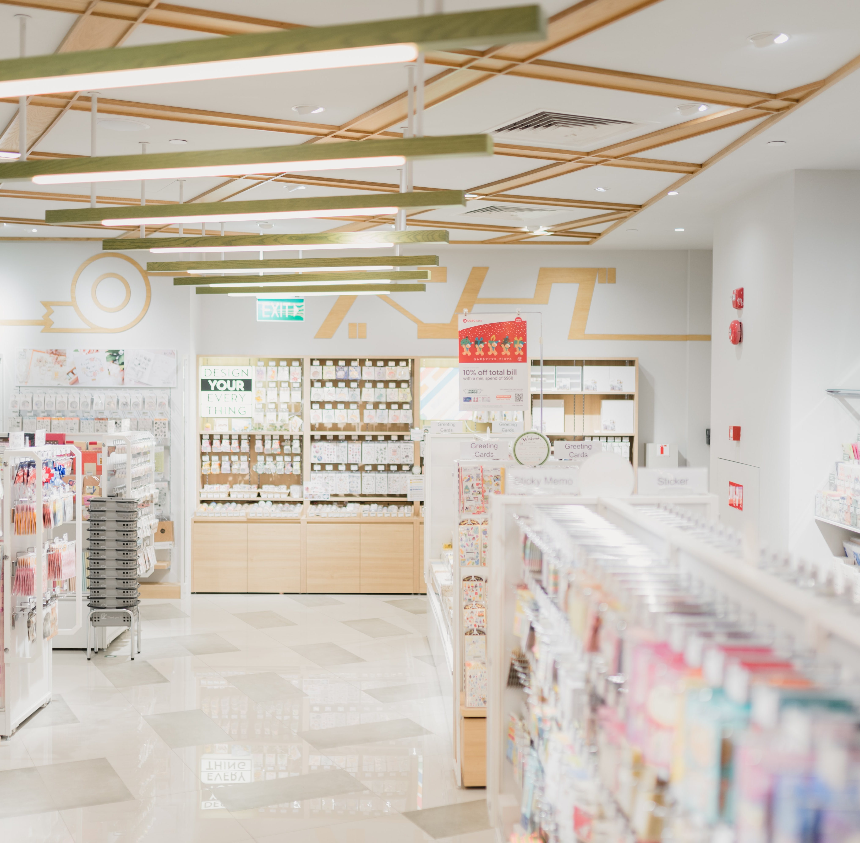
eCommerce for LS Pharmacy
eCommerce support for our Pharmacy solution
Online ordering of prescription medication
Front end available on Magento
API access for 3rd party eCommerce platforms

Slide 14




One of the world’s leading eCommerce platforms
Non unified commerce approach
Easier – Simpler - Faster
Cloud hosted by Shopify
Phase #1 being released in June

Slide 15
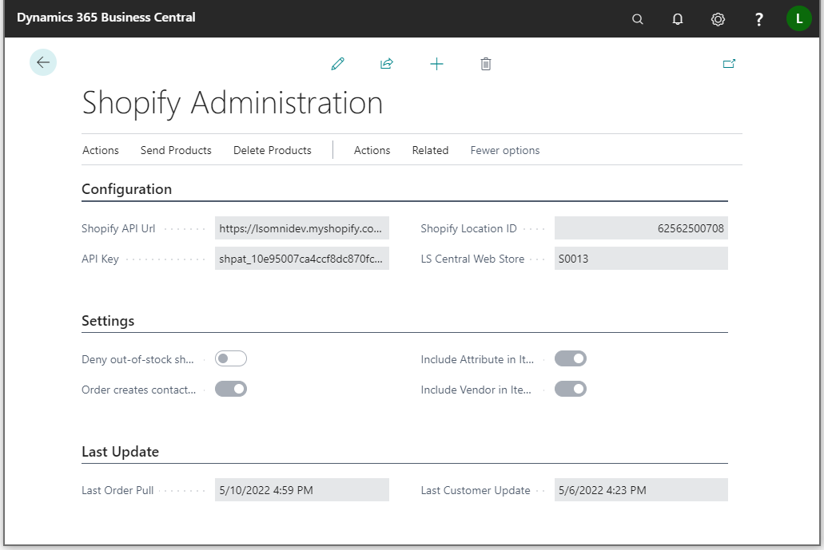
LS Central - Configuration
Basic environment configuration:
Shopify API URL
API Key
LS Central Web Store
Tender type and shipping agent mapping
Various settings, etc.
Replication driven by item distribution and scheduler jobs

Slide 16
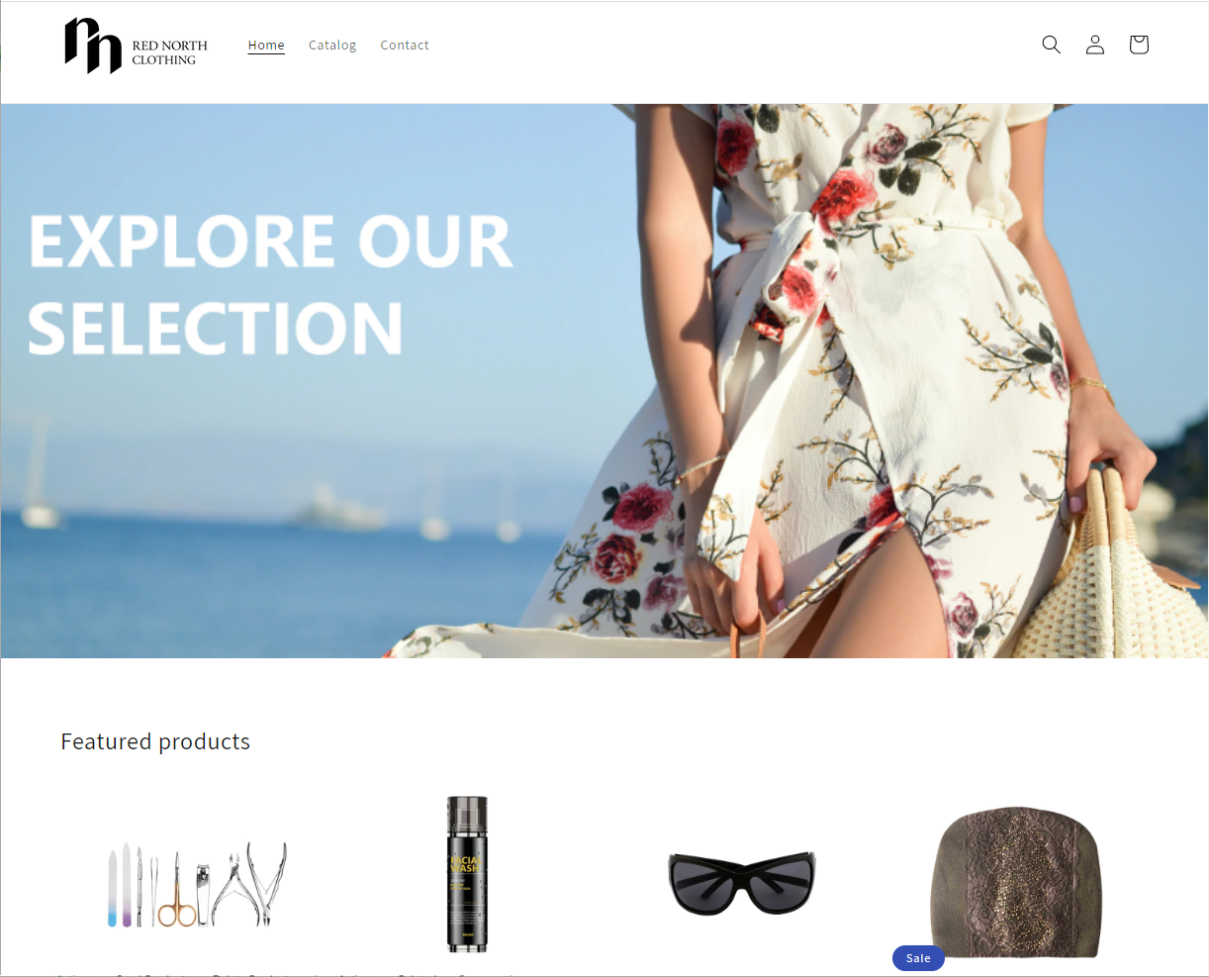
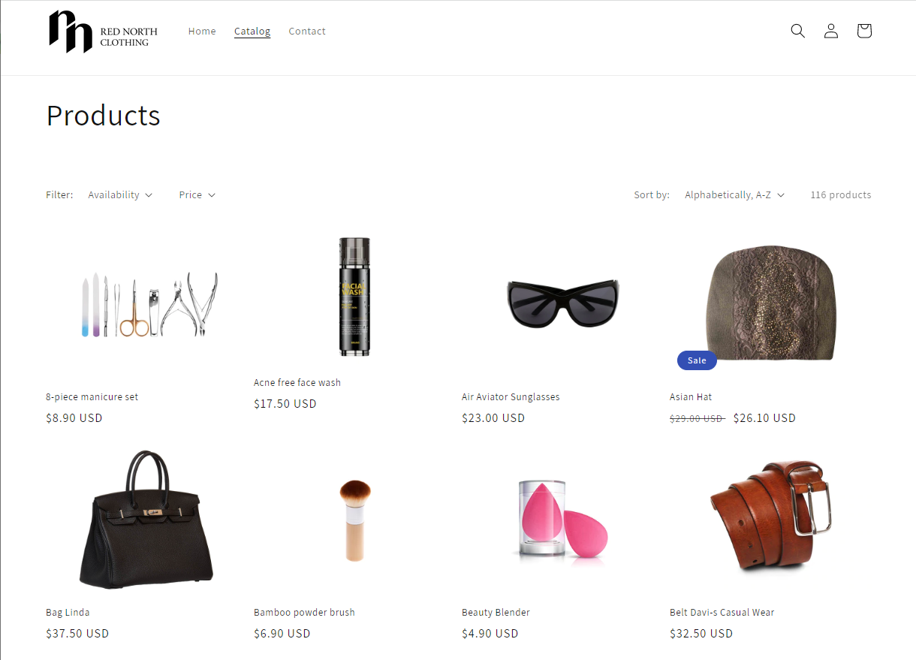
Shopify Storefront
Shopify or Shopify Plus
Choose the platform for your needs
The theme sets the context
Go with themes made for what you’re selling
Employ a digital agency

Slide 17
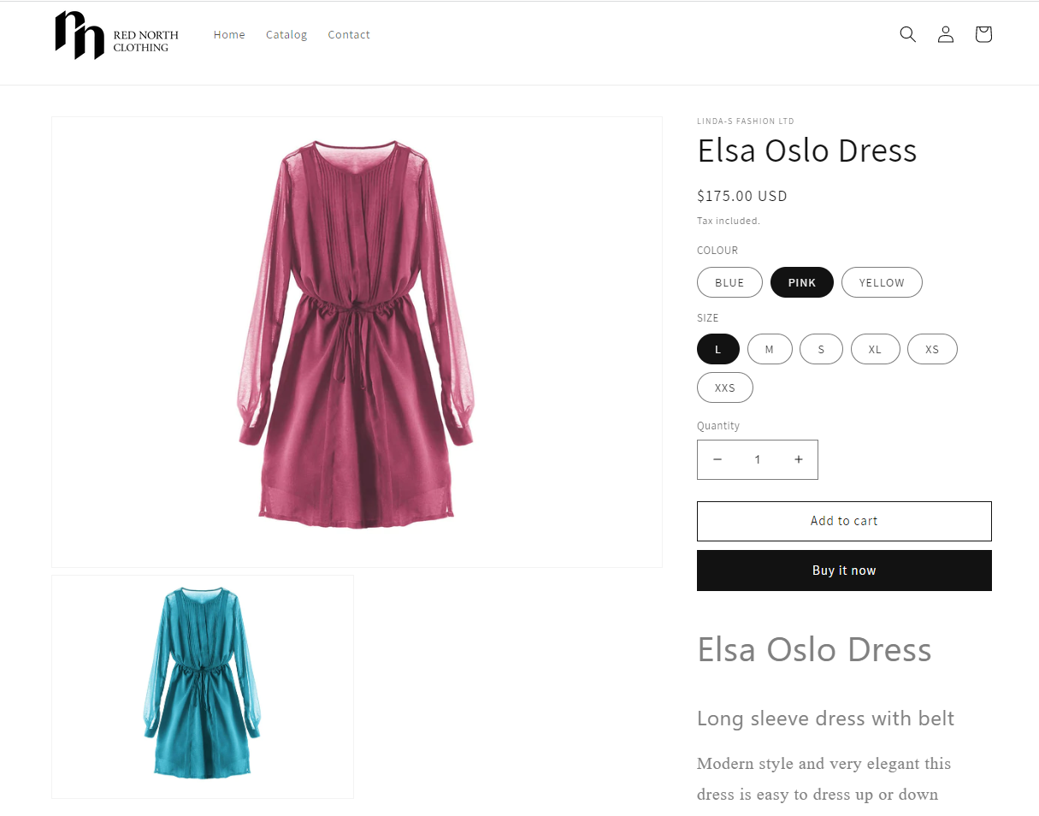
Items
Full item replication:
Name, description, images
Attributes, categories
Inventory, prices
Periodic discounts
Full variant support

Slide 18
Orders
Orders from Shopify created as Customer Orders in LS Central
Support for shipping agents and amounts
Support for tender mapping
Customers in Shopify created as Member Contacts in LS Central
Batch pulling
With individual orders

Slide 19


Retail
Hospitality
Activity
Pharmacy
Retail
eCommerce API
LS Commerce Services
3rd party
eCommerce
providers

Slide 20




LS eCommerce as SaaS
eCommerce API
LS Commerce Services

Slide 21
How to get started?

Slide 22
LS eCommerce
How to embark on an eCommerce project?
Zeeshan Khuwaja
Kristjan Asvaldsson
Product Owner
Solution Lead

Slide 23


Slide 24
Q&A

Slide 25
Thank you!

