Slide 1
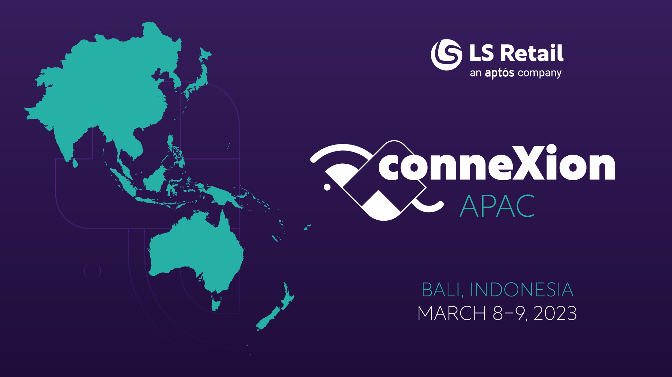

Slide 2
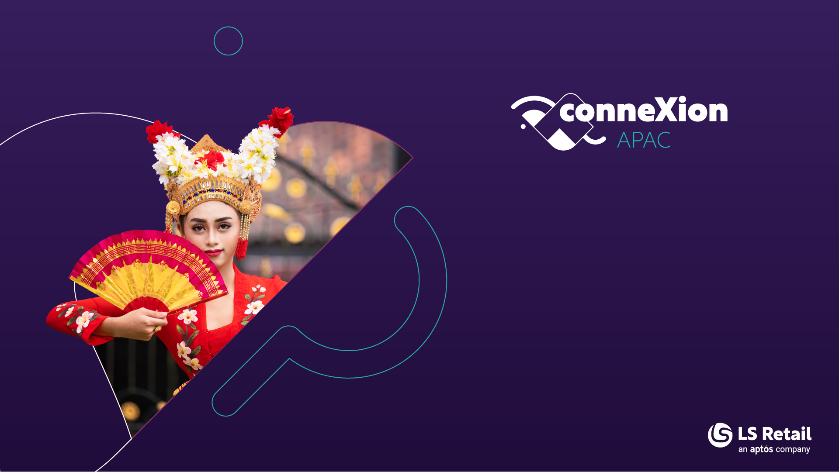
LS Central SaaS
Experiences and
stories from the field
Bjarni Asmundsson
Regional Director

Slide 3
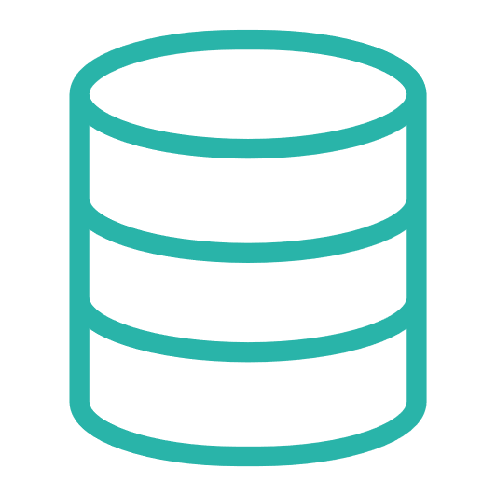


What is SaaS?
Dynamics 365 cloud
SaaS
SaaS = Software as a Service
You subscribe to SaaS instance
of the software
The instance…
  is always updated
  benefits from newest technology
  is still running on the same code or
  solution as On Prem
Hybrid component server
HQ
LS Commerce
Store
Online POS
Offline POS
Offline POS Service

Slide 4
Who is running my environment?
Dynamics 365 cloud
SaaS
Hosted by Microsoft
  Both the public BC cluster and the private LS cluster are hosted and maintained by
  Microsoft
Forget about infrastructure maintenance/cost
Reliable scalable environment for performance
Tools to monitor and analyze – like telemetry
Best in class-security
Potential outage should be
reported to Microsoft
Hybrid component server
HQ
LS Commerce
Store
Online POS
Offline POS
Offline POS Service

Slide 5

When did we start the SaaS journey?
Our first SaaS customers started
the SaaS journey in 2019
Among the first ones were
  Philippines with hospitality customer
  Germany with grocery / c-store customer

Slide 6
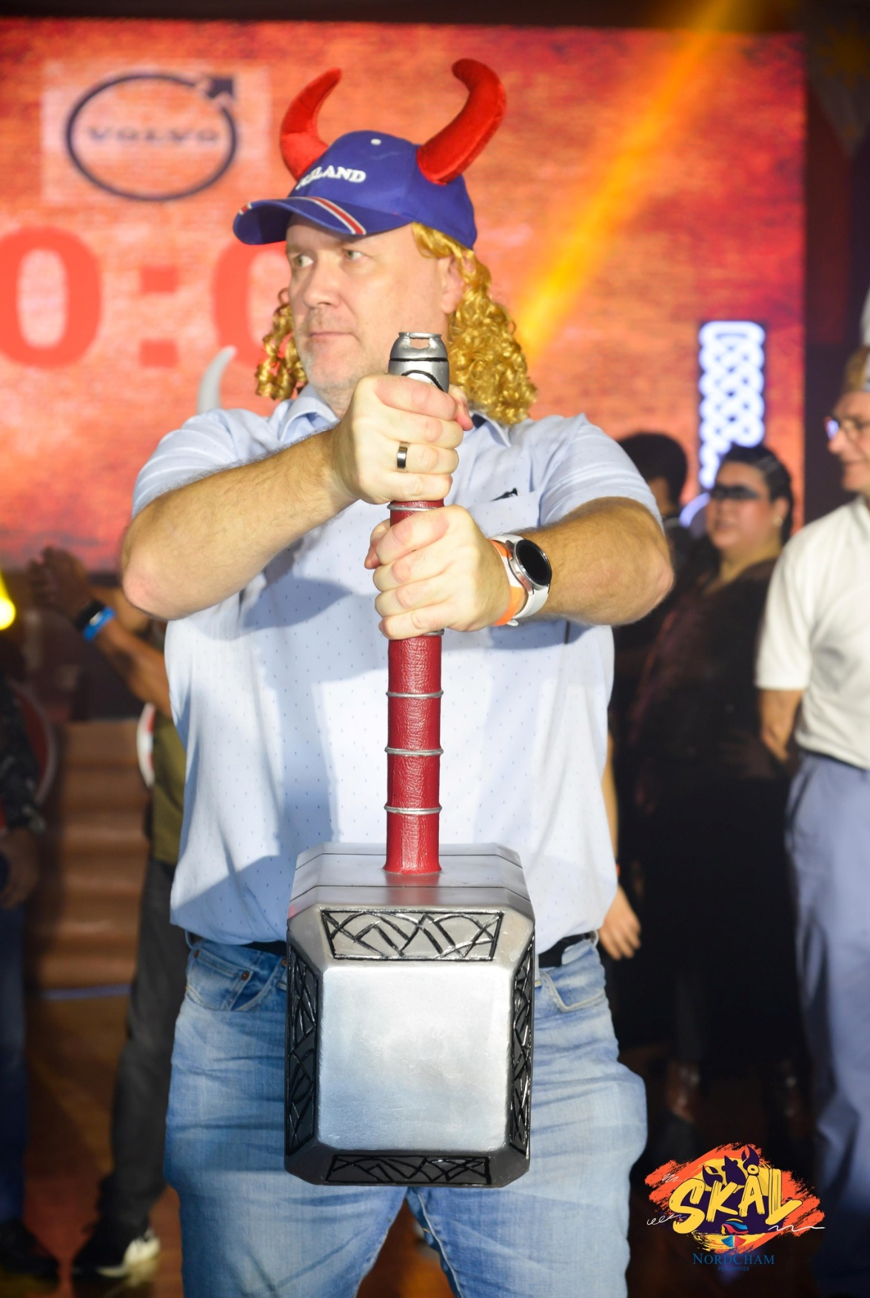
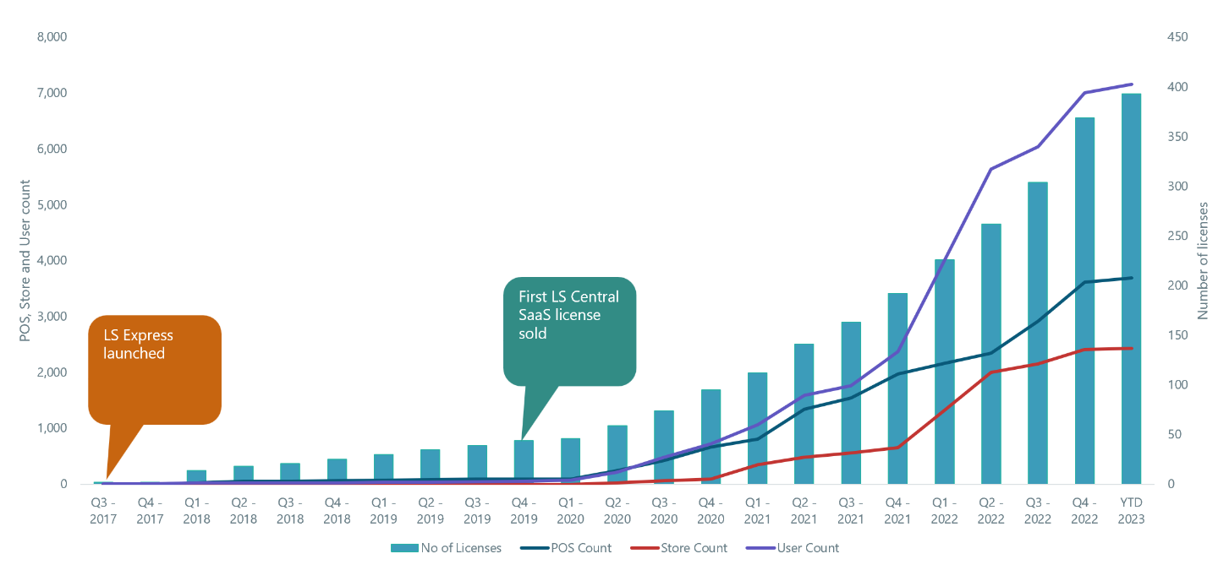
What has happened on the way
Licensing model
Database size included
LS Central got SaaS mature – no DLLs
More customers, more stores, more …

Slide 7
The development of SaaS within LS Retail
First LS Central SaaS license sold

Slide 8
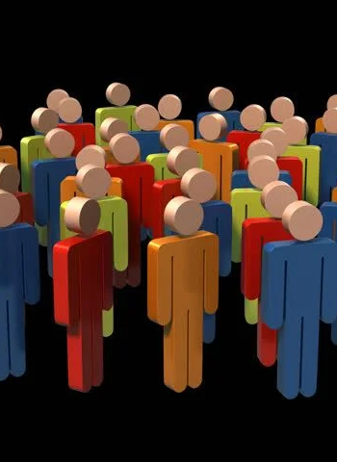
Where are we now?
About 400 customers
All regions – All verticals
Customers
  with from 1 store to over 100 stores
  operating in multiple countries
APAC
  Over 200 stores live, over 100 more WIP
  Multiple countries

Slide 9
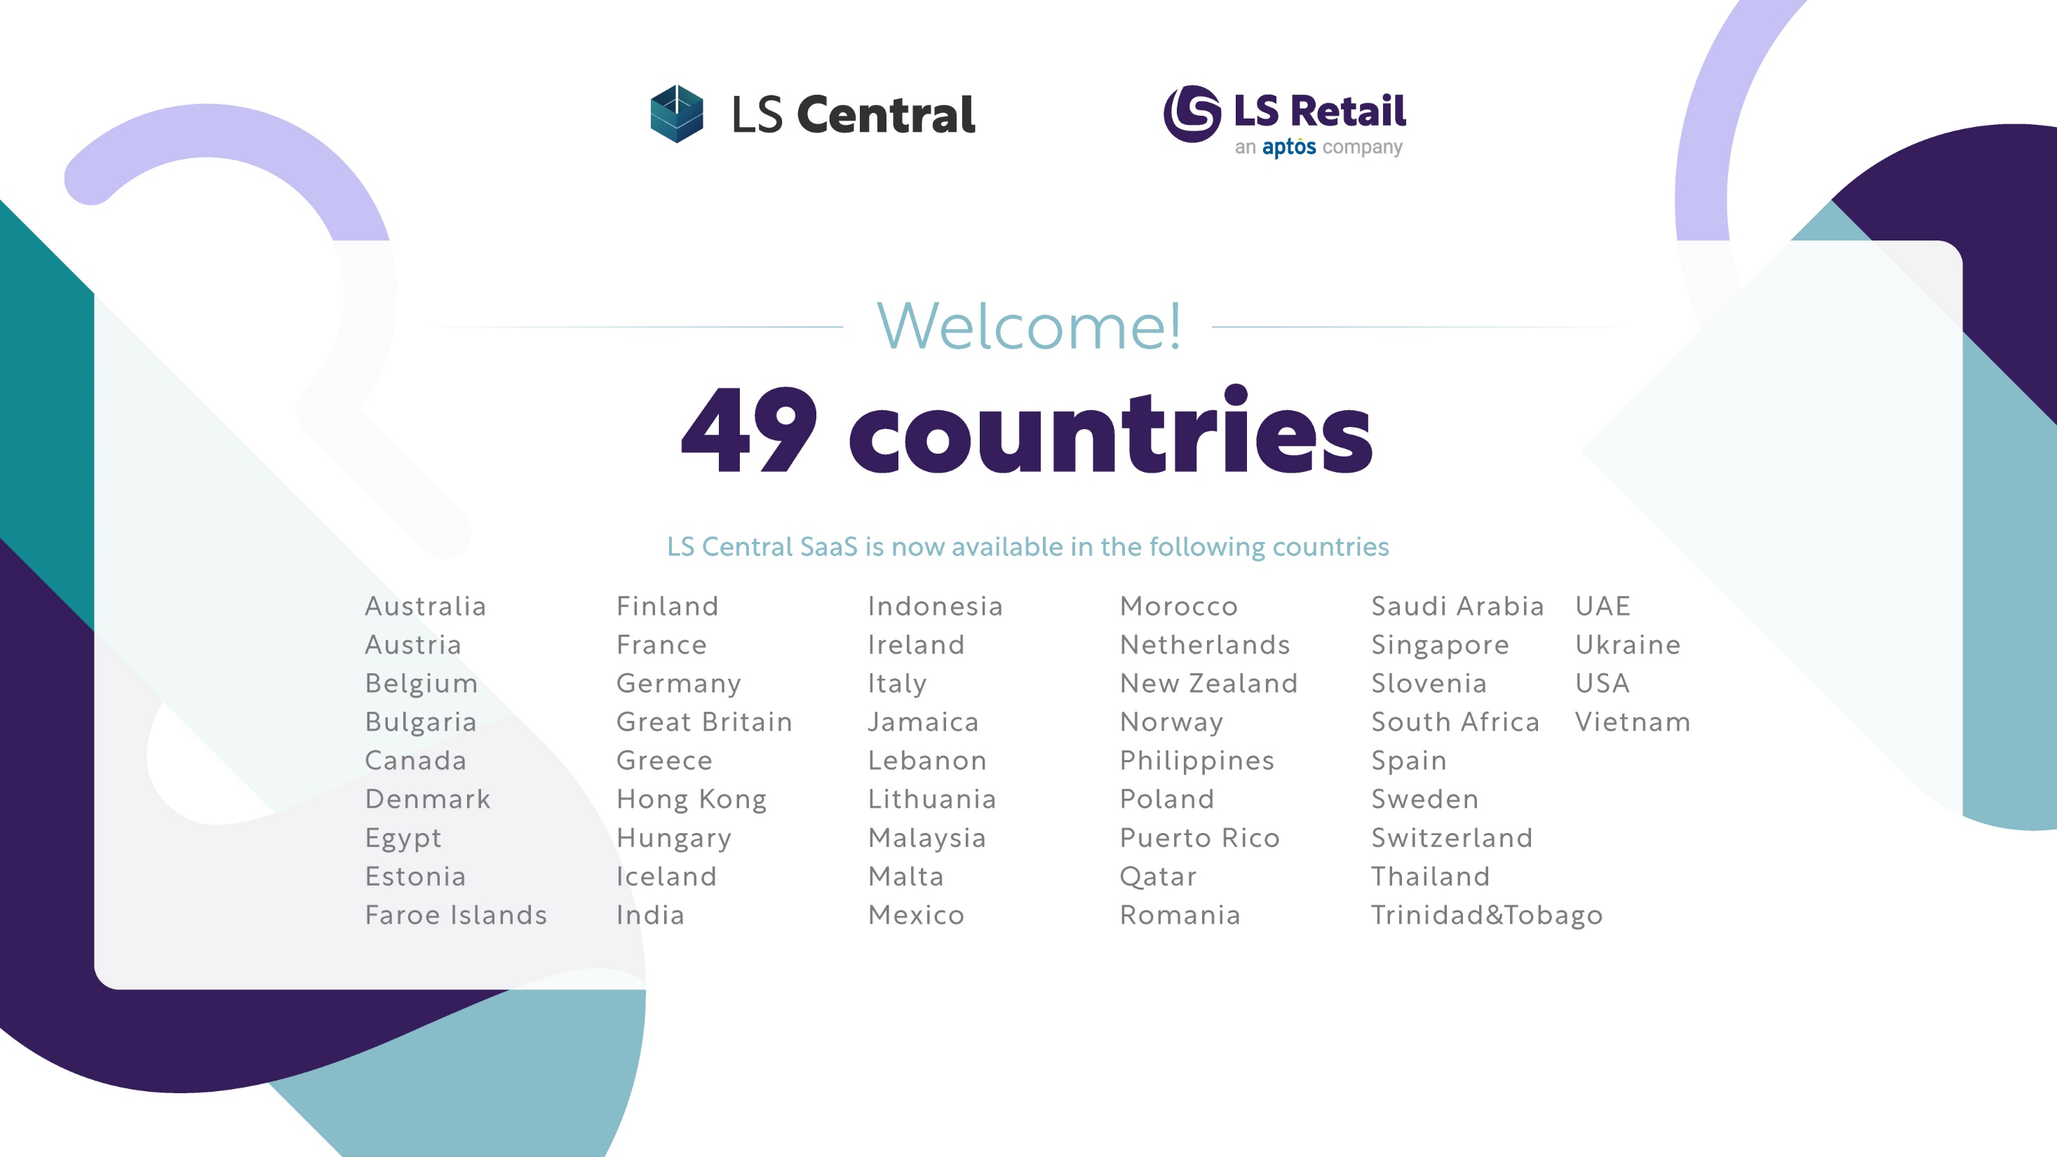

Slide 10

What are we offering
CAP
Cloud Acceleration Program
SaaS Training
SaaS Onboarding
SaaS Best Practises
Update Services for LS Central
Frequent releases
  Events and fixes weekly
  New minor version monthly
  Twice a year major version

Slide 11
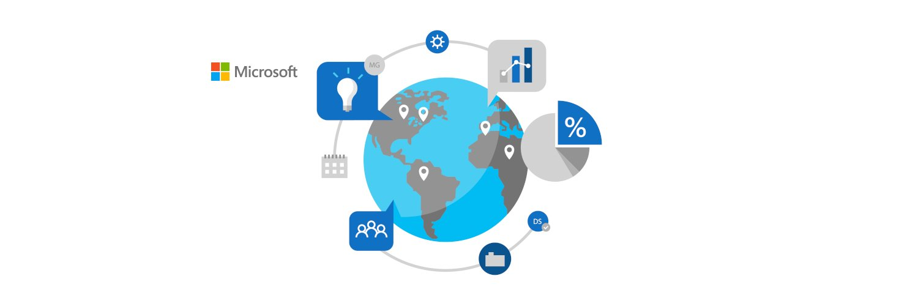
In case of Outage or Blockers
Outage
  No user can log in to Business Central 365
  Customer/Partner must report directly to Microsoft and then share the support incident number with LS Partner Support
Microsoft is continuously enhancing the environment
Blocker
  ONLY for issues when customer cannot trade on any POS in a Store in a LIVE environment

Slide 12
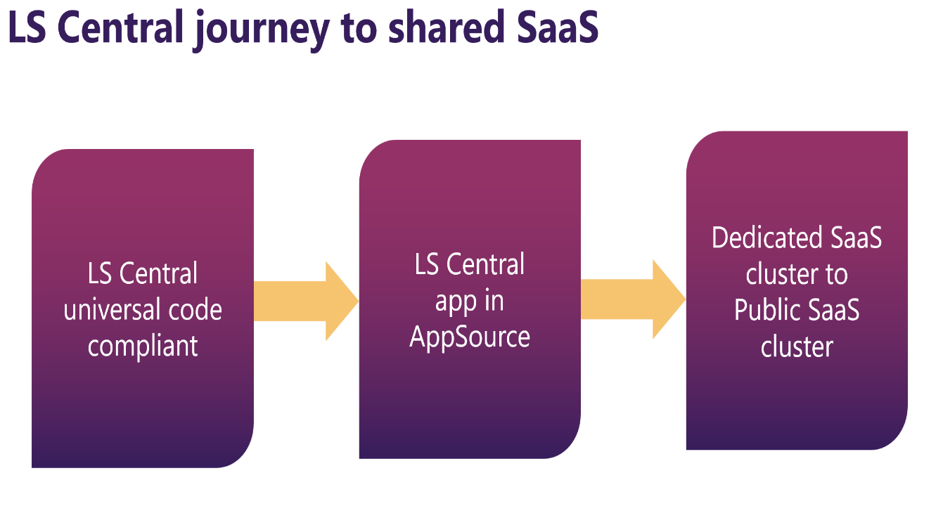
Where are we going
Future plan
  Update Service as Azure Service
  Data replication via Azure Storage
  Public BC cluster
Multiple customers are on the Bridge 2 Cloud journey and are migrating within the next years

Slide 13
Thank you

