Slide 2


LS Retail Office Hours
Matthias Matthiasson
Director Partner Experience
How to demonstrate performance
in SaaS
Marta Sigmarsdóttir
Partner Experience Manager

Slide 3

Moving to SaaS

Slide 4
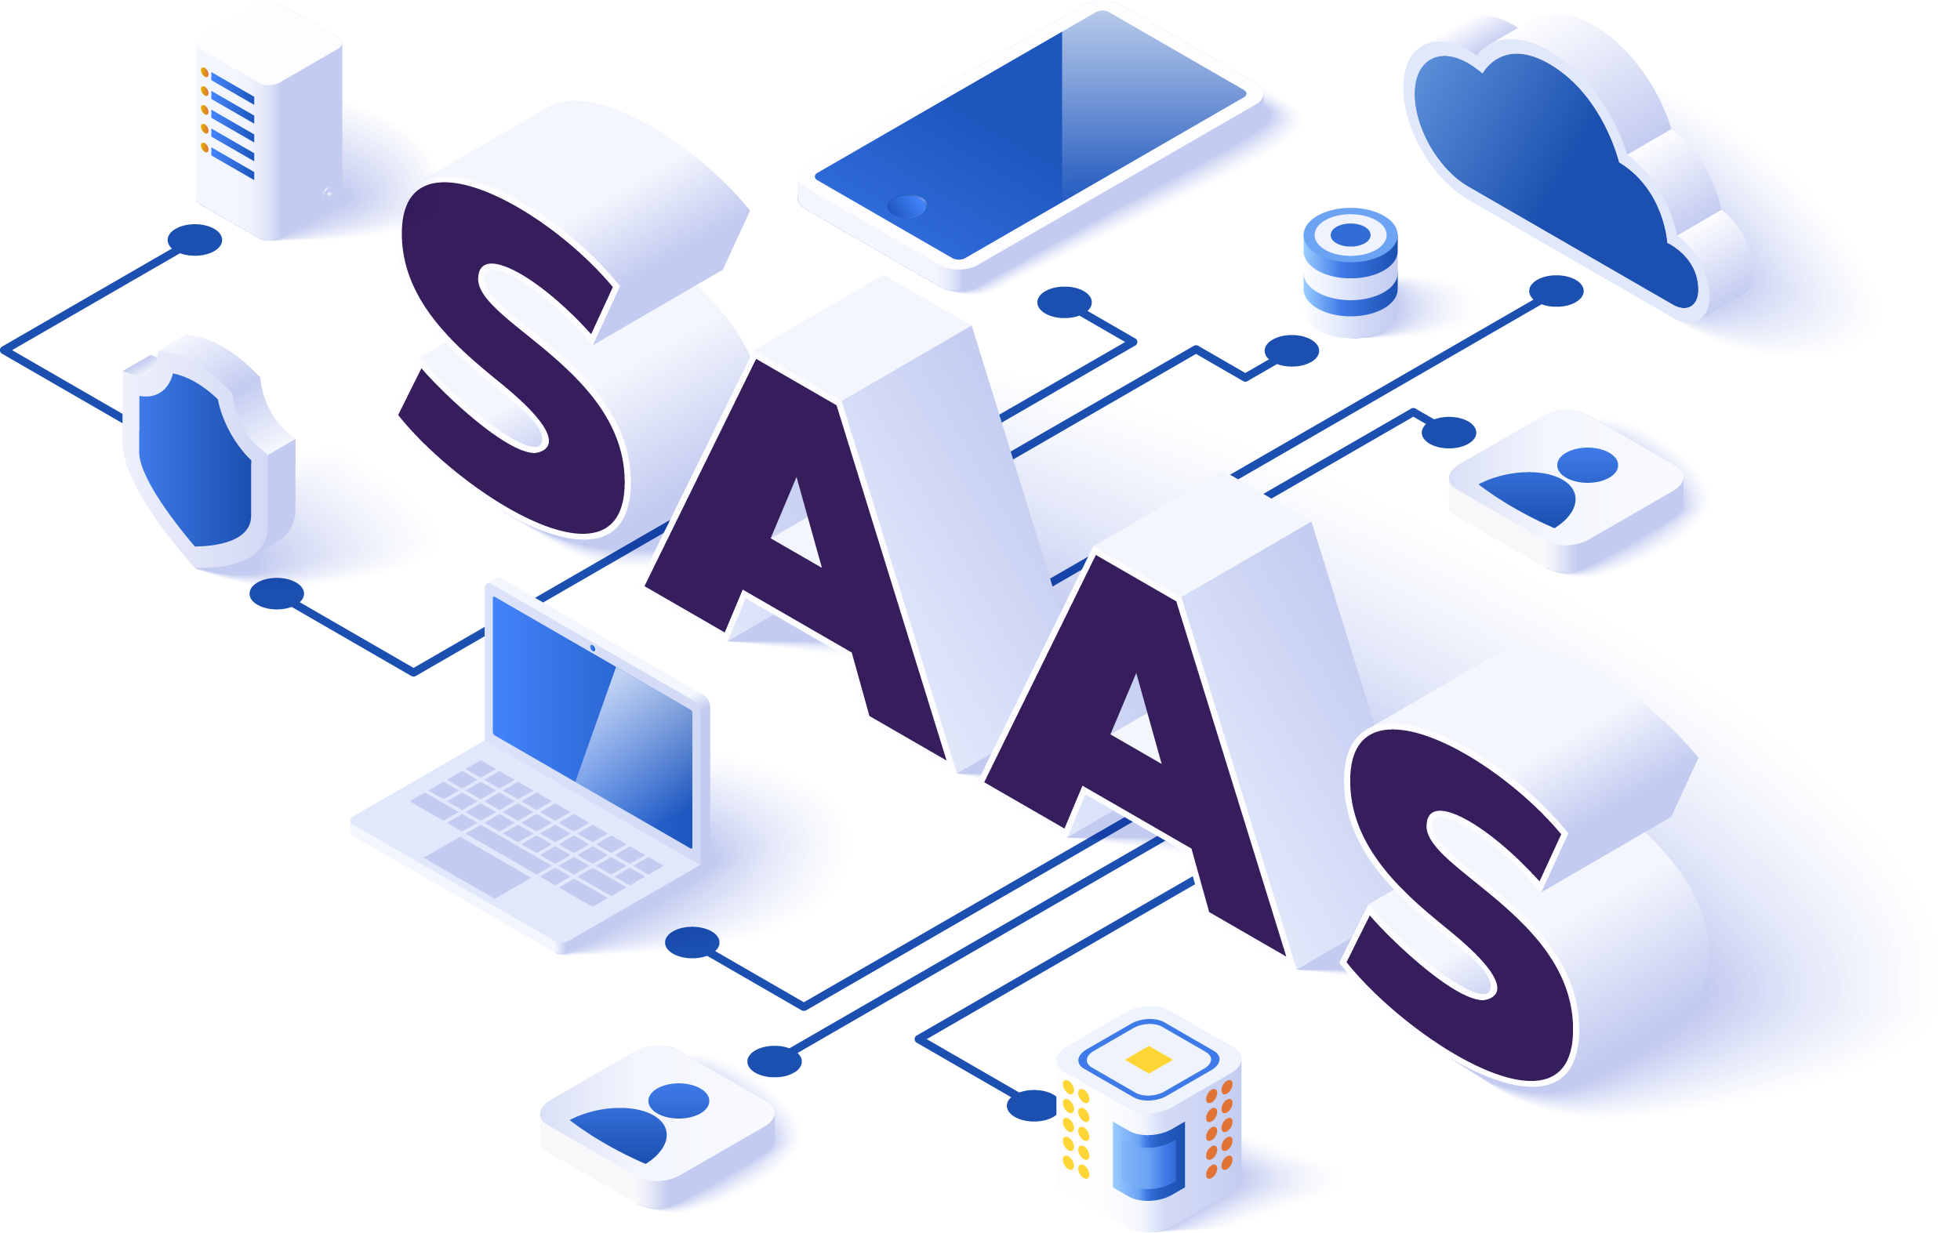
Moving to SaaS discussion
Concerns
  Is SaaS suitable for the task?
  Challenges in their on-premises implementations
  Resolve performance challenges by :
  By adding CPUs
  By adding Disks
  Controlling configuration
Hardware must meet peaks in the business
By going to SaaS, they lose these options/control

Slide 5
Moving to SaaS discussion
Business Central in SaaS:
  Is a service
    Everything included in the subscription
  BLACK BOX
LS Retail has received numerous questions about whether SaaS can manage specific scenarios
  Number of online POS
  Heavy batch processes
Has been very difficult to answer because not all customers are the same
Very few customers want to be the first

Slide 6
Tools
LS Retail has invested in performance testing tools :
  Improve performance of LS Central in SaaS
  Provide numbers to partners for sales purposes
  To provide partners/customers with
  tools to prove SaaS performance
    Especially targeting existing on-premises customers
  Tools for pre-go-live test processes in SaaS
    Test SaaS capabilities and boundaries
    Verify that customizations do not negatively impact SaaS performance

Slide 7
LS Retail
Performance Testing Effort
Replenishment
Data Creation

Slide 8

Replenishment
First effort
  LS Central 20 release
  Parallel background sessions (Max 10)
LS Central 26 release
  Job Queue sessions run by multiple Entra users
  More details to be found in release notes
Data
  Use customer data
  Create data for test
    Replenishment data creator
It can be run in a production environment

Slide 9
LS Retail
Performance Testing Effort
Replenishment
Online POS
Statement
Posting
Data Creation
Data Creation
Business Central
Performance Tool
Data Creation - POS
Business Central
Performance Tool

Slide 10


Online POS vs Offline POS
Online POS
  Can SaaS handle X number of Online POS?
  Retail
  Hospitality
Should we rather install
Offline POS
Azure
BC SaaS
BC Environment
Azure
Storage
Online POS
Online POS
Online POS
Offline POS
Offline POS
Printer
Printer
Printer
Printer
Printer

Slide 11
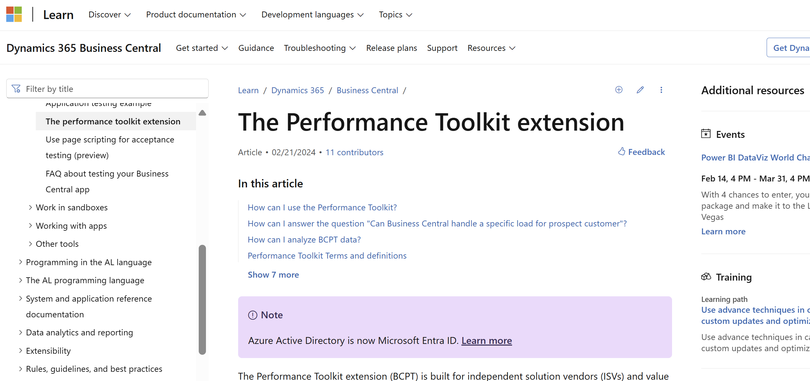
Business Central Performance Tool
Also known as BCPT
Performance Toolkit extension - Business Central | Microsoft Learn

Slide 12
LS Central and BCPT
LS Central
LSPT Add-On
Command Lines
LS POS Codeunit A
Create
Command
Lines
LS POS Codeunit B
LS POS Codeunit C
Create
Test Data
Test
Database
Business
Central
Performance
Tool
(BCPT)
Test
Results
Customers
Data

Slide 13

Demonstration
Moving to SaaS

Slide 14
LS Central Performance Tools (LSPT)
Independent from LS Central release cycle
AL code in 50.400 number range
Easily customized to support the customer’s use cases
BCPT only runs on
  SaaS sandbox
  On-premises

Slide 15
Replenishment test results
Done in sandbox environment
LS Central v25 with improvements
10 Entra users (5 Job queue each)
250 stores
50.000 SKU (items)
12,5 million records RIQ records
100 minutes
125k writes/minute
Production 70 minutes
Better read/write performance in Production SQL
Estimated 20%+ performance in version 26

Slide 16
BCPT POS test results
Run in a Sandbox Environment
Older test
300 POS test for 60 minutes
  41.000 transactions per hour
    328.000 per 8 hours day
  683 transactions per minute
  2,2 transactions per minute/POS
500 POS test for 60 minutes
  78.000 transactions per hour
    624.000 per 8 hours day
  1300 transactions per minute
  2,6 transactions per minute/POS
10 item lines per transaction
0,1 second pause between transactions
Re-engineering sift indexes on the transaction tables
  Release in a hotfix on 25
Continue sift index work
  Planned to be released in a hotfix on 26

Slide 17

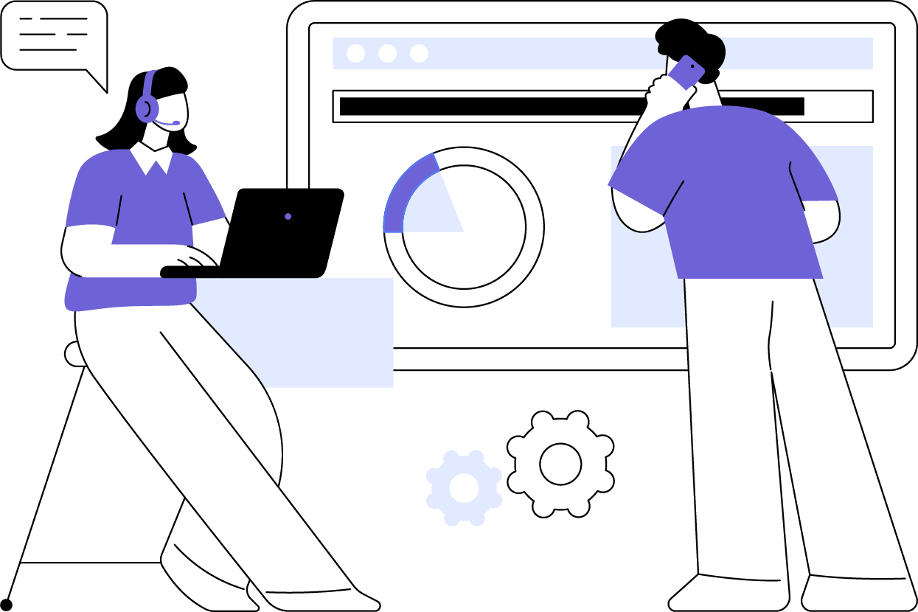
LS Retail Support
Please book a meeting if needed
  Discuss scenarios or to get information
Partners must request the code
  Plans to make available on GitHub
  (martasi@lsretail.com)

Slide 18
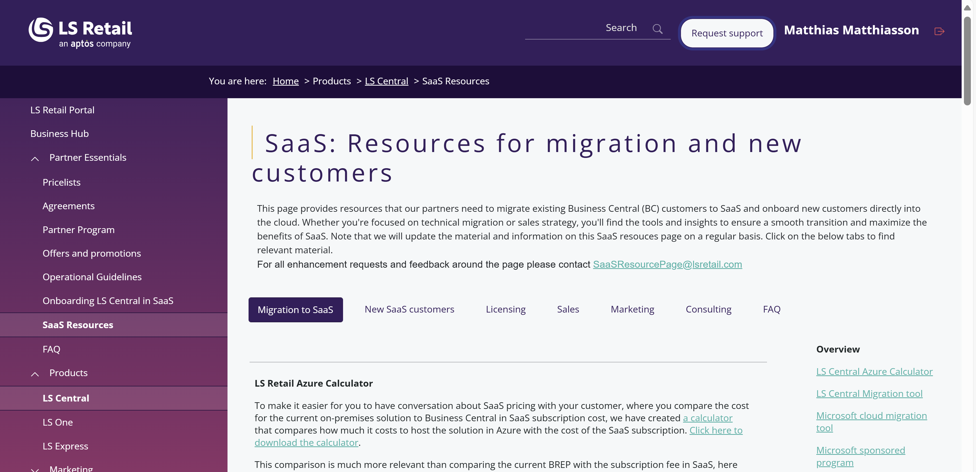
SaaS: Resources for migration and new customers
https://portal.lsretail.com/products/ls-central/saas-resources/
Topics
  Migration
  New customers
  Licensing
  Sale
  Marketing
  Consulting
  FAQ
    Technical
    License
Please share your feedback
SaaSResourcePage@lsretail.com
SaaSResourcePage@lsretail.com
Azure Storage Cost Calculator
LS Retail Support Matrix

Slide 19

Almost
SOLD OUT

Slide 20
Time for QUESTIONS
Please book a
meeting

Slide 21
Thank you matti@lsretail.com martasi@lsretail.com

