Slide 2
Accelerating LS Central with AI and Power Platform
Alejandro
Vázquez

Slide 3

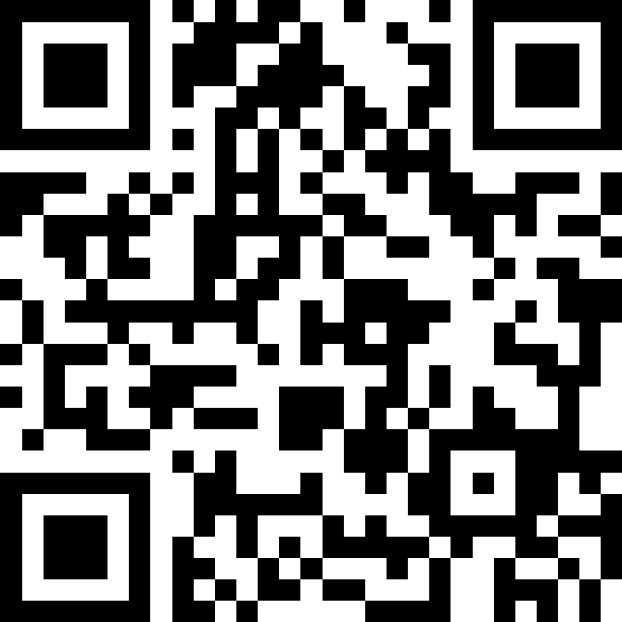
Power Platform
What’s new? Code Apps
Setting up Agent-Dev environment
Building a PoC with Agents for Code Apps
Powergenda
Implementing our idea
Connecting with data sources (LS Central)
Deployment (ALM)
Q&A

Slide 4
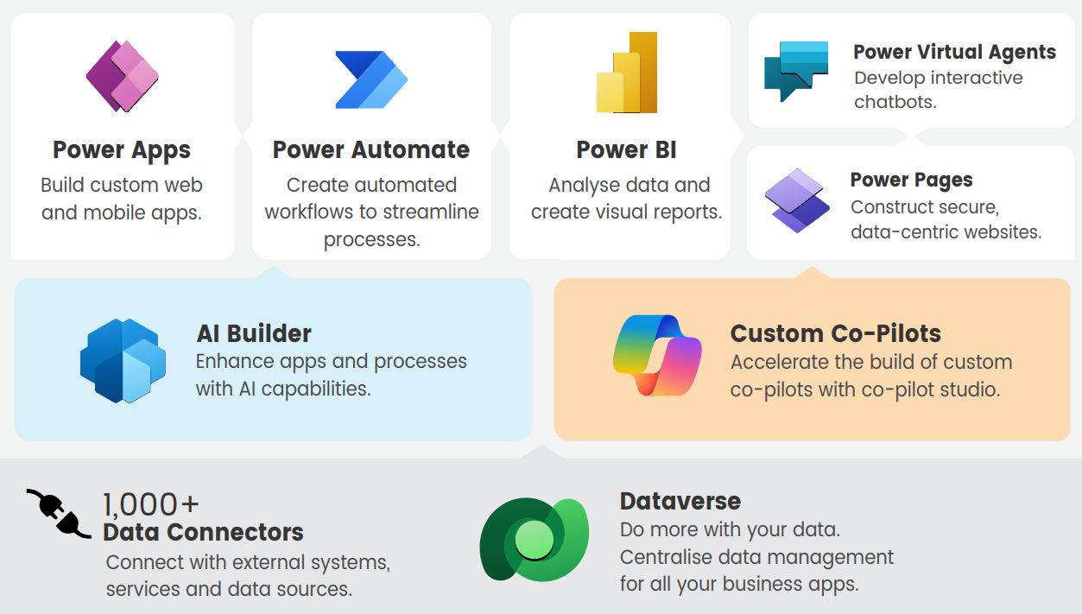

Slide 5
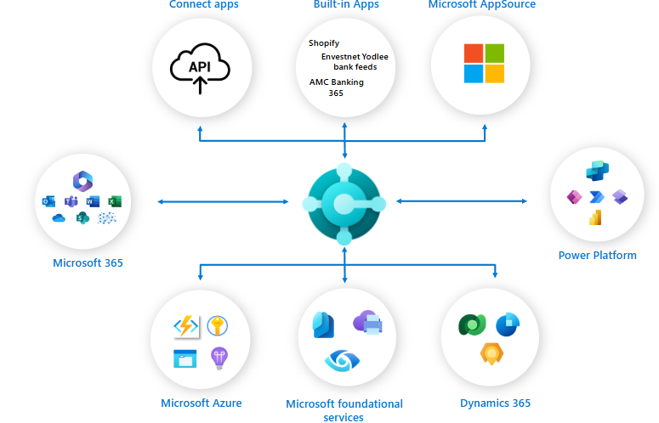
Extend the system capabilities with the Microsoft integration universe…
Business Central supports multiple integrations to:
Office and Microsoft 365 products and services, including Excel, OneDrive for Business, Teams, Graph, SharePoint and more
Power Platform products and services, including Power Apps, Power Automate, Power BI, Power Pages
Dataverse
Dynamics 365 including Sales and Field Service
Azure services, including Azure OpenAI Service to extend Copilot in BC with new genAI capabilities

Slide 6
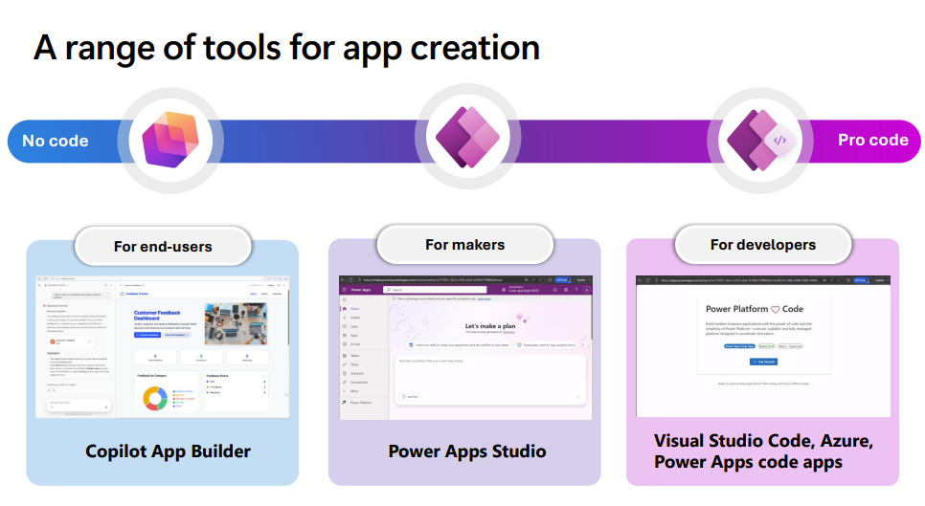
Why code in Power Apps?
AI-Assisted Full Stack
  Dedicated IDE for pro-devs to create enterprise-ready apps
A range of tools for app creation

Slide 7

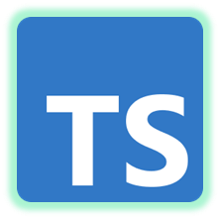





Pro-Code
inside
PowerApps

Slide 8
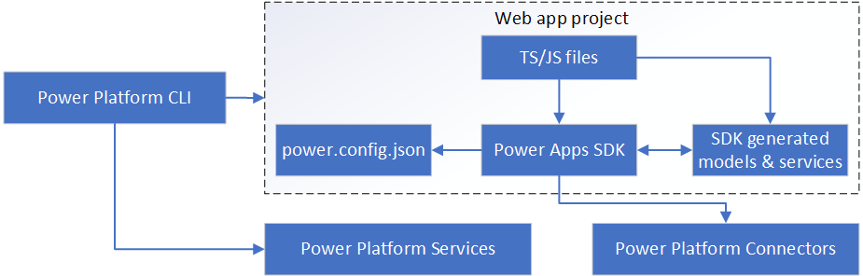
Dev: JS apps use the Power Apps SDK
When developing, code apps consist of:
  Your code, a Single-Page Application (SPA)
  The Power Platform CLI (pac CLI)
  The Power Apps SDK
The Power Apps CLI creates a power.config.json file and generates strongly-typed models/services for connections.
Your code runs locally using the Power Apps SDK to use connections and interact with the Power Apps shell.

Slide 9
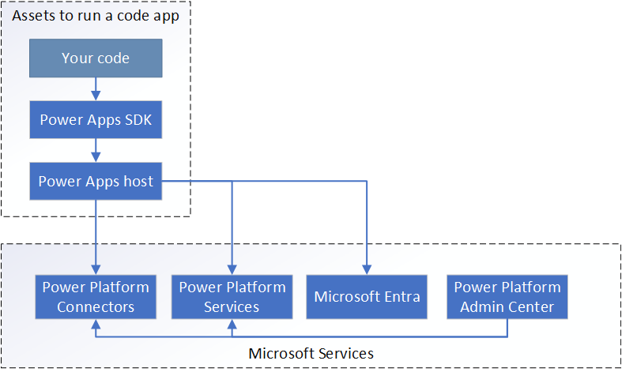
Runtime: Power Apps host loads your app
When a code app runs, there are three components:
  Your compiled code
  The Power Apps SDK
  The Power Apps host
Your compiled code is published to Power Apps and runs inside of the Power Apps host, which manages end-user authentication, app loading, and enforcing governance boundaries.
The SDK communicates with the host to enable secure access to connections and platform features

Slide 10
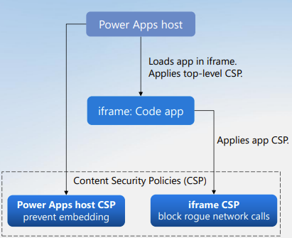
Runtime: Power Apps host is a secure sandbox
The Power Apps host will support Content Security Policies (CSP) to control what apps can access.
Power Apps will enforce a strict CSP policy by default, but admins can configure it to be more permissive.
The host applies CSP settings to prevent undesired embedding. E.g. your app will run in apps.powerapps.com.
The app code runs in a sandboxed iframe that applies additional CSP settings to prevent rogue network calls (data exfiltration risk) and disallow insecure JavaScript patterns.

Slide 11
Lifecycle: Code Apps use the Managed Platform
Managed Op
Managed Gov
Managed Sec
“Solution aware” and support connection references
Appear in Admin Center inventory
Respect tenant isolation
Deploy via Power Platform pipelines
Honor sharing limits
Apply default Content Security Policy (configurable)
Health metrics, alerts in Monitor
Respect app quarantine
Enforce Conditional Access Policies
(Coming soon..) Solution pack/unpack support
Support Azure B2B users
Comply with loss prevention (DLP) policies
and many more...

Slide 12
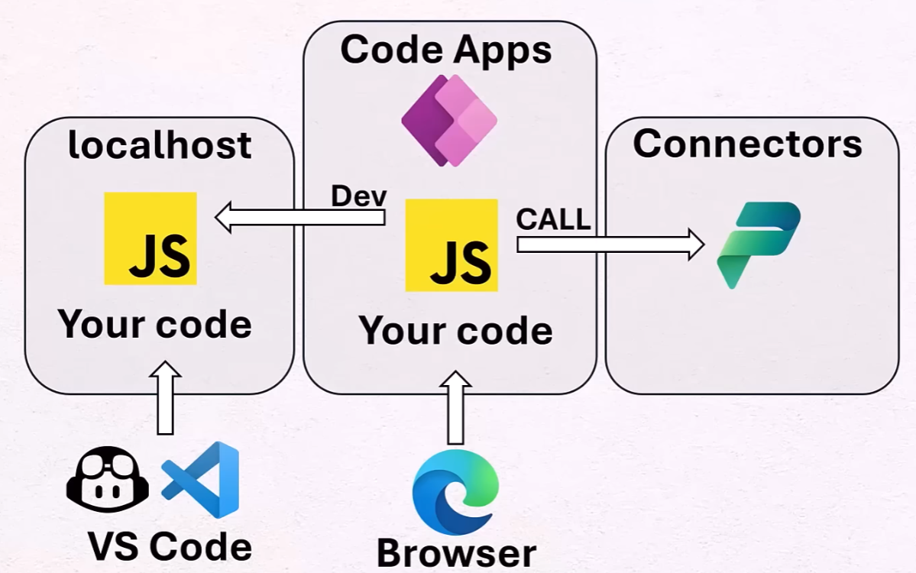
Dev environment
VS Code
Github Copilot
Claude Agent
  Cop-instructions
  Requirements
  Implementation plan
  Execution plan
Code Apps
LS Central SaaS
LS Central API
Commerce Service
Custom Connector
PowerAppsCodeApps Repo

Slide 13

Building the idea
My bookings app
  Reservation
  Activities
  Catalog
  Custom API
    Commerce Service API & BC API
    Get data from LS Central
    Post data to LS Central

Slide 14
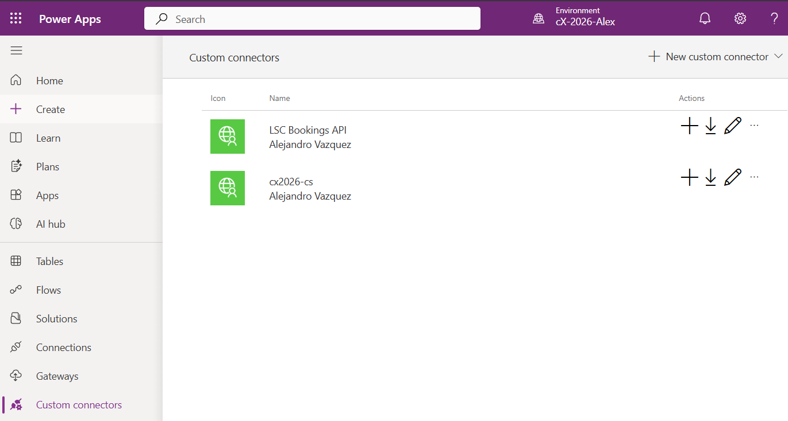
My bookings app
Custom Connector
  Cx2026-cs
    Commerce service on localhost using a Gateway
  Bookings for LSC API (BC)
    Direct connection to BC SaaS using Page API

Slide 15
My bookings app (final PoC)
The PoC Solution
  Dashboard
  Appointments
  Product Catalog
  Availability
  Customers
  Reports
  User configuration
  Dark Mode
Mock data at the beginning

Slide 16
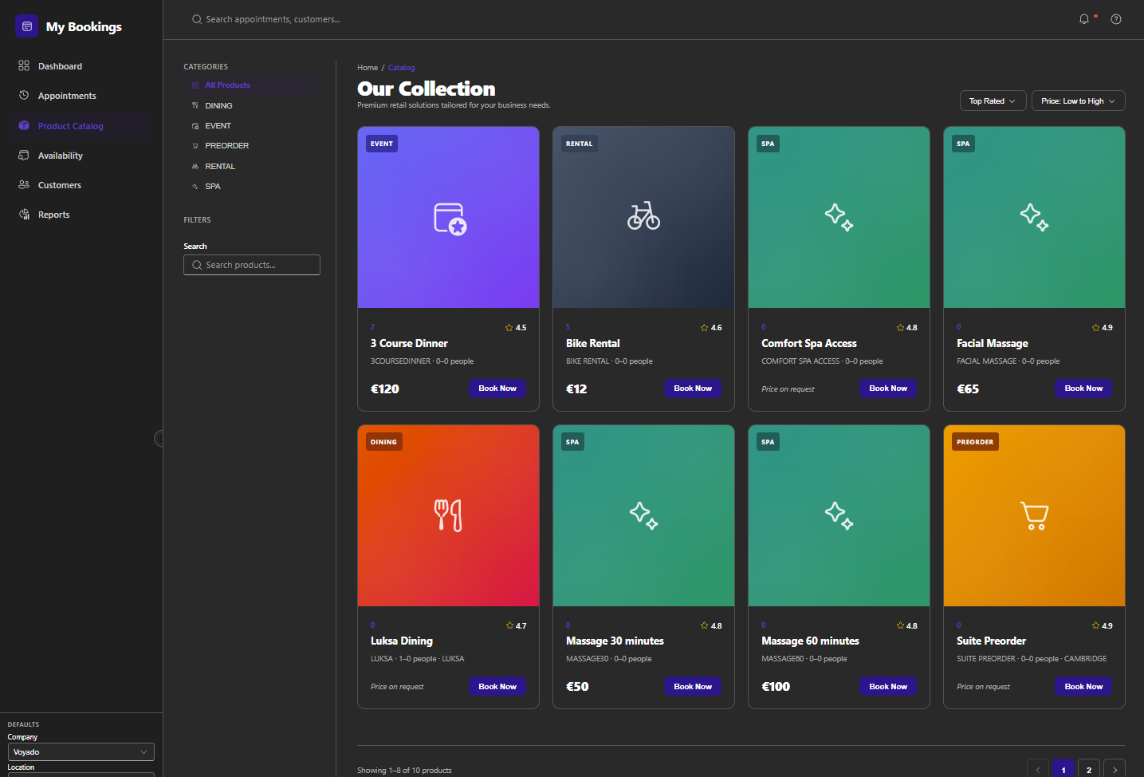
My bookings app
Replace mocks with real data connector
Connect to Office 365
Connect to Custom Connectors
Request AI to replace mock by real connector (one by one)

Slide 17
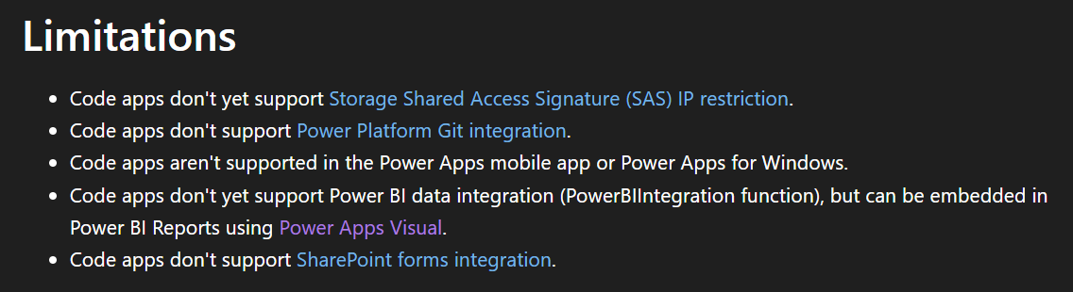

Slide 18
Other ideas
1. Custom Dashboards
  Build interactive dashboards with dynamic filters, charts, and external data sources—beyond what Power BI embeds can offer.
2. Advanced Forms
  Create multi-step forms with conditional logic, validation, and custom UI elements for onboarding, compliance, or HR workflows.
3. External API Integration
  Connect to third-party services (e.g., Stripe, Salesforce, SAP) using secure tokens and custom connectors.
4. Embedded AI Experiences
  Use Azure OpenAI or GitHub Copilot to build intelligent assistants directly into your app interface.
5. Developer Portals
  Design internal tools for engineering teams with GitHub integration, deployment triggers, and telemetry dashboards.

