Slide 1
Intelligent Cloud Suite
add intelligence to your ERP!
Martin Kleindl | Jonheidur Isleifsdottir
Product Director | Product Owner

Slide 2

874 AD

Slide 3



Slide 4


Slide 5


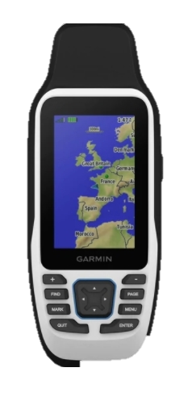



Slide 6

Intelligent Cloud
Suite

Slide 7


Intelligent Cloud
Suite
LS Insight
(Datawarehouse & Analytics)
LS Central (ERP)

Slide 8
Intelligent Cloud
Suite
New release:
Q1 2022
LS
Recommend
LS
Forecast
Future
Int. Cloud apps
LS Insight
(Datawarehouse & Analytics)
LS Central (ERP)

Slide 9

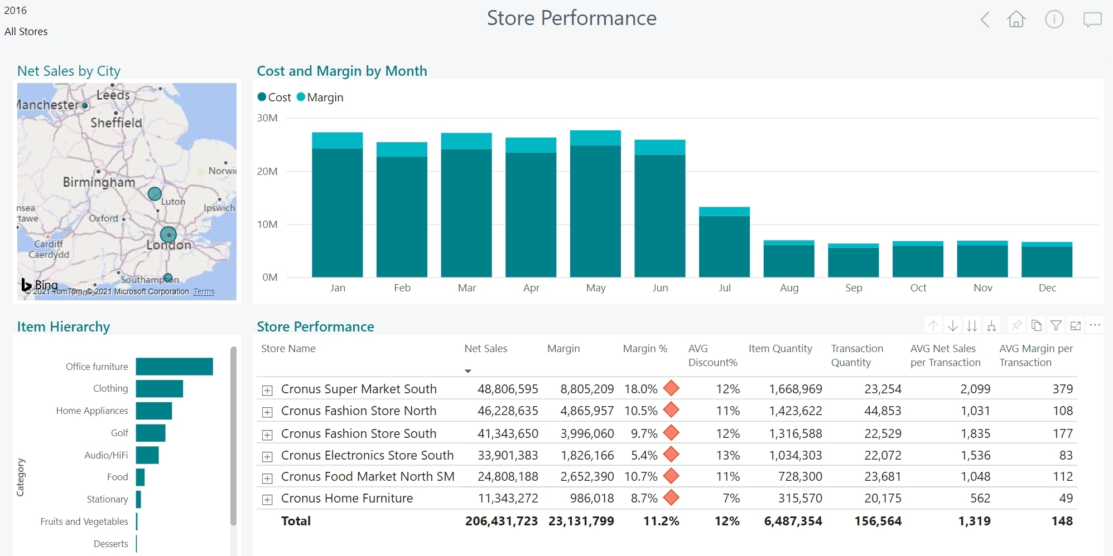
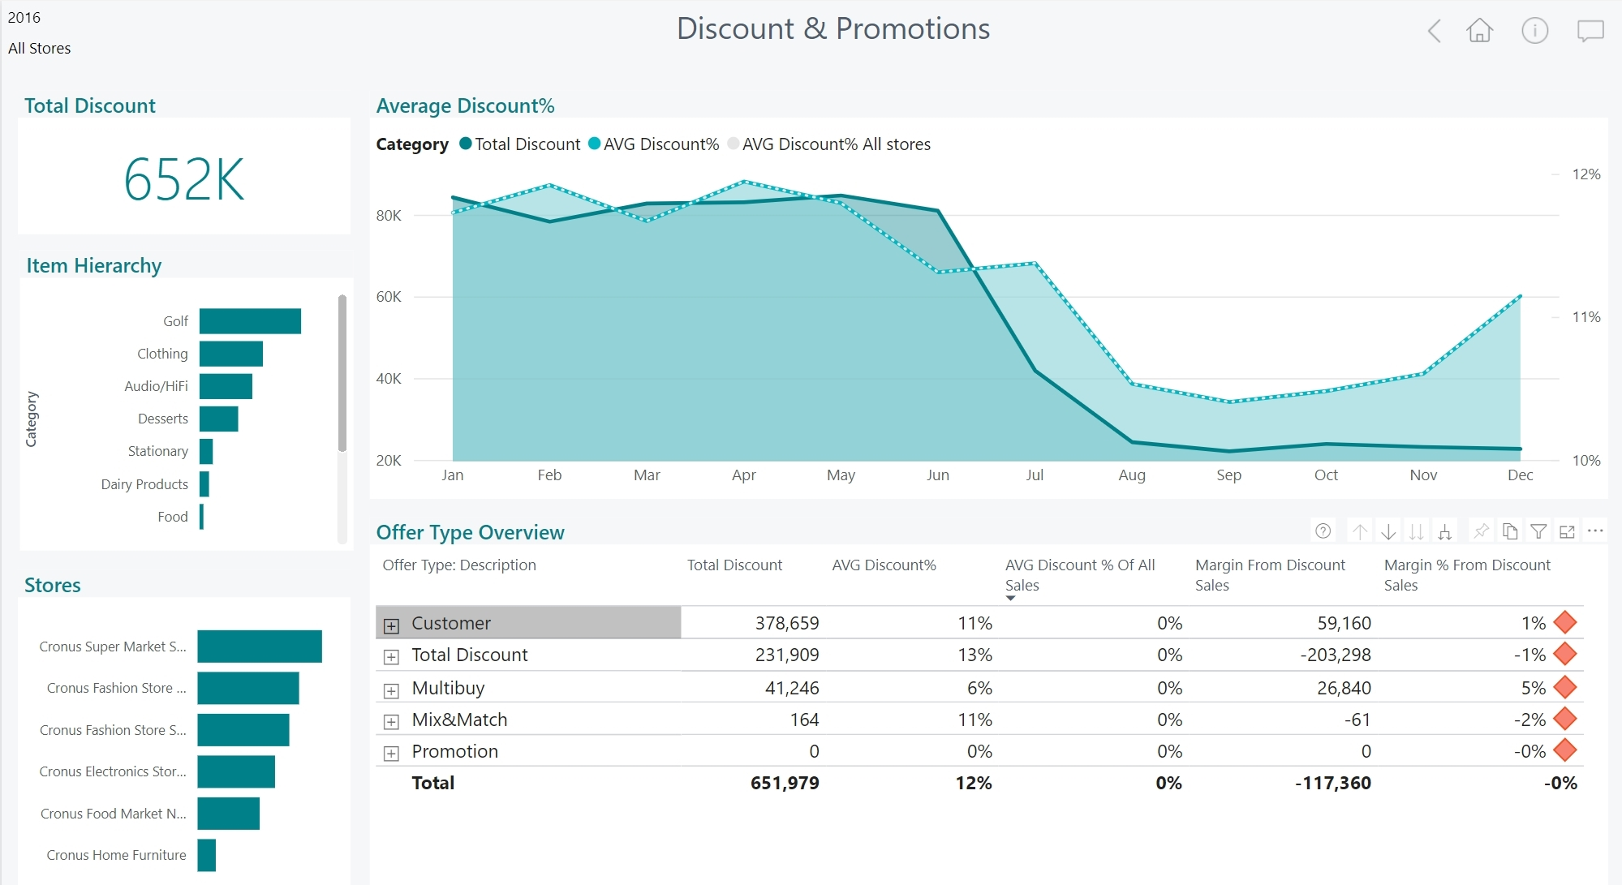
LS Insight
Datawarehouse and Analytics platform
  Datawarehouse built on Azure SQL (Cloud)
  Open, easy to extend with other data sources
  Reports and Dashboards based on Power BI
  Browser based, supports mobile devices
  Report templates for Sales, Inventory, Supply Chain, Actionable Insights and Hotels. More to come
  Hosted by customers
Access actionable reports.
Take better business decisions.

Slide 10
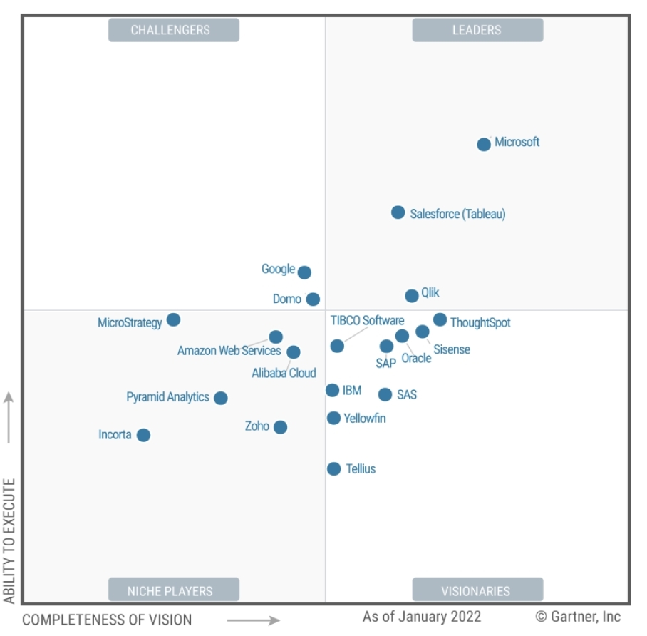
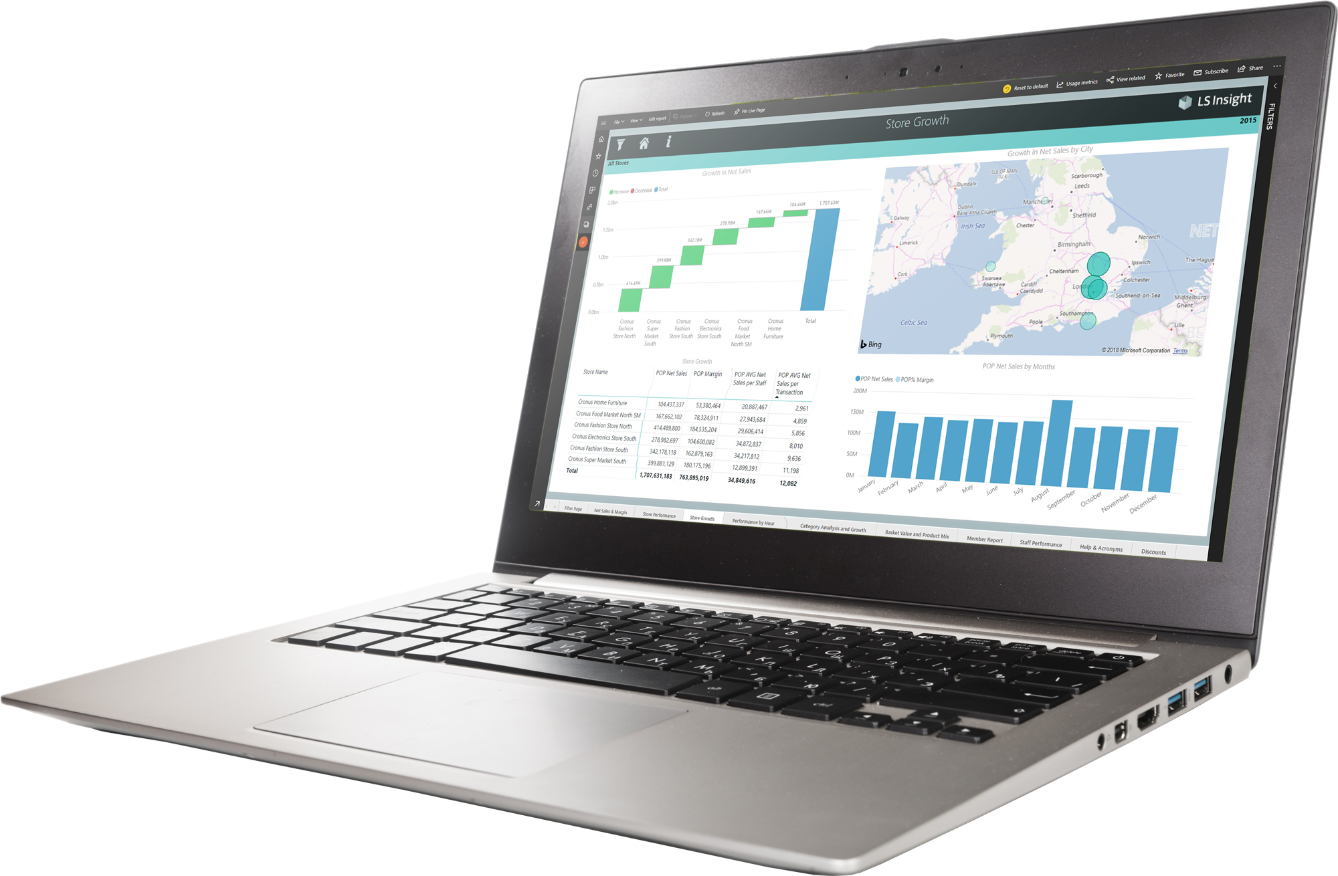
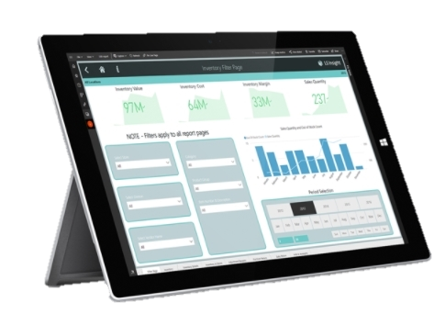

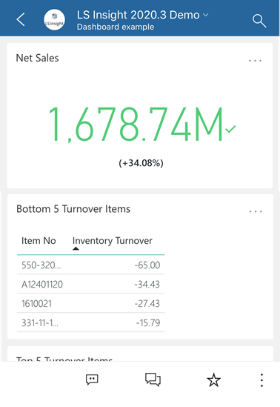
LS Insight
Gartner®
^{March 2022}
PBI named as Leader in Analytics & BI Platforms
and scored highest for the 4th consecutive year.
^{Microsoft Power BI has helped}
^{over 250,000 organizations}
including 97 percent of Fortune 500
*) Magic Quadrant for Analytics and Business Intelligence Platforms,
from 2013 – 2022

Slide 11
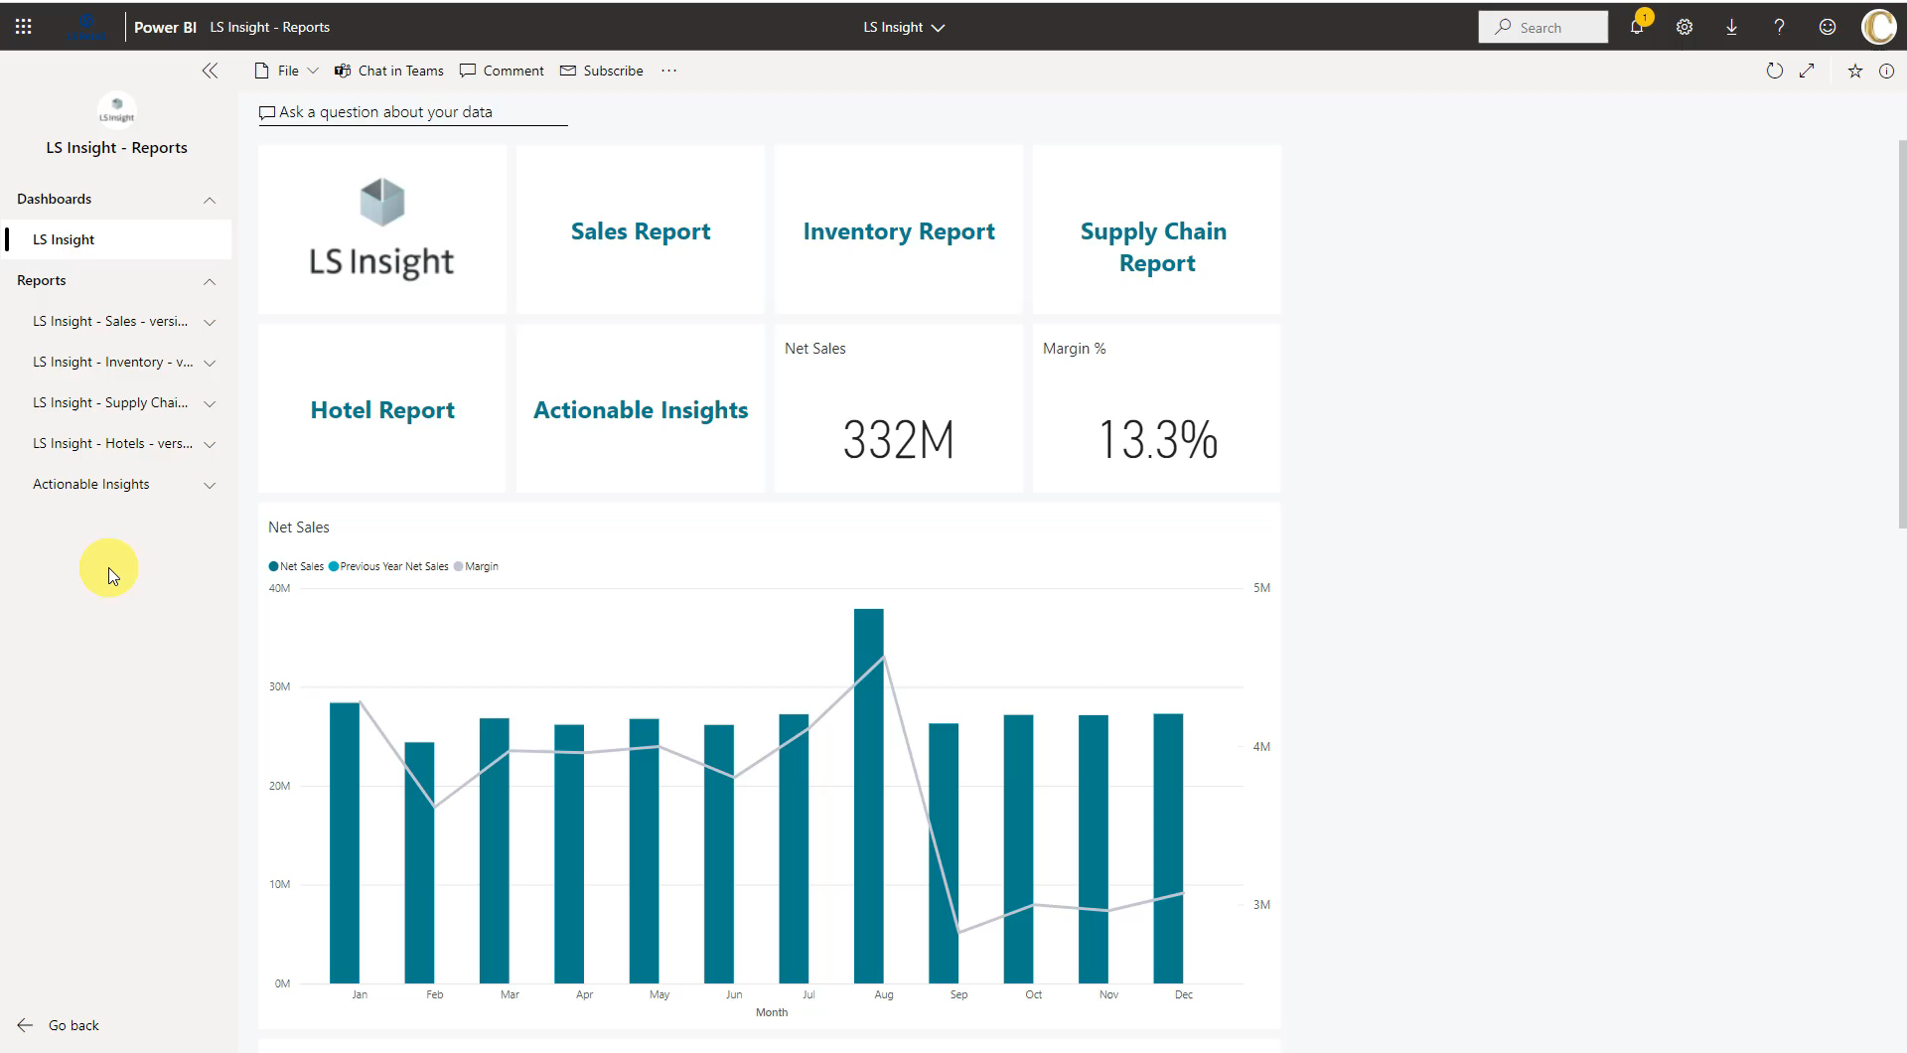

Slide 12
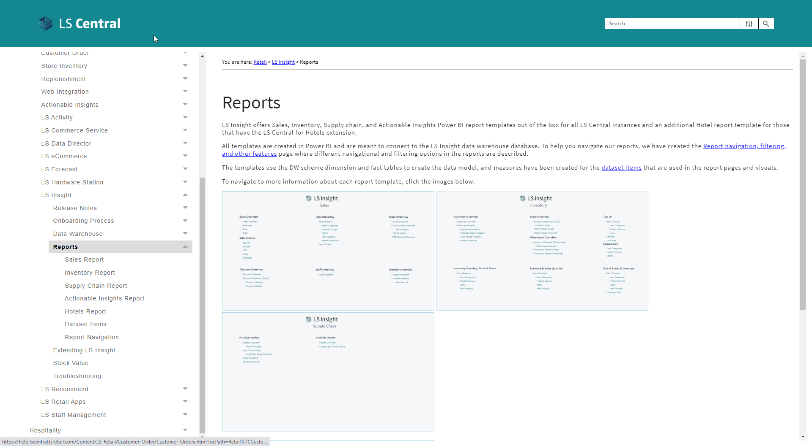

Slide 13
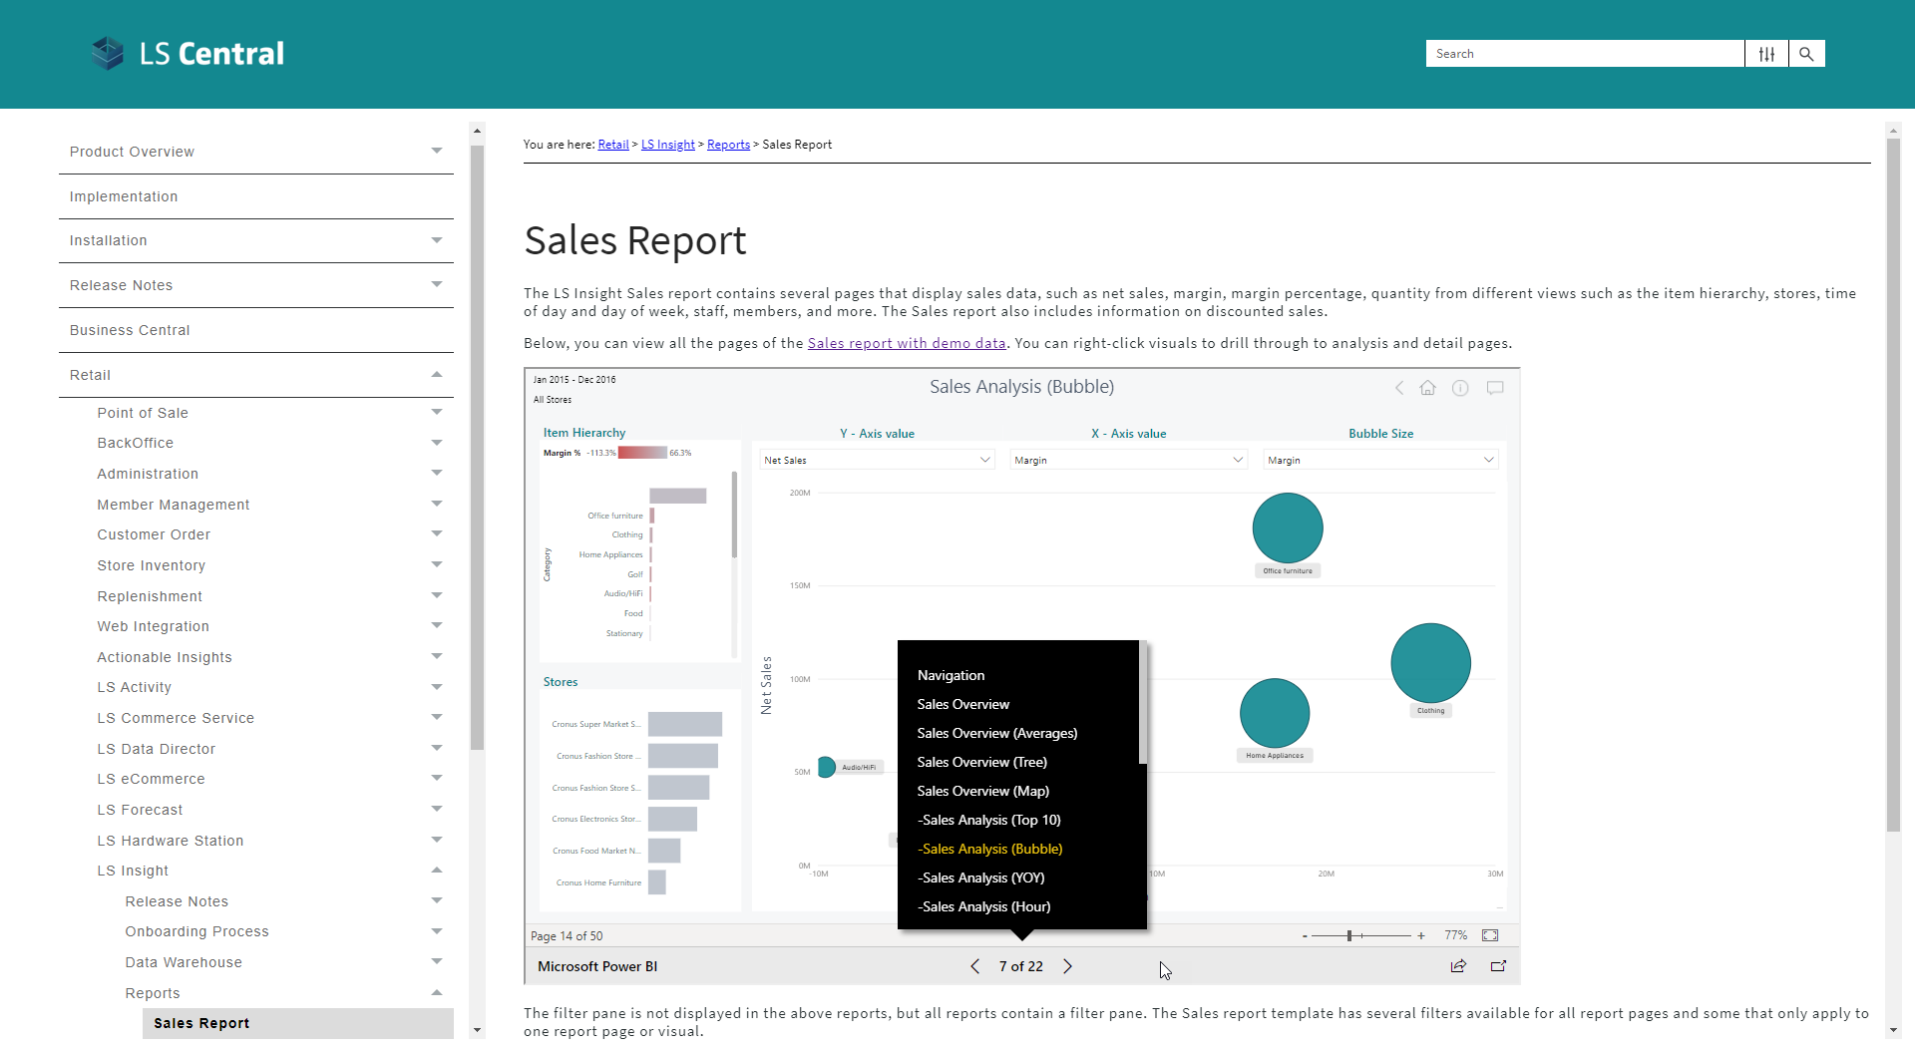

Slide 14
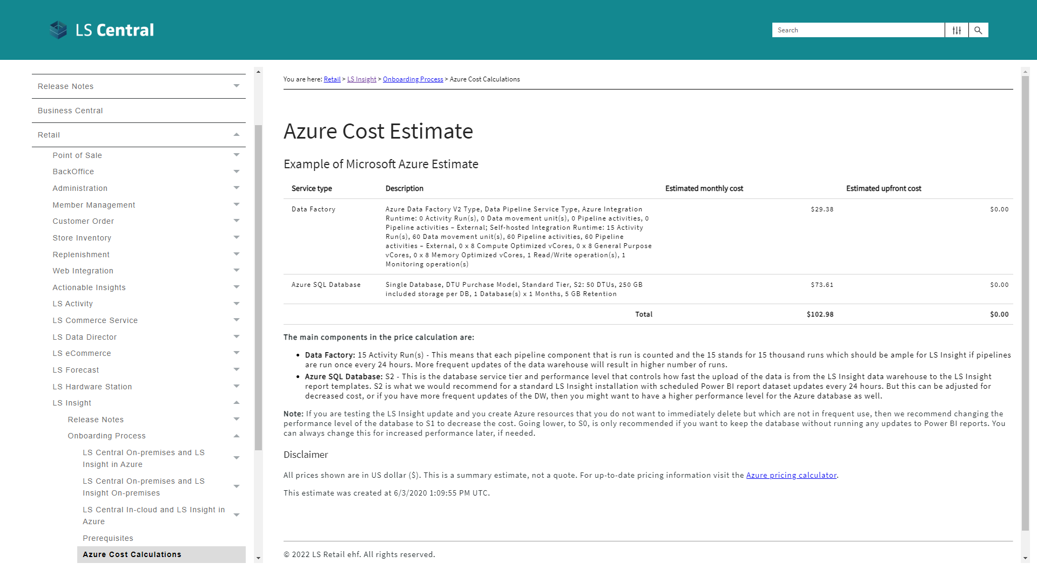

Slide 15
Conversation
Martin:
Ok, I see. This is low cost for these services. How difficult is it to extend the reports?
Fantastic, so there is no reason that should stop our partners to provide first class reporting to their customers.
Jonheidur:
The reports are open source and are meant as templates. If you have knowledge in PBI, you can modify, copy or create new ones from scratch. Same goes for the data warehouse.
We have documentation how to add fields and tables on our Online Help pages.
And of course, the LS Retail’s consulting team is also available to support customers and partners.

Slide 16
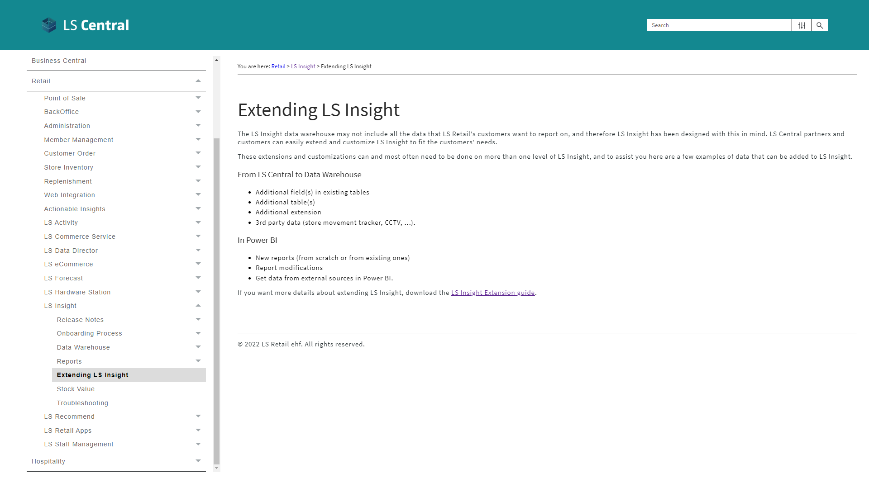

Slide 17


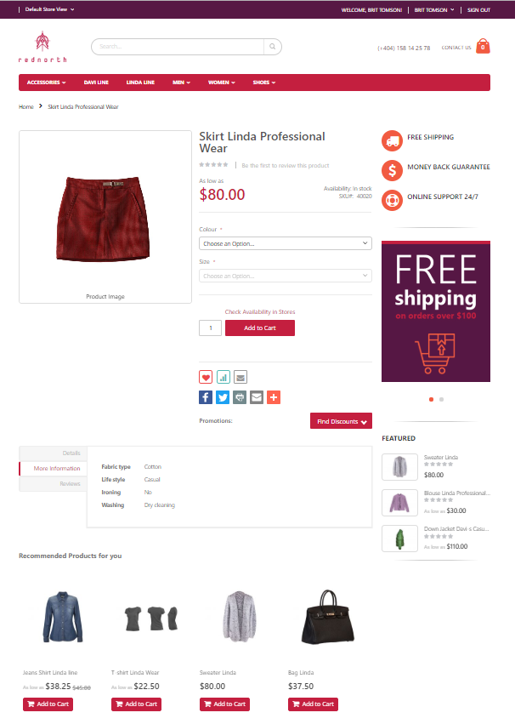

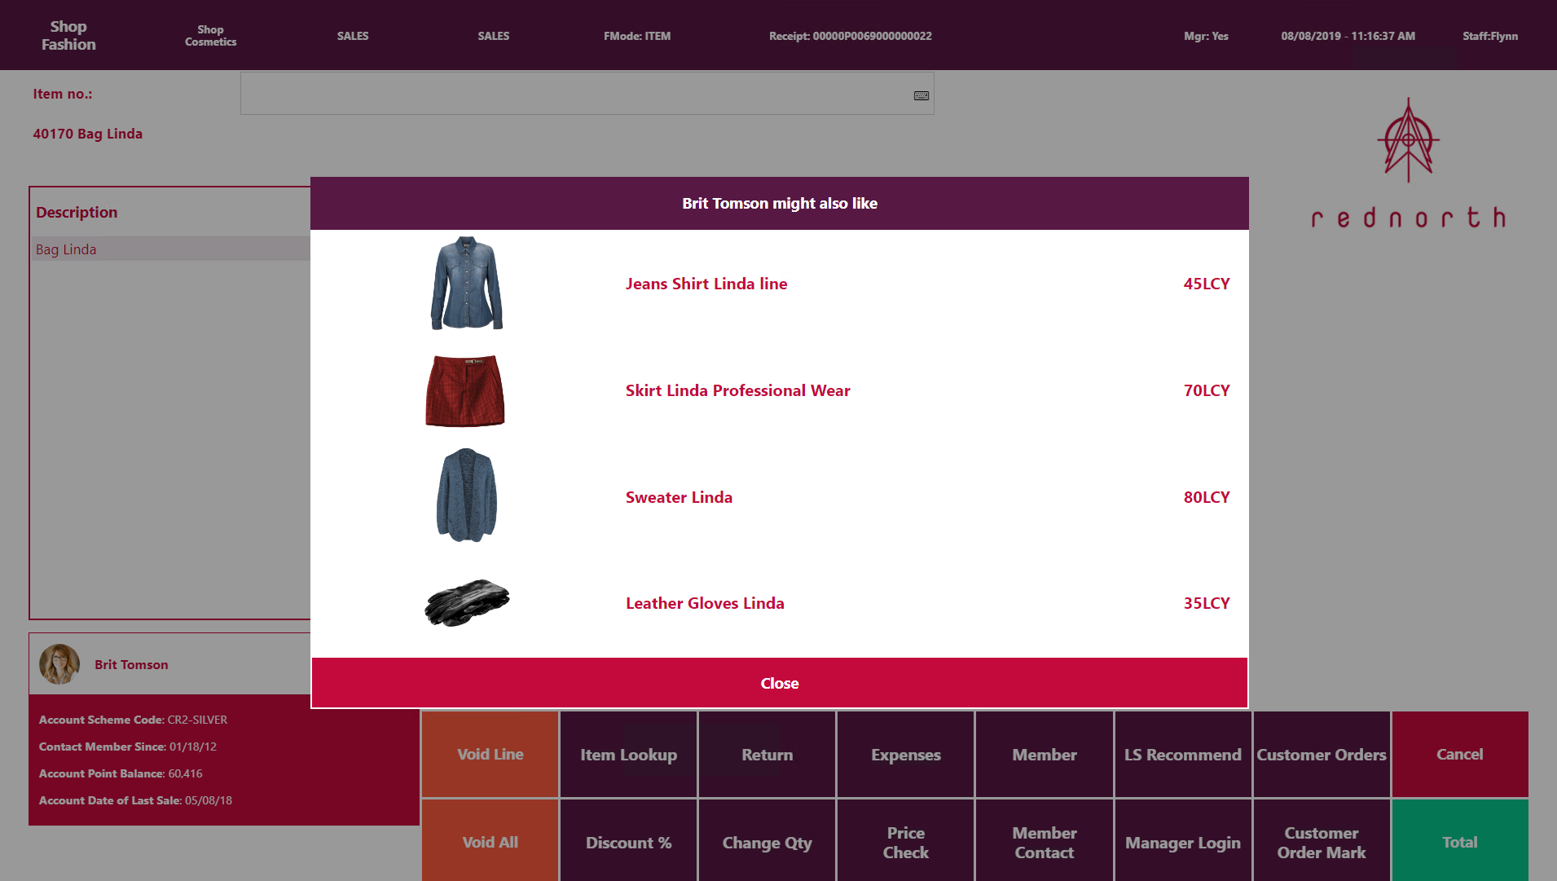
LS Recommend
Product recommendations
  Basket analysis and Recommendation engine
  Provides targeted, personalized suggestions
  based on your shopping history and preferences
  Optimized upselling and cross-selling
  Supports POS and eCommerce
  SaaS solution - hosted by LS Retail
Know what your customers want, before they do
through machine learning

Slide 18

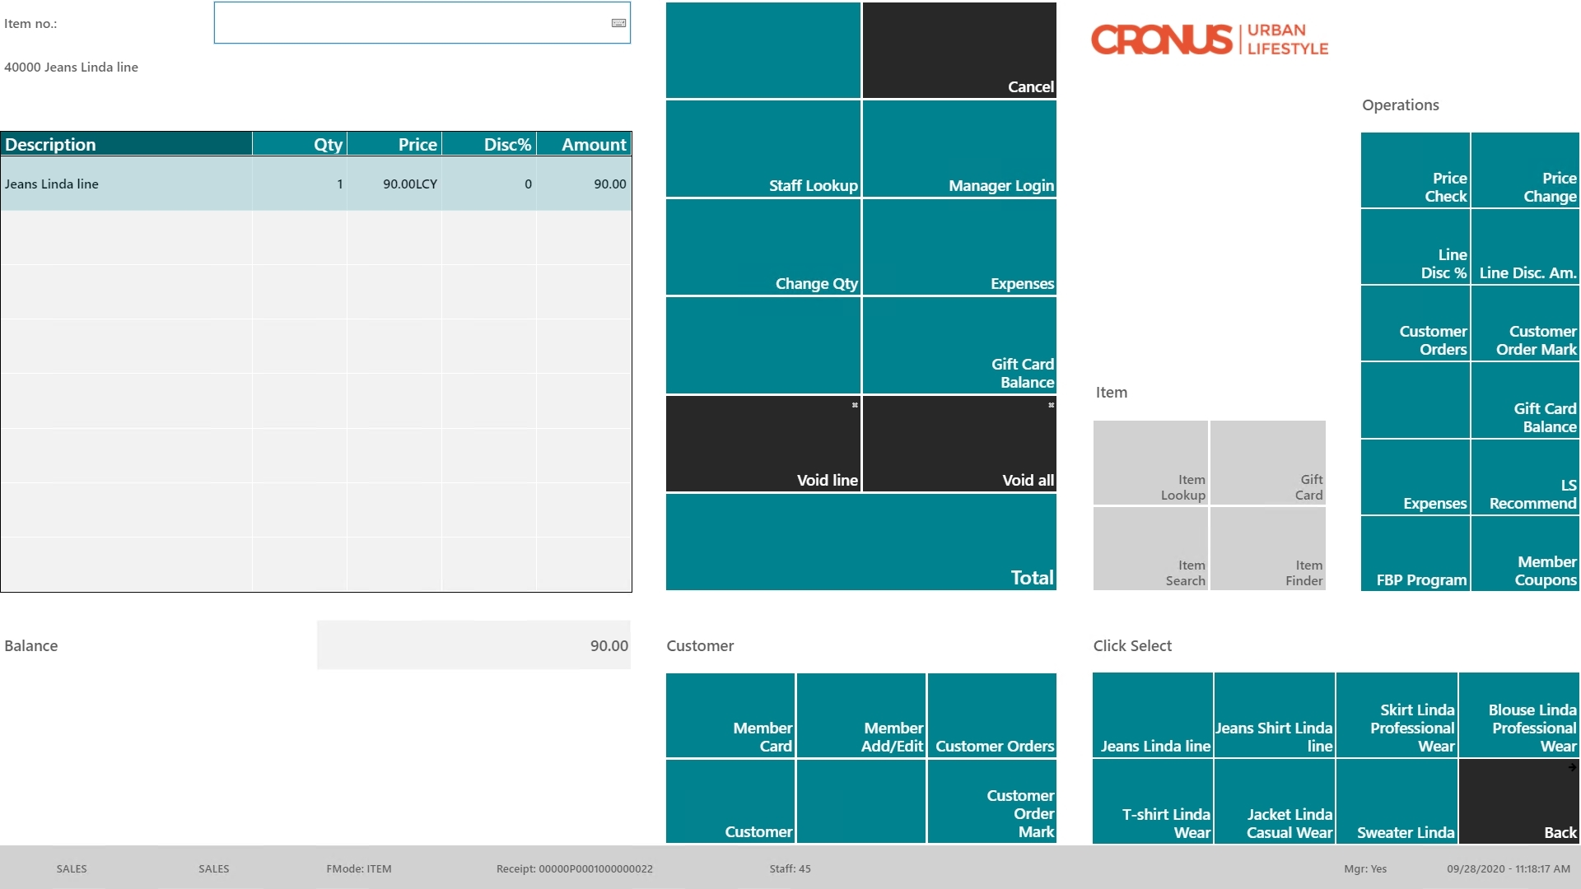
Item “Jeans”
in the sale

Slide 19
Item “Jeans”
in the sale
Recommendation
triggered manually
or
when pressing “TOTAL”

Slide 20
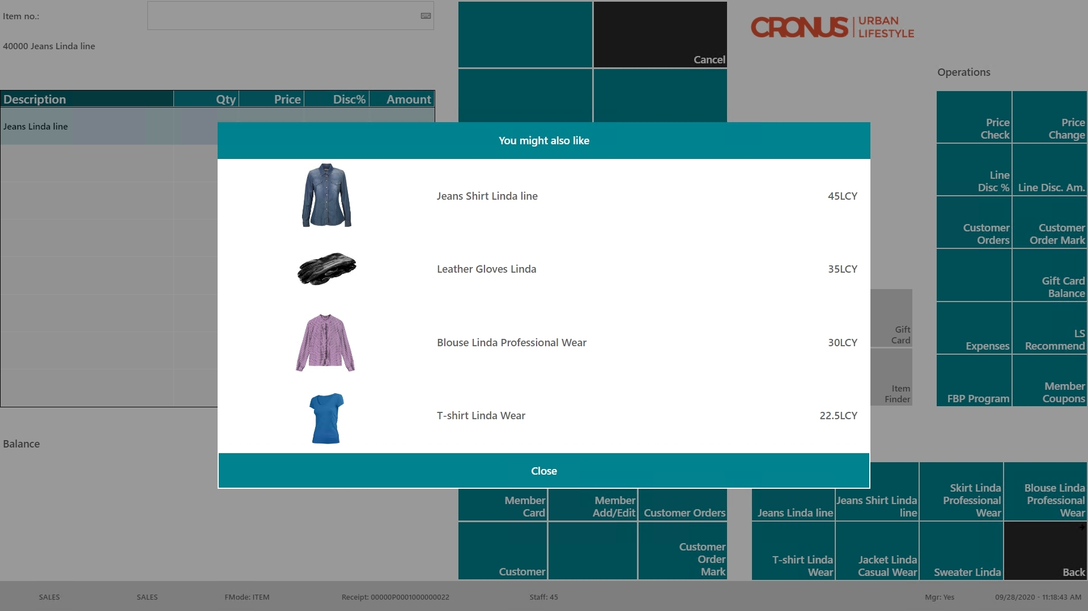
Item “Jeans”
in the sale
Recommendation
triggered manually
or
when pressing “TOTAL”
Recommendation
page with
options

Slide 21
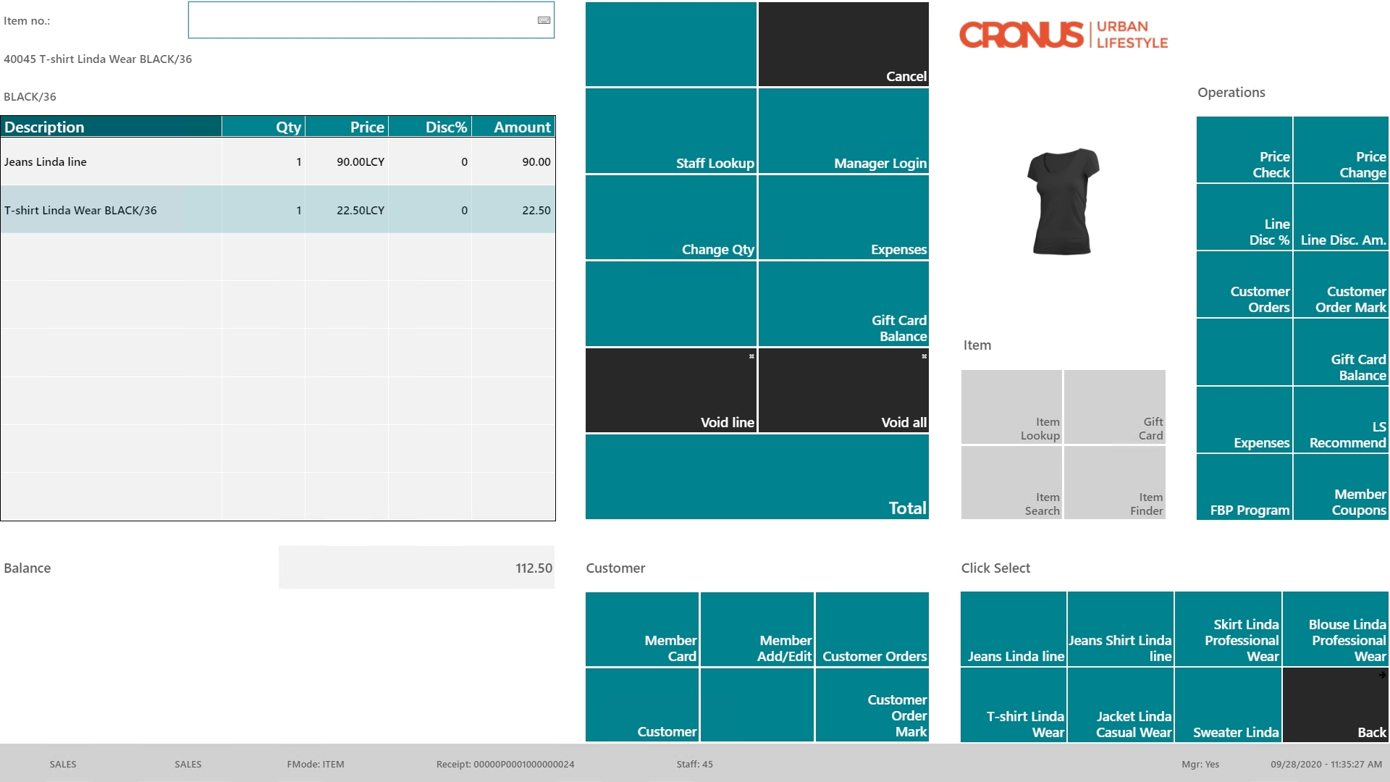
Item “Jeans”
in the sale
Recommendation
triggered manually
or
when pressing “TOTAL”
Recommendation
page with
options
Item “T-Shirt”
added

Slide 22

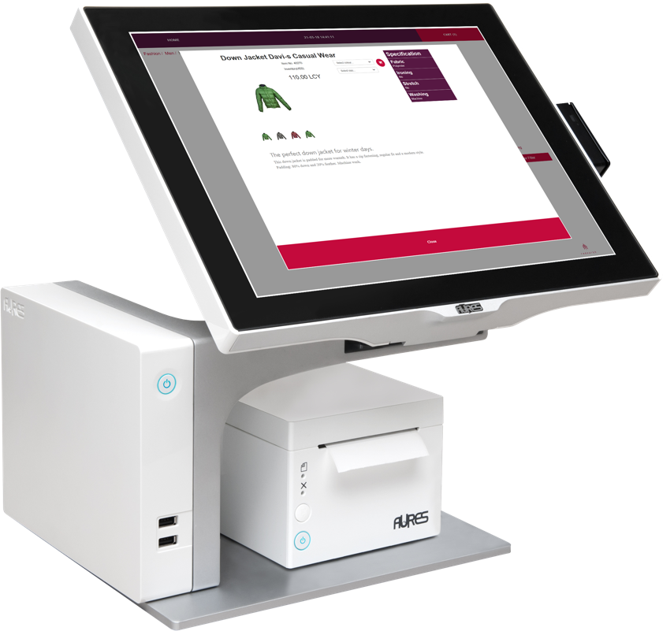
Model calculation
LS Recommend
  Version 2 available (LS Central 19.5)
  Supports LS Central SaaS
  Simplified setup in LS Central
  Faster Model calculation
  Improved scalability with Model Readers
  Pricing model change
  Now based on considered
  Transaction Sales Lines during
  calculation
Model download
Model Reader
Model Reader
Recomm-
endation

Slide 23

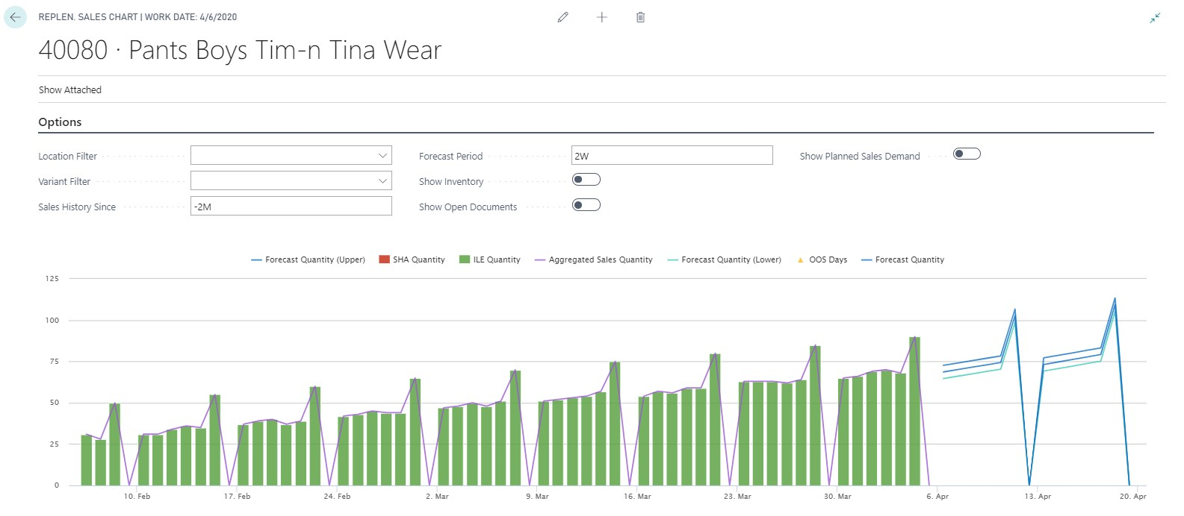
LS Forecast
Advanced sales forecasting for everyone
  Predicts future sales based on sales history
  Improves availability, reduces out-of-stock situations
  Automatic forecast model selection
  Turn-key solution, no data scientists needed
  SaaS solution - hosted by LS Retail
Training
  LS Retail Academy – video on demand training
Increase availability and sales
with advanced sales demand forecasts
Sales history
Forecast

Slide 24
LS Forecast
LS Forecast:
Turn-key solution
Seamless integration
with Replenishment
No data scientists/experts
needed
Advanced
demand forecasting
for everyone
LS Replenishment
Planning & Data Maintenance
Manual Replenish- ment
Automatic Replenish- ment
Execution
Monitoring
Sales & Purchase Budgets
Allocation
Plans
Buyer‘s Push,
Stock Recall
Allocation Rules
Variant Weight Dim. Pattern
Demand Forecasts
Store Stock
Redistribution
Purchase & Transfer
Orders
Stock Requisition
Buyer‘s Workbench
Inventory and Demand
Store
Capacity
Stock Coverage
Vendor Performance
Open to Buy
Assortment Mgmt.
Lifecycle Mgmt.
Replenishment Journal Calculation
Threshold Mgmt.
Lifecycle Planning WS
Cross Docking
Manual Purch. & Transfer Orders
Replen. Item Quantity Calculation
Out-of-Stock Calculation
Item Import

Slide 25
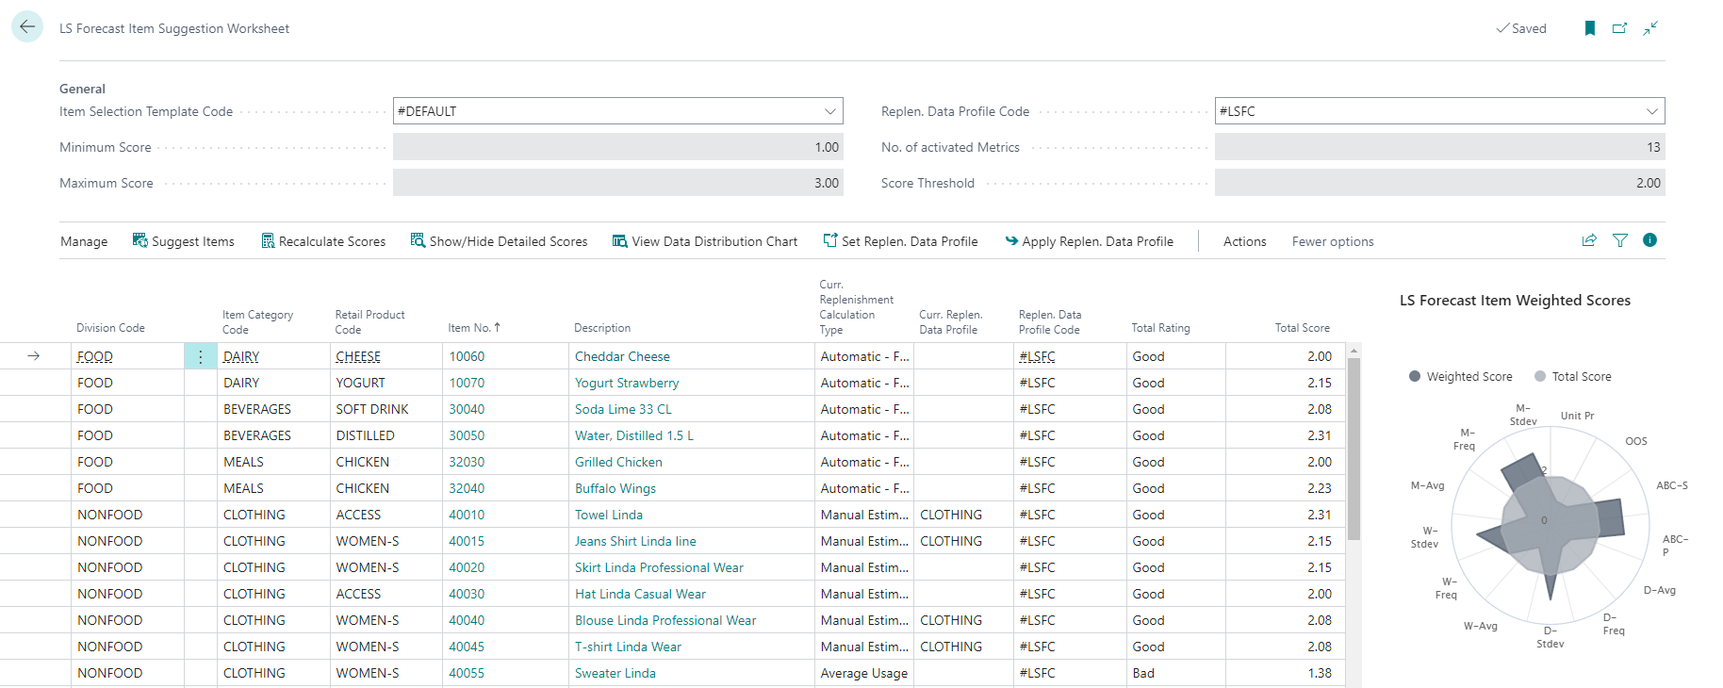
LS Forecast: Item Suggestion Worksheet
Tool for partners and customers
Identify good item candidates
Scorecard approach with weights
Easy, simple, fast
Total Rating
Total Score

Slide 26
LS Forecast
Pack | Calculations from | Calculations to | Price per 1000 calc.
LSFC-10k | 1 | 10.000 | 5,99 €
LSFC-50k | 10.001 | 50.000 | 2,98 €
LSFC-100k | 50.001 | 100.000 | 2,49 €
LSFC-500k | 100.001 | 500.000 | 1,80 €
LSFC-1M | 500.001 | 1.000.000 | 1,20 €
New price model
Old approach:
  Total number of calculations within 1 month
New approach:
  Stepwise model
  Pack (and price) is
  selected for each
  individual calculation
Calculation
(3.000)
Calculation
(18.000)
Calculation
(18.000)
1.4.
30.4.
Pack LSFC-10k
3 * 5,99€ = 17,97€
Pack LSFC-50k
18* 2,98€ = 53,64€
Pack LSFC-50k
18* 2,98€ = 53,64€

Slide 27





LS Intelligent Cloud Suite
Designed for LS Retail’s customer base
  SaaS solutions
  hosted by
  LS Retail
  Turn-key
  solutions,
  no data-scientists
  or experts
  needed
  Quick ROI,
  Low risk,
  easy to use,
  fast to deploy
Easy to add more apps
due to common architecture

Slide 28

The future
LS Insight
New report packs
Alternative approach for data load (via Azure Data Lake)
LS Forecast
Consideration of internal/external effects (weather)
LS Recommend
Improvements based on your feedback
LS Basket Analysis
Basket analysis solution to calculate correlations in sales history
Will affect:
- Assortment decisions
- Promotions and Discount Offers

Slide 29
Partner Survey
2021

Slide 30
Partner Survey, Fall 2021
Questions:
  Which of the following LS Retail software enhancers
  does your company offer?
  Which of the following software enhancers
  does your company not currently offer,
  but you would be open to offering to customers in the future?
Responses: 113
  29 replied they are actively offering at least one of the
  Intelligent Cloud solutions
    LS Insight (25%)
    LS Forecast (19%)
    LS Recommend (17%)

Slide 31

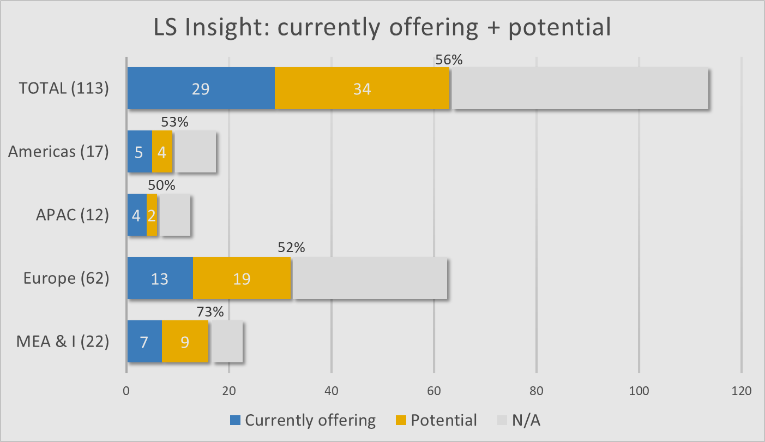
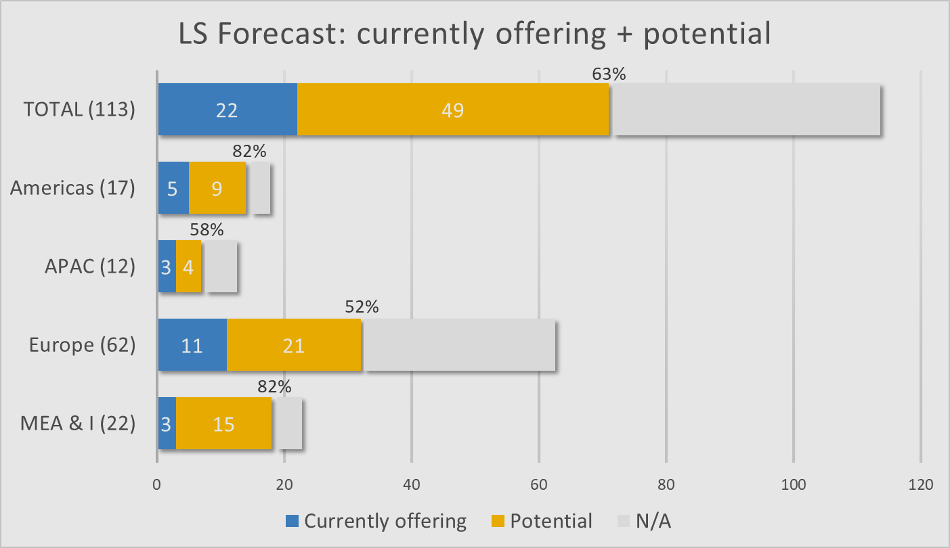
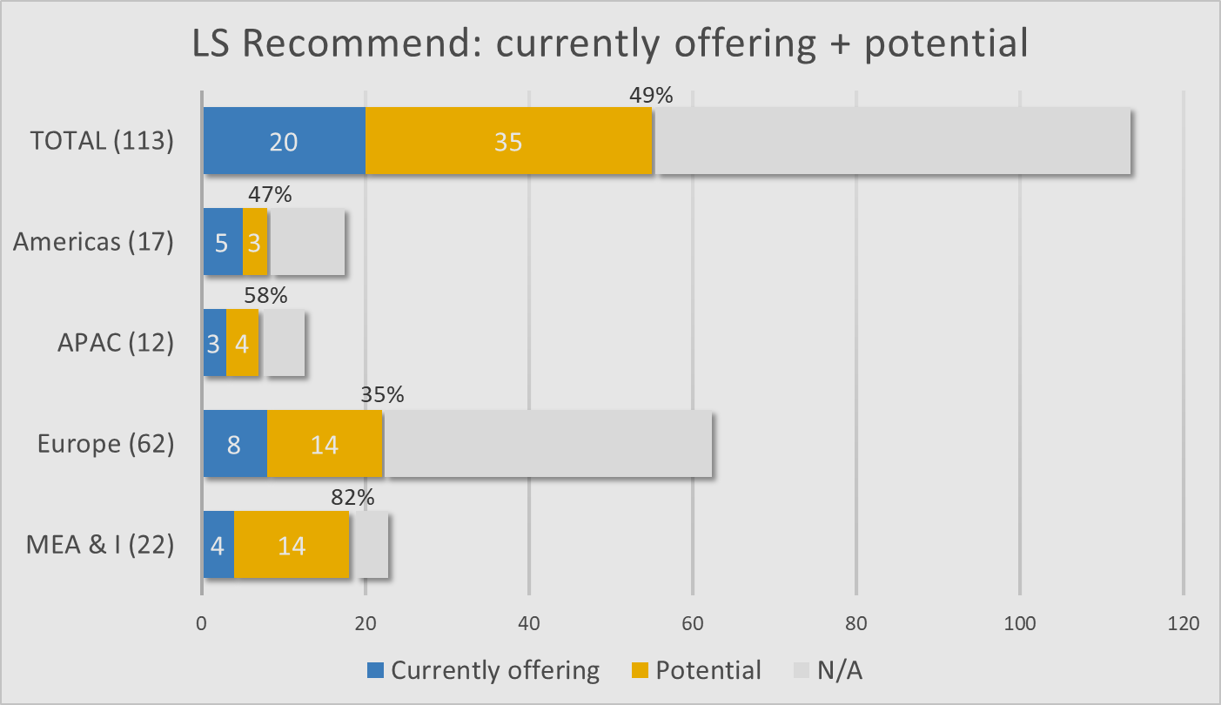
Partner Survey
Status and potential:
  LS Insight (29→63; ▲117%; 56%)
    Europe leading in absolute potential
    MEA&I leading in % potential
  LS Forecast (22→71; ▲223%; 63%)
    Europe leading in absolute potential
    Americas; MEA&I leading in % potential
  LS Recommend (20→55; ▲175%; 49%)
    MEA&I; Europe leading in absolute potential
    MEA&I leading in % potential

Slide 32
Questions

Slide 33



