Slide 1


Slide 2

eCommerce for LS Central
Part I
Petur Thor Sigurdsson
Product Director

Slide 3






Our product strategy is Unified Commerce
Financials
& budgeting
Inventory & warehouse
management
Map of locations
with directions
Sales & marketing
Consumer experience
Personal, personalized
Business processes
Easier, simpler, faster
Reporting & analytics
Human resource
management
Personalized offer
and notifications
Store/POS
configuration
%
Price, offer,
coupon management
Mobile loyalty on
various devices
Replenishment
eCommerce
& mobile
✓
Loyalty
management
Social Media
Staff interactions
with cross/up-sell
Business insights
Drive actions that improve
customer service
Easy-to-use
POS/mobile POS
Global cloud service
Providing our customers
the option of the SaaS/cloud
Ordering & transfers
End-of-day
cash management
Stock management

Slide 4






eCommerce
POS
Master Data
Store Inventory
Point of Sale
Basket Calculation
Hospitality
Customer Loyalty
Click & Collect
Customer Orders
Transaction Repository
Token Vault
Gift Cards
Activity
KDS
Pharmacy
+
+

Slide 5

eCommerce API
LS Commerce Services

Slide 6
eCommerce API
LS Commerce Services

Slide 7
Traditional UI
Progressive Web App (PWA)
eCommerce API
LS Commerce Services

Slide 8




Eco system: Available Payment Plugins
Payment Service Provider
(PSP)
Point of Sale
Transaction Repository

Slide 9
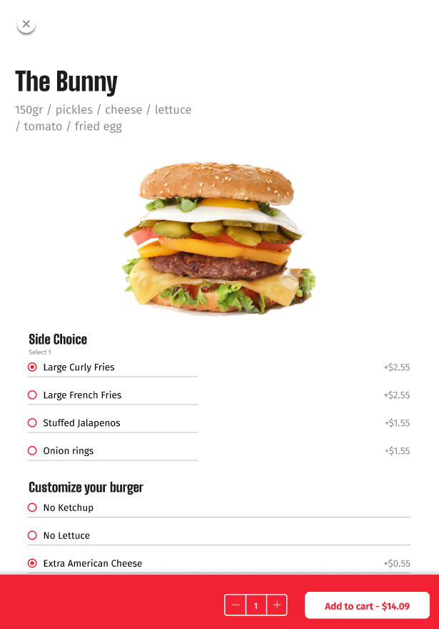
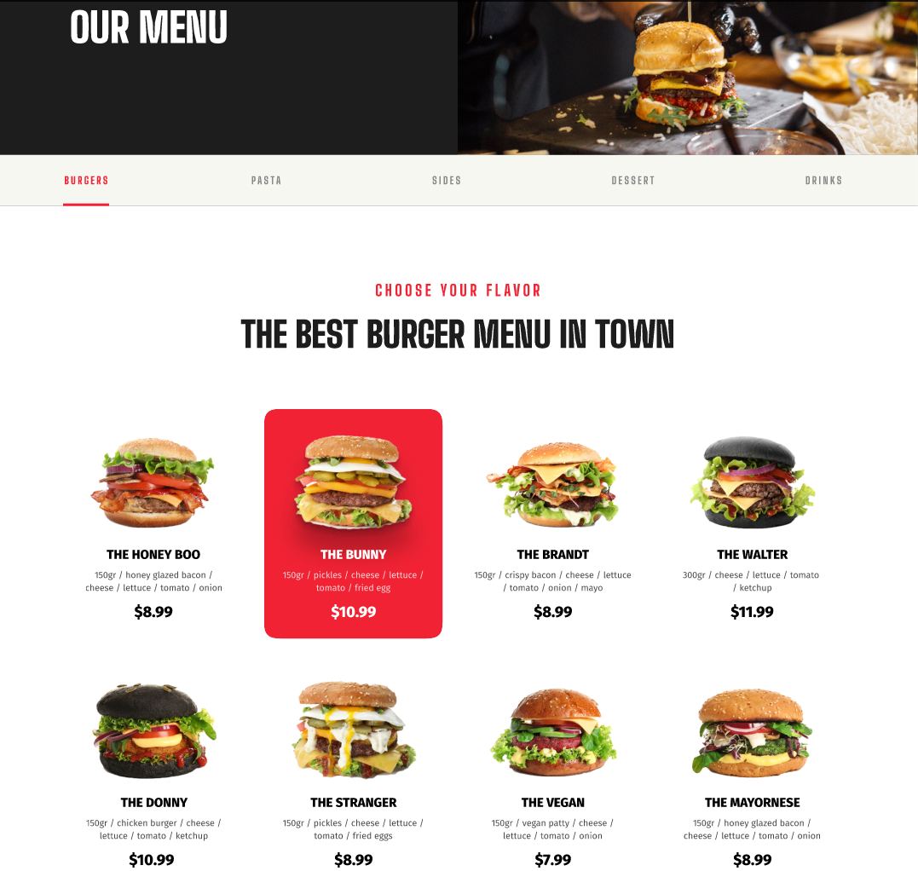
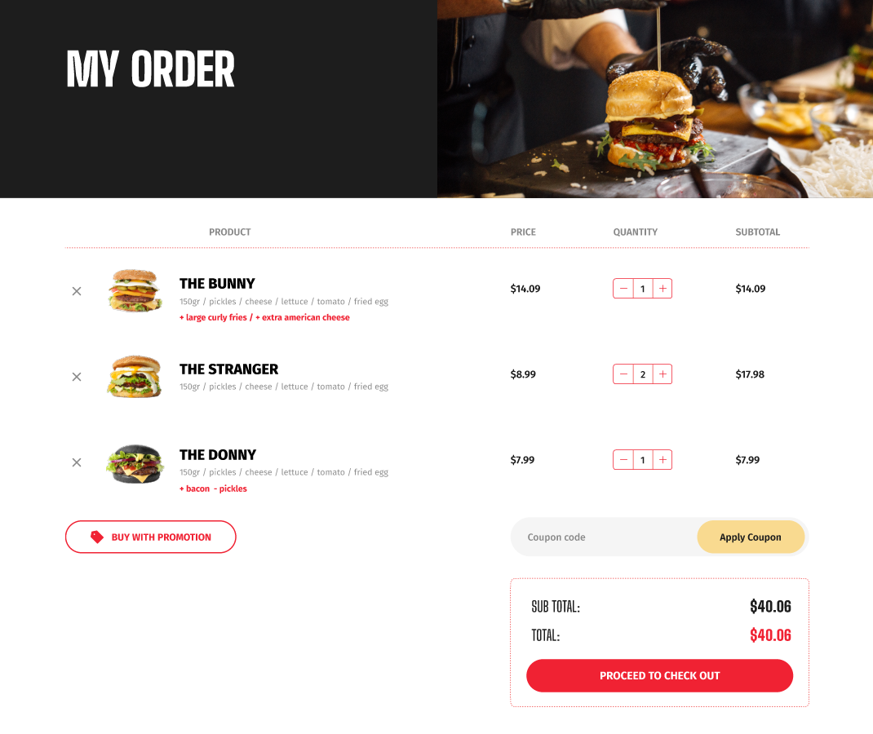
eCommerce for Hospitality – Online food ordering

Slide 10
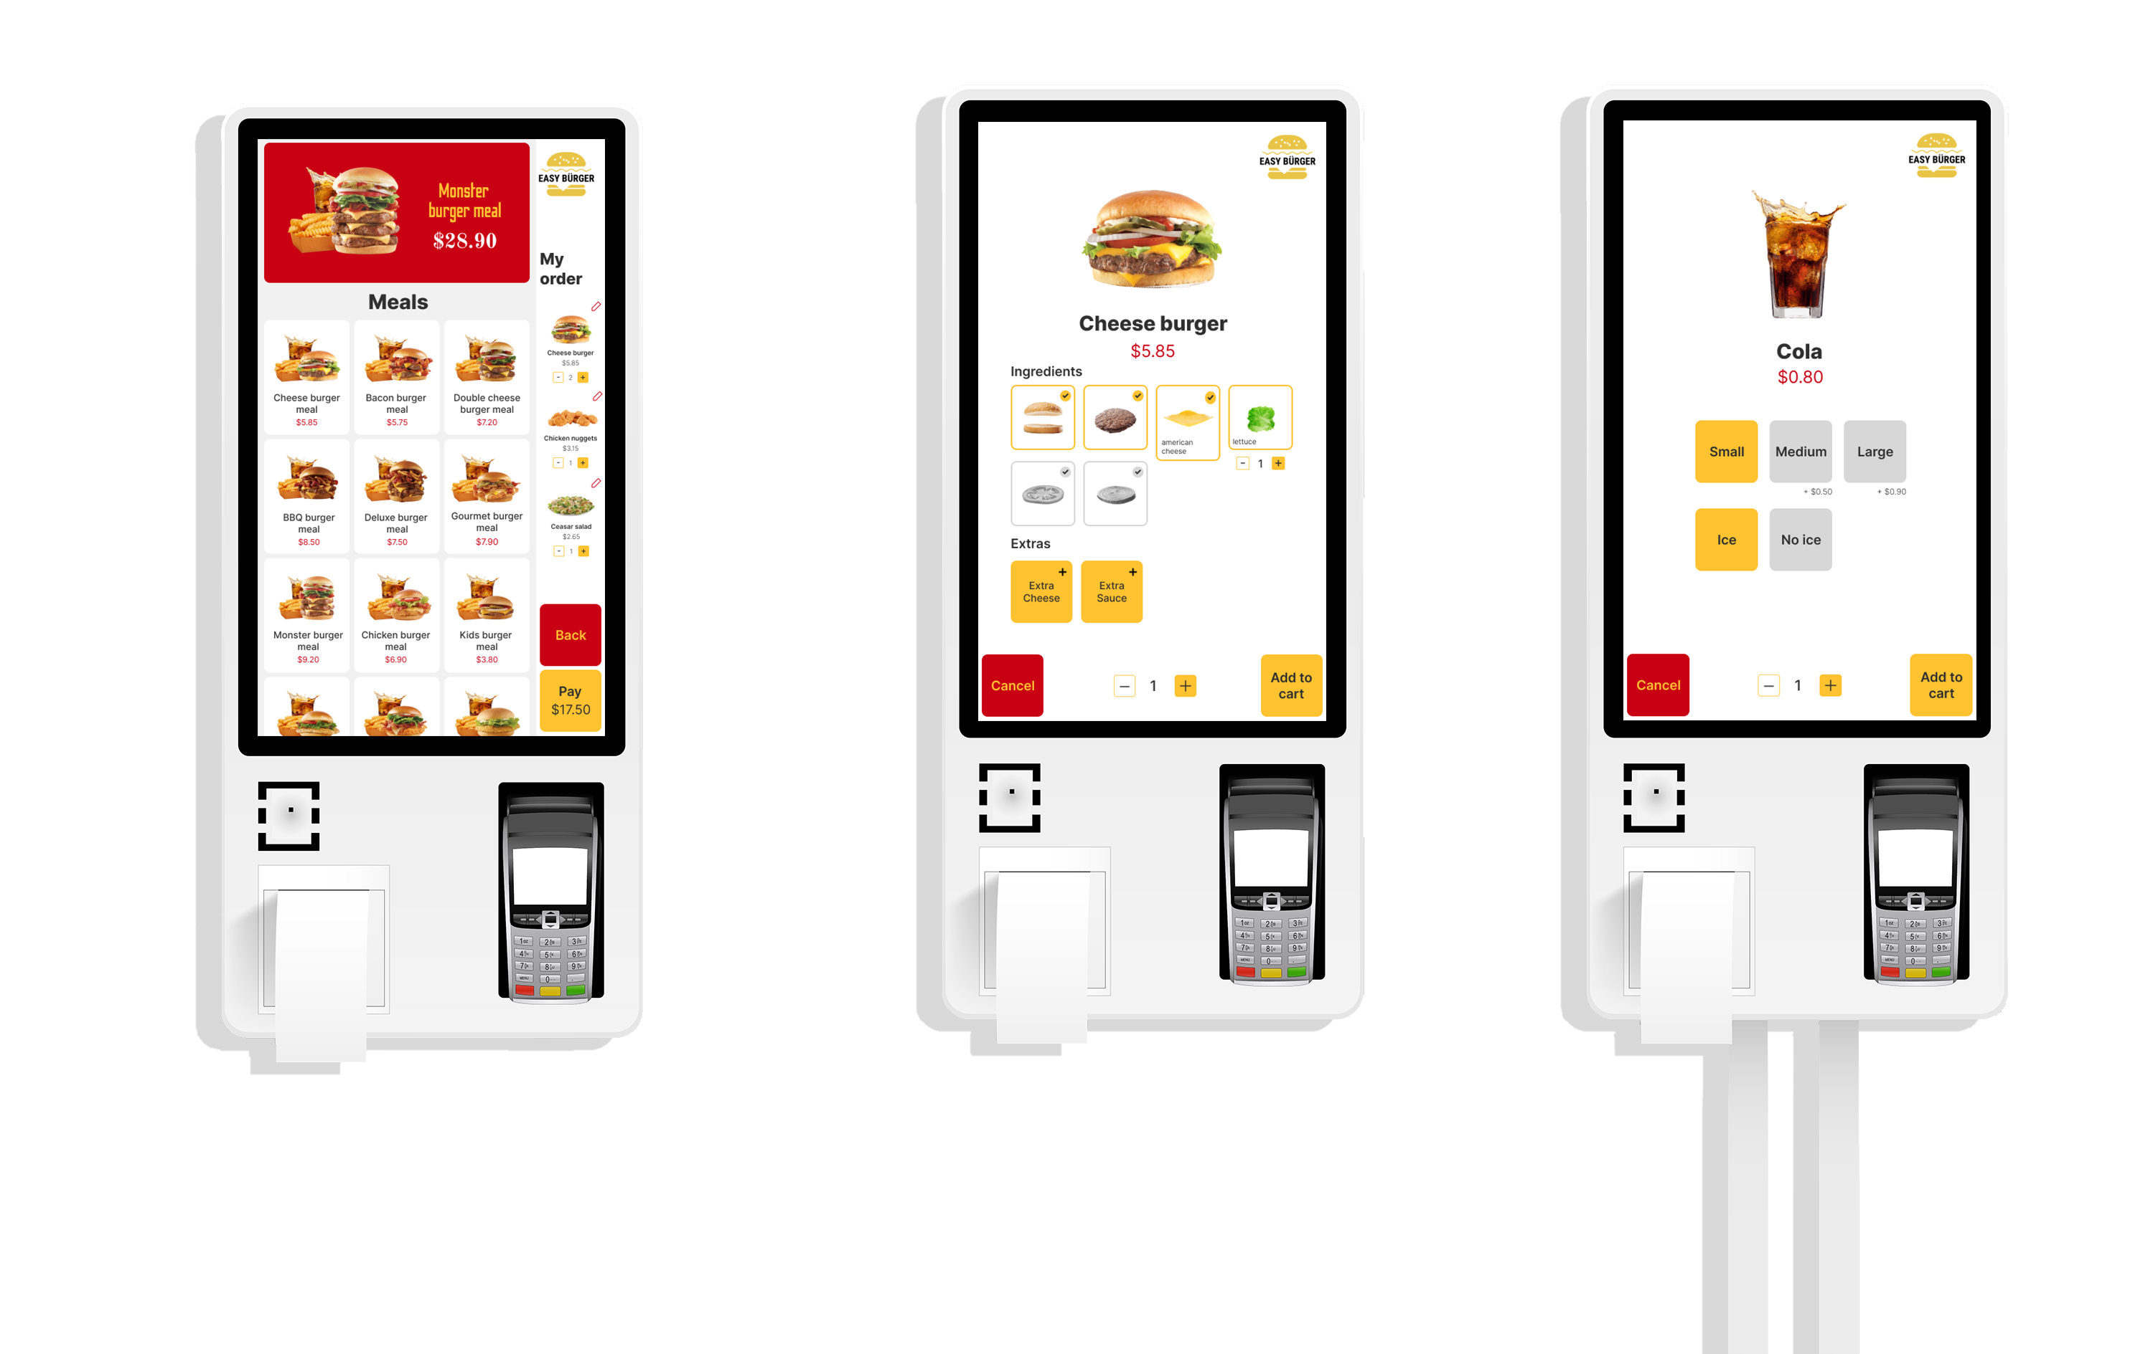

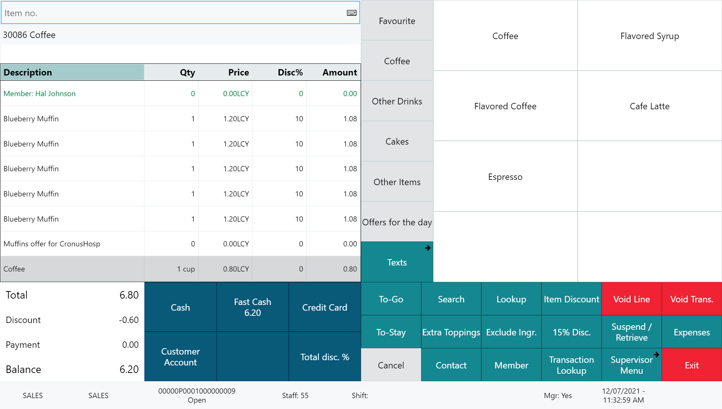






Restaurant
KDS preparation stations
Self Service Kiosks
POS 1
POS 2
LS KDS
Grill
KDS
Cold
Expeditor
station
Kitchen Service
Dessert
Bar
Online ordering

Slide 11
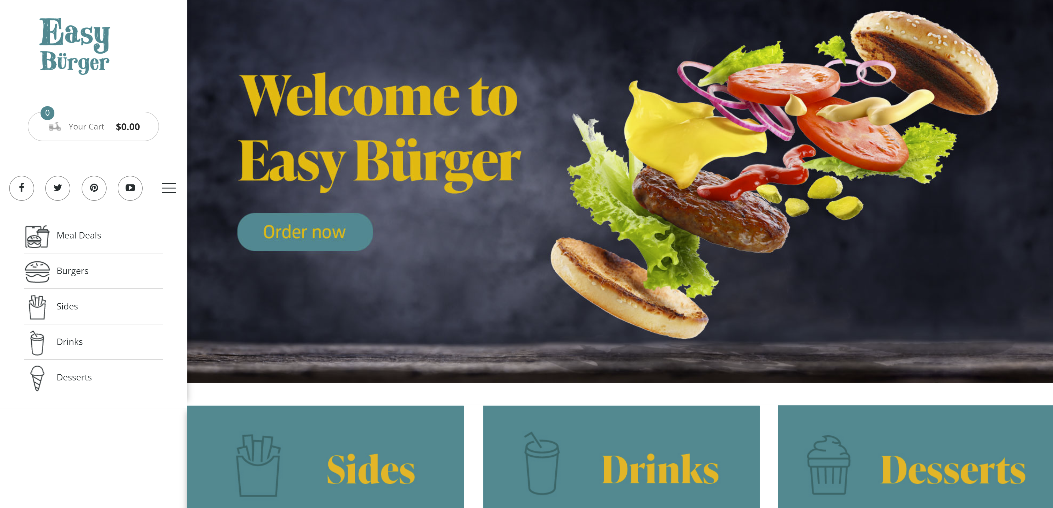
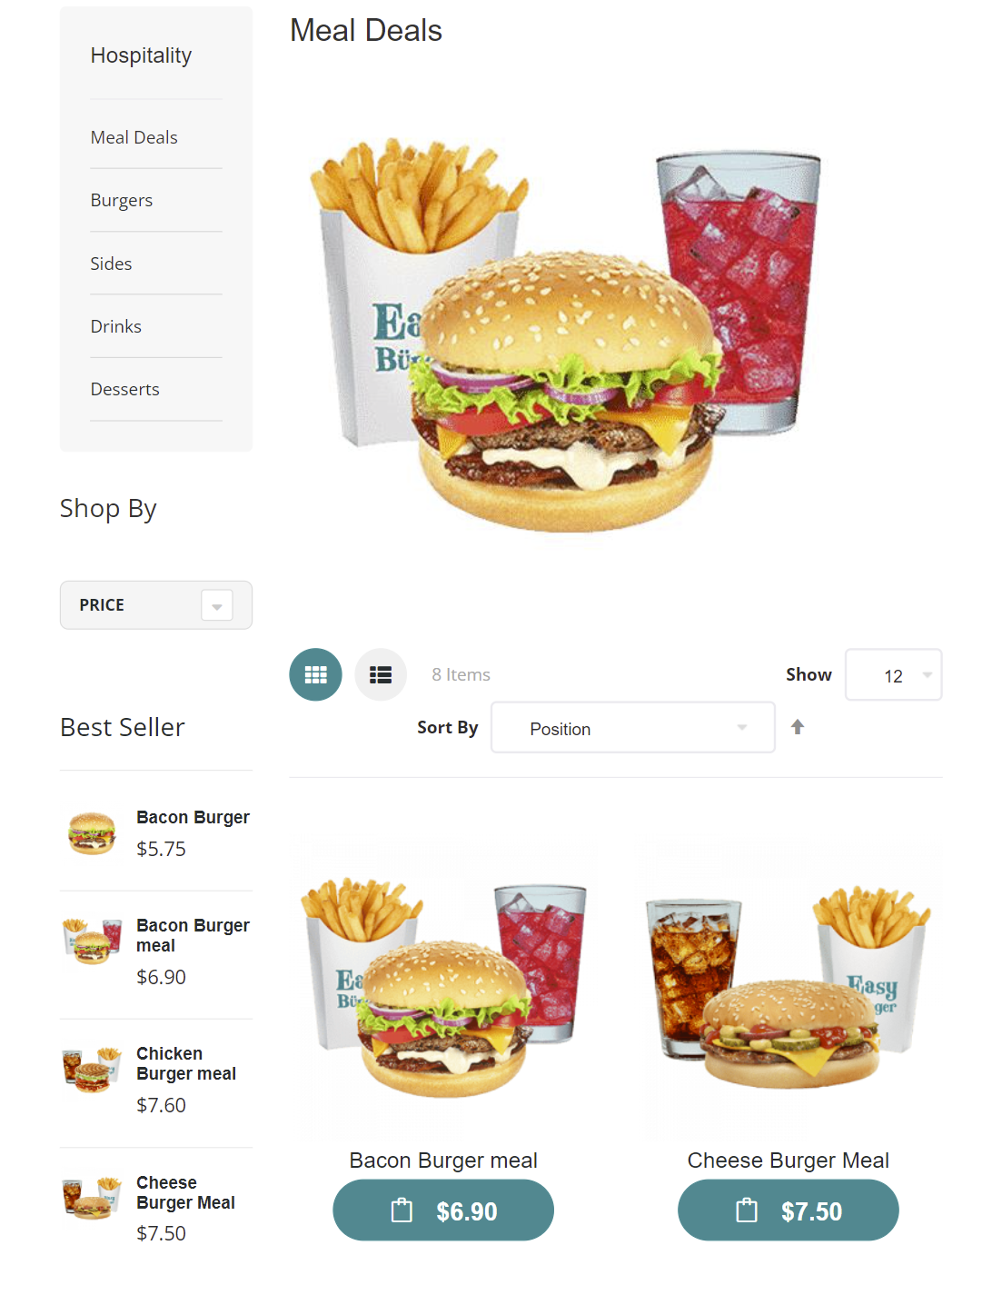
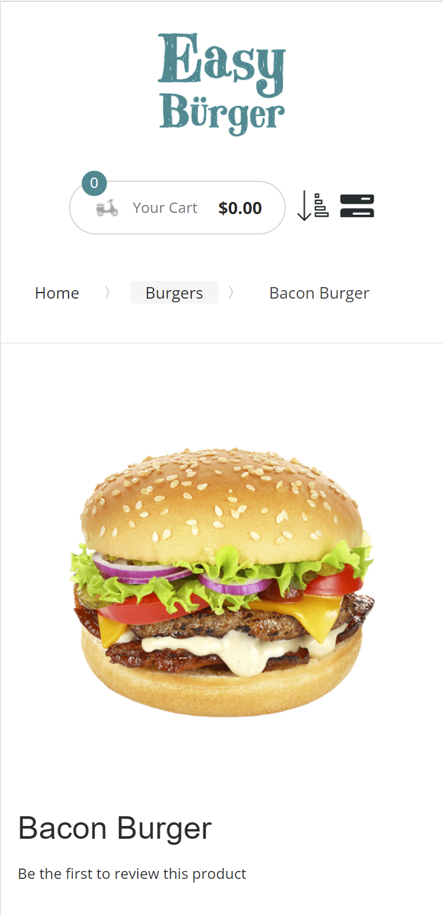
Magento UI options
Traditional

Slide 12
Magento UI options
Traditional
Progressive Web App (PWA)

Slide 13

Features
Take-away and dine-in
Menu setup in LS Central
  Items (Images, longer descriptions)
  Deals, with price change support
  Modifiers
  Ingredients and allergens
Basket calculation via LS Central
Customers are member contacts in LS Central
Orders instantly posted to LS Central and routed to the KDS

Slide 14
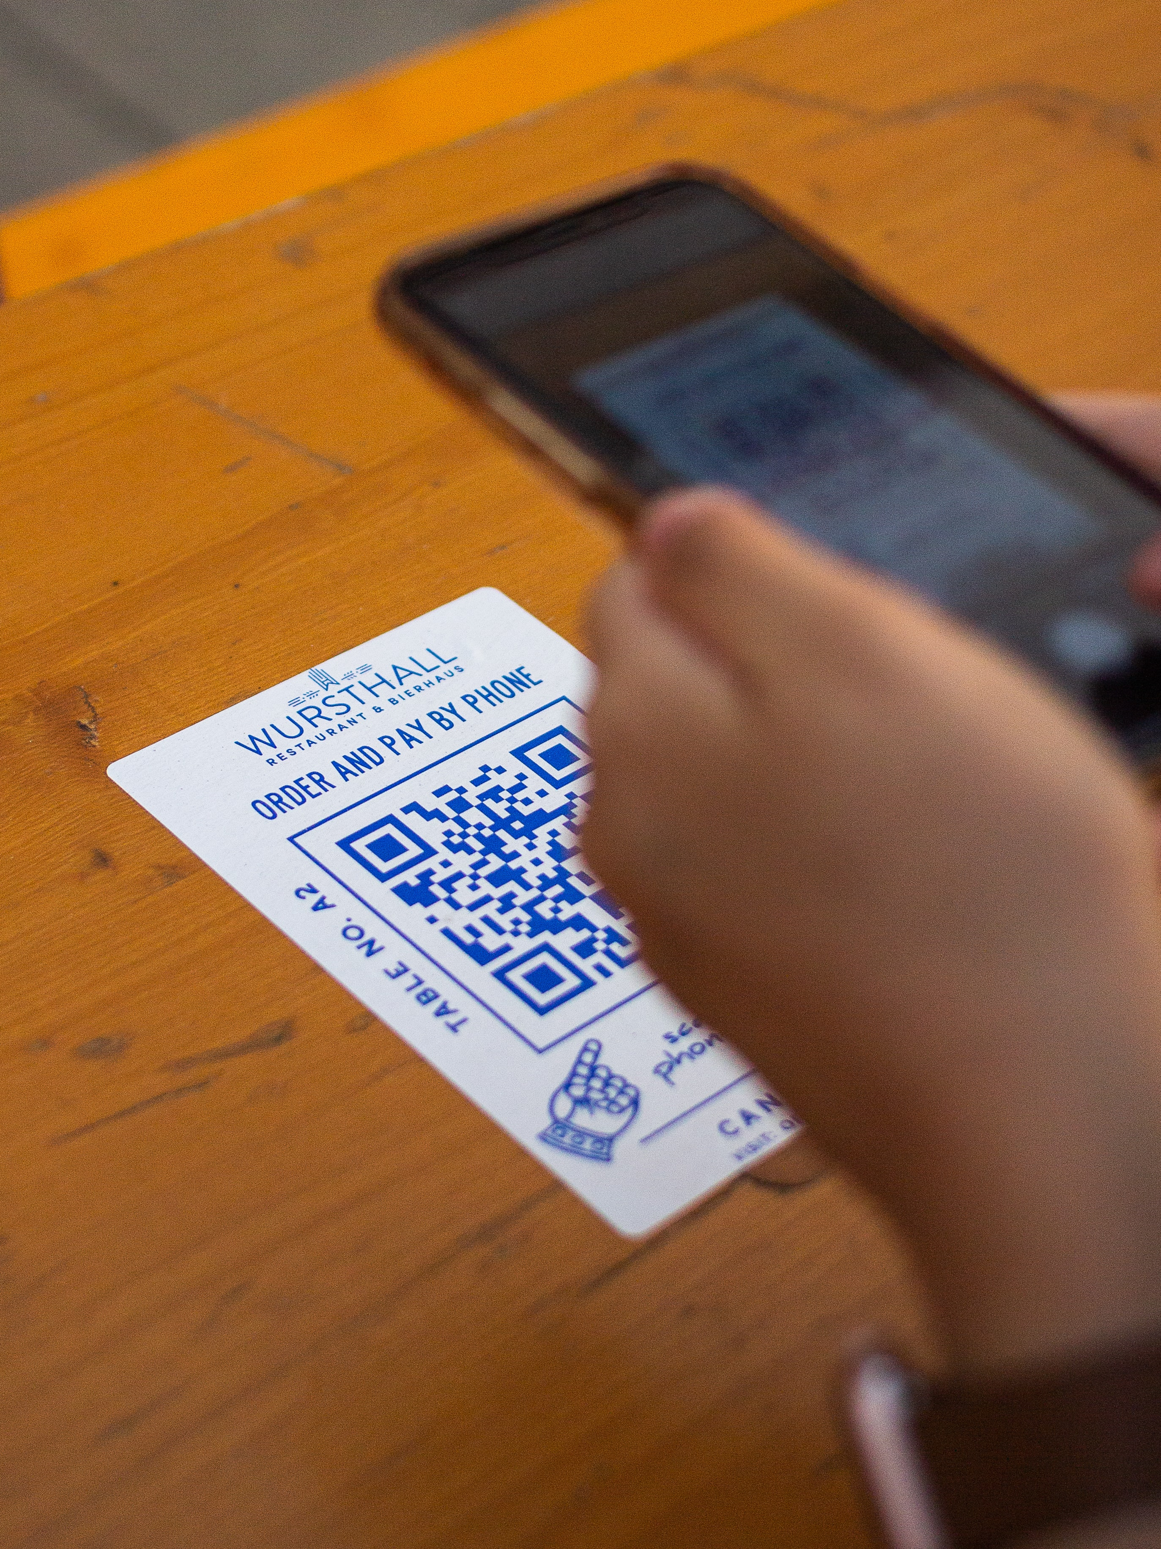
QR Code ordering process
Customer scans a QR Code at a restaurant table, directing the customer to the restaurant’s website and disclosing the ID of the customer’s location (table, seat, cabin, etc.)
Customer orders via the web site. Payment is either online or on the POS.
The order is instantly posted to LS Central and routed to the KDS system for preparation
When ready LS Central instructs the waiters where to deliver the dish

Slide 15




One of the world’s leading eCommerce platforms
Non unified commerce approach
Easier – Simpler - Faster
Cloud hosted by Shopify
Extendable by partners

Slide 16
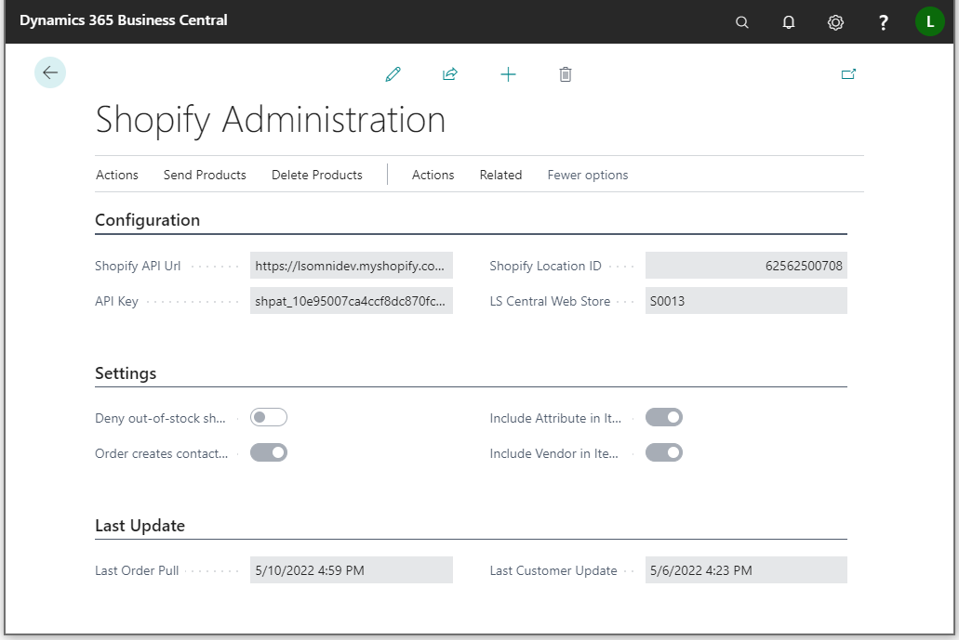
LS Central - Configuration
Basic environment configuration:
Shopify API URL
API Key
LS Central Web Store
Tender type and shipping agent mapping
Various settings, etc.
Replication driven by item distribution and scheduler jobs

Slide 17
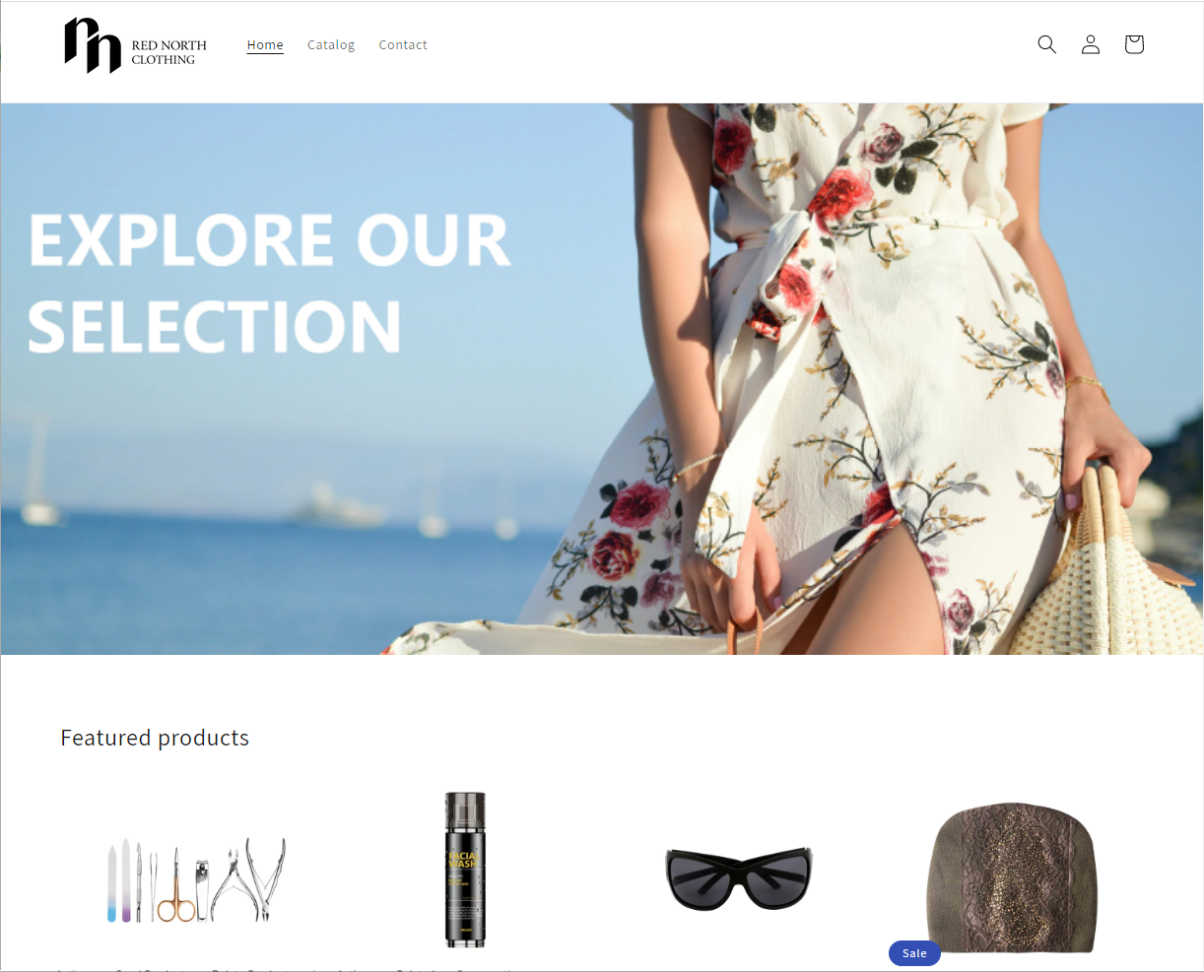
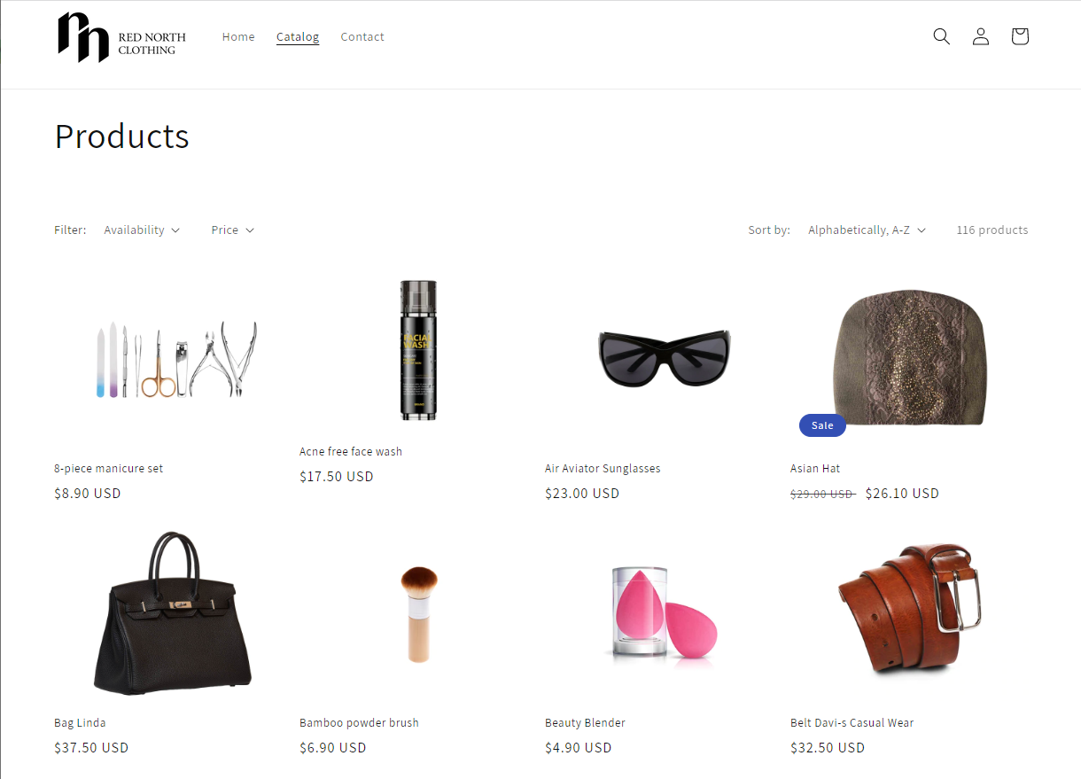
Shopify Storefront
Shopify or Shopify Plus
Choose the platform for your needs
The theme sets the context
Go with themes made for what you’re selling
Employ a digital agency

Slide 18
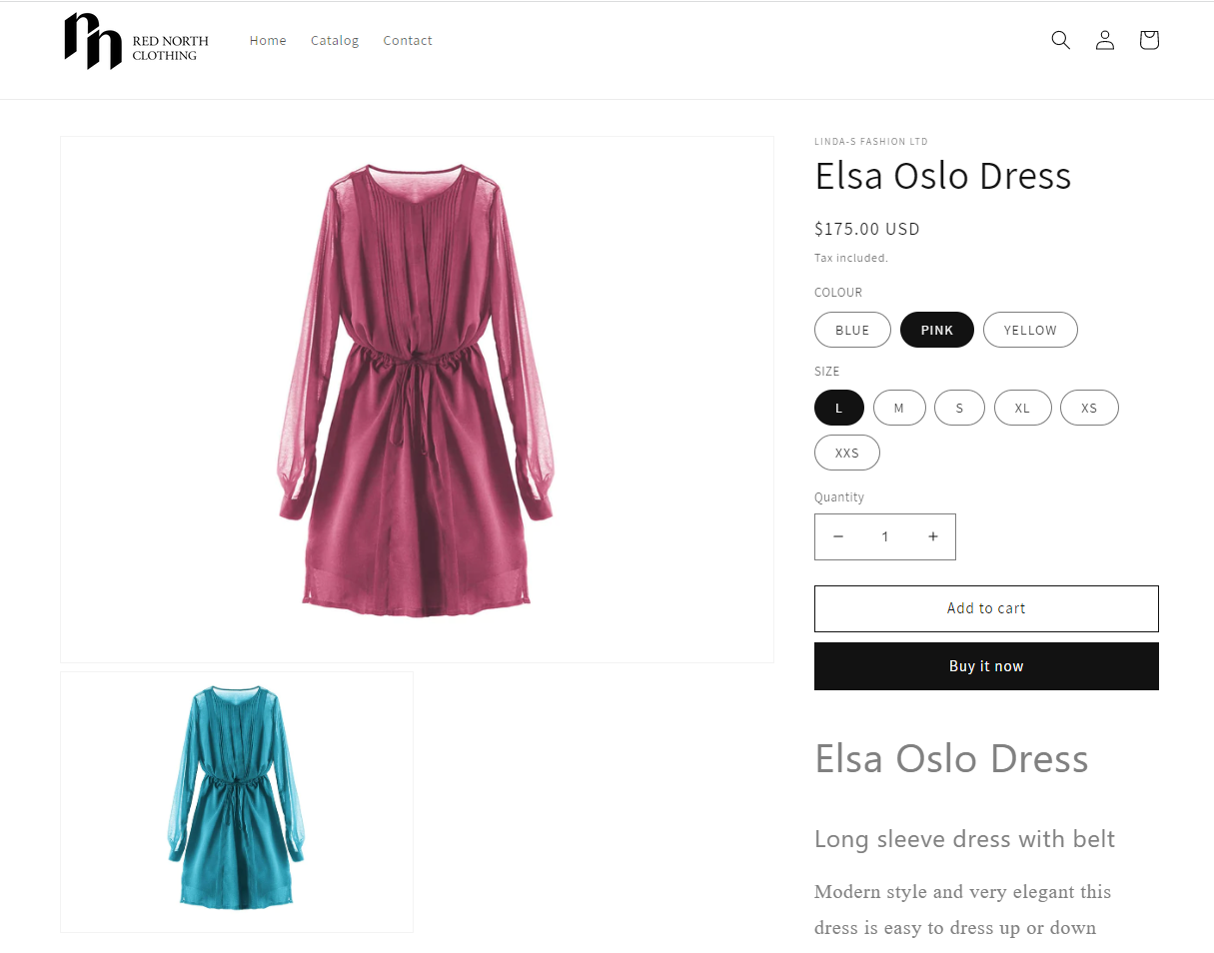
Items
Full item replication:
Name, description, images
Attributes, categories
Inventory, prices
Periodic discounts
Full variant support
Support for metafields

Slide 19
Orders
Orders from Shopify created as Customer Orders in LS Central
Support for shipping agents and amounts
Support for tender mapping
Customers in Shopify created as Member Contacts in LS Central
Batch pulling
With individual orders

Slide 20


Retail
Hospitality
Activity
Pharmacy
Retail
eCommerce API
LS Commerce Services
3rd party
eCommerce
providers

Slide 21

Ongoing & roadmap – H1 2023
  LS Retail Academy – Courses for retail and hospitality
  Item vendor sourcing
  Multicurrency support for gift cards and loyalty points
  Online gift card purchase
  Gift cards – Added security
  R&D – New calculation engine
  Shopify
    Partner extensibility, loyalty points, coupons, gift cards & UI development
Roadmap – H2 2023
  LS Retail Academy – Courses for Shopify
  Hospitality – Home delivery
  Online returns
  Click and Collect – Feature improvements
  Attribute images
  Abandoned baskets and shared wish lists
  Shopify
    Added partner extensibility, further UI development & multistore support

Slide 22


Slide 23

Questions?

Slide 24



What’s next…?
Zeeshan Khuwaja
Kristjan Asvaldsson
Petur Sigurdsson
Product Owner
Solution Lead
Product Director
zeeshan.khuwaja@lsretail.com
kristjan@lsretail.com
petur@lsretail.com

Slide 25
Thank you

