Slide 1


Slide 2

Get to know LS Central
for Restaurants
Gunnar Orn Thorsteinsson
Product Director

Slide 3
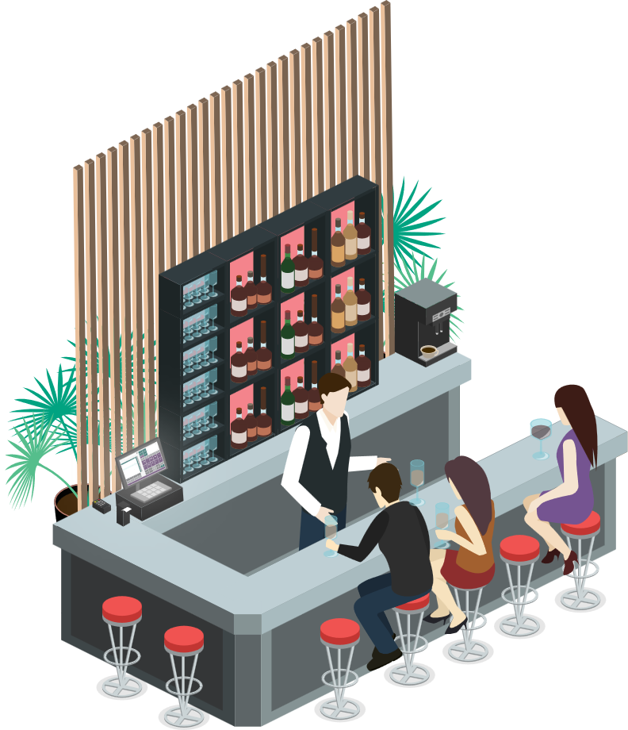
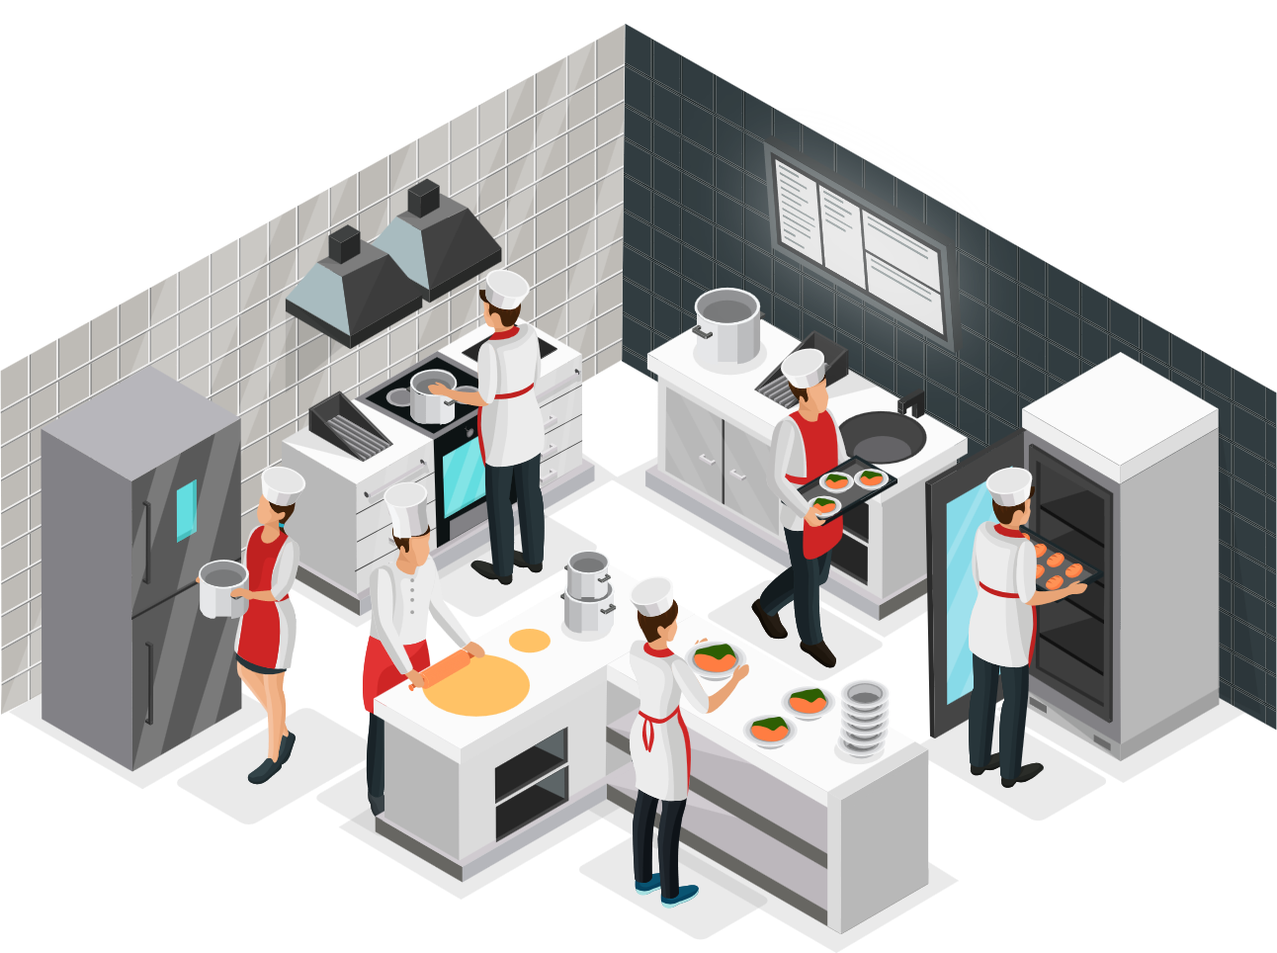





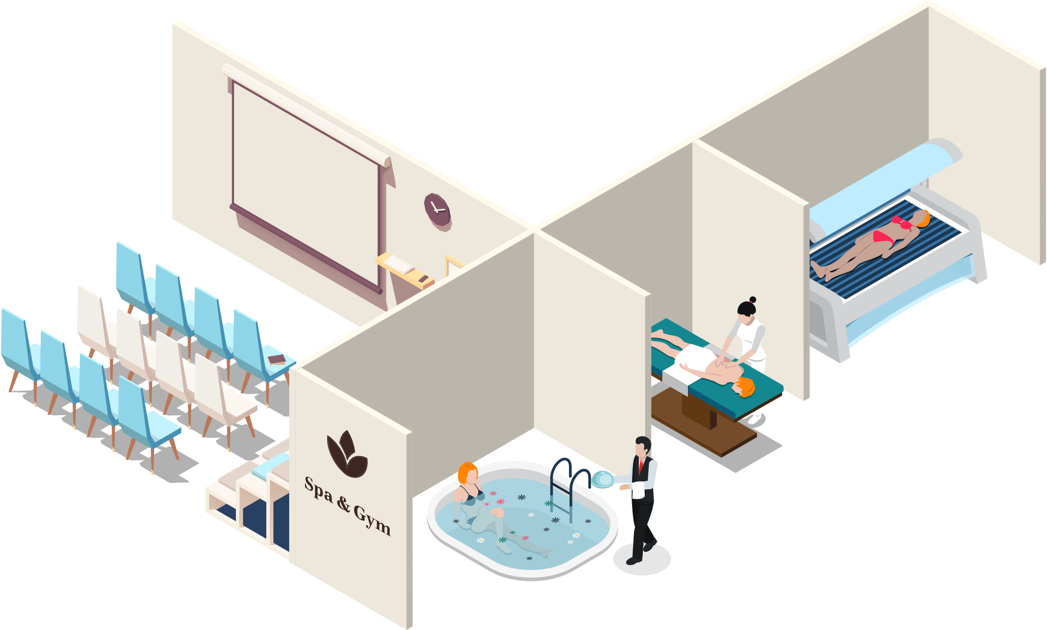
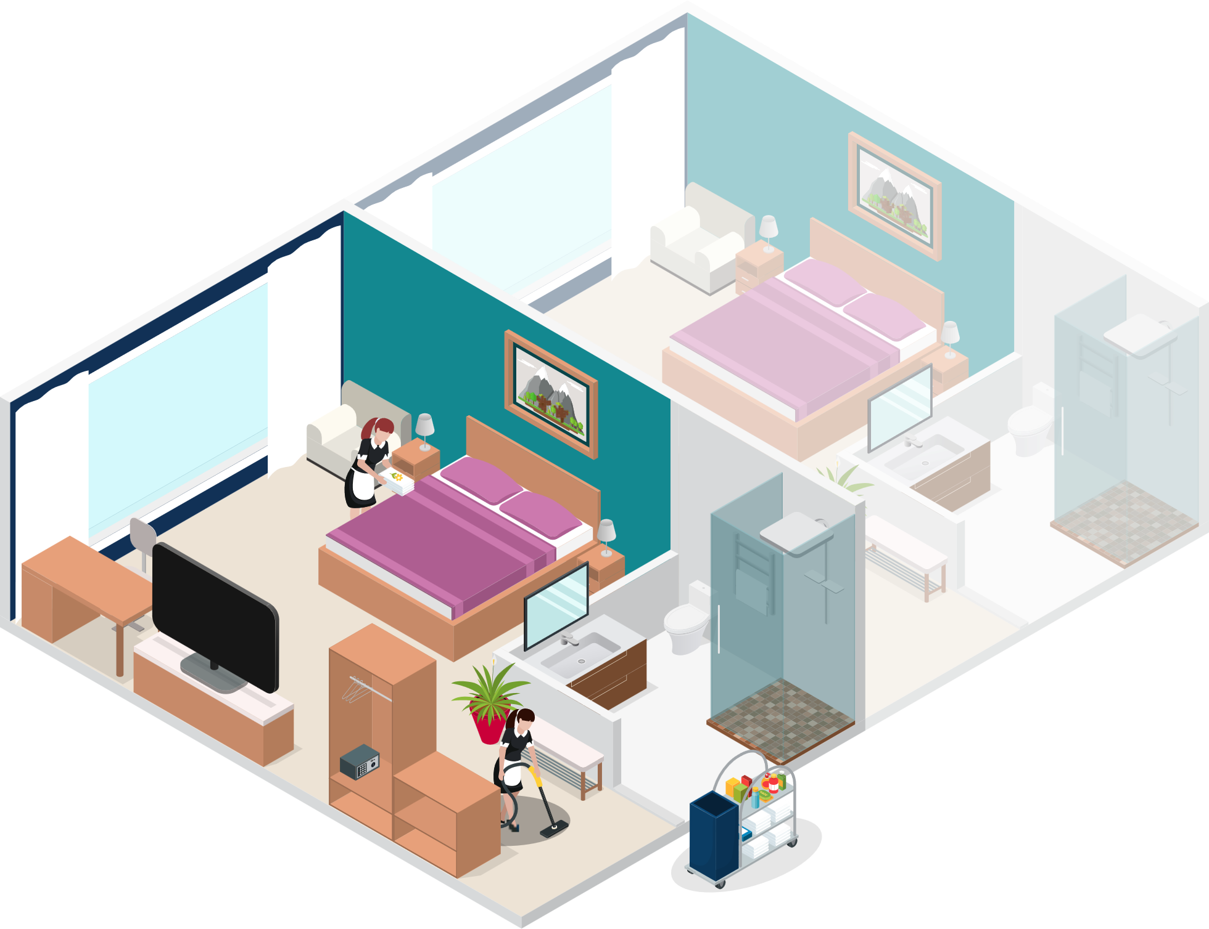


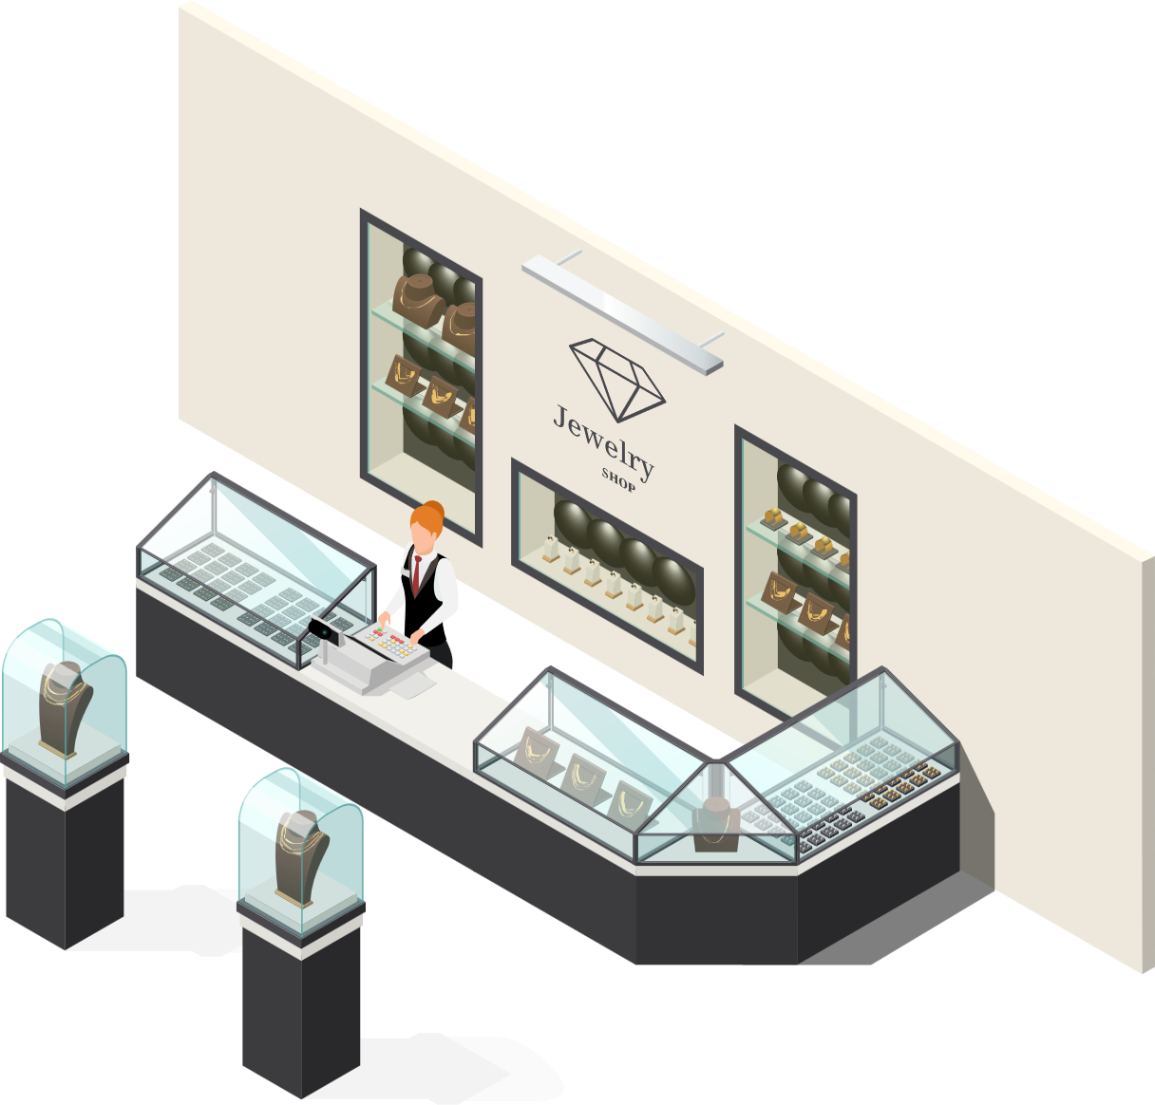


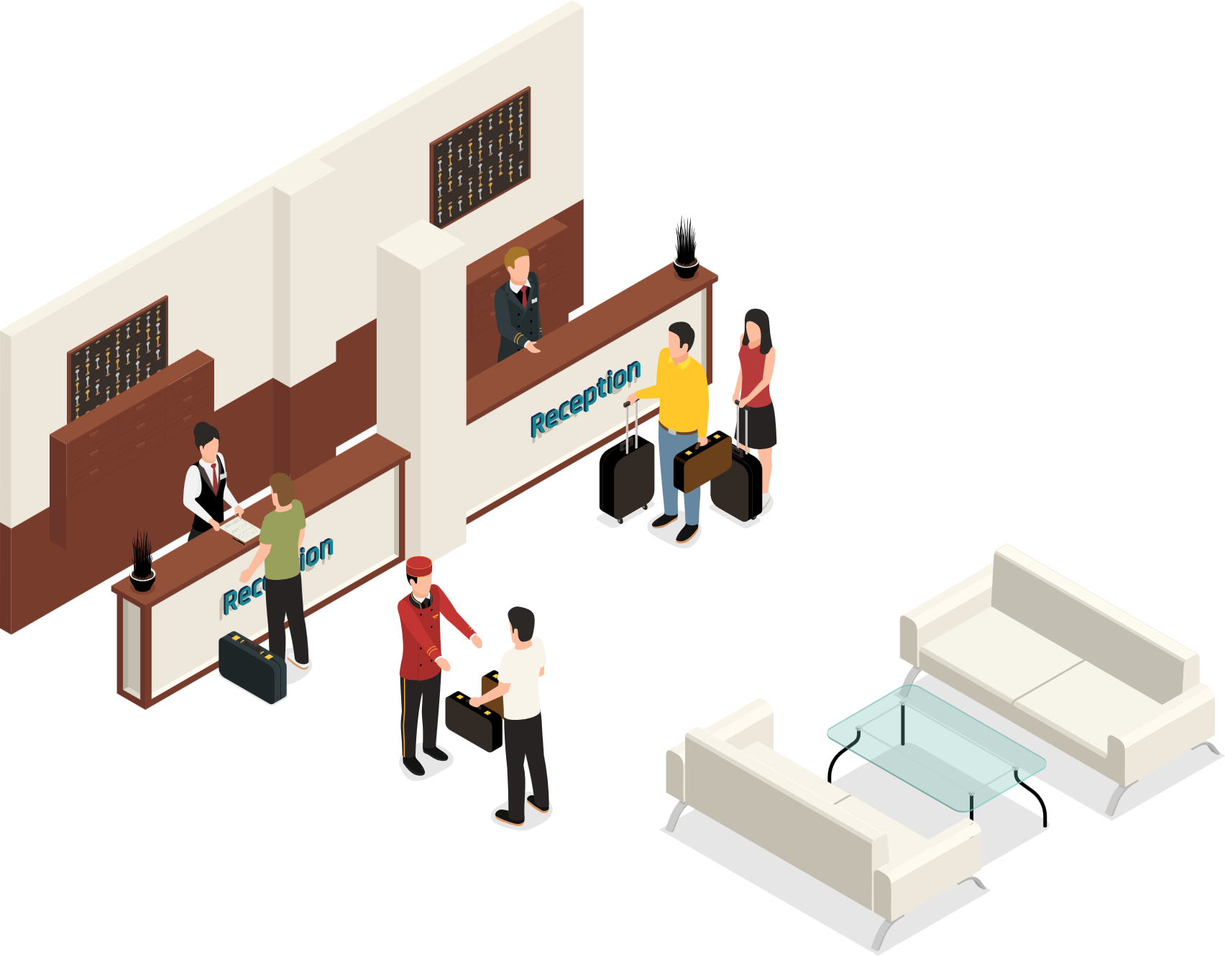
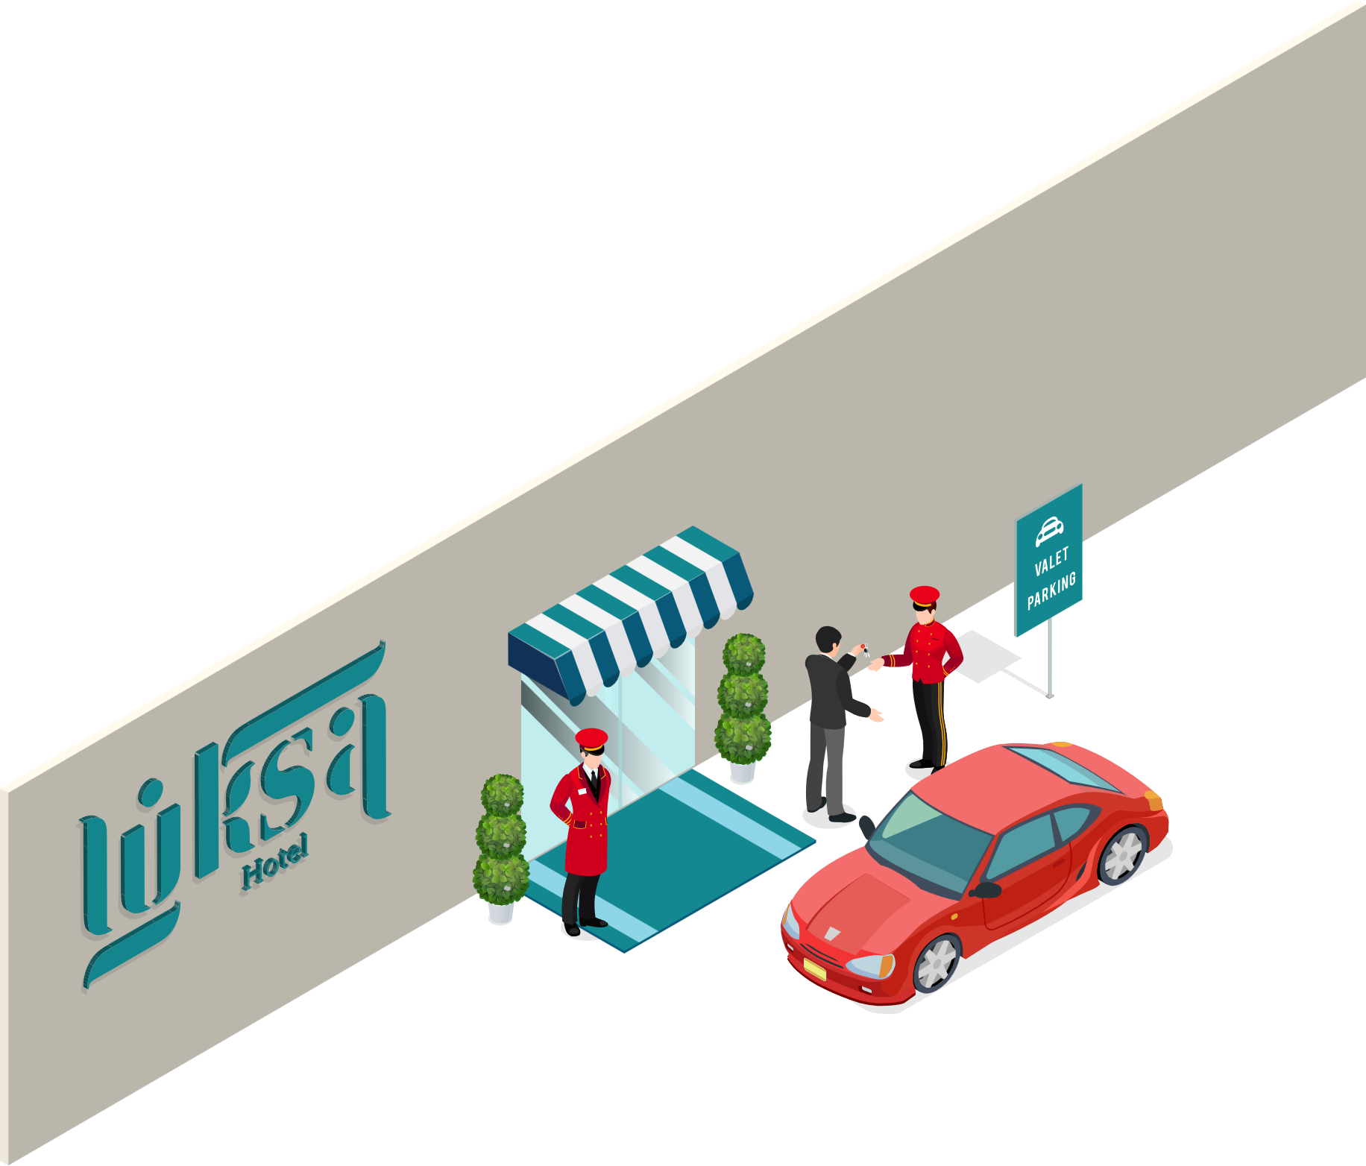


LS Hospitality
LS Central
Food & Beverage
Activity
Staff Mgmt
KDS
Hotels

Slide 4

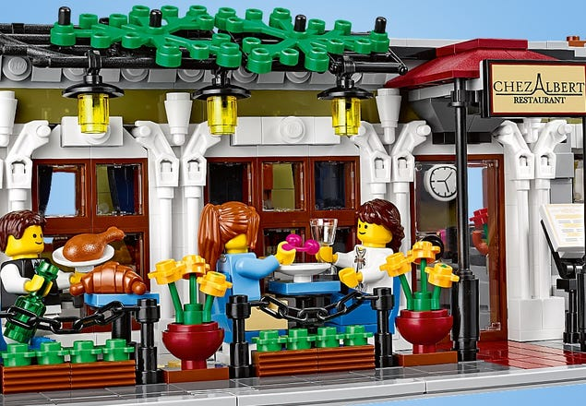
Restaurant functionality
Recipes
Deals
Modifiers (items and deals)
Unit of Measures
Hospitality Types and Service Flows
Table management
Table Reservations and Allocations
Loading Cards
Self-Service Kiosks
Kitchen Display System

Slide 5

Restaurant types
Table Reservations
Restaurants
Casual Dining
QSR
Pubs
Food Courts
Cafés
Fine Dining
Table Allocations
Comments
Loading Cards
Meal Planning
QR Code ordering
Deliveries
Open Tabs
Call Centers
Kiosks

Slide 6

Latest additions
Kiosk enhancements
eCom ordering with QR code ordering
QSR Host
KDS enhancements
Comments

Slide 7
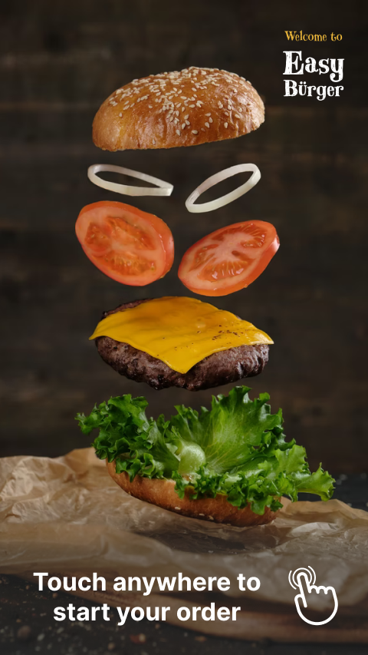
Kiosk
Recent enhancements
Refactored order flow
Roadmap
Discounts
Scan items
Scan member
Responsive layout
Multi-Language
Accessibility
Make it a meal
Cross-selling

Slide 8
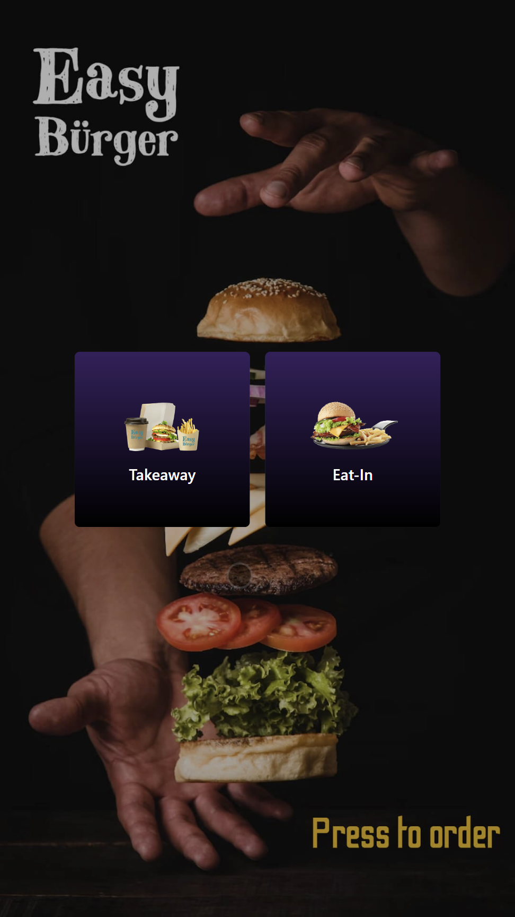
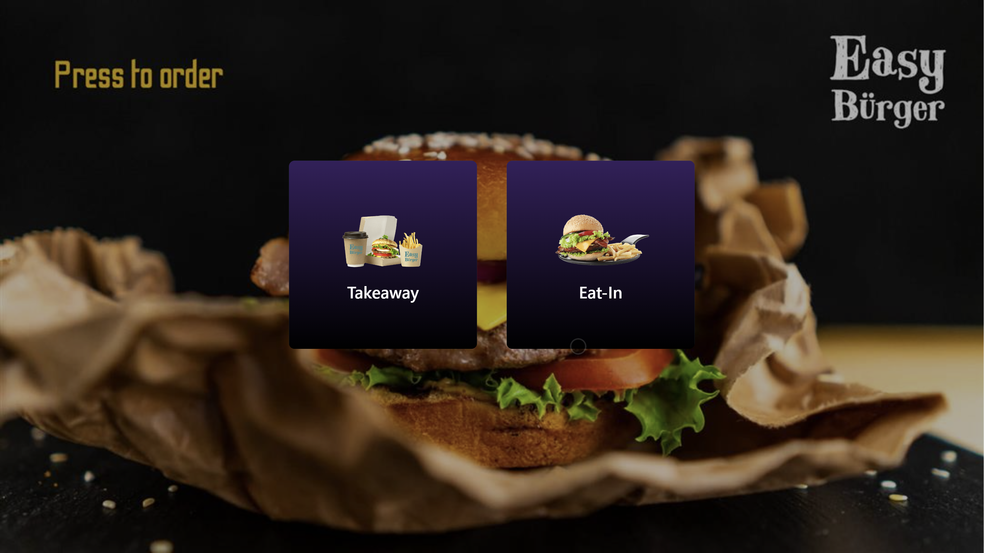

Slide 9
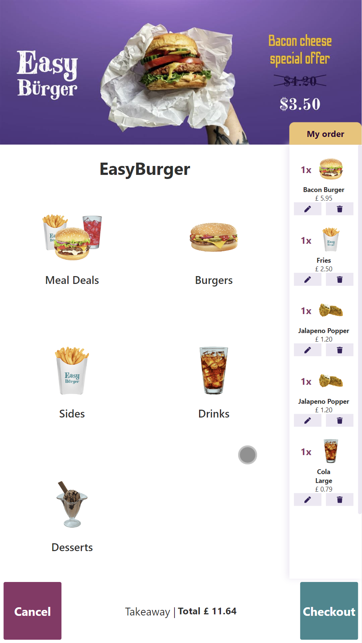
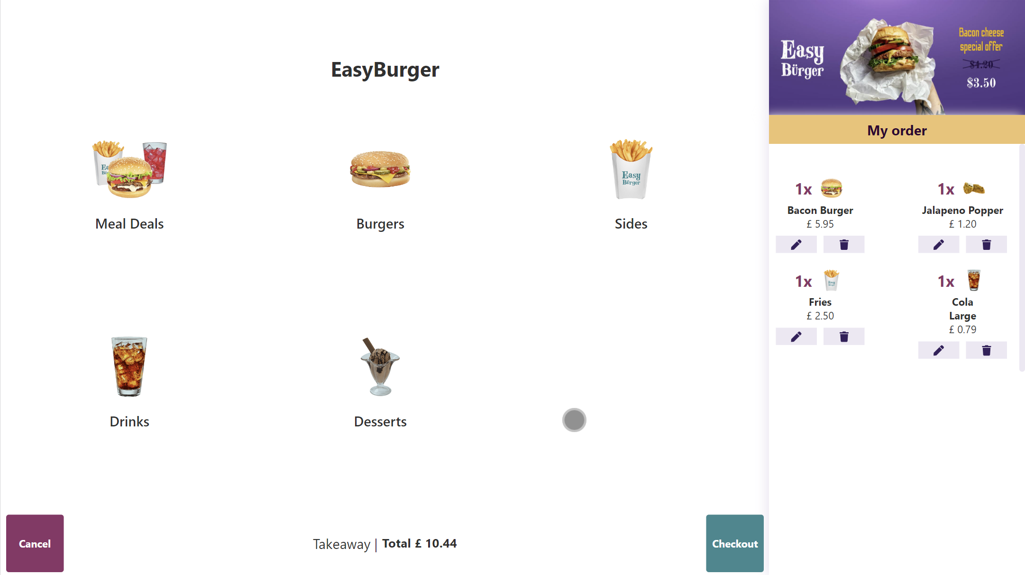

Slide 10
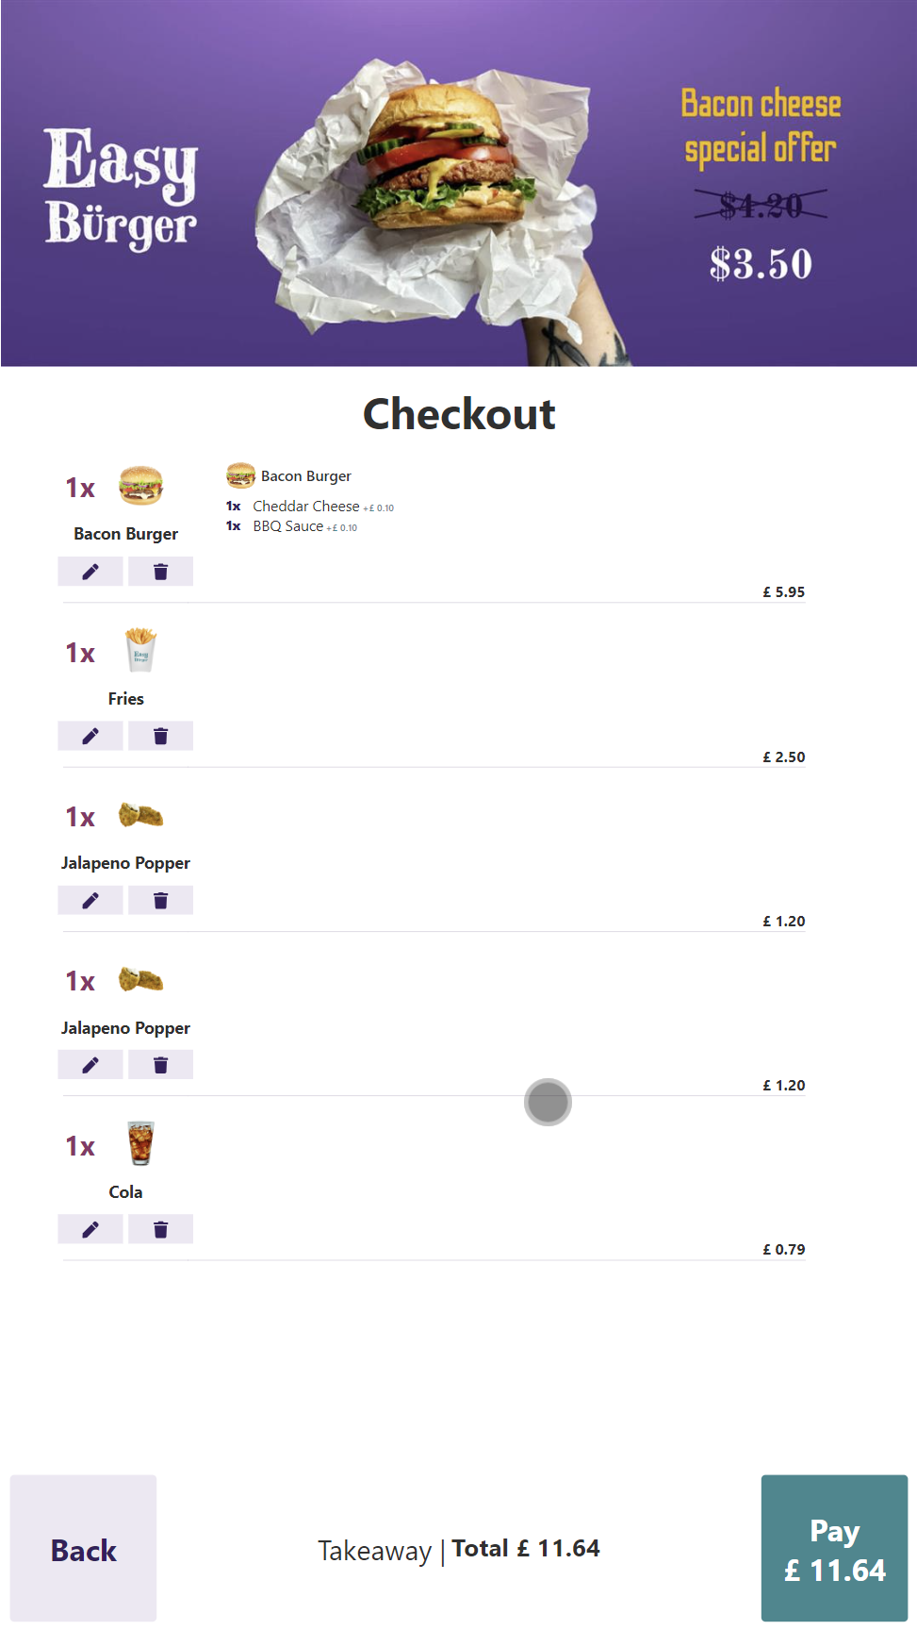
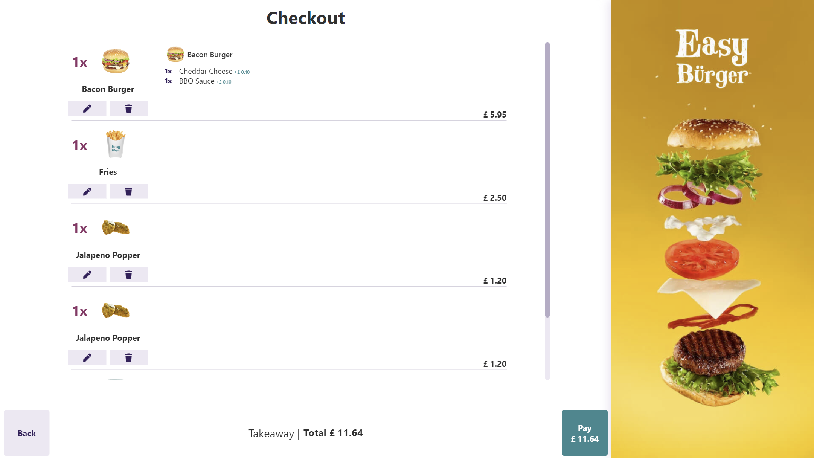

Slide 11
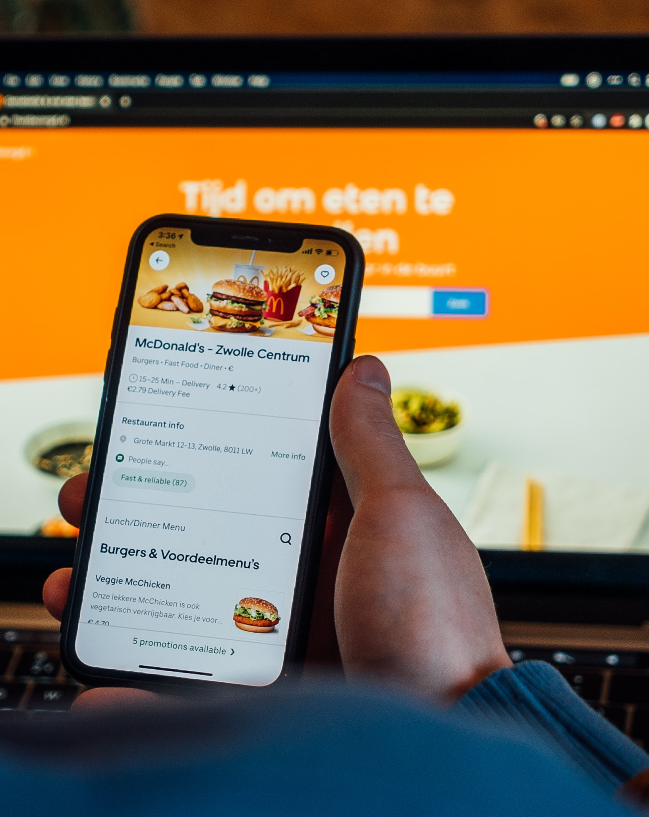
eCom & QR ordering
Recent enhancements
eCom ordering
Roadmap
Call Center to FAB orders
Webhooks
Deliveries
QR code ordering
FAB Host
Order information to KDS

Slide 12

Unified Comments
One single table with all comments
Comments related to entities (Dining Reservation, Activity Reservation, Groups etc.)
Comment Priority
View all related comments to an entity
View both in Back Office and on POS

Slide 13
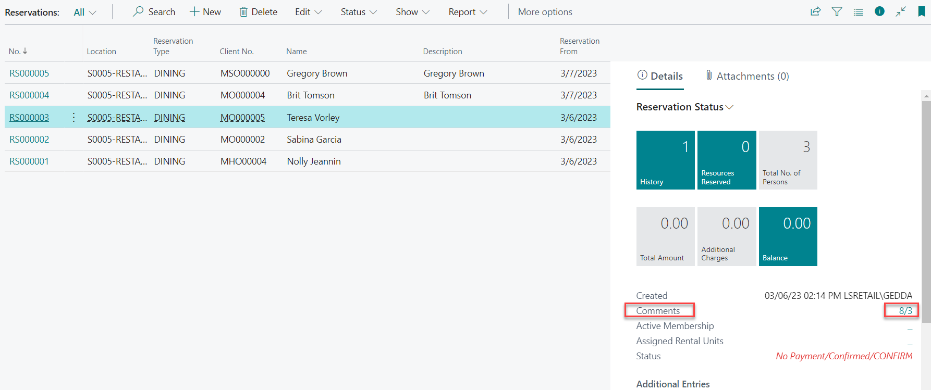

Slide 14
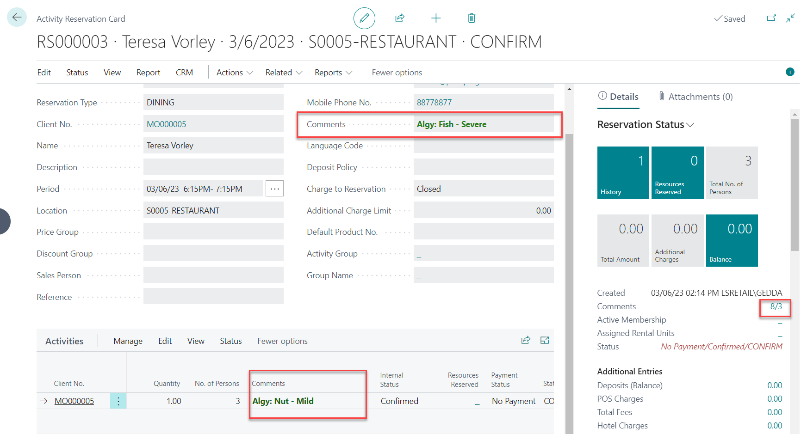

Slide 15
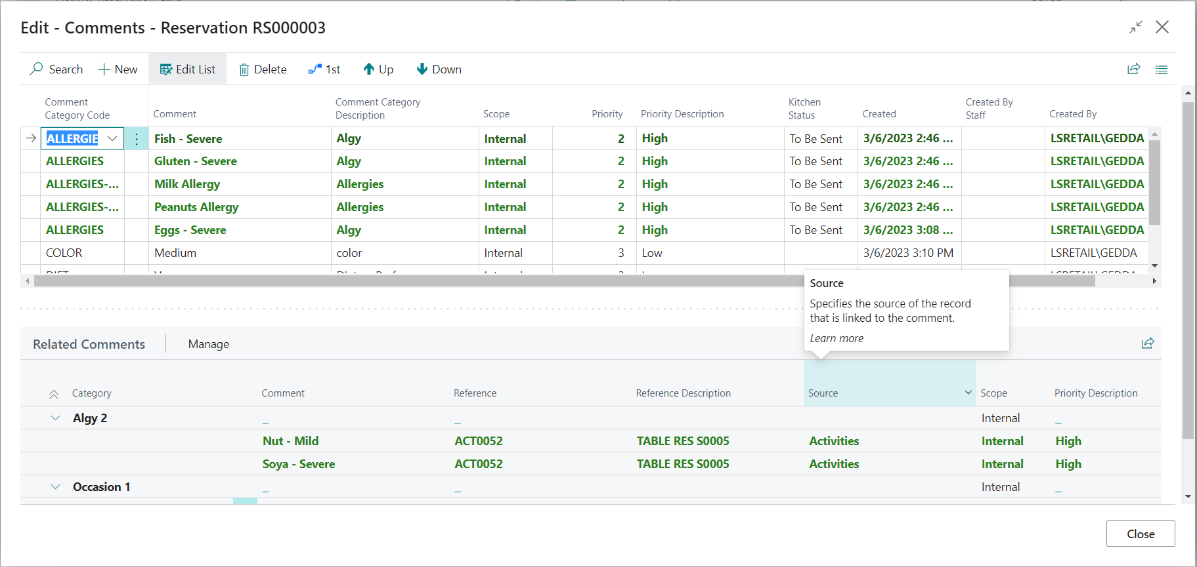

Slide 16
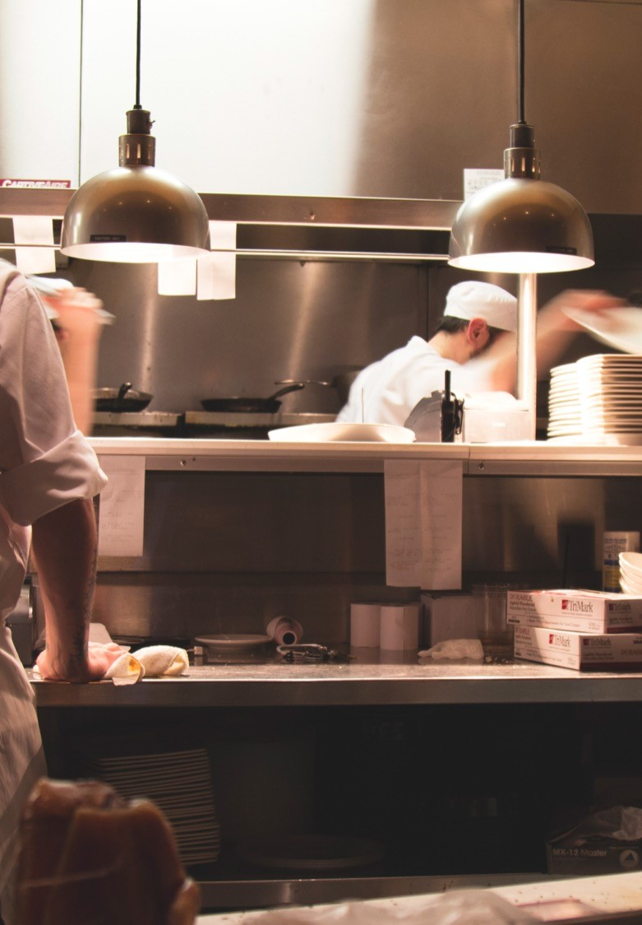
Kitchen Display System
Communication between FOH and BOH
Mix Display stations and Printer stations
Flexible setup for routing, functionality and UI
Works with BC in SaaS
KDS Web app
  Display Station web app
    Browser-based
    More flexibility on screen configuration
  KDS web app designer
    Enhanced
  Kitchen Service
    Enhanced performance

Slide 17
KDS Web App

Slide 18

LS Central for
Restaurants roadmap
QSR enhancements
KDS
Split larger tables in multiple parts
Allocate multiple reservations to a table
Allergens enhancements
Proactive allergens – warning on adding item
KDS Web Designer
KDS Web App
Coursing station
Change items/modifiers after sent to kitchen
Kiosk enhancements
Make it a meal
Cross-selling
Discounts
Accessibility
Deliveries and Call Center
Refine Deliveries order process
Move CC orders to FAB orders
Manage CC orders in FAB Host
Split Tables

Slide 20
Thank you

