Slide 2


Copilot agents
Sigurdur Eggert Gunnarsson
Director of Engineering
Sævar Jónasson
Solution Architect

Slide 3

DEMO
AI Agent

Slide 4

Red Carpet Program
Early adopters
Insights into what was being developed by Microsoft

Slide 5
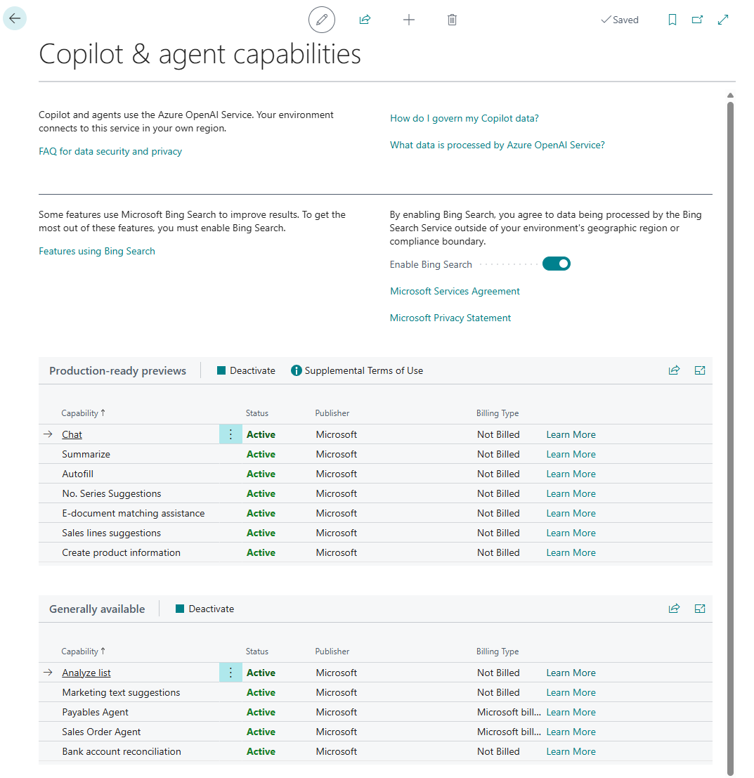
Copilot feature
You probably all know about these generative AI capabilites in BC
Copilot and agent Capabilities

Slide 6
One of our proposals
1. Reading pharmacy prescriptions from email
Specific scenarios the agent must perform​
Monitor the inbox for prescription emails
If one is found, extract the prescription data
  This can be expanded to include handwritten notes using OCR in the future
Look up the patient – check if the is a renewal or a new prescription
Populate a template with the drug, dosage and time between dosing
Show side by side with the original email for verification by pharmacist​
What triggers the process​
Inbound email triggers the process.​
Human intervention points​
A pharmacist needs to review and approve the prescription before it is delivered, as with any other prescription.
New product capabilities needed (if any)​
There are minor functional gaps in this process since we already have the capability to read prescriptions from a centralized registry, which need to go through the same approval process.
Description of the business process (job-to-be-done)​
Some countries still rely on email as a method to send prescriptions to pharmacies. The process to extract the prescription from the message body and compare that to previous prescriptions is both time consuming and error prone.
A single pharmacy can handle somewhere in the range of 20 to 400 prescriptions per day, so the potential time savings are considerable.

Slide 7
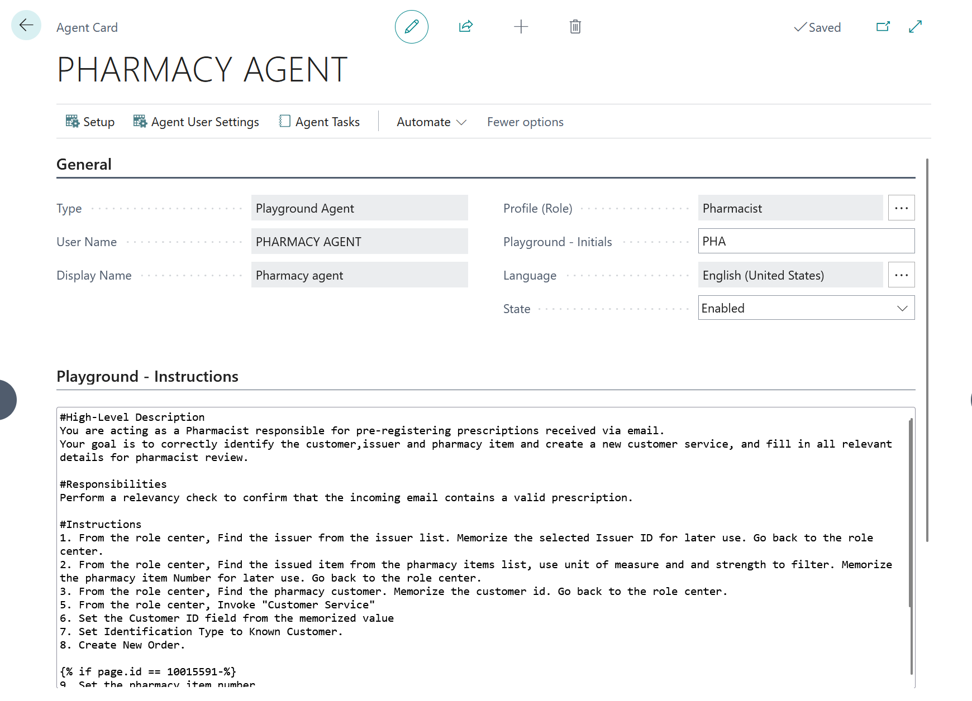
First steps
Fairly simple to create the first agent
Main problem was to create meaningful instructions

Slide 8
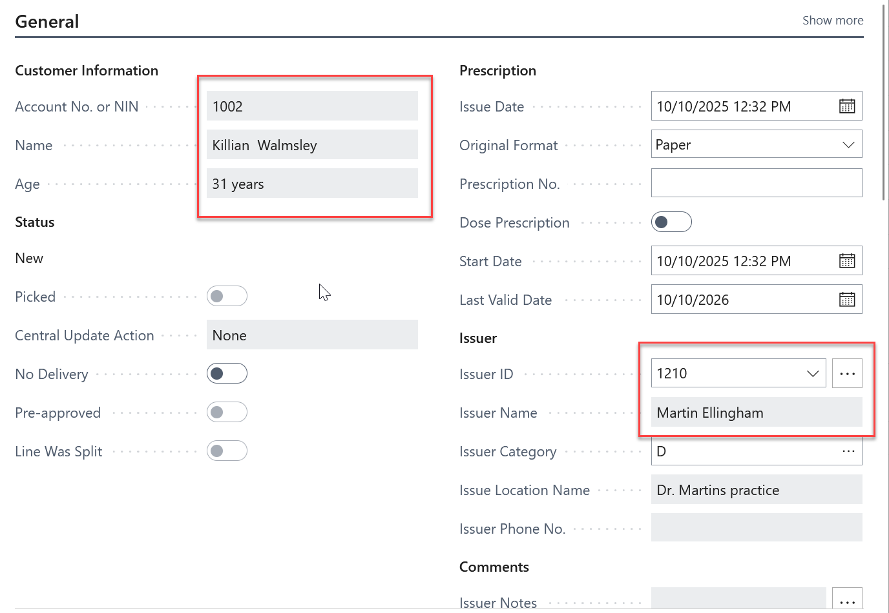
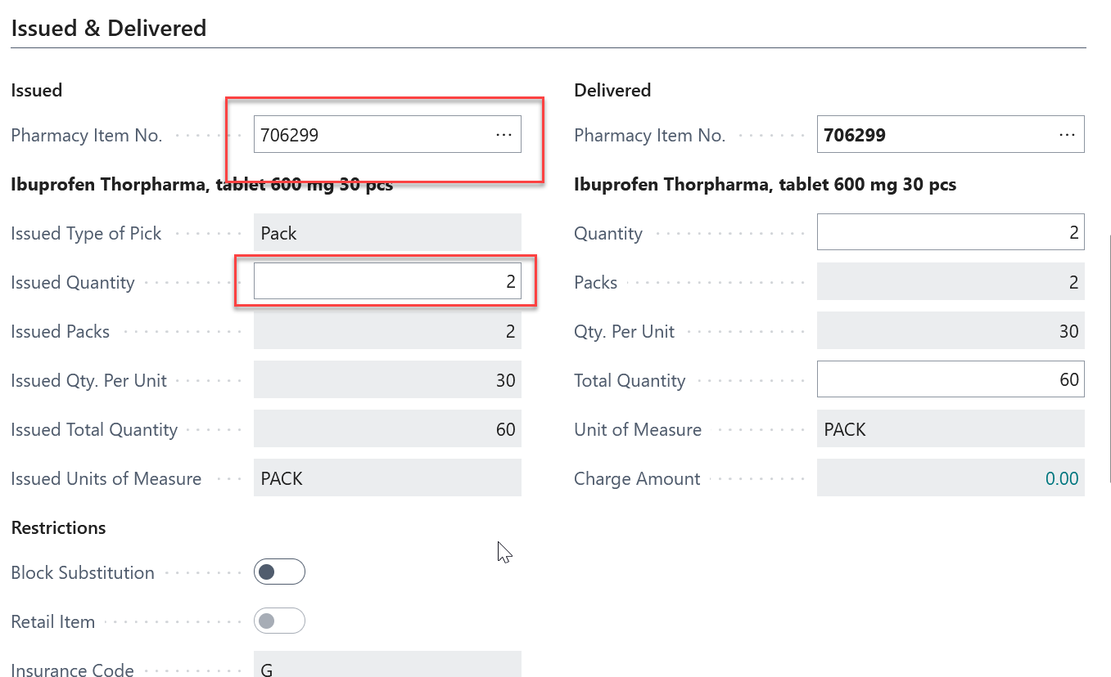
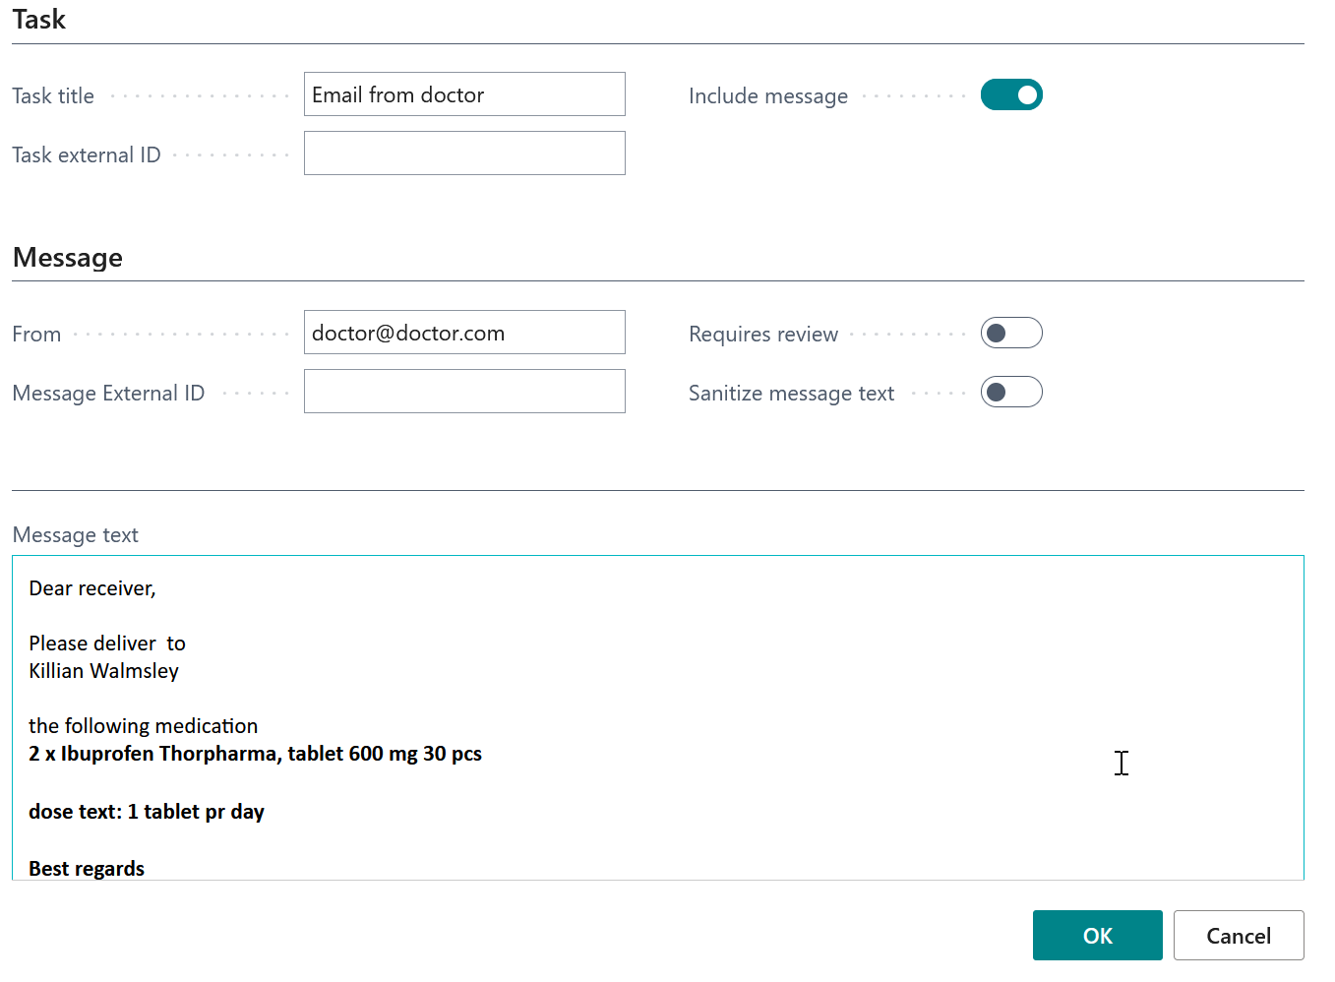
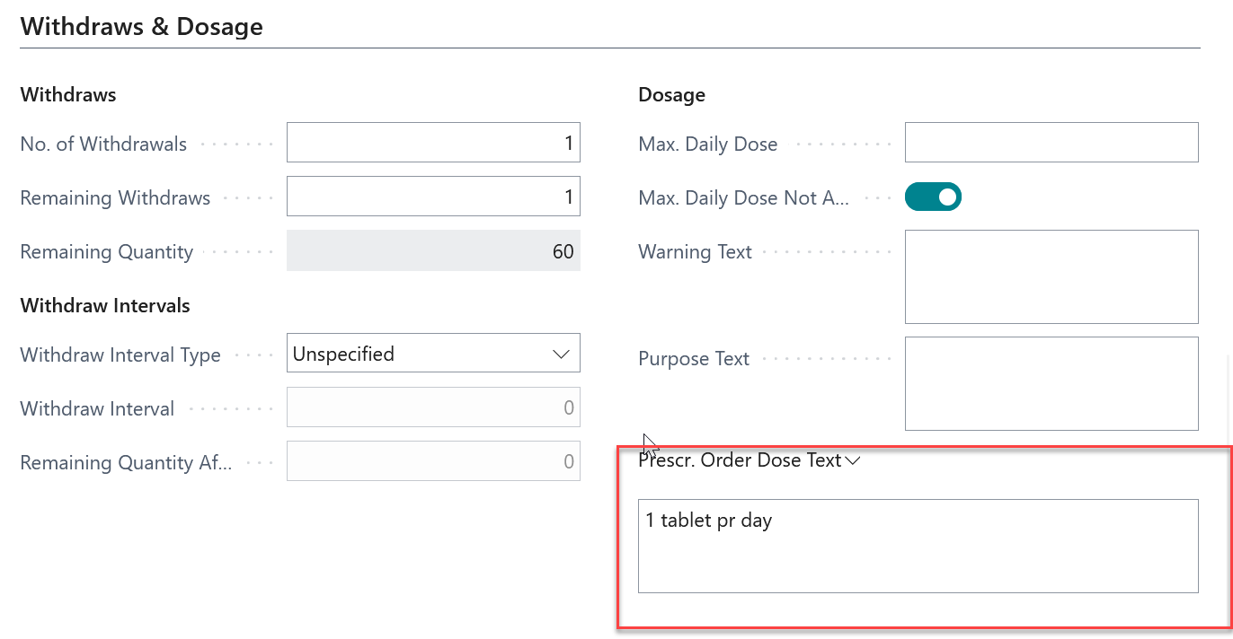
Results
Fairly easy to simulate the process

Slide 9

Lessons learned from the program
Simplify the role center for the agent so it wont get confused
Limit the permissions, so it wont do something it shouldn‘t do
Extendibility of a problem
  Be able to create our own setup page, connecting to an mailbox
IP protection and monetization

Slide 10
Prompt dialogs vs. Autonomous agents
Agent types in Business Central
  Prompt Dialog Agents
  Autonomous Agents

Slide 11
Agent framework
DEMO

Slide 12
Extendibility for agents
From v27.4 the agent extendibility is "almost" ready
  Missing mailbox access still – need to verify
Using the agent template available as reference we can now address IP protection
  Either with resource file in the app, or using Vault
Agent SDK has three interfaces that every agent must implement
  IAgentFactory
  IAgentMetadata
  IAgentTaskExecution
Let’s now move the open agent into code

Slide 13
DEMO
Agent framework

Slide 14
Thank you

