Slide 1
Winter, Spring, Summer and Fall
Replenishment for fashion
Martin Kleindl Product Director

Slide 3
Items Colors, Sizes Prepacks Seasons
Planning, Budgets, Open-to-Buy
Assortmt. Mgmt.
Allocation Plans, Purchase Orders
Replenish ment
Store Stock Redistribu- tion
End-of-Season Sales
Stock Recalls

Slide 4
Items Colors, Sizes Prepacks Seasons
Planning, Budgets, Open-to-Buy
Assortmt. Mgmt.
Allocation Plans, Purchase Orders
Replenish ment
Store Stock Redistribu- tion
End-of-Season Sales
Stock Recalls

Slide 5
Budgets and open-to-buy
Budgets with limitless levels and top-down and bottom-up approach
Features:
Calculate budgets from historical data
Master-child budget consolidation
Excel integration
Advanced copy features for budget versions
Budget breakdown to stores, items and days
Integration with automatic replenishment
Open-to-Buy calculation
Intergration
Budget
Budget
Automatic Replenishment
Bottom-Up (Consolidation)
Top-Down (Break down)
Budget Clothes
Budget Shoes
Break down to: - Stores - Items - Days
Budget Cloth-Men
Budget Cloth-Women

Slide 6
Items Colors, Sizes Prepacks Seasons
Planning, Budgets, Open-to-Buy
Assortmt. Mgmt.
Allocation Plans, Purchase Orders
Replenish ment
Store Stock Redistribu- tion
End-of-Season Sales
Stock Recalls

Slide 7
Assortment management
Easy and powerful assortment management with top-down approach and inheritance
Drastically reduces effort and cost for maintaining assortments
Full transparency
Reduces risk of failure with versions and assortment history
Supports grading
Assortment
Items
Stores

Slide 8
Live Demo

Slide 9
Items Colors, Sizes Prepacks Seasons
Planning, Budgets, Open-to-Buy
Assortmt. Mgmt.
Allocation Plans, Purchase Orders
Replenish ment
Store Stock Redistribu- tion
End-of-Season Sales
Stock Recalls

Slide 10
Manual replenishment
Processes for seasonal/one-time items
Concepts
Plan/rule driven with Fashion Matrix
Push-principle
Allocation rules (distribution rules for stores)
Variant weight curves (distribution rules for sizes, colors, …)
Processes
Allocation Plan
Buyer’s Push
Manual Purchase & Transfer Orders
Vendor A
Purchase and/or Push
Warehouse 1
Store 1
Store 2
Store 3

Slide 11
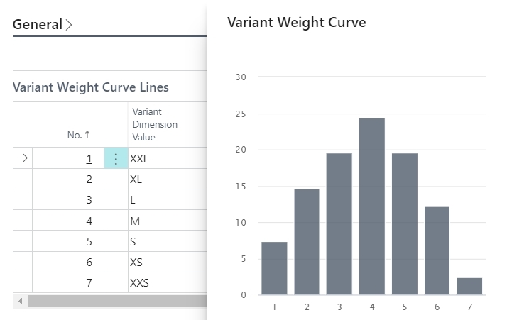
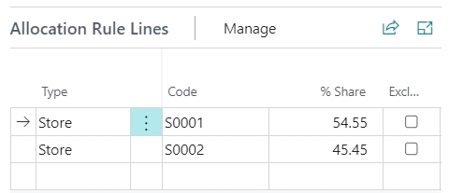
Allocation & Variant Rules
Distribute items to stores based on store allocation rules and size/color weight curves
Calculation of size/color distribution from historical sales data
Based on item categories and product groups
Geographical influence factors (distribution curves on global stores and store groups level)

Slide 12
Items Colors, Sizes Prepacks Seasons
Planning, Budgets, Open-to-Buy
Assortmt. Mgmt.
Allocation Plans, Purchase Orders
Replenish ment
Store Stock Redistribu- tion
End-of-Season Sales
Stock Recalls

Slide 13
Automatic replenishment
For reoccurring items
Concepts
Demand driven
Pull-Principle
Multiple warehouses
Different item flows
Multiple calculation methods
Processes
Periodic calculation of stock and demand across the supply chain
Proposals for transfers and purchases
Automatic or manual document creation and processing
To warehouse with Xdocking
To store
To warehouse
Vendor A
Vendor B
Vendor C
Warehouse 1
Warehouse 2
Store 1
Store 2
Store 3
Store 4
Store 5

Slide 14
Live Demo

Slide 15
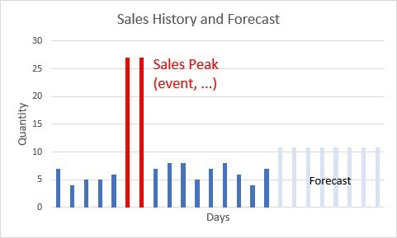
Important concepts
Planned Sales Demand
Plan future events that have a demand impact
Adjust expected sales and replenishment
Sales History Adjustment
Simulate sales history for new items
Simulate sales history for new stores
Correct biased sales history (peaks, etc.)
Out-of-Stock Management
Monitor and track Out-of-Stock situations
Consideration in demand forecasting
Handling of warehouse shortages

Slide 16
Items Colors, Sizes Prepacks Seasons
Planning, Budgets, Open-to-Buy
Assortmt. Mgmt.
Allocation Plans, Purchase Orders
Replenish ment
Store Stock Redistribu- tion
End-of-Season Sales
Stock Recalls

Slide 17
Store stock redistribution
WHSE
Store 5
Easy, simple, fast approach
Define allowed routes to avoid non efficient transfers
Calculation of overstocked and understocked stores
Selection of redistribution strategy
Proposal of optimal Transfer Order combinations with integration to Bing maps (route planning)
Elimination of non efficient proposals
Creation of Transfer Orders
Store 4
Store 1
Store 2
understocked
overstocked
Store 6
Store 3
overstocked

Slide 18
Live Demo

Slide 19
Items Colors, Sizes Prepacks Seasons
Planning, Budgets, Open-to-Buy
Assortmt. Mgmt.
Allocation Plans, Purchase Orders
Replenish ment
Store Stock Redistribu- tion
End-of-Season Sales
Stock Recalls

Slide 20
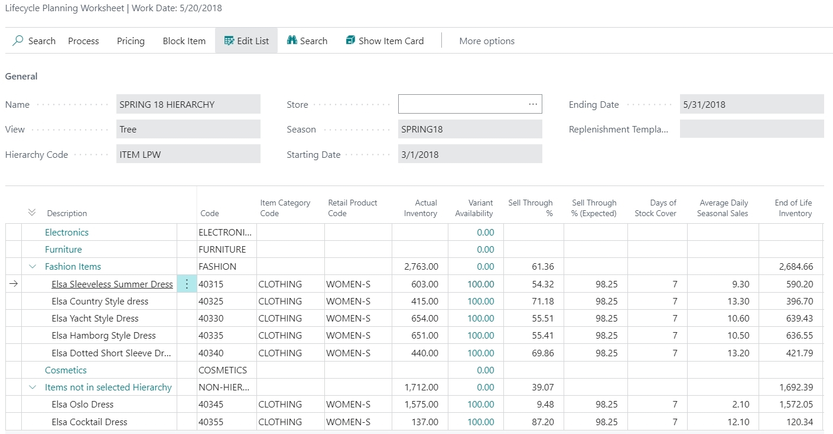
Lifecycle worksheet
Business goal:
Provide an overview of inventory, sell-through and
variant availability for seasonal items
Easy detection of stock-outs
Easy detection of slow selling items
Easy workflows
Block from purchasing
Apply new price or discount to increase sales
END of SEASON SALE

Slide 21
Lifecycle worksheet
Business goal:
Provide an overview of inventory, sell-through and
variant availability for seasonal items
Easy detection of stock-outs
Easy detection of slow selling items
Easy workflows
Block from purchasing
Apply new price or discount to increase sales

Slide 22
Lifecycle worksheet
Apply Discounts
Apply new (lower) Prices
Business goal:
Provide an overview of inventory, sell-through and
variant availability for seasonal items
Easy detection of stock-outs
Easy detection of slow selling items
Easy workflows
Block from purchasing
Apply new price or discount to increase sales

Slide 23
Items Colors, Sizes Prepacks Seasons
Planning, Budgets, Open-to-Buy
Assortmt. Mgmt.
Allocation Plans, Purchase Orders
Replenish ment
Store Stock Redistribu- tion
End-of-Season Sales
Stock Recalls

Slide 24
Manual replenishment
Processes for seasonal/one-time items
Concepts
Plan/rule driven
Push-principle
Allocation rules (distribution rules for stores)
Variant weight curves (distribution rules for sizes, colors, …)
Processes
Stock Recall
Manual Transfer Orders
Vendor A
Recall
Warehouse 1
Store 1
Store 2
Store 3

Slide 25
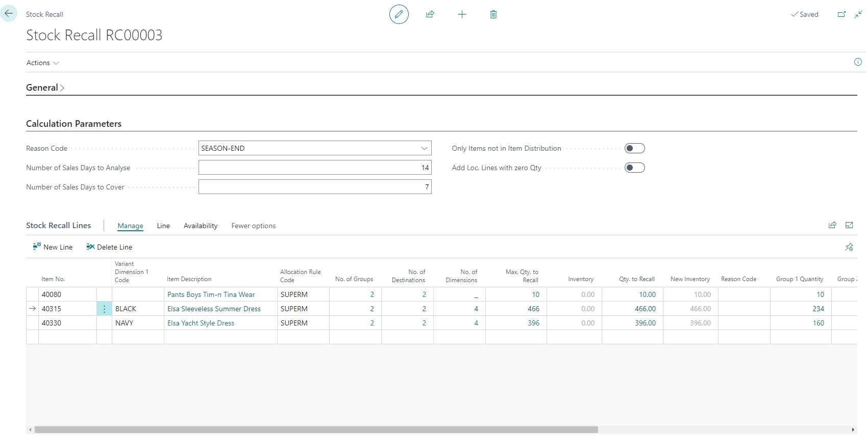
Stock Recall

Slide 26
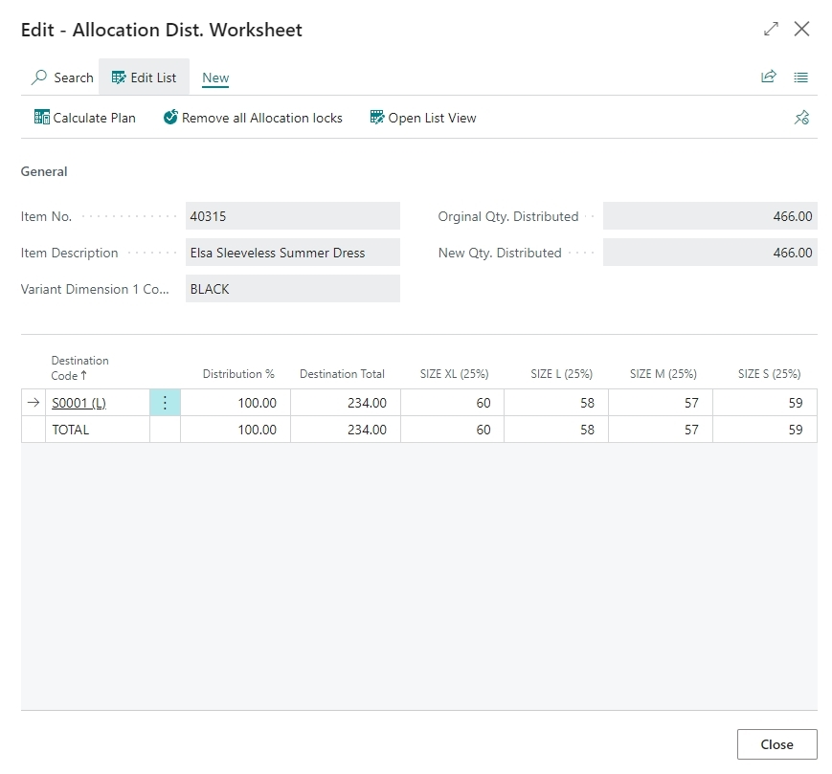
Stock Recall

Slide 27
Items Colors, Sizes Prepacks Seasons
Planning, Budgets, Open-to-Buy
Assortmt. Mgmt.
Allocation Plans, Purchase Orders
Replenish ment
Store Stock Redistribu- tion
End-of-Season Sales
Stock Recalls

Slide 28
Replenishment
Planning & Data Maintenance
Manual Replenish- ment
Automatic Replenish- ment
Execution
Monitoring
Sales & Purchase Budgets
Allocation Plans
Buyer‘s Push, Stock Recall
Allocation Rules
Variant Weight Dim. Pattern
Demand Forecasts
Store Stock Redistribution
Purchase & Transfer Orders
Stock Requisition
Buyer‘s Workbench
Inventory and Demand
Store Capacity
Stock Coverage
Vendor Performance
Open to Buy
Assortment Mgmt.
Lifecycle Mgmt.
Replenishment Journal Calculation
Threshold Mgmt.
Lifecycle Planning WS
Cross Docking
Manual Purch. & Transfer Orders
Replen. Item Quantity Calculation
Out-of-Stock Calculation
Item Import

Slide 29
More functionality
Stock Coverage Management
Capacity Management
Item Import
Vendor Performance Measurement
Roadmap
Prepack improvements
Enhanced Season Management

Slide 30
Of course, you can!

Slide 31
Thank you

