Slide 2
Migrate to the latest Kitchen Display System
Anna Kristin
Wesley
Jeppesen
Silva

Slide 3

Have you heard about the Web KDS?
New kitchen display system
First release - LS Central 25.0
Browser based
Hardware agnostic

Slide 4
Basic functionality
Hardware
Printers
Display
Bumpbars
Sounds
Screen for upcoming orders
Preparation stations
Routing by
Items – Item hierarchy
Sales types
Terminals
Customer facing display
Expeditor

Slide 5
System overview
POS
Printers
Hardware
station
Multiple Business Central
Service Tiers
Kitchen screens
Business Central
Service Tier
Kitchen
Service
eCommerce

Slide 6
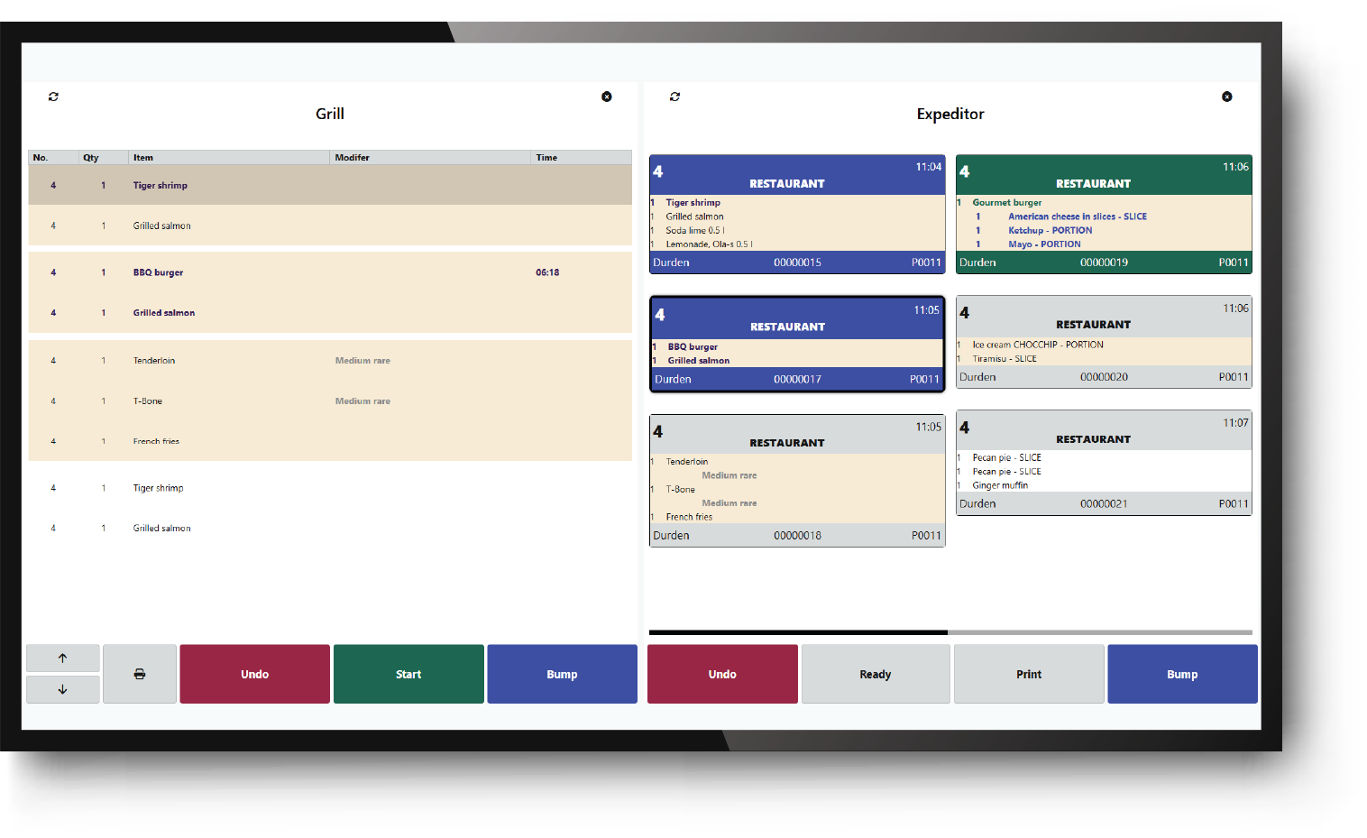
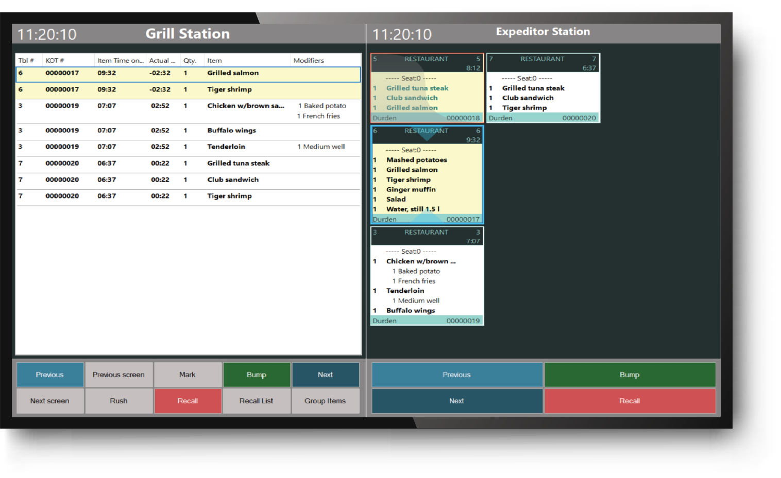
Web KDS vs Standard KDS comparison

Slide 7
Comparison
Web KDS
Standard KDS
Hardware agnostic
Windows
Routing on service side
Routing in LS Central
Flexible styling
Limited styling
CFD configurability
CFD Prep screen & Ready
Custom operations
No customizations
Configurable print layout
Print layout defined in code
Media component
No images
Connect to multiple
BC instances
Only one source

Slide 8
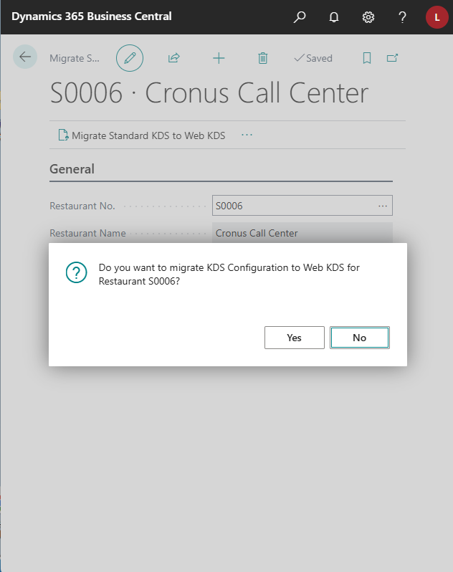
Migration tool
Migrates kitchen display stations
  Copies routing setup
Migrates queue profiles
  (aggregate profiles)
Creates a set of default profiles

Slide 9

How to get started
Checklist
Run migration tool
  Check stations
  Restaurant stations
Install Web KDS
Connect to LS Central
Check routing
Send an order
After migration
Create screens
Import profiles from demo data

Slide 10
DEMO
Migration in action

Slide 11

Latest news highlights – Versions 27 & 28
Media panel
Preparation instructions
Conditional styling
Pushing out KOTS through external events
Priority routing
Custom operation
Multiple instances

Slide 12
DEMO
Web KDS in action

Slide 13

Performance improvements
Added better logic for routing
Implemented queues to feedback information to BC/LS Central
Removed the use of history tables
Refactored the Update Stations logic; now it only updates if new KOT or Bump in stations
Separated background works to update panels

Slide 14
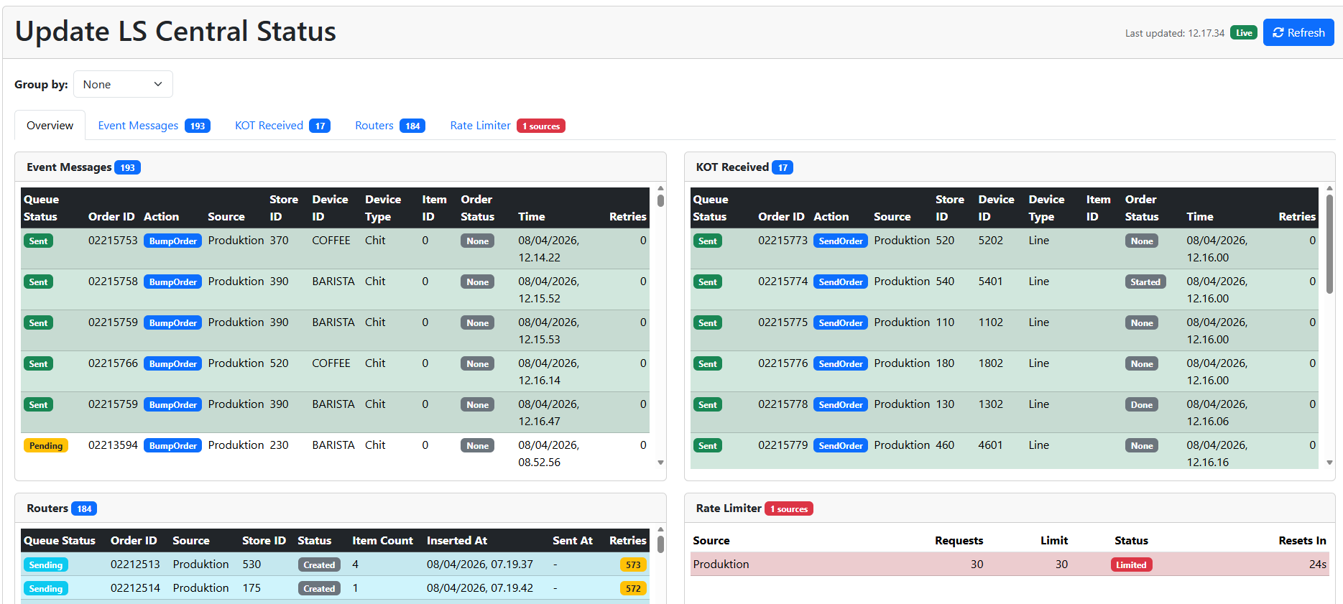
Performance improvements

Slide 15
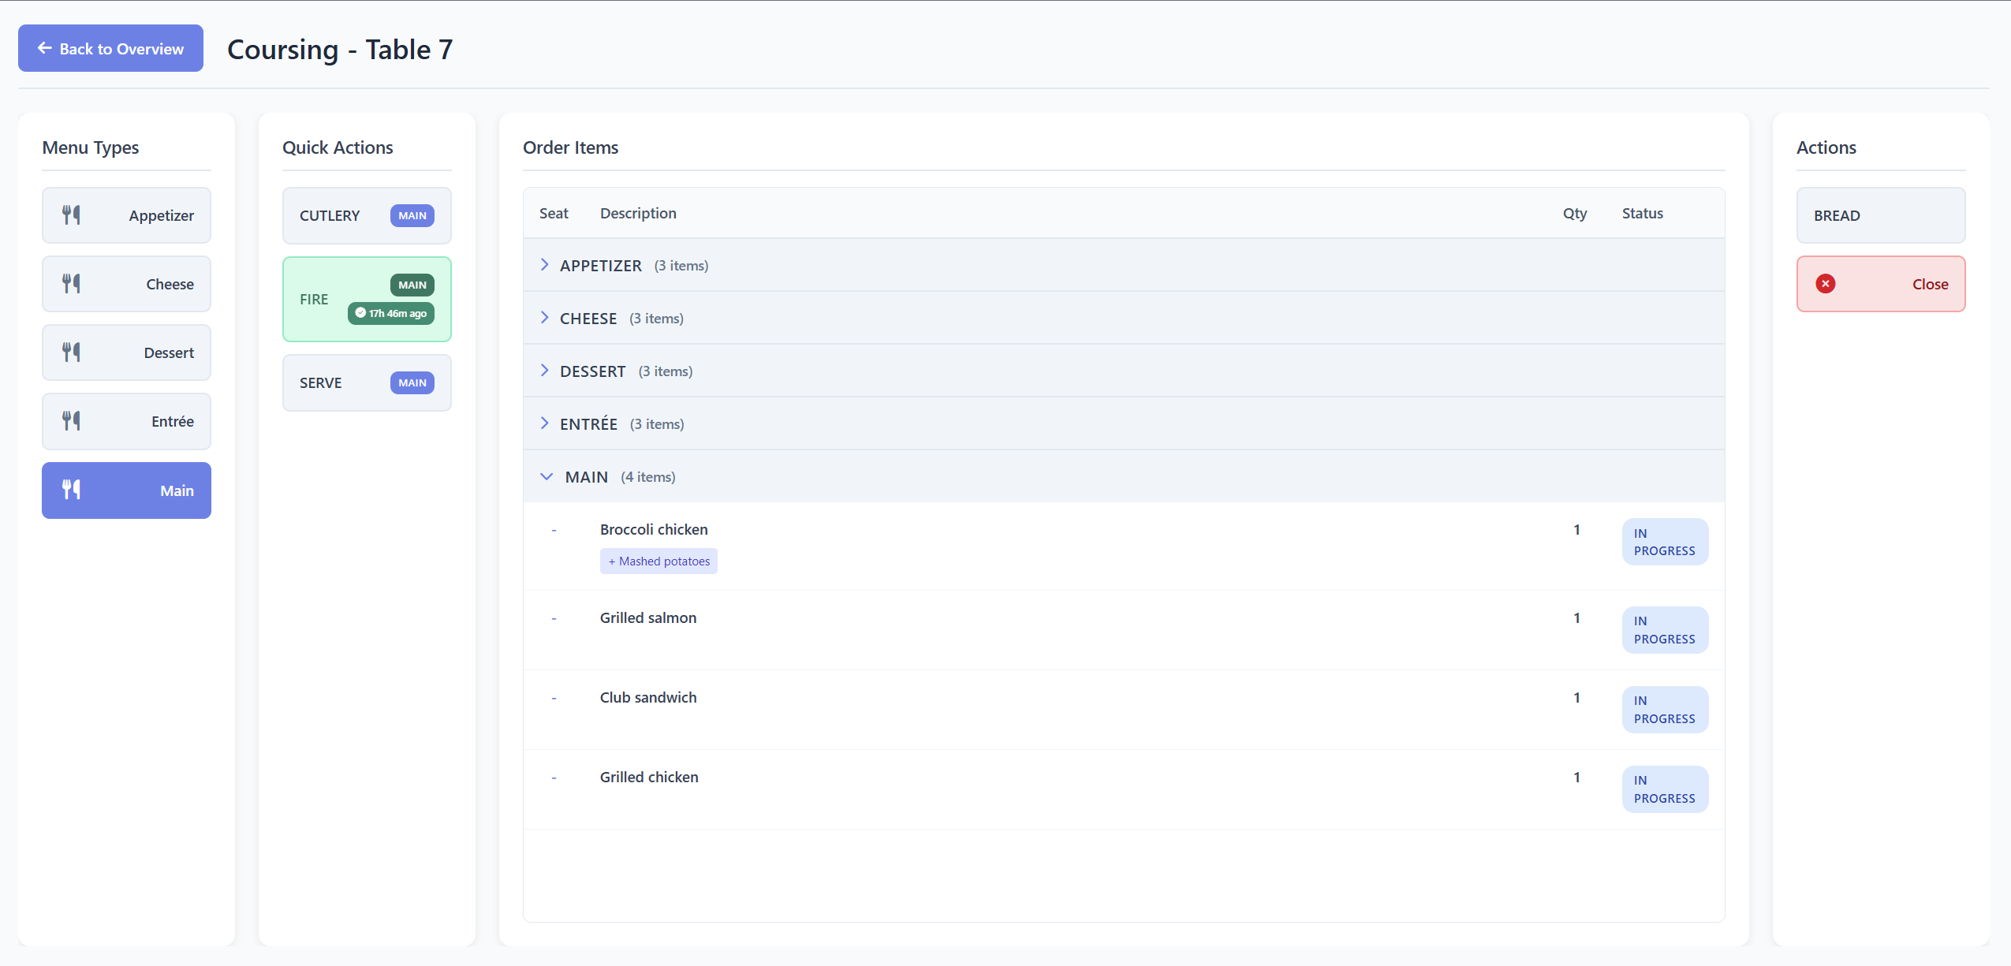
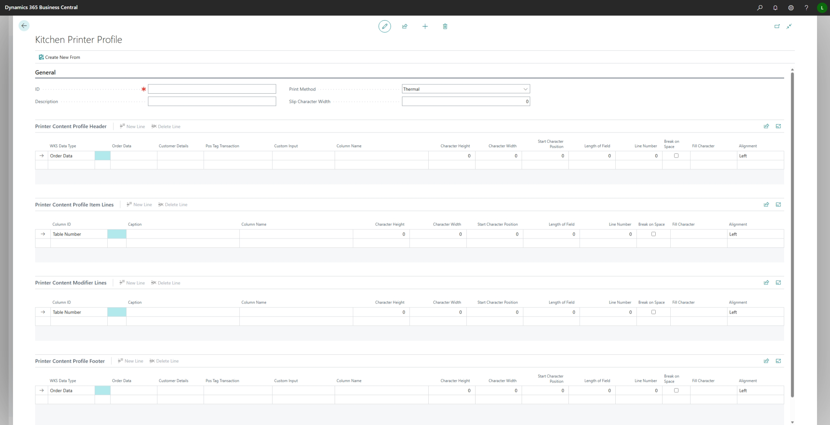
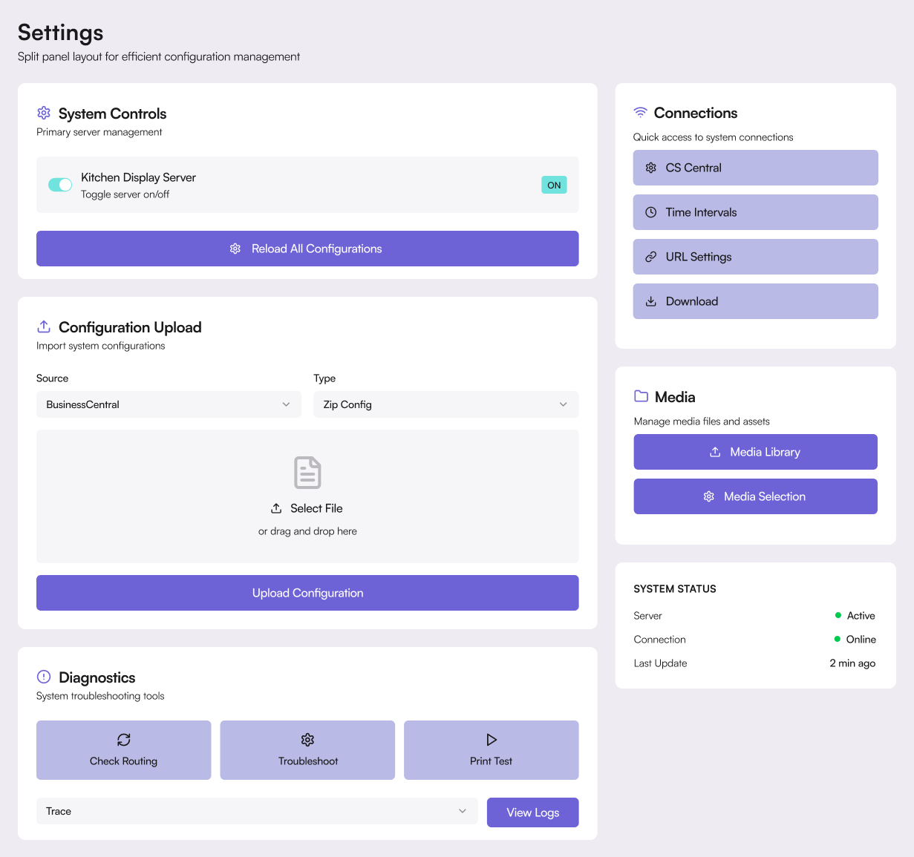
Roadmap version 29
Coursing display
Configuration panel redesign
KOT Print Configurations

