Slide 1
LS Central SaaS
Onboarding Process and Support
Aðalbjörg Karlsdóttir – Onboarding Lead Guðrún Ólafsdóttir – Product Director Gunnar Ingimundarson – Chief Consulting Officer

Slide 2
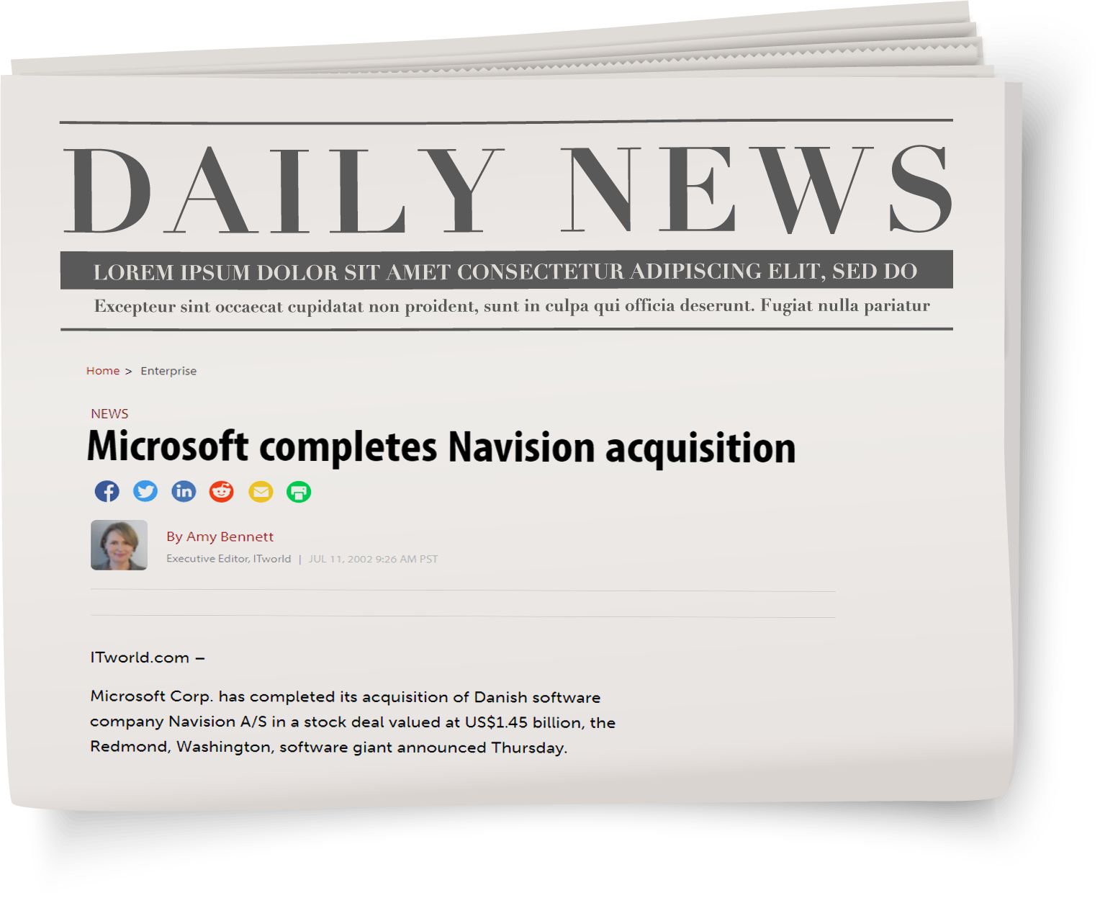

Slide 3
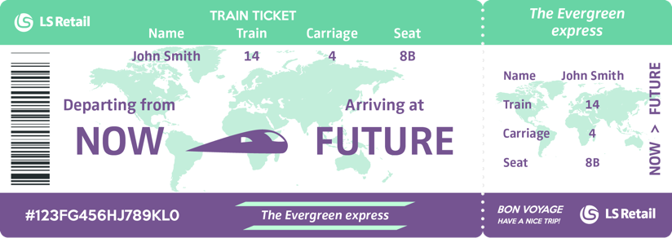
The Evergreen train
Get your ticket now!

Slide 4
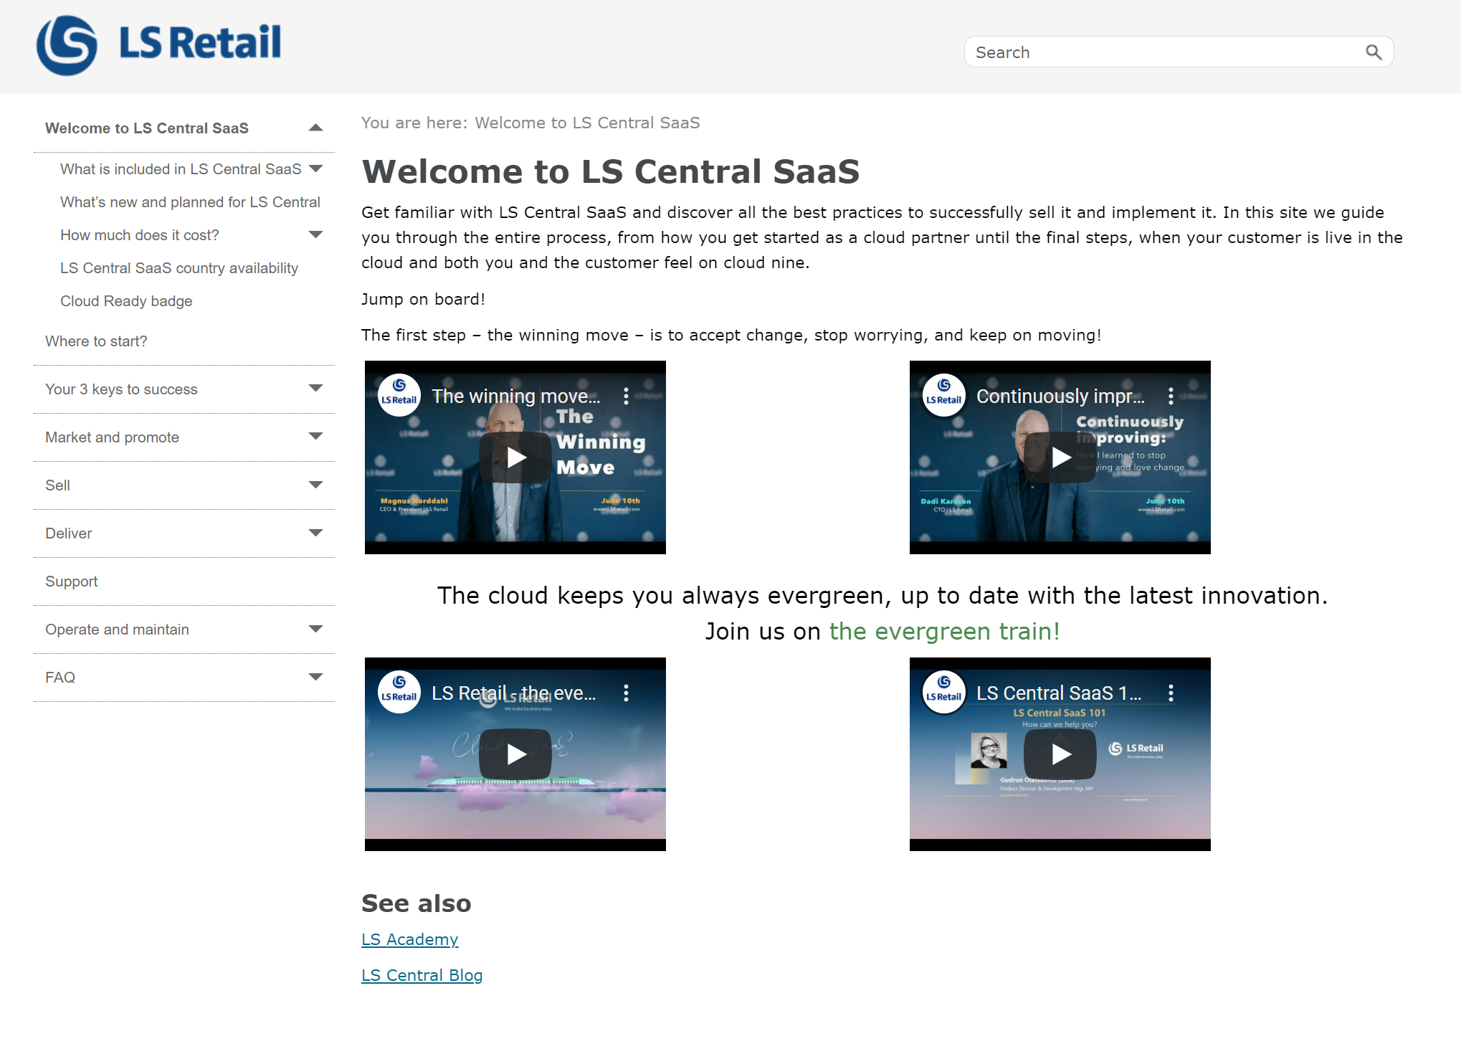
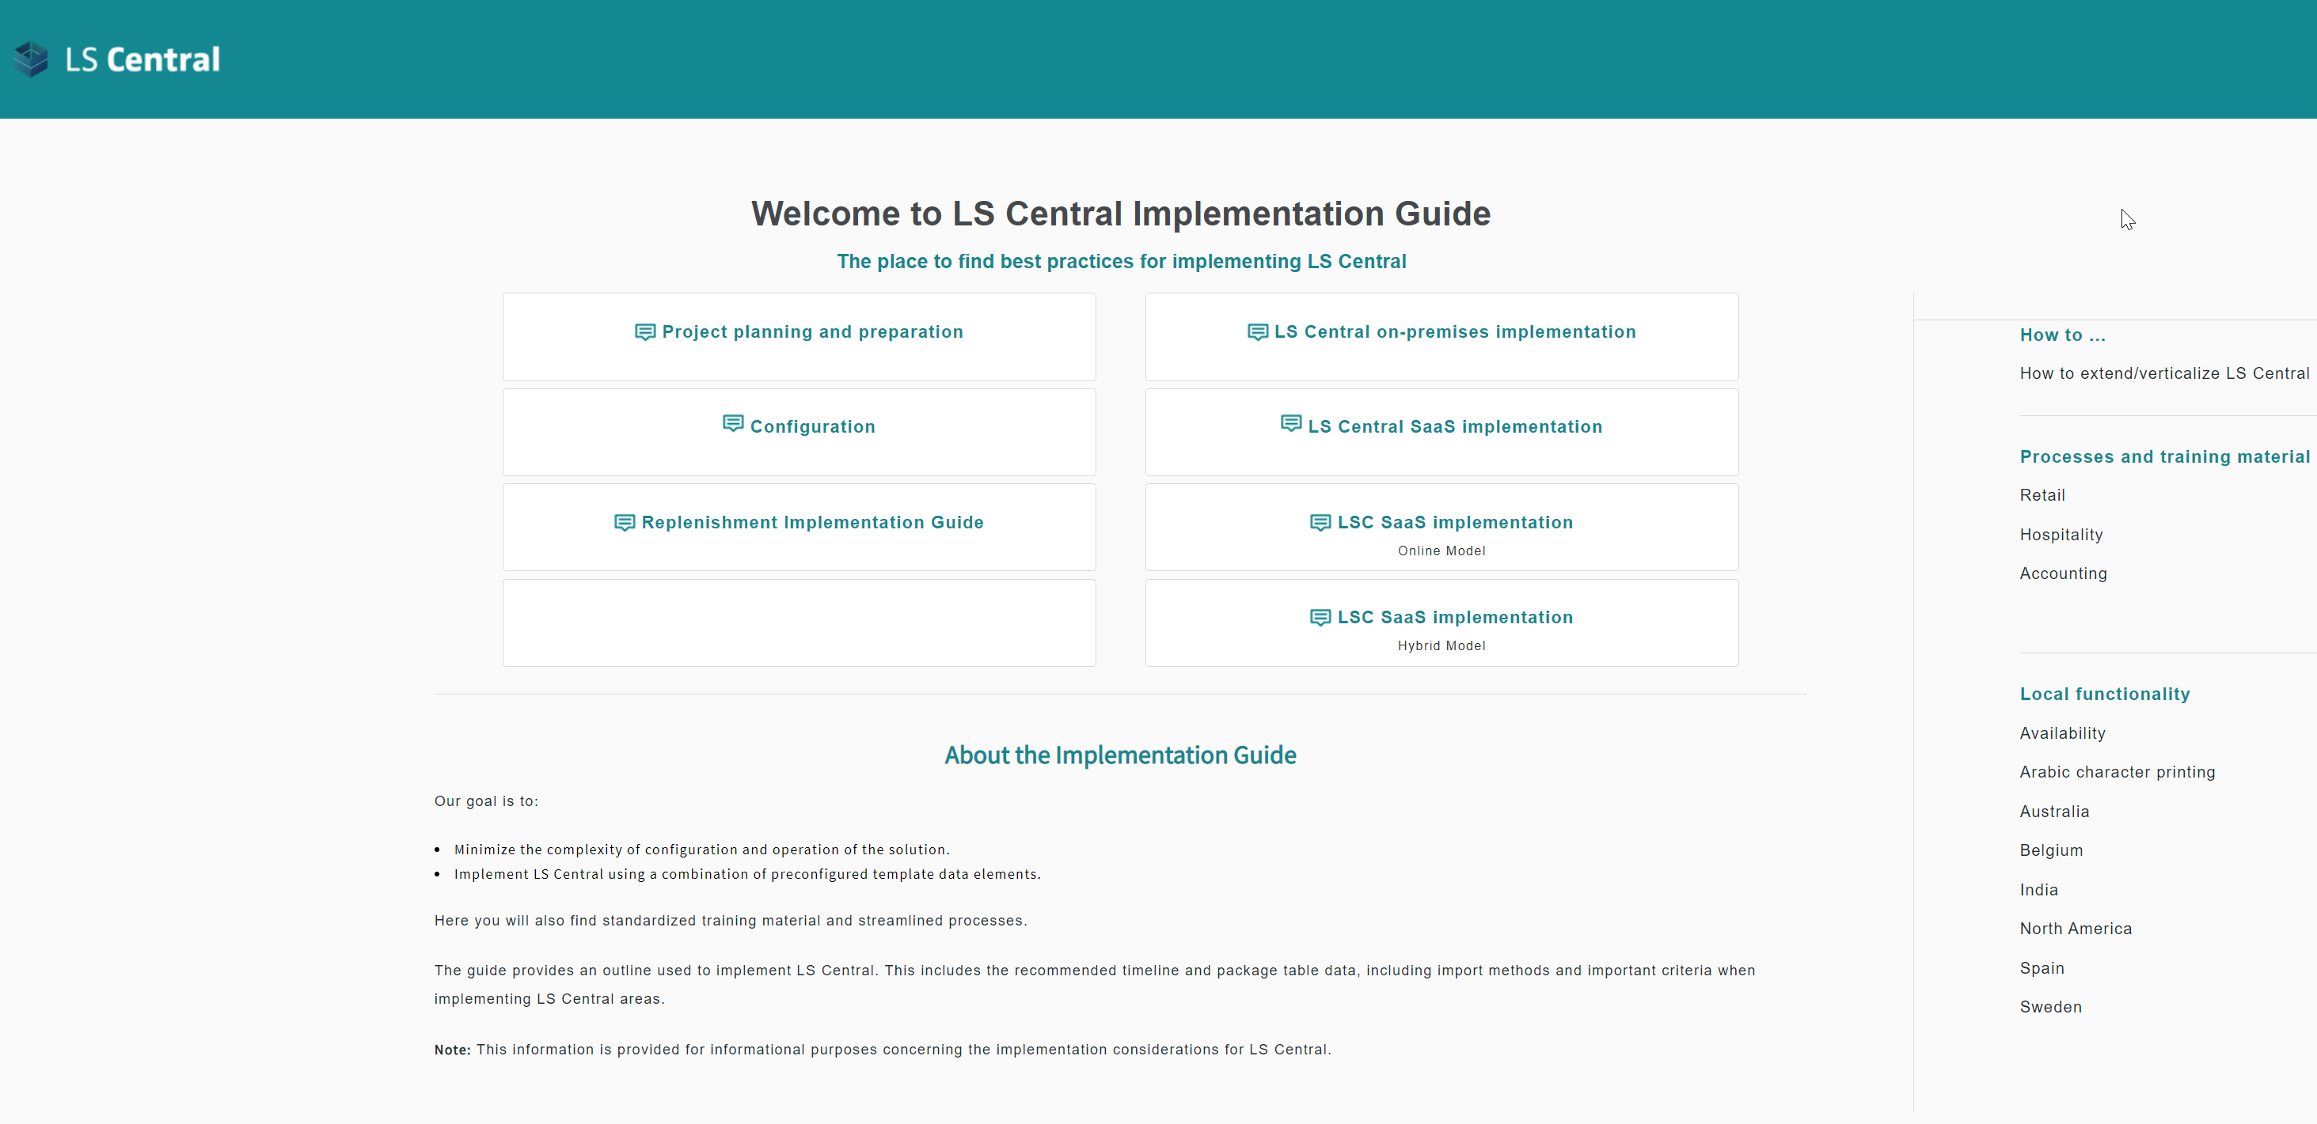
Get familiar with guides on LS Central SaaS
Onboarding Guide (Where to start) portal.lsretail.com/products/ls-central/ls-central-saas/
Implementation guide (How to implement) helplscentralimplement.lsretail.com

Slide 5
Before you start the journey

Slide 6
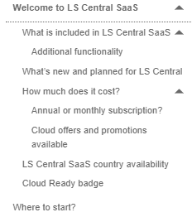
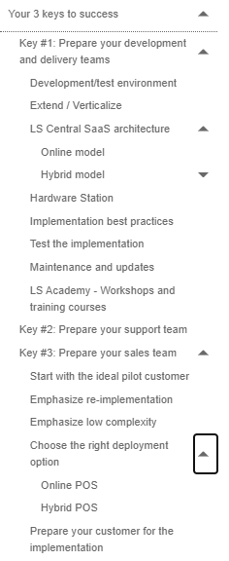
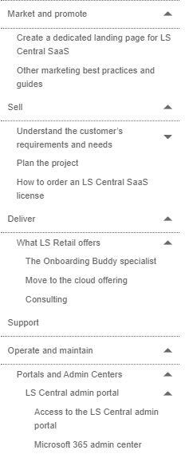
Plan
Prepare
Go

Slide 7
Clarity brings mastery
This is LS Central SaaS
Implementation
Guidelines
LS Retail
Portal
Microsoft
docs.
Online help

Slide 8
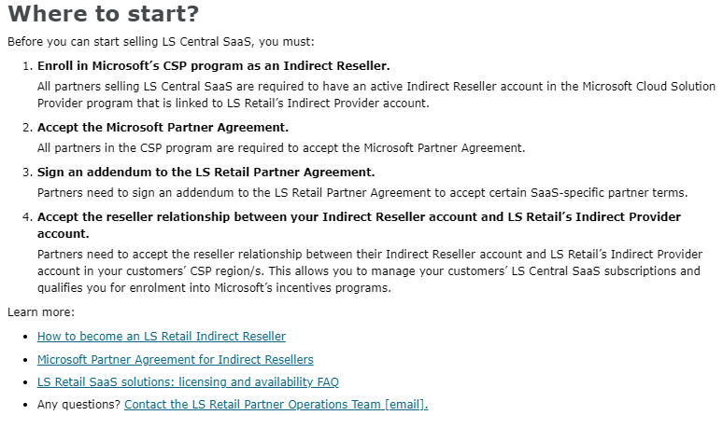
Get familiar with the travel destination

Slide 9
Plan your trip and prepare
Your 3 keys to success
Prepare your development and delivery teams
Prepare your support team
Prepare your sales team

Slide 10
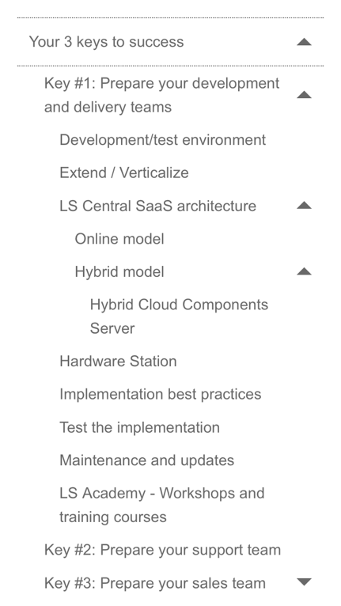
Key #1
Prepare your
development and
delivery teams
LS Retail can help
LS Central Base Training!

Slide 11
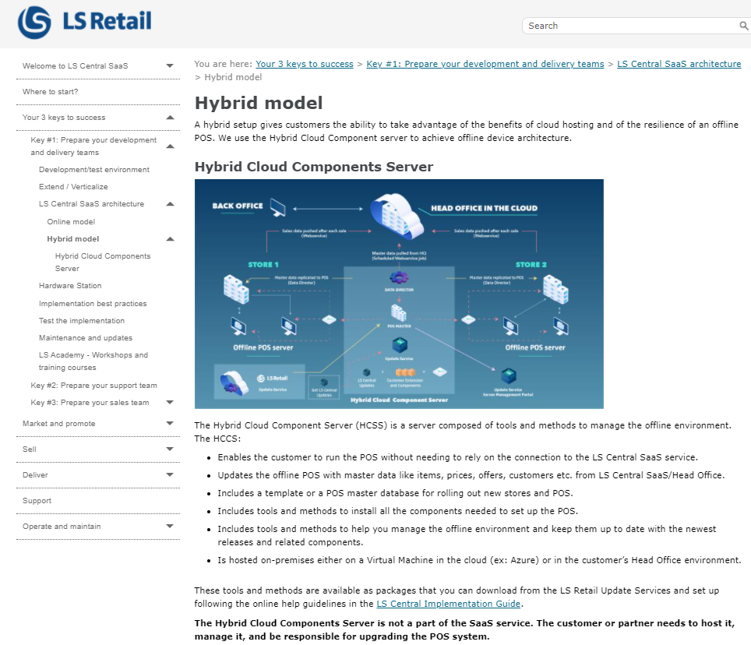
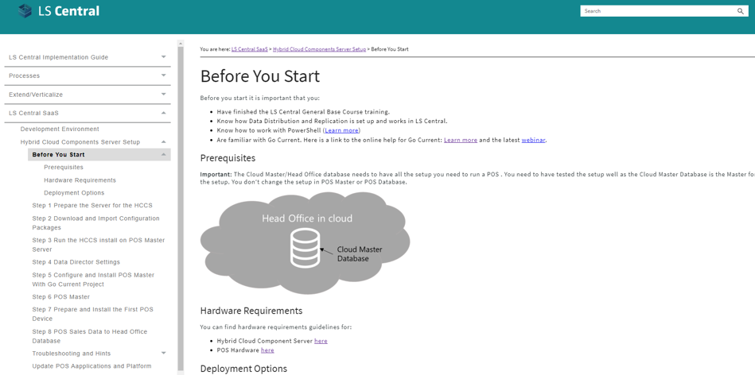

Slide 12
Key #2
Prepare your
support team

Slide 13
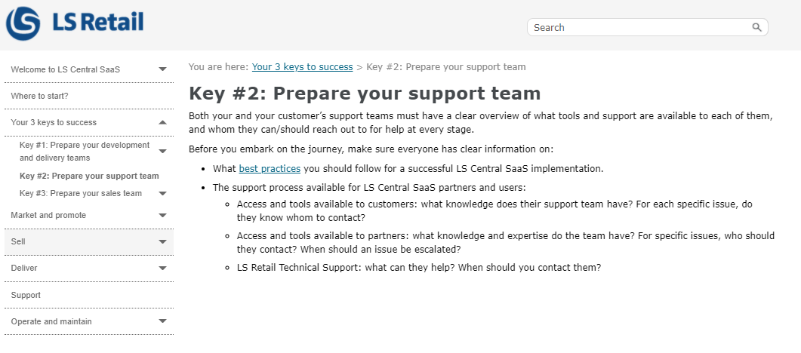

Slide 14
Key #3
Prepare your
sales team

Slide 16
Product knowledge
Active Listening
Effective Communication

Slide 17
Partner onboarding
100
LS Central SaaS private partner onboarding sessions in 2021-2022

Slide 18
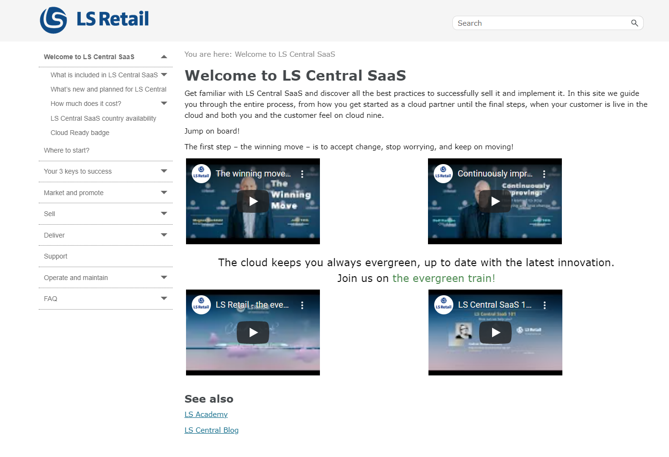
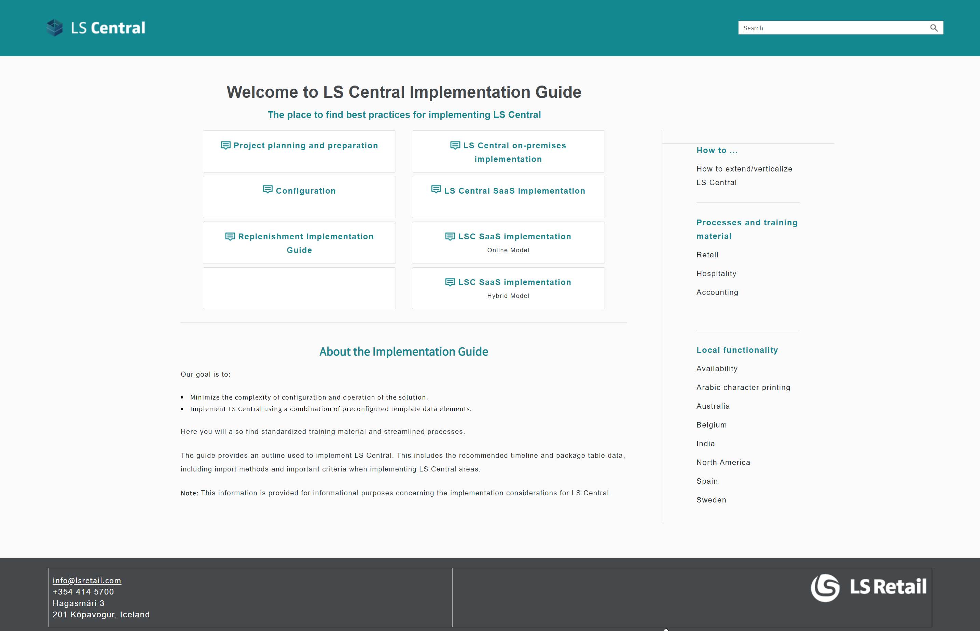
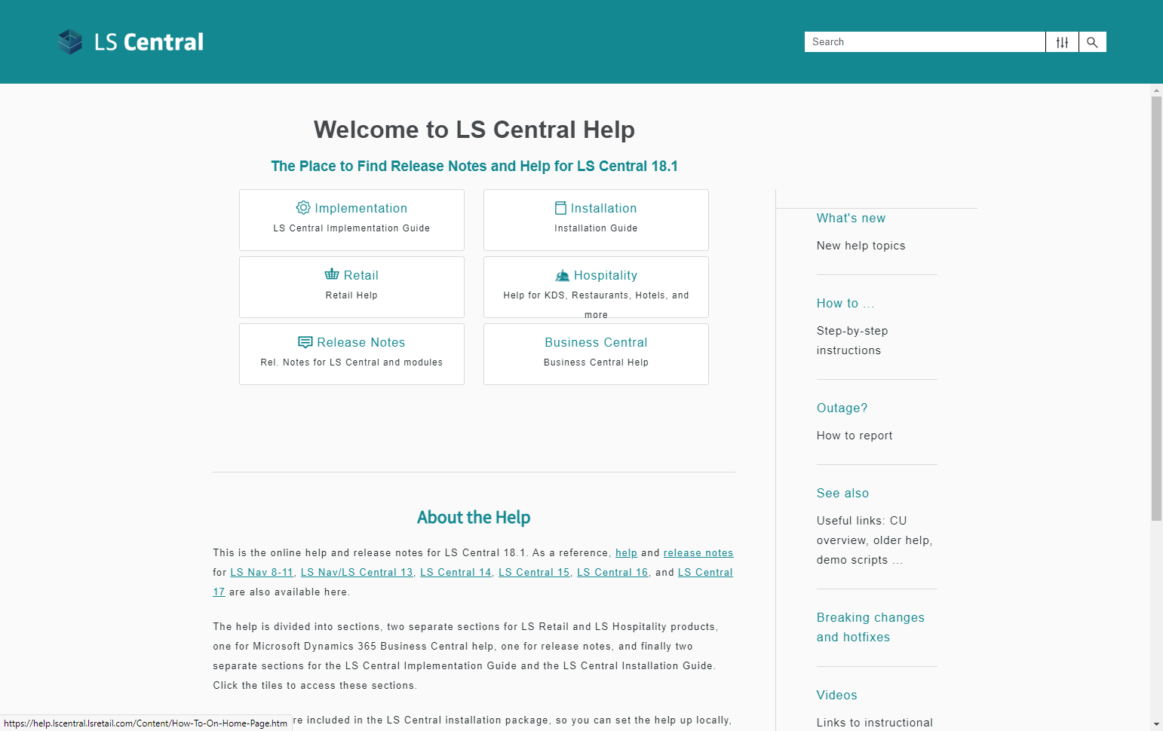
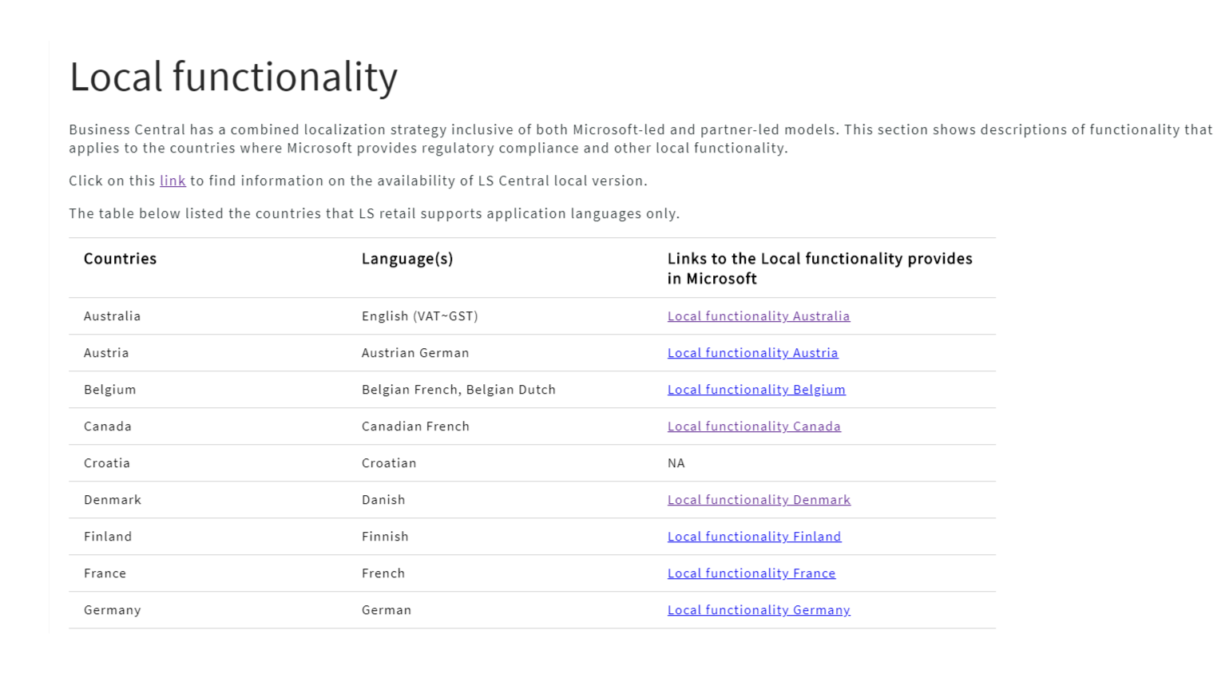
Training Material
Partner / Customer
Onboarding Material
Feedback
LS Academy
Sales
Partner Operations
Consulting
Technical Support
Partner onboarding

Slide 19
LS Retail Academy - Training
At the end of this course, participants should be able to set up, implement and operate the LS Central SaaS.

Slide 20
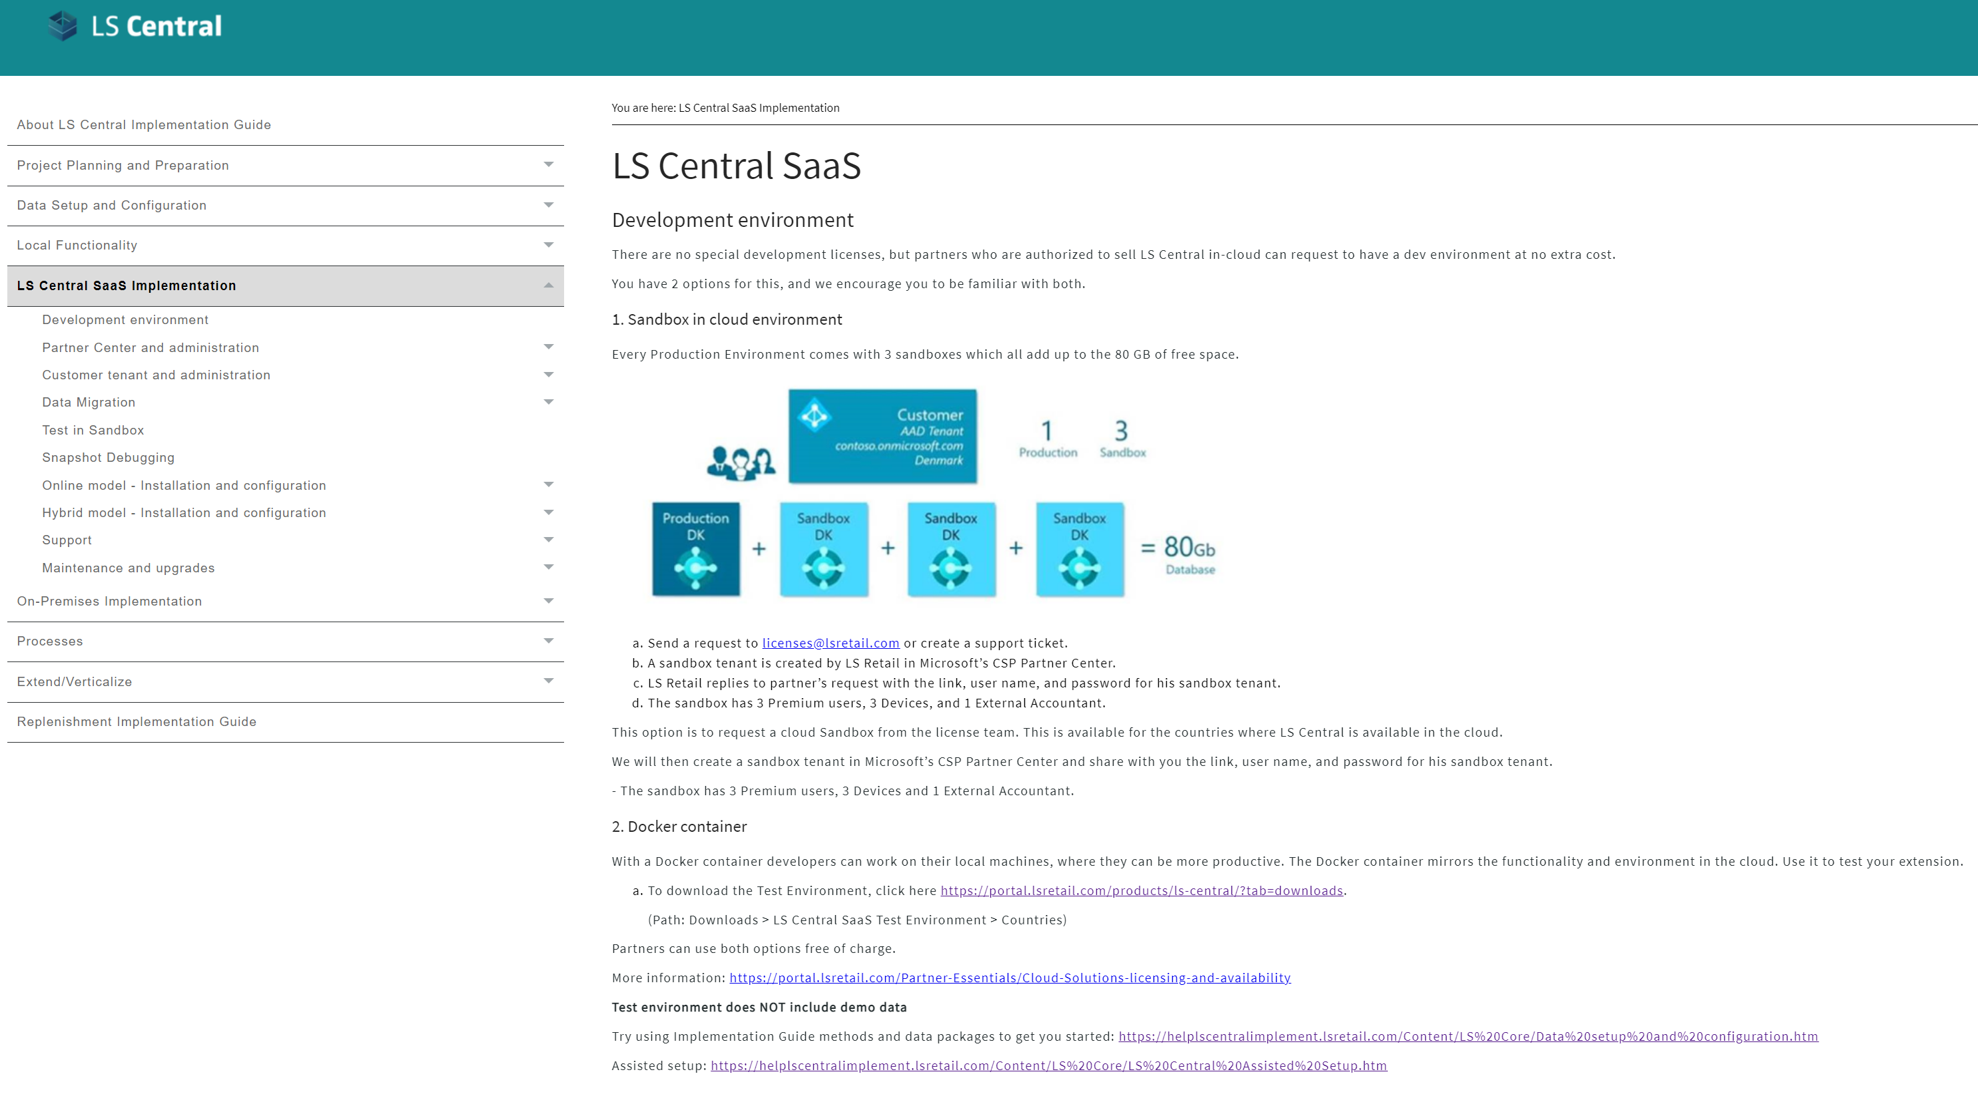
Implementation Guide

Slide 21
CAP - Mission
To:
Assist partners in implementing their first LS Central SaaS project in the form of online workshops & meetings
Educate partners and make them ready to do onward LS Central SaaS implementations on their own, as the partners will be doing the hands-on work or learning by doing.
Do our best to make our partners comfortable with the SaaS environment
Improve LS Central SaaS guidelines
Exclude no one - consider all
Alla - our onboarding buddy

Slide 22
Go

Slide 23
Partners journey to SaaS
Phase 1 – CSP Partner
CSP
Overview
Training

Slide 24
CAP
Cloud Acceleration Program

Slide 25
Partners journey to SaaS
Phase 2 – Cloud Acceleration Program (CAP)
Onboarding with Buddy Support
SaaS License
SaaS Project Evaluation Meeting
Guided Onboarding
Onboarding with Consulting Team

Slide 26
Onboarding with Buddy Support
Ad hoc support
Teams sessions
Support option for experienced partners

Slide 27
Onboarding with Buddy Support
Ad hoc support
Teams sessions
Support option for experienced partners

Slide 28
By using the SaaS support provided by LS Retail we have been able to address issues quickly and effectively without the need to spend too much time on analyzing the matters. The onboarding buddy team is experienced, has been working on numerous projects and is usually quick to point out what needs to be done – pointing us in the right direction.
Janus Lund-Larsen DXCa

Slide 29
CAP – Guided Onboarding
Migration
Test environment

Slide 30
CAP – Guided Onboarding
First Store/ POS
Q&A Session
Migration
Test environment
First HO/POS Update

Slide 31
CAP – Guided Onboarding
First Store/ POS
Q&A Session
Migration
Test environment
First HO/POS Update

Slide 32
CAP – Guided Onboarding
First Store/ POS
Q&A Session
Migration
Test environment
First HO/POS Update

Slide 33
Onboarding with consulting support

Slide 34
Partners journey to SaaS
Phase 2 – Cloud Acceleration Program (CAP)
Onboarding with Buddy Support
SaaS License
SaaS Project Evaluation Meeting
Guided Onboarding
Onboarding with Consulting Team
Second SaaS License

Slide 35
Partners journey to SaaS
Phase 1 – CSP Partner
Onboarding session
Training
Phase 2 – Cloud Acceleration Program (CAP)
Onboarding with Buddy support
Guided Onboarding
Onboarding with Consulting team

Slide 36
How much?

Slide 37
The onboarding buddy specialist
CAP
Cloud Acceleration
Program
Consulting
support

Slide 38
CONTINUOUS IMPROVEMENT IS BETTER THAN DELAYED PERFECTION.
- MARK TWAIN

Slide 39
Q&A Time

Slide 40
Thank you!

