Slide 2
LS Central SaaS Onboarding
Matthias Matthiasson
Product Director

Slide 3
Your Journey to LS Central Saas
Overview Session
SaaS Training
Onboarding Guide
Implementation Guide
CAP

Slide 4
Your Journey to LS Central Saas
Overview Session
SaaS Training
Onboarding Guide
Implementation Guide
CAP

Slide 5
SaaS Overview session
https://calendly.com/lsconboarding/onboarding

Slide 6
LS Retail Academy – SaaS Training
Partner Center
Delegate Admin role
Admin Center
Administrative tasks for tenants
Online POS vs. Hybrid POS

Slide 7
LS Retail Academy – SaaS Training
Partner Center
Delegate Admin role
Admin Center
Administrative tasks for tenants
Online POS vs. Hybrid POS
Update Service - NEW

Slide 8
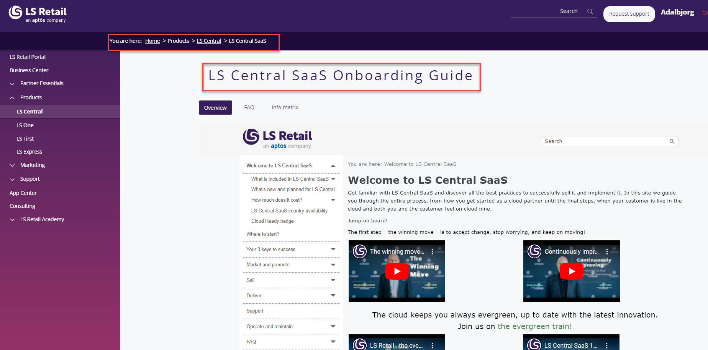
LS Central SaaS Onboarding Guide

Slide 9
LS Central SaaS Onboarding Guide

Slide 10
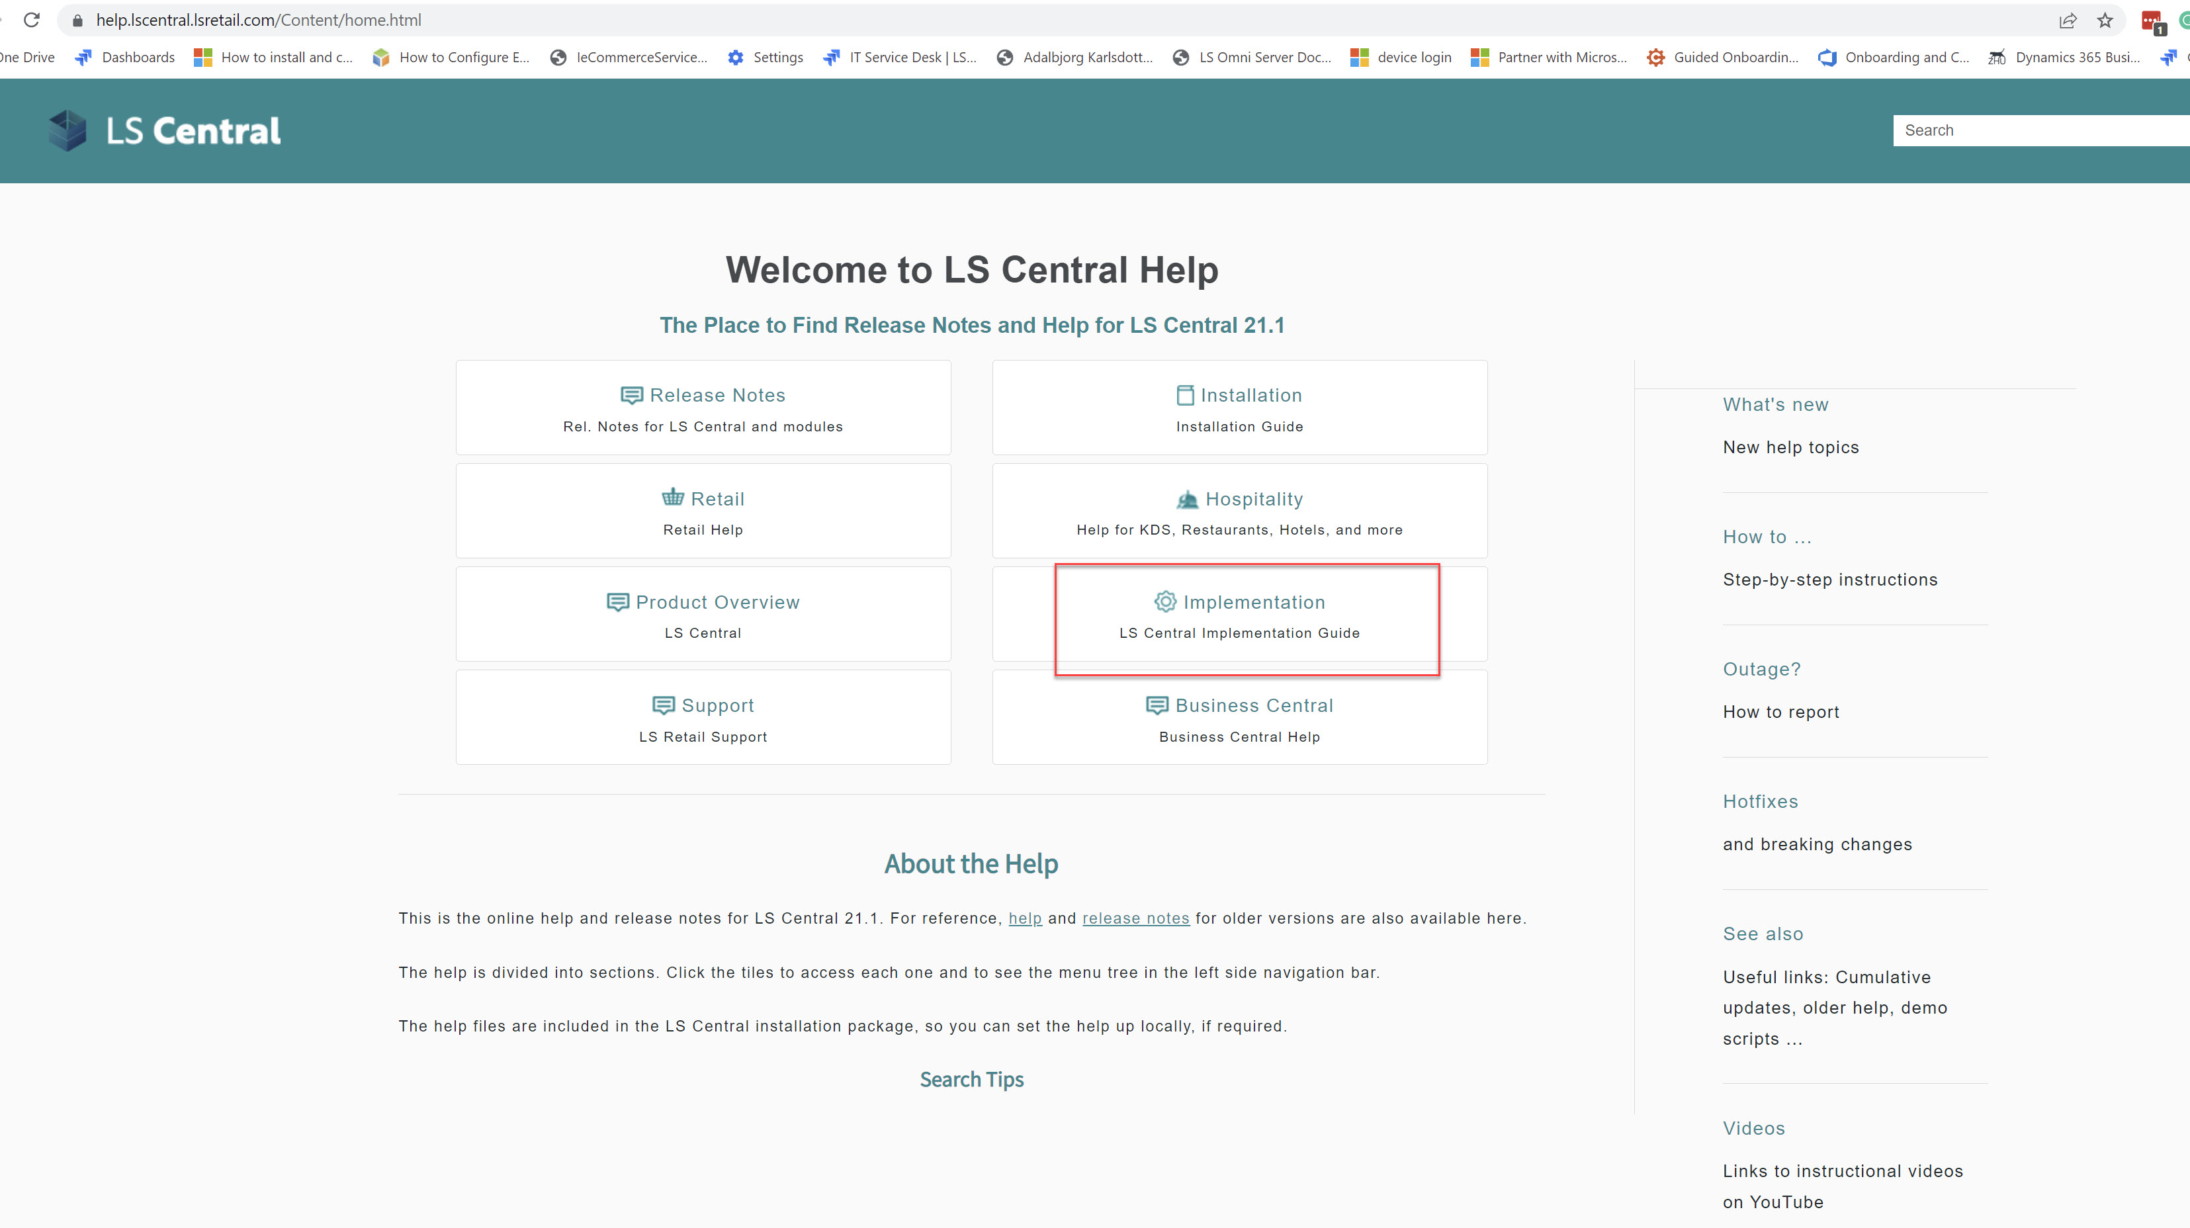
Implementation Guide

Slide 11
Customer story

Slide 12
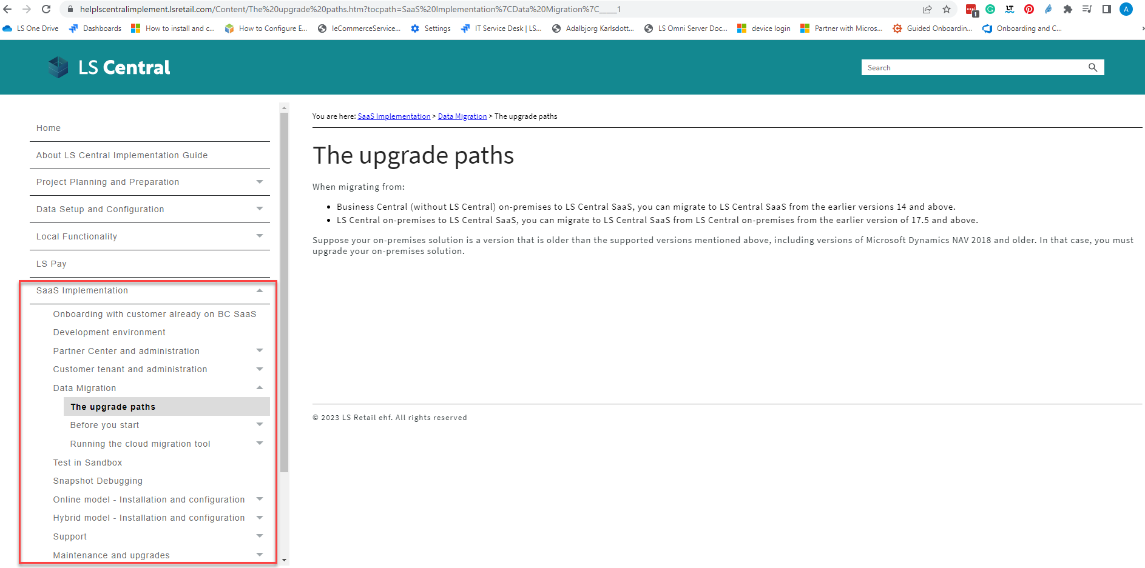
How to move your data to SaaS?

Slide 13
How to move your data to SaaS?
Older than LS14.2
LS Central 14.2 and later
LS Central latest
LS Central SaaS
Using Upgrade Codeunits
Using Table Migration Extensions
Using Cloud Migration Tool
On-premises
SaaS

Slide 14
Online or Hybrid?
Web Replication
LS Central in SaaS
HQ
Hybrid component server
Store
Online POS
Offline POS
Offline POS Service

Slide 15
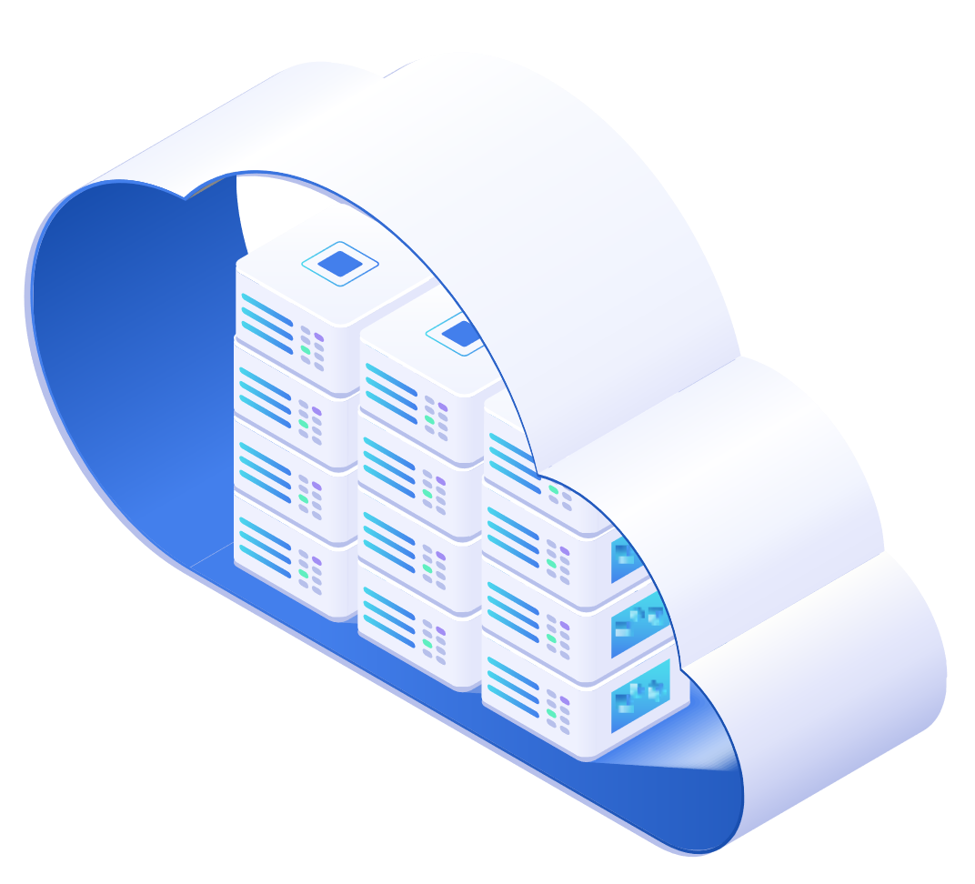
Online POS
HEAD OFFICE IN THE CLOUD
BACK OFFICE
ONLINE POS
ONLINE POS
ONLINE POS

Slide 16
Online POS
Microsoft Dynamics 365
Business Central
HQ
Store
POS 1
POS N
LS Hardware Station
…

Slide 17
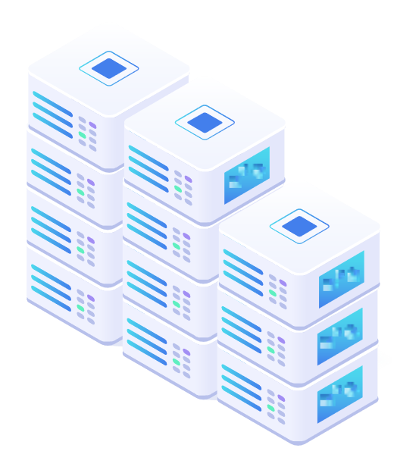
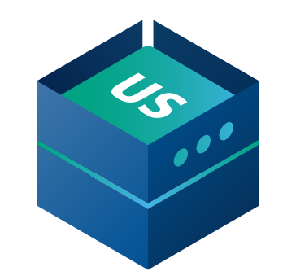
Hybrid POS
BACK OFFICE
HEAD OFFICE IN THE CLOUD
Sales data pushed after each sale
(Webservice)
Sales data pushed after each sale
(Webservice)
Master data pulled from HQ
(Scheduled Webservice job)
STORE 1
STORE 2
Master data replicatied to POS
(Data Director)
HYBRID CLOUD
COMPONENT SERVER
Master data replicatied to POS
(Data Director)
POS MASTER
Offline POS
Offline POS
DATA DIRECTOR
Offline POS
Offline POS
UPDATE SERVICE

Slide 18
Hybrid POS

Slide 19
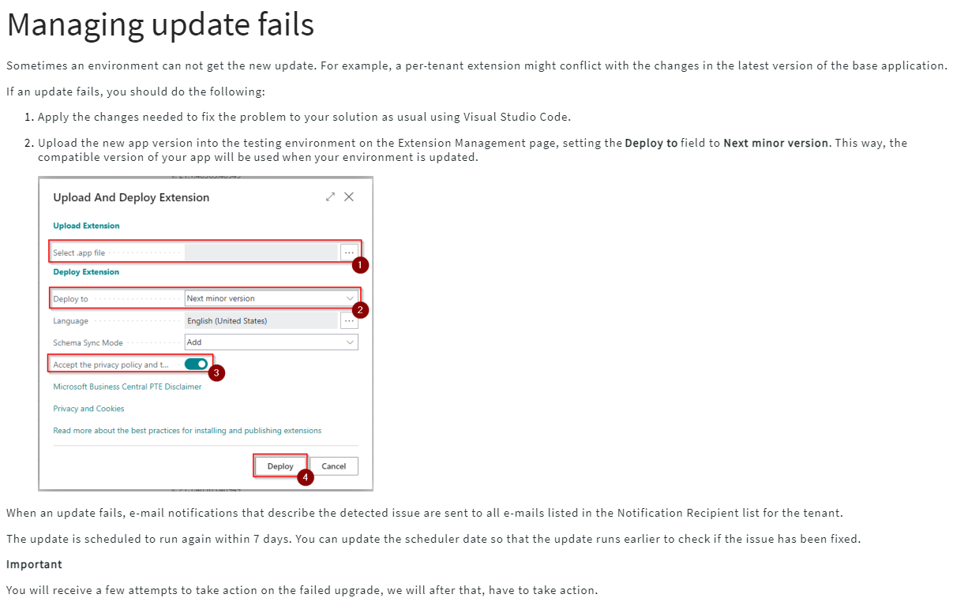
Updates in SaaS
Last selectable Scheduled Update date
Update is available
Outside upgrade window
Within upgrade window
Test window
Upgrade starts*
Day 1
Day 14
Day 21
* If Scheduled Update date has not been set earlier within the upgrade window
The day when the version of LS Central SaaS becomes available
The day when the update is automatically scheduled
The last day you can choose to extend your upgrade date to.

Slide 20
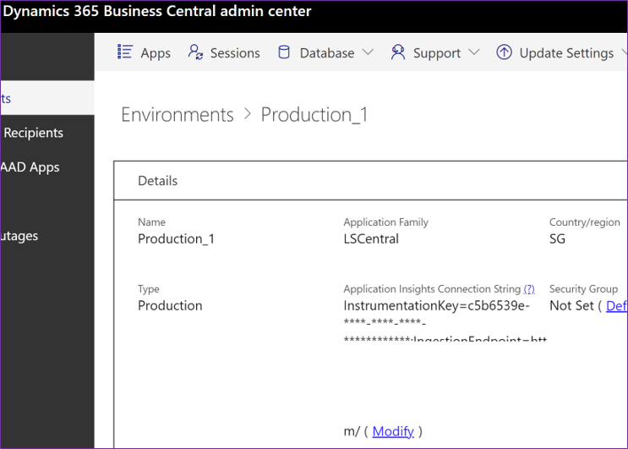
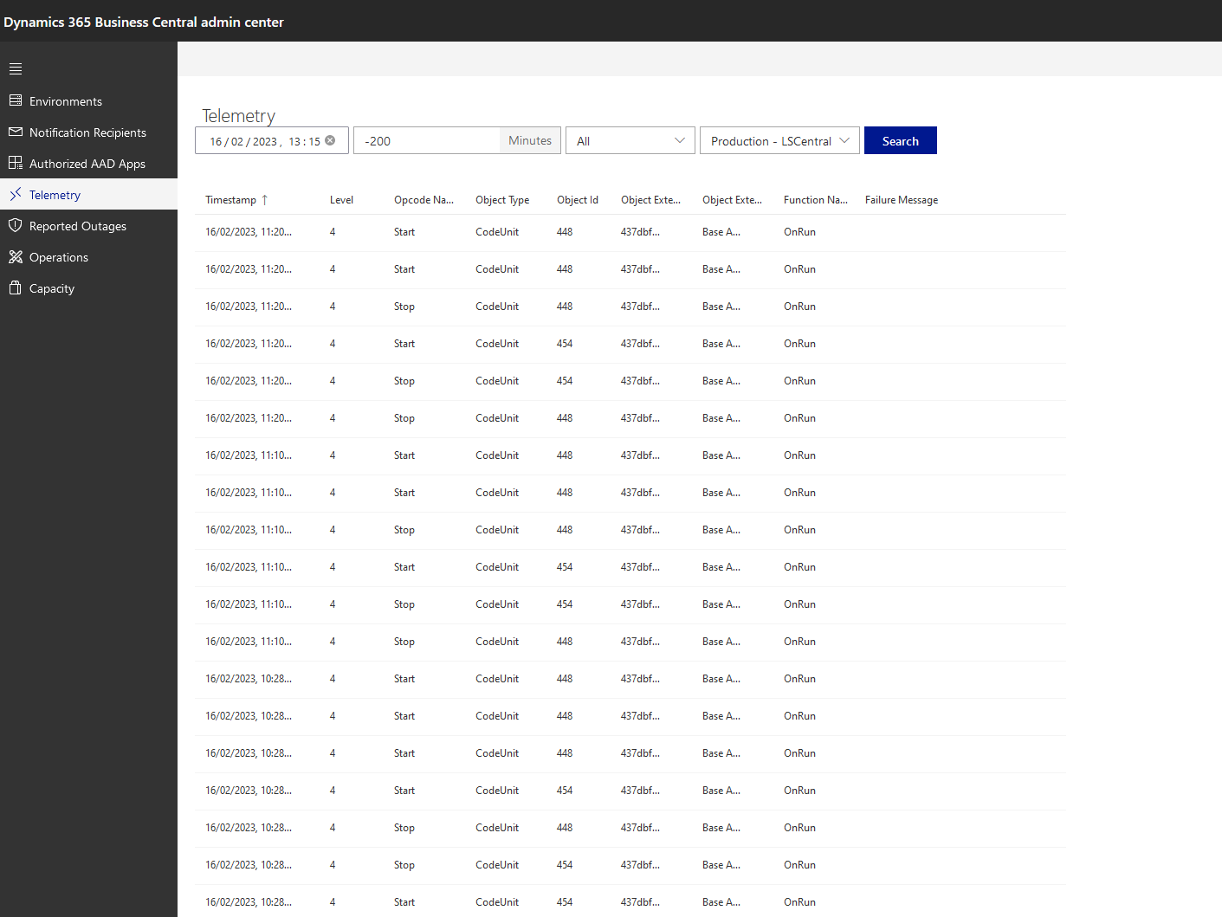
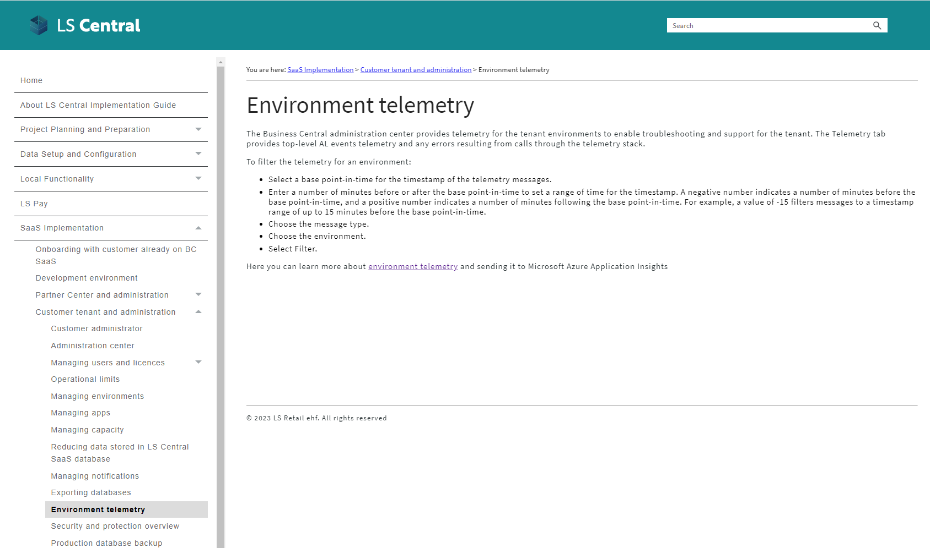
Telemetry

Slide 21
How are we supporting you in your SaaS journey?

Slide 22
Partners journey to SaaS
Phase 1 – CSP Partner
Over 130 onboarding sessions with partners
CSP
Overview
Training

Slide 23
CAP
Cloud Acceleration Program

Slide 24
Partners journey to SaaS
Phase 2 – Cloud Acceleration Program (CAP)
Guided Onboarding
SaaS License
SaaS Project Evaluation Meeting
Onboarding with Consulting Team

Slide 25
CAP – Guided Onboarding
Migration
Test environment

Slide 26
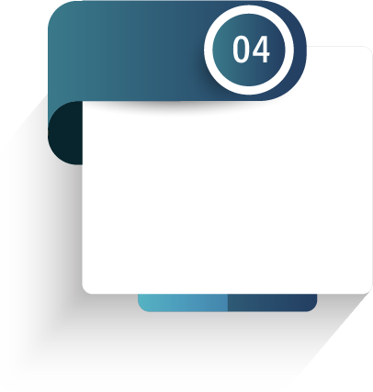
CAP – Guided Onboarding
First Store/ POS
Q&A Session
Migration
Test environment
First HO/POS Update

Slide 27
CAP – Guided Onboarding
First Store/ POS
Q&A Session
Migration
Test environment
First HO/POS Update

Slide 28
Onboarding with consulting

Slide 29
How much does it cost?

Slide 30
Book a session with the Onboarding team
https://calendly.com/lsconboarding/onboarding
https://calendly.com/lsconboarding/30minsession

Slide 31
Recap
Overview Session
SaaS Training
Onboarding Guide
Implementation Guide
CAP

Slide 32
Thank you

