Slide 1
How to implement an eCommerce project
Petur Thor
Sigurdsson
Alejandro
Vasquez

Slide 2
Our Journey Today
Introduction to eCommerce for LS Central
Running a Project
Handling Customizations
LS Retail Consulting Services
Q&A

Slide 3
Introduction
What is eCommerce for LS Central
Topology
Installation
Configuration

Slide 4
Introduction
What is eCommerce for LS Central
Topology
Installation
Configuration

Slide 5
Retail
Hospitality
Activity
Pharmacy
Retail
eCommerce API
Commerce Service for LS Central
3rd party
eCommerce
providers

Slide 6
Introduction
What is eCommerce for LS Central
Topology
Installation
Standalone
Virtual Machine
Configuration

Slide 7
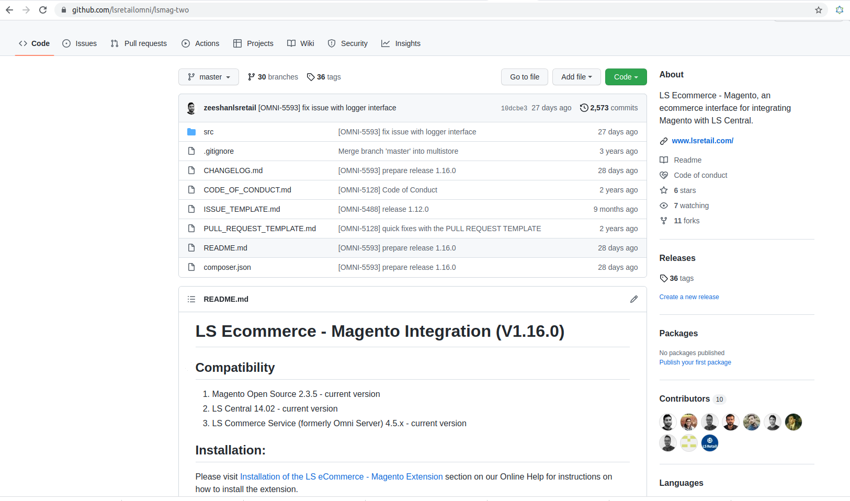

Slide 8
Introduction
What is eCommerce for LS Central
Topology
Installation
Standalone
Virtual Machine
Configuration

Slide 9
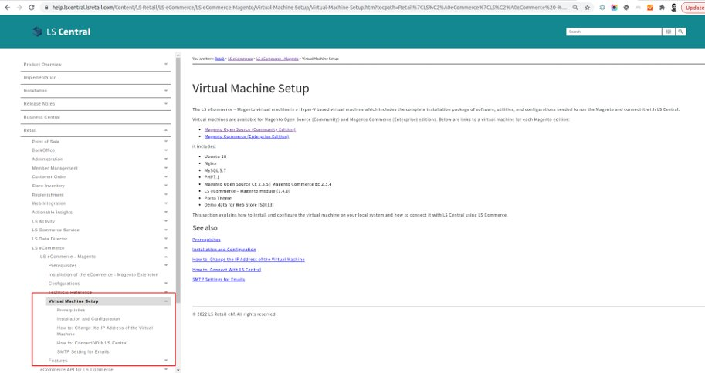

Slide 10
Introduction
What is eCommerce for LS Central
Topology
Installation
Configuration

Slide 11
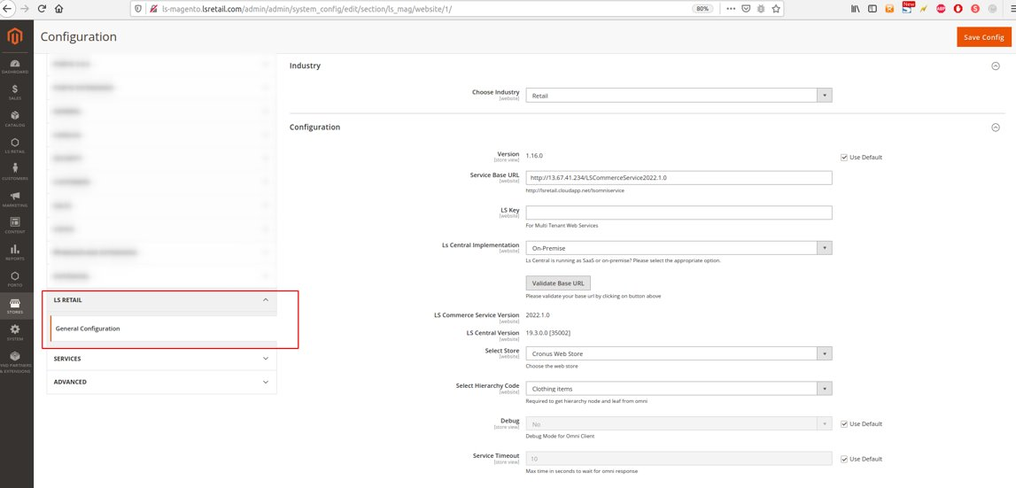

Slide 12
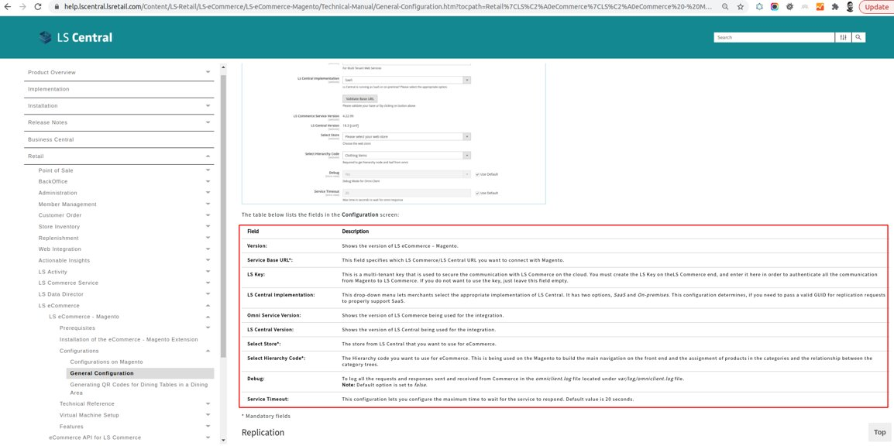

Slide 13
Running a Project

Slide 14
Running a Project
Scoping
Selecting the Magento Platform
Look and Feel
Hosting

Slide 15
Scoping
Client Requirements
Supported Features
Gaps?

Slide 16
Running a Project
Scoping
Selecting the Magento Platform
Look and Feel
Hosting

Slide 17
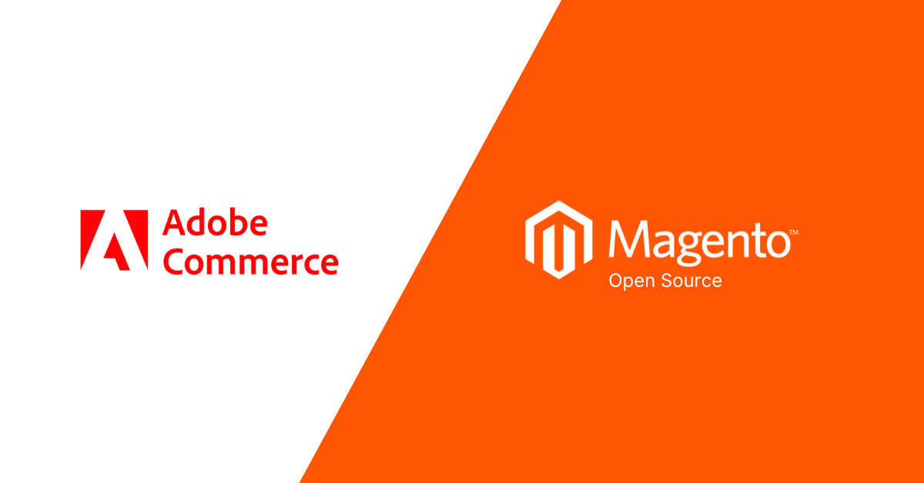
Adobe Commerce vs Magento Open Source
Store Size
Scalability
Cost
Advance Features
Hosting
Adobe Support

Slide 18
Running a Project
Scoping
Selecting the Magento Platform
Look and Feel
Hosting

Slide 19
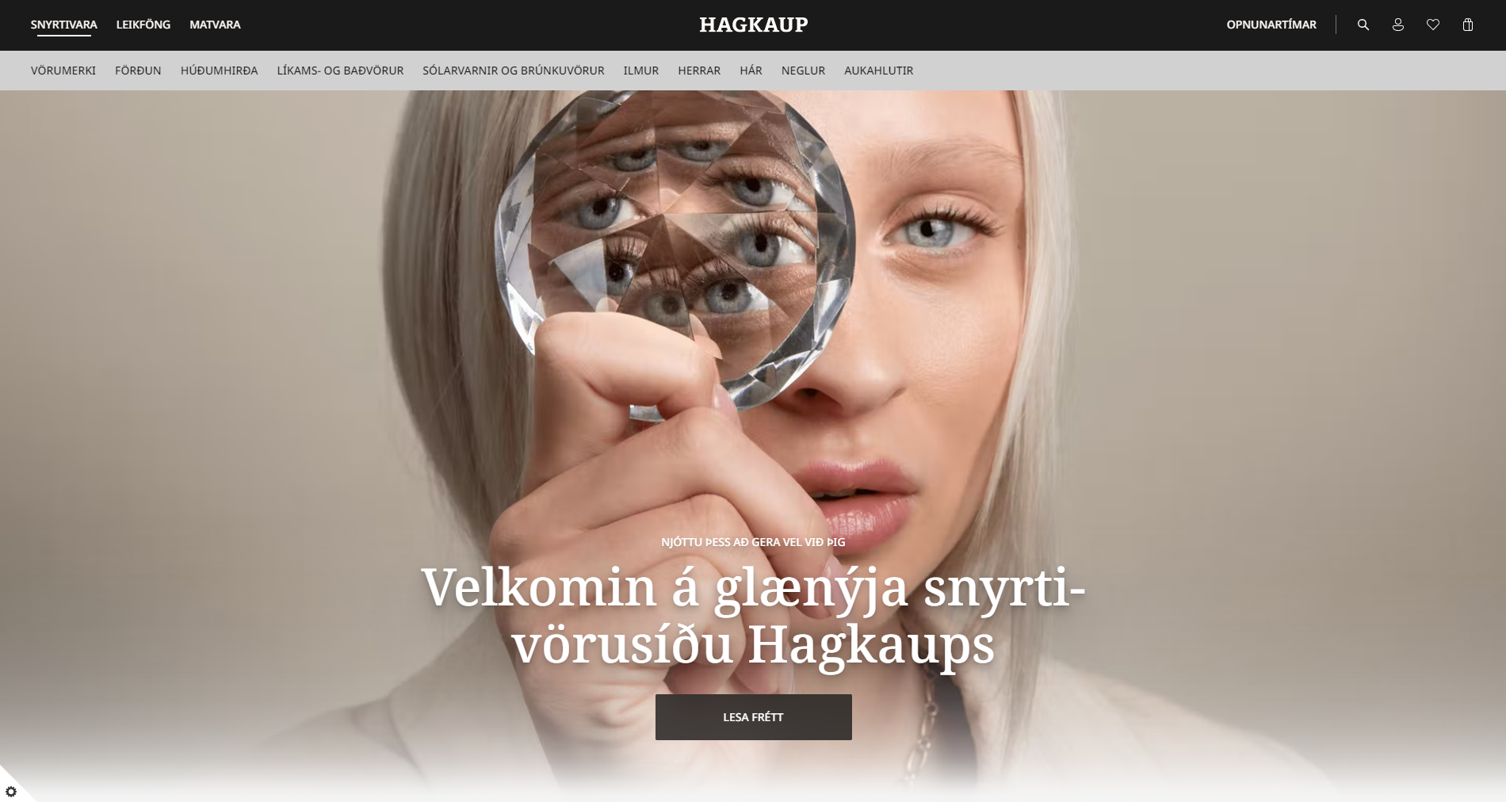
Look & Feel
Marketplace Themes
Custom Designs
PWA (Progressive Web Apps)

Slide 20
Running a Project
Scoping
Selecting the Magento Platform
Look and Feel
Hosting

Slide 21
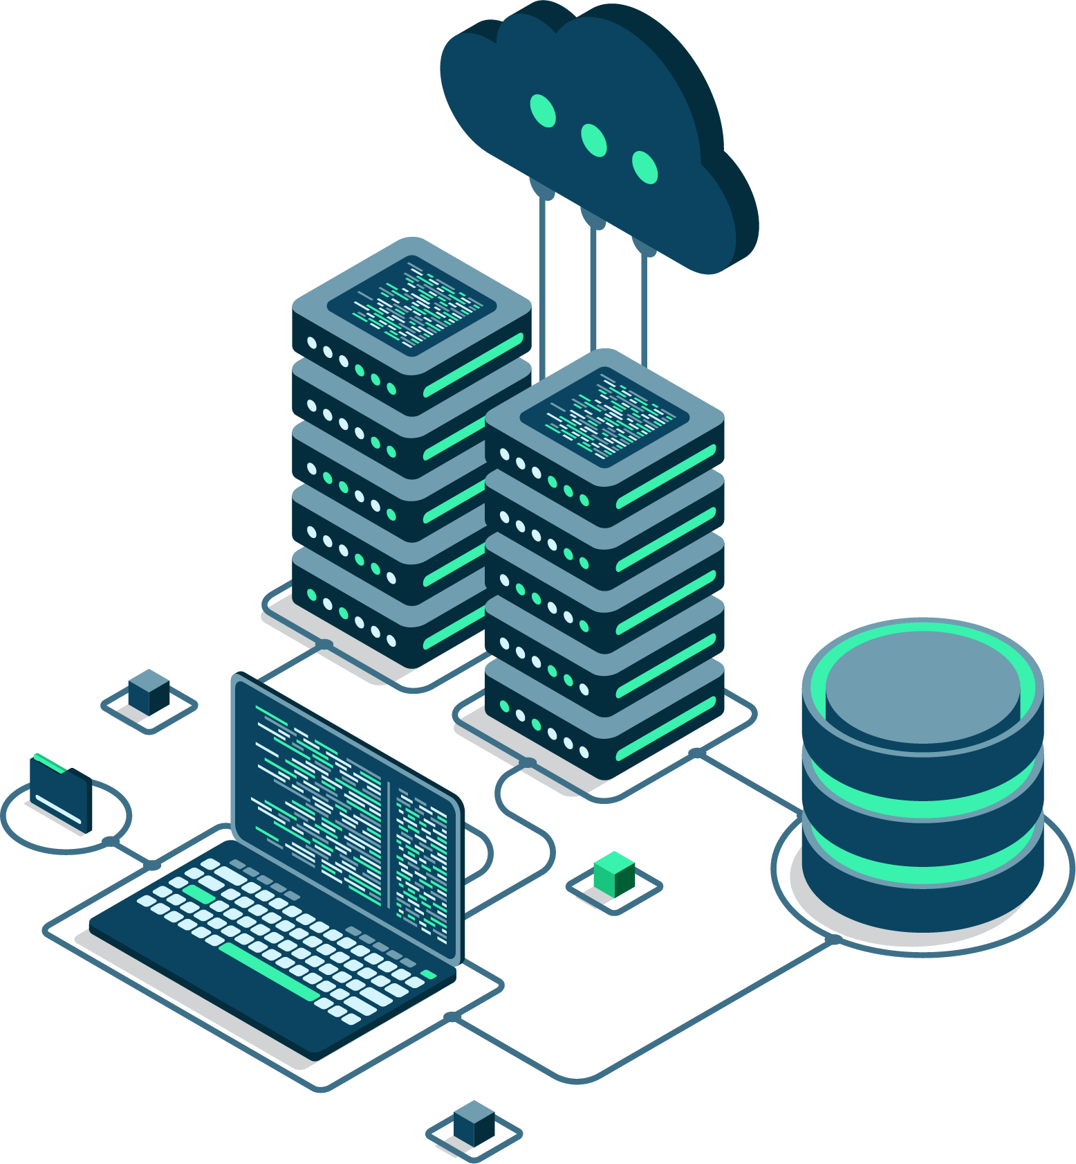
Hosting
Adobe Commerce Cloud
On Premise
Third Party

Slide 22
Handling Customizations

Slide 23
Customizations
Frontend – UI
Magento
eCommerce for LS Central - Magento module
Commerce Service for LS Central
LS Central

Slide 24
LS Retail Consultancy

Slide 25
LS Retail Consultancy
Discovery Workshops
Training
Customization Requests
Deployment

Slide 27
Thank you

