Slide 2

LS Pay for Business Central
Sell from the BC back office
Petur Thor Sigurdsson
Product Director

Slide 3


Adding frictionless payments to generic Sales Documents in Business Central

Slide 4
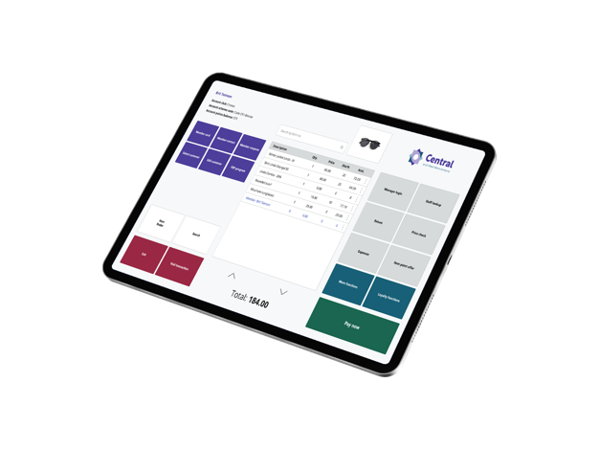


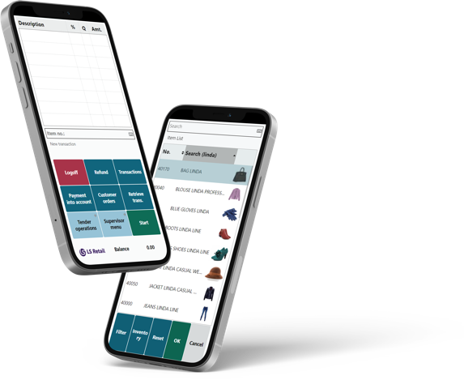

A world-leading provider of unified software for retail, hospitality, food service and forecourt businesses of all sizes.
30+
YEARS OF EXPERIENCE
Part of the Aptos group of companies since 2021

Slide 5

Powered by ERP Microsoft Dynamics 365 Business Central

Slide 6


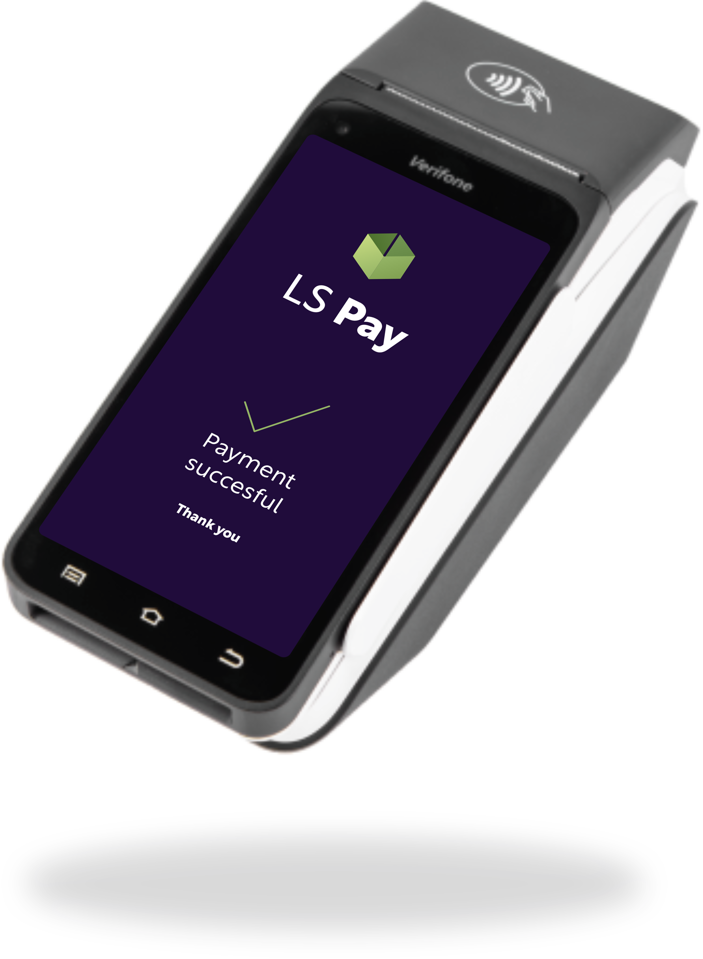
Offering EFT integrations to the leading PSPs, in all our main market regions
Allowing our customers
to have a choice

Slide 7

70+
PSP Integrations
35+
Active PSPs
50+
Supported countries

Slide 8























Slide 9
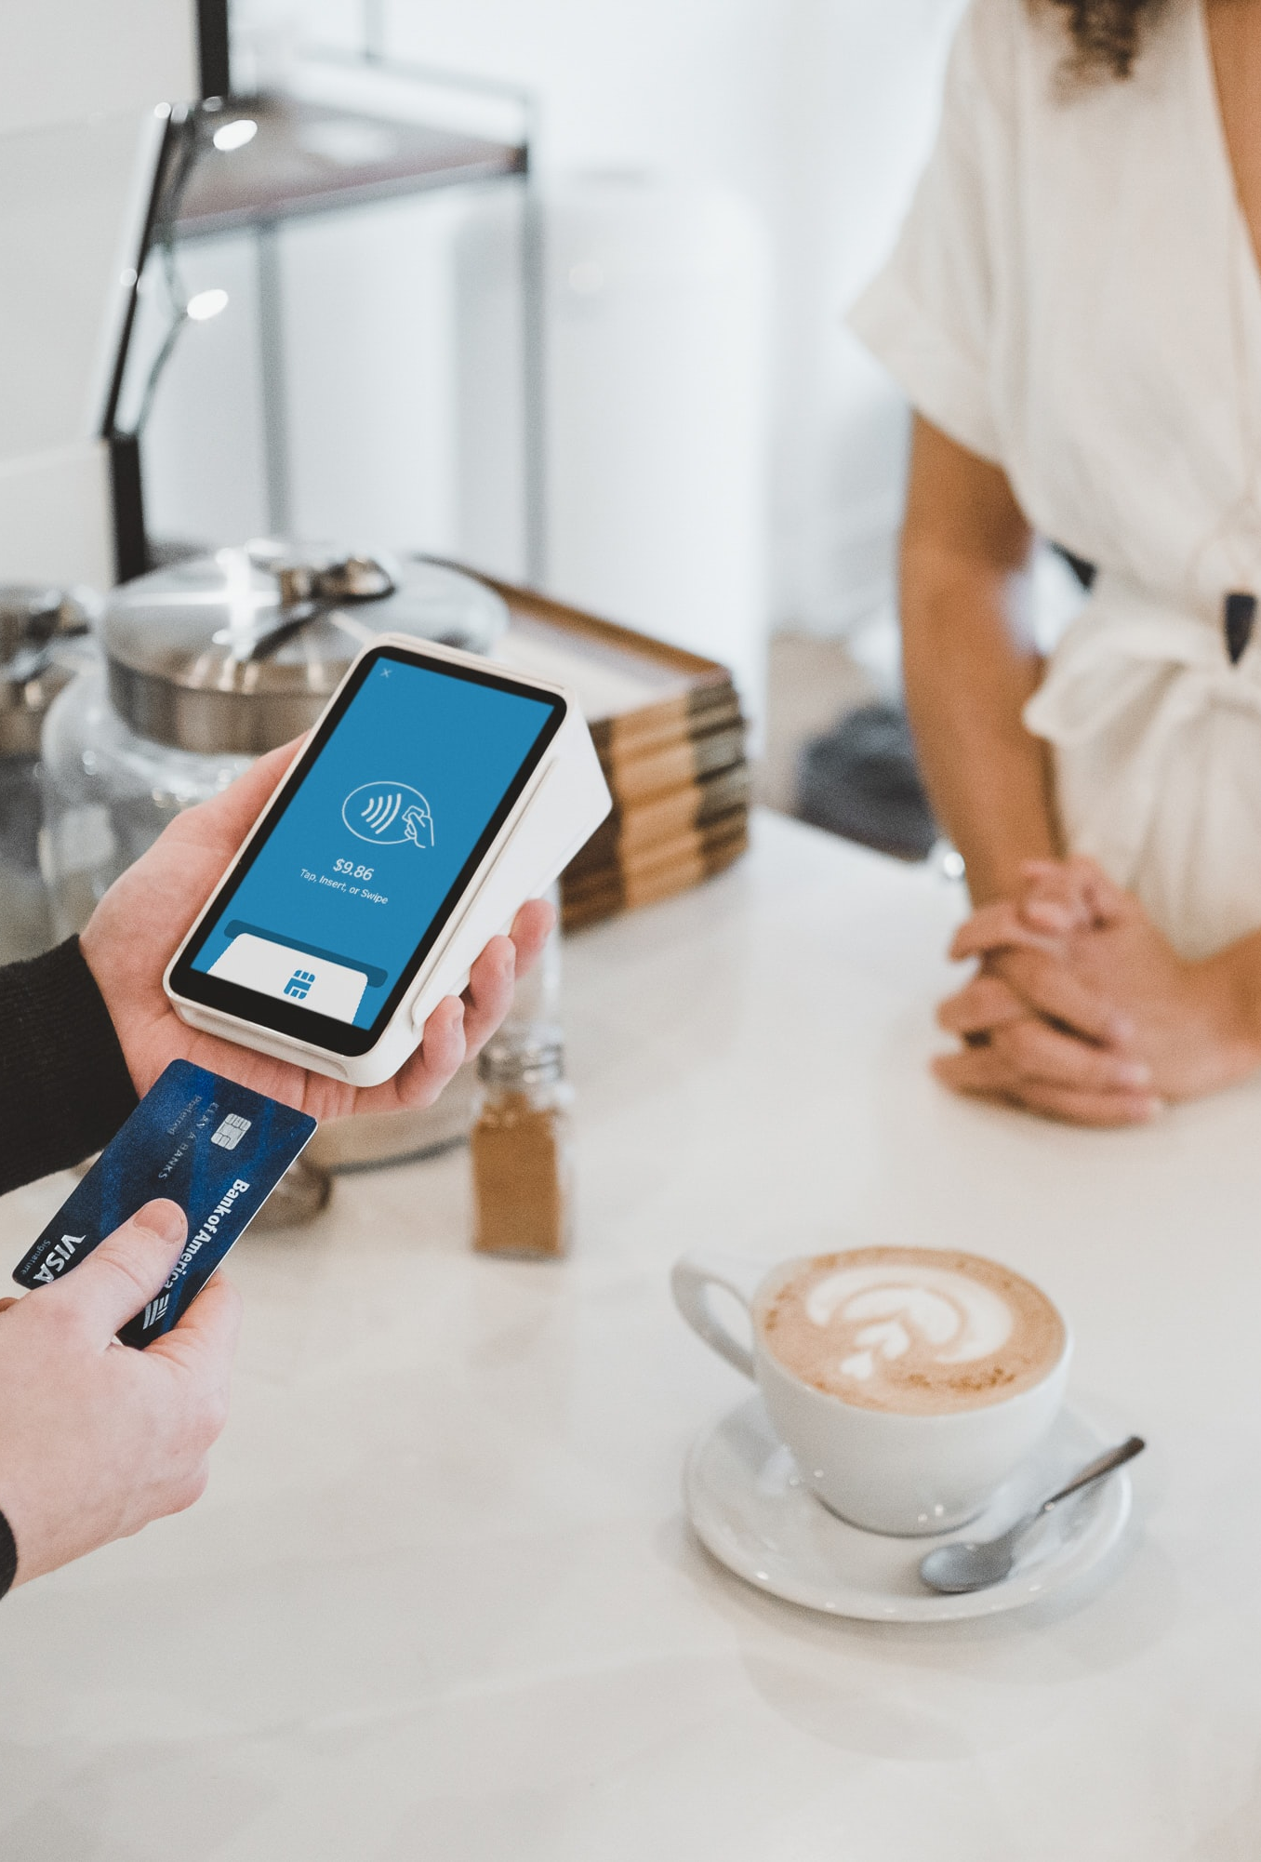















Some of our customers

Slide 10
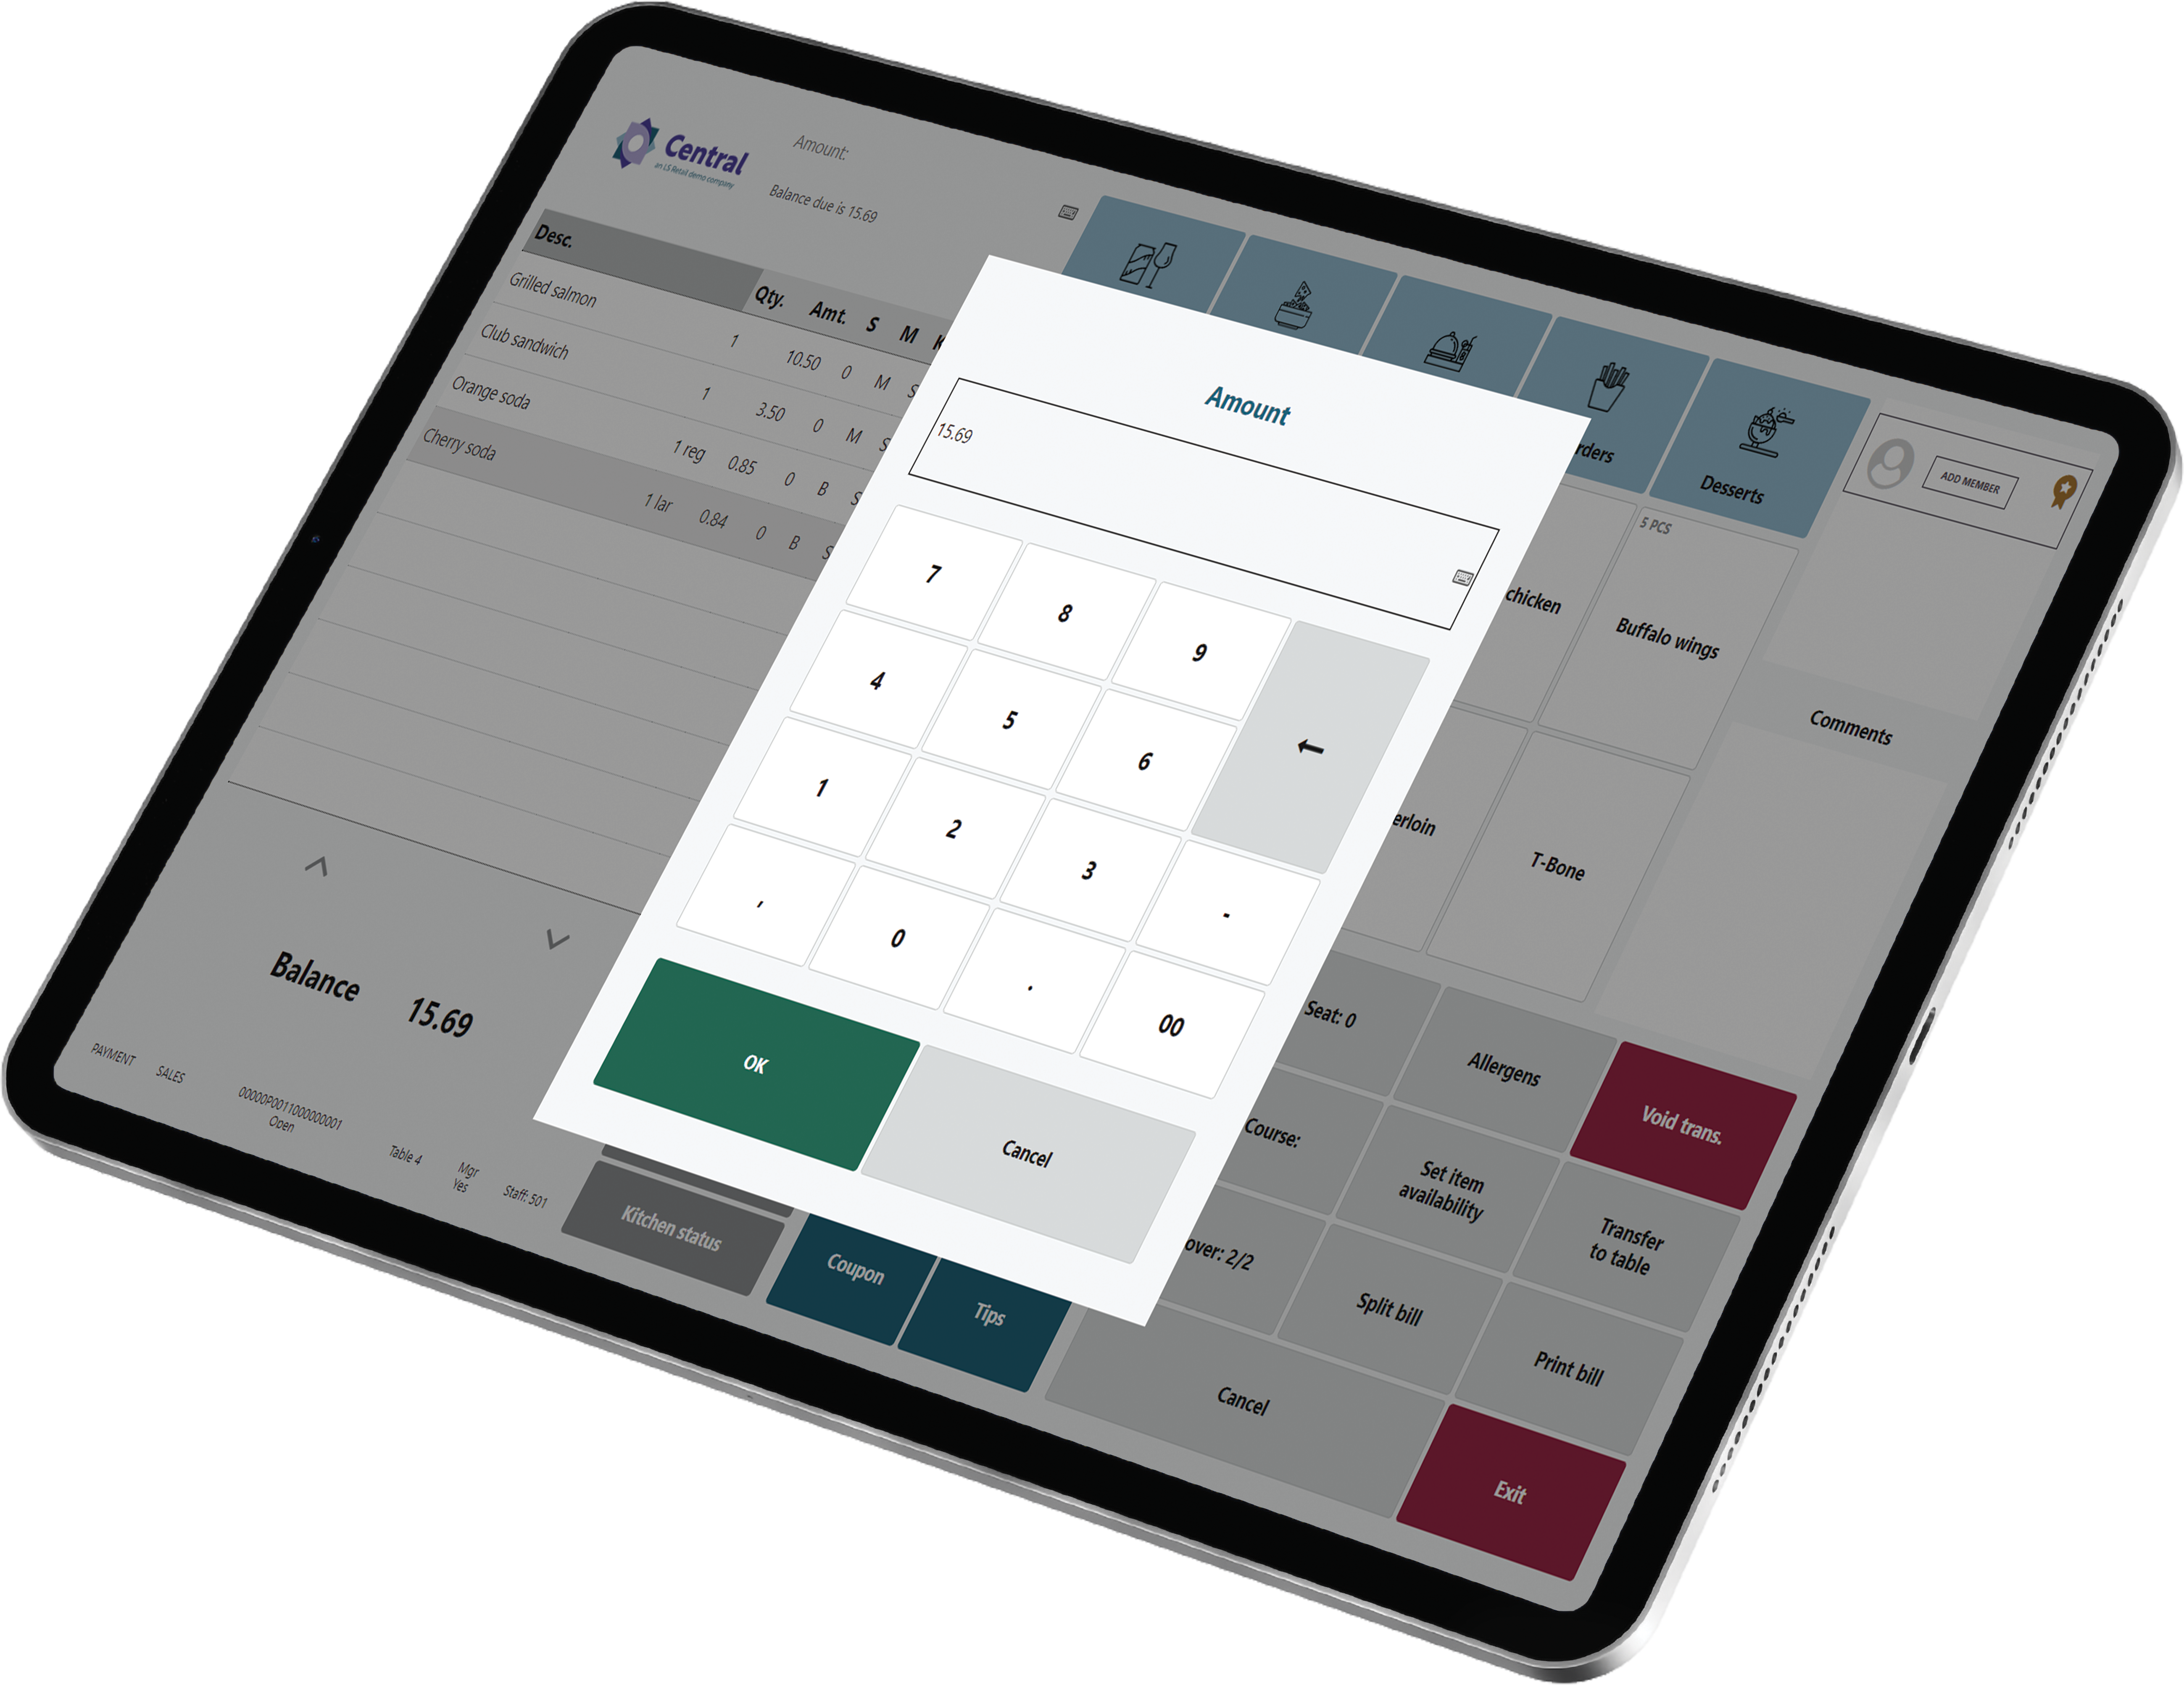

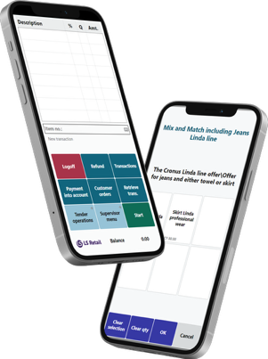
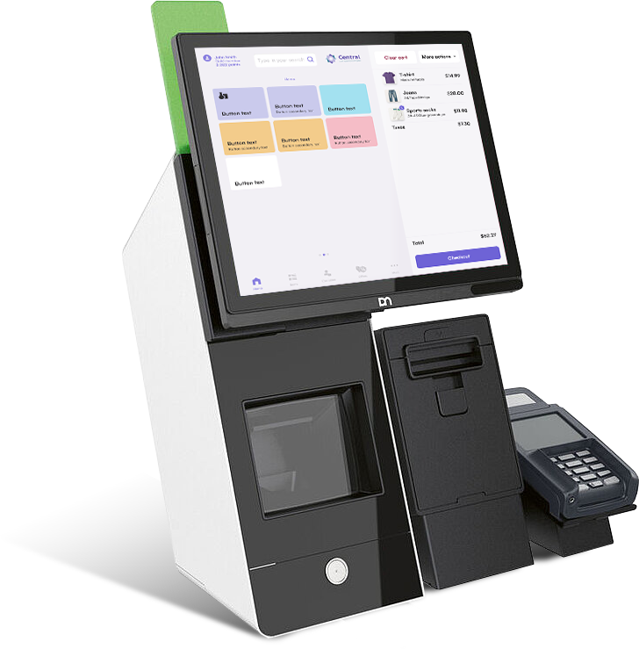
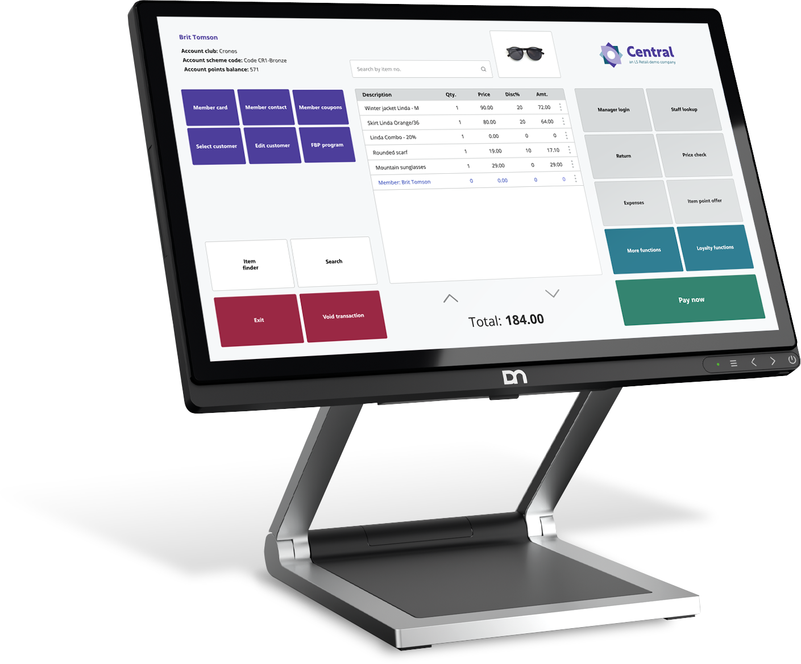
Supporting all platforms & form factors

Slide 11

LS Pay for Business Central
Payment support for standard Sales Documents in BC
Published on the Microsoft AppSource

Slide 12
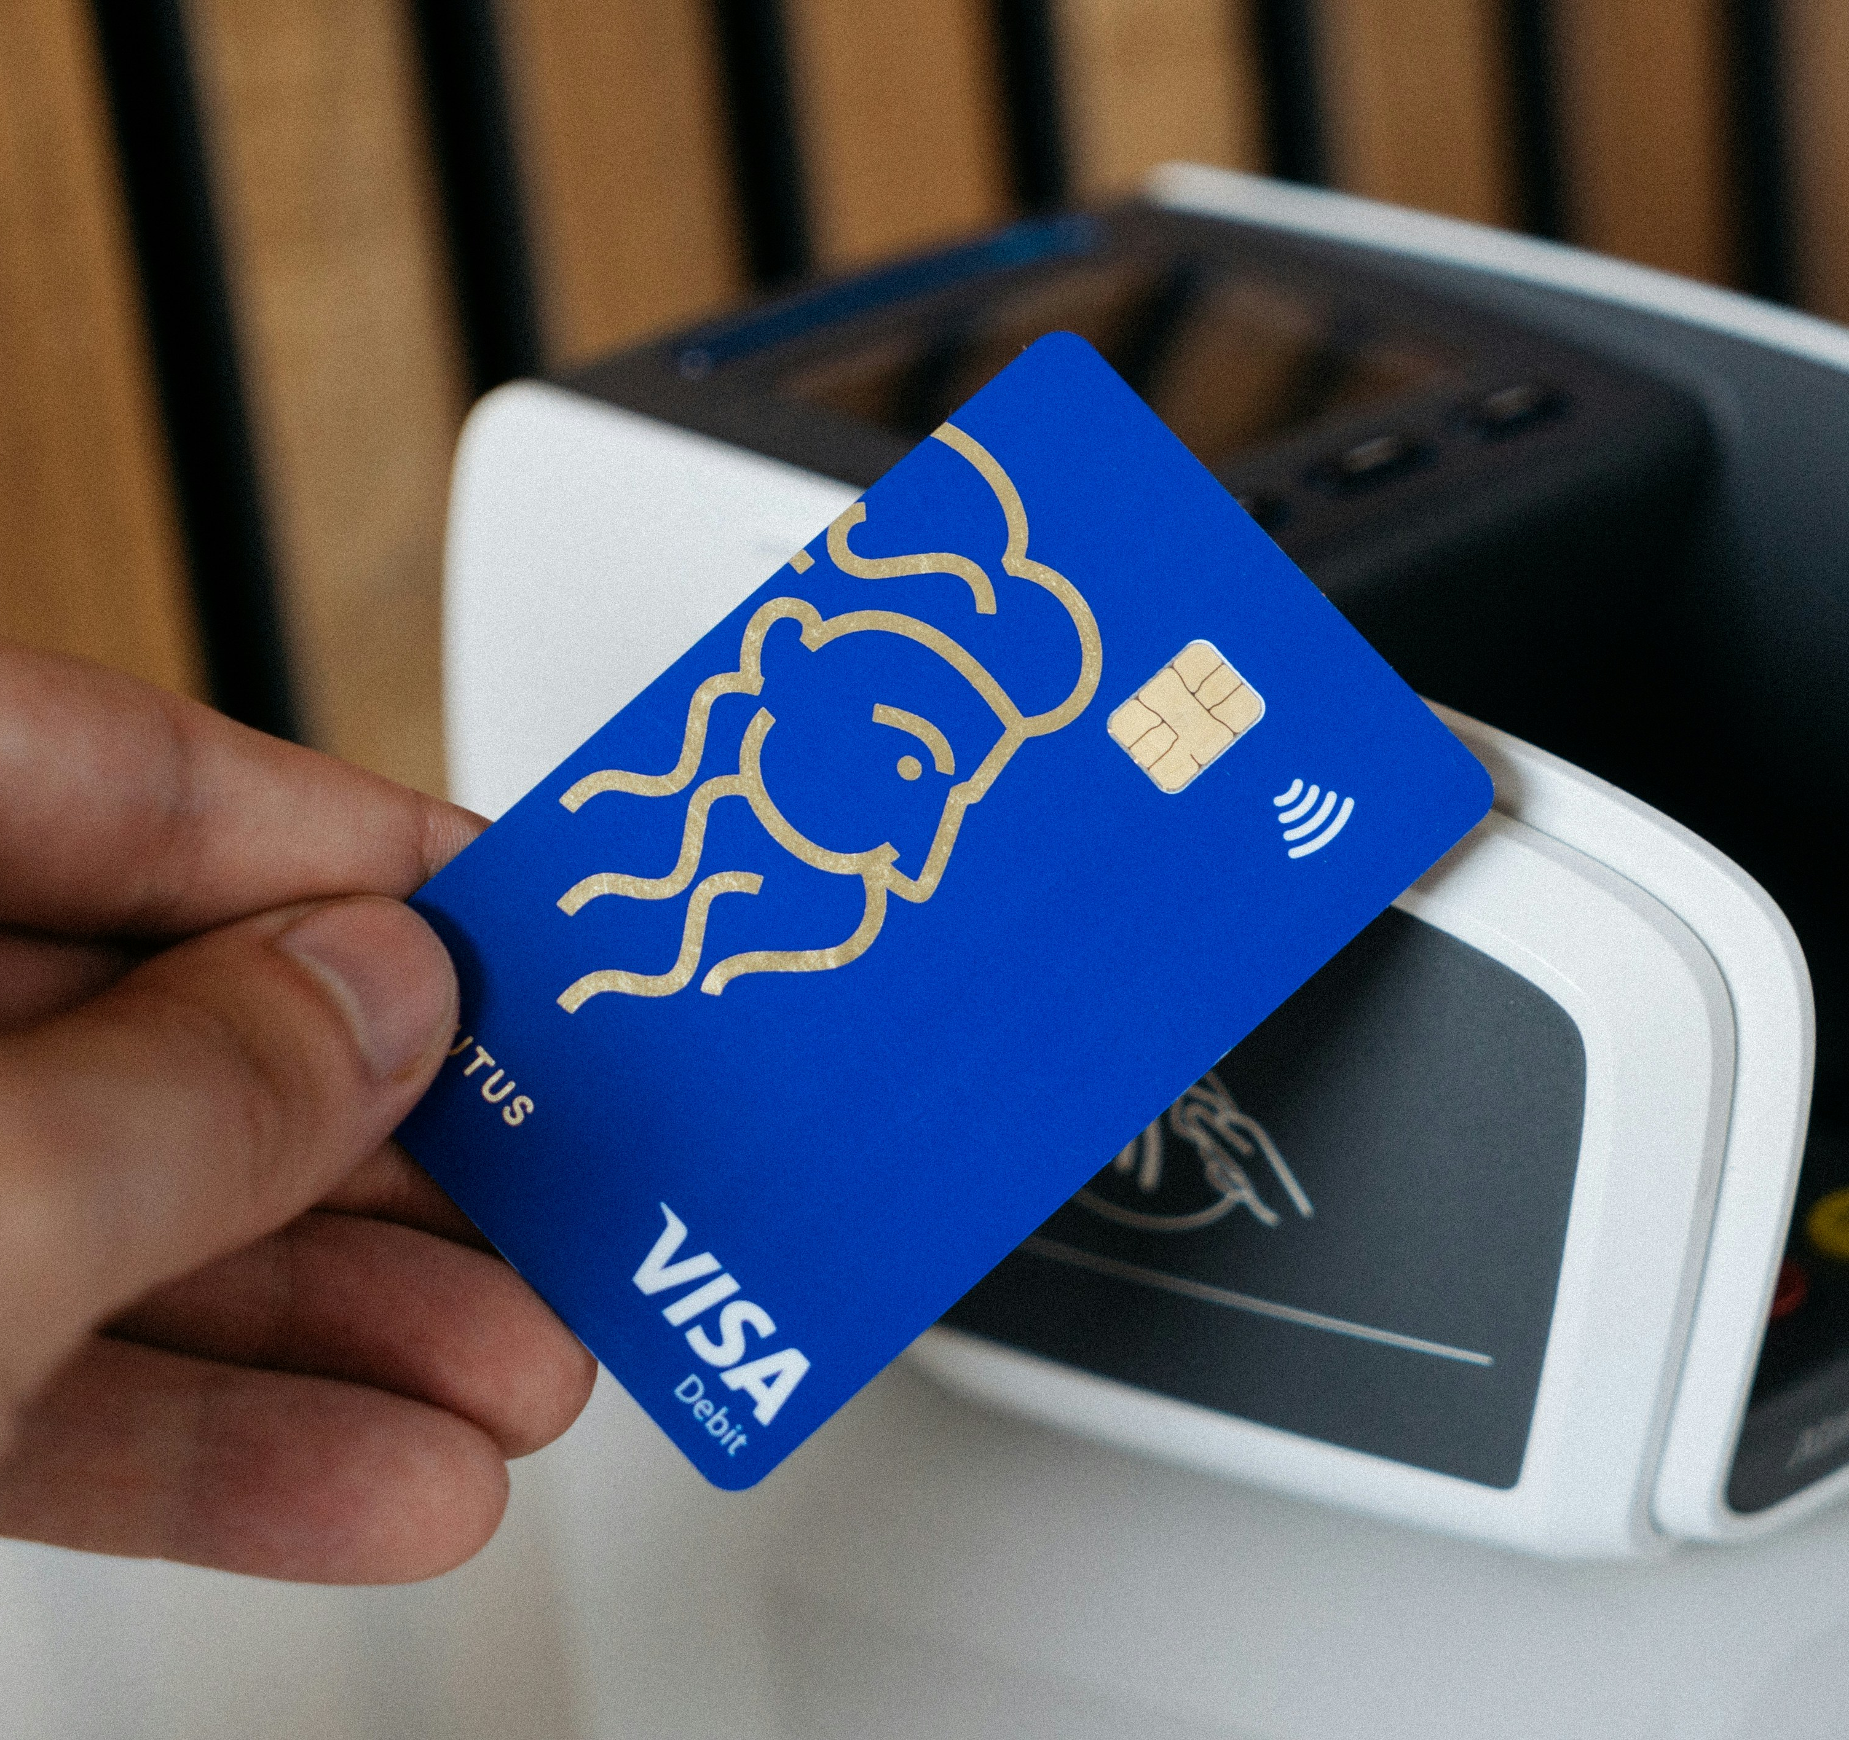
Businesses in scope
LS Central merchants
Requiring back-office payments
Enterprises using Business Central
Not having a Point-of-Sale solution
Selling into sales documents
  Sales Orders
  Sales Invoices
Requiring payment support
  Card-present
  Card-not-present
More than 50,000 businesses use
Business Central as their ERP

Slide 13

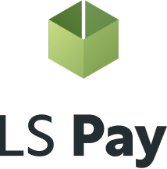
LS Pay – Core engine
Adyen
Elavon
Planet
Freedom Pay

Slide 14
LS Pay Service
Adyen
LS Pay Service
Elavon
Planet
Freedom Pay

Slide 15


Introducing the EFT Extension
Contains all payment logic and dialogs for EFT payments
Exposes a payments API that the various solutions can interface
Connects to the LS Pay Service
A generic Business Central extension
EFT Extension
LS Pay Service

Slide 16
Base topology
Business Central
LS Pay App
EFT Extension
LS Pay Service
LS Central
POS
BO
HO
Call Center
EFT Extension

Slide 17

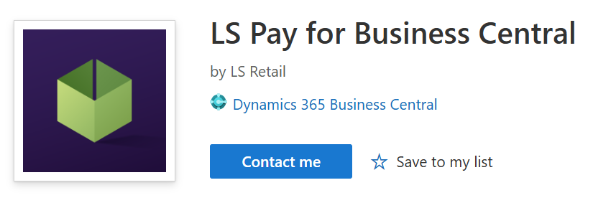
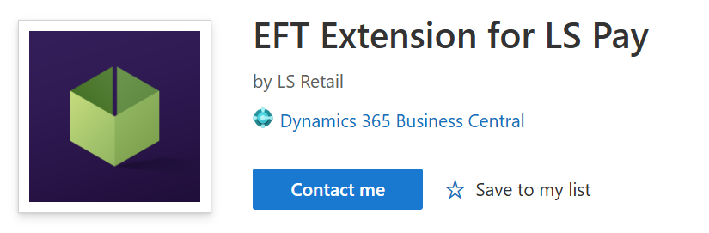
Two deployment options
Business Central
Business Central
LS Pay App
EFT
Extension
Partner App
EFT
Extension
Available on the Microsoft AppSource

Slide 18
Payment API
BC Sales documents operations
Purchase
Refund
Void
X & Z reports
Settlement
Payment links
Tokens
Etc.
Card present payments and returns
  Sales orders
  Sales Invoices
  Sales return orders
  Sales credit memos
Card not-present payments
  Online payment links
  Manual card number entry (MOTO)
Multiple tender types
Payment profiles

Slide 19
LS Pay for
Business Central
Demo

Slide 20

Supported countries
Europe
Austria
France
Latvia
Portugal
Belgium
Finland
Lithuania
Romania
Bulgaria
Germany
Luxembourg
Slovakia
Croatia
Greece
Liechtenstein
Slovenia
Cyprus
Hungary
Malta
Spain
Czech Republic
Iceland
Netherlands
Sweden
Denmark
Ireland
Norway
Switzerland
Estonia
Italy
Poland
United Kingdom

Slide 21



Supported countries
Americas
APAC
MEA
Brazil
Australia
United Arab Emirates
Canada
Hong Kong
Mexico
Japan
Puerto Rico
Malaysia
United States of America
New Zealand
Singapore

Slide 22




Supported
PSPs

Slide 23


Security
LS Pay is out of scope for PCI DSS certifications
LS Pay is out of scope for PCI DSS related vulnerabilities

Slide 24


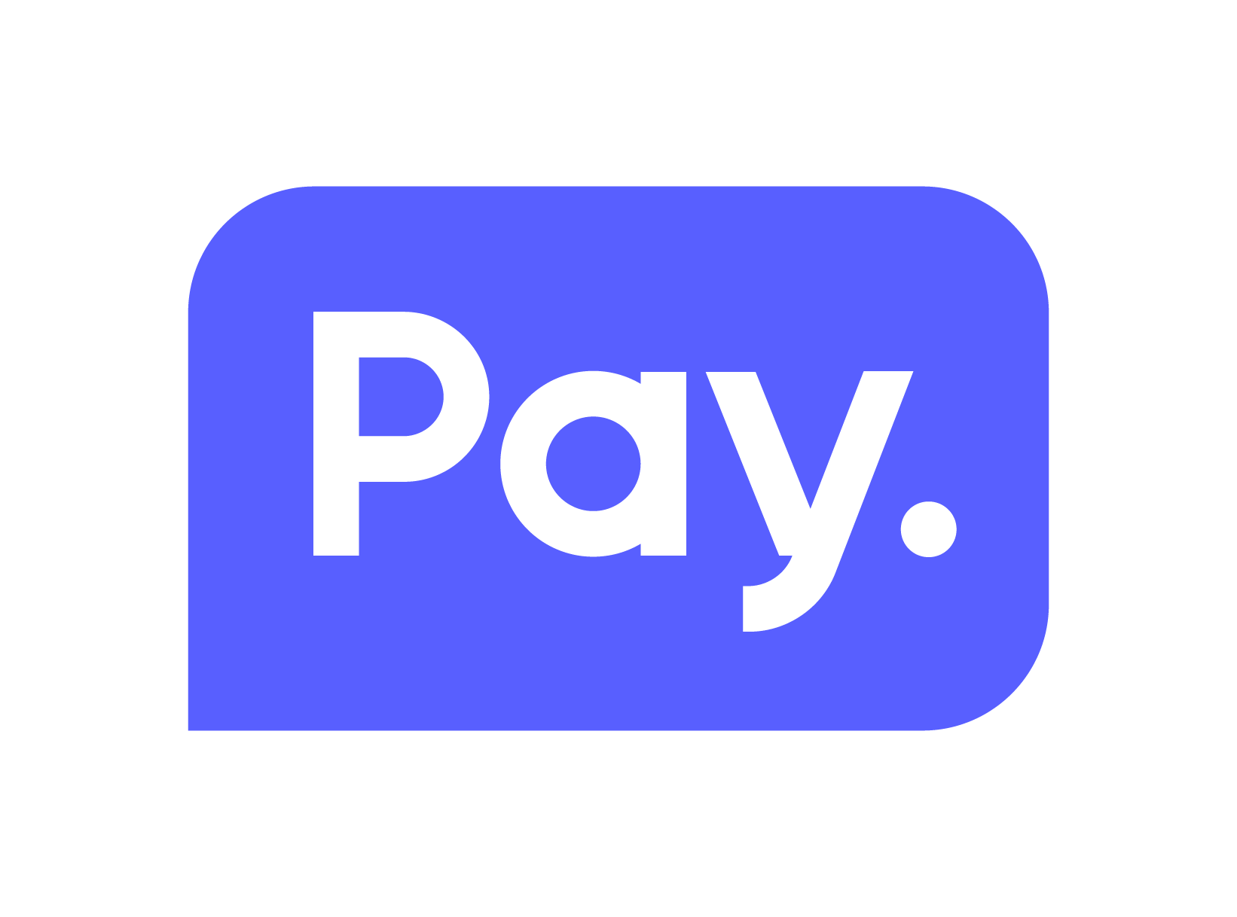



Roadmap
Automatic reconciliation
Virtual terminal support
Service orders support
Tokenization / Token storage
  Card on file
  PreAuth & Full Capture

Slide 25


Integrations via our Professional Services

Slide 26



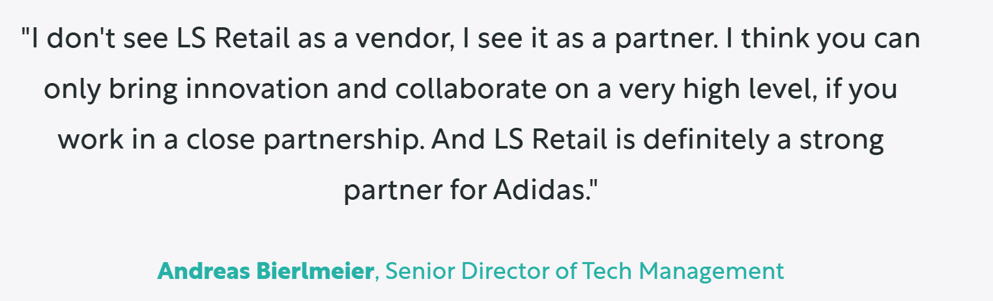

Slide 27

Rapid integrations
Statement of Work (SOW)
  Contract for delivery
  Time and material
Short lead time
  Next available consultant
Development
  Typical timeline is approximately 3 months
    Development and certification
  Full support from the LS Pay team
  Using LS Pay’s development processes
Deployment
  Integration is incorporated into standard LS Pay, with continuous maintenance and support provided

Slide 28
How to get started?
Available on the Microsoft AppSource

Slide 29
Licensing
Same license model as with LS Pay for LS Central
The number of LS Pay licenses equals the number of connected pin pads (PEDs)
SaaS, on prem subscription or on prem perpetual
Pricelist available on the LS Retail portal or by demand

Slide 30


Slide 31
Your questions please?

Slide 32
Thank you!

