Slide 1
Dadi Karason
Chief Technology Officer

Slide 2
Dadi Karason
Chief Technology Officer

Slide 3
Contactless
shopping
Social media
Digital commerce
Bigger baskets
The new shopping window
grew like never before

Slide 4
The merger of physical and digital commerce
Is this new world here to stay?
How quickly will consumers return to their old pre-covid habits?
Where these changes permanent?

Slide 5
What will
post-covid
look like?

Slide 6
We are all human

Slide 7
Unified Commerce

Slide 8
End-to-end retail
Head office
Back office
POS
Simplified maintenance and administration
Easy customization
Low cost of ownership

Slide 9
Unified Commerce
End-to-end retail
Head office
Back office
POS
Simplified maintenance and administration
eCommerce
Payments
BI
Easy customization
Support for a number of new verticals
Low cost of ownership

Slide 10
LS Retail
Microsoft
Customers
Partners
We as a community are in a perfect position
COVID has accelerated this merger of physical retail and digital
This is the time!

Slide 11
Our unified commerce portfolio
Built on Business Central
SaaS and on-premise
Easy to set up
Fit for retail and F&B
eCommerce

Slide 12
Our unified commerce portfolio
Built on Business Central
SaaS and on-premise
Easy to set up
Fit for retail and F&B
Built on Business Central
SaaS and on-premise
Very flexible
eCommerce
eCommerce

Slide 13
Our unified commerce portfolio
Built on Business Central
SaaS and on-premise
Easy to set up
Fit for retail and F&B
Built on Business Central
SaaS and on-premise
Very flexible
Commerce, F&O
Enterprise solution
F&B, Hospitality
eCommerce
eCommerce
eCommerce
LS Pay 35+ integrations in 50+ countries

Slide 14
Unified Experiences
ERP
Retail
Food & Beverage
Activity and Hotels
Unified Commerce
for the hospitality industry

Slide 15
Unified Experiences
Gunnar Orn Thorsteinsson
ERP
Retail
Product Director – LS Central hospitality
Food & Beverage
Activity and Hotels
Unified Commerce
for the hospitality industry

Slide 16
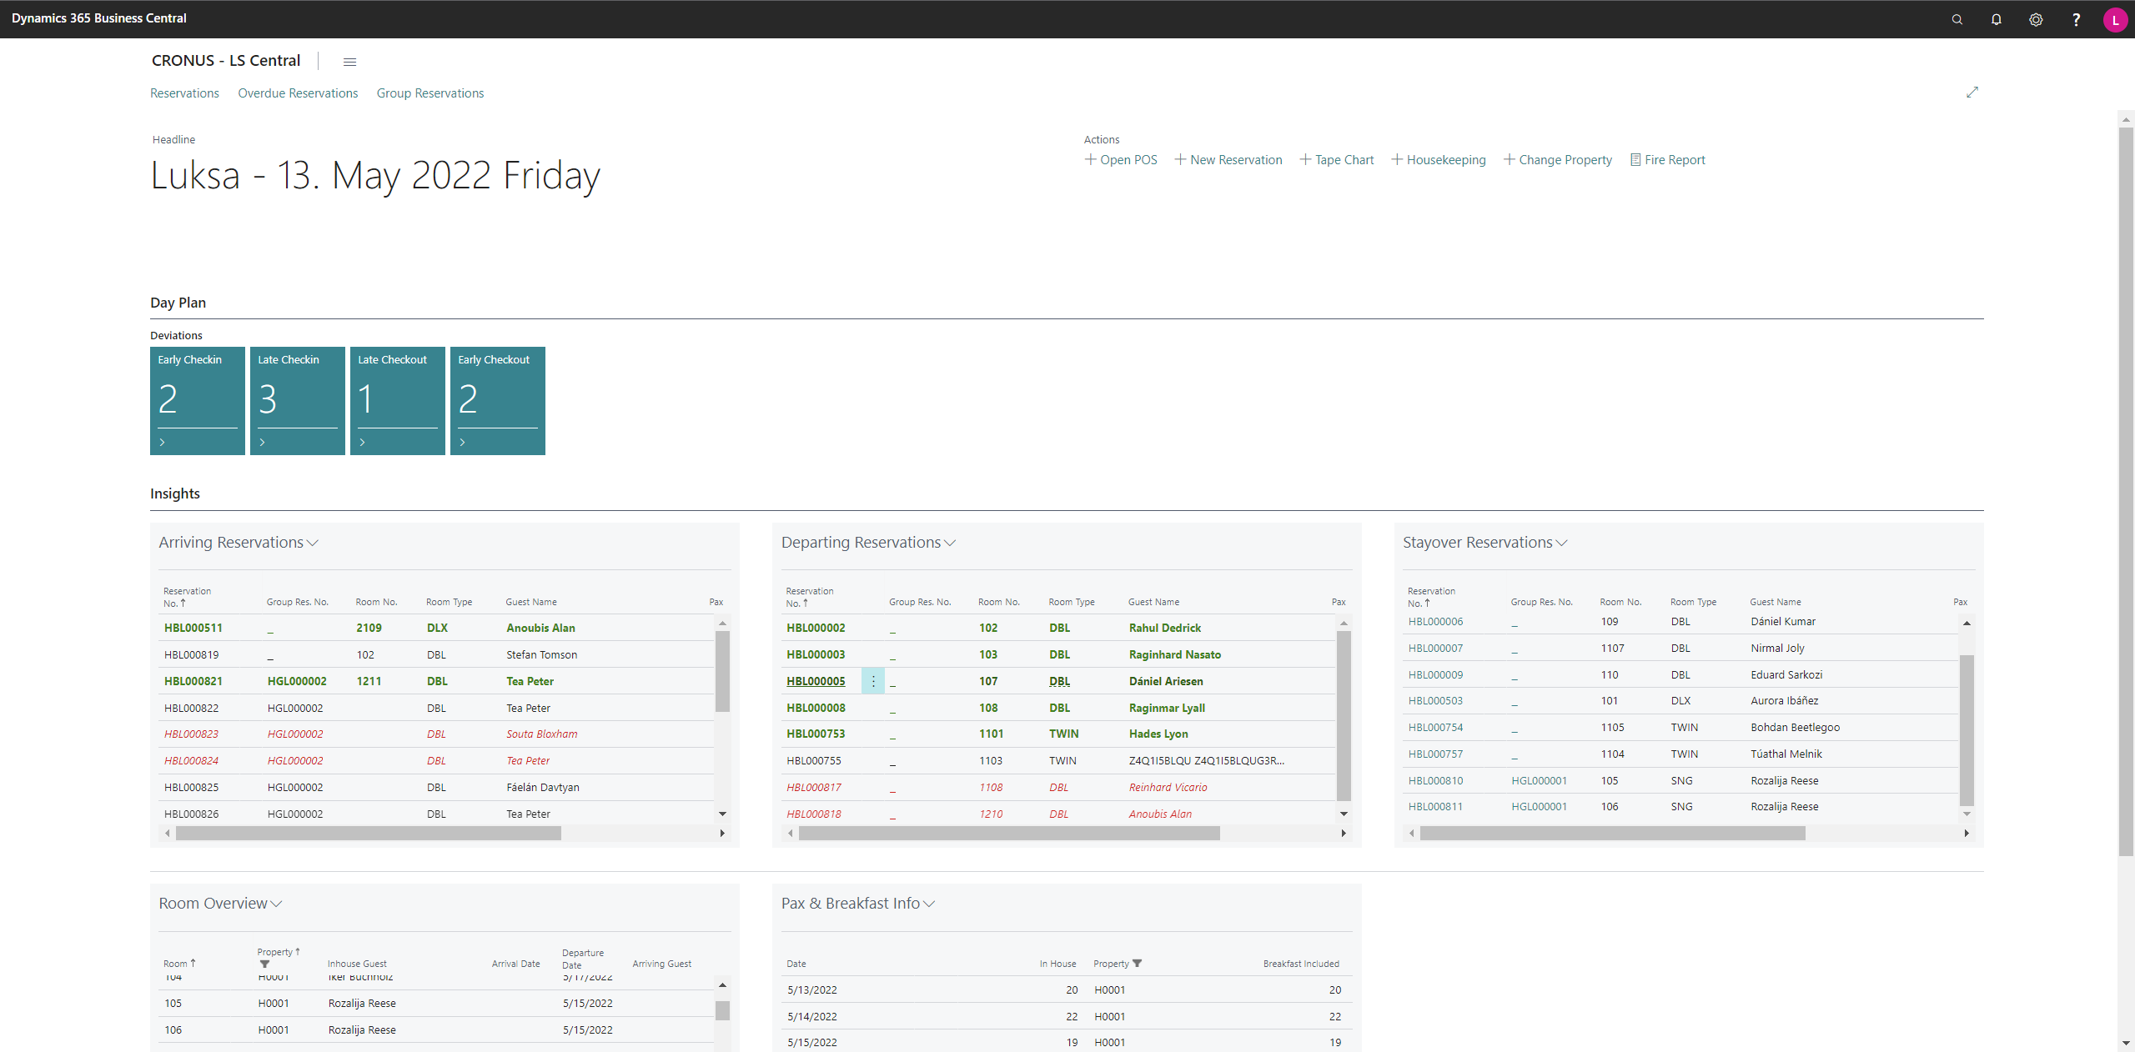
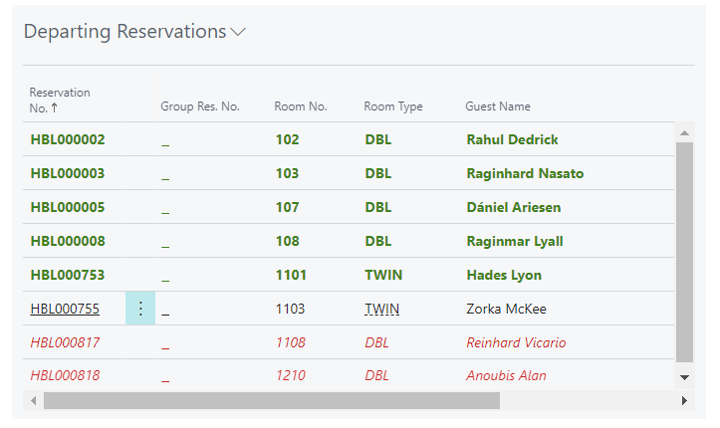
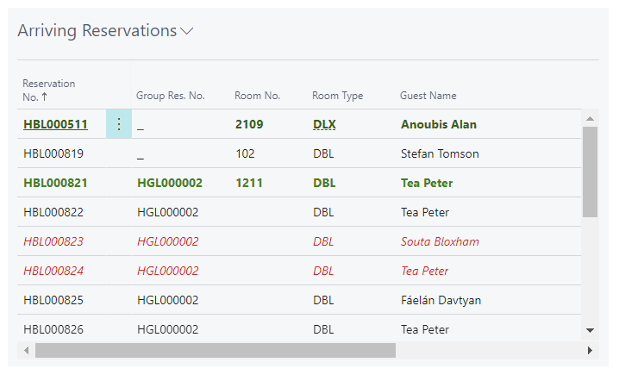

Slide 17
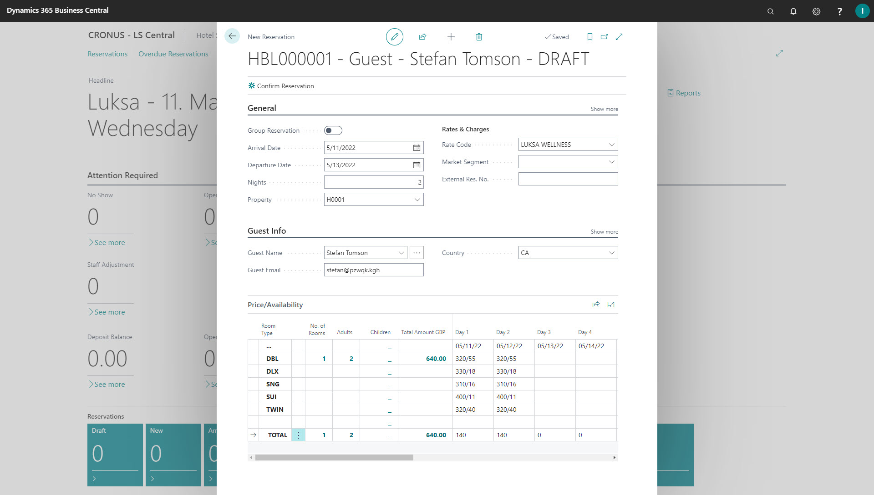
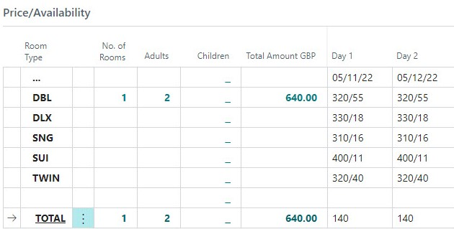

Slide 18
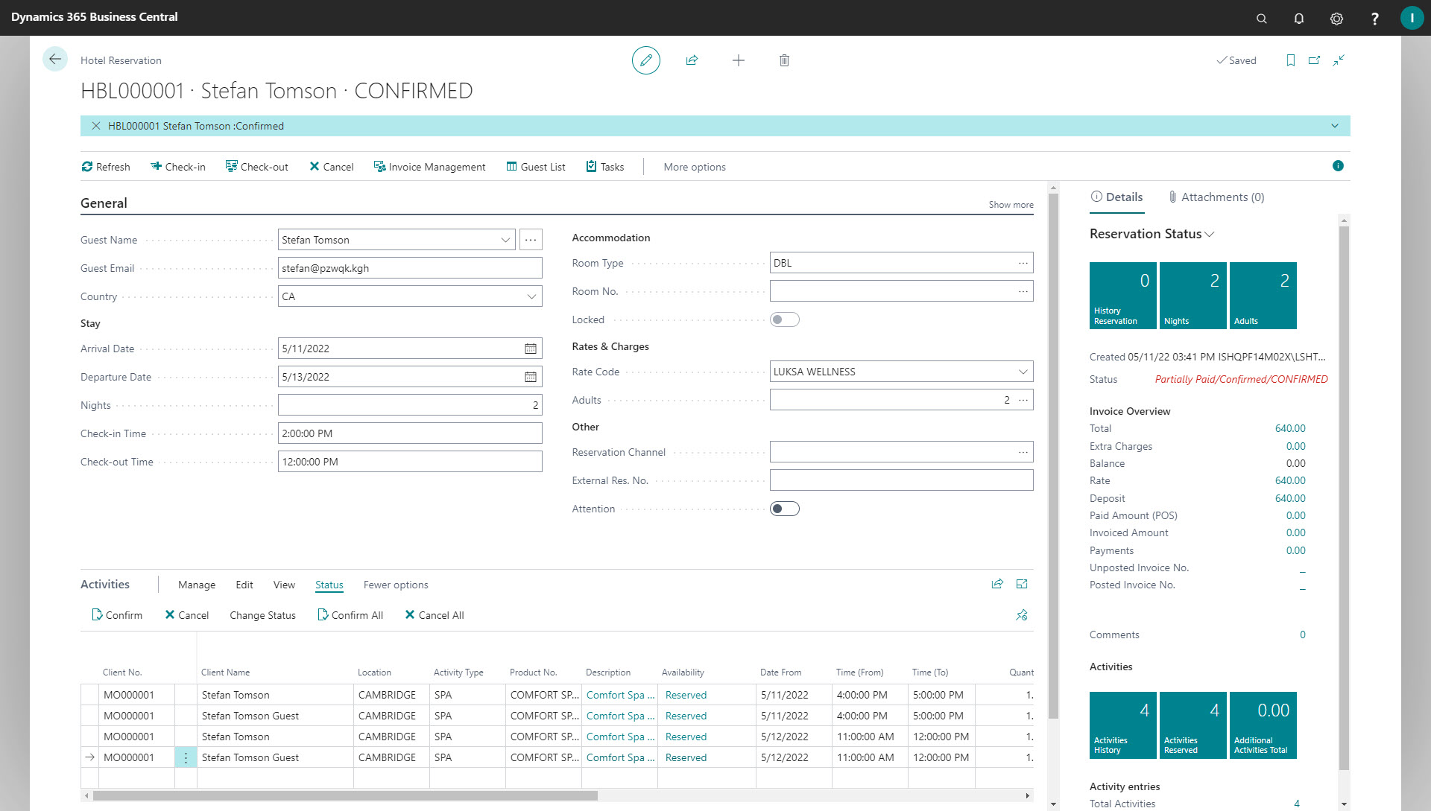

Slide 19
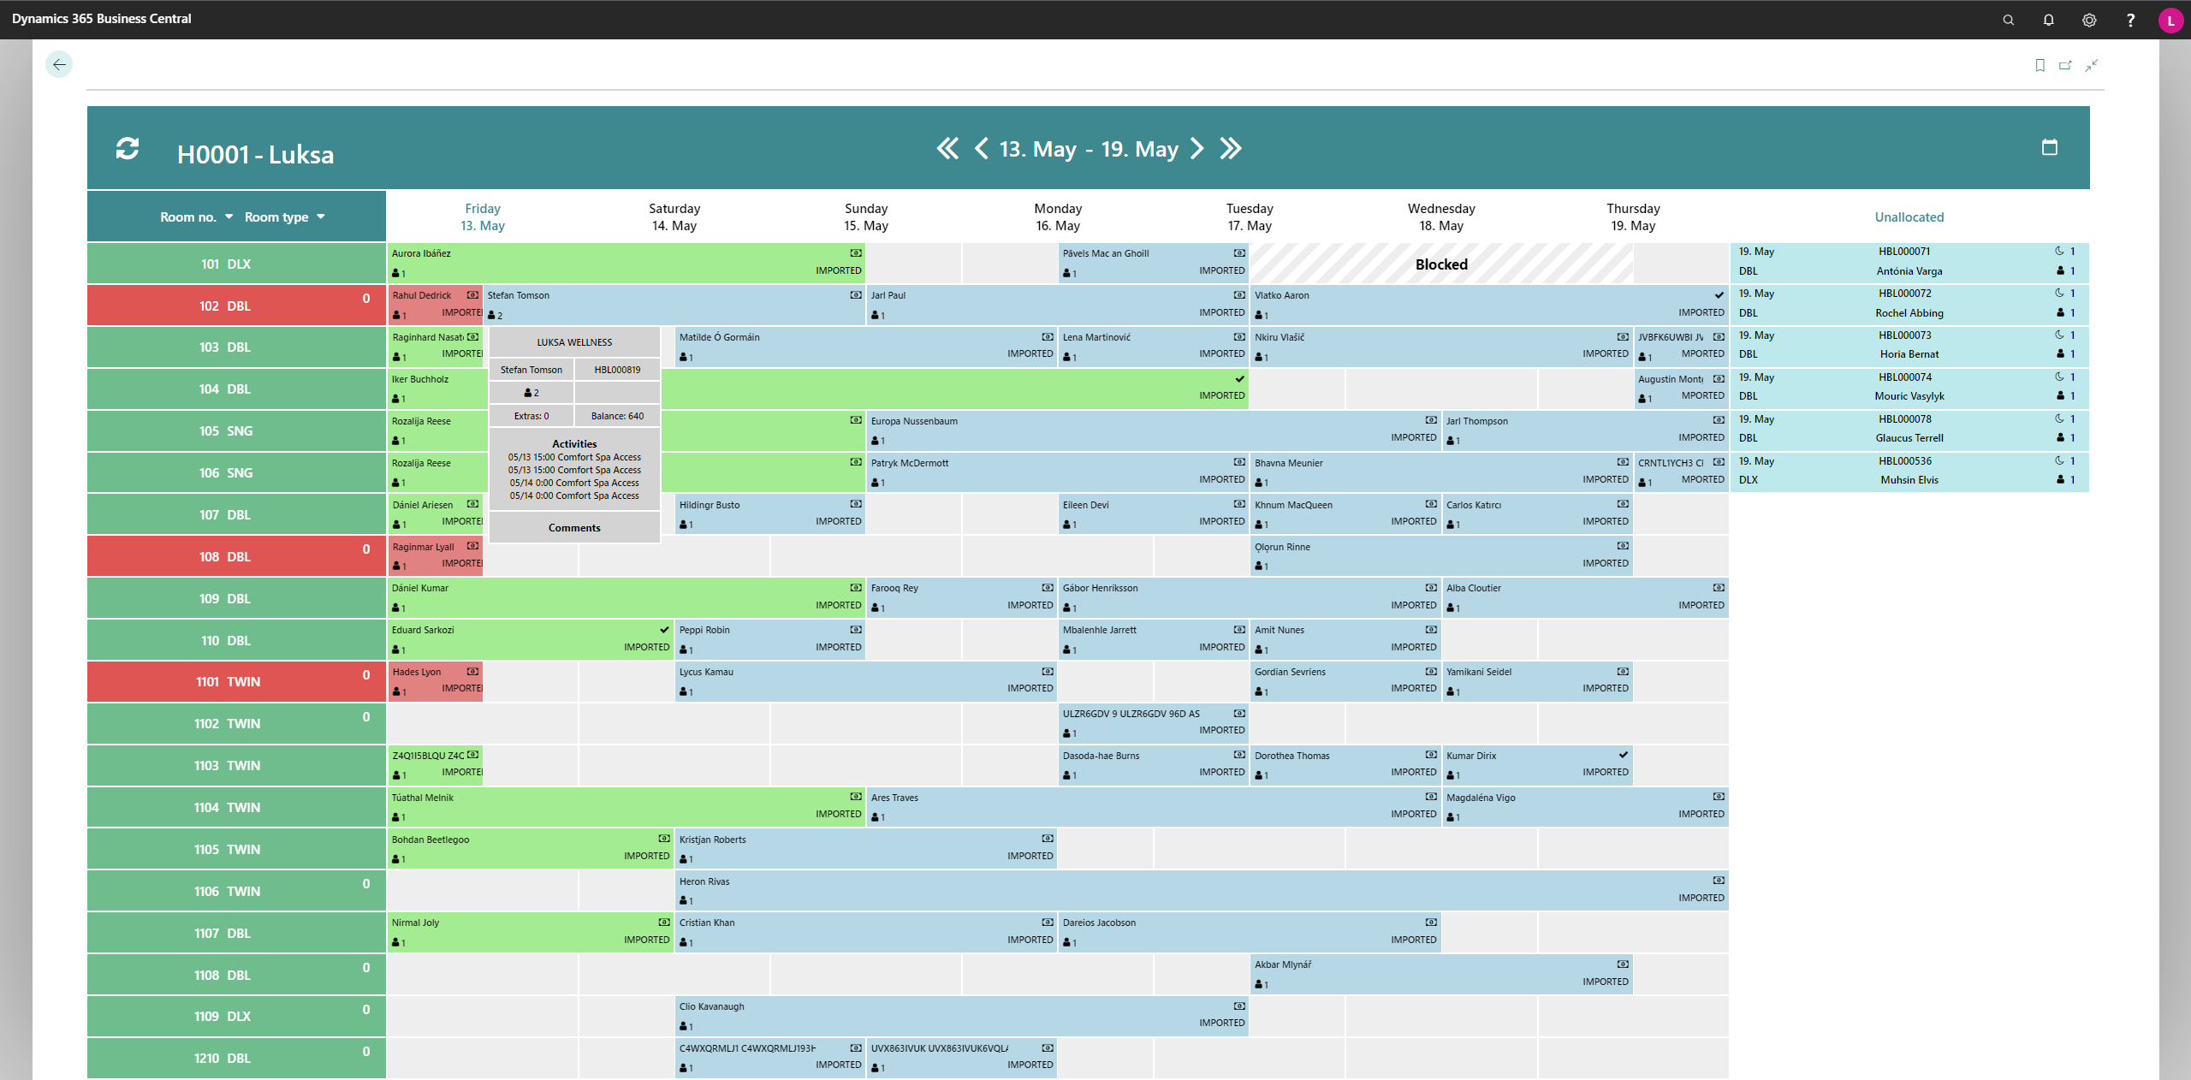
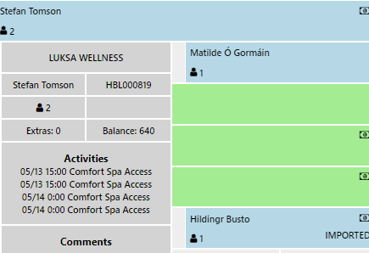

Slide 20
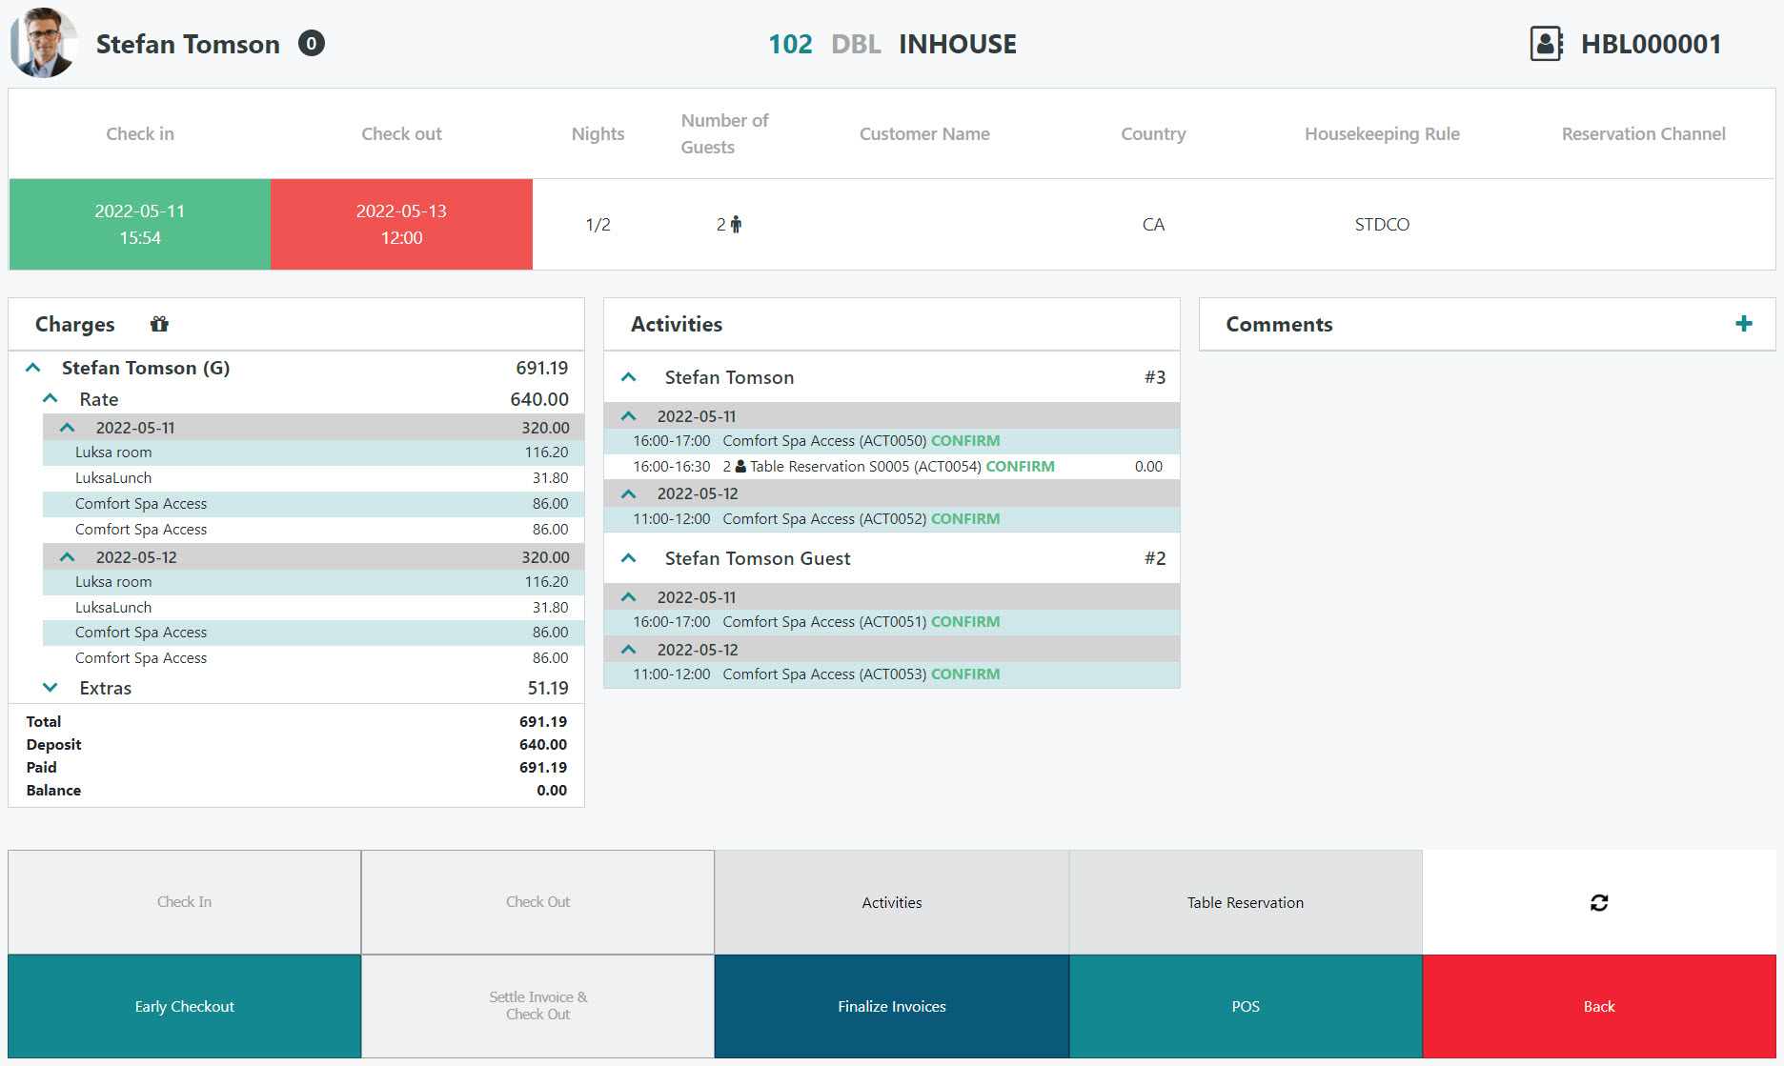
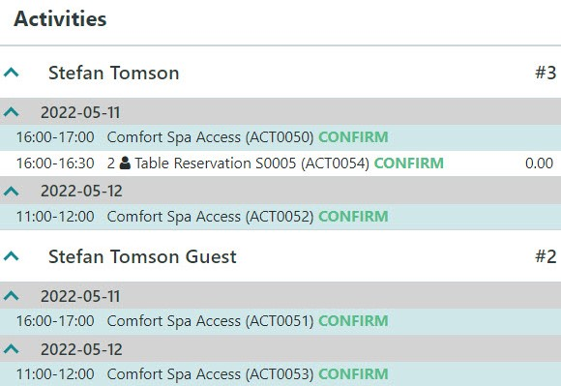
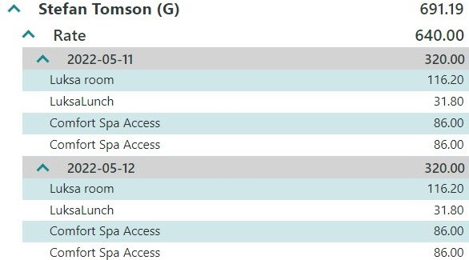

Slide 21
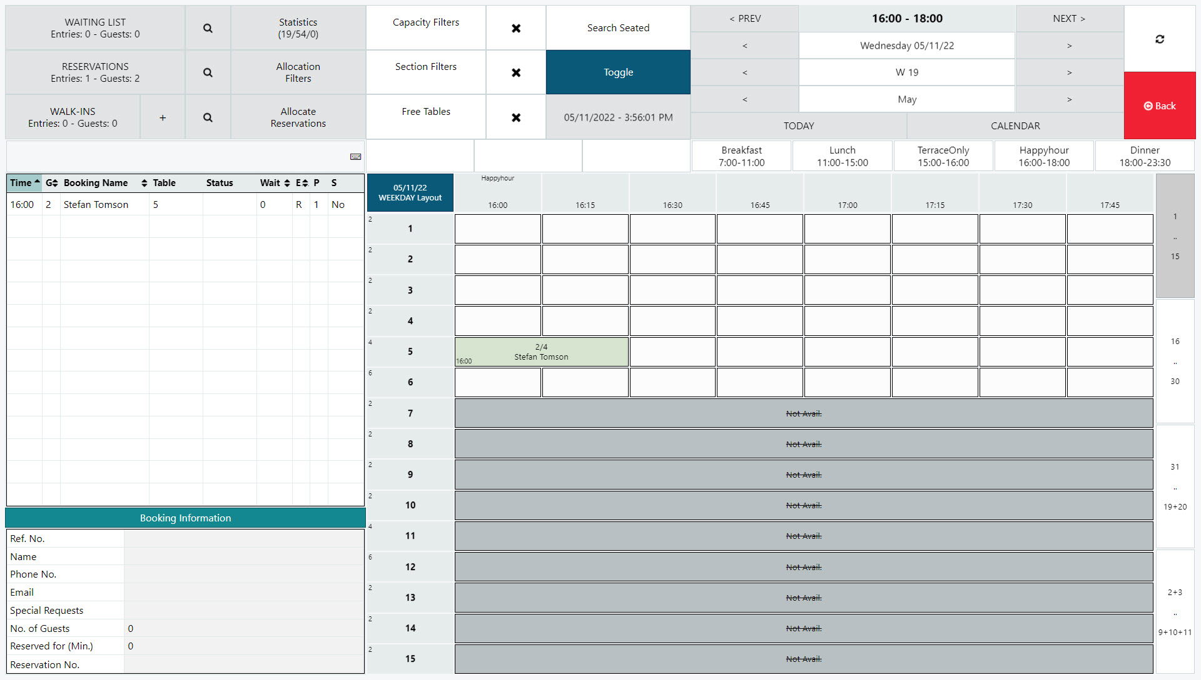

Slide 22
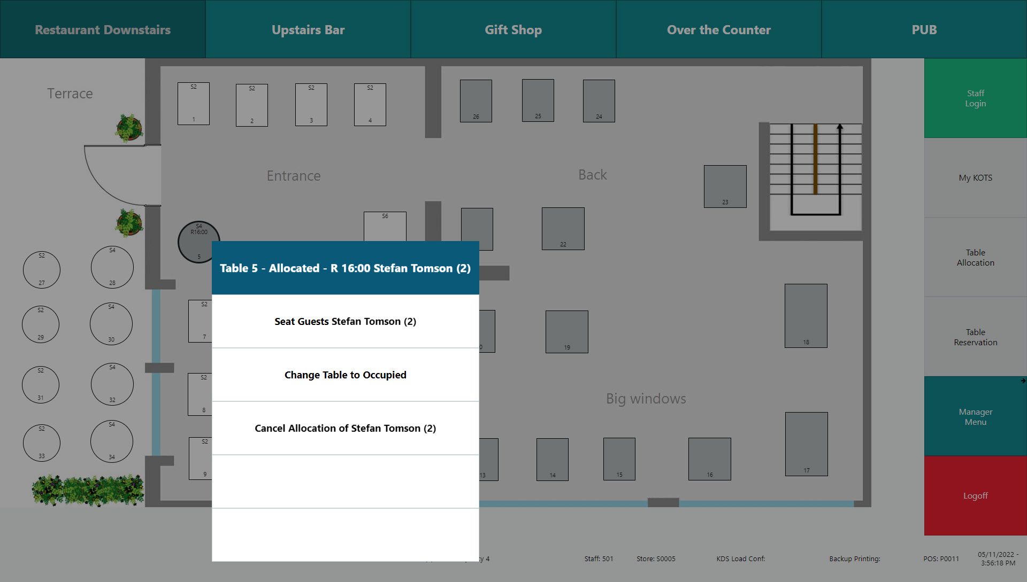

Slide 23
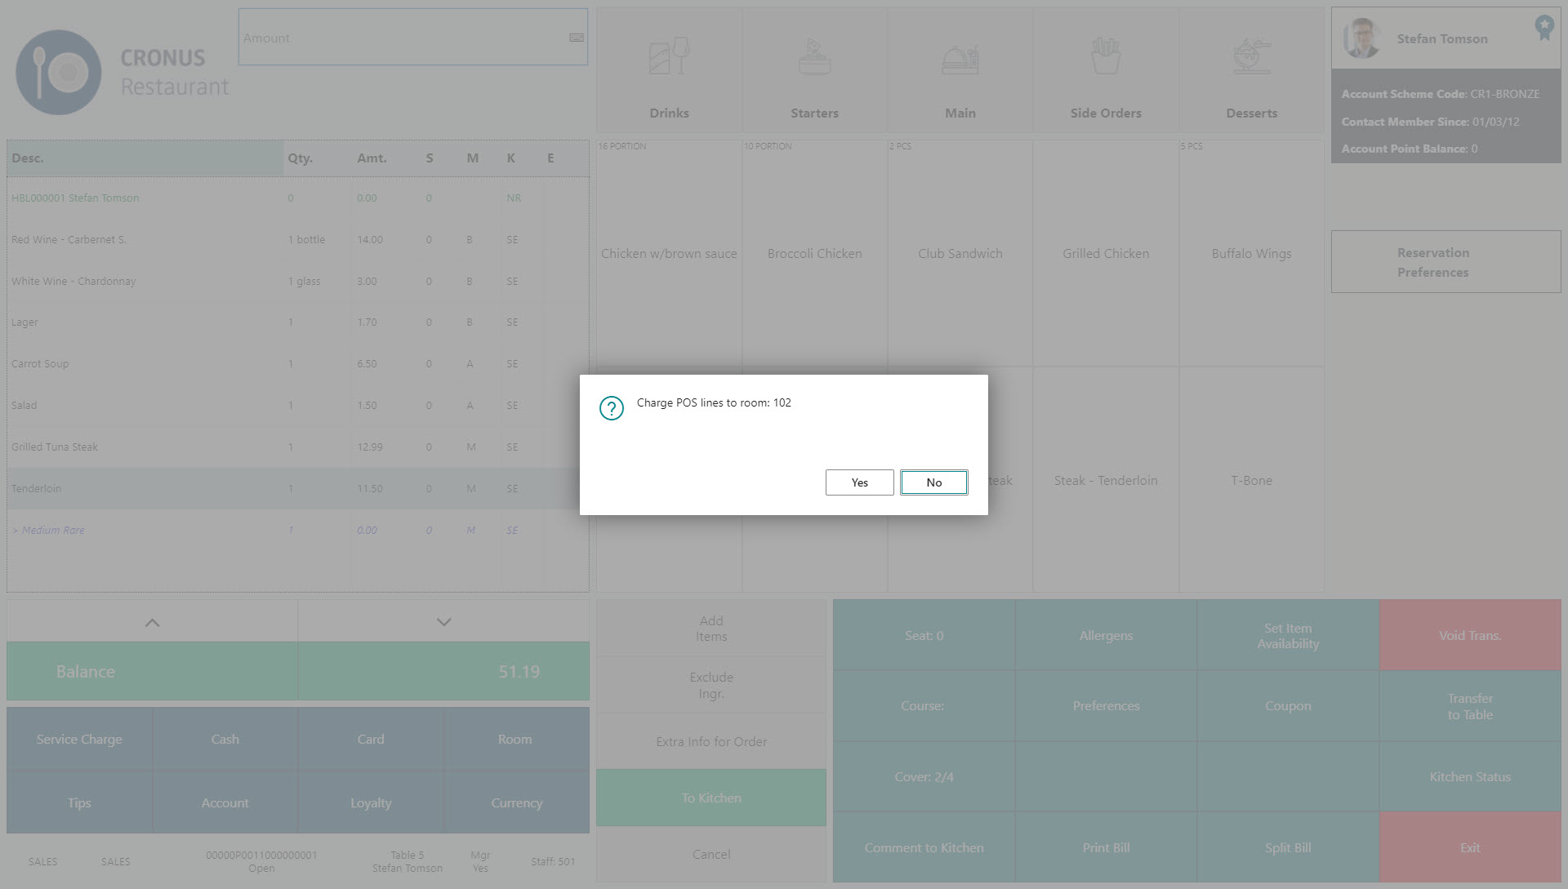

Slide 24
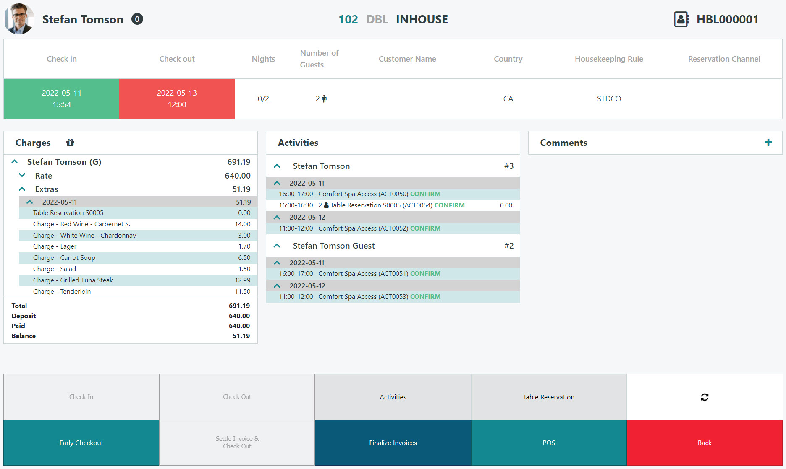
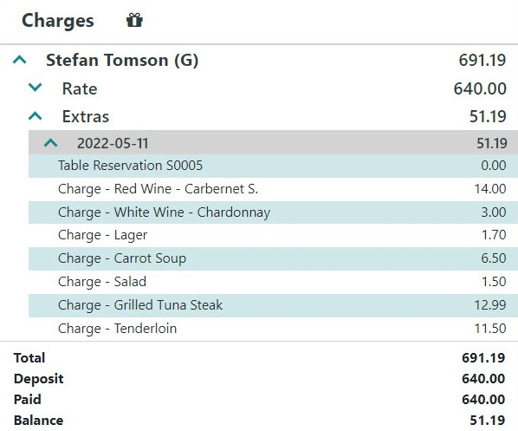

Slide 26
Unified Commerce
What‘s next?

Slide 27
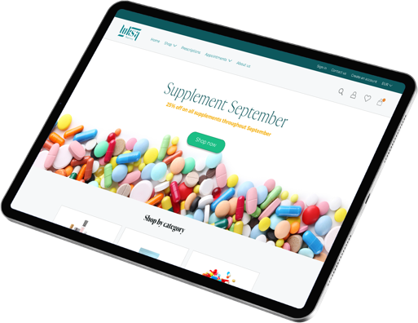
Unified Commerce
for pharmacies
Unified Commerce
What‘s next?

Slide 28
Easier
How can we help?
Simpler
Faster

Slide 29
How can we make sure our products are
SIMPLE TO LEARN

Slide 30
SaaS
Launched
2019
Available in
36
countries
In testing:
Portugal, Bulgaria, Lithuania, Croatia, Serbia, Slovenia
In progress:
Romania, Poland, Qatar, Ukraine, Latvia, Slovakia, Tunisia

Slide 31
SaaS
Later this year officially compliant with:
Microsoft Universal Code guidelines

Slide 32
SaaS
Universal Code is the end of a long journey for us

Slide 33
SaaS
No funtionality removed
Up-to-date with the latest releases from Microsoft

Slide 34
Still committed
to running LS Central both on SaaS as well as on-premises

Slide 35
Hybrid-cloud
strategy
customers can mix SaaS based back-office with an on-premises POS installation

Slide 36
SaaS = On premises
Same codebase – same functionalities
Hosting is the only difference

Slide 37
Increased release frequency
Two releases per month

Slide 38
1
week
average waiting time for a new event
LS Central
secondary release
Hotfix within
1 hour
LS Central
primary release
Microsoft Dynamics 365 Business Central

Slide 39
1
week
average waiting time for a new event
LS Central
secondary release
Hotfix within
1 hour
LS Central
primary release
Microsoft Dynamics 365 Business Central

Slide 40
Constantly
evolving

Slide 41
Constantly evolving
More users
and workloads

Slide 42
Constantly evolving
More transactions
and automatically scale up

Slide 43
Constantly evolving
Service tiers
handle increased loads automatically

Slide 44
Mike Morton
Microsoft Keynote
Tomorrow at 09:00

Slide 45
SaaS
is a great option
Low cost of ownership
Simple deployments
Monthly updates
Minimal IT management
Performance is good and getting better

Slide 46
SaaS Buddy program
helping partners implement their first SaaS projects

Slide 47
Gudrun Olafsdottir
Product Director

Slide 48
SaaS and on-premises
guided material

Slide 49
2020
Implementation guide

Slide 50
2021
SaaS guide

Slide 51
Active
listening

Slide 52
Onboarding buddy program
Assistance on SaaS related support and questions

Slide 53
Private onboarding sessions
100+
sessions

Slide 54
Cloud Acceleration Program

Slide 55
CAP
Cloud Acceleration Program

Slide 56
Partners journey to SaaS
Phase 1 – CSP Partner

Slide 57
Partners journey to SaaS
Phase 1 – CSP Partner
CSP

Slide 58
Partners journey to SaaS
Phase 1 – CSP Partner
CSP
Overview

Slide 59
Partners journey to SaaS
Phase 1 – CSP Partner
CSP
Overview
Training

Slide 60
Partners journey to SaaS
Phase 2 – Cloud Acceleration Program (CAP)

Slide 61
Partners journey to SaaS
Phase 2 – Cloud Acceleration Program (CAP)
SaaS License

Slide 62
Partners journey to SaaS
Phase 2 – Cloud Acceleration Program (CAP)
SaaS License
SaaS Project Evaluation Meeting

Slide 63
Partners journey to SaaS
Phase 2 – Cloud Acceleration Program (CAP)
Onboarding with Buddy Support
SaaS License
SaaS Project Evaluation Meeting

Slide 64
Partners journey to SaaS
Phase 2 – Cloud Acceleration Program (CAP)
Onboarding with Buddy Support
SaaS License
SaaS Project Evaluation Meeting
Guided Onboarding

Slide 65
Partners journey to SaaS
Phase 2 – Cloud Acceleration Program (CAP)
Onboarding with Buddy Support
SaaS License
SaaS Project Evaluation Meeting
Guided Onboarding
Onboarding with Consulting Team

Slide 66
Partners journey to SaaS
Phase 2 – Cloud Acceleration Program (CAP)
Onboarding with Buddy Support
SaaS License
SaaS Project Evaluation Meeting
Guided Onboarding
Onboarding with Consulting Team
Second SaaS License

Slide 67
Migration of commonly used services to the cloud
(Data Director, Update service, etc)

Slide 68
The future
of the POS
is unattended

Slide 69
The future
of the POS
is unattended

Slide 70
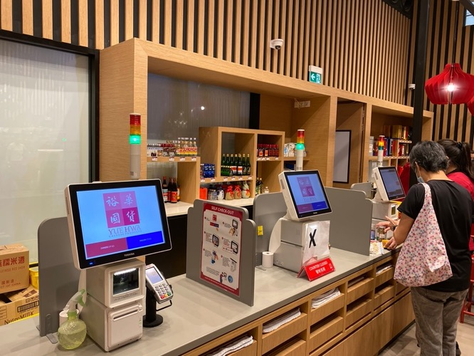
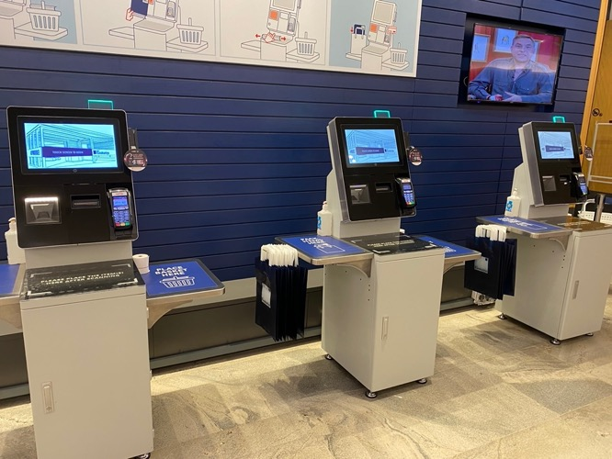
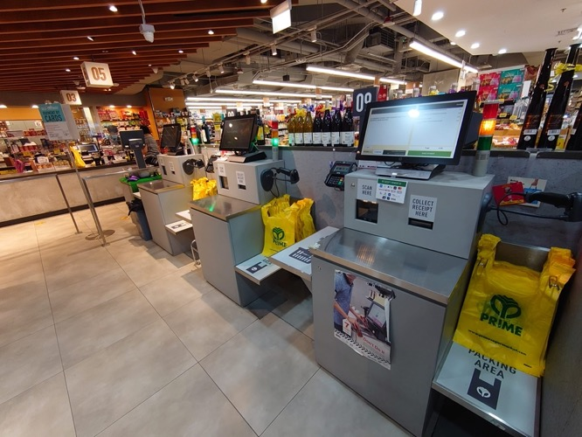
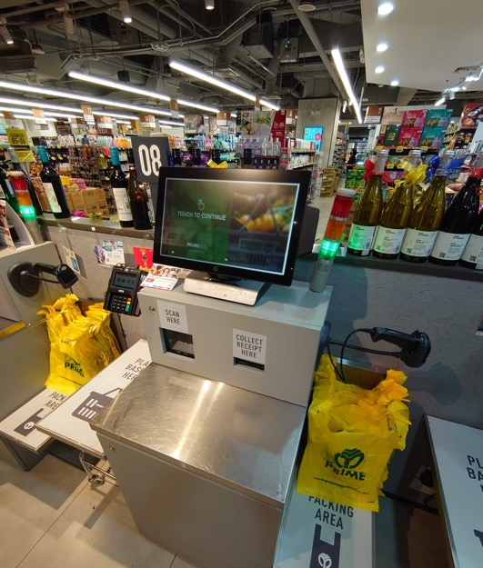
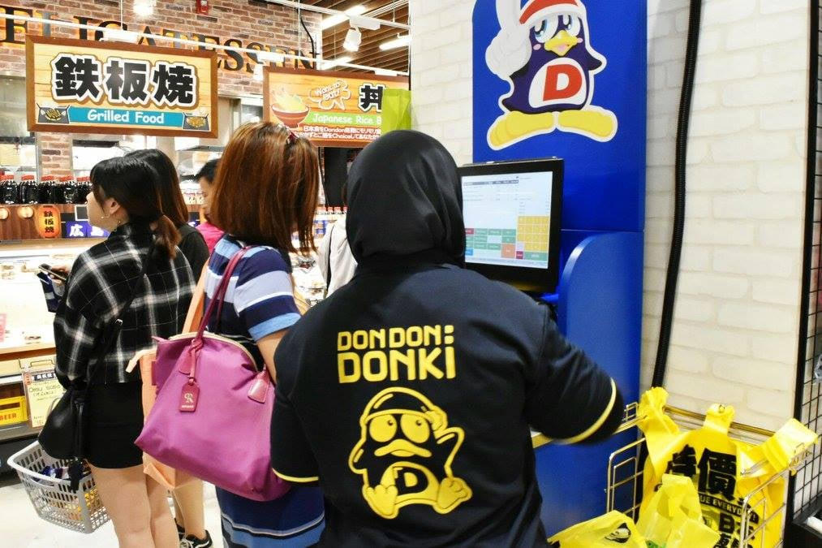
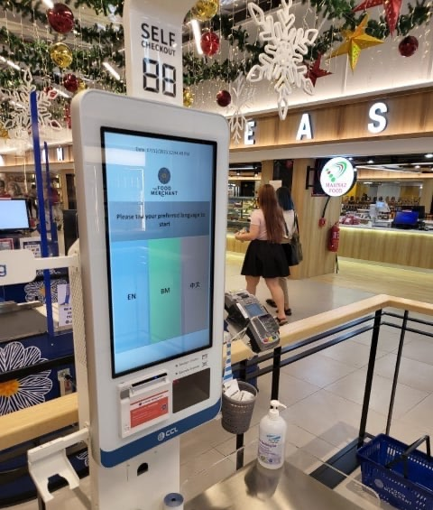
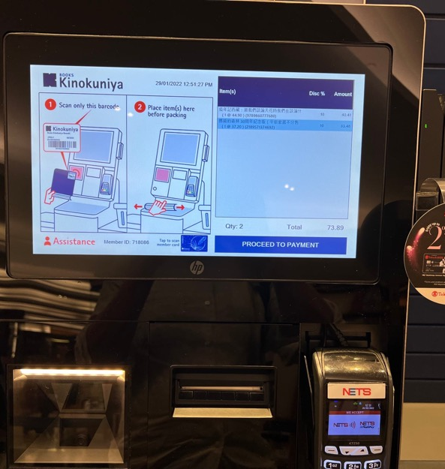

Slide 71
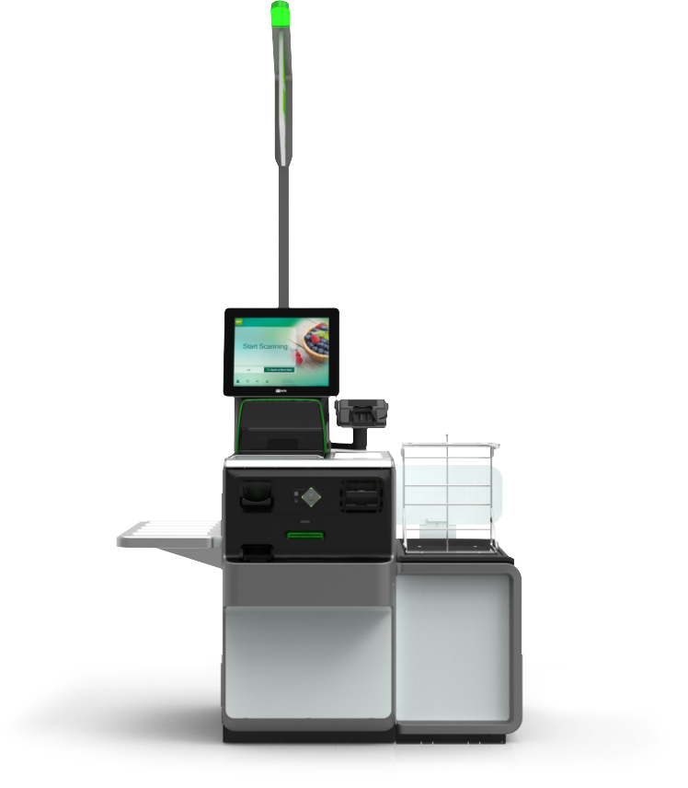
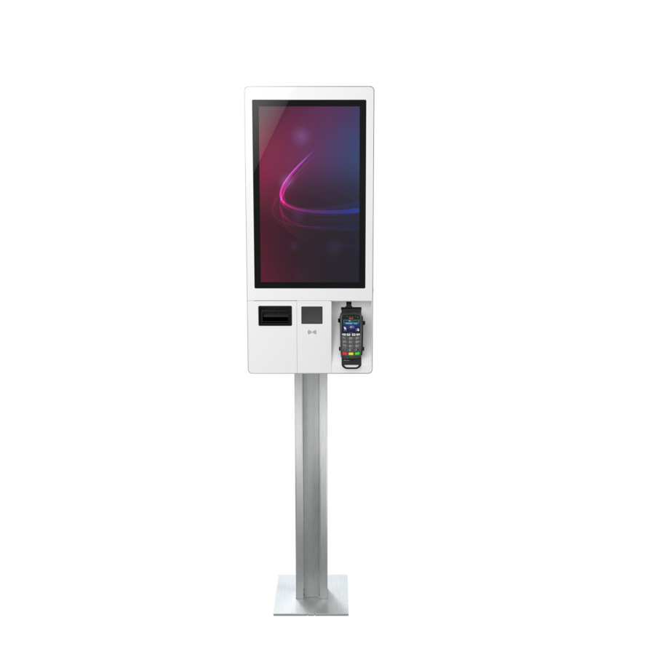
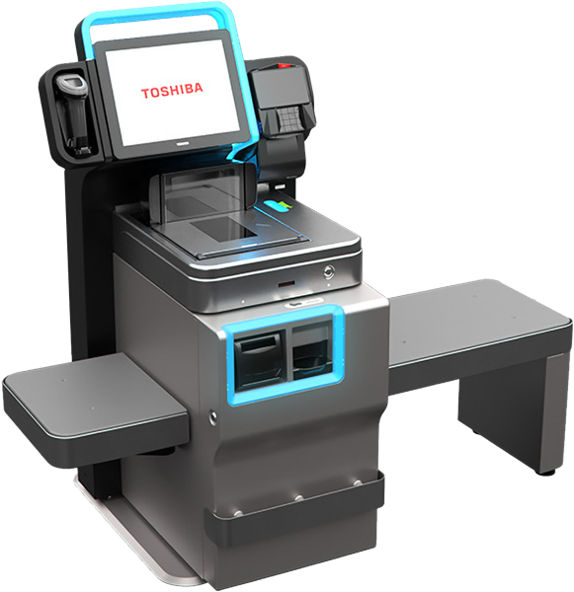

Slide 73
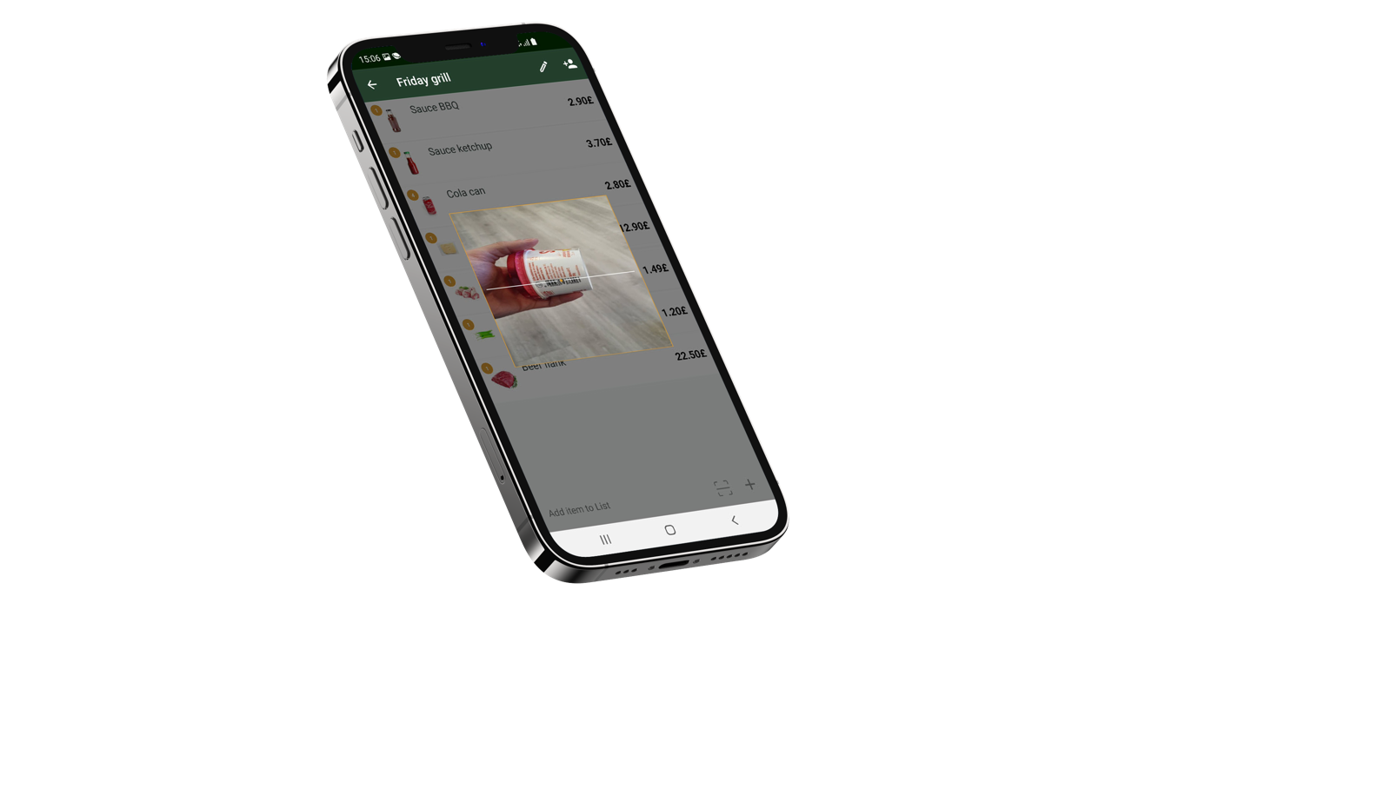
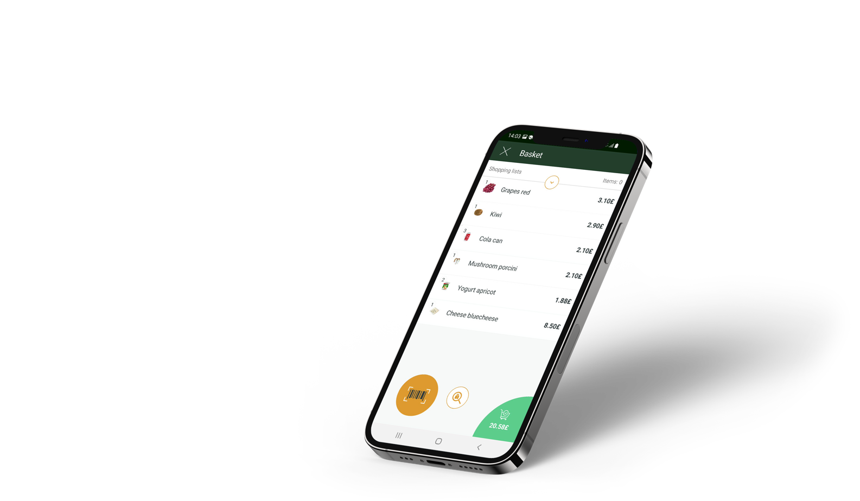

Slide 74
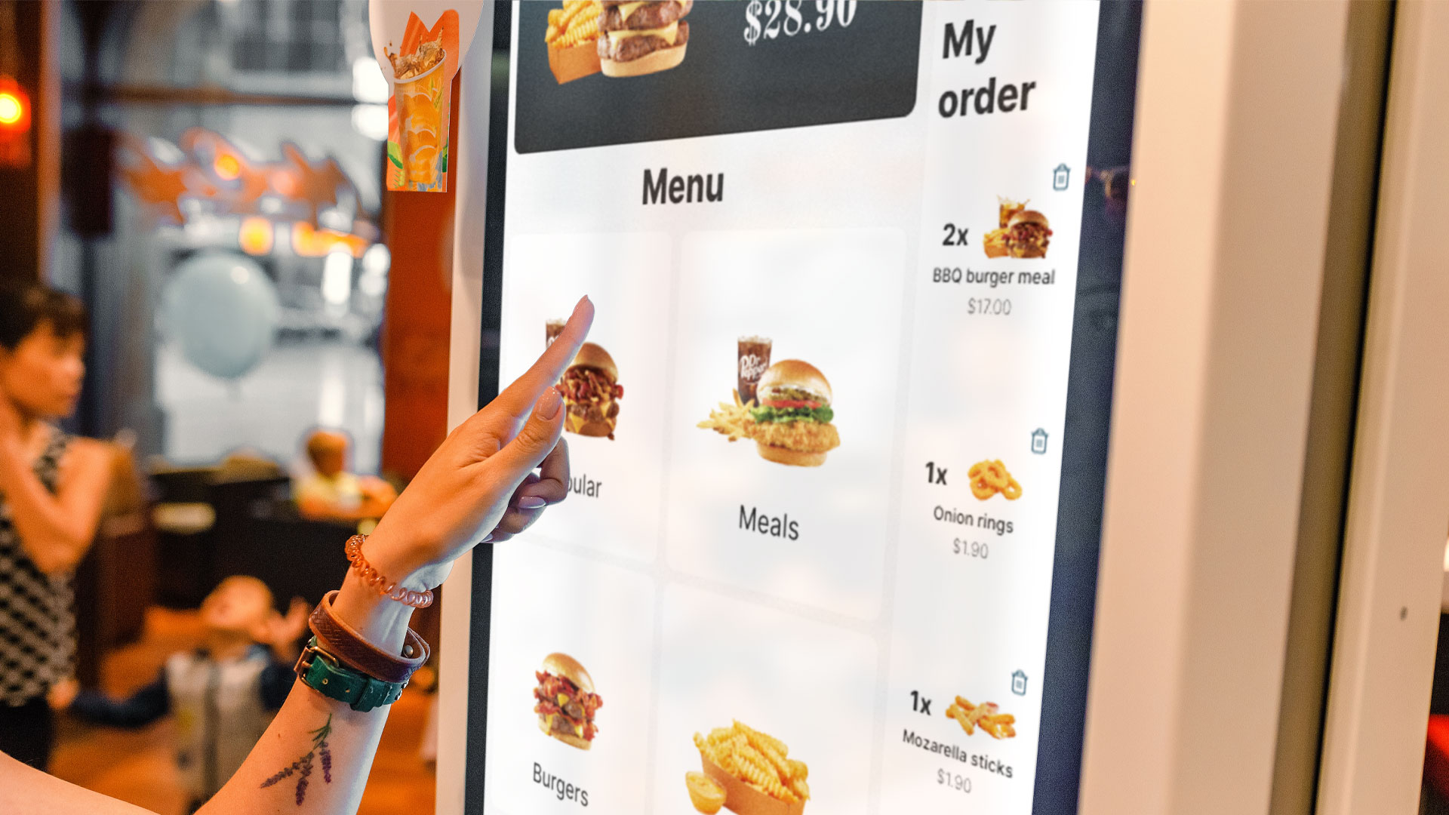

Slide 75
Unattended POS Part of Unified Commerce

Slide 77
LS Insight
Business Intelligence based on Microsoft PowerBI + Azure
Integrates out-of-the Box with LS Central
78 reports in 5 report packs
Available for free

Slide 78
LS Recommend
Recommendations based on sales history for POS & eCommerce
New version supports LS Central SaaS
Reduced calculation time and simplified implementation process
30 min. to calculate 100 million transactions

Slide 79
LS Forecast
Sales forecasting engine
Avoid out-of-stock situations and increase product availability
SaaS based – Transaction based pricing
Integrates out-of-the-box with LS Central

Slide 80
Actionable Insights
Transforming data in LS Central to insights - on top of processes

Slide 81
Martin Kleindl
Product Director

Slide 82
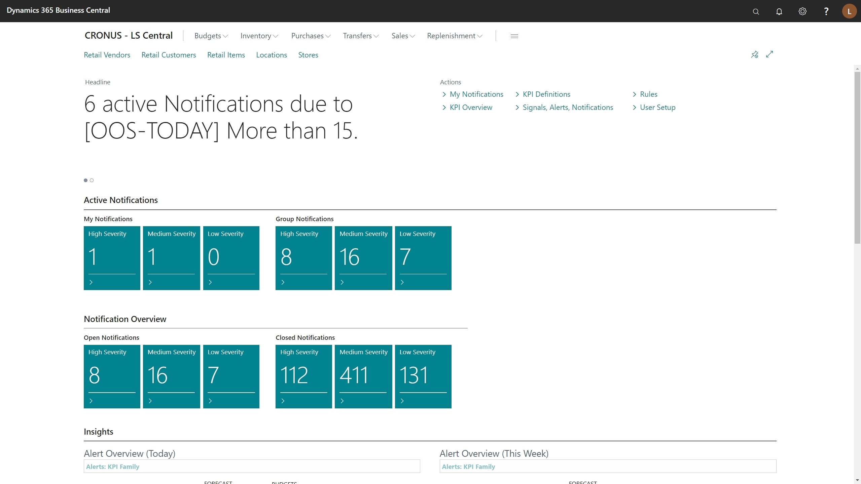

Slide 83
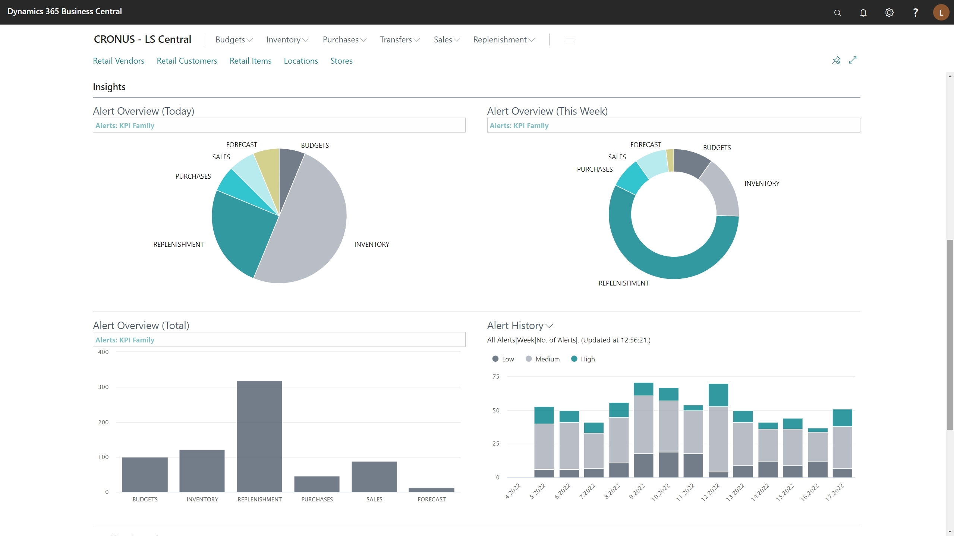

Slide 85
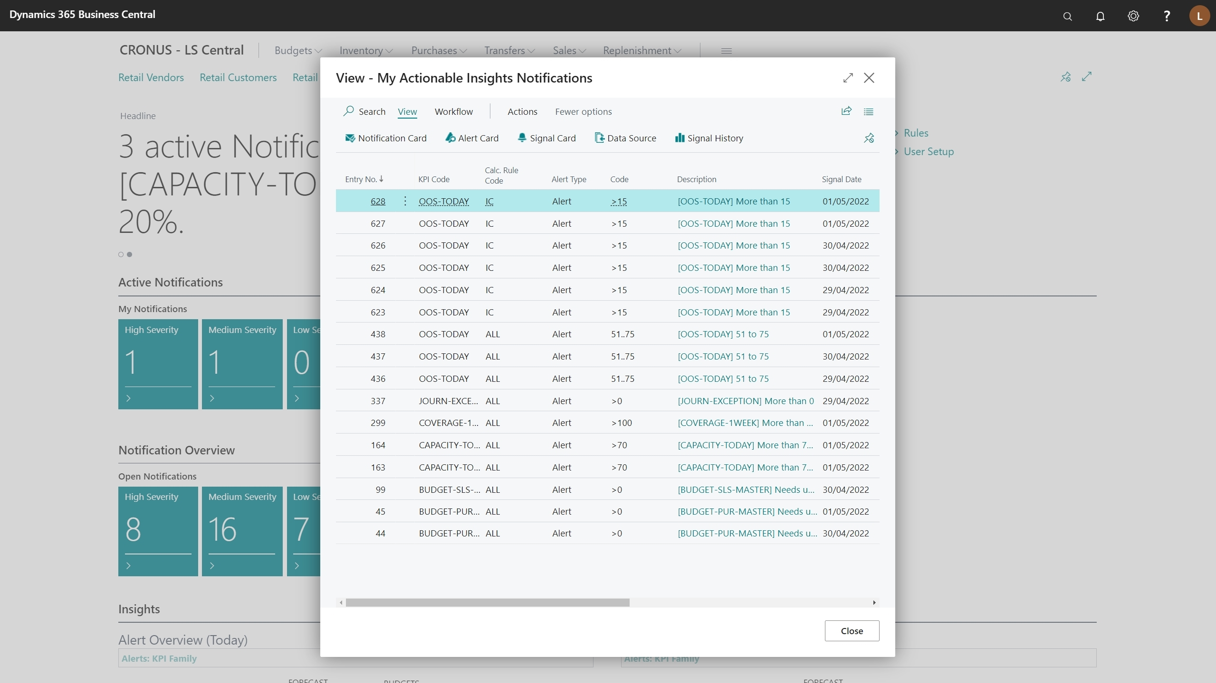

Slide 86
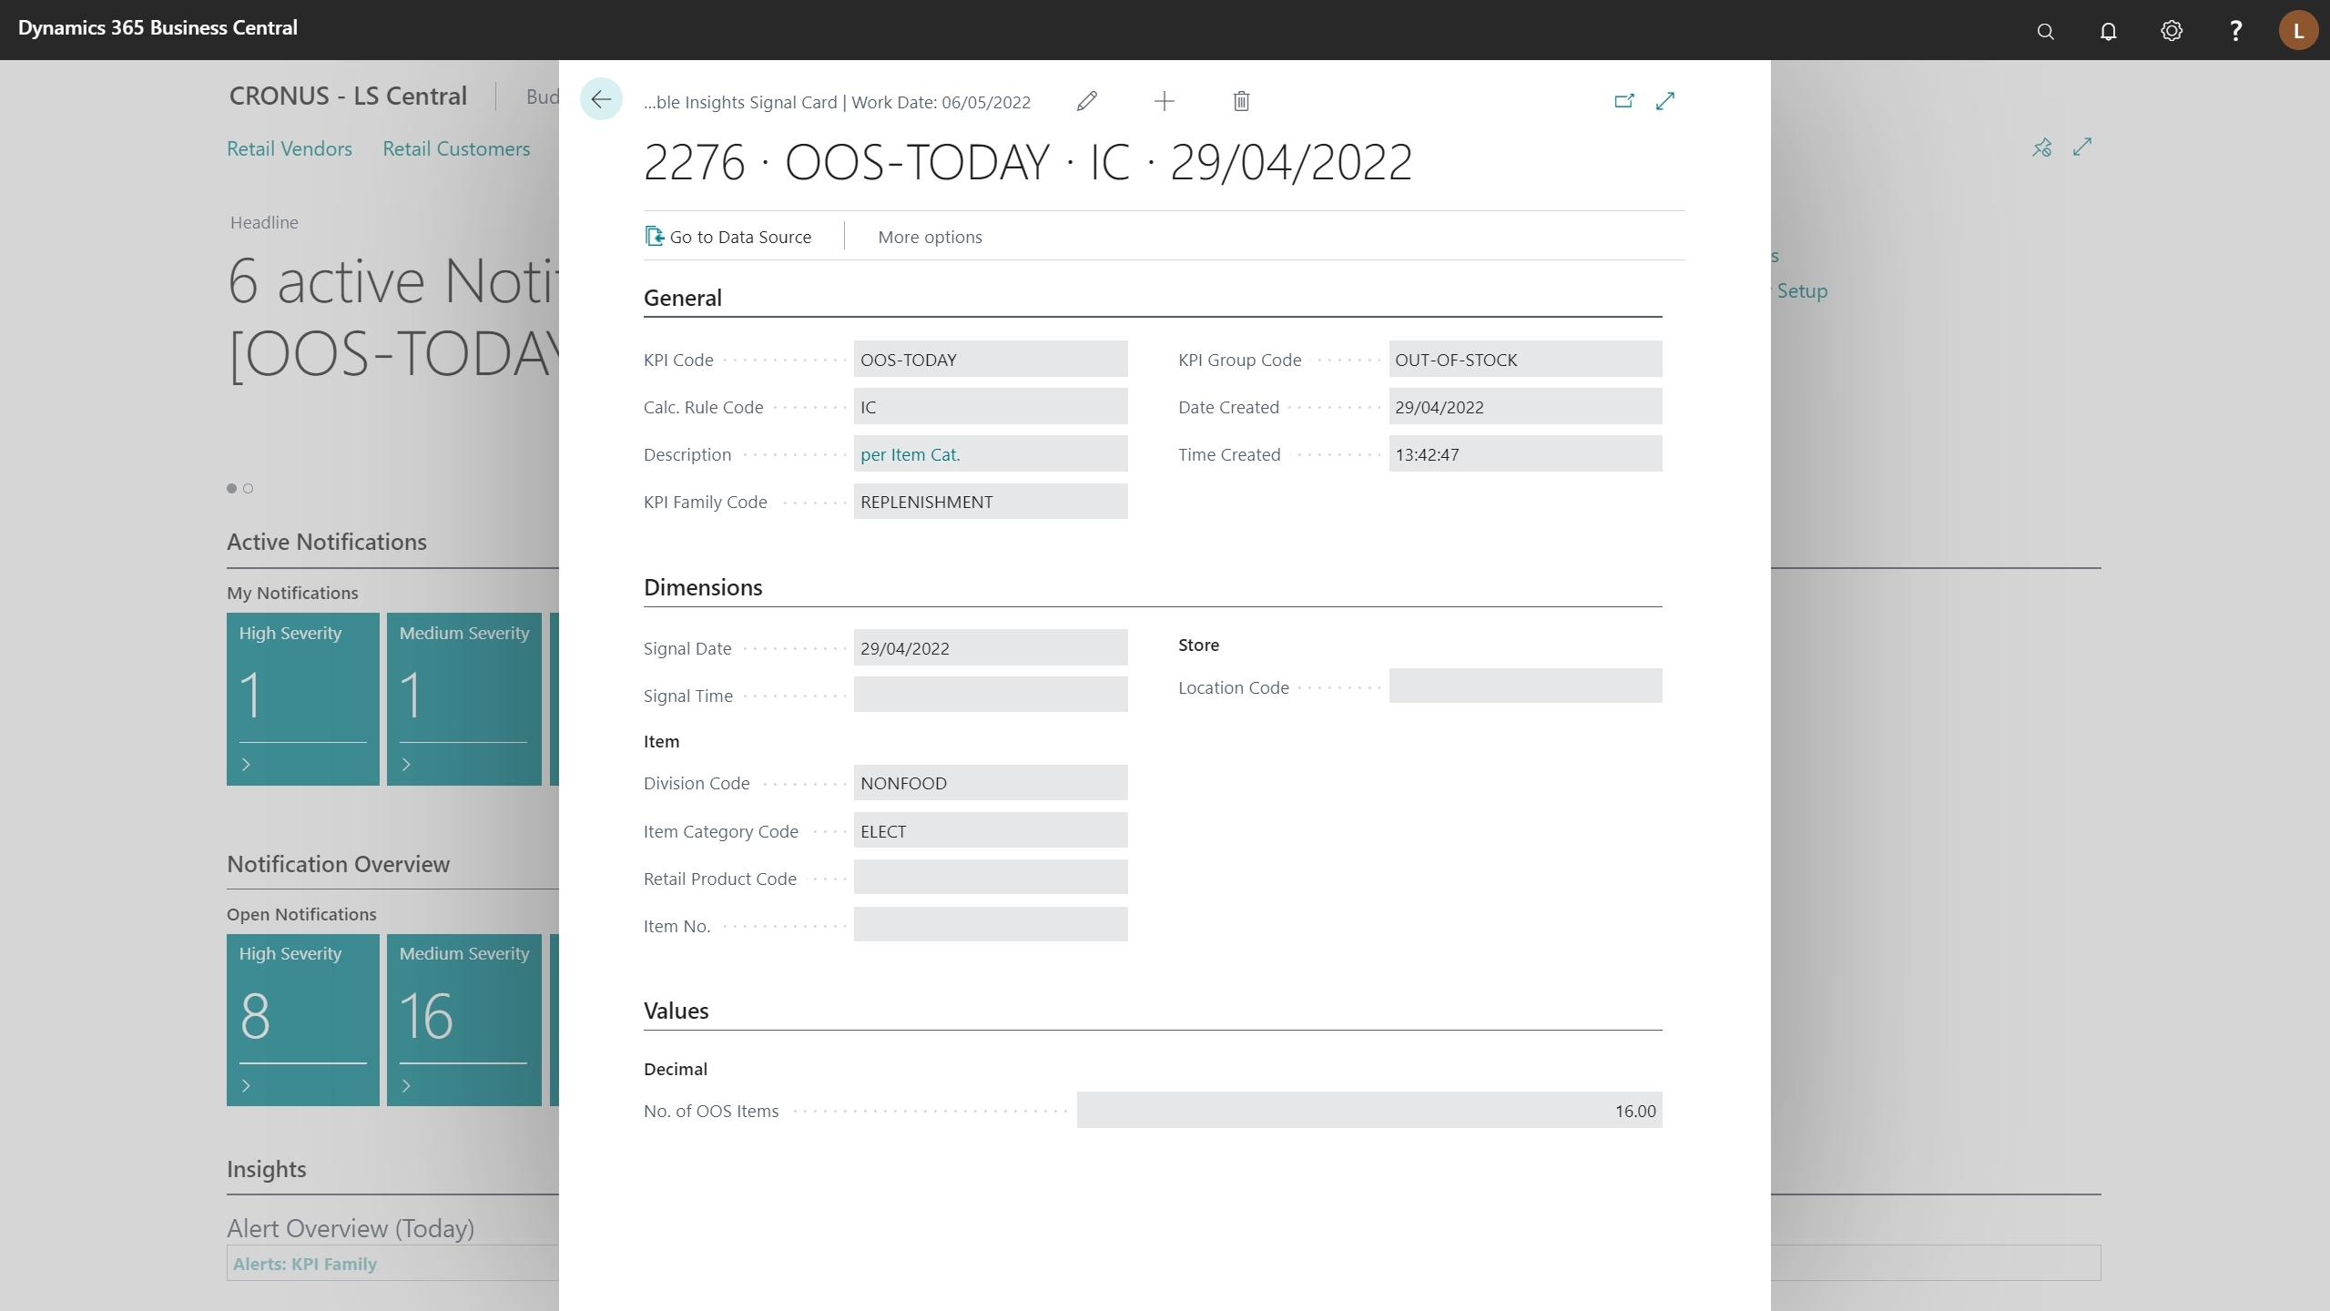

Slide 87
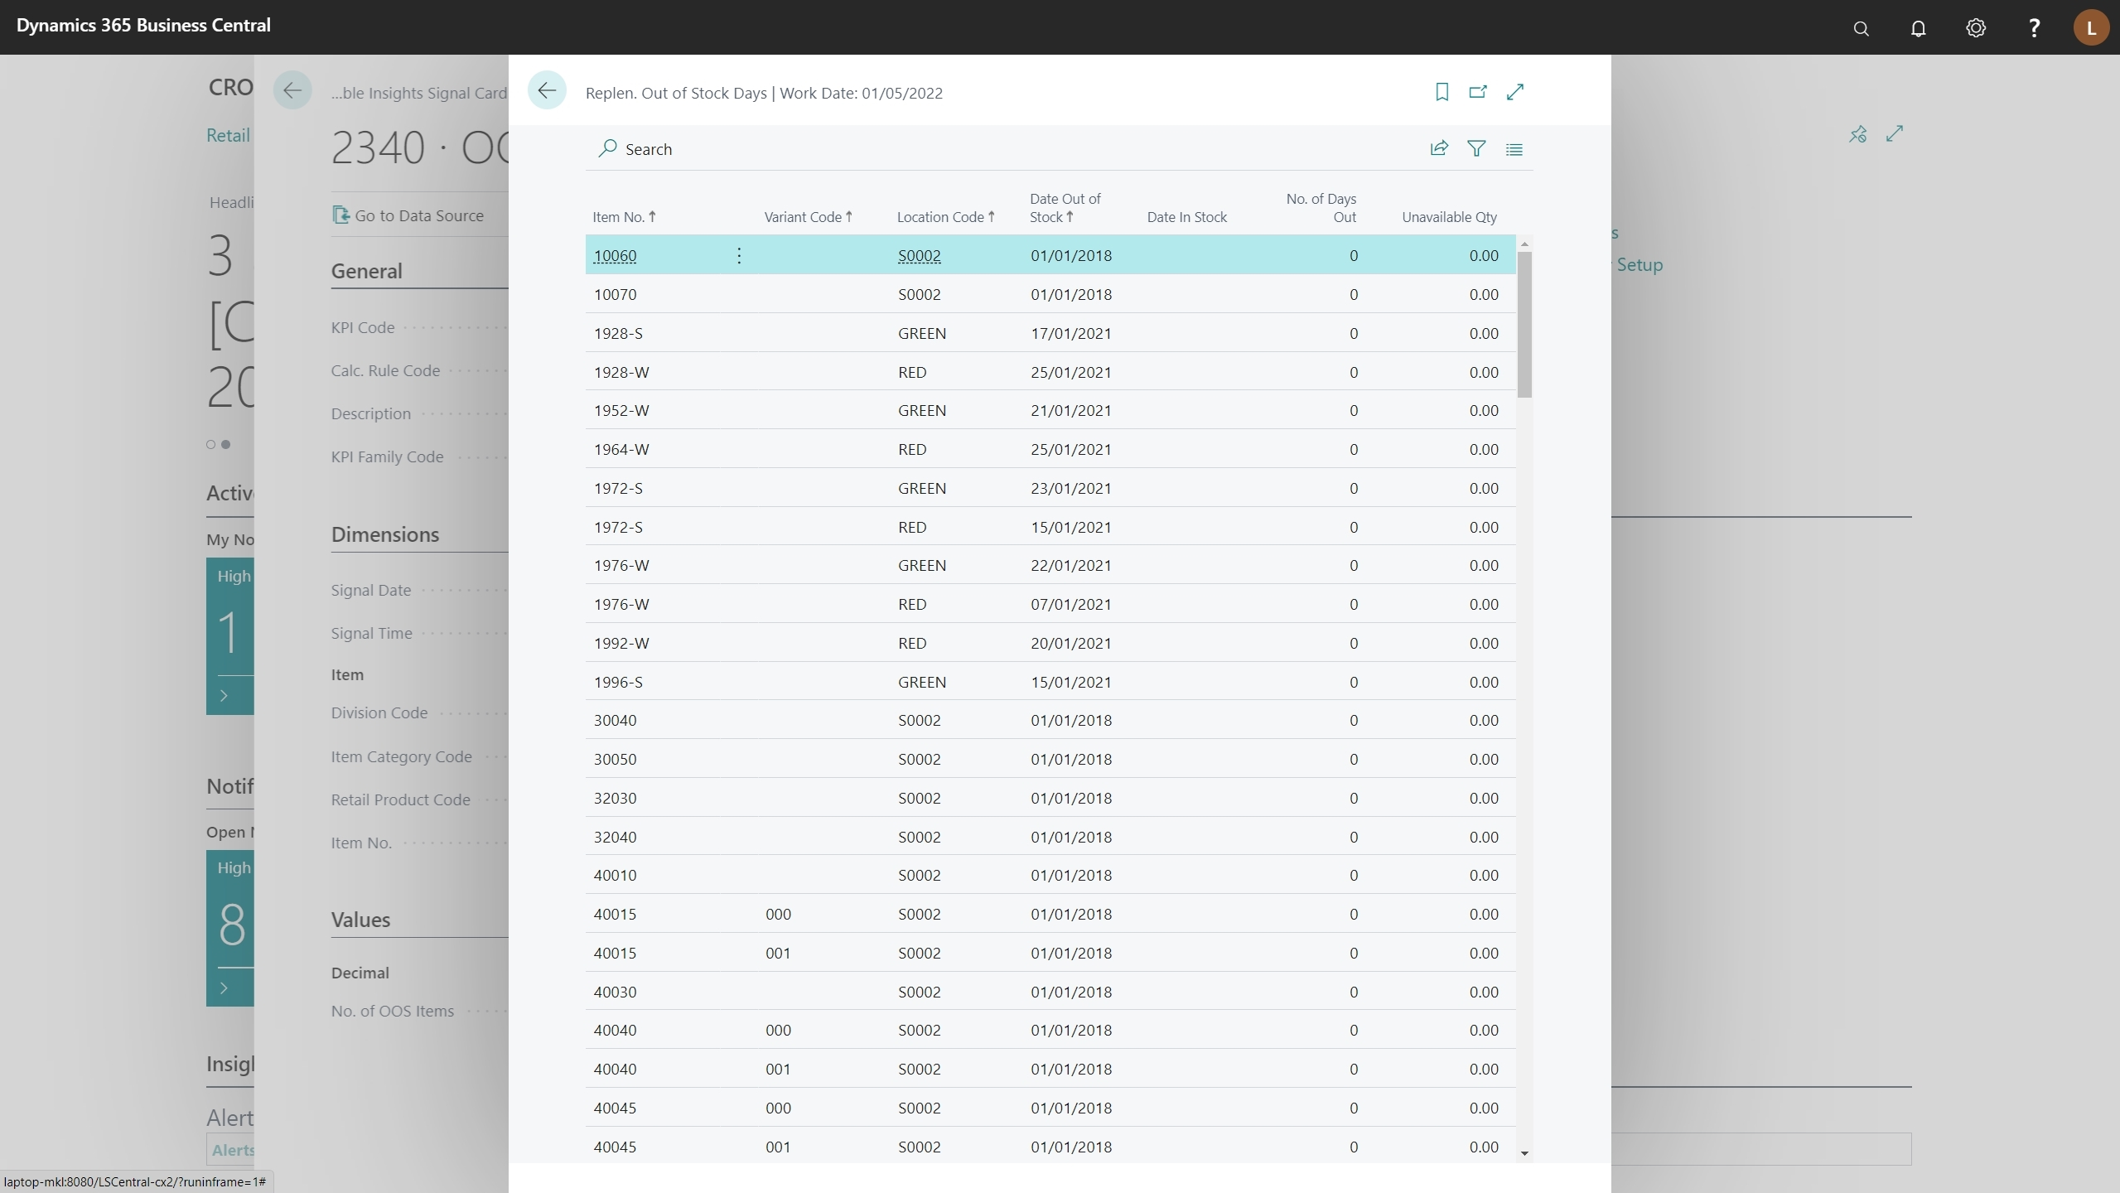

Slide 89
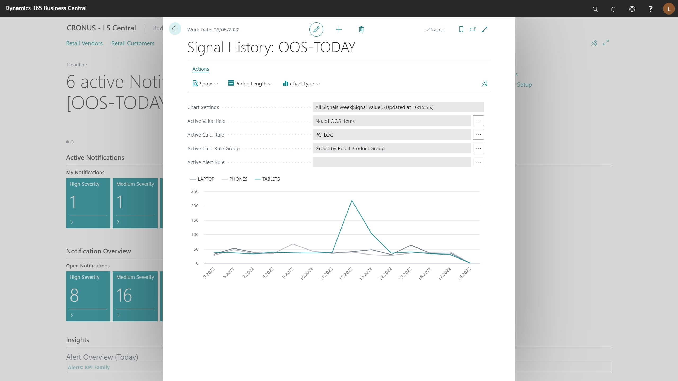

Slide 91
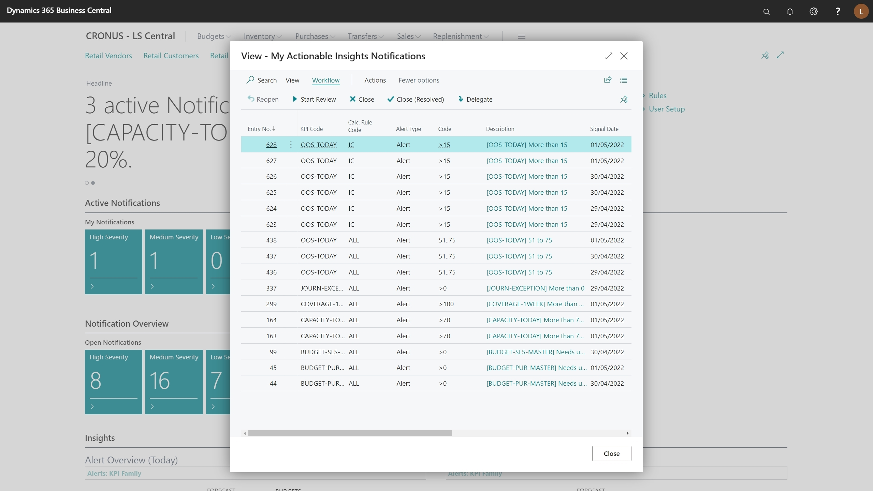

Slide 93
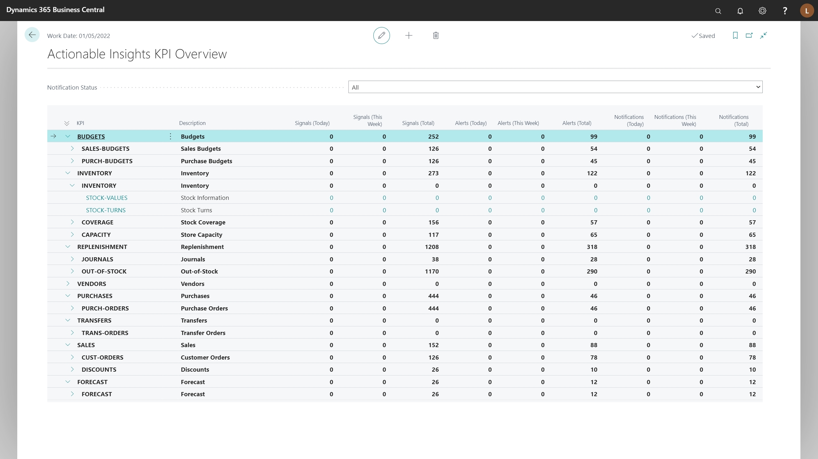

Slide 95
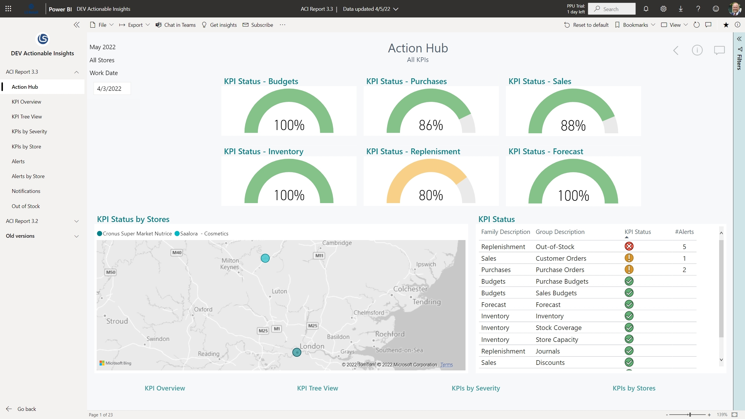

Slide 96
Actionable Insights
Transforming data in LS Central to insights - on top of processes

Slide 97
Roadmap
Universal Code support
Performance
Telemetry and monitoring in Azure
Pull-requests from partners
Migration of services to the cloud
Intelligent Cloud

Slide 98
Roadmap
Universal Code support
Performance
Telemetry and monitoring in Azure
Pull-requests from partners
Migration of services to the cloud
Intelligent Cloud

Slide 99
Roadmap
Universal Code support
Performance
Telemetry and monitoring in Azure
Pull-requests from partners
Migration of services to the cloud
Intelligent Cloud

Slide 100
Thank you
#together

Slide 101
Thank you
#together

