Slide 1


Slide 2

eCommerce for LS Central
Part II
Petur Thor Sigurdsson
Product Director

Slide 3





Retail
Hospitality
Activity
Pharmacy
Retail
eCommerce API
LS Commerce Services
3rd party
eCommerce
providers

Slide 4






Eco system: Available Payment Plugins
Payment Service Provider
(PSP)
Point of Sale
Transaction Repository

Slide 5
Magento Unified
Commerce Demo

Slide 6
Traditional UI
Progressive Web App (PWA)
eCommerce API
LS Commerce Services

Slide 7


Slide 8
Questions?

Slide 9


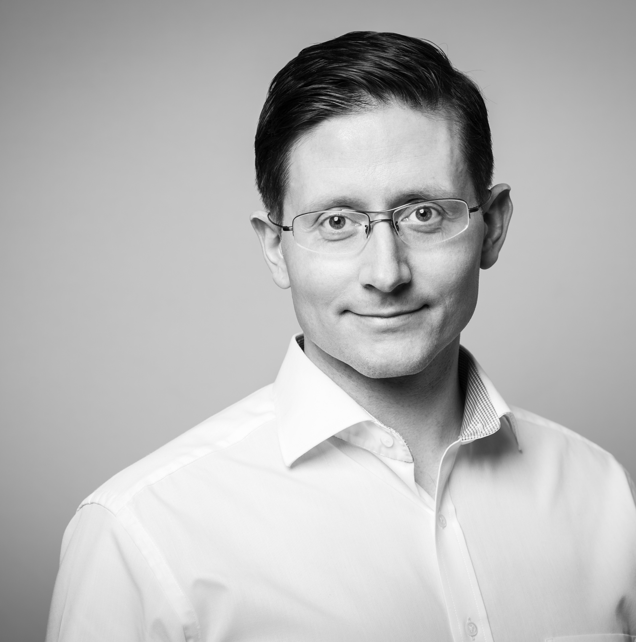
What’s next…?
Zeeshan Khuwaja
Kristjan Asvaldsson
Petur Sigurdsson
Product Owner
Solution Lead
Product Director
zeeshan.khuwaja@lsretail.com
kristjan@lsretail.com
petur@lsretail.com

Slide 10
Thank you

