Slide 1
Microsoft Keynote
Mike Morton
Vice President, SMB Business Applications
Microsoft

Slide 2
Dynamics 365 Business Central offerings
Connects sales, service, finance, and operations teams in a single SMB optimized solution to help them adapt faster, work smarter, and deliver results.
Financial Management
Project Management
Sales Management
Manufacturing Management
Reporting &
business insights
Service Management
Supply chain Management

Slide 3
What SMB customers value when choosing an ERP
Core functionality Finance, supply chain management
Ease and speed of implementation Business is changing faster than ever and SMBs need agility
Collaboration and productivity The lines between productivity, communication, and business applications are blurring
Reliability, performance, security, compliance, and scale

Slide 4
Business Central differentiation: core functionality Global core ERP capabilities in the SMB segment without customization through a unique combination of built-in features and rich ISV ecosystem
High quality core functionality for finance, sales, service, supply chain, projects, and operations
aka.ms/BCcapabilities
Unmatched ecosystem with geographic and industry specific solutions
Seamless experience with consistent UX, one bill via a Dynamics 365 partner, and app management via AppSource

Slide 5
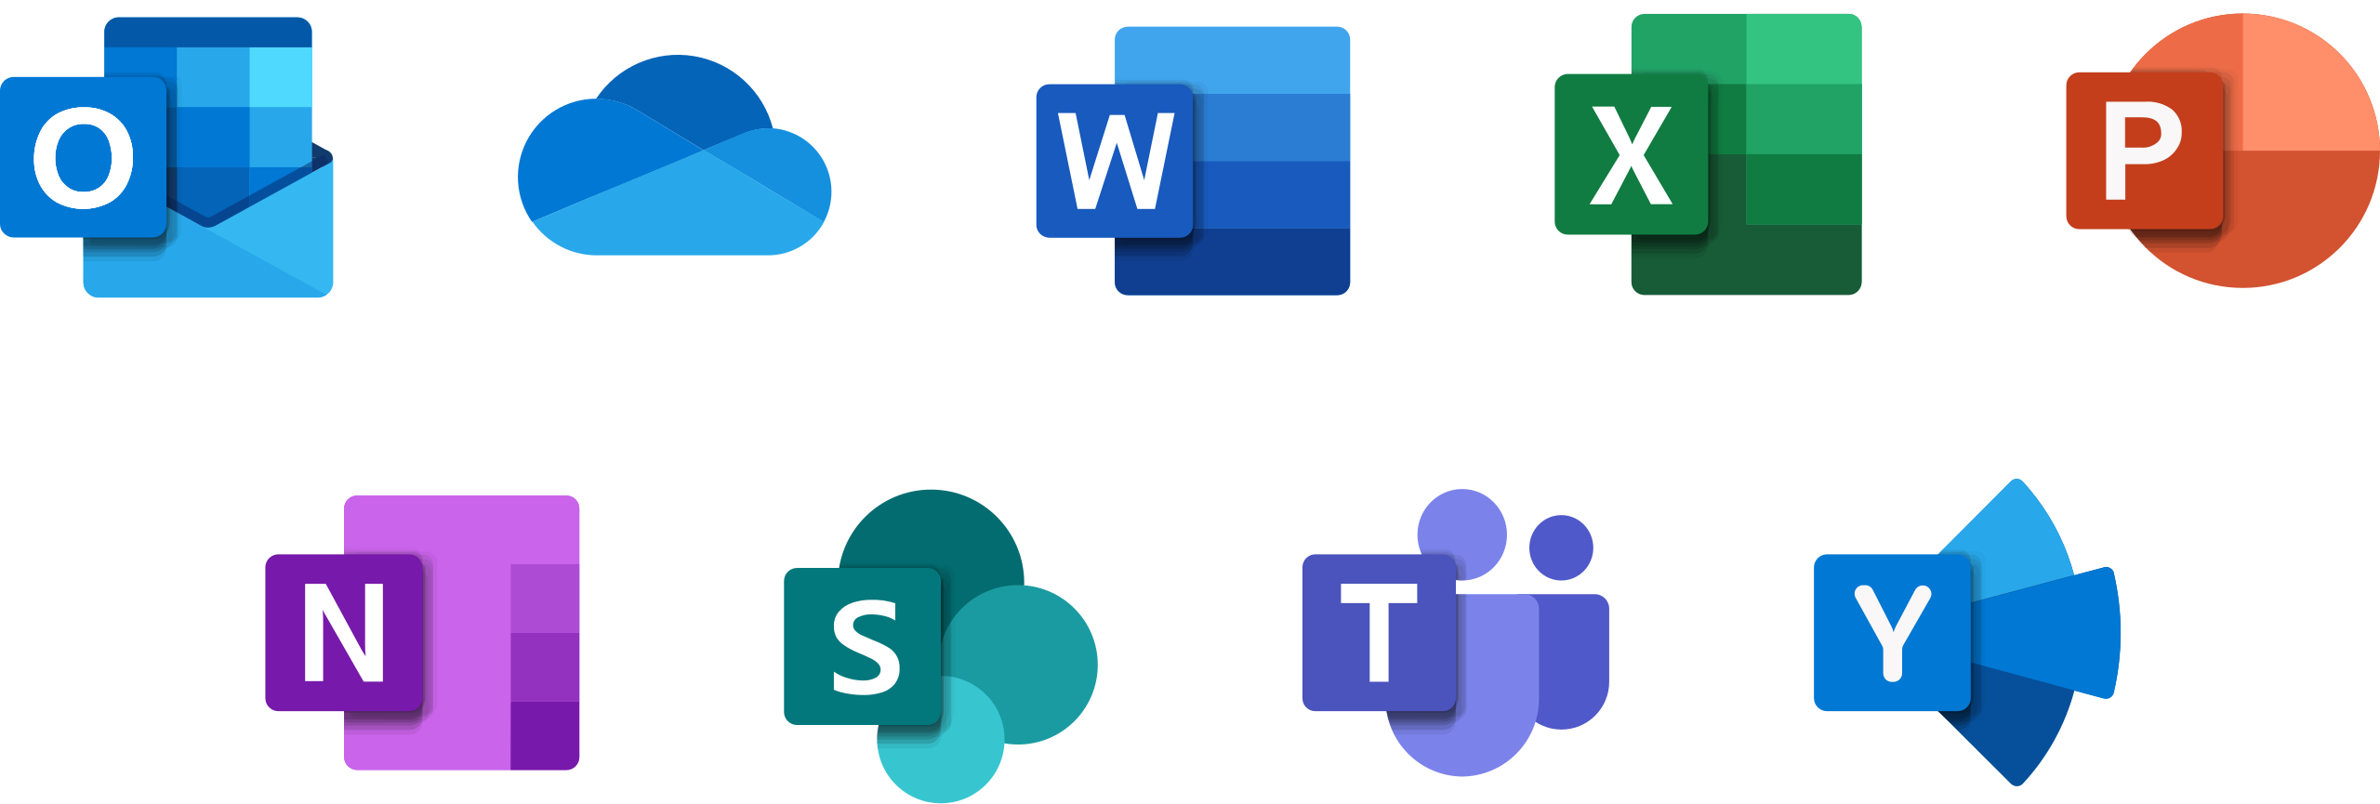
Business Central differentiation: collaboration and productivity Unmatched experiences built on the broad Microsoft ecosystem
Microsoft 365
Business Central
Power Platform
Microsoft Dynamics 365 Copilot

Slide 6
Business Central Differentiation: reliability, performance, and scale The best cloud platform for ERP
Performance and scale
Security
40+ microservices
21 Azure regions
Business continuity and disaster recovery
Compliance
Learn more: aka.ms/BCsecurity & aka.ms/BCcompliance

Slide 7
Business Central differentiation: ease and speed of implementation Implementations are often measured in weeks, not years. Onboarding efforts include:
Customer interview
Teaching tips, tours, spotlights
Partner specific trial
Getting started checklist
Management API
Onboarding framework
https://aka.ms/ BConboarding
Configuration questionnaire
Configuration packages
Manual setup
Assisted setup wizards

Slide 8
Core functionality
Collaboration and productivity
Finance
Use statistical accounts to collect data for financial reports
Review general ledger accounts faster
Do data analysis inside Business Central
Sync master data management across companies
Enhanced Intercompany capabilities
Supply chain
Inventory enhancement
Warehouse enhancements
Shopify returns
Key tips
Drag and drop for file dialog
More compact adaptive cards​
Copilot - Marketing text suggestions
Security controls for Teams cards​
Simplified setup of Power Automate
New Power Automate templates with multiple choices
Use Power Automate inside Business Central
More document approval workflows
Simplified for environments and companies

Slide 9
Inventory and warehouse
Undo transfer shipments
Define content of created warehouse documents with filters
Define invoice posting policy for various users
Add more columns through personalization to gain more insight on more pages
Post multiple transfer orders at the same time
Use advanced warehouse functionality with minimal complexity
Set default dimensions on locations, inventory documents, and journals
Usability improves for item tracking codes: visibility, creation of new entries
Easier to create opening balances for item tracked inventory
Ship and receive non-inventory items on warehouse documents
Preview item journals and twenty other journals and documents before posting
Synchronize returns, refunds from Shopify

Slide 10
Dynamics 365 Business Central 2023 release wave 2 investment areas
Core ERP
Collaboration and productivity
Ease and speed of implementation
Performance and scale
Finance
Multi-company
G/L
A/R & A/P
Regulatory
Reporting
Out-of-the box Power BI App
Analysis Mode
Report Explorer
Enable Developers
Supply chain
Improved picking process
SKU management
Fulfillment suggestions
Improved Warehouse Management for jobs and manufacturing
Generative AI
Marketing Text
Platform Support
And more to come…
Teams & Office Integration
Teams
Outlook
Power Platform
Power Automate
Power Apps
Dataverse
Geographic expansion
Andorra
Armenia
Azerbaijan
Bahamas
Bermuda
Bolivia
British Virgin Islands
Cambodia
Cameroon
Cayman Islands
Ethiopia
Fiji
Ghana
Guernsey (United Kingdom)
Isle of Man (United Kingdom)
Jersey (United Kingdom)
Kazakhstan
Kosovo
Liechtenstein
Macao (SAR China)
Madagascar
Malawi
Mozambique
Namibia
Nepal
San Marino
Sao Tome & Principe
Senegal
Tanzania
Uganda
Zambia
Fundamentals
Performance
Reliability
Tooling
Efficient Development
Connected experience
AppSource Monetization
AL Go and DevOps in GitHub
Efficient Troubleshooting
Administration
Access Control
App Management
Migrations
User experience
Action bar
Navigation
Drag and Drop
Search
Error handling
Time Sheets
Onboarding
User Assistance
Cloud Connectivity
Setup
October 2023
April 2024
October 2024

Slide 11
Microsoft Cloud Runs on trust
Your data is your data
Your data from any fine-tuning is not used to train the foundation AI models
Your data is protected by the most comprehensive enterprise compliance and security controls

Slide 12
Leader in AI and Business Applications
Others demo generative AI capabilities in their solutions – Microsoft has durable advantages.
1
2
3
4
Undisputed leader in generative AI
AI across the Microsoft portfolio
First mover &
self-reinforcing ecosystem
Compliance and data boundaries
Microsoft is the premier and primary partner of OpenAI, the undisputed leader in generative AI. This allows us early access to new models, custom tuning of models, and optimized infrastructure (Azure AI super computing scale).
Customers running Microsoft 365, Teams, SharePoint, LinkedIn, Dynamics 365, etc. will have the broadest access to data that can be used as context/prompting with foundation models.
Training based on a large corpus of company specific terminology, language, culture, communication style, etc.
Borderless User Experiences that span productivity, communications, business app, and developer tools
Microsoft saw the promise of this technology back in 2019 when we made the first OpenAI investment, and we have been shipping innovation since early 2021. AI is a self-reinforcing ecosystem, where greater usage results in better models.
Other companies will have to work third party services. Microsoft will ensure:
Data stays within Microsoft ecosystem – Many customers will not accept their data being sent to third parties.
Data boundaries – Data stays within promised data boundaries (e.g., data in Germany stay in Germany, Government clouds, European Union Data Boundary (EUDB), etc.), including information staying within the company.

Slide 13
Thank you

