Slide 1
Update Service
Tips and Tricks
Arnþór Magnússon
Developer

Slide 2
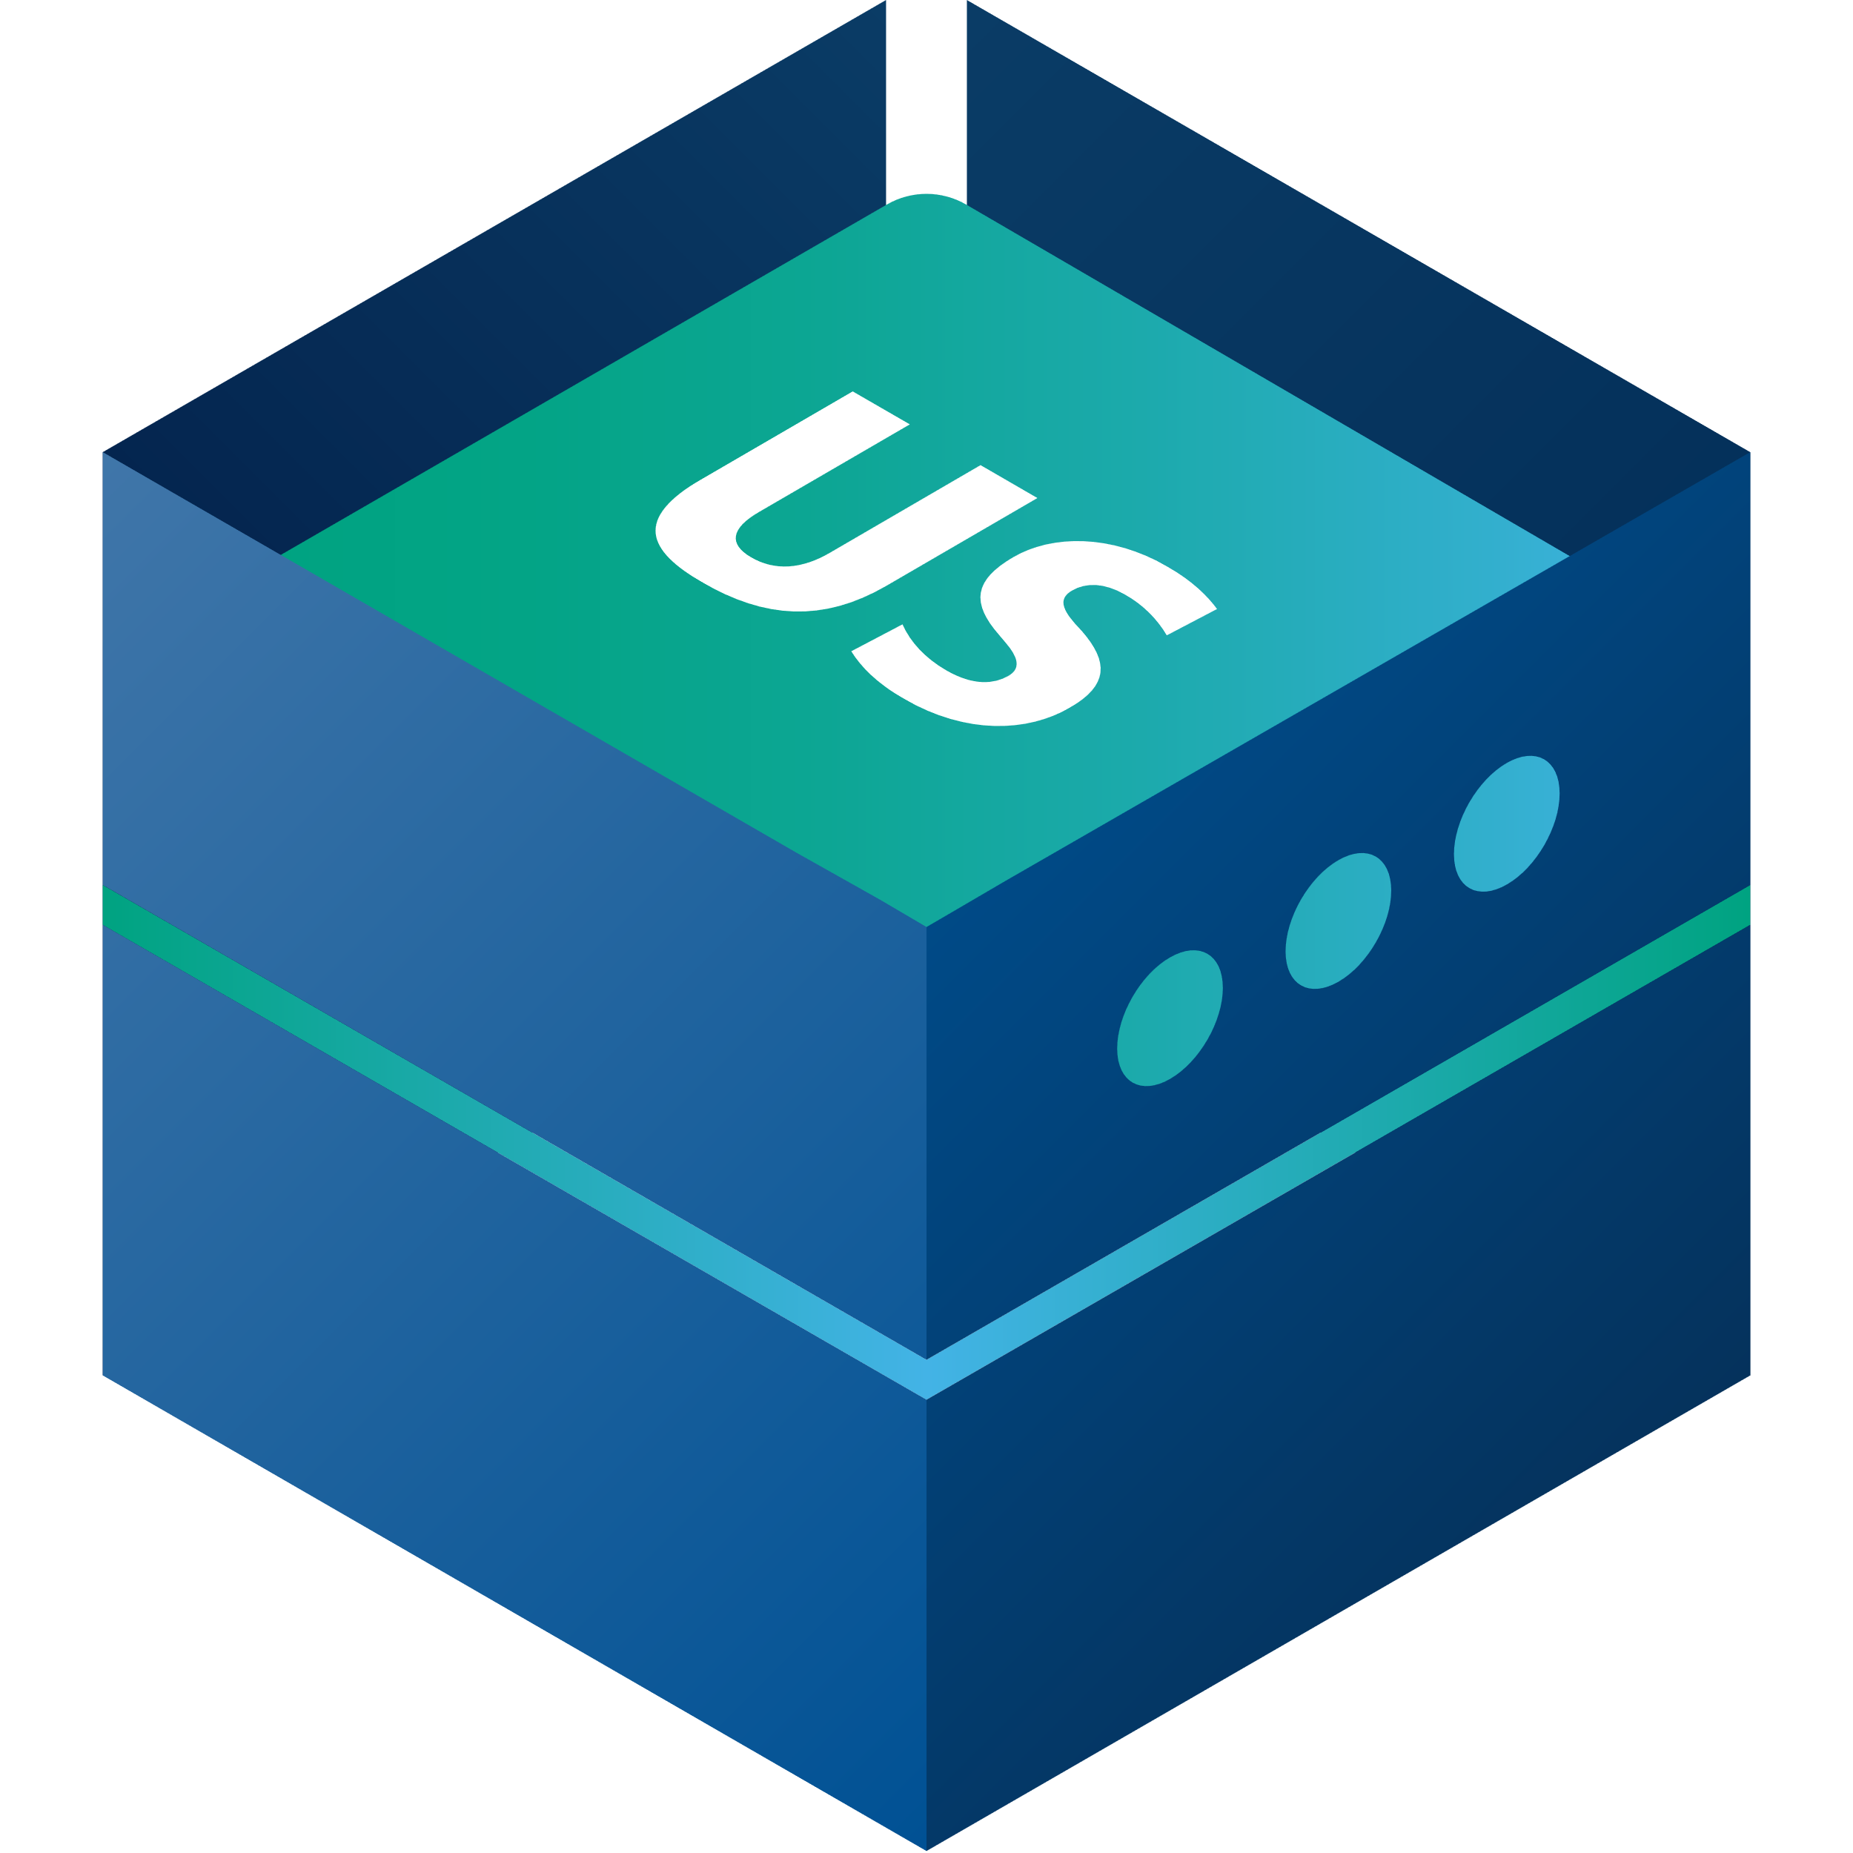
LS Retail
Update Service
formally known as Go Current

Slide 3
Packages
Components split into multiple packages
Package is a zip archive:
Installation files
Install scripts
Manifest:
Name
Id
Version

Slide 4
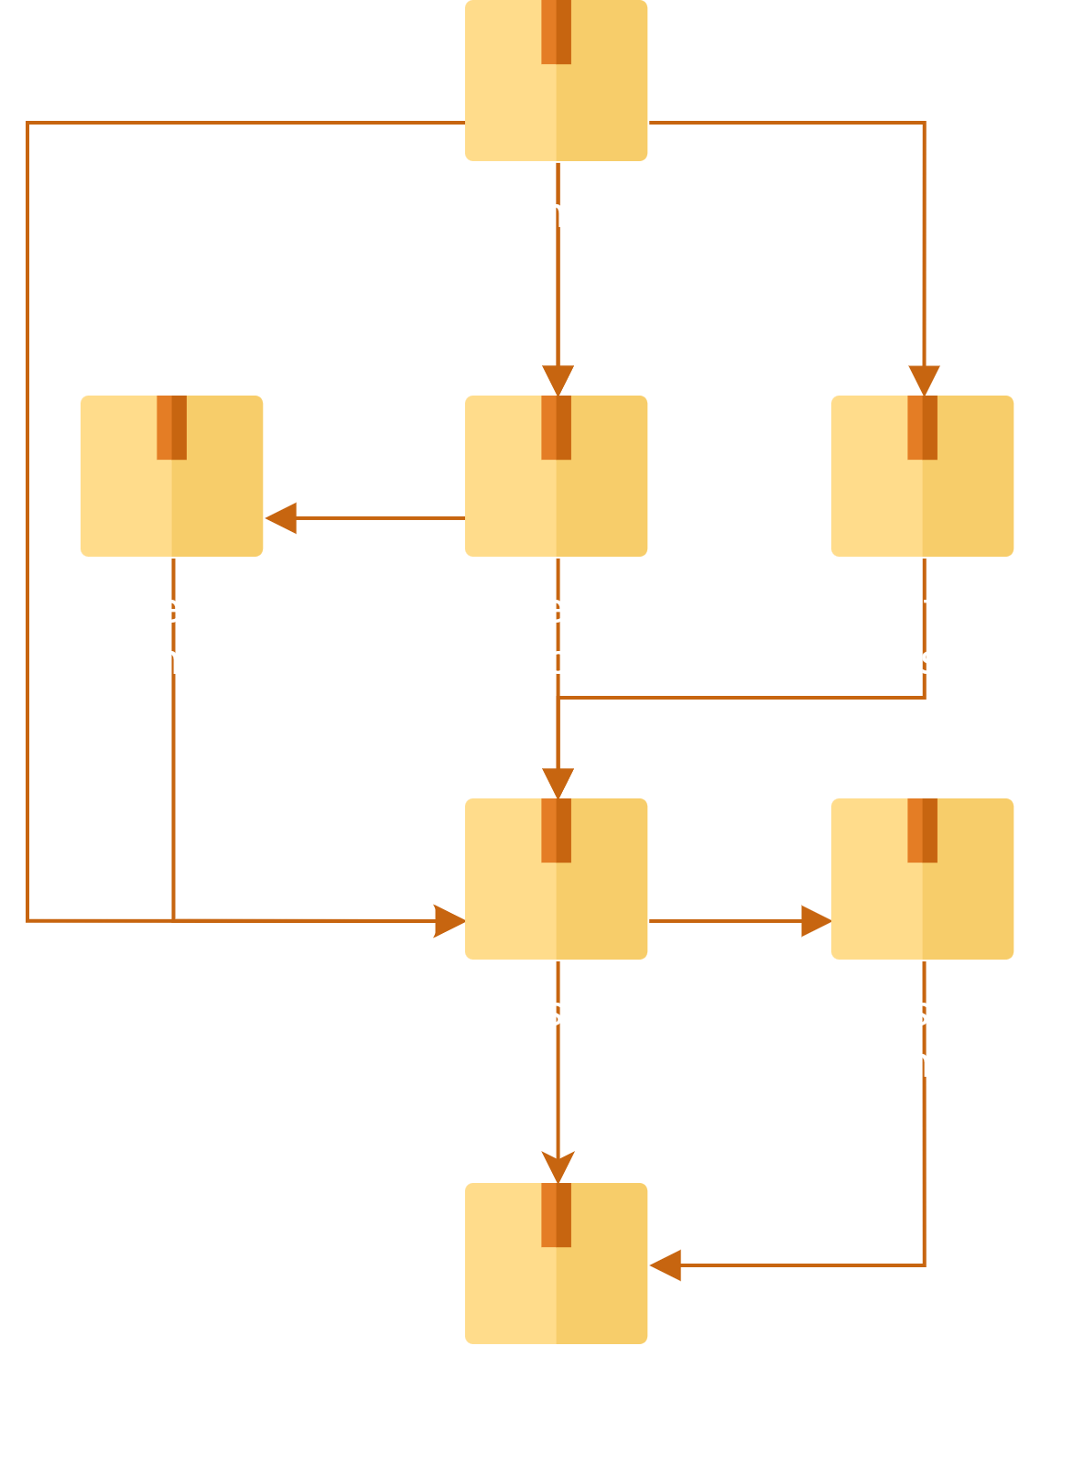
Dependencies
Package can depend on other packages
Installing a package, will install it‘s dependencies
Ensures correct order

Slide 5
Bundle
Create a bundle to
Pick components
Select versions
Set configuration
Installs all components
In correct order
Bundle a package with dependencies

Slide 6
Bundle
Create a bundle to
Pick components
Select versions
Set configuration
Installs all components
In correct order
Bundle a package with dependencies

Slide 7
Bundle
Create a bundle to
Pick components
Select versions
Set configuration
Installs all components
In correct order
Bundle a package with dependencies

Slide 8
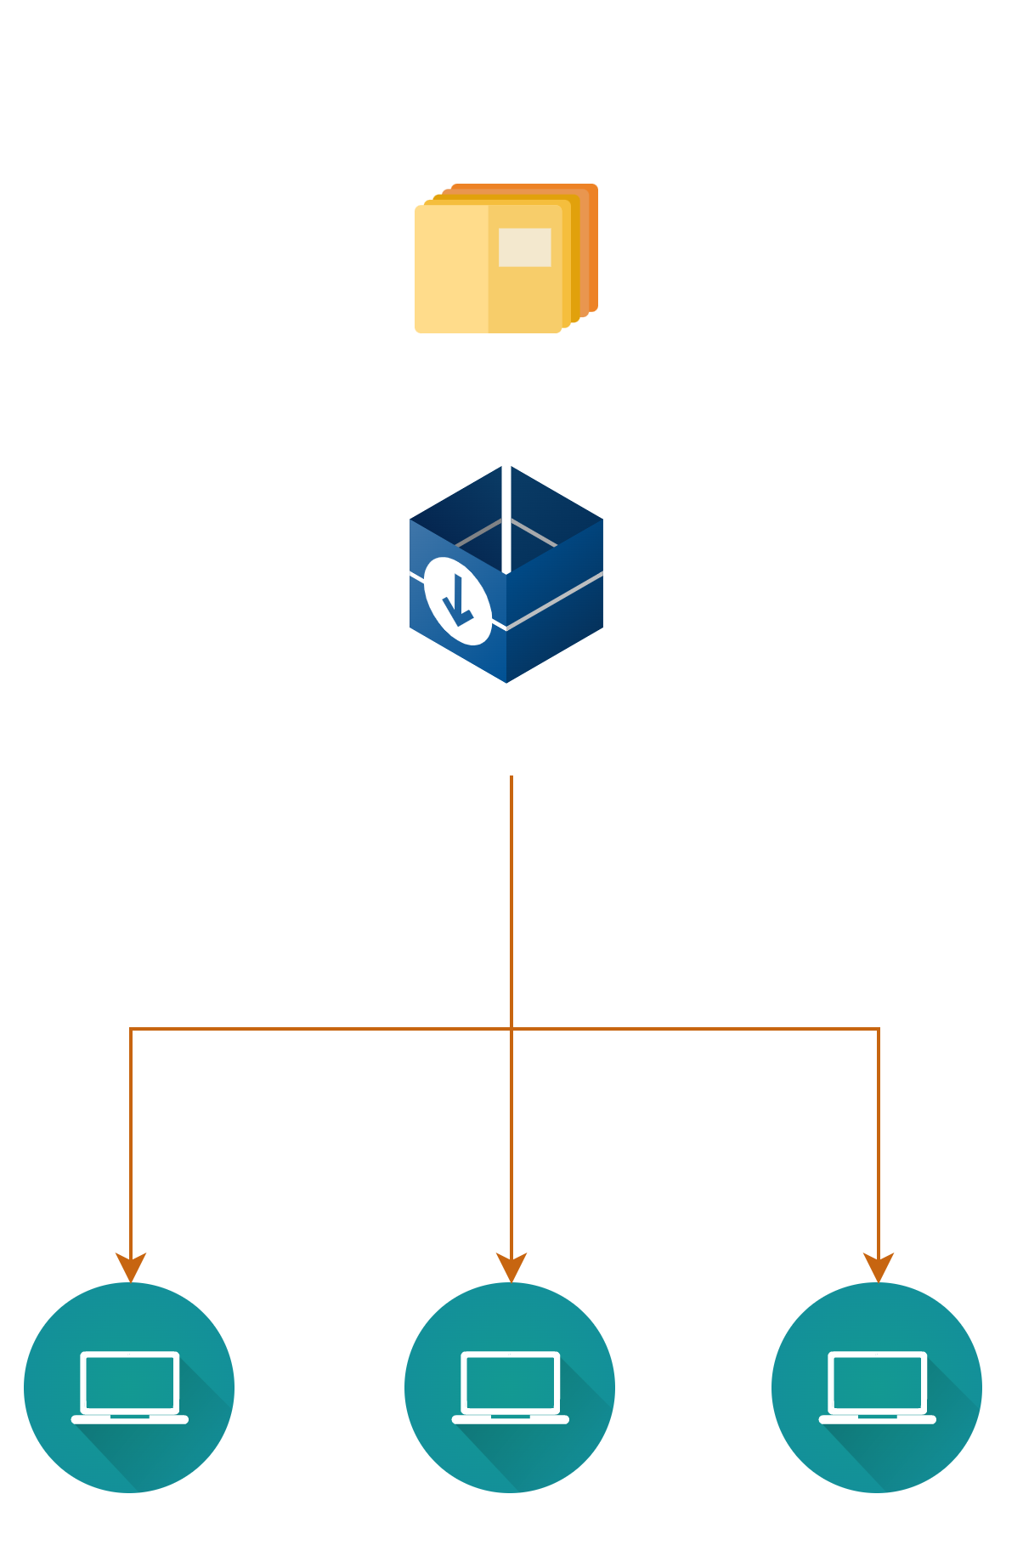
Install: Installer

Slide 9
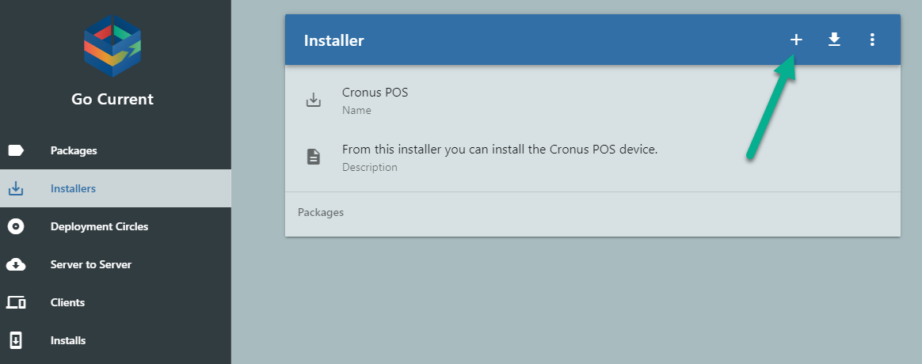
Install: New Installer

Slide 10
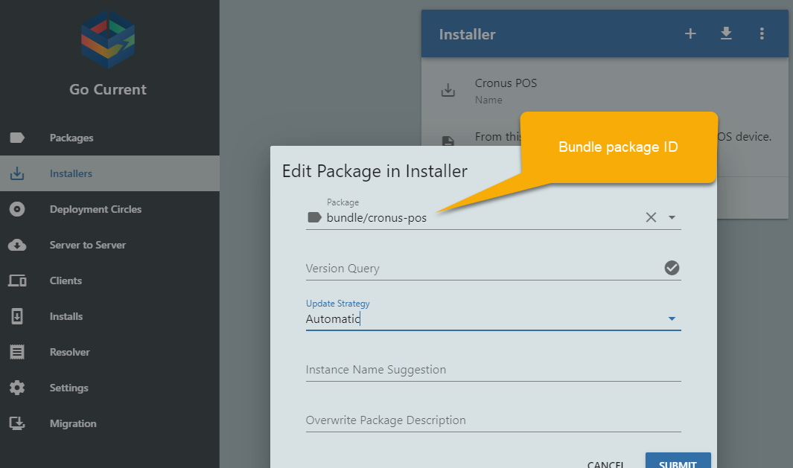
Install: Add bundle

Slide 11
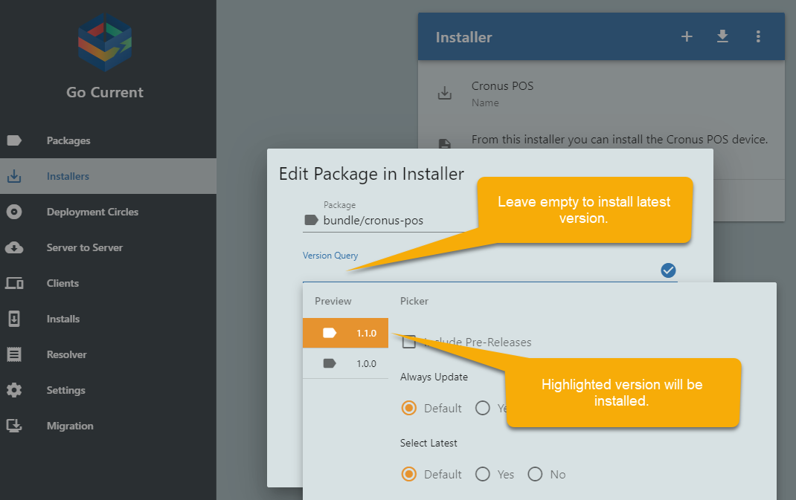
Install: Latest Version

Slide 12
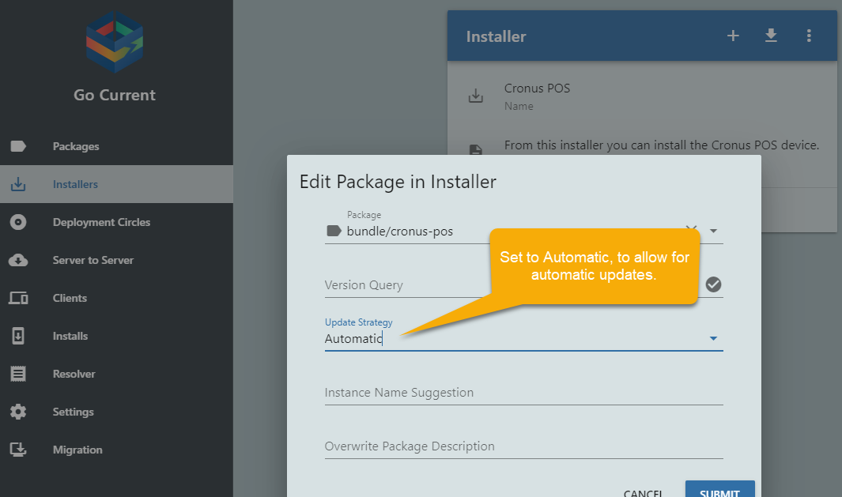
Install: Automatic updates

Slide 13
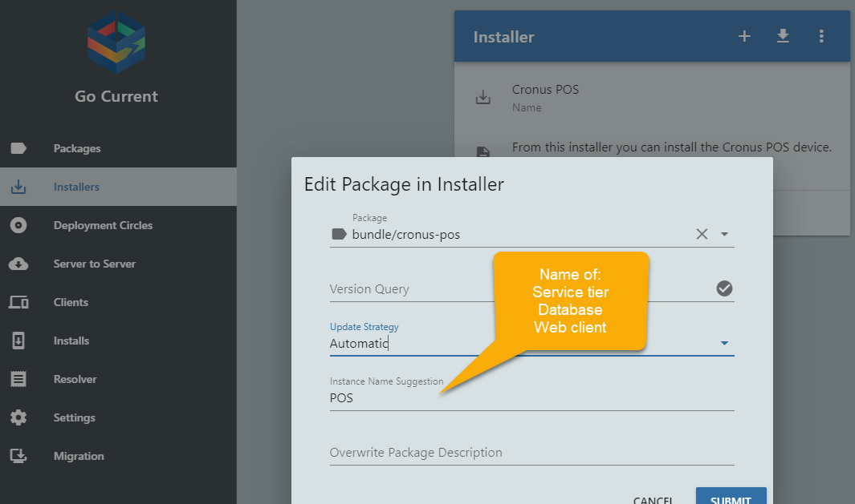
Install: Instance Name

Slide 14
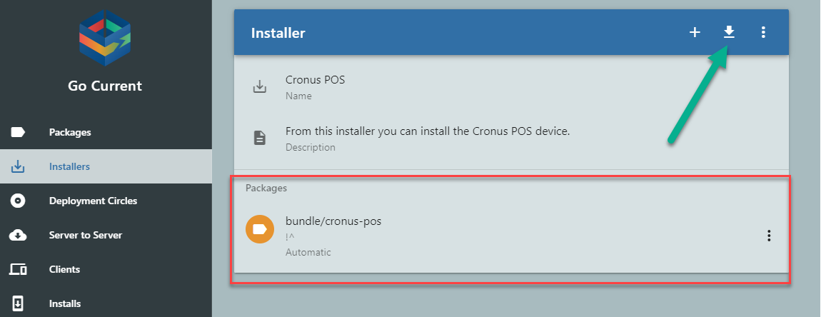
Install: Download installer

Slide 15
Install: PowerShell
Install-GocPackage -Id 'bundle/cronus-pos' -InstanceName 'POS'-UpdateStrategy Automatic

Slide 16
Install: PowerShell
Bundle ID
Install-GocPackage -Id 'bundle/cronus-pos' -InstanceName 'POS'-UpdateStrategy Automatic

Slide 17
Install: PowerShell
Name of
Database
Service tier
Web client
Install-GocPackage -Id 'bundle/cronus-pos' -InstanceName 'POS'-UpdateStrategy Automatic

Slide 18
Install: PowerShell
Updates automatically
Install-GocPackage -Id 'bundle/cronus-pos' -InstanceName 'POS'-UpdateStrategy Automatic

Slide 19
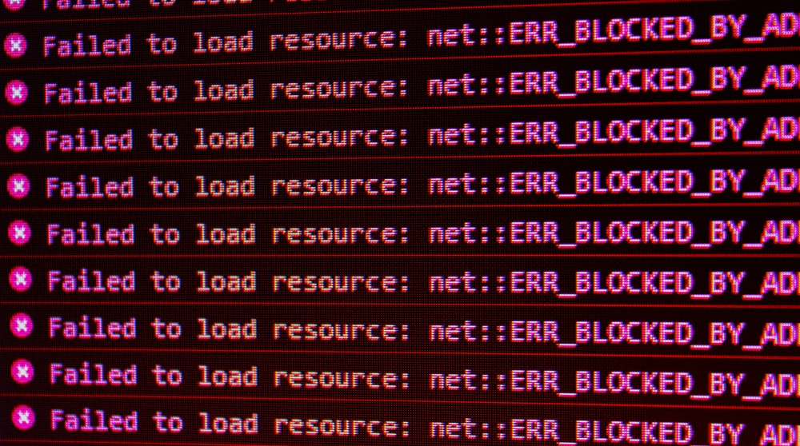
Installation Errors!

Slide 20
Installation Errors
Common errors
First install fails – restart required
Sensitive to Windows Updates
Configuration errors,
I.e. incorrect SQL server
Apps incompatible
Destructive schema changes
Machine out of memory.
Online troubleshooting page

Slide 21
Update Bundle
Update customer apps to version 1.1.0
Update bundle to version 1.1.0

Slide 22
Update Bundle
Update customer apps 1.1.0
Update bundle to 1.1.0

Slide 23
Update Bundle
Update customer apps 1.1.0
Update bundle to 1.1.0

Slide 24
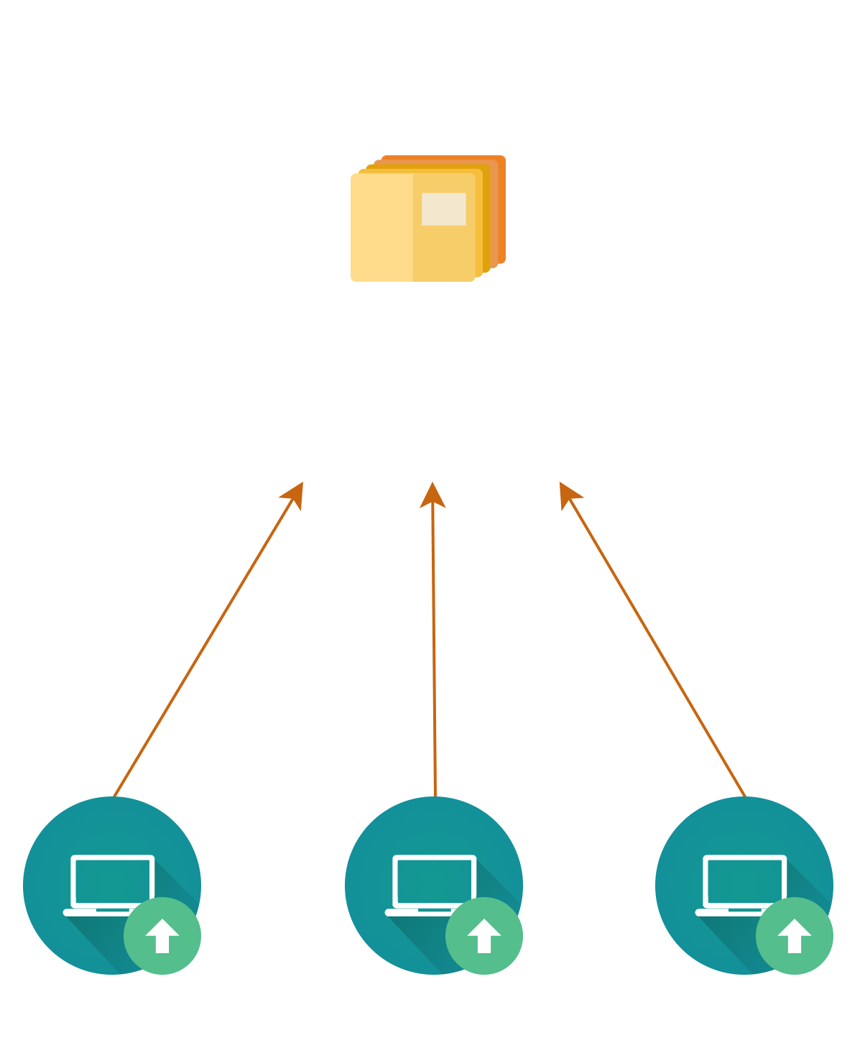
Update

Slide 25
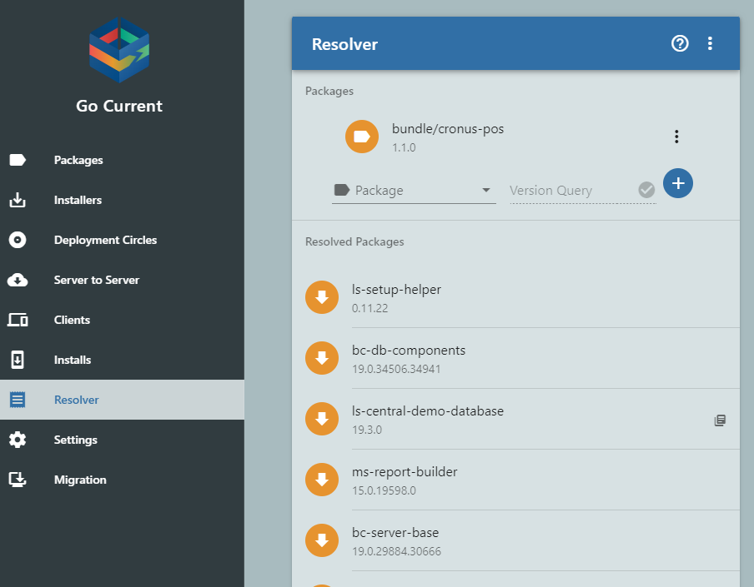
TIP: Resolver
Resolve’s dependencies for selected packages.
List of
Packages
Versions

Slide 26
TIP: Resolver
Resolve’s dependencies for selected packages.
List of
Packages
Versions

Slide 27
TIP: Resolver
Resolve’s dependencies for selected packages.
List of
Packages
Versions

Slide 28
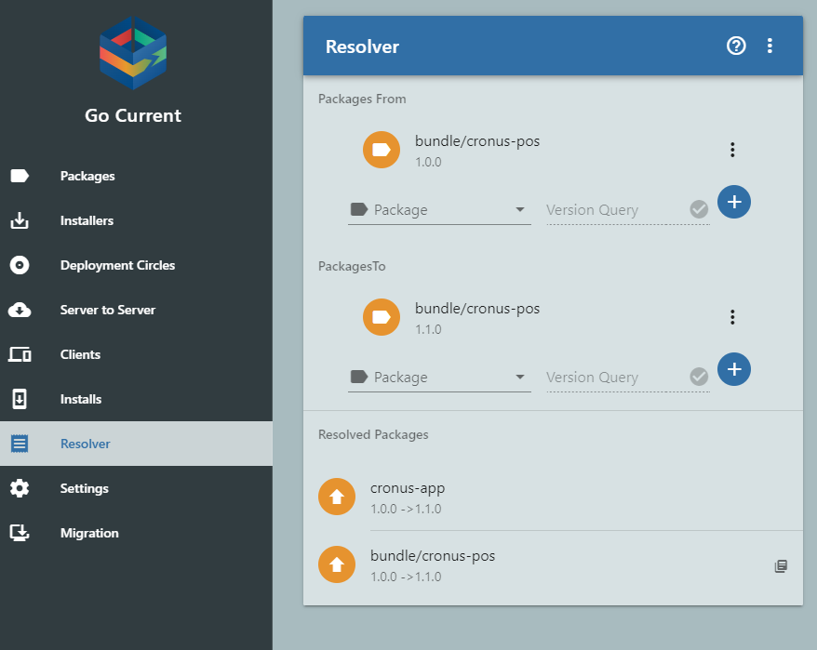
TIP: Resolver
Resolve’s dependencies for selected packages.
List of
Packages
Versions

Slide 29
TIP: Resolver
Resolve’s dependencies for selected packages.
List of
Packages
Versions

Slide 30
TIP: Resolver
Resolve’s dependencies for selected packages.
List of
Packages
Versions

Slide 31
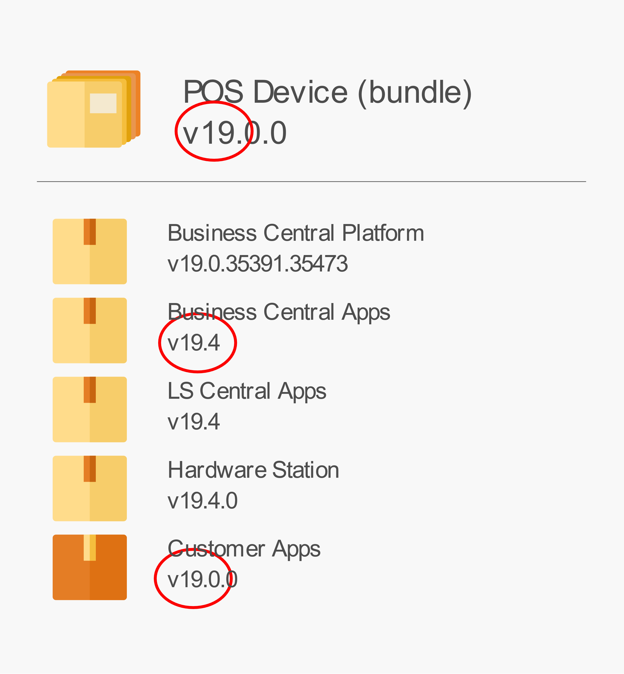
TIP: Use same major version
Version customer packages with relevant Business Central major version.

Slide 32
Multiple Bundles
Different packages (or apps) for different requirements

Slide 33
Multiple Bundles cont.
Multiple service tiers for one database.

Slide 34
Getting started
PowerShell basics
Install LS Central with PowerShell
Project Lifecycle
Step by step guide
Video series
Do a test project
Learning curve

Slide 35
Need help?
Yammer group
https://yammer.com/gocurrent
Troubleshooting
Consulting
Feedback
Community - anyone can help
LS Retail’s support desk
Troubleshooting
Urgent matter
Customer specific

Slide 36
Next Release
Rebranded as LS Retail Update Service
.NET 6 - ASP Core
Rest API
Server can run on Windows and Linux
SaaS Ready
Azure Storage
Azure Active Directory
Multi tenant
Breaking changes
With migration plan
Few extra steps to upgrade

Slide 37
Road Ahead
Simplified project management and package creation
Deploy new installation remotely
Scheduling
Improved deployments
Monitoring

Slide 38
Questions?

Slide 39
Thank you

