Slide 1
Contactless Shopping
Self Checkout and ScanPayGo
Matthias Matthiasson
Product Director

Slide 2
New challenges in retail
The modern shopper wants to:
Do their shopping quicker and more efficiently
Do contactless shopping
Stop waiting in queues at the checkout lane
Know more about stores’ offers and promotions
Find more information about products
Have their own shopping lists that they can share with friends and family
Find stores, their locations and opening hours

Slide 3
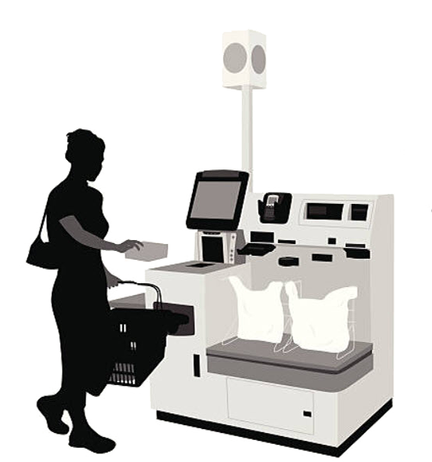
Evolution – what is retail´s next step?

Slide 4
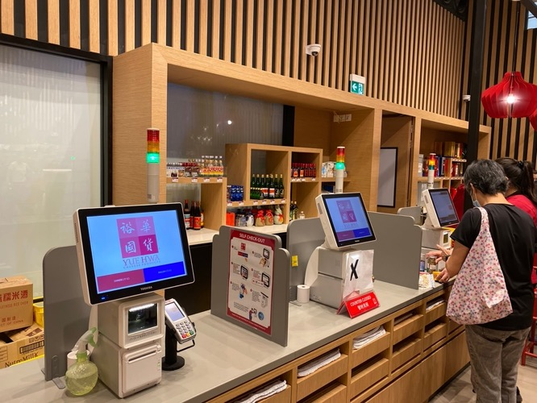
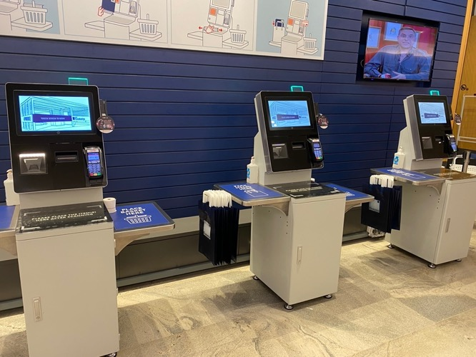
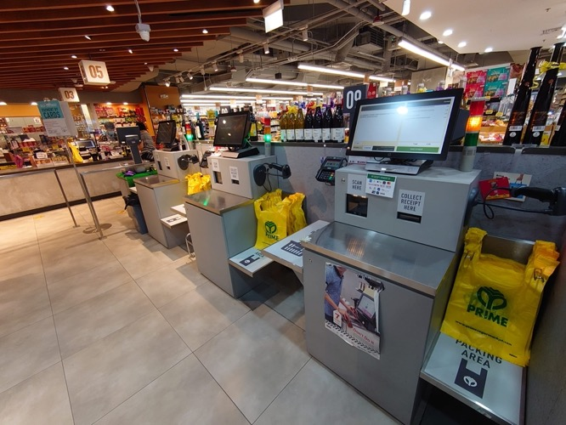
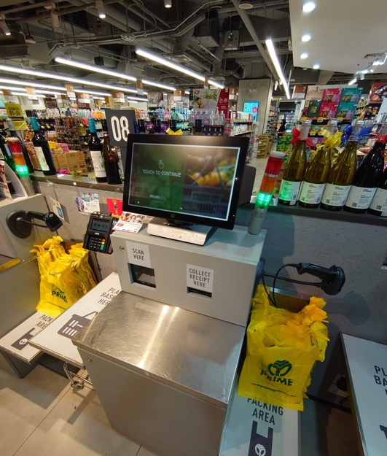
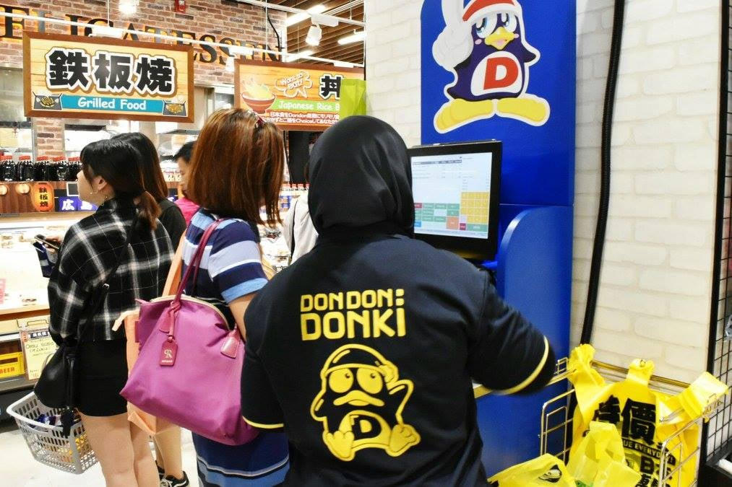
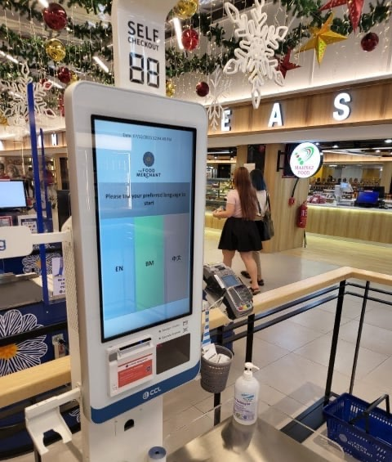
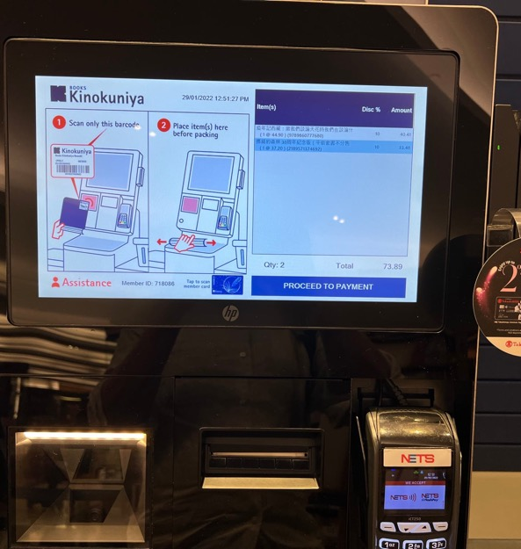

Slide 5
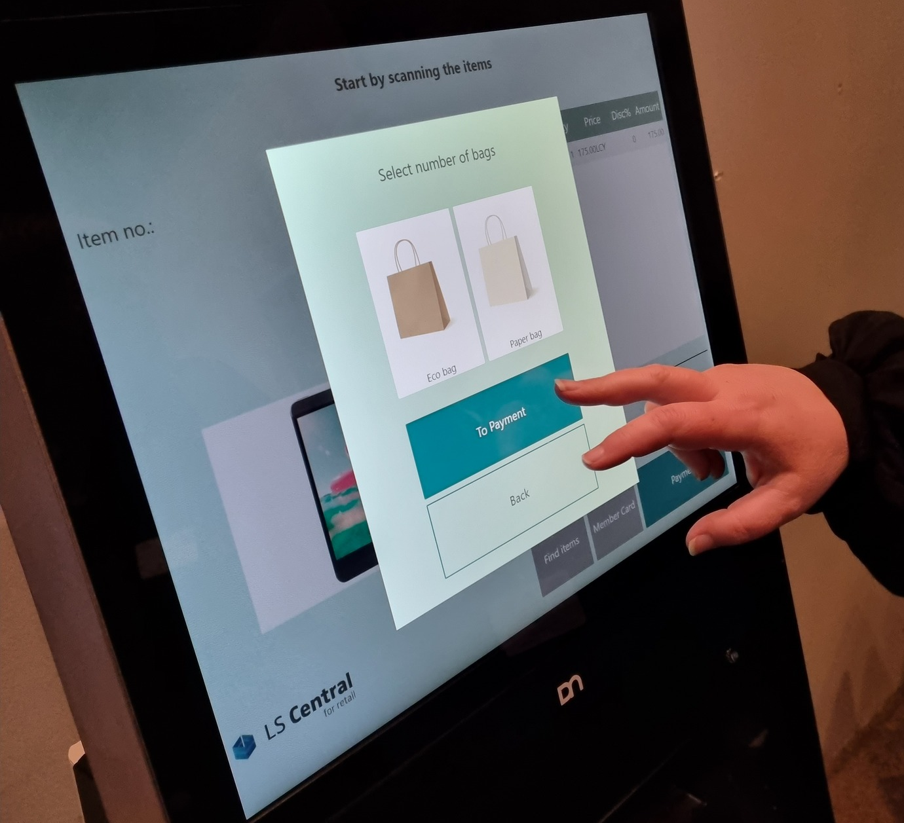

Slide 6
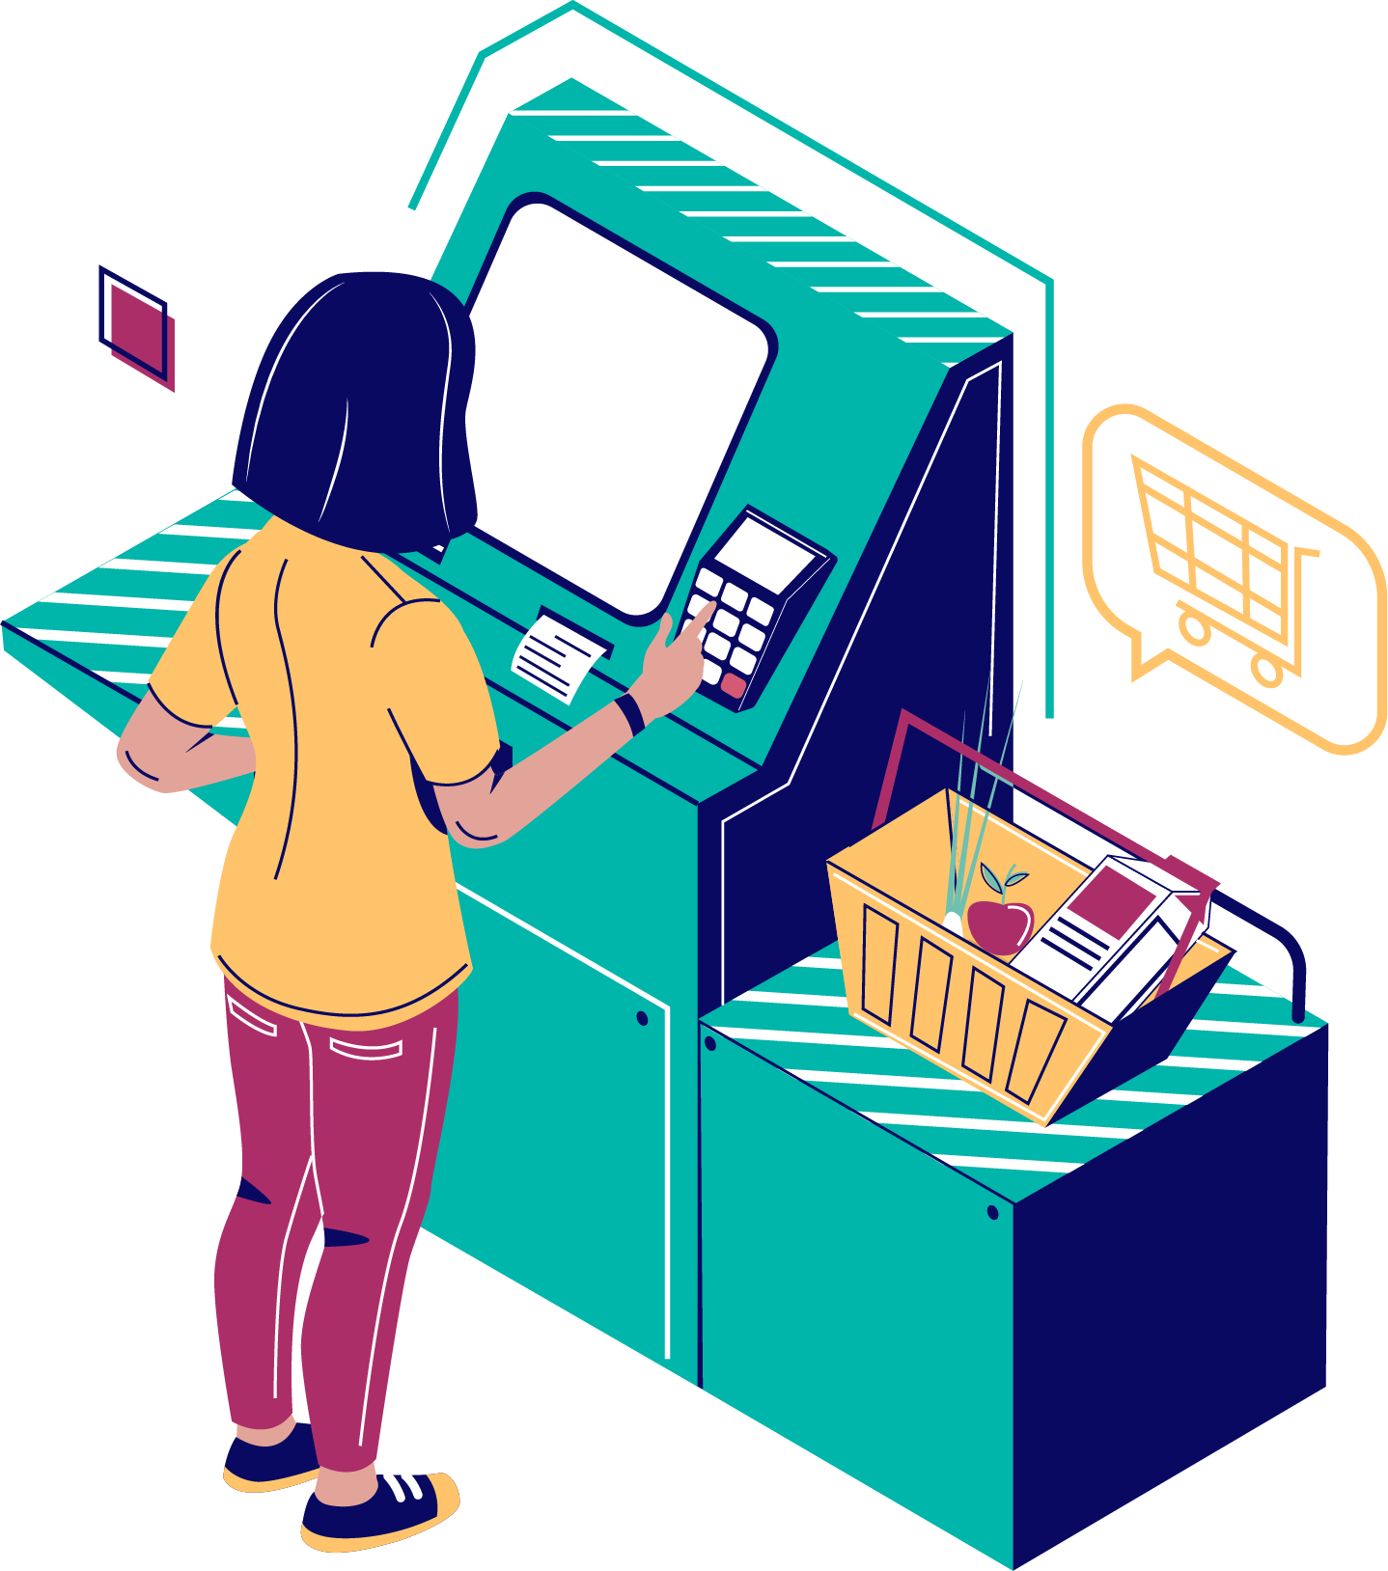
Self Checkout (SCO)

Slide 7
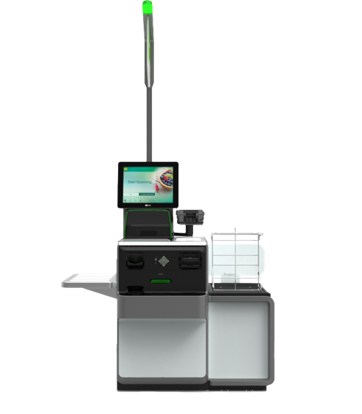
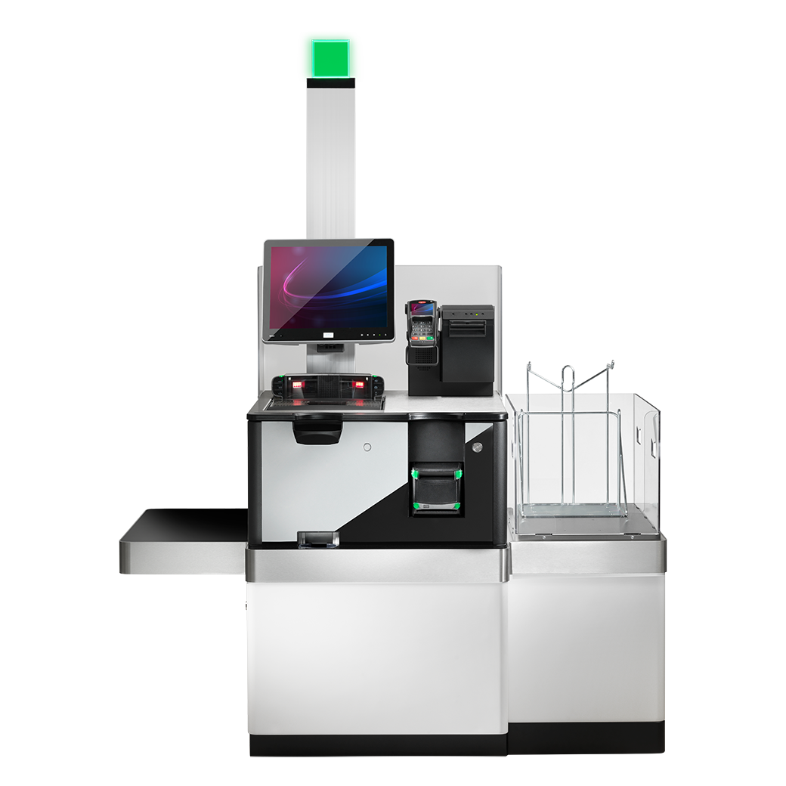
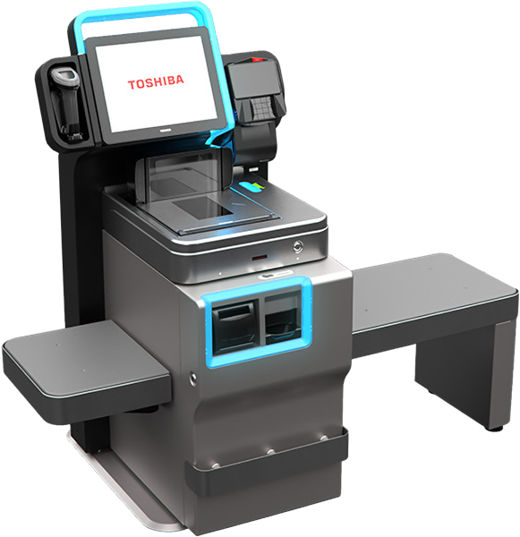

Slide 8
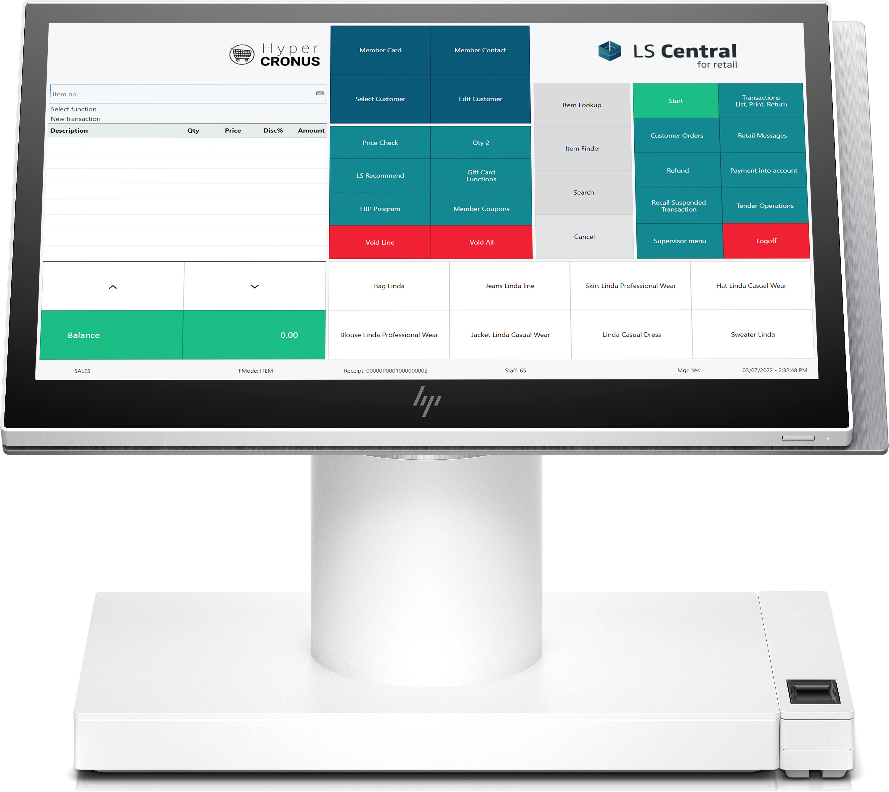
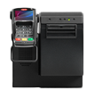
Self Checkout Connection
LS SCO
?

Slide 9
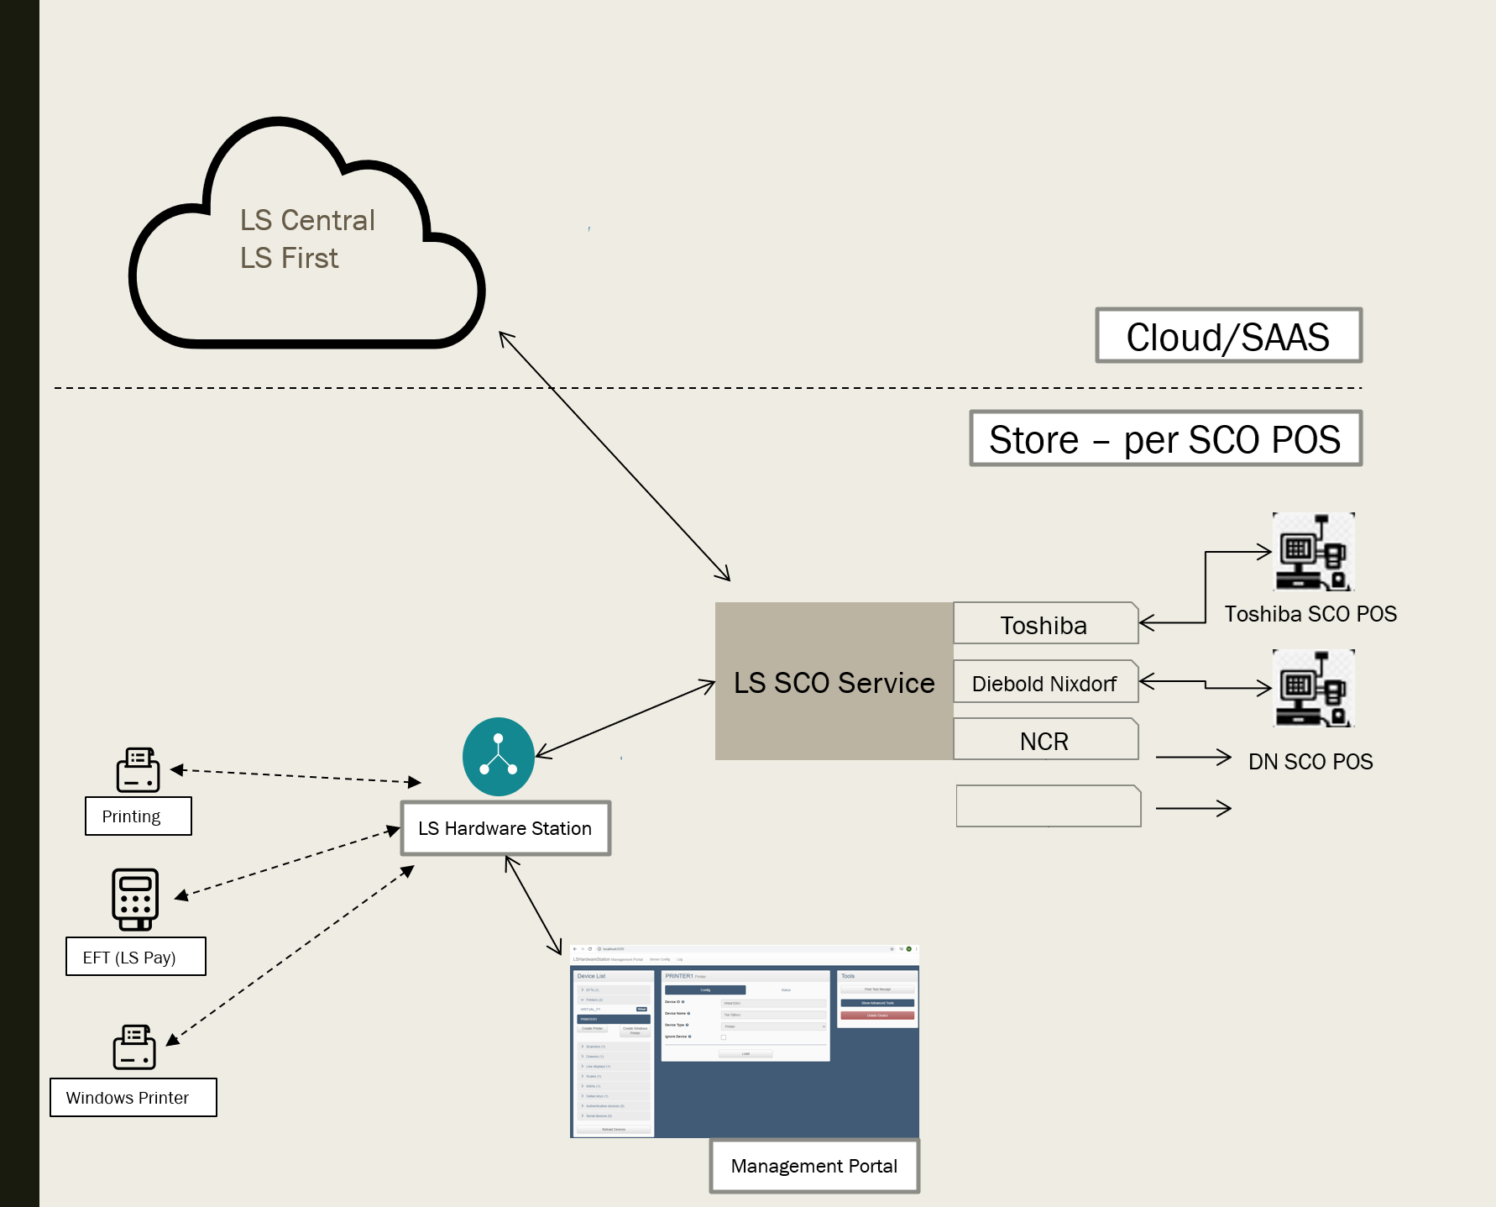
SCO architecture
LS Central will have an LS SCO Extension
Configuration
Webservices
LS SCO Service is a layer between the SCO Hardware and LS Central
Calls the webservices
Receives the information
Maps to objects that will then need to be mapped to be understood by the SCO Hardware
LS SCO Service uses LS Hardware Station for printing and EFT payments
SCO with Diebold release plan is Q1 2023
LS Central POS

Slide 10
LS SCO Service Phase 1
Selling of items using a barcode scanner
Selling of items requiring customer to key in the quantity
Translation of item descriptions
Support for scale / weighing of items
Support for security scale
Voiding of items in manager menu (in SCO)
Promotions and periodic discounts offers in LS Central supported
Basket calculations through LS Central
Voiding of transaction in manager menu (in SCO)
Support for EFT integration through LS Pay (through LS Hardware Station)
Support for receipt printer through LS Hardware Station
Configurations for SCO specific functionality in LS Central
Online help for configurations and supported functionality
Configuration package with default values for SCO configurations

Slide 11
LS SCO Service Phase 2
Selling of items with age restriction (cigarettes and alcohol)
Displaying item image at sale of item
Loyalty cards
Adding a loyalty card to sale
Displaying Loyalty point information
Configurations for PLU menu for items from LS Central
Translation of PLU menu items

Slide 12
Evolution – what is retail´s next step?

Slide 13
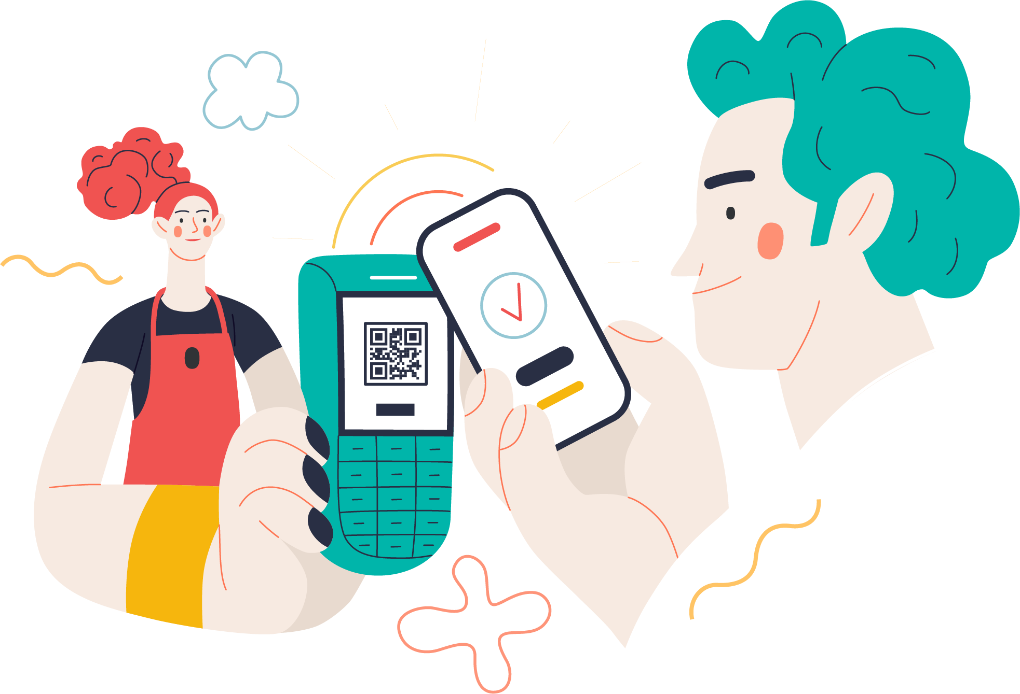
ScanPayGo (SPG)

Slide 14
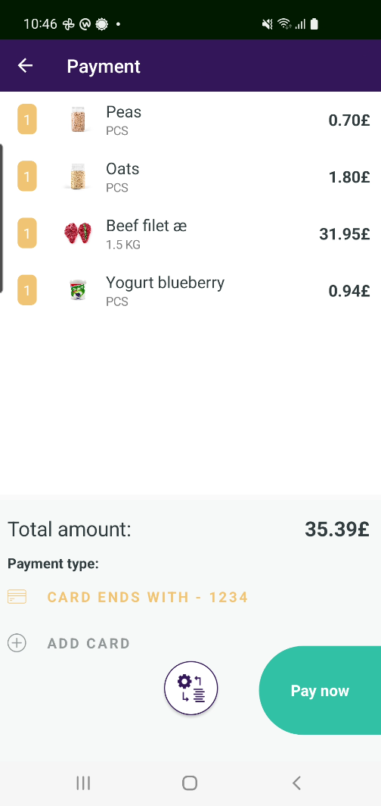
The ScanPayGo app
ScanPayGo is an app that retailers provide to their customers
An easy-to-use loyalty app
Designed for the modern shopper

Slide 15
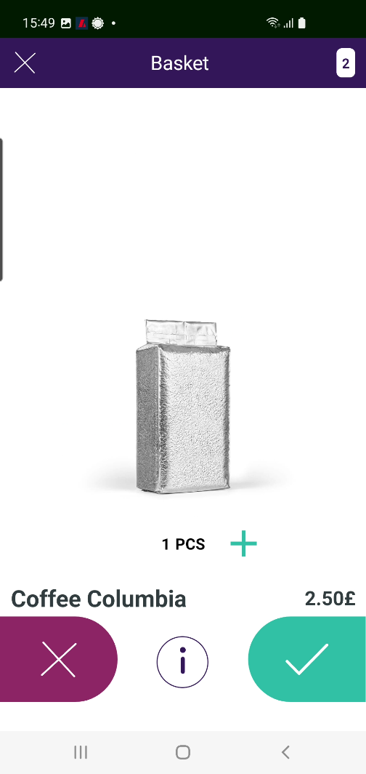
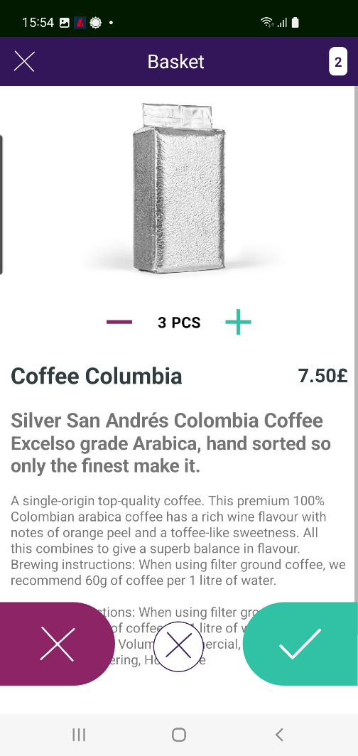
LS ScanPayGo
App for Android & iOS
Released by the retailer
Downloaded to and operated from the customers mobile device

Slide 16
Nutrice journey to use ScanPayGo
Nutrice
Grocery store chain
Operates 10 stores
The steps
Download the code for SPG
Add logo and set color schema
Configure SPG in LS Central BO
Payment, Security etc

Slide 17
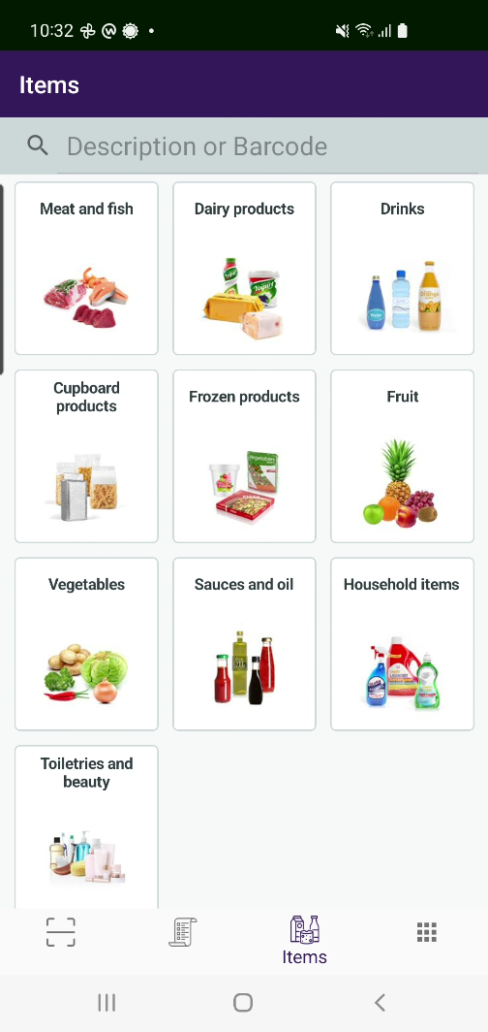
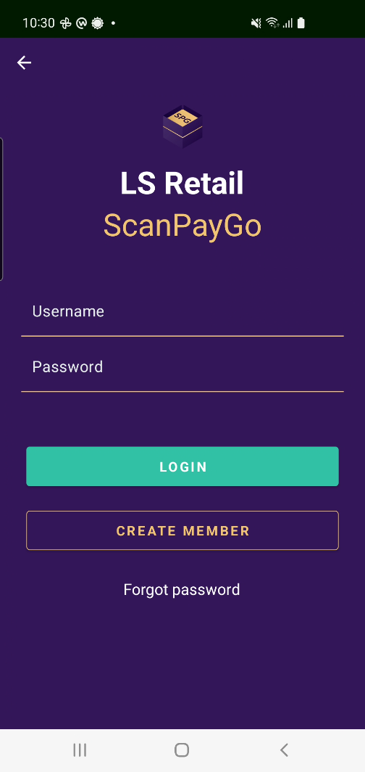
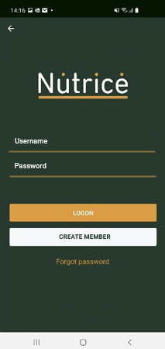
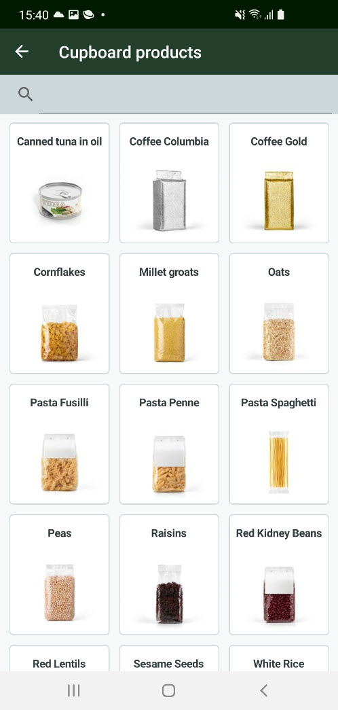
The ScanPayGo app
Easy to change logo and main colors – and possible to develop it further

Slide 18
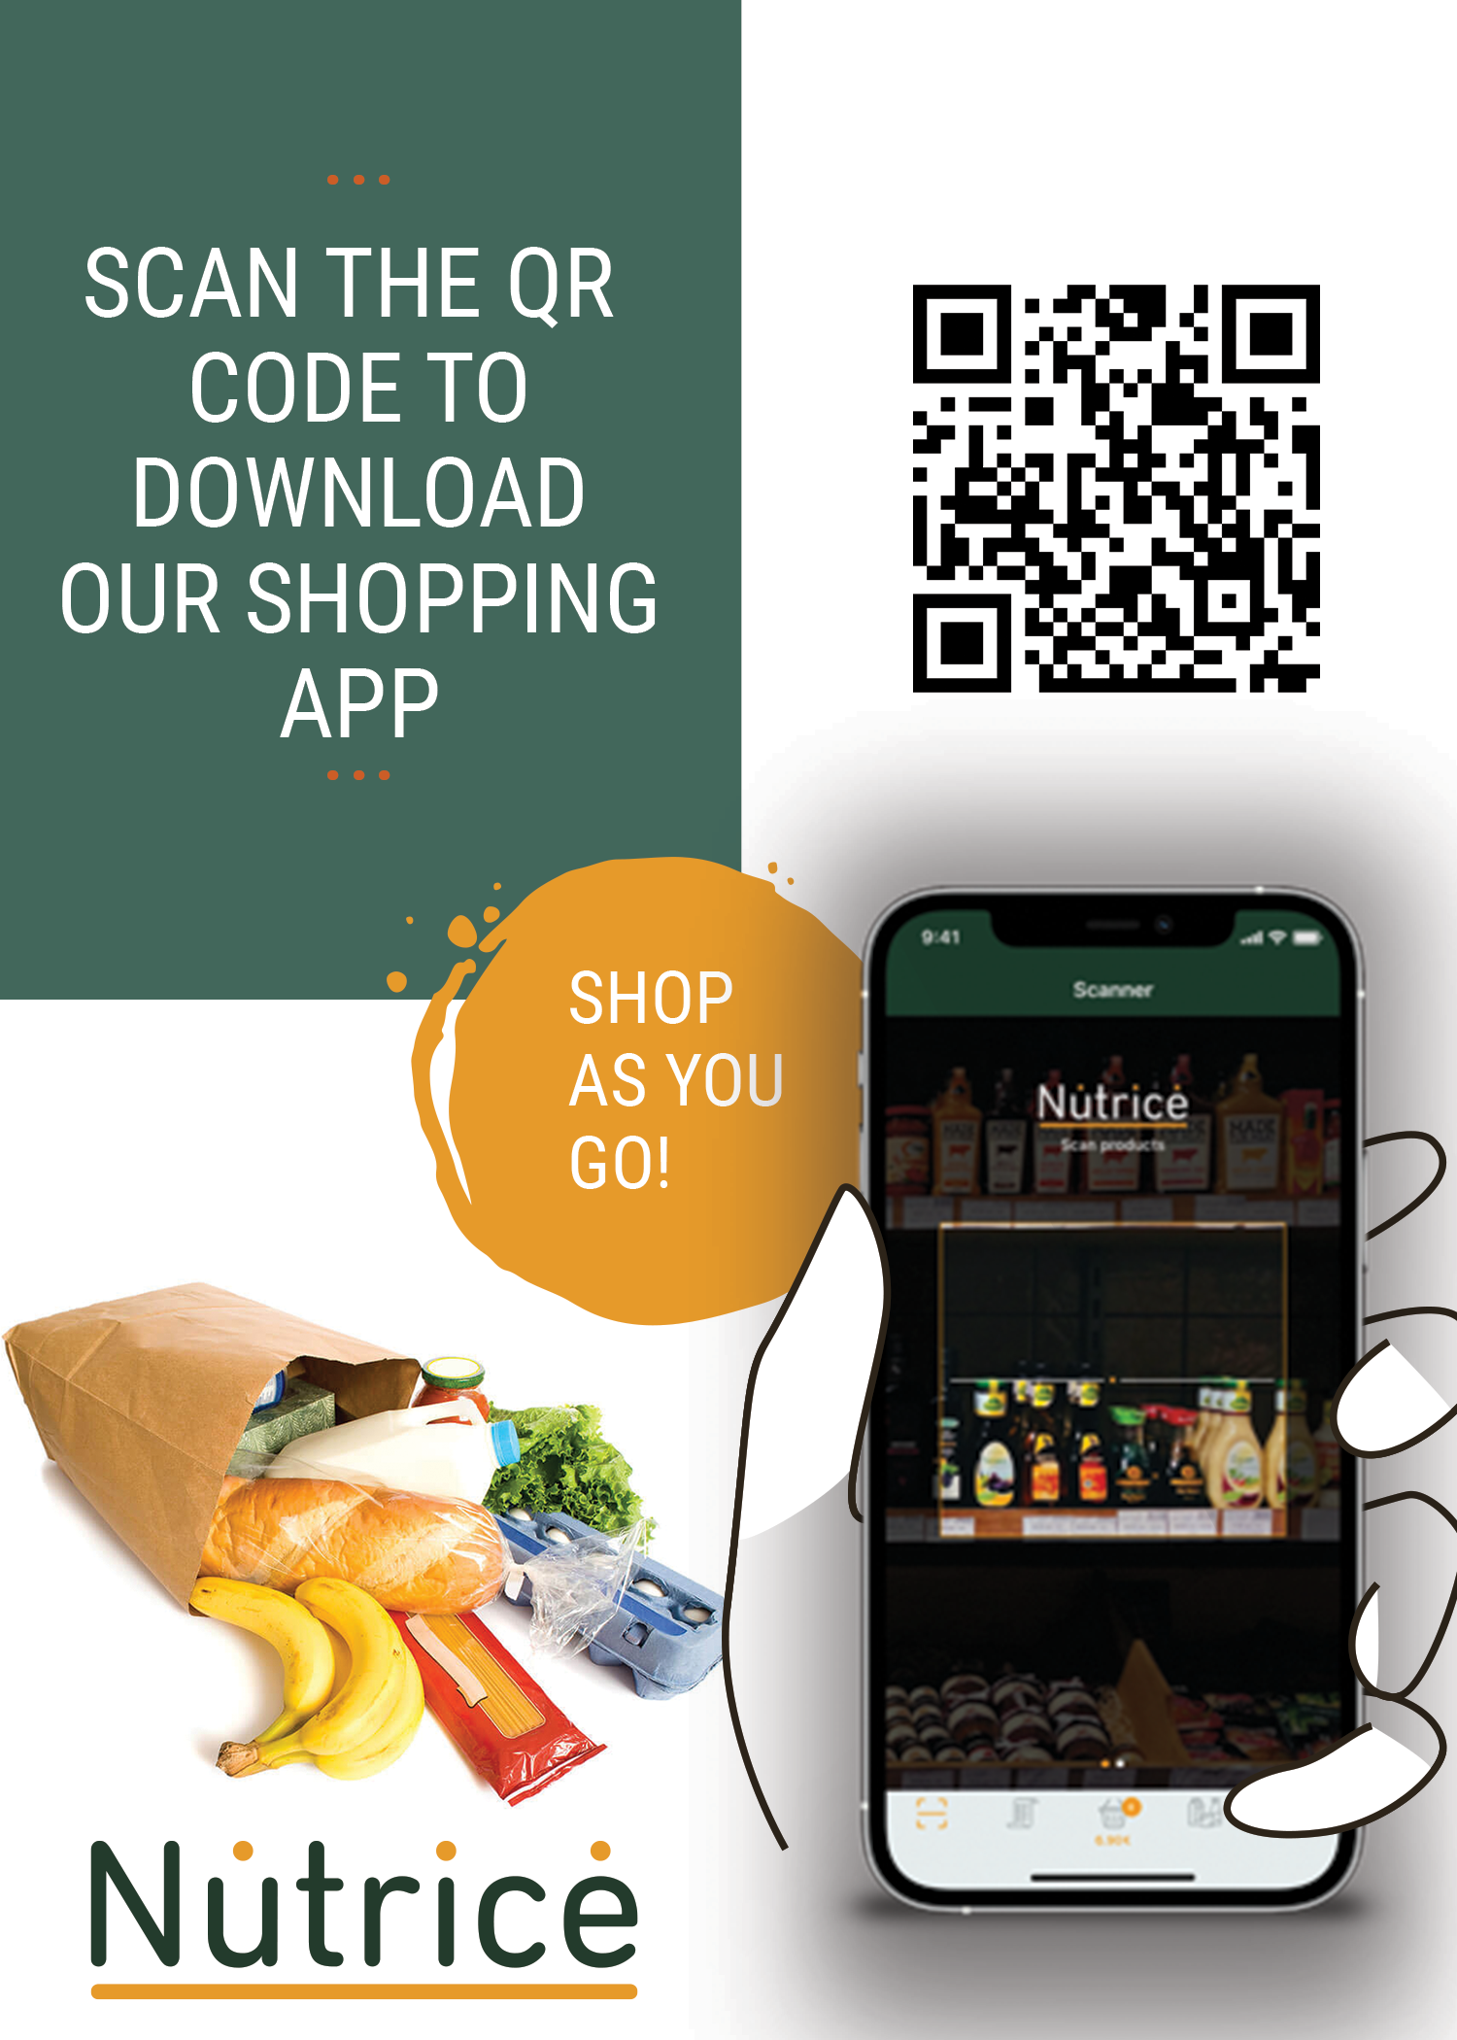
Take shopping into your own hands today with Nutrice ScanPayGo

Slide 19
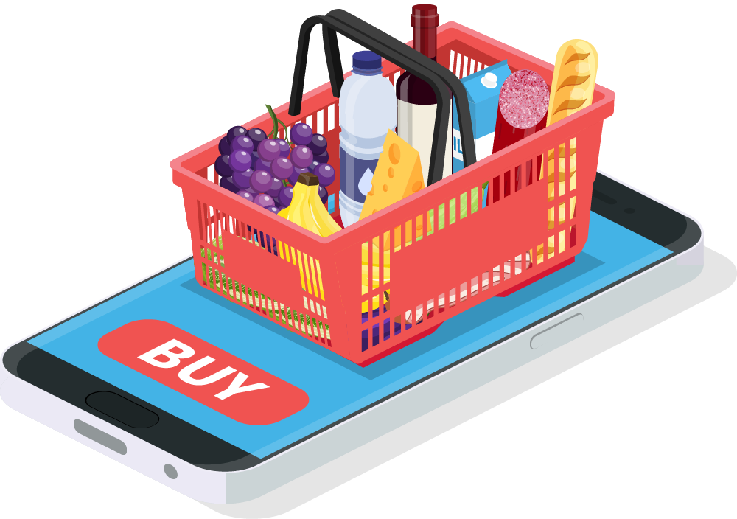
ScanPayGo architecture
Head office
External
ScanPayGo
LS Commerce Services
LS Central posting services
LS Central Data and basket calculation
eCommerce API
Store 1
Store N
…
…
POS 1
POS N
POS 1
POS N

Slide 20
No additional hardware needed in store
Shoppers use their own phones while shopping
Possible to pay for the shopping in the ScanPayGo app or with loyalty points
Scan QR code quickly to a POS / POS self-service station and pay for it there
Benefits:
Shorter queues for customers – quicker throughput
No additional hardware is required in the store
Quick and easy shopping

Slide 21
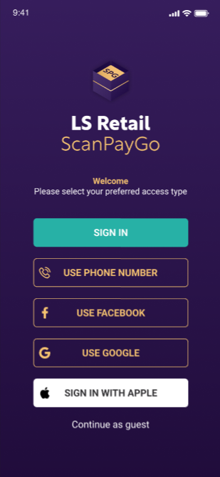
Login to the ScanPayGo app
The customer in the app is a member contact in LS Central.
Easy to create new loyalty customers/accounts in:
SPG App
LS Central POS
LS Central Back Office
eCommerce

Slide 22
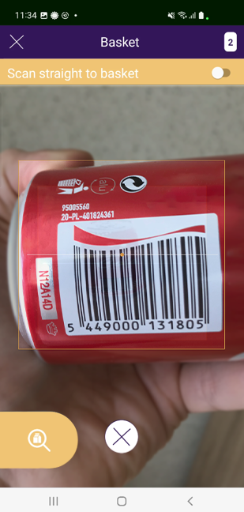
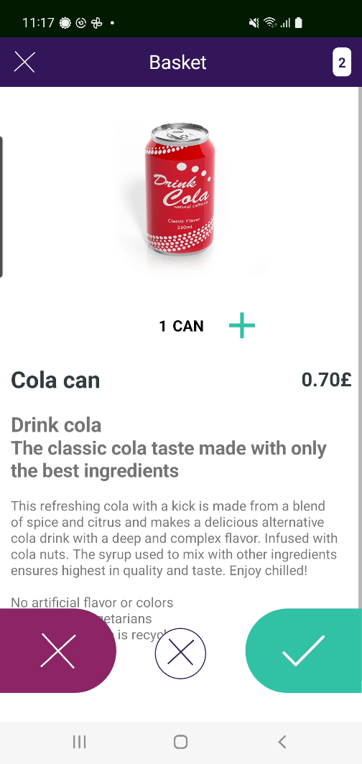
Easy shopping with ScanPayGo
The shopper enters the store
The app detects in which store he or she is
Possible to open the store’s gate with ScanPayGo
The shopper scans items into the basket
After scanning the shopper puts the items directly into his shopping bag
When finished the shopper pays for his shopping in the app or at the POS

Slide 23
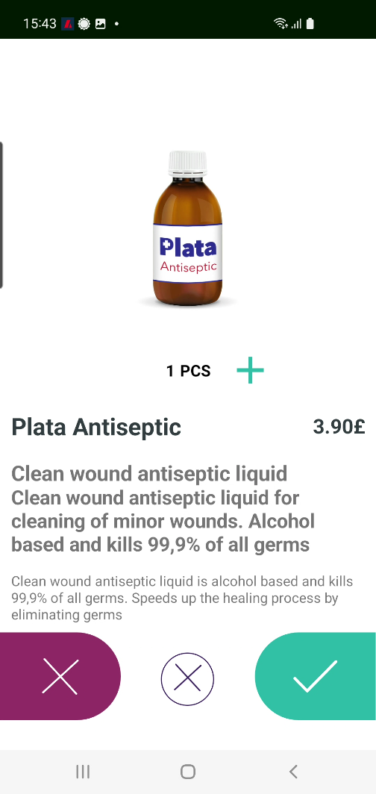
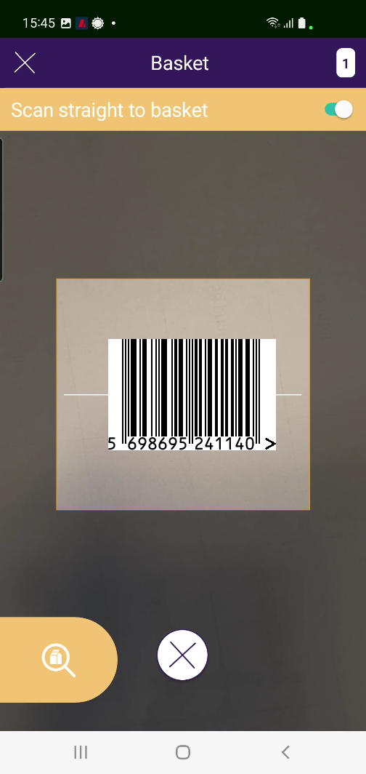
Scanning items into your basket
Two methods:
Scan and confirm
Scan an item, a window opens where the user must confirm if he wants to buy this item
Scan straight to basket
Scan an item and this way the item goes directly into the basket without confirmation

Slide 24
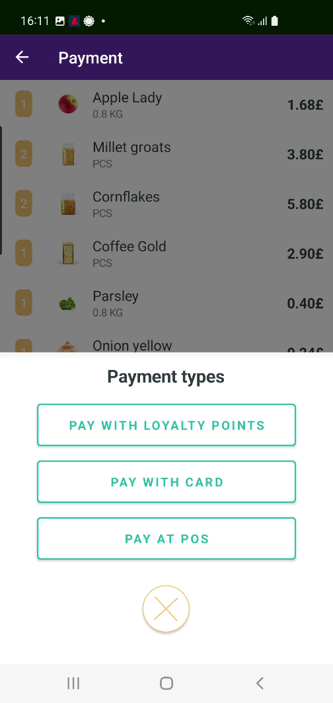
Easy checkout with ScanPayGo
When ready, it is time to pay for the shopping
Fast checkout options
The app displays all available payment options
The retailer decides which options are valid for his setup
This ensures quick checkout with short, or no lines

Slide 25
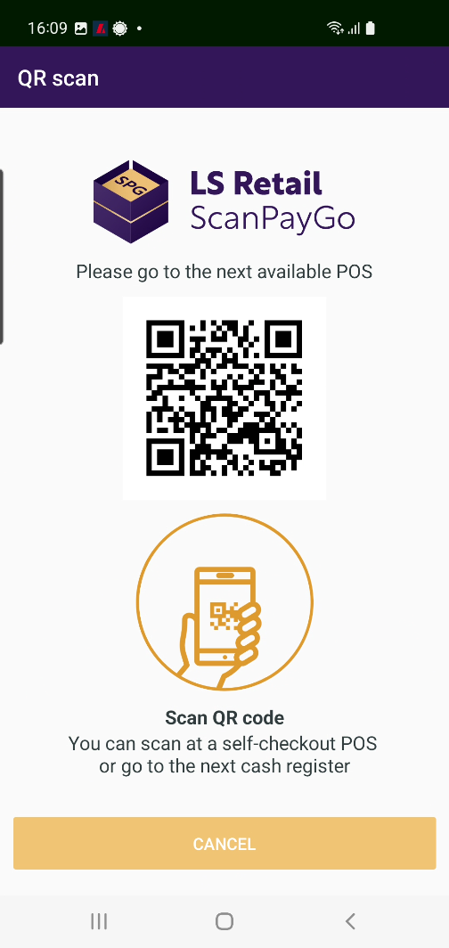
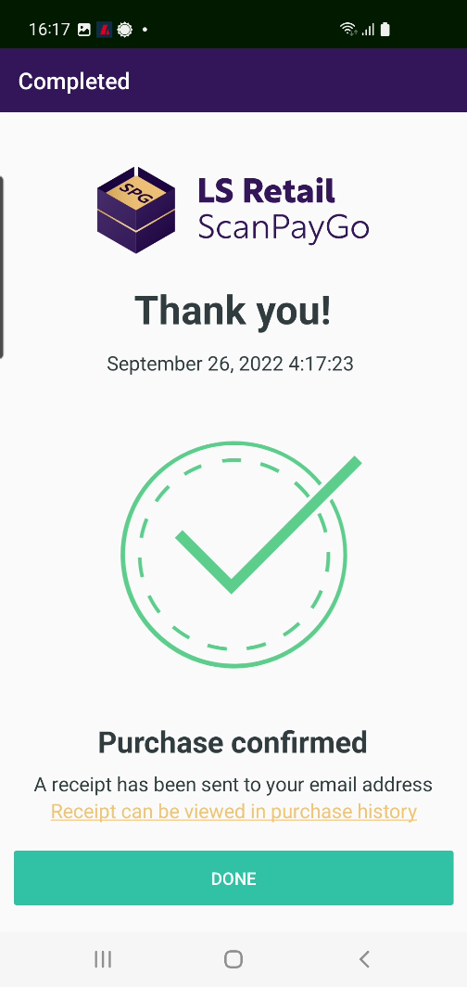
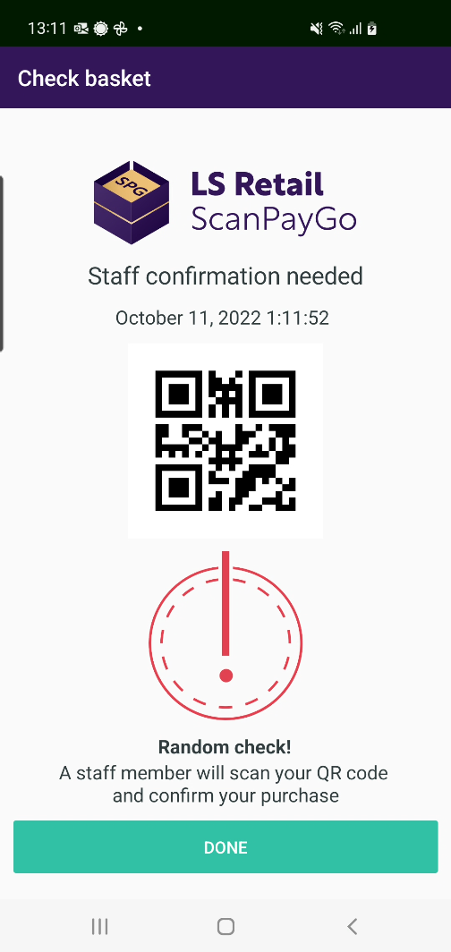
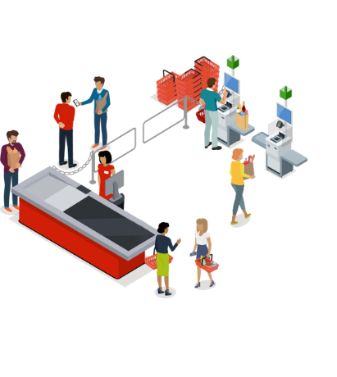
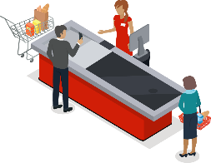
Fast checkout
The retailer decides how he wants the payment process to be:
Pay at the POS / self-service POS
Pay in app with card/loyalty points
POS lane
POS station
Payment station

Slide 26
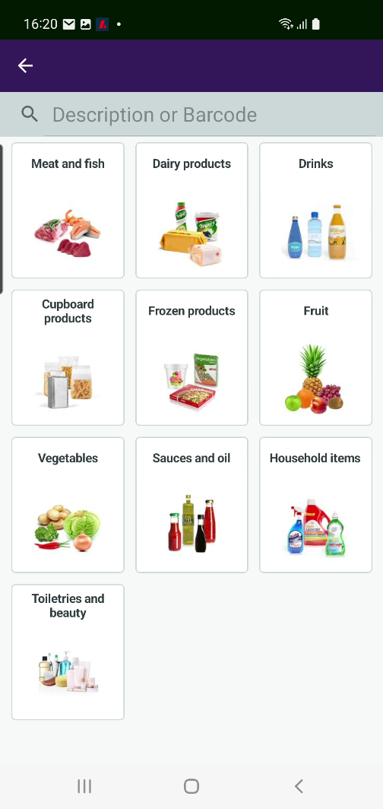
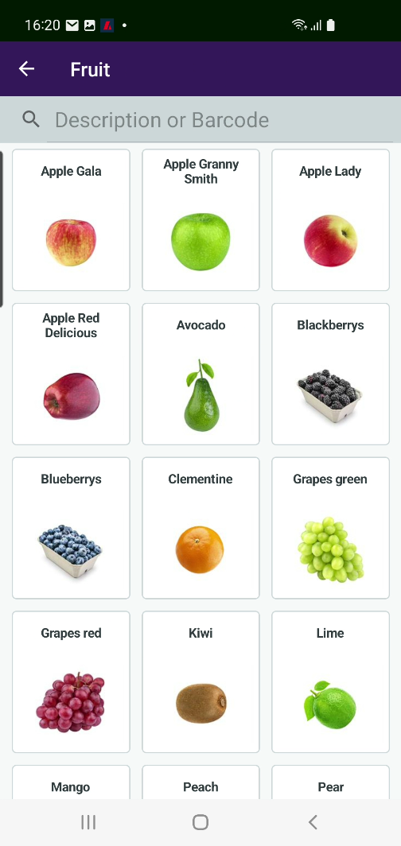
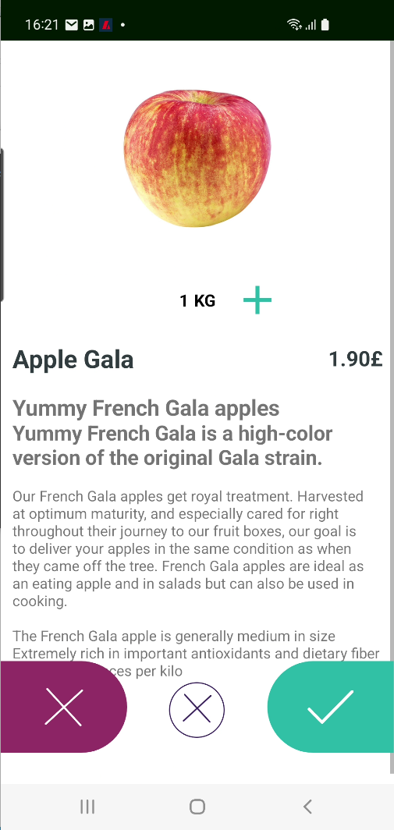
Easy to browse and find items
The retailer creates the grouping of items
Items in a group
Item details

Slide 27
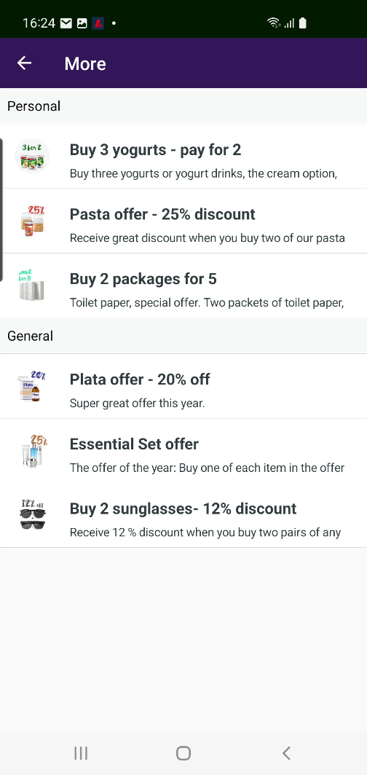
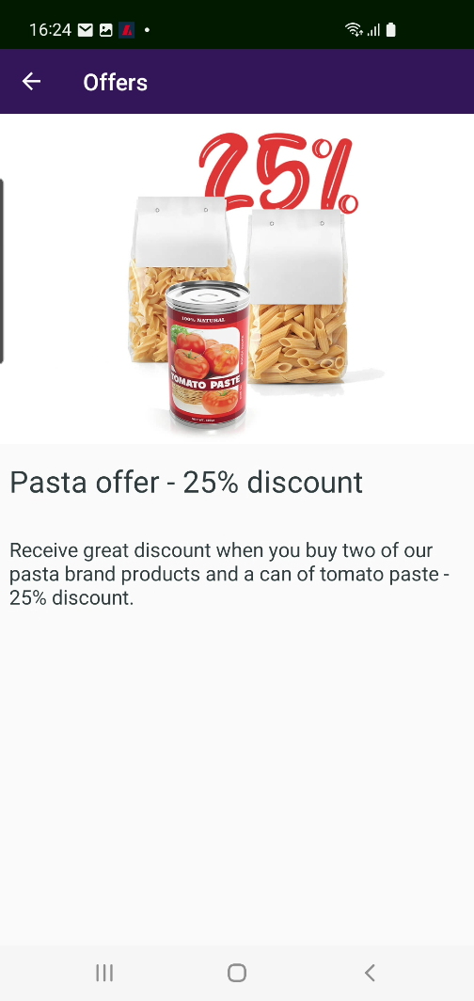
Offers in ScanPayGo
Easy to browse the retailer’s offers
Personal offers
Only valid for login users
General offers
Select an offer and you see the offer’s details

Slide 28
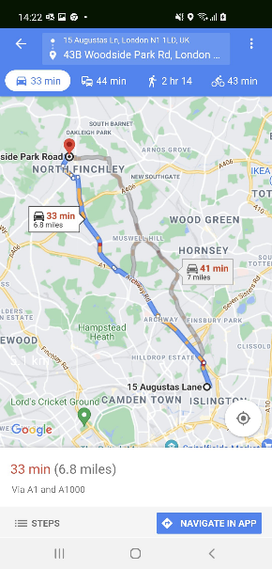
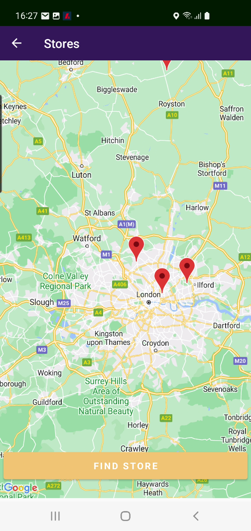
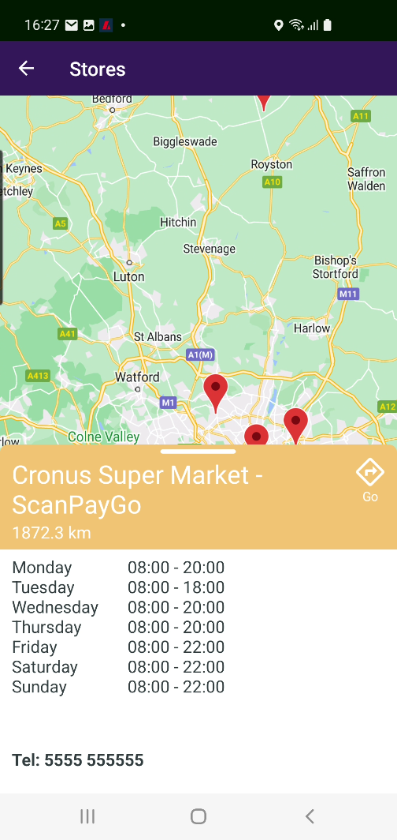
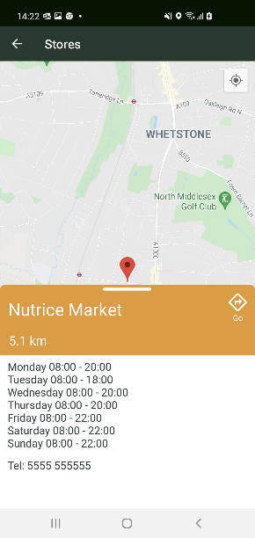
Stores and locations
Find your store and locate it on the map
Easy to look up opening hours for each store
Do you need driving instructions to go to the store? – The app provides them for you

Slide 29
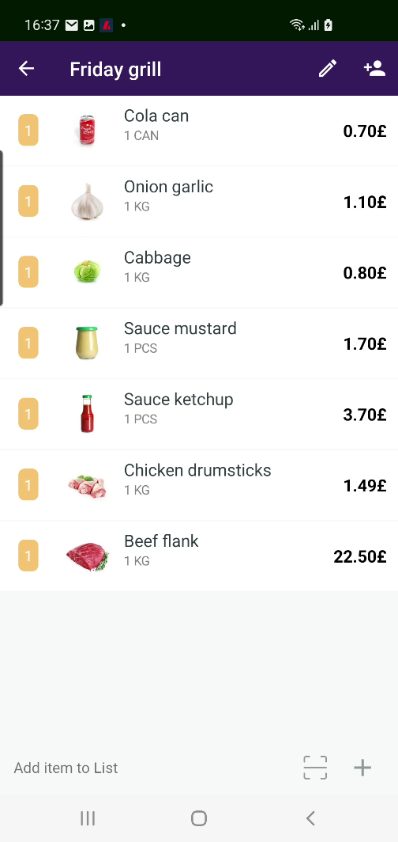
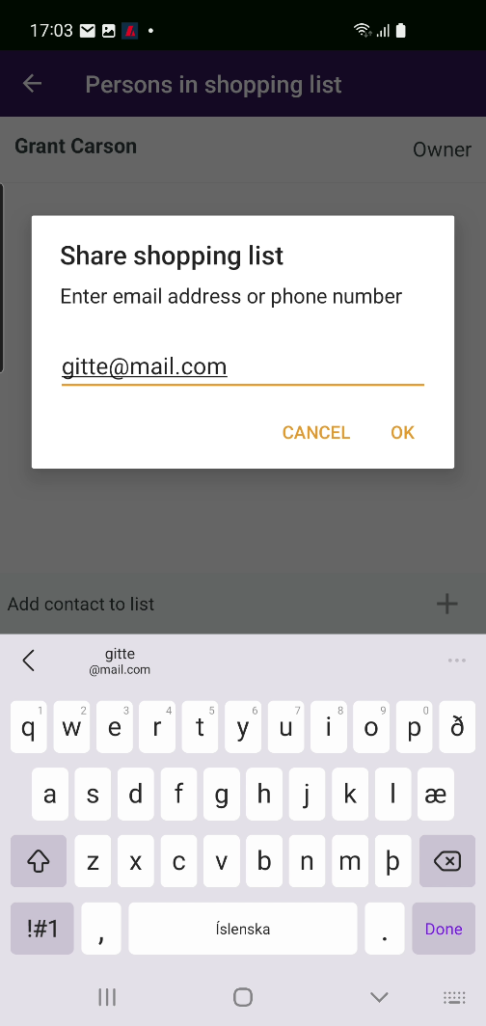
Share shopping lists
It is easy to ensure that you remember to buy all your items
Create your shopping lists in the app
As many as you want
Share your shopping lists with family and friends within the app
All members can change, add and delete items in the lists
Easy to share text format version of the list with friends who do not have the app

Slide 30
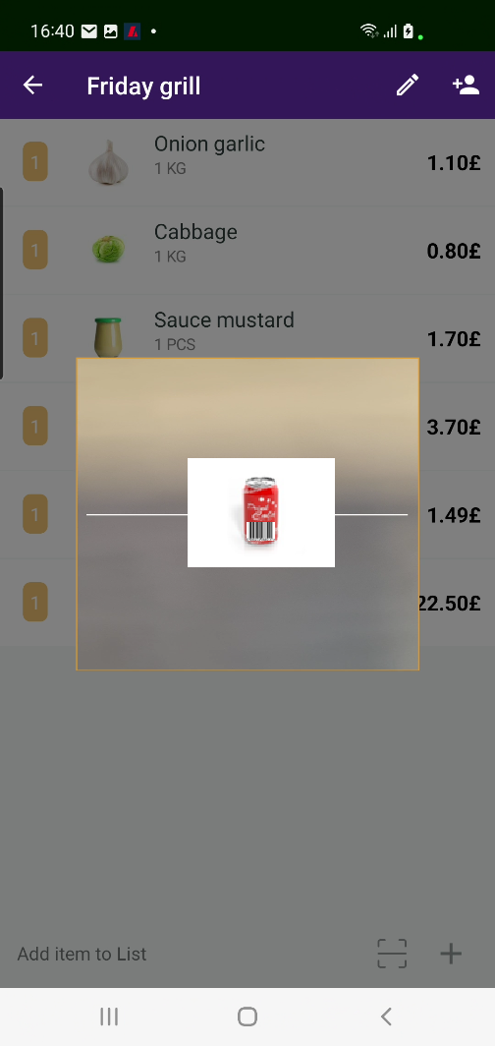
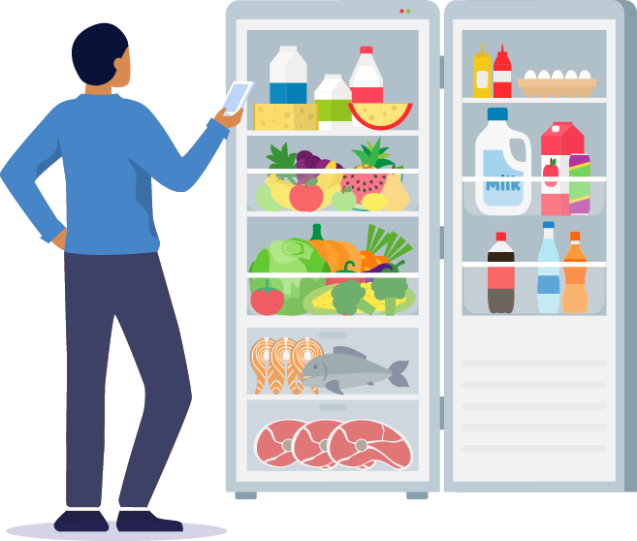
Shopping lists
Possible to scan items straight into the shopping list
Are you at home and only one cola can in the fridge?
It is so easy to scan the barcode straight into your shopping list
By scanning
By item hierarchy

Slide 31
Shopping the smart way
Activate a shopping list/lists for the basket
When shopping
You see how items go out of your shopping list when they get into the basket, which makes it very easy to monitor which items from your list/lists are not there yet
Activate shopping list, Friday grill, for the basket
When items from the list go into the basket they disappear from the list
No items are left in your shopping list

Slide 32
Purchase history
In ScanPayGo it is possible to view previous purchases
All purchase history is there
Purchases done in ScanPayGo
Purchase done in Ecommerce
Purchases done in the POS
The latest one is at the top of the list
Possible to create a shopping list based on a previous purchase
Select one, two or more items
Select the all items in the list

Slide 33
Security considerations
Concerns
Is the customer scanning all items and using the correct quantities?
Is everything paid for when the customer leaves?
In ScanPayGo
After payment, two types of messages can be displayed:
Purchase confirmed
A store employee must first verify purchase
Controlled by LS Central settings
A part of implementation
Configure to line with retailers’ rules and processes

Slide 34
Availability and licensing
Availability – Scan Pay Go will be available with LS Central 20.1 (June)
Licensing - Transaction fees for the app’s usage to be charged in the following month.

Slide 35
ScanPayGo on retailer-owned-device
Additional option is for retailers to provide devices for the customers to use in store
Devices can be stored in the entrance of store
Customer picks up the device
Customer uses the device for his shopping with ScanPayGo
Customer delivers the device back to the device stand

Slide 36
Mobile Inventory to check SPG
Store employee performs security check using the Mobile Inventory App:
Scans the QR code in Mobile Inventory to view SPG transaction details: items and payment status
Performs a random check on the items in customers shopping bag against the transaction list in Mobile Inventory
If an item is found in the bag that is not in the SPG transaction list, cancels the transaction and customer goes to a cashier to finalize sale again
If everything is OK, customer leaves the store ☺

Slide 37
ScanPayGo
Identify customers with external service
Digital signature
Payments
Apple Pay and Google Pay
Customer account

Slide 38
The Evergreen Train

Slide 39
Thank you

