Slide 1
LS Central SaaS
How we applied automation and continuous improvement in our localization and delivery process
Gudrun Olafsdottir
Product Director

Slide 2
LS Central SaaS/On-premises localizations
Country Availability (36 countries)
Europe
MEA & India
Denmark (DK)
Great Britain (GB)
Spain (ES)
Greece (GR)
South Africa (ZA)
Finland (FI)
Iceland (IS)
Ireland (IE)
Austria (AT)
UAE (AE)
Germany (DE)
The Netherlands (NL)
Switzerland (CH)
Estonia (EE)
India (IN)
Italy (IT)
Norway (NO)
Sweden (SE)
Saudi Arabia (SA)
France (FR)
Belgium (BE)
Malta (MT)
Morocco (MA)
Egypt (EG)
APAC
Americas
Australia (AU)
New Zealand (NZ)
Thailand (TH)
Canada (CA)
Hong Kong (HK)
Philippines (PH)
Vietnam (VN)
Mexico (MX)
Indonesia (ID)
Singapore (SG)
Malaysia (MY)
United States (US)

Slide 3
Languages
Austrian German Belgian French Belgian Dutch Canadian French Croatian Danish Dutch Estonian Finnish French German Greek Icelandic
Italian Lithuanian Mexican Spanish Norwegian Portuguese Serbian Slovenian Spanish Swedish Swiss German

Slide 4
LS Central SaaS /On-premises localizations
6 in testing, 7 in progress
In Testing
In Progress
Portugal (PT)
Romania (RO)
Bulgaria (BG)
Poland (PL)
Lithuania (LT)
Qatar (QA)
Croatia (HR)
Ukraine(UA)
Serbia (RS)
Latvia (LV)
Slovenia (SI)
Slovakia (SK)
Tunisia (TN)

Slide 5
Those were the days
Code merge!
Code merge!

Slide 6
The LS Central journey to SaaS

Slide 7
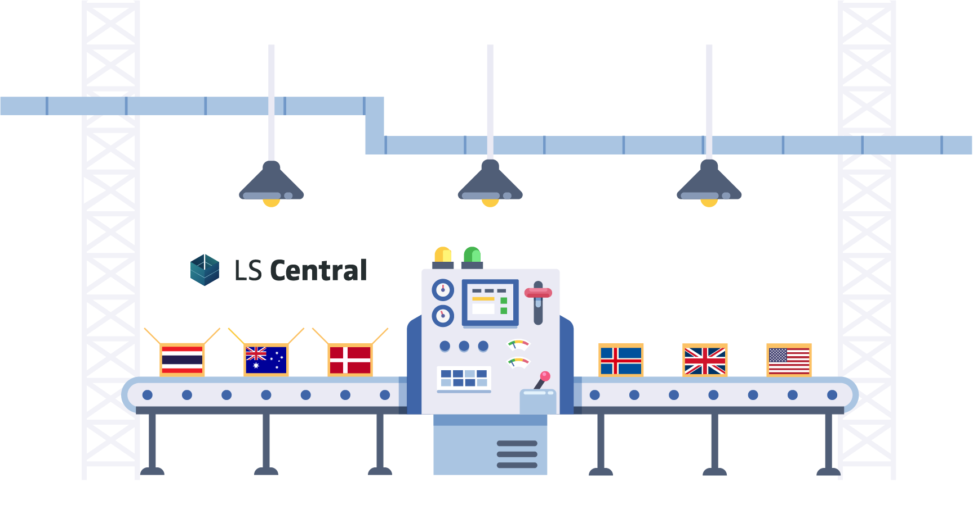
Localization, Devops and Delivery team
Team focusing on:
Localizations
Release automation
LS Central SaaS updates and management
Development environment

Slide 8
Vision and Values
Our vision is to continuously deliver rapid and guided
user experience

Slide 9
Values
Clarity

Slide 10
Values
Efficiency

Slide 11
Values
Compassion

Slide 12
Goal
We want to make:
Difficult EASY
Complicated SIMPLE
Slow FAST

Slide 13
Quality?

Slide 15
Continuous improvement

Slide 16
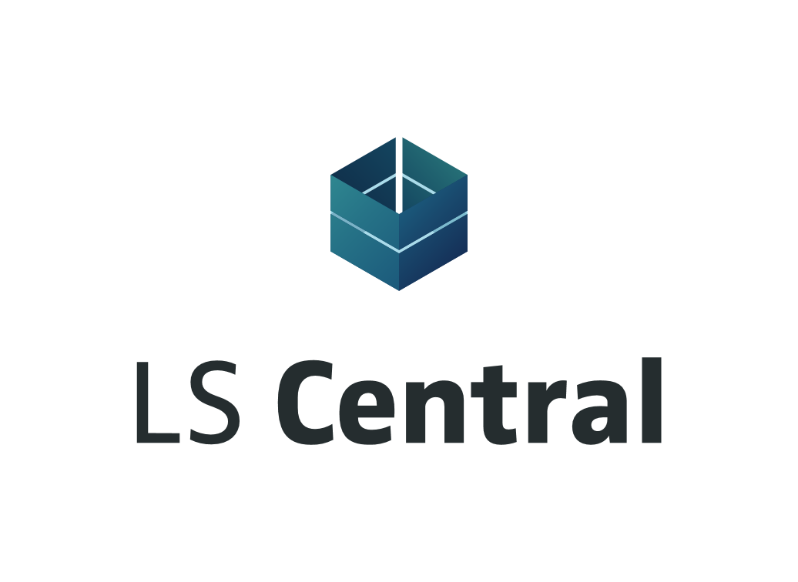
Then this happened
Code merge!

Slide 17
Release automation
LS Central Release Builds
The actual release work is 2-3 days for 34 countries + North America and India
30 min. to release a hotfix in SaaS (build – upload)
Trigger Localization build to run auto translation (stage 1)
Self service portal for translator
Resume Localization build to run create app
(Stage 2)
Run autotest for localization
Resume Localization build for release
Create pull request before merging to master

Slide 18
LS Central W1 release
Code Freeze
LS Central W1
Release
LS Central W1 on-premises Release
QA

Slide 19
Translation process 23 languages
Major release?
Yes
Auto Translation
Merge Translations
Create missing translation file for major release
Translators' pick-ups the missing translation and proceed with translation
Auto translation by reusing the translation from previous version.
No
Complete translation file

Slide 20
1. Release process W1 countries
LS Central SaaS
Greece
LS Central SaaS
UK
LS Central SaaS
Ireland
LS Central SaaS
Malta
LS Central SaaS
South Africa
LS Central SaaS
Morocco
LS Central SaaS
Malaysia
LS Central SaaS
Estonia
LS Central SaaS
Hong Kong
LS Central SaaS
Indonesia
LS Central SaaS
Vietnam
LS Central SaaS
Philippines
LS Central SaaS
Egypt
W1
LS Central SaaS
Singapore
W1
LS Central SaaS
Saudi Arabia
BC and LS Central localization and fiscalization requirements are done by local partners
LS Central SaaS
Thailand
Arabic receipt
App
LS Central SaaS
UAE

Slide 21
2. Release process BC localized countries
LS Central SaaS
New Zealand
LS Central SaaS
Australia
LS Central SaaS
Denmark
LS Central SaaS
Finland
LS Central SaaS
Germany
LS Central SaaS
France
LS Central SaaS
Iceland
LS Central SaaS
The Netherlands
LS Central SaaS
Switzerland
LS Central SaaS
Austria
W1
W1
W1
W1
W1
W1
W1
W1
W1
W1
Update testenvironment with new release
Test
Create bacpac
Release in SaaS
QA
LS Central localization and fiscalization requirements are done by local partners

Slide 22
3. Release process BC and LS Central localized countries
LS Central SaaS
Norway
LS Central SaaS
Belgium
LS Central SaaS
Sweden
LS Central SaaS
Spain
LS Central SaaS
Italy
LS Central SaaS
India
LS Central SaaS
Canada
LS Central SaaS
Mexico
LS Central SaaS
United States
Fiscalization
App
i-seal
App
Fiscalization
App
SII
App
Localization
App
Localization
App
NA localization
App
W1
W1
W1
W1
W1
W1
W1
Update testenvironment with new release
Test
Release on-premises
Create bacpac
Release in SaaS
LS Central localization and fiscalization requirements are done by LS Retail
QA

Slide 23
Does it look complicated?

Slide 24
Processes
Clarity
Continuous improvement
Automation
LS Central
Release
Update
QA
Extension A
Extension B
Update test environment with new release

Slide 25
Vision and Values
Our vision is to continuously deliver rapid and guided user experience

Slide 26
Product knowledge
Active Listening
Effective Communication

Slide 27
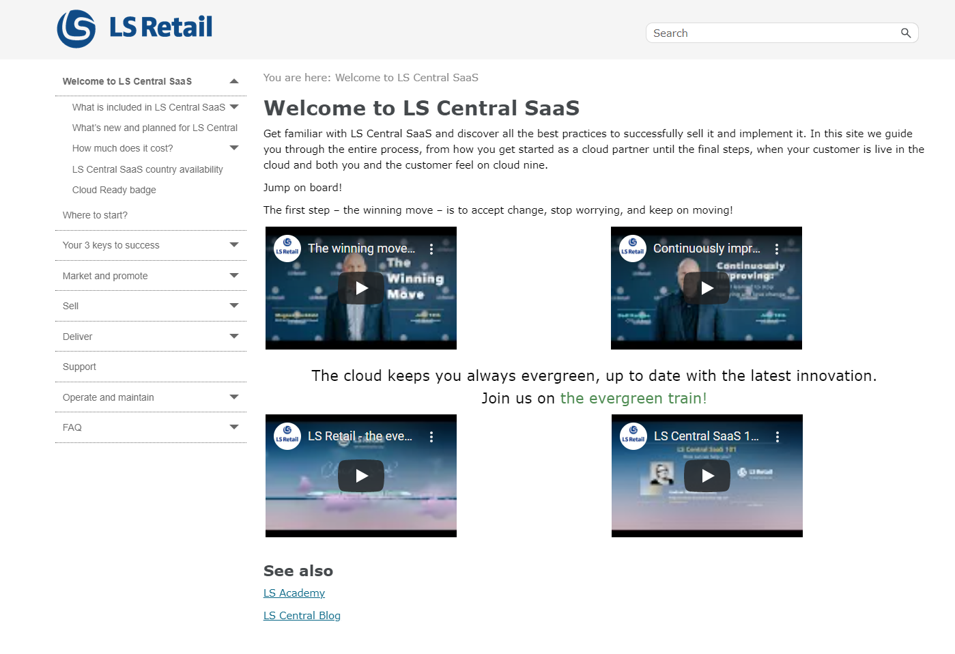
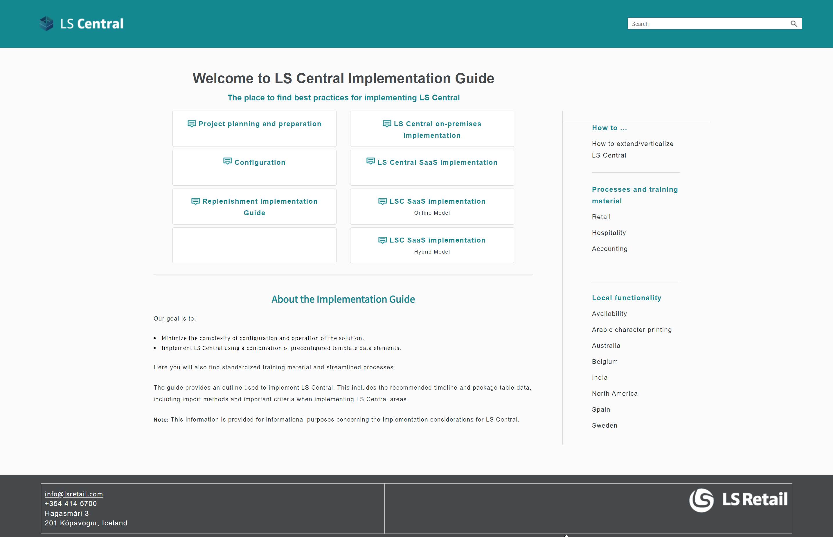
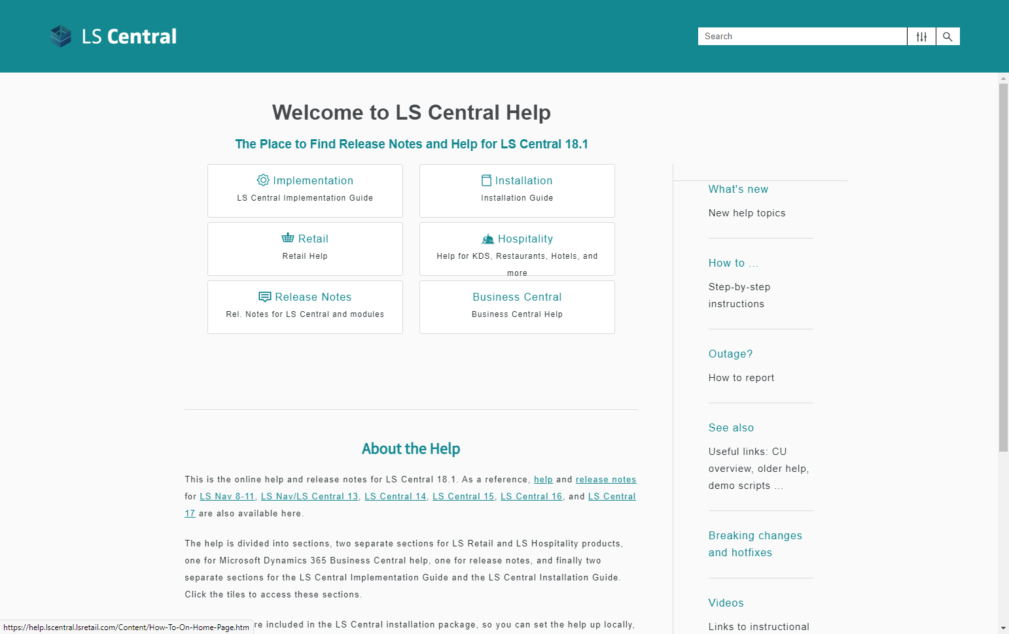
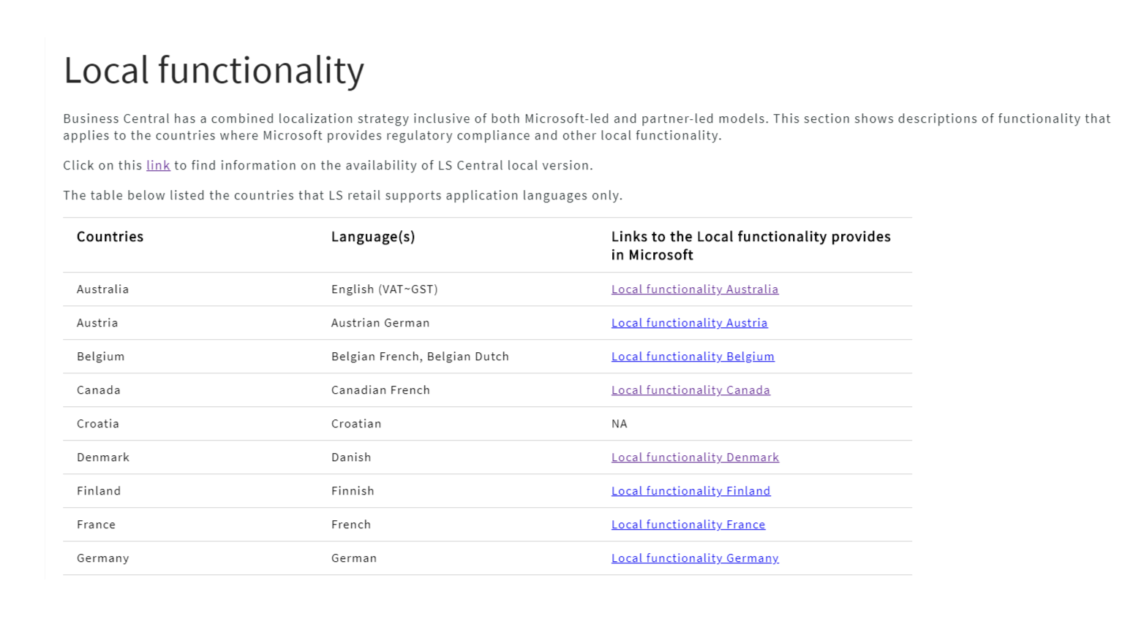
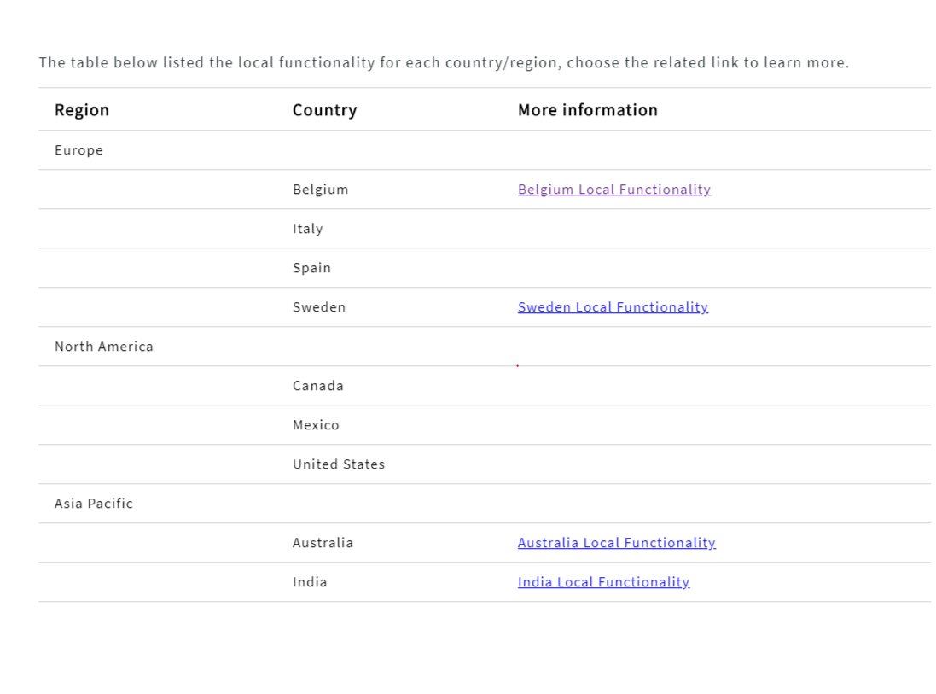
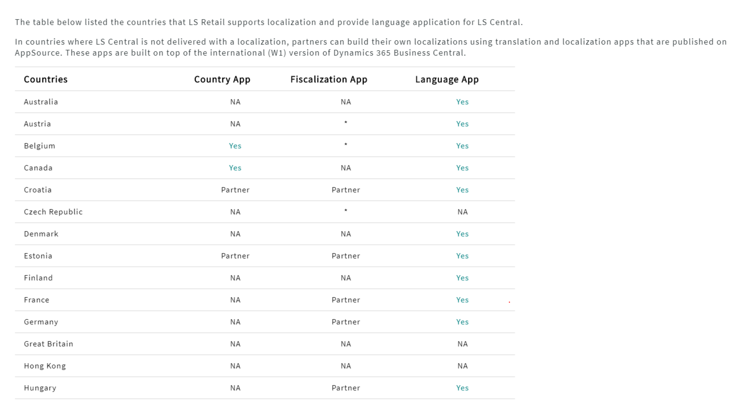
Get Directions (where to start)
How to implement (the project)
Online help (the product)
Local functionality (My country)

Slide 28
Partner onboarding
100
LS Central SaaS partner onboarding sessions in 2021-2022
Delivery
+
The LS Central SaaS Buddy Program

Slide 29
Training Material
Partner / Customer
Onboarding Material
Feedback
LS Academy
Sales
Partner Operations
Consulting
Technical Support
Partner onboarding

Slide 30
CAP - Mission
To:
Assist partners in implementing their first LS Central SaaS project in the form of online workshops & meetings
Educate partners and make them ready to do onward LS Central SaaS implementations on their own, as the partners will be doing the hands-on work or learning by doing.
Do our best to make our partners comfortable with the SaaS environment
Improve LS Central SaaS guidelines
Exclude no one - consider all
Alla - our onboarding buddy

Slide 31
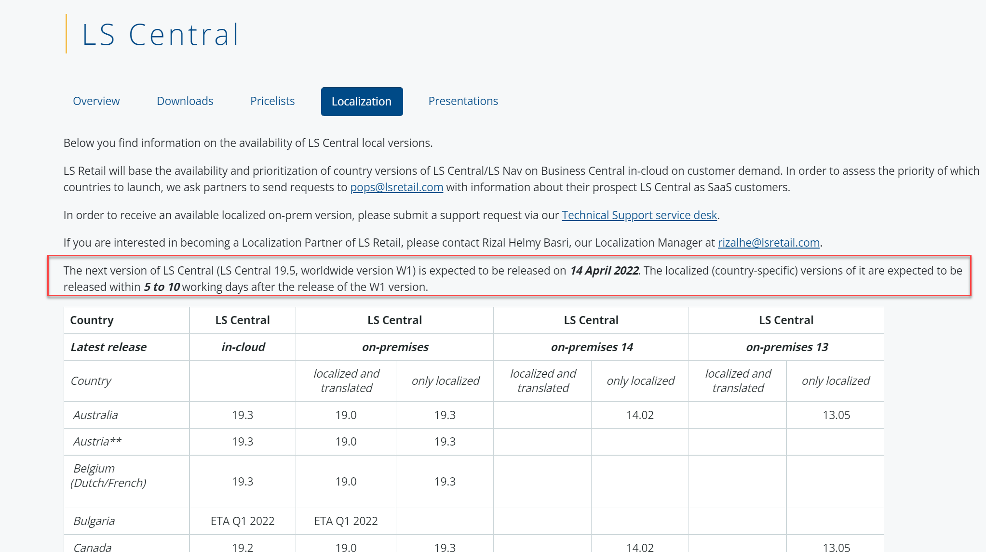
Partner Portal

Slide 32
Questions?

Slide 33
Thank you

