Slide 1
Contactless food ordering in LS Central for restaurants
Gunnar Orn Thorsteinsson
Petur Thor Sigurdsson
Product Director
Product Director

Slide 2
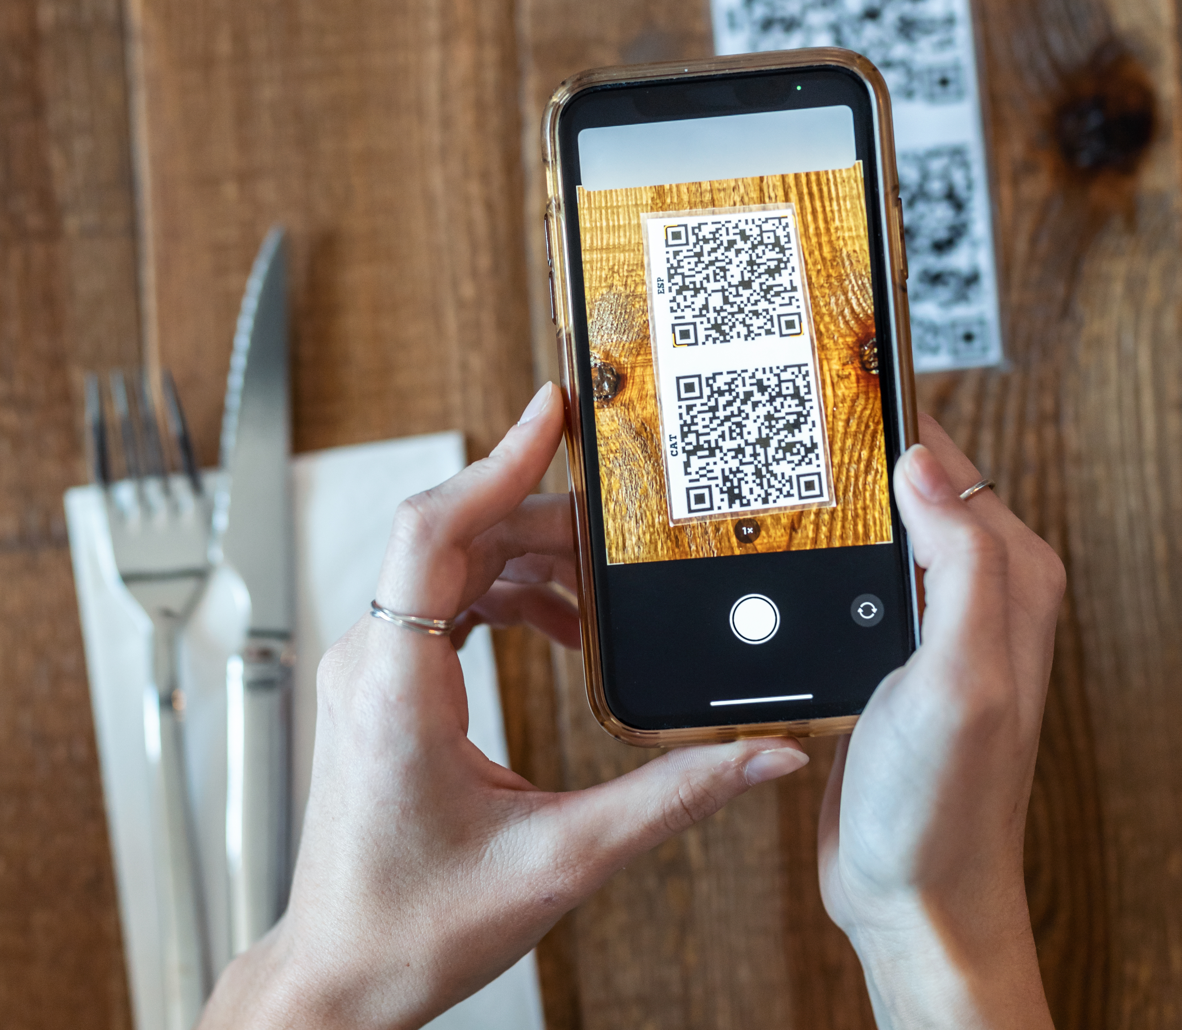

Contactless food ordering
A restaurant experience that reduces time guests spend in close contact with restaurant
staff and other guests

Slide 3
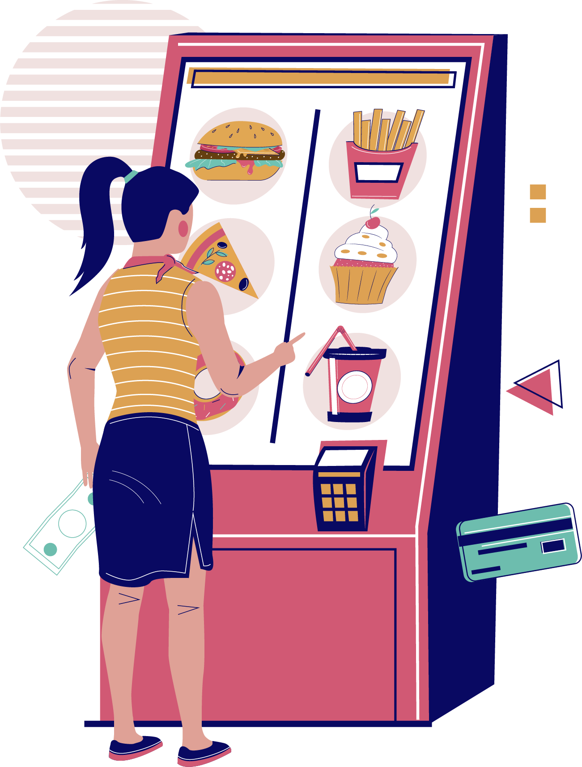
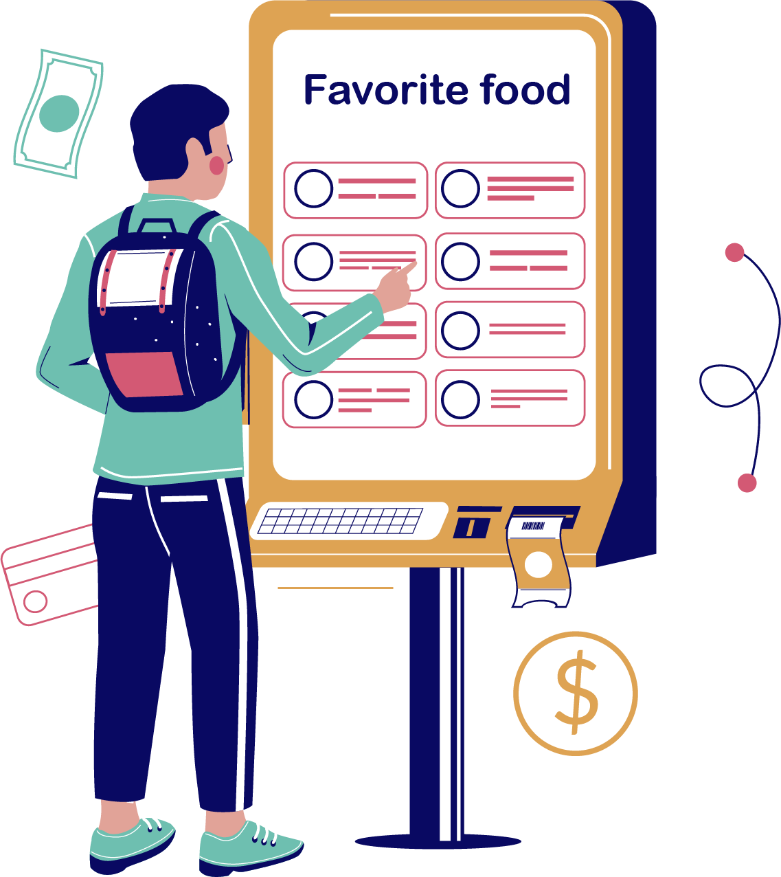
Benefits of Contactless Dining
Less personal contacts (good in Covid)
Better Order Accuracy
Bigger Check Sizes
Faster Table Turnover
Reduced Staffing Costs

Slide 4
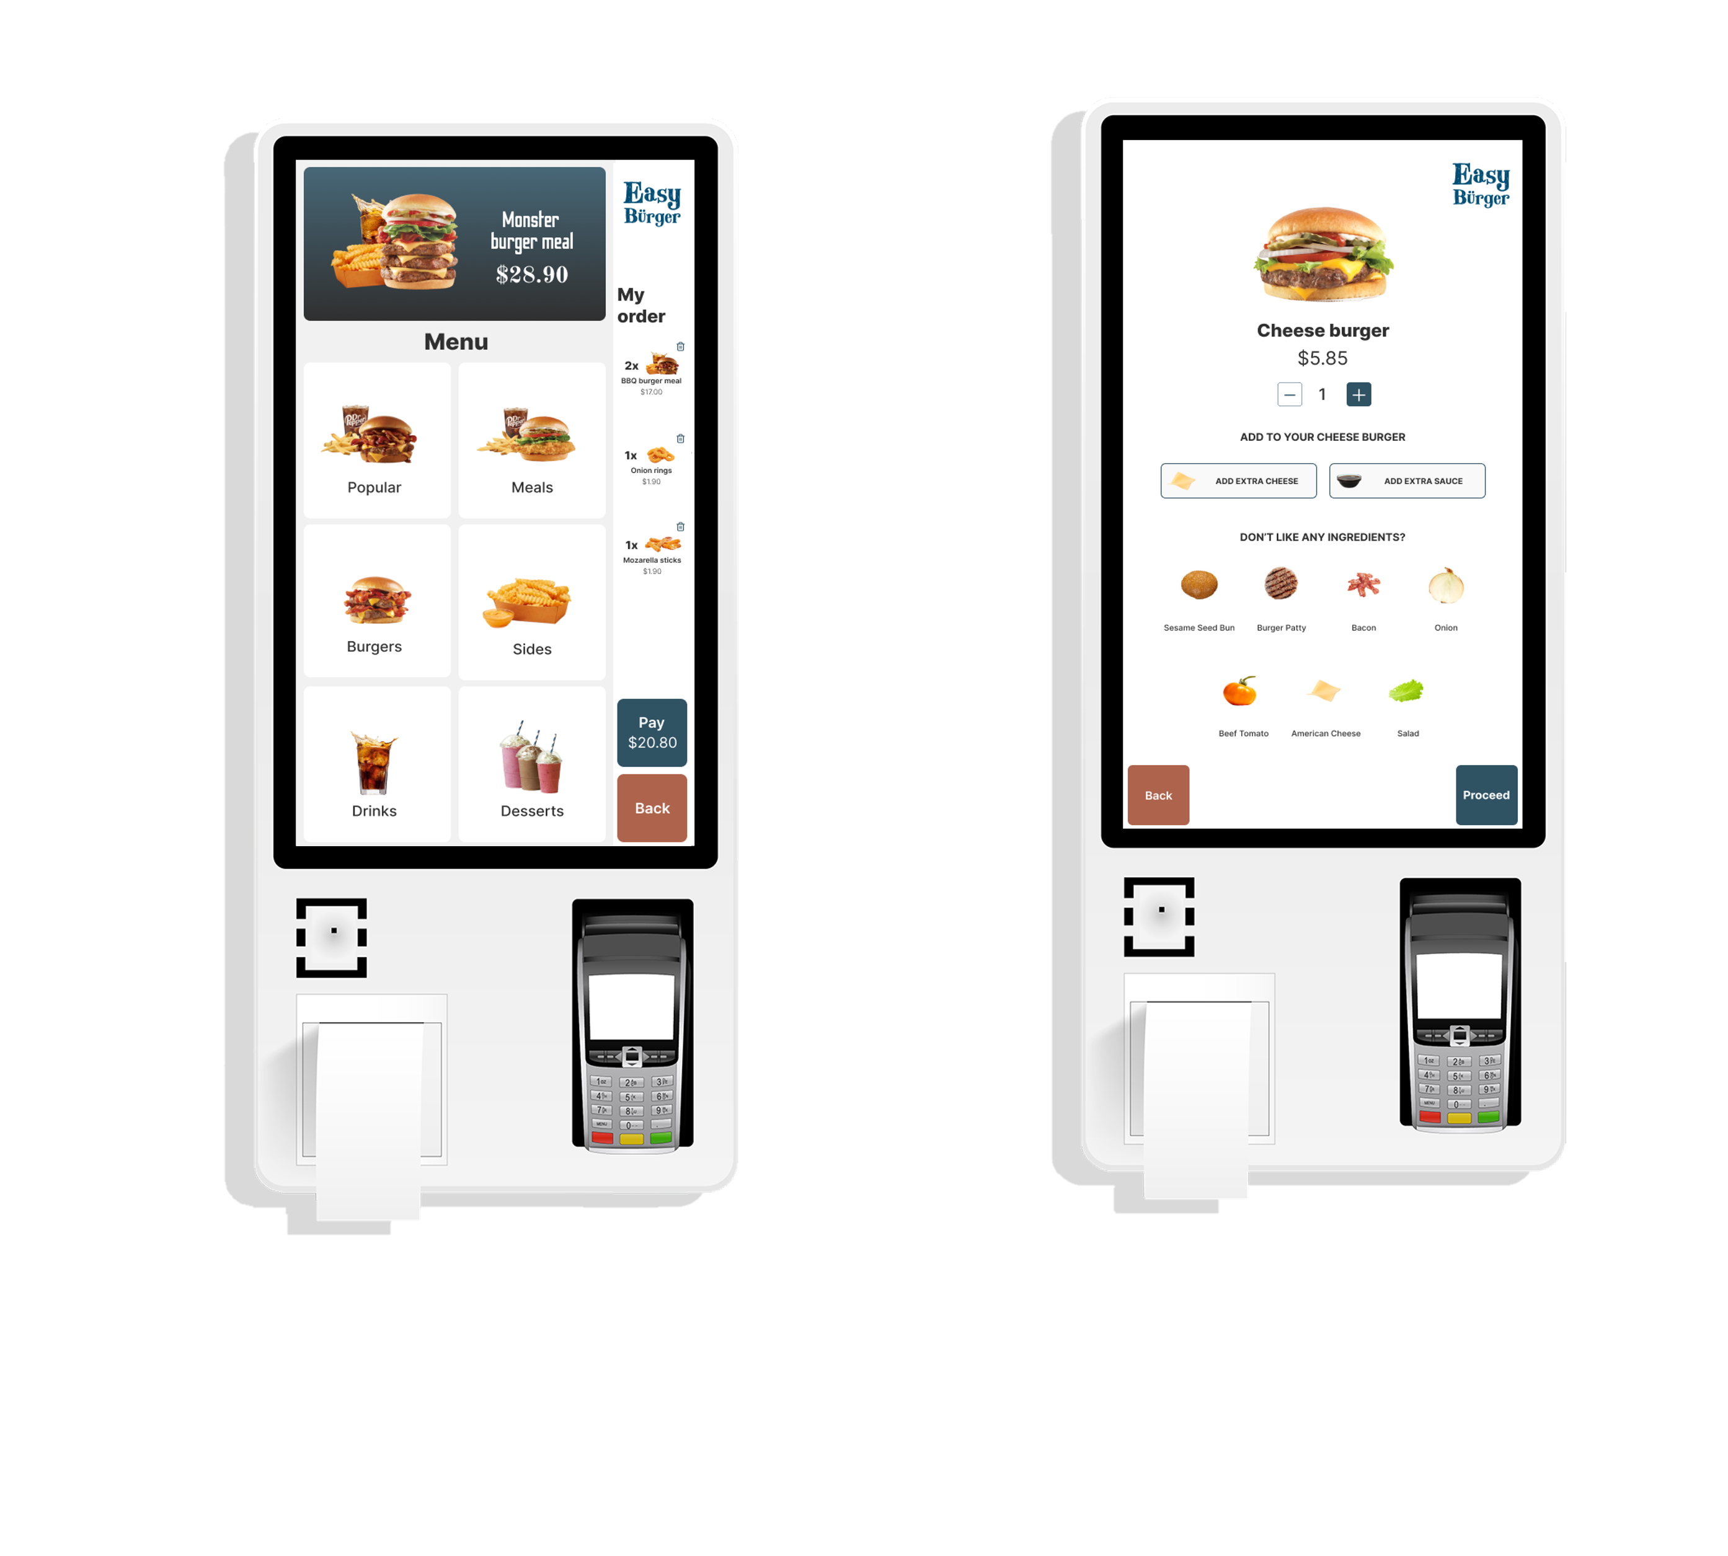
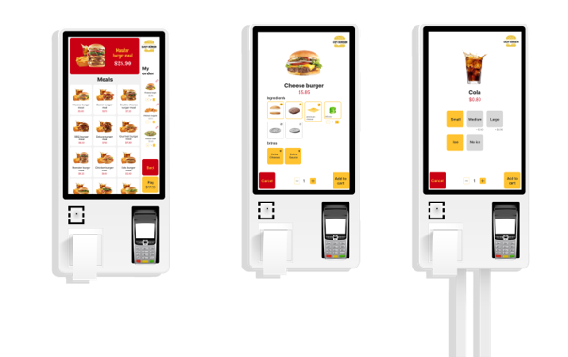
Self-Service Kiosk
New User Experience
  Html web templates
  “Conversational” order taking
  Fast order taking
Menu hierarchy
  Same hierarchy for all channels
Basket calculation in LS Central
  Prices, deals and offers
  Member point accrual

Slide 5
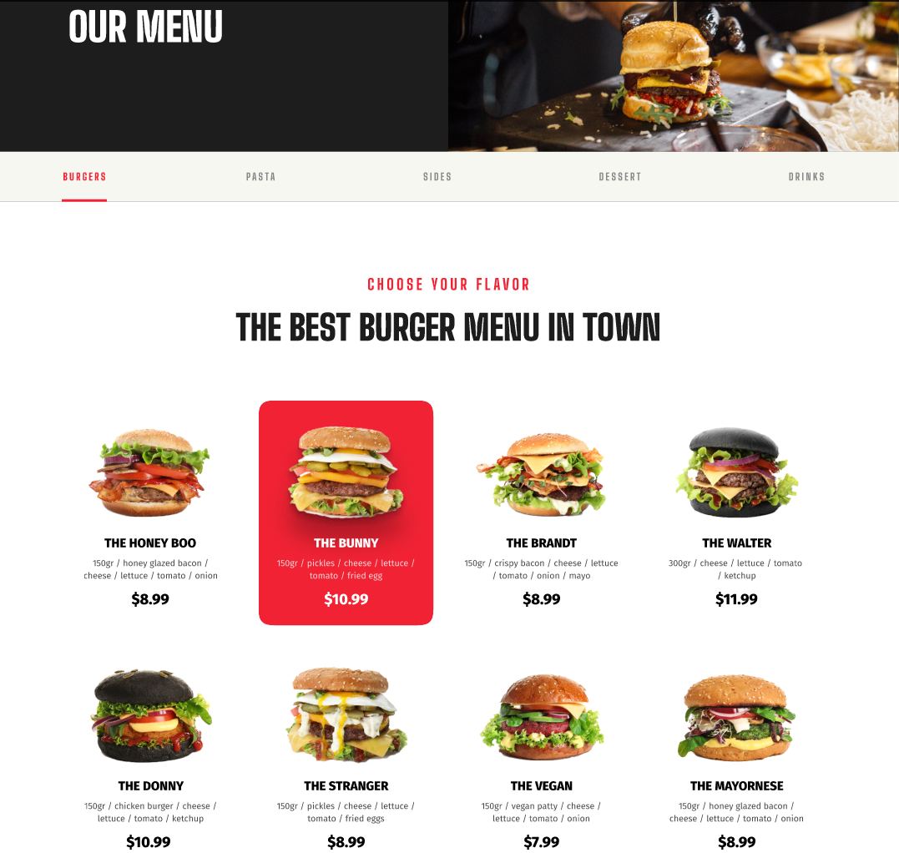
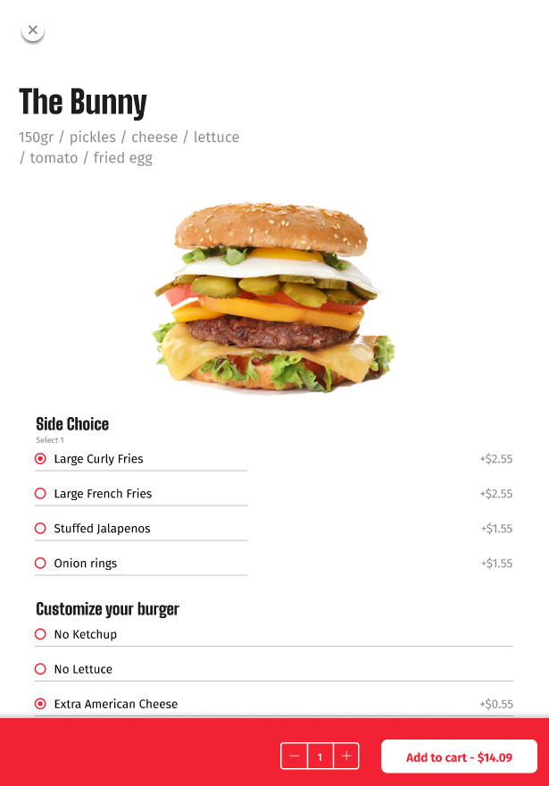
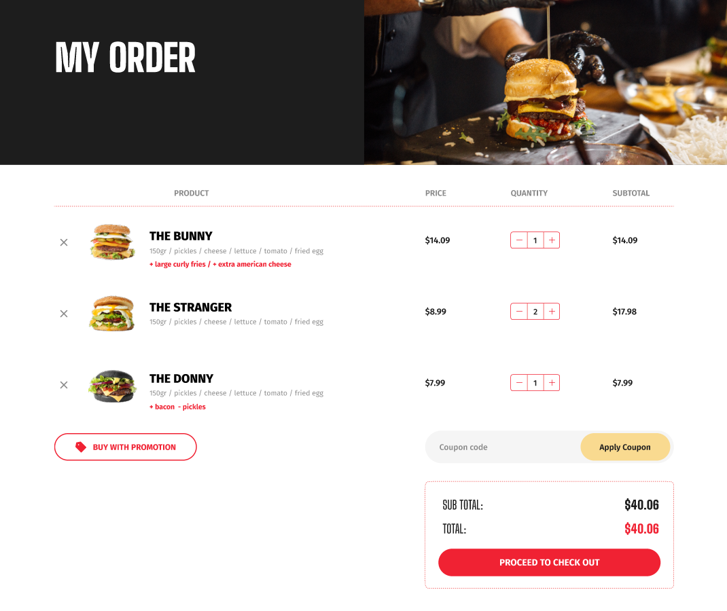

Introducing online ordering

Slide 6






eCommerce
POS
Master Data
Store Inventory
Point of Sale
Basket Calculation
Hospitality
Customer Loyalty
Click & Collect
Customer Orders
Transaction Repository
Token Vault
Gift Cards
Activity
KDS
Pharmacy
+
+

Slide 7
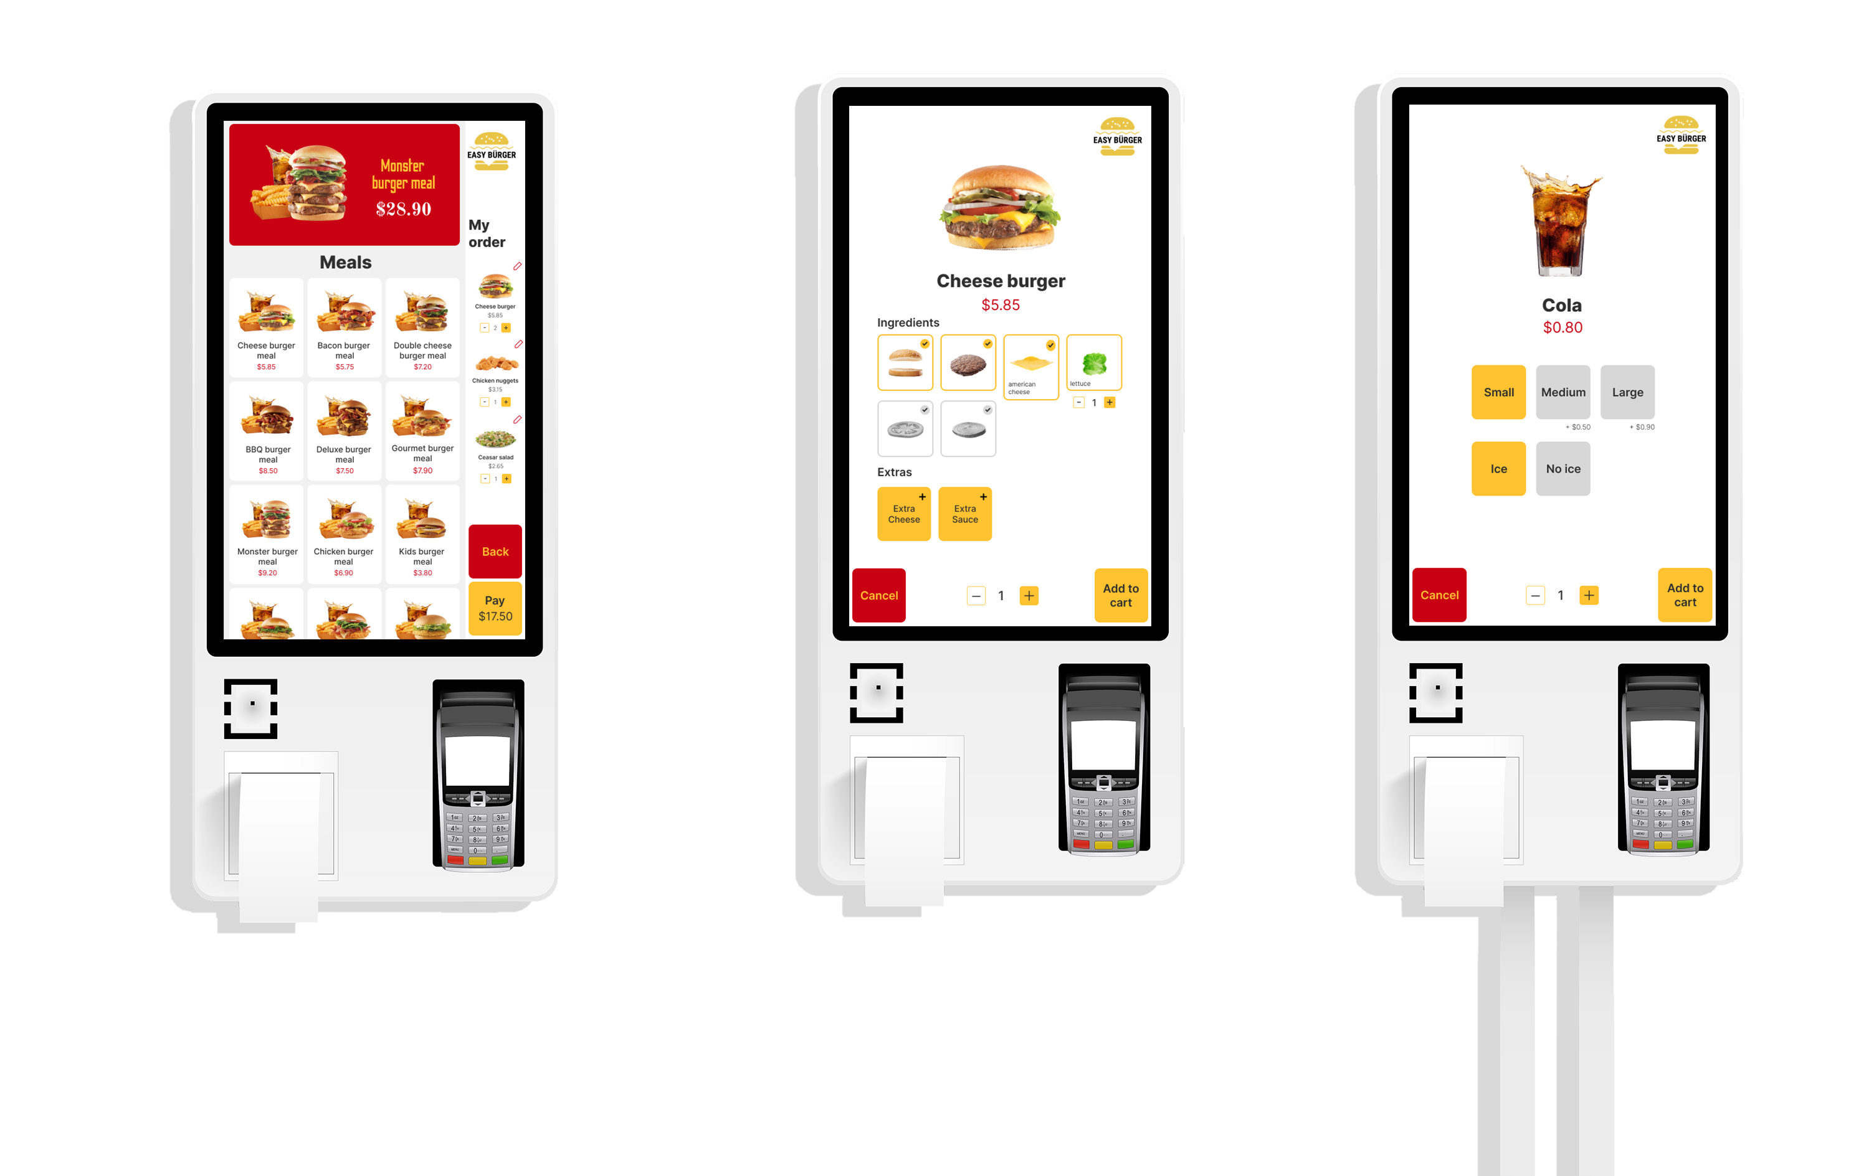

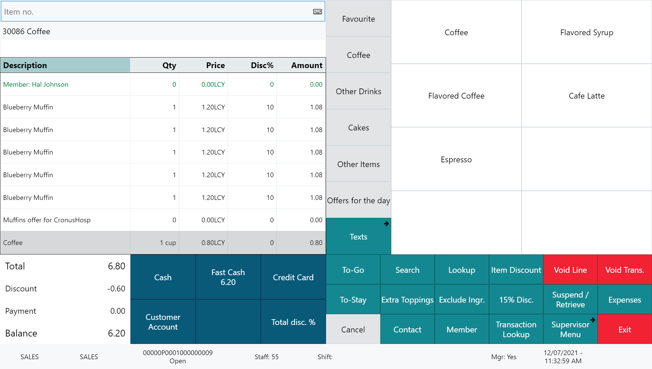






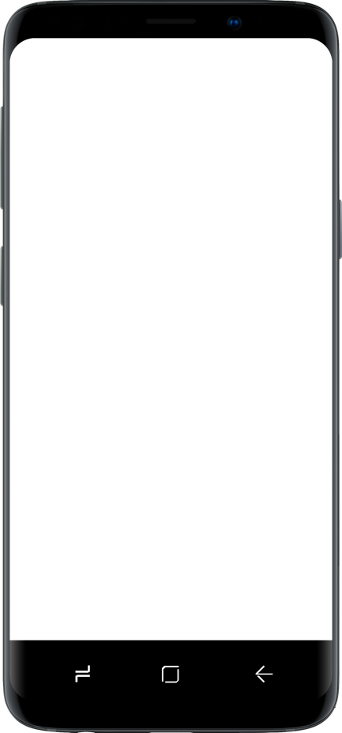
Restaurant
KDS preparation stations
Self Service Kiosks
POS 1
POS 2
LS KDS
Grill
KDS
Cold
Expeditor
station
Kitchen Service
Dessert
Bar
Online ordering

Slide 8


Retail
Hospitality
Activity
Pharmacy
Retail
eCommerce API
LS Commerce Services
3rd party
eCommerce
providers

Slide 9
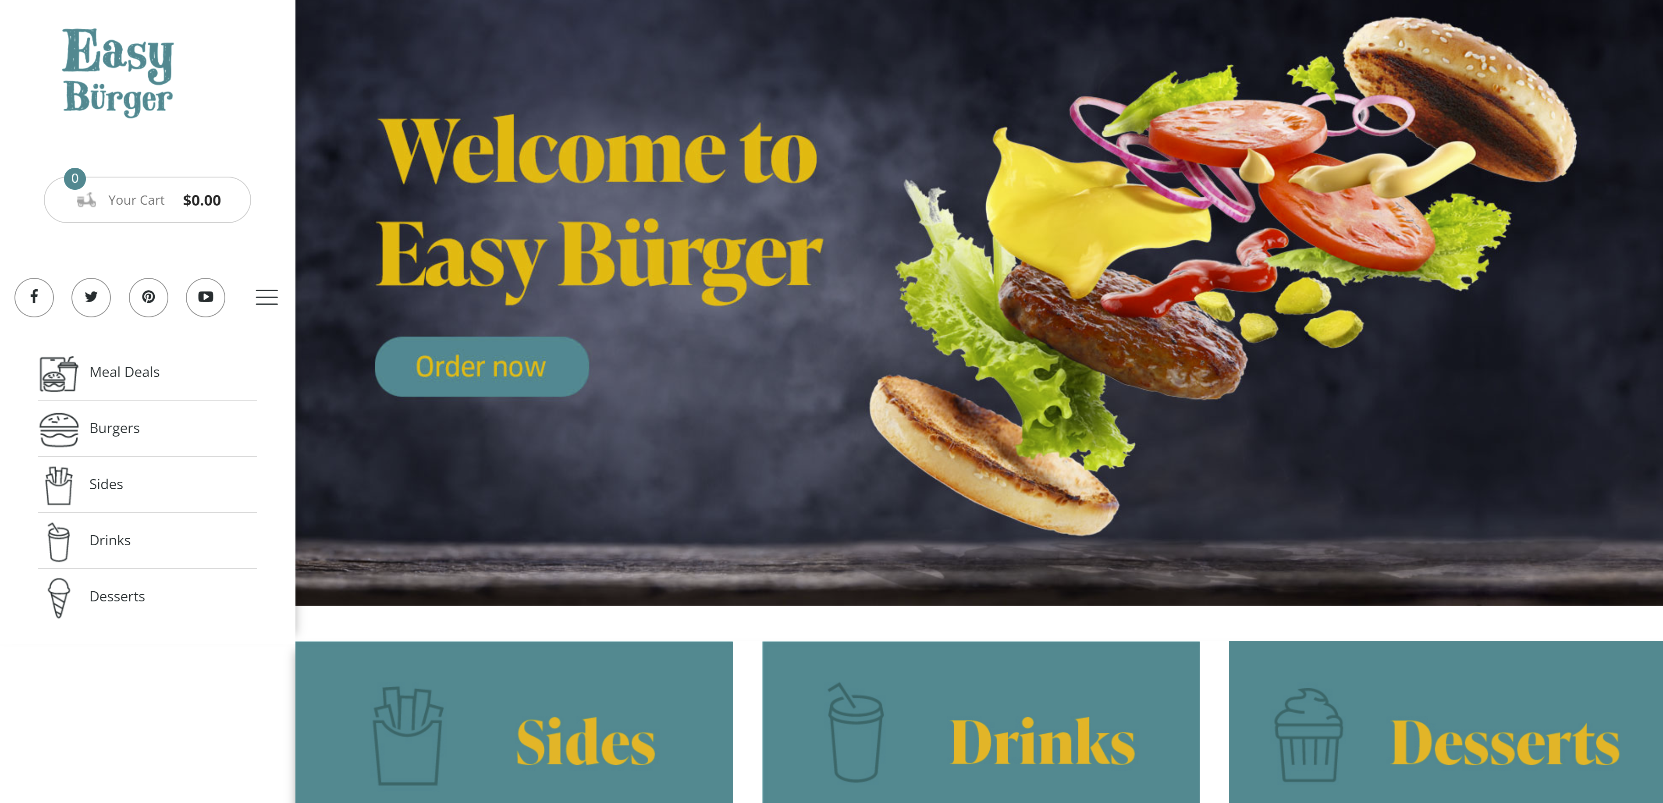
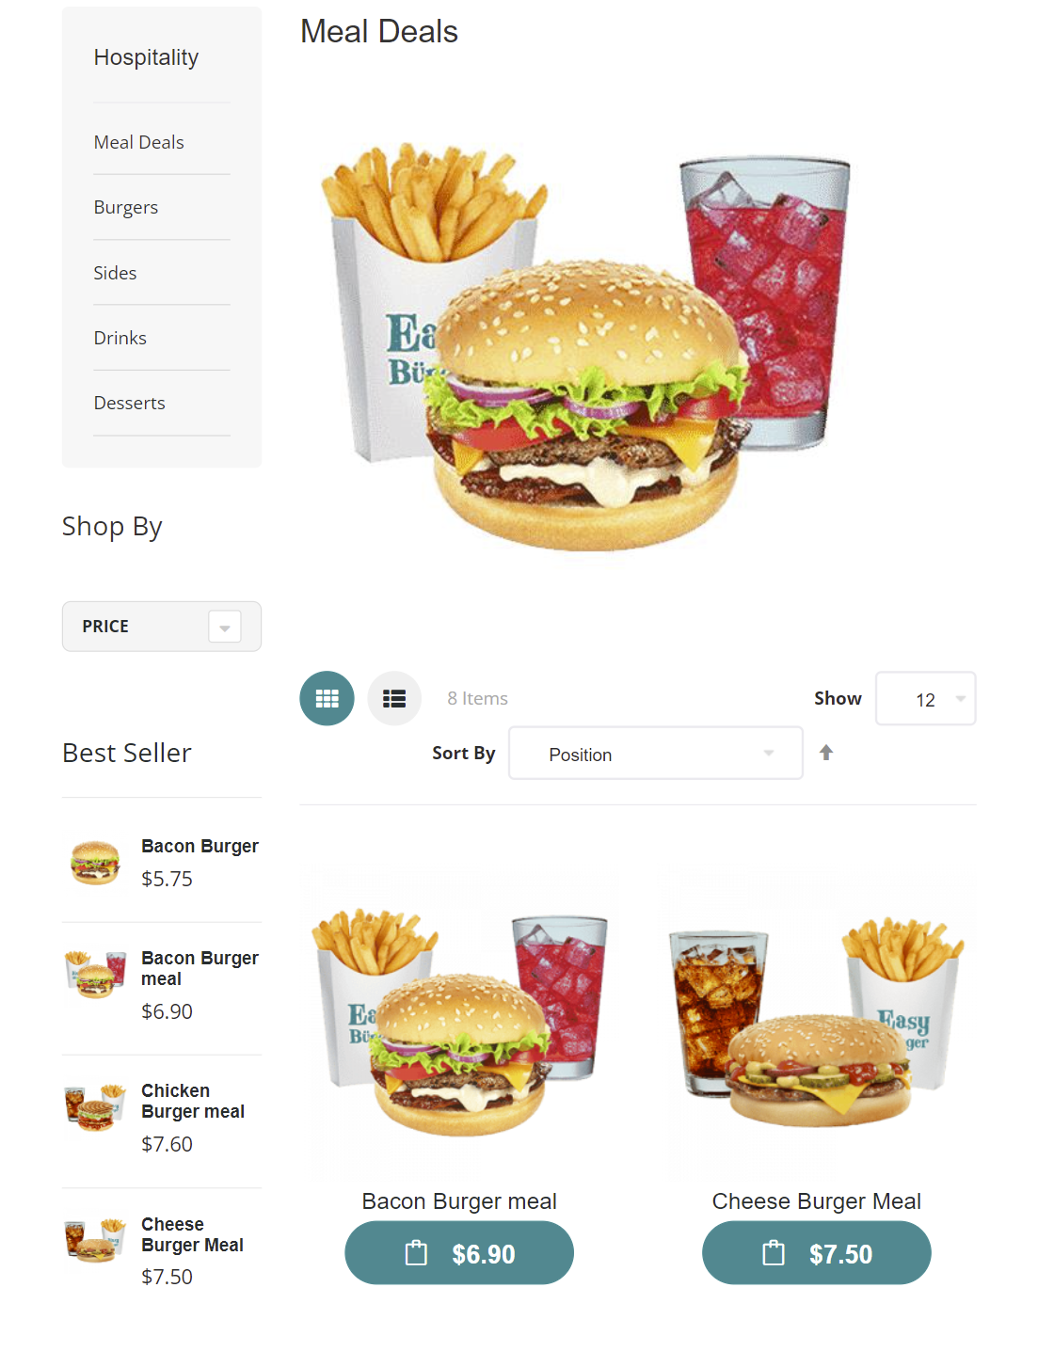
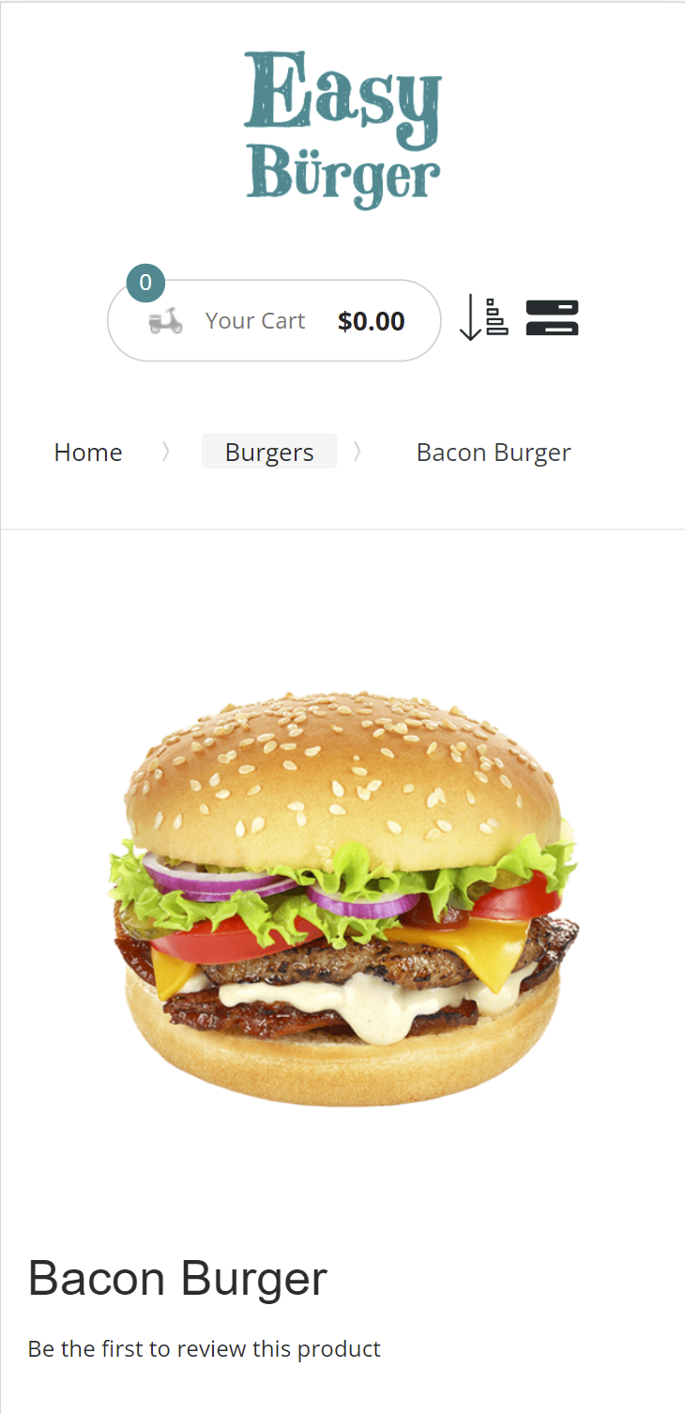
Magento - UI Options
Traditional
Progressive Web App (PWA)

Slide 10

Features
Take-away and dine-in
Menu setup in LS Central
Items (Images, longer descriptions)
Deals, with price change support
Modifiers
Ingredients and allergens
Basket calculation via LS Central
Customers are member contacts in LS Central
Orders instantly posted to LS Central and routed to the KDS

Slide 11
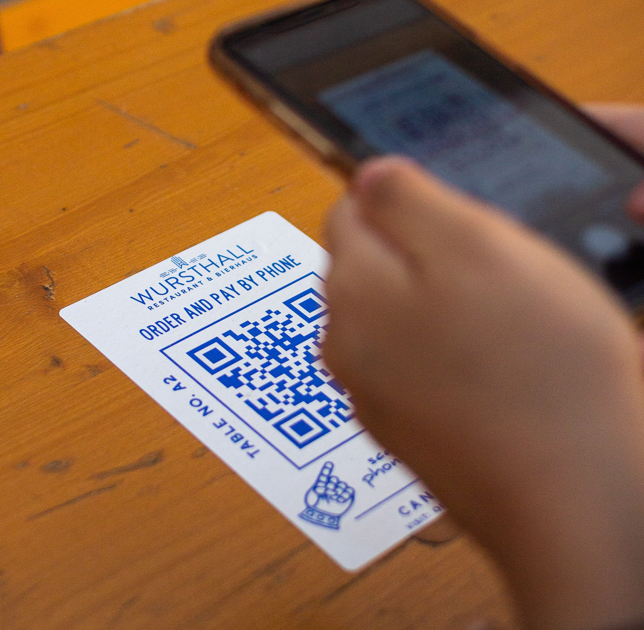
QR code ordering process
Customer scans a QR Code at a restaurant table, directing the customer to the restaurant’s website and disclosing the ID of the customer’s location (table, seat, cabin, etc.)
Customer orders via the web site. Payment is either online or on the POS.
The order is instantly posted to LS Central and routed to the KDS system for preparation
When ready LS Central instructs the waiters where to deliver the dish

Slide 12
Demo

Slide 13




Roadmap
PWA (Progressive Web App)
Web hooks for order updates
Home delivery
Anonymous ordering
Loyalty points and gift cards

Slide 14
Q&A

