Slide 2
Turning thousands of hours of project experience into proven success strategies
Jennifer
Urdur Anna
Oddo
Bjornsdottir

Slide 3

Proven methodology foundations
Risk, change & communication lessons
Case studies from the field
Adapting the framework
Key takeaways
Q&A
Agenda

Slide 4
Our proven project methodology
A consistent framework — adapted for every customer

Slide 5

Our proven project methodology
Continuous across every phase:
  Expectation setting
  Risk management
  Change control
  Designed for consistency — executed with flexibility.

Slide 6
Our proven project methodology
Continuous across every phase:
  Expectation setting
  Risk management
  Change control
  Communication
  Governance & structured checkpoints
  Designed for consistency — executed with flexibility.

Slide 7

What thousands of hours have taught us
Successful projects follow predictable patterns
After thousands of delivery hours, we’ve consistently observed:
Clarity before execution
Clear decision ownership
Consistent checkpoints and discipline

Slide 8
What thousands of hours have taught us
Successful projects follow predictable patterns
After thousands of delivery hours, we’ve consistently observed:
Clarity before execution
Clear decision ownership
Consistent checkpoints and discipline
Early visibility into risks and trade-offs
Change is managed effectively
Open, continuous communication

Slide 9
Clarity, ownership & discipline
How structure creates a solid foundation

Slide 10

Pattern #1
Clarity before activity
Successful projects:
Confirm scope before starting build
Align on what “done” means
Clarify who owns which decisions
Surface assumptions early
Slow down briefly to move faster later

Slide 11

Pattern #1
Clarity before activity
Struggling projects:
Start building before alignment
Assume shared understanding
Leave decision ownership unclear
Clarity drives momentum

Slide 12

Pattern #2
Clear ownership drives progress
Successful projects:
Define clear decision ownership
Escalate quickly when blocked
Avoid decision paralysis
Hold stakeholders accountable to timelines

Slide 13

Pattern #2
Clear ownership drives progress
Struggling projects:
Blur ownership
Delay decisions
Allow bottlenecks to persist
Assume someone else is responsible
Decisions drive progress

Slide 14

Pattern #3
Discipline creates predictability
Successful projects:
Keep structured checkpoints — even when things feel “on track”
Make trade-offs explicit before committing
Protect scope and timeline integrity
Document decisions so alignment is visible
Address small misalignments before they compound

Slide 15

Pattern #3:
Discipline creates predictability
Struggling projects:
Skip or shorten checkpoints when busy
Absorb “small” changes informally
Allow scope to expand quietly
Rely on memory instead of documentation
React when drift becomes visible
Consistency builds stability

Slide 16
Risk, change & communication
Where projects stabilize —
or start to unravel

Slide 17
Pattern #4
Risk management: Prevention over reaction
Successful projects:
Identify risks early
Maintain active risk registers
Escalate before impact
Adjust plans proactively

Slide 18
Pattern #4
Risk management: Prevention over reaction
Struggling projects:
Treat risks as issues
Escalate late
React under pressure
Risk is inevitable in projects
Minimize surprises

Slide 19

Pattern #5
Managing change without losing control
Successful projects:
Evaluate impact before approving change
Align stakeholders on trade-offs
Protect timeline and budget integrity
Document decisions clearly

Slide 20

Pattern #5
Managing change without losing control
Struggling projects:​
Allow informal changes​
Make decisions without impact review​
Accept scope creep quietly
Change control is not bureaucracy, it protects the project.

Slide 21

Pattern #6
Communication that prevents surprises
Successful projects:
Clearly and consistently communicate
Building trust through transparency
Escalate issues early
Foster collaboration and confidence

Slide 22

Pattern #6
Communication that prevents surprises
Struggling projects:
Communicate late, inconsistently, or vaguely
Hide or soften bad news
Escalate issues late
Rely on assumptions instead of alignment
Erode trust and confidence
Visibility that builds trust

Slide 23
Case study #1
Turning risks into results

Slide 24
The situation
Complex implementation
with warning signs
Multiple stakeholders across business and IT
Competing priorities and dependencies
Early indicators of delivery risk:
  Unclear ownership
  Timeline pressure
  Different interpretations of scope

Slide 25
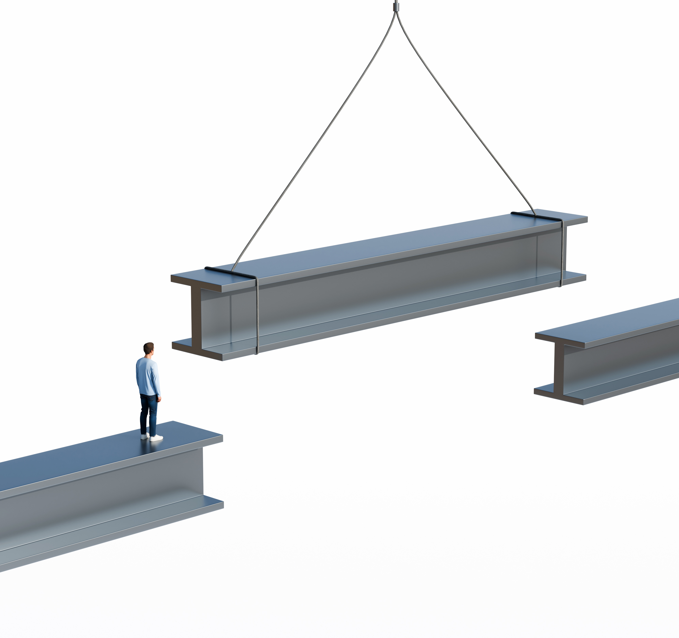
What we did
Making risk visible and actionable
Surfaced risks through structured checkpoints
Escalated early to the right stakeholders
Clarified decision ownership
Adjusted scope and sequencing to reduce dependencies

Slide 26

The outcome
Stabilized delivery and restored momentum
Timeline stabilized
Cross-team alignment improved
Core business objectives delivered

Slide 27
Case study #2
Structured foundation for discipline

Slide 28

The situation
Customer lead project management
Governance structure missing
Processes and project ownership limited
Escalations were frequent

Slide 29
The situation
Customer lead project management
Governance structure missing
Processes and project ownership limited
Escalations were frequent

Slide 30

What we did
Implement project management methodology framework for project delivery
Set clear roles and responsibilities
Document and mitigate risk
Set overall governance to all customer delivery

Slide 31
What we did
Implement project management methodology framework for project delivery
Set clear roles and responsibilities
Document and mitigate risk
Set overall governance to all customer delivery

Slide 32

The outcome
Communication improved
Less escalations
More quality in deliveries
Productivity and satisfaction increased

Slide 33
Adapting the framework to every project
Why “one size fits all” fails
Different level of structure
Proportionate governance

Slide 34
What can be tailored
Delivery approach
Governance intensity
Planning timeframe

Slide 35
What can be tailored
Delivery approach
Governance intensity
Planning timeframe
Risk management depth
Change management threshold
Decision rights

Slide 36
What can be tailored
Delivery approach
Governance intensity
Planning timeframe
Risk management depth
Change management threshold
Decision rights
Communication
format and cadence
More…

Slide 37
The common thread of successful projects
Proven methodology framework is essential for a successful delivery
Success patterns focus on clarity, ownership, checkpoints, risk, change control and communication.

Slide 38

Discipline creates predictability
When risk, change, and communication are handled well:
Issues are smaller
Decisions are faster
Stakeholders are aligned
Outcomes are measurable
Adapt the framework, but don't abandon it

Slide 39
Please reach out if you'd like to hear more or work with our Professional Services Team!
urdur@lsretail.com
jennifer.oddo@lsretail.com

