Slide 1
Self-Service Transformation: Why It’s Imperative for 2022 and Beyond… And What Retailers Should Do About It Today
Usman Tariq Janjua

Slide 2
Overview
4 major catalysts are converging (labor economics, consumer expectations, growth in digital, availability of next-generation technologies), driving an urgent need for retailers in every segment to offer consumers rich self-service experiences.
The next wave of self-service transformation will see further maturing of traditional self-service with advanced technology and self service full-store transformation; and (the beginning of) maturity for fully frictionless checkout.

Slide 3
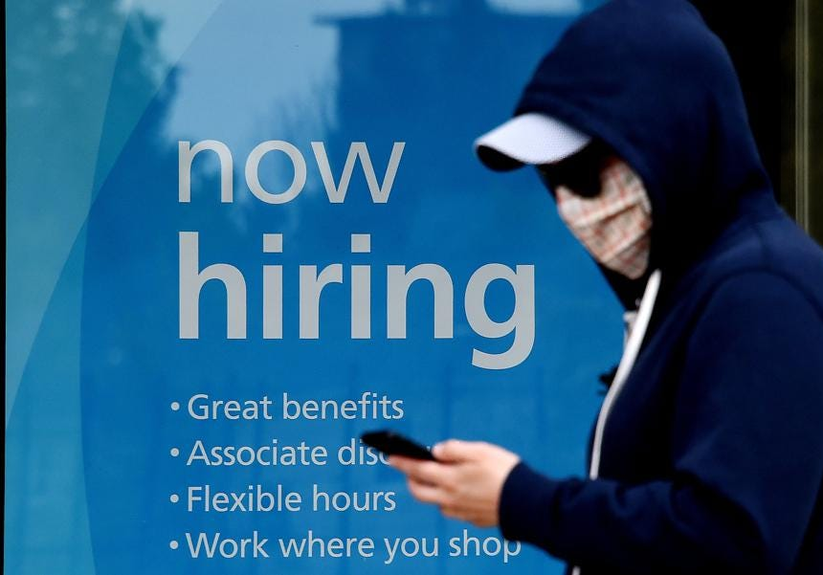
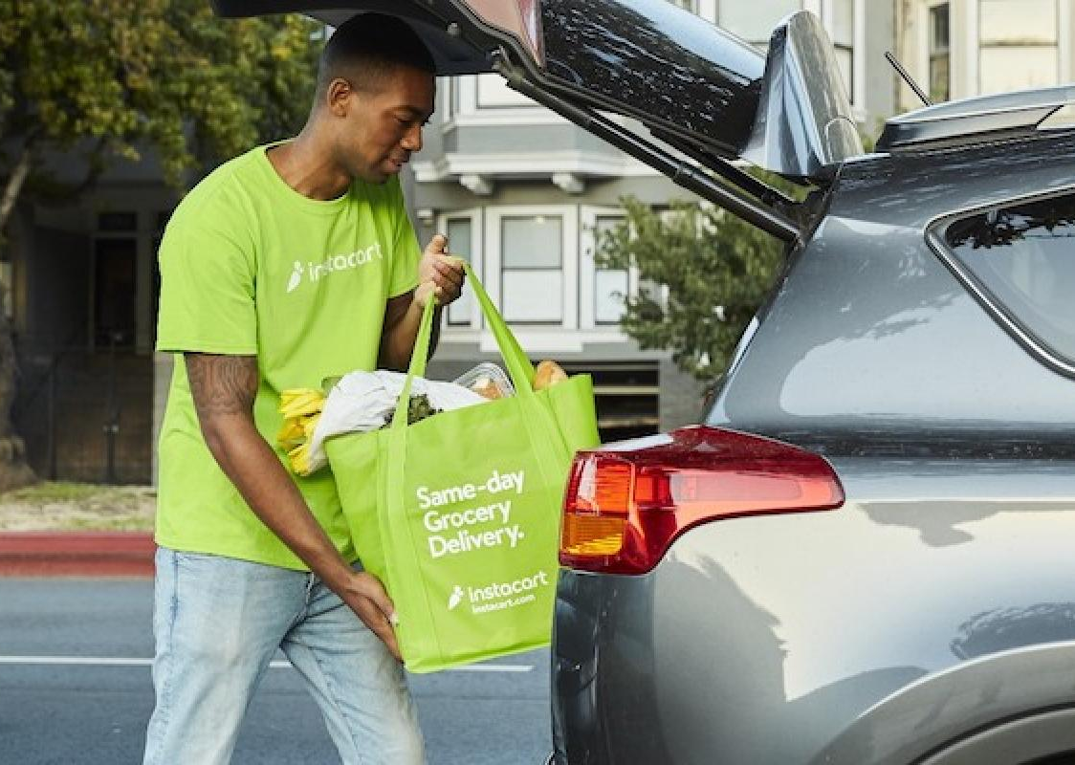
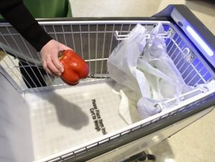
Converging Catalysts
Consumer
1. Labor Economics
2. Consumer Demands
Covid accelerated the need for retailers to do more with less
People like self-service more than ever – and they want more in more places
3. Growth in Digital Shopping
4. Technology
Consumers adopted digital forms of shopping at a record pace between 2020-22
New technologies, mean new possibilities for self service transformation.

Slide 4
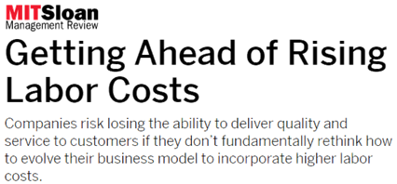
Labour Economics
The Great Resignation
47.4 million U.S. workers quit their jobs in 2021*
20% of European millennials quit their jobs in 2021***
COVID drove people either out of the workforce or into other industries.
Labor shortages and the rise of wages are forcing retailers to focus their people on value-added services.
Increasing Labor Cost
EU Salaries increased ~3% percent in 2021**
The lack of available labor drove up the hourly cost of labor.
Pressure on quality and service levels
Must “fundamentally rethink” business model
Source: MIT.edu, Jan ‘22
* U.S. Bureau of Labor Statistics ** Europa.EU ***Ypulse

Slide 5
Consumers Want “Fast & Easy” with a Growing Baseline Expectation for Self-Service
Consumer Demand
Why shoppers say they use self-service*:
Self-service can improve a retailer’s customer service levels.
One client analysed stores with 70%+ self-service utilisation; had the highest customer service ratings.
66%
49%
36%
no waiting in line
social distancing / no staff
faster
Accelerators of demand for self-service:
Demographics
Covid
Expectations
Gen Z (58%) and Millennials (56%) prefer self-service*
Gen X (41%) and Baby Boomers+ (26%) less likely to prefer self-service*
Social distancing
Touchless transactions
Safety of workers
Shoppers want to checkout as easily as they do online
*Source: PYMNTS Self Service Shopping Journey

Slide 6
“More, Please”
Consumer Demand
More than 80 percent of consumers want to use nontraditional & self-service checkout options.
Only a third of consumers say traditional checkout lines are their most preferred choice.

Slide 7
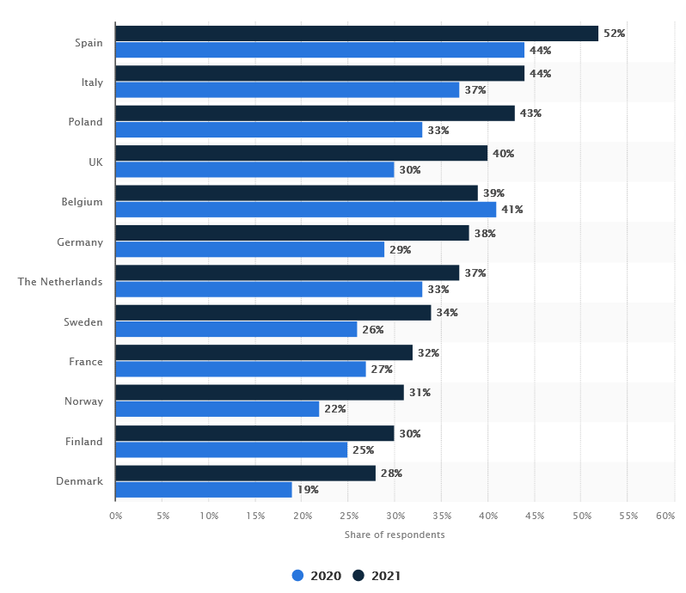
Covid Accelerated Digital Adoption in Grocery By 2026, One in Five Grocery Orders Will Be Online
Digital Shopping
Increase in Online Shopping Since COVID
Increased demand for buy online, click and collect
Further strain on store labor
Real-time inventory visibility remains a key unsolved issue
Average +7%
Only 15% of shoppers are willing to pay for home delivery
Delivery costs will need to be passed on to shoppers
Physical stores still account for 76% of revenue
Source: IHL / RIS News
Source: Statista / Mecatus

Slide 8
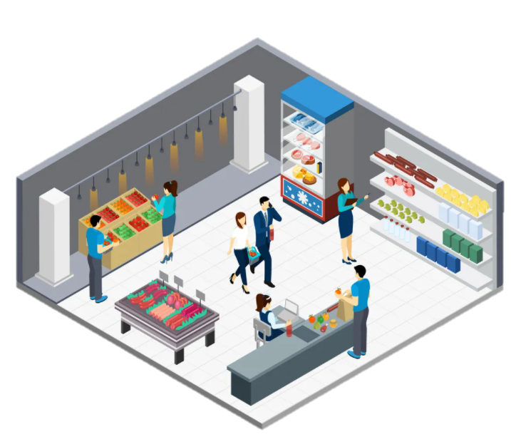
Availability of with Next-Generation Technologies for Self-Service
Technology
A.I. smart carts
Frictionless “grab and go” stores
Flexible designs: large, small, and mixed baskets
Computer vision, item recognition, loss prevention

Slide 9
Technology
A.I. smart carts
Frictionless “grab and go” stores
Flexible designs: large, small, and mixed baskets
Computer vision, item recognition, loss prevention
Examples
Amazon Dash Cart\ IMAGR Caper Veeve Shopic Clip-On Smart Cart Mo-Ka Smart Basket A2Z Smart Cart | Amazon Just Walk Out Stores Grabango WalkOut (Flow) Standard AI Trigo UST Frictionless Zliide RFID Self Checkout Boxy Autonomous Store Zippin Sensei | Toshiba XXL Bagger Toshiba Hybrid Kiosk Convertible Front End Large Retailers Building “DIY” Self-Service Larger Screen Sizes for Retail Media | Toshiba Produce Recognition Toshiba Loss Prevention Everseen Loss prevention Focal System Check:lens loss prevention Datalogic Produce Recog Edgify Produce Recognition Tiliter Produce Recognition Mashgin Item Recognition
Key challenges: High cost , maintenance; logistics to keep carts in store and charged
Key challenges: Cost of large-scale implementation; labor intensive; can’t handle cash shoppers
Key challenges: Large requirement for floorspace, hardware cost
Key challenges: Full integration of item recognition and loss prevention to replace current SCO scanning and weight security

Slide 10
Prior Waves
(Late 90’s to Late 10’s)
Current Wave
(Underway)
Future Waves
(3-5+ Years)
Introduction:
Early experimentation
Emergence of “pods” (“corrals”)
Focus on “saving labor” led to frustrating user experience
Front-End Transformation:
Emergence of “all self-service” front-end; moving labour to customer service and user experience
Maturing SCO with AI & Computer Vision
Frictionless stores limited to small, controlled, high margin environments
Expansion of self-service into new segments
Self-Service Transformation:
Expansion of “self-service throughout the store” w/ consumer owned technologies
Retail media expands adoption of targeted promotions and personalization
Full Frictionless shopping
End-to-end self-service as e-commerce further converges with physical stores
20-30%
Self-Service Utilisation
60-80+%
90%+
4-8+ SCO lanes
12-20+ self-service lanes
Few attended lanes remain

Slide 11
The Current Wave of Self-Service
How retailers can begin self-service transformation with the following key elements:
Maturing Current SCO Solutions w/ AI
New Form Factors Self Checkouts
Expansion to new segments
Journey to full frictionless

Slide 12
Maturing SCO
Consumers Want Better Self-Service
Consumer priorities for further improving self-service:
Faster
More self-service lanes (higher density)
Easier
More help available
Minimize errors using better technology
More space for bagging

Slide 13
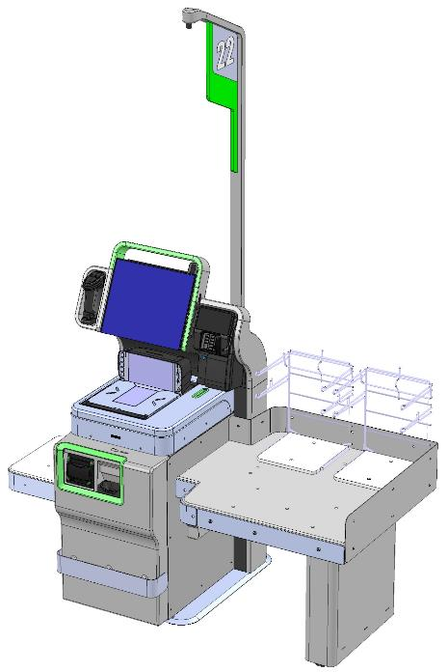
Maturing of self-checkout with AI and item recognition
Maturing SCO
AI Enabled Produce Recognition
Better UX – faster, easier
More secure – “not an apple”
Can also minimize training at attended POS
Integrated overhead Camera Mount
Enhanced Loss Prevention
Integrated Produce AND Item Recognition
Eventually eliminate weight security
Overhead camera and integrated personal video monitoring / behavior monitoring
Integrated Personal Video Monitor (if needed)
Item Recognition (No-Scan SCO)
Identify items using computer vision vs. barcode scanning alone
Improved speed, user convenience, reduces some shrink scenarios
Faster Age ID
Where legal→ Age verification without human intervention
Item Security
The result: “Nearly laborless” self-service business model for retailers w/ enhanced security, fewer interventions, and automation

Slide 14
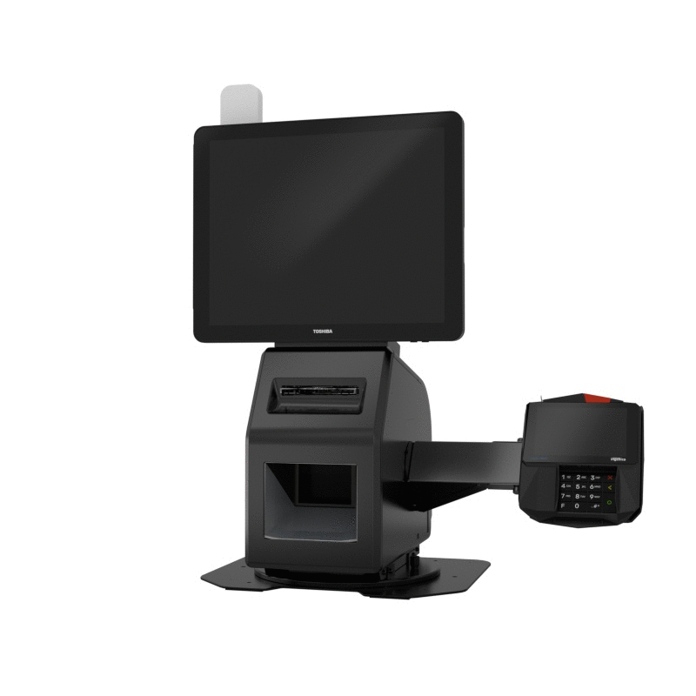
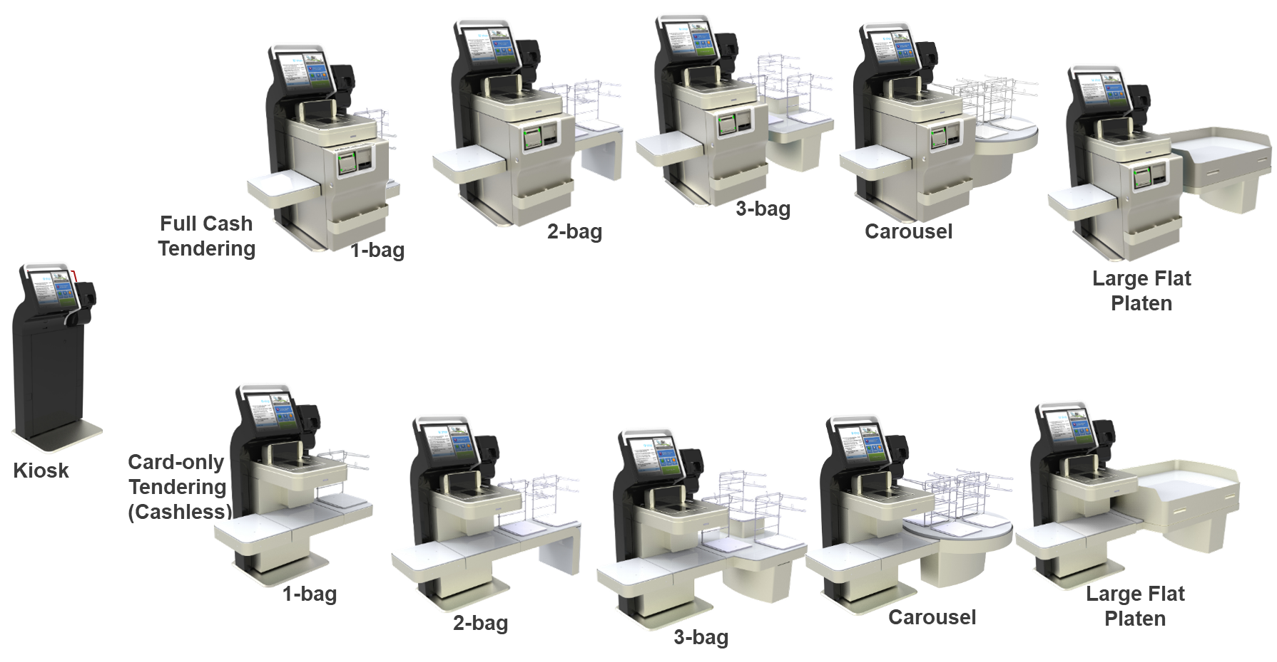
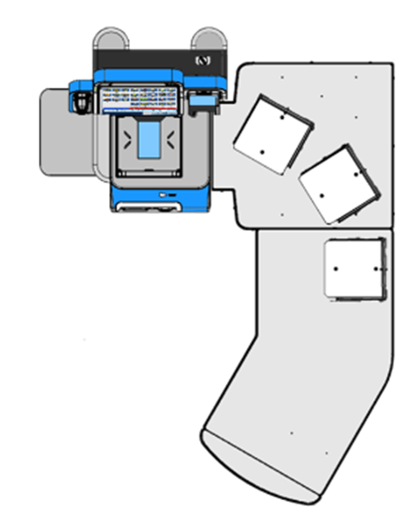
New Form Factors & Segments
More Retailers Asking Self Checkout
Toshiba System 7
Self Checkout
Pro-X Hybrid Kiosk
Toshiba System 7 XXL

Slide 15
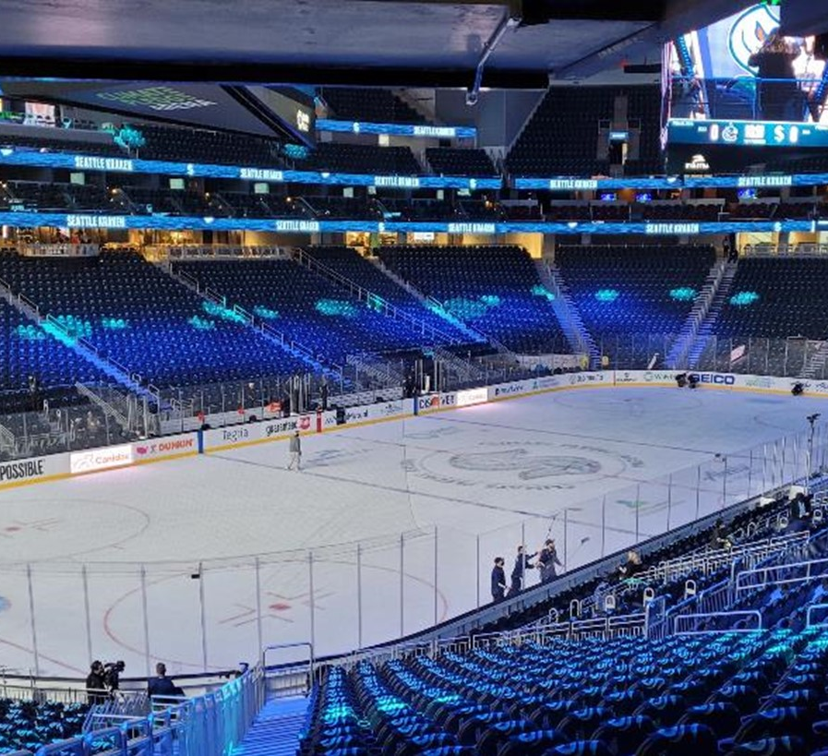
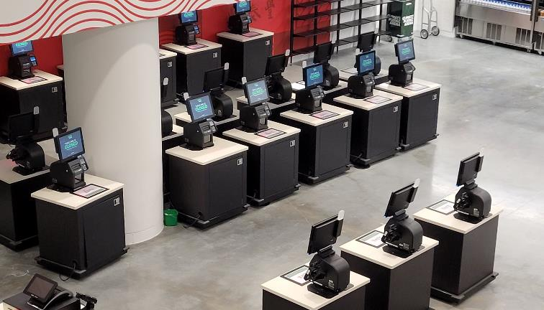
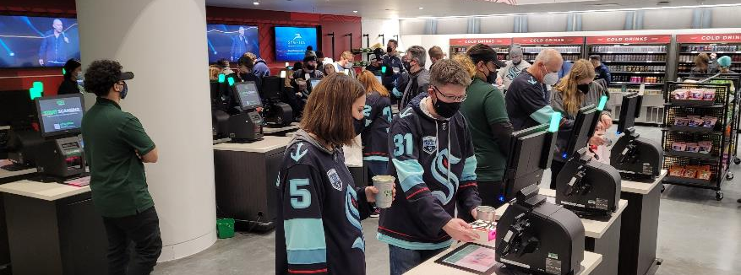

Slide 16
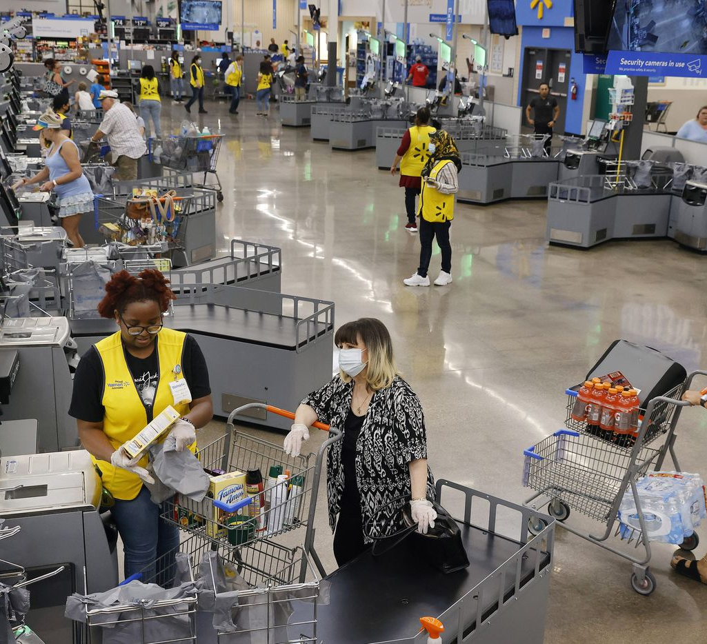
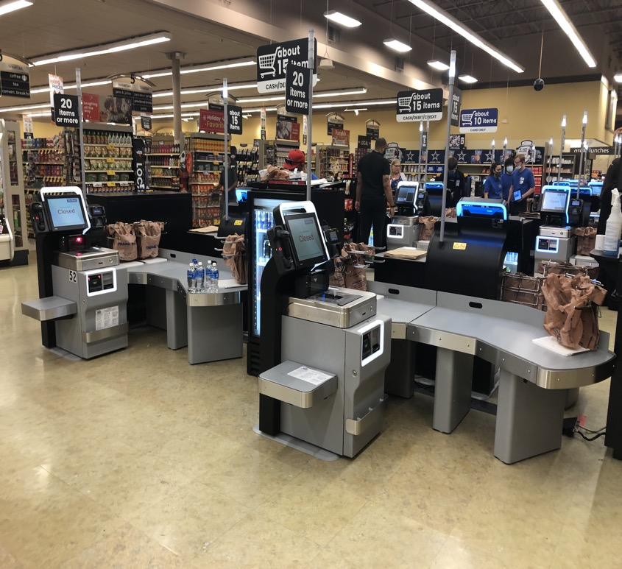
The Rise of the “All Self-Checkout” Store
Key enablers:
Mix of types / basket sizes
Focus on customer service (“assisted checkout”)
Mobile intervention handling

Slide 17
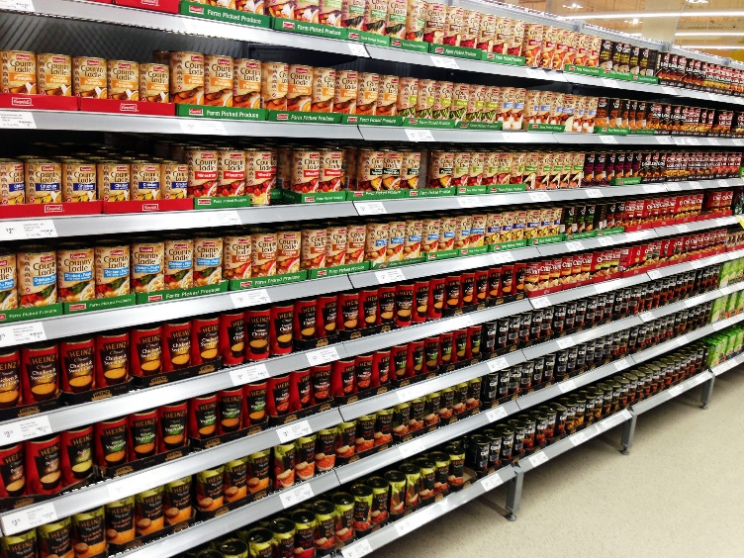
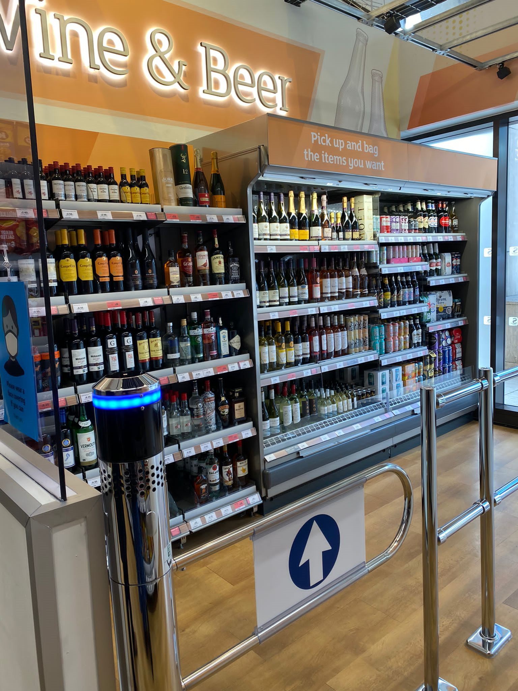
Journey to Frictionless
Theme: Journey to Frictionless
While fully frictionless shopping is not likely to become the predominant form of self-service within the next 3-5 years – we will see more applications of the technology…
Key challenges to overcome for mainstream grocery adoption:
Accuracy of ~95% is not good enough for low-margin stores; accuracy must exceed 99%
Frictionless stores require a labor-intensive focus of ensuring correct items in correct locations on shelves
Frictionless “store within a store” may be the first thing we see in larger grocery stores)
Real-time on-shelf inventory technology may provide a stepping stone to frictionless.
Technology cost per square meter remains prohibitive but continues to fall quickly

Slide 18
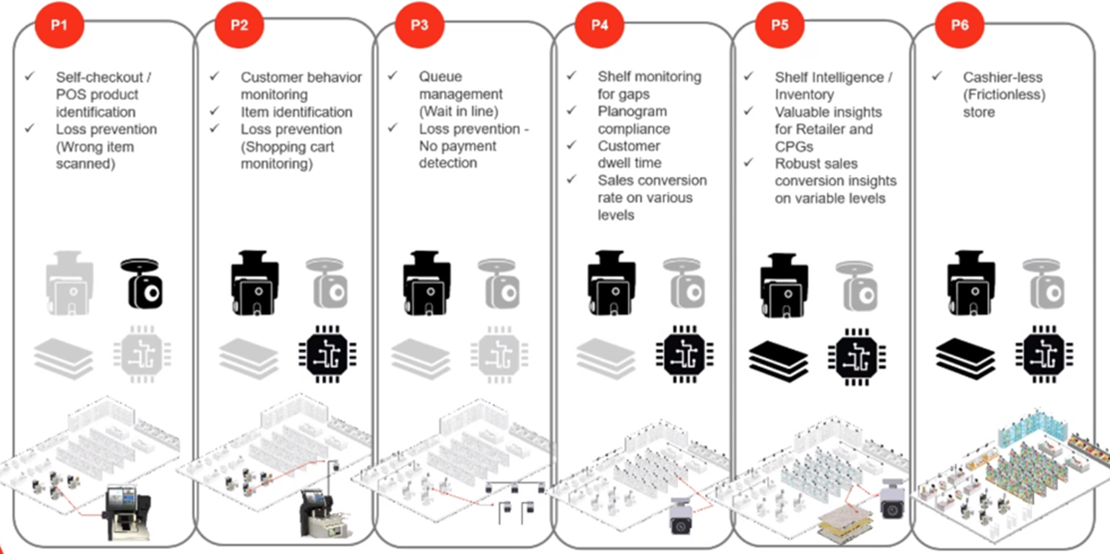
2021
2022
2023
2024
Theme: Journey to Frictionless
Phased Approach to Frictionles
2025

Slide 19
Thank You
Usman Tariq Janjua
General Manager Nordic
Mobile: +45 2077 5680
Email: utariq@toshibagcs.com

