Slide 1
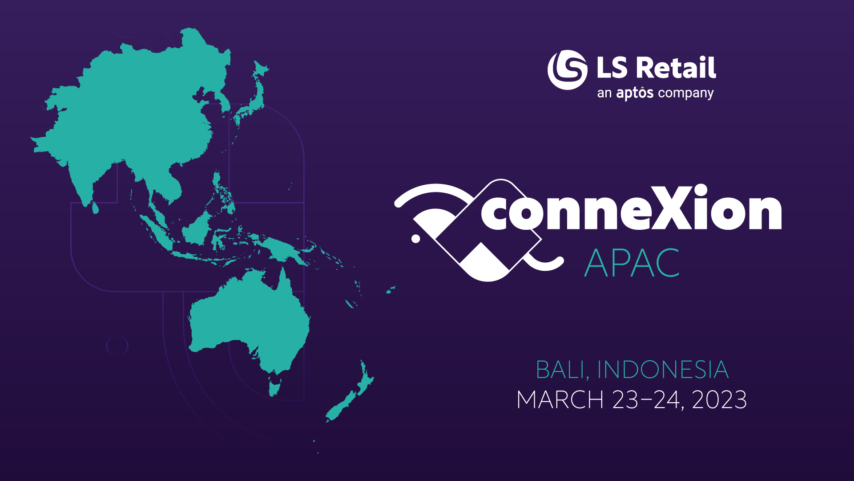

Slide 2
Bjarni Asmundsson
Regional Director
Bjarni@LSRetail.com
Discover clarity and insights with Performance Audit
Martin Kleindl
Product Director
Martin.Kleindl@LSRetail.com

Slide 3
What is On-Prem?
All installations that are not SaaS (Software as a Service)
Therefore, including hosted solutions like…
Private cloud
Microsoft Azure (Azure)
Amazon Web Services (AWS)
Google Cloud Platform (GCP)
Hosting Center
and your own hardware

Slide 4
The Why? What will you gain as a client or partner?
Comprehensive report
Quick overview over the health status of the solution
Actionable Insights which are prioritized
Input into best practices approach
Guidance on housekeeping processes
Then what?
You should do yearly health-check
Potentially get support working the action-list
Consider further review on specific business processes

Slide 5
What does LS Central solution consist off
Microsoft’s
SQL Server and SQL Express
Dynamics 365 Business Central service tier(s)
Internet Information Services (IIS)
Browser based client – Edge
LS Retail’s
Data Director
LS Commerce Service
Update Service
Hardware Station
mobile Inventory / mobile POS
Kitchen Display System
LS Central AppShell

Slide 6
Architecture
Dynamics 365 cloud
SaaS
HQ
Microsoft SQL Server
Microsoft Dynamics 365 Business Central
LS Commerce Service
eCom, ScanPayGo, integrations, mobile Inventory/POS
Online POS
running browser and most likely LS Central AppShell and LS Hardware Station
Offline POS
Microsoft SQL Express, Microsoft Dynamics 365 Business Central, LS Data Director
LS Hardware Station, LS Central AppShell
Dynamics 365 OnPrem
1
HQ
Hybrid component server
LS Commerce
2
LS Commerce
Store
Online POS
Offline POS
Offline POS Service
Online POS
Offline POS
Offline POS Service
3
4
5

Slide 7
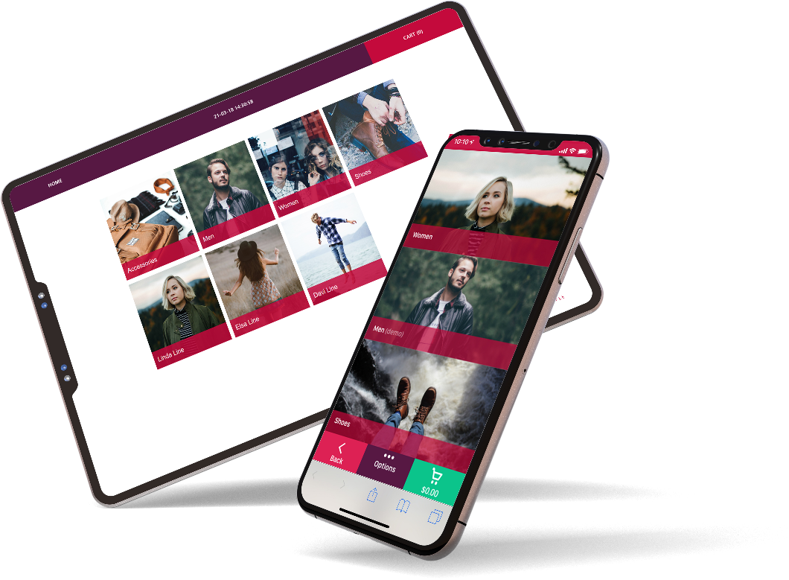
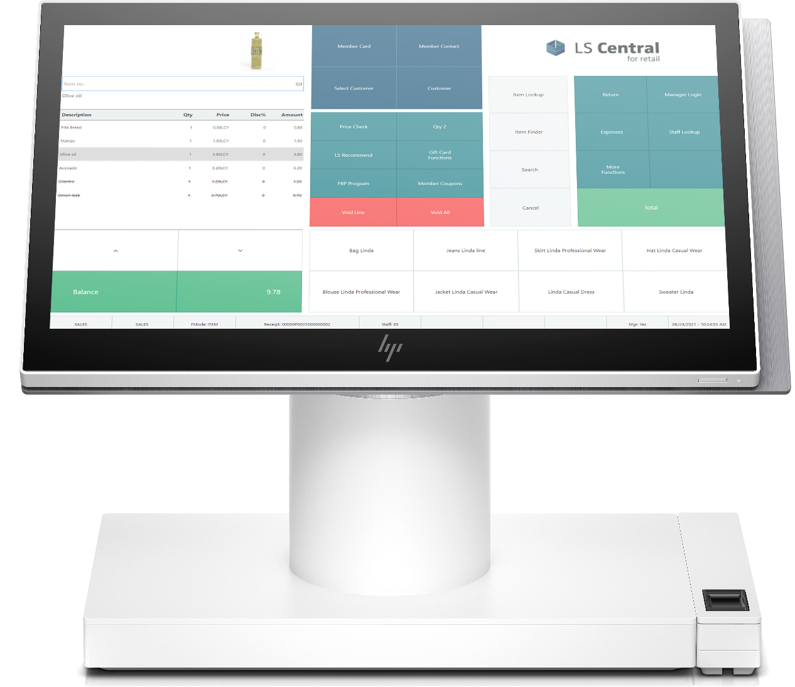
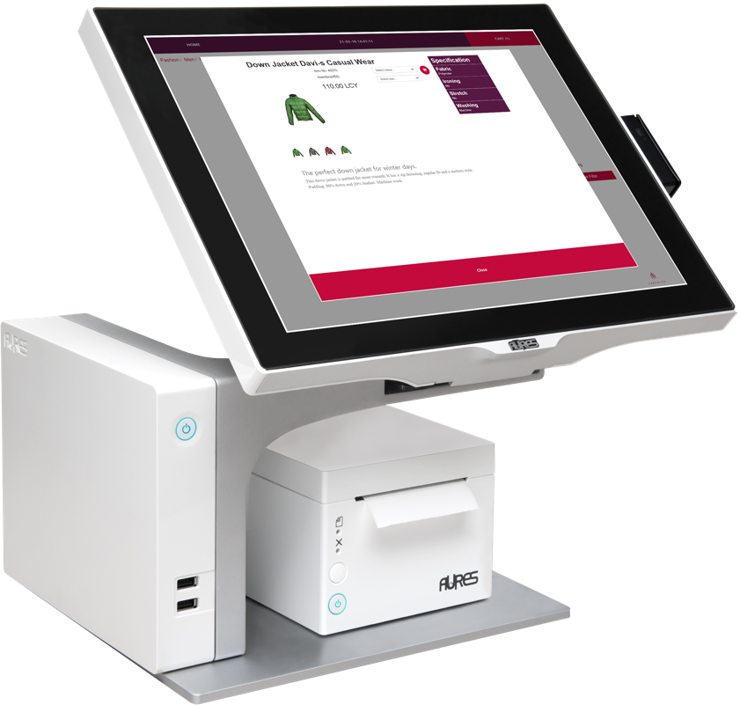
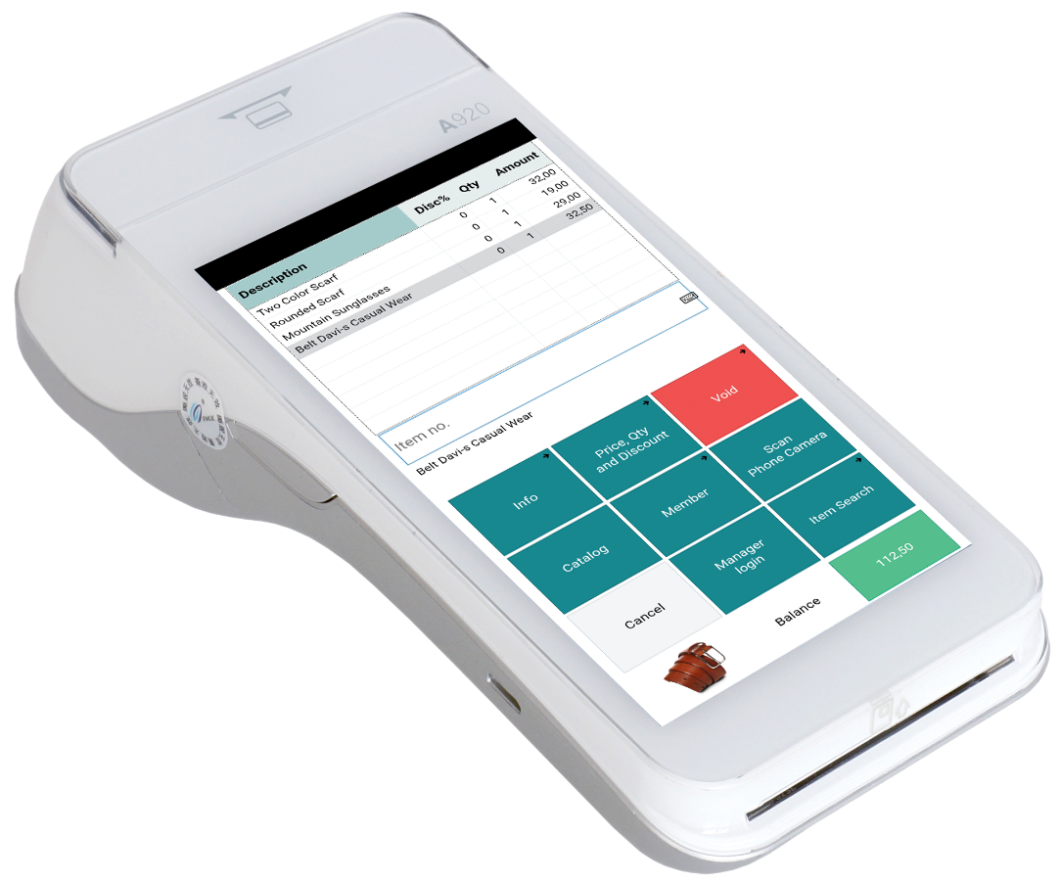
The Offline POS
Store
Or could be called Offline POS Service aka Store Server
Never both used for the same POS
Normally running SQL Express
is limited to 10 Gb size
is limited to 1410 Mb RAM
has limited out of the box maintenance options, but can be worked around
is limited to lesser of 1 socket or 4 cores
Consider SQL Standard if running Offline POS Service (Store Server) in demanding environment
Offline POS
Offline POS Service
https://learn.microsoft.com/en-us/sql/sql-server/editions-and-components-of-sql-server-2019?view=sql-server-ver16#Cross-BoxScaleLimits

Slide 8
Inventory for LS Central
Performance improvements for large retailers
Martin Kleindl
Product Director
Martin.Kleindl@LSRetail.com

Slide 9
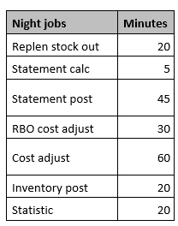
The Challenge
Challenges for large retailers
Data volume in Ledger Entry tables
Item Ledger Entries
Value Entries
Long running processes
Statement Calculation
Statement Posting
Replenishment Out of Stock calculation
Replenishment Item Quantity and Journal Calculation
Cost Adjustment & Posting
We made huge improvements for the LS Retail processes For Microsoft processes we need to find and build out-of-the-box solutions/approaches.
Example from customer

Slide 10
Current approach
G/L Entries
Item Ledger Entries
Store 1 - Cash - CC
Store 2 - Cash
- CC
Store 500 - Cash - CC
Store 1 - Item A, 10 pcs - Item B, 20 pcs
Store 2 - Item A, 20 pcs
- Item B, 20 pcs
Store 500 - Item A, 15 pcs - Item C, 10 pcs
Sales
Statement Calc.
Statement Post
Store 1
Sales
Statement Calc.
Statement Post
Store 2
…………………………………………………………………………………………….......…
Sales
Statement Calc.
Statement Post
Store 500
Many stores → data volume → long running processes

Slide 11
New approach
Aggregated Posting for Store Locations
Current approach
Item Ledger Entries for individual stores
New approach
Item Ledger Entries for aggregated Store Location(s)
Details are stored in a new table “LS Inventory Entries”
Item Ledger Entries current
LS Inventory Entries
new
Store 1 ---------------
---------------
Store 2 ---------------
---------------
Store 3 ---------------
---------------
Store 4 --------------- --------------- Store 500 --------------- ---------------
Store 1 ---------------
---------------
Store 2 ---------------
---------------
Store 3 ---------------
---------------
Store 4 --------------- --------------- Store 500 --------------- ---------------
Store “RETAIL” --------------- ---------------

Slide 12
New approach
G/L Entries
Item Journal
Store 1 - Cash - CC
Store 2 - Cash
- CC
Store 500 - Cash - CC
Store 1 - Item A, 10 pcs - Item B, 20 pcs
Store 2 - Item A, 20 pcs
- Item B, 20 pcs
Store 500 - Item A, 15 pcs - Item C, 10 pcs
Sales
Statement Calc.
Statement Post
Store 1
Sales
Statement Calc.
Statement Post
Store 2
…………………………………………………………………………………………….......…
Sales
Statement Calc.
Statement Post
Store 500
Store “RETAIL” - Item A, 45 pcs - Item B, 40 pcs - Item C, 10 pcs
1. Aggregate Stores
2. Post

Slide 13
New approach
G/L Entries
Store 1 - Cash - CC
Store 2 - Cash
- CC
Store 500 - Cash - CC
Store 1 - Item A, 10 pcs - Item B, 20 pcs
Store 2 - Item A, 20 pcs
- Item B, 20 pcs
Store 500 - Item A, 15 pcs - Item C, 10 pcs
Sales
Statement Calc.
Statement Post
Store 1
Sales
Statement Calc.
Statement Post
Store “RETAIL” - Item A, 45 pcs - Item B, 40 pcs - Item C, 10 pcs
Store 2
…………………………………………………………………………………………….......…
Sales
Statement Calc.
Statement Post
Store 500
Item Ledger Entries
Detailed LS Inventory Entries

Slide 14
Document posting
Purchase Order creation
Item Ledger Entries
Process flow
Document Posting (Purchase Orders, Transfer Orders, …)
Location is replaced with generic Store Location (“RETAIL”)
Document posting creates LS Inventory entries
release
Store 1 ---------------
---------------
Store “RETAIL” --------------- ---------------
Store “RETAIL” ---------------
---------------
LS Inventory Entries
Store 1 ---------------
---------------

Slide 15
Inventory for LS Central
The scope & timeline
Core solution prototype (Statement posting, document handling)
Performance tests
Mandatory “core” features
Selected Page improvements
POS Inventory Lookup
Stock Counting process
Release
Project based work
Customizations for
Reports
Pages
Processes
Integrations
handled as project by partners with optional support from LS Retail consulting

Slide 16
Performance Audits
find the bottlenecks in your environment

Slide 17
Performance Audit
HQ
Dynamics 365 OnPrem
1
Health Audit of SQL server
Installing Microsoft Monitoring Agent
all Service Tiers servers (NST)
including servers running
LS Data Director (WIP)
LS Commerce
Consuming Event Viewer Log
sent to LS Retail’s Azure environment
Parsing it for Business Central detailed information
If hosted in Azure
Optional to enable Azure Application Insights
SQL
2
1
Data Director
2
LS Commerce
NST
2
NST
NST
NST
NST
2
NST

Slide 18
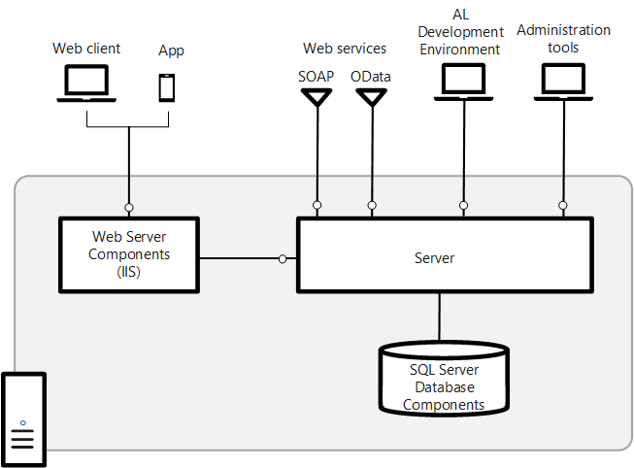
Performance Audit - SQL
Hardware
RAM, Disk System, CPU, Network
Operating System
Version, Disk Management, RAM
SQL Server
Datafile setup and distribution on disks
Service Parameters
Wait statistics
Database
Parameters
Housekeeping processes
Application
Index maintenance and tuning

Slide 19
Performance Audit – Services and Service Tiers
Indication of Load schedule and Incidences per hour per day in graphical format
Deadlocks
Table Locks
Long running SQL Queries
Extensions impacting performance
Performance Profiler
Table Information
Database and Table growth info
Housekeeping processes

Slide 20
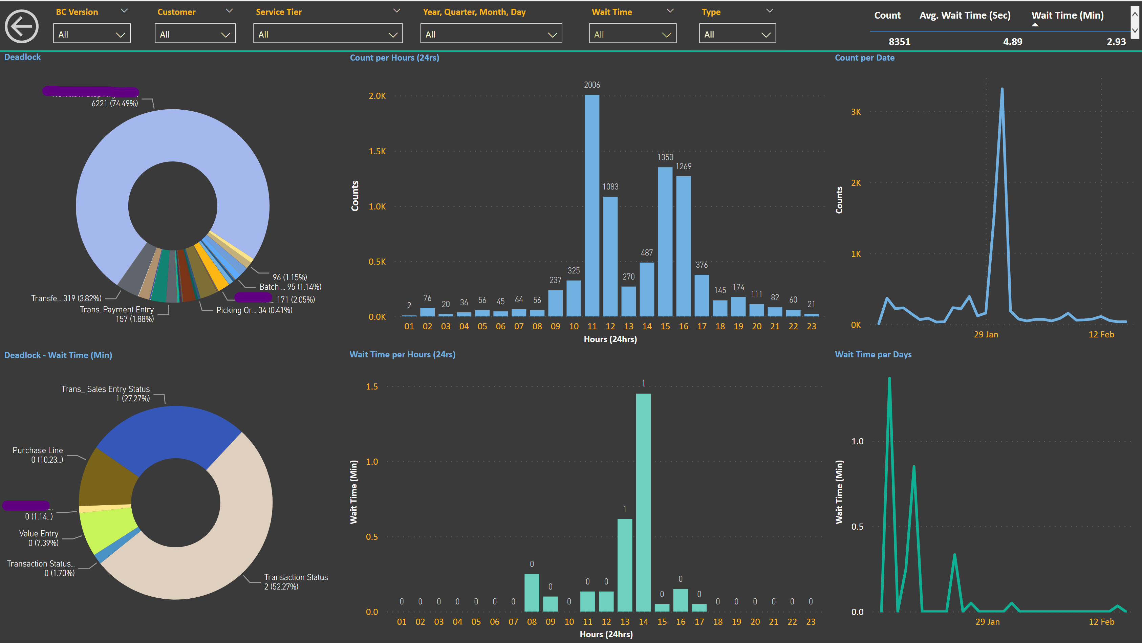

Slide 21
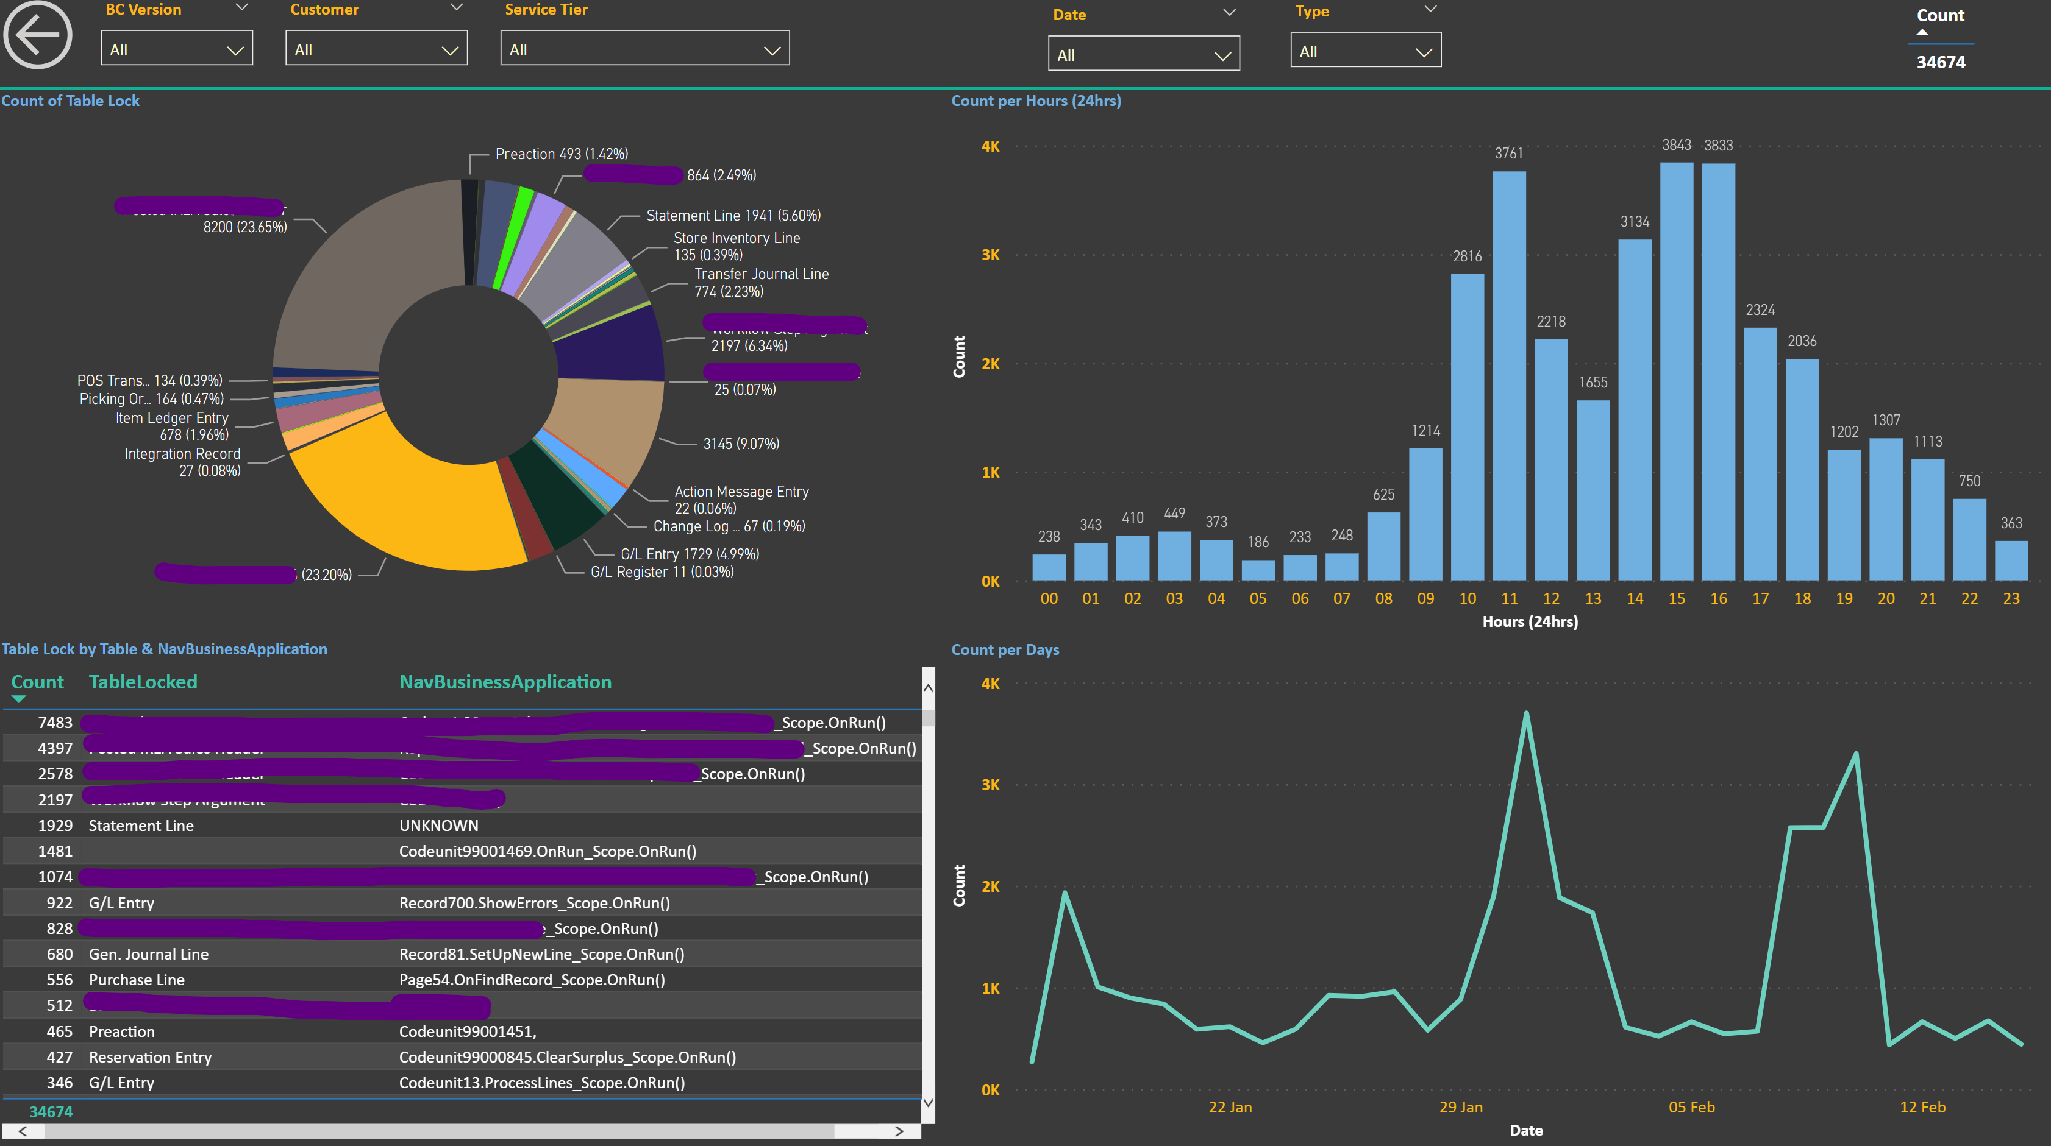

Slide 22
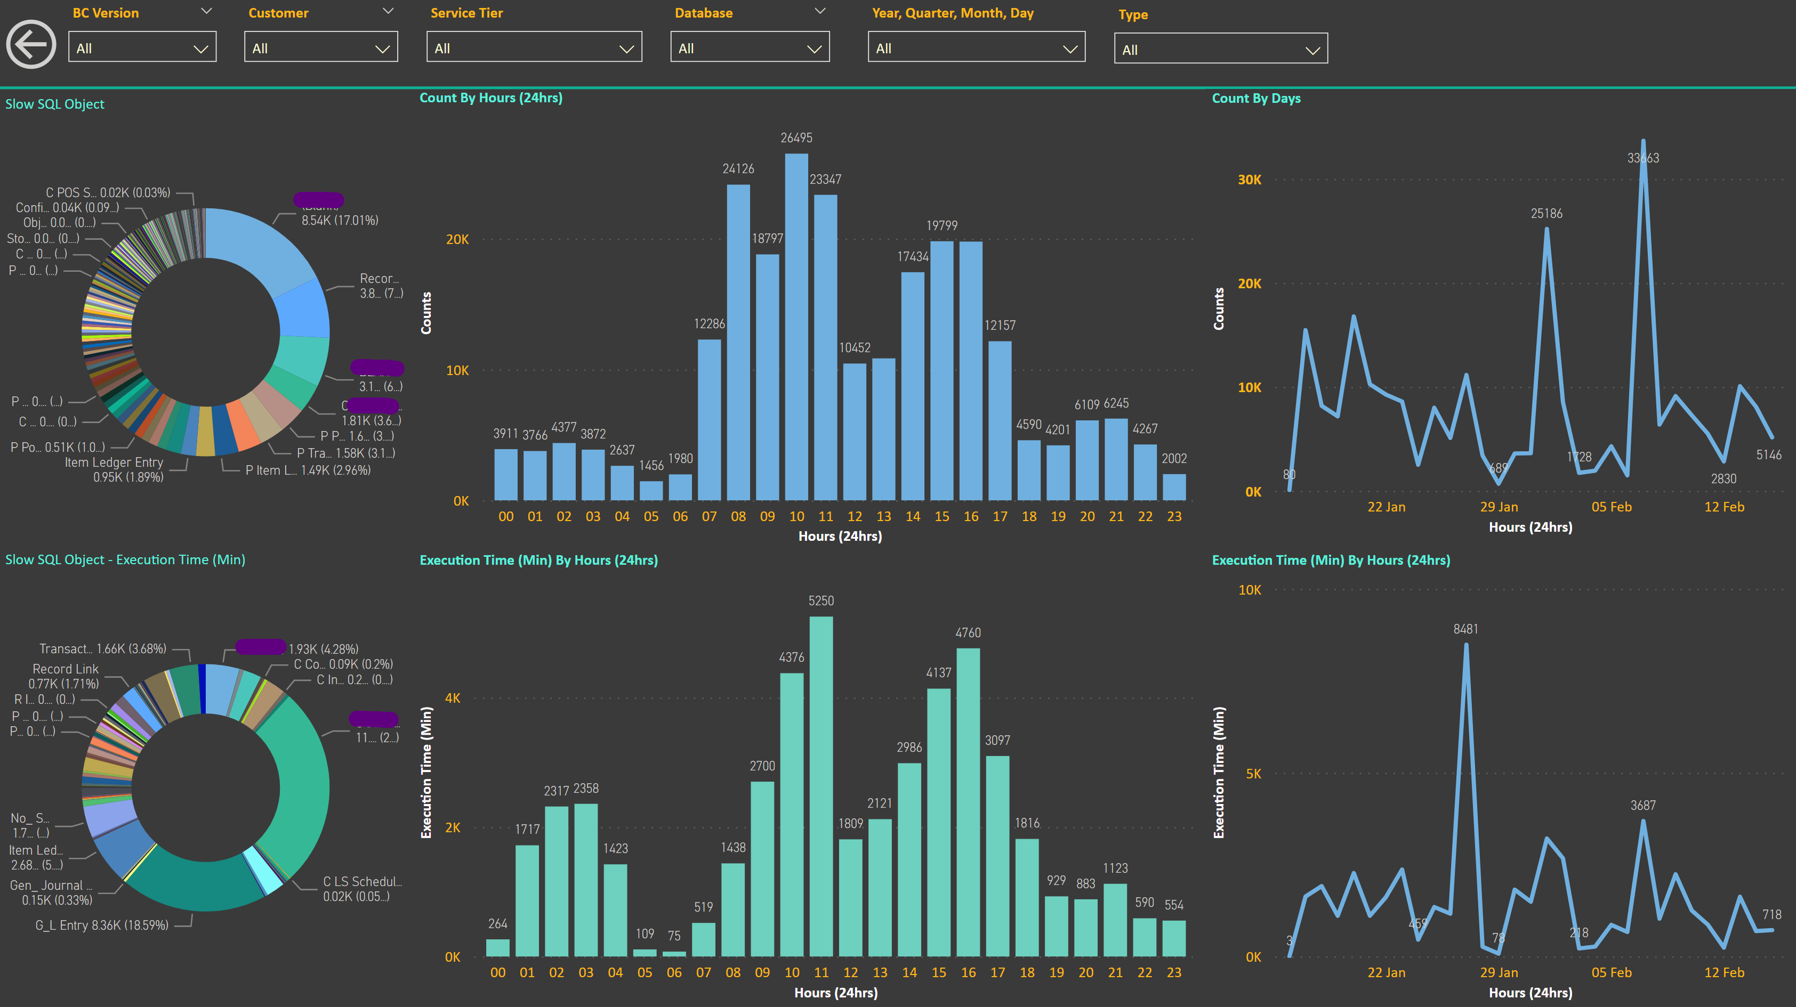

Slide 23
The Audit Output
Detailed overview of performance
SQL review for both hardware and software
Prioritized list of recommended actions

Slide 24
questions? คำถาม?
câu hỏi?
问题?
mga tanong?
pertanyaan?
質問？
pitakonan?
질문?
ຄໍາຖາມ?
soalan?
Bjarni Asmundsson
Regional Director
bjarni@LSRetail.com

Slide 25
Thank you

